Slide 1
J-PARCにおけるK中間子原子核探索実験のための円筒形ドリフト・チェンバーの開発II
JPS meeting @ Yamagata Univ. 2008/09/21
理研
塚田暁
E15 experiment
CDS & CDC
Present status of CDC
Readout systems
Study of test chamber
summary

Slide 2
collaborations
JPS meeting @ Yamagata Univ. 2008/09/21
理研, KEK^{A}, 東大理^{B}, 東大教養^{C}, 京大理^{D}, 阪大理^{E}, 阪大RCNP^{F},
東工大理^{G},東理大理工^{H},大阪電通大^{I},Victoria大^{J}, ソウル国立大^{K},SMI^{L},
ミュンヘン工大^{M}, INFN-LNF^{N}, INFN-Torino^{O}, Torino大^{P}
塚田暁, 飯尾雅実, 板橋健太, 岩崎雅彦, 應田治彦, 大西宏明, 佐久間史典,
佐藤将春, 友野大, 山崎敏光, 石元茂^{A}，岩井正明^{A}, 鈴木祥仁^{A},
関本美知子^{A}, 豊田晃久^{A}, 石川隆^{B}, 竜野秀行^{B}, 鈴木隆敏^{B}, 早野龍五^{B},
松田恭幸^{C}, 永江知文^{D}, 平岩聡彦^{D}, 藤岡宏之^{D}, 味村周平^{E}, 阪口篤志^{E},
野海博之^{F}, 藤原裕也^{G}, 徳田真^{G}, 千葉順成^{H}, 福田共和^{I}, 溝井浩^{I},
G. Beer^{J}, H.Bhang^{K}，S. Choi^{K}，H. Yim^{K}，石渡智一^{L},
P.Buehler^{L}, M. Cargnelli^{L}, A. Hirtl^{L}, P. Kienle^{L,M}, J. Marton^{L},
E. Widmann^{L}, J. Zmeskal^{L}, 岡田信二^{N}, C. Curceanu^{N},
C.Guaraldo^{N}, M. Iliescu^{N}, D. Pietreanu^{N}, D. Sirghi^{N}, F. Sirghi^{N},
D. Faso^{O}, O. Morra^{O}, L. Busso^{P}

Slide 3
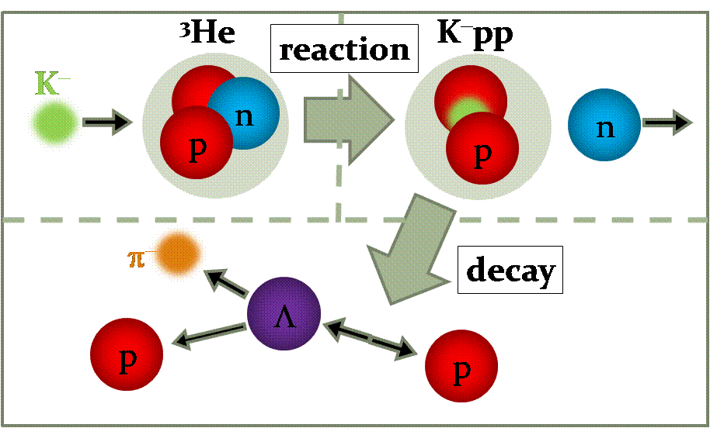
E15 experiment
JPS meeting @ Yamagata Univ. 2008/09/21
Search for the kaonic nuclear bound state
  Some experiments & theoretical calculations implies the existence of the bound state.
To clarify this question, we proposed the experiment detecting the formation & decay of the second simplest state.
Really? If exist, how?
Missing Mass detecting neutron
Invariant Mass for decayed particles

Slide 4
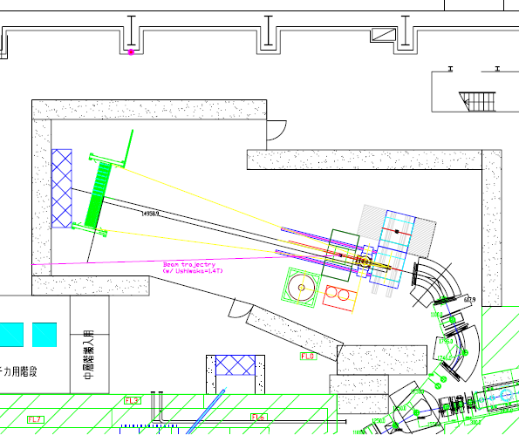
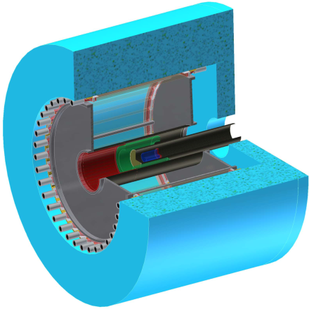
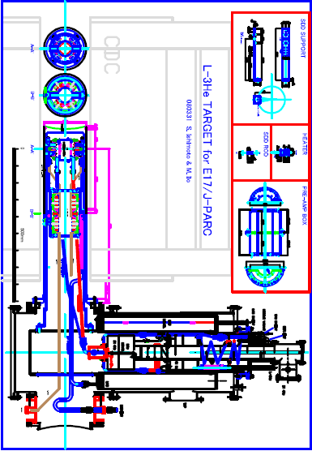
Experimental setup
JPS meeting @ Yamagata Univ. 2008/09/21
K1.8BR beam line
CDS
Neutron counter array
Sweep Magnet
KURAMA
15m
1.0GeV
K⁻ beam
³He
23aSD-9
Y. Fujiwara will report about the Beam Line detectors.
23pSN-4 & 23pSN-5
M.Iio and M. sato will report about the Liquid ³He target.

Slide 5
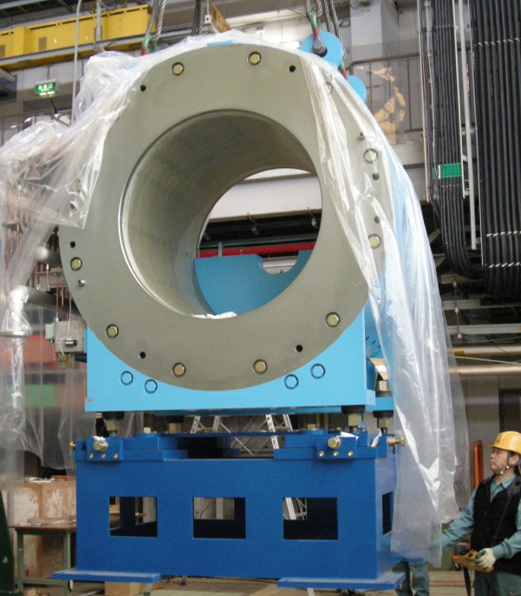

Cylindrical Detector System (CDS)
Solenoid Magnet Yoke
³He Target
Target chamber
Z-vertex Chamber
Cylindrical
Detector Hodoscope
In production
In production
Kaon Decay Counter
Under development
JPS meeting @ Yamagata Univ. 2008/09/21

Slide 6
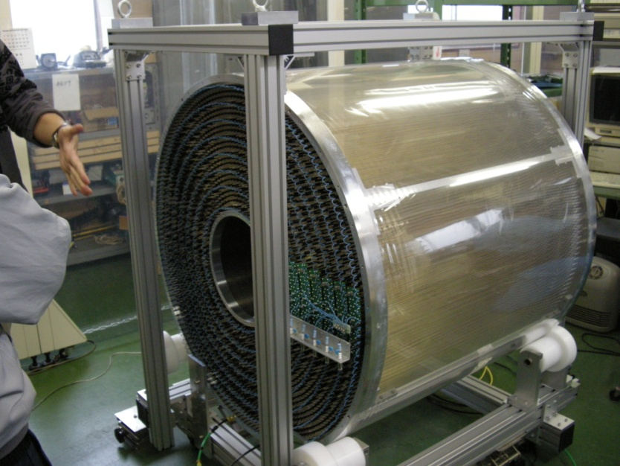
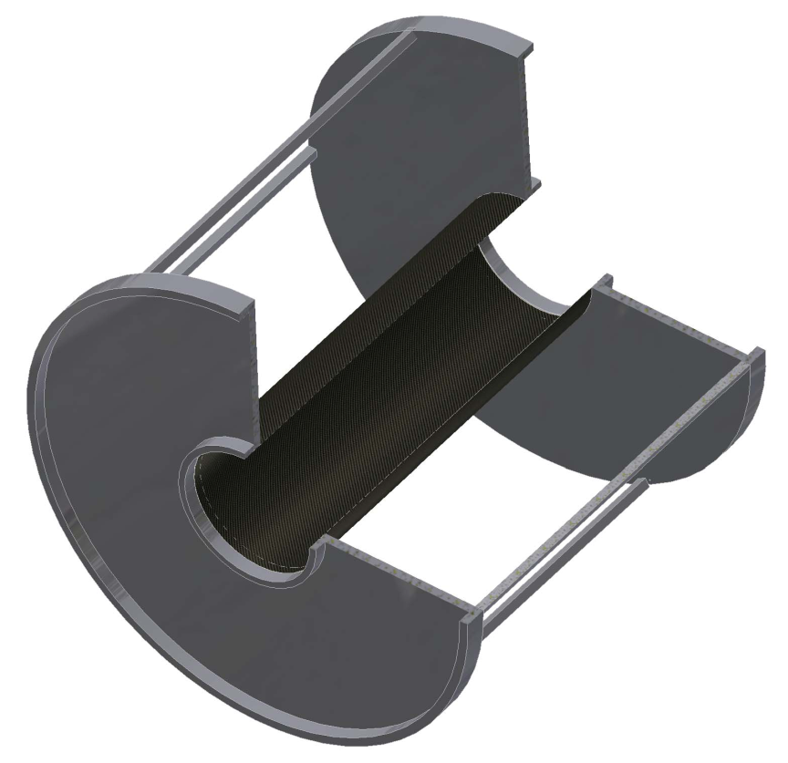
Cylindrical Drift Chamber (CDC)
Layer# | Direction | #cells | Radius [cm] | Cell size [cm] | Tilt [deg]
1 | X | 72 | 19.05 | 0.83 | 0
2 | X’ |  | 20.4 | 0.89 | 0
3 | X |  | 21.75 | 0.95 | 0
4 | U | 90 | 24.85 | 0.87 | 3.72
5 | U’ |  | 26.2 | 0.91 | 3.92
6 | V | 100 | 29.3 | 0.92 | 3.95
7 | V’ |  | 30.65 | 0.96 | 4.12
8 | X | 120 | 33.75 | 0.88 | 0
9 | X’ |  | 35.1 | 0.92 | 0
10 | U | 150 | 38.2 | 0.80 | 3.43
11 | U’ |  | 39.55 | 0.83 | 3.55
12 | V | 160 | 42.65 | 0.84 | 3.59
13 | V’ |  | 44 | 0.86 | 3.71
14 | X | 180 | 47.1 | 0.82 | 0
15 | X’ |  | 48.45 | 0.85 | 0
CFRP
t1mm
Wires
  Sense : Au-W 30μm
  Field : Au-Al 100 μm
#sense wire : 1816
Shield layers among super layers
Alminum Support
×6
JPS meeting @ Yamagata Univ. 2008/09/21

Slide 7
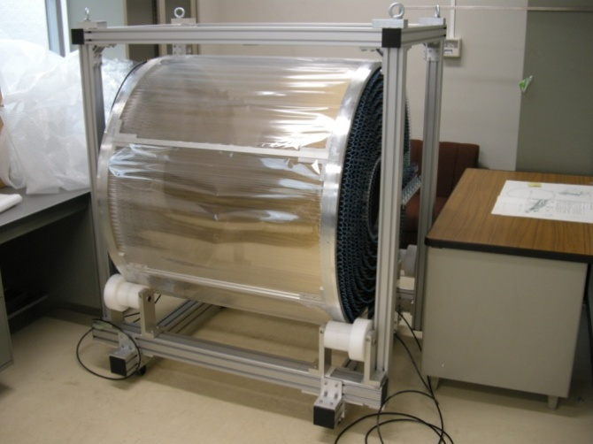
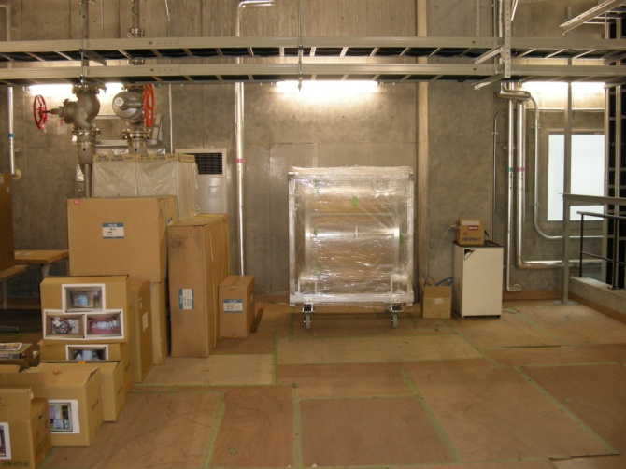
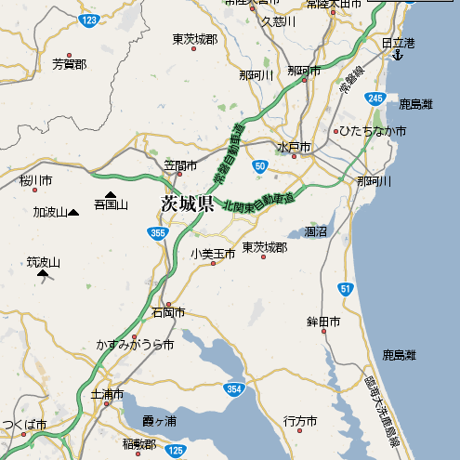
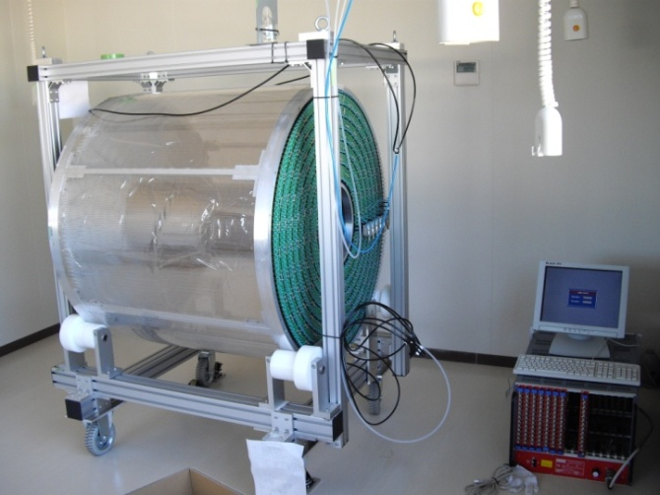
Transition & present status of CDC
Mar 2008
CDC was completed and moved to KEK.
19 Aug 2008
CDC was moved to J-PARC.
J-PARC
We could not use any electronics here.
We could not use any electronics here.
9 Sep 2008
CDC was moved in the K1.8BR counting room.
KEK
We could supply the HV (a few 100 V) at last.
The aging procedure and more studies will be done from now
JPS meeting @ Yamagata Univ. 2008/09/21

Slide 8
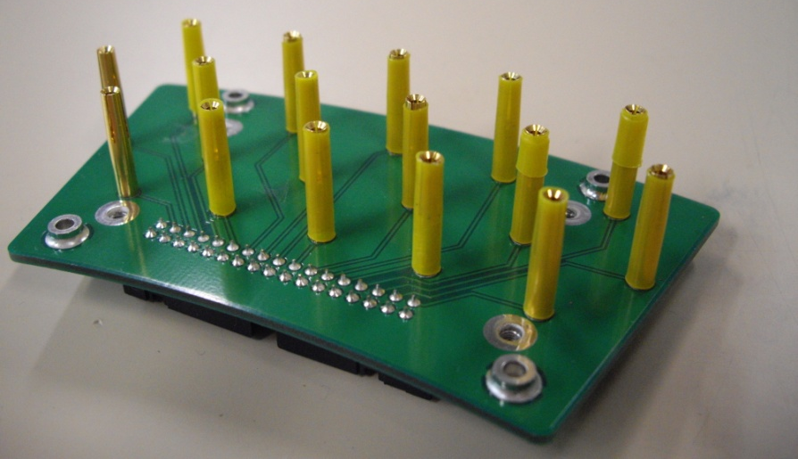
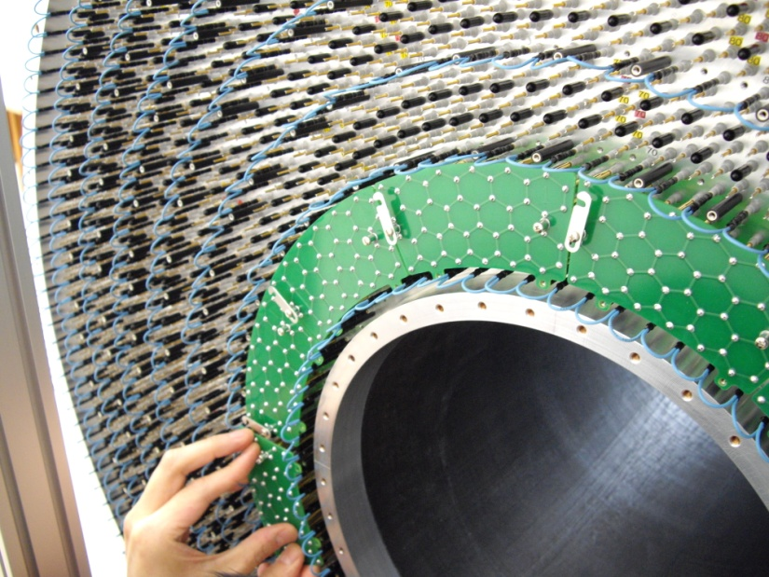
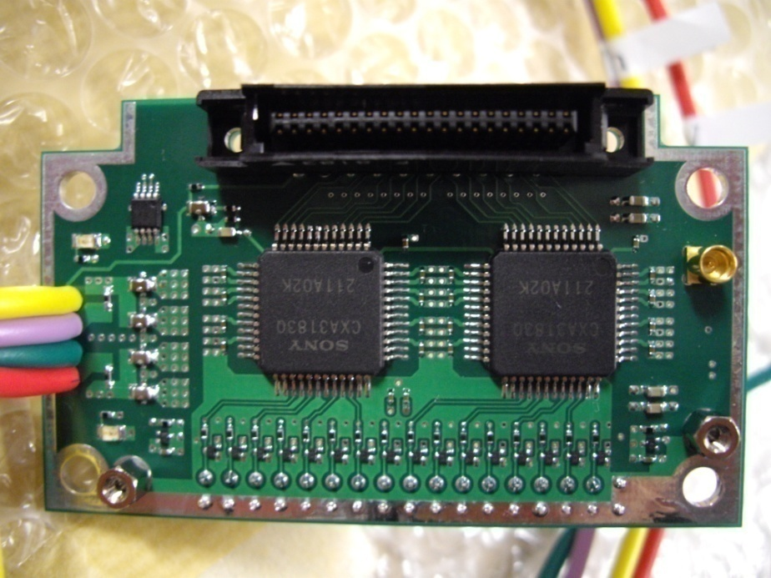
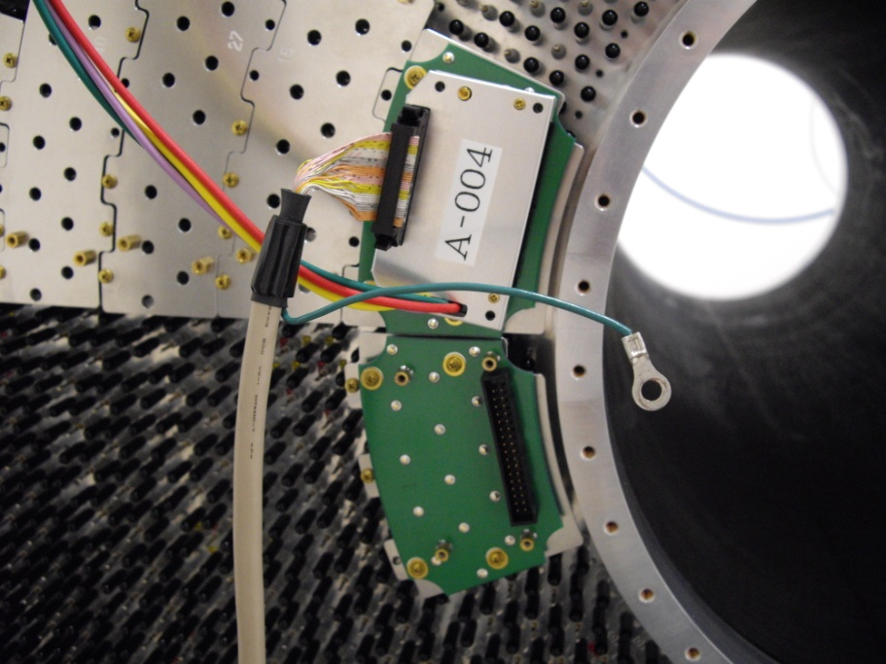
Readout systems
JPS meeting @ Yamagata Univ. 2008/09/21
HV board
Amp card
  Chip : CXA3183Q (SONY, low noize ASD IC, τ=16nsec)
  Output : LVDS differential
  Gain : 0.8V/pC at preamp
3 layers structure
Output
1
3
Analog out
2
All parts will be ready in September.

Slide 9
Readout system (2)
ASD
LVDS → ECL translation boards ( in the experimental hall )
TKO DrT modules ( in the counting room)
8m flat cables
In production
60m flat cables to the K1.8BR counting room

Slide 10
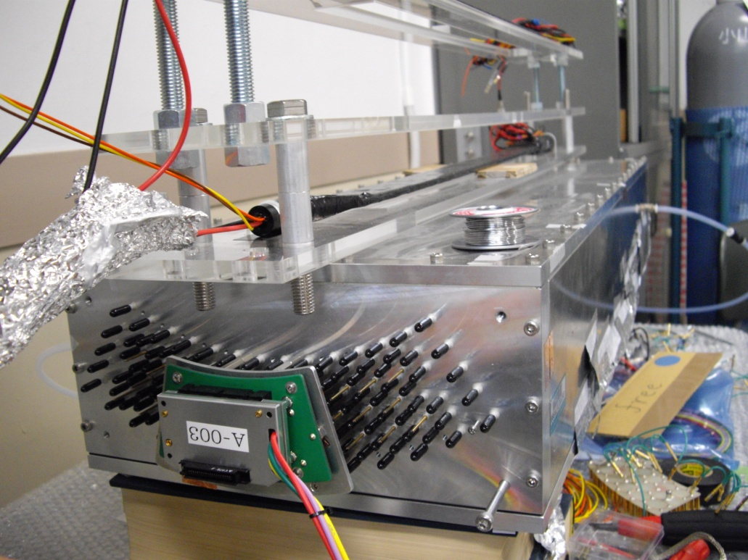
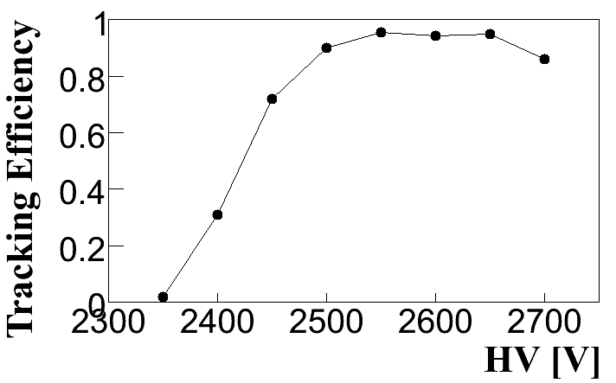
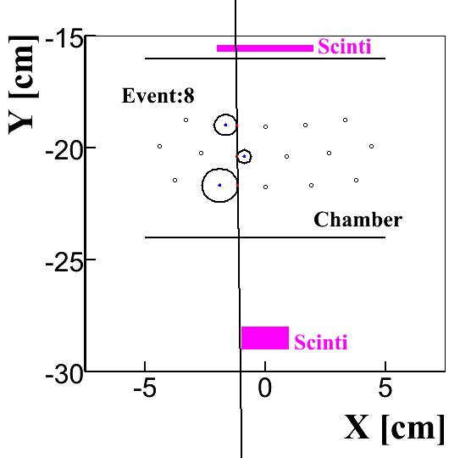
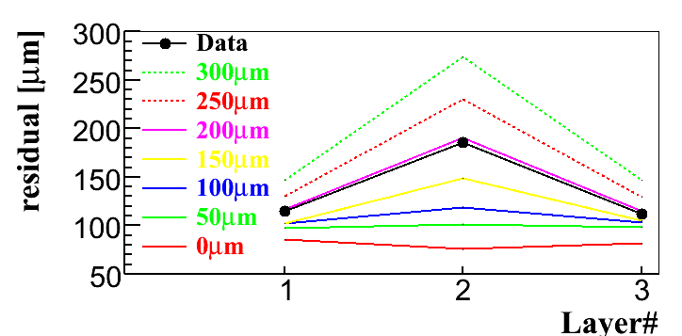
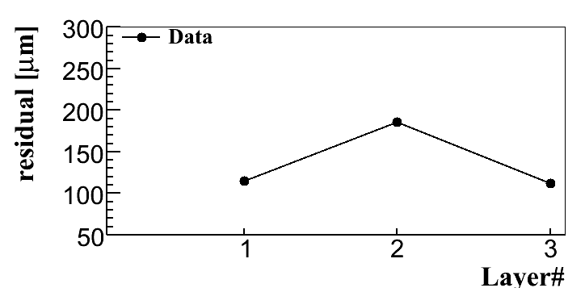
Study using a test chamber
JPS meeting @ Yamagata Univ. 2008/09/21
Corresponding to Layer#1 ~ 3
Gas : Ar-C₂H₆ (50:50)
Trigger : 2 plastic scintilator
TDC : CAMAC 2277
DAQ : unidaq
HV : 2600 V
Spacial resolution < 200μm

Slide 11
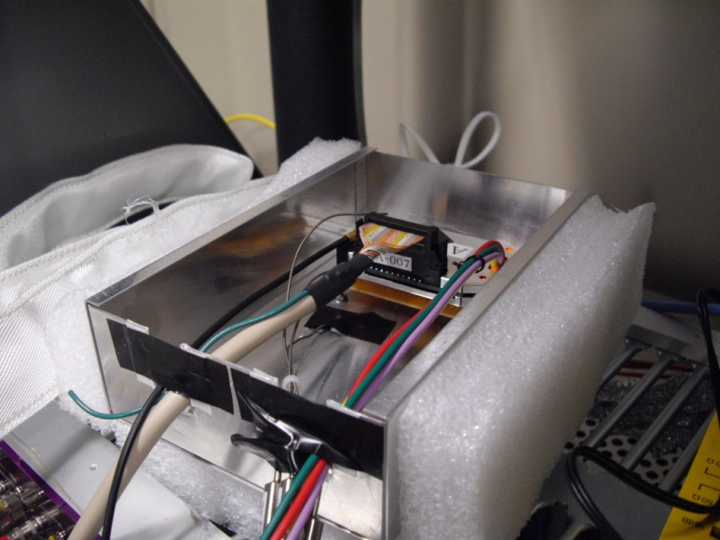
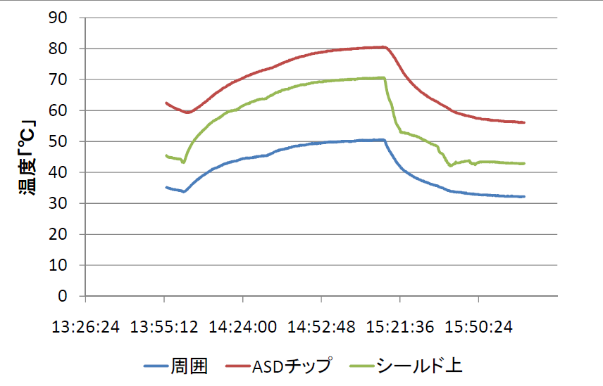
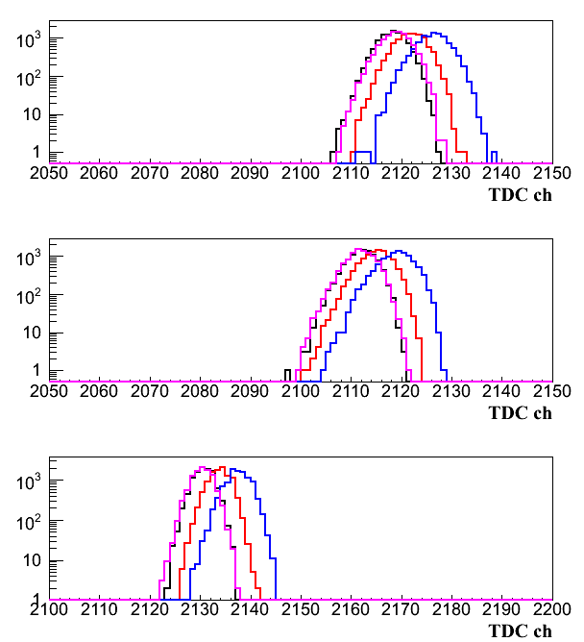
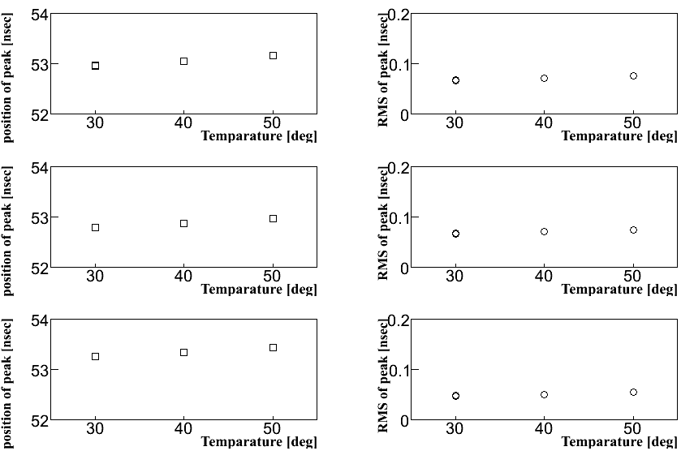
Tolerance for temperature
JPS meeting @ Yamagata Univ. 2008/09/21
Heater
By thermocouple thermometer
TDC (test pulse)
center
RMS
黒：６０℃
赤：７０℃
青：８０℃
紫：６０℃
ASD can work in the high temperature.
The timing change, but it is small (0.1nsec/10deg ).
1nsec

Slide 12
Summary & Outlook
At the J-PARC K1.8BR beam line, we are constructing the dedicated detector system for the search of Kaonic nuclear bound state.
CDC was already moved to J-PARC, and more studies will be done in a few month.
  The test chamber shows good performance.
  Needed parts will be ready soon.
The installation method and jigs must be confirmed in this year.
  Design & Construction
JPS meeting @ Yamagata Univ. 2008/09/21

Slide 13
Backup 1

Slide 14
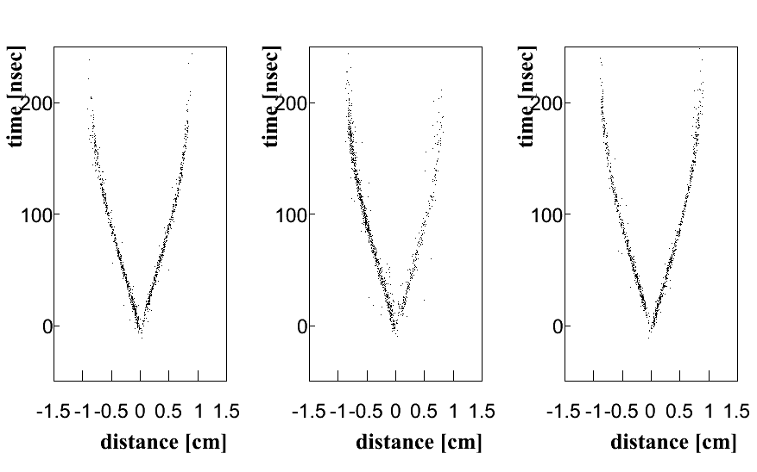
Backup 2

Slide 15
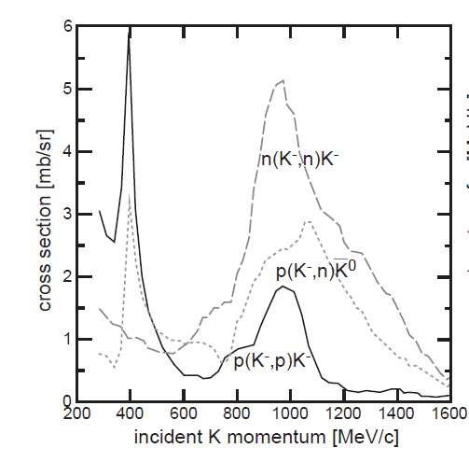
Backup 3

Slide 16
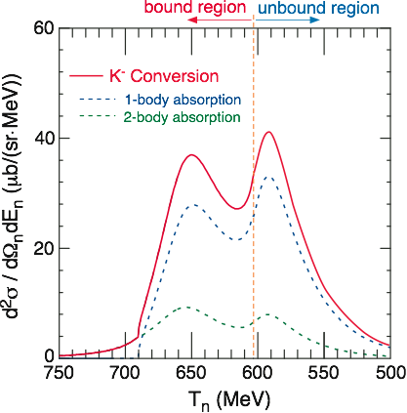
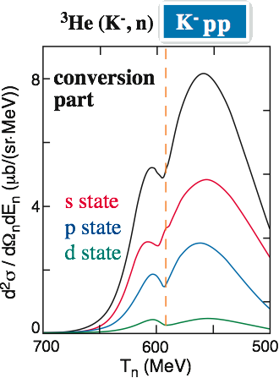
Backup 4
Bound state will be seen if exist.
  Cross section : 5 ~ 40 μb/(sr MeV)
  Resolution should be < 20 MeV
Deep Potential
Shallow Potential
T. Koike, T. Harada, Phys. Lett. B652 (2007) 262
J. Yamagata, S. Hirenzaki, H. Nagahiro, D. Jido, Mod. Phys. Lett. A accepted. Proc. of Chiral07.

Slide 17
Readout systems (2)
8m cable
Repeater
50m cable
TKO DrT in the counting house

