Slide 1

Development of an Aerogel Cherenkov Counter for the J-PARC E16 Upgrade
課題番号：22105516（平成22年度～23年度）
研究代表者：佐久間 史典（理化学研究所）
F.Sakuma (RIKEN), M.Nakamura (TITECH), H.Kawai (Chiba-U), H.Ohnishi (RIKEN), M.Tabata (JAXA), M.Tokuda (TITECH)
Motivation
Aerogel Cherenkov Counter
Present Status
Summary
新学術領域「多彩なフレーバーで探る新しいハドロン存在形態の包括的研究」 領域研究会
@ 理研 2011/02/28-03/01

Slide 2

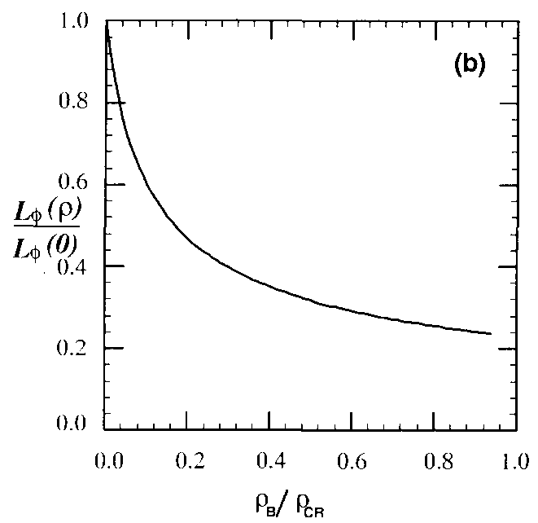
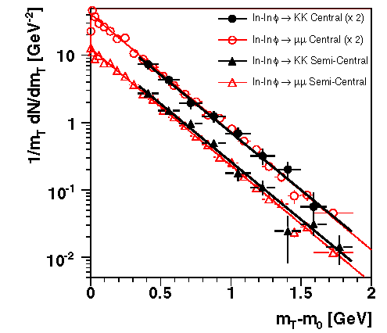
Motivation
J-PARC E16 experiment
→ measures in-medium
φ-meson modification in
di-electron spectrum
Do decay widths of
φ→ll / KK change in
nuclear matter caused by
φ / K spectral modification?
topics of the φ-meson
di-lepton spectrum
Γ_{ll} vs Γ_{KK} (φ-puzzle)
PLB262,485(1991).
Theory
Br*(φ→ll)
/Br₀(φ→ll)
K⁺K⁻ measurement in the E16 experiment is very important
density (ρ_{CR}/ρ₀)
installation of Kaon detectors in the E16 spectrometer is desired
NA60
NPA830,753c(2009).

Slide 3
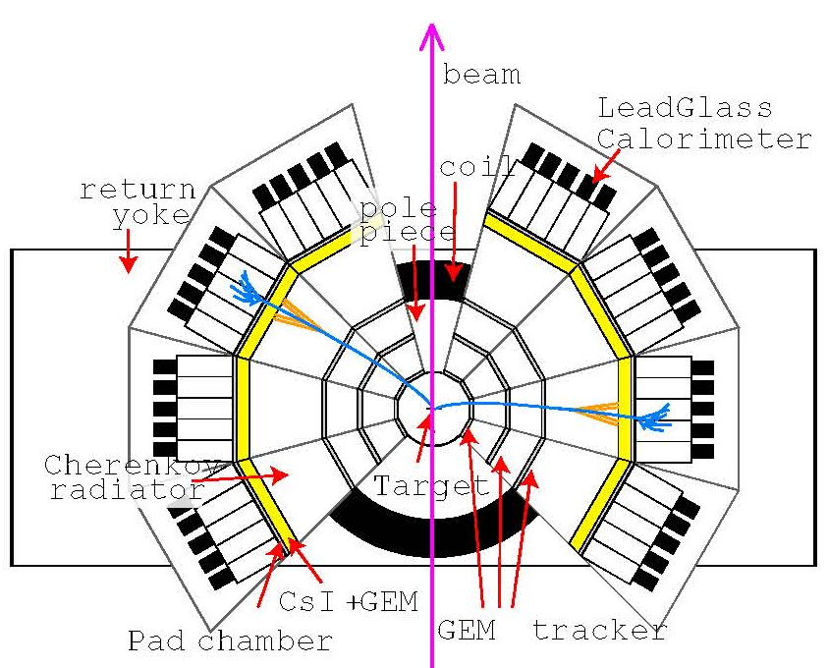
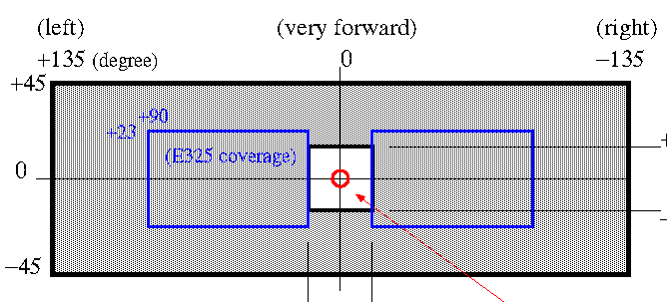
Forward Kaon Spectrometer
AC(n=1.034) + TOF counter
segmented STC
+15
-15
+45
+15
-15
-45
e⁺e⁻ acceptance
K⁺K⁻ acceptance
--- Requirements ---
threshold type AC for kaon trigger (veto counter)
work in magnetic field
small & compact

Slide 4
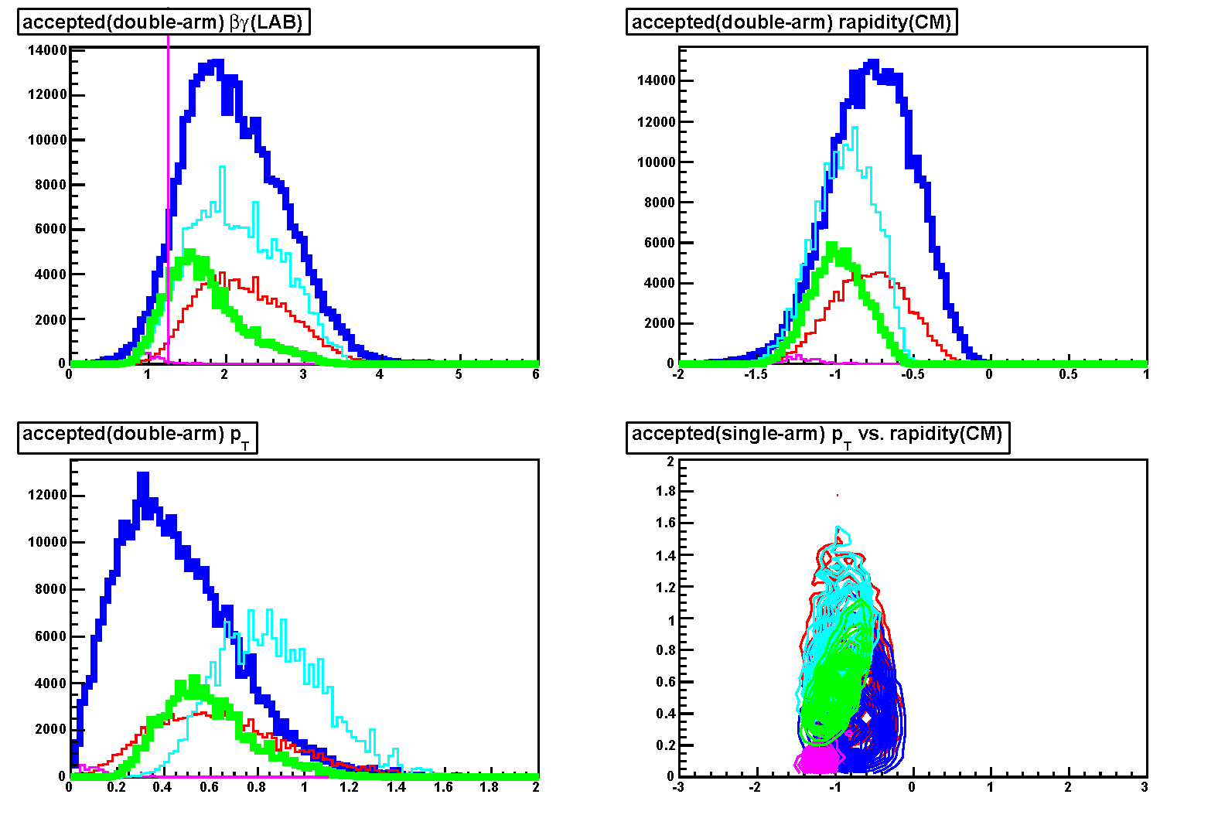
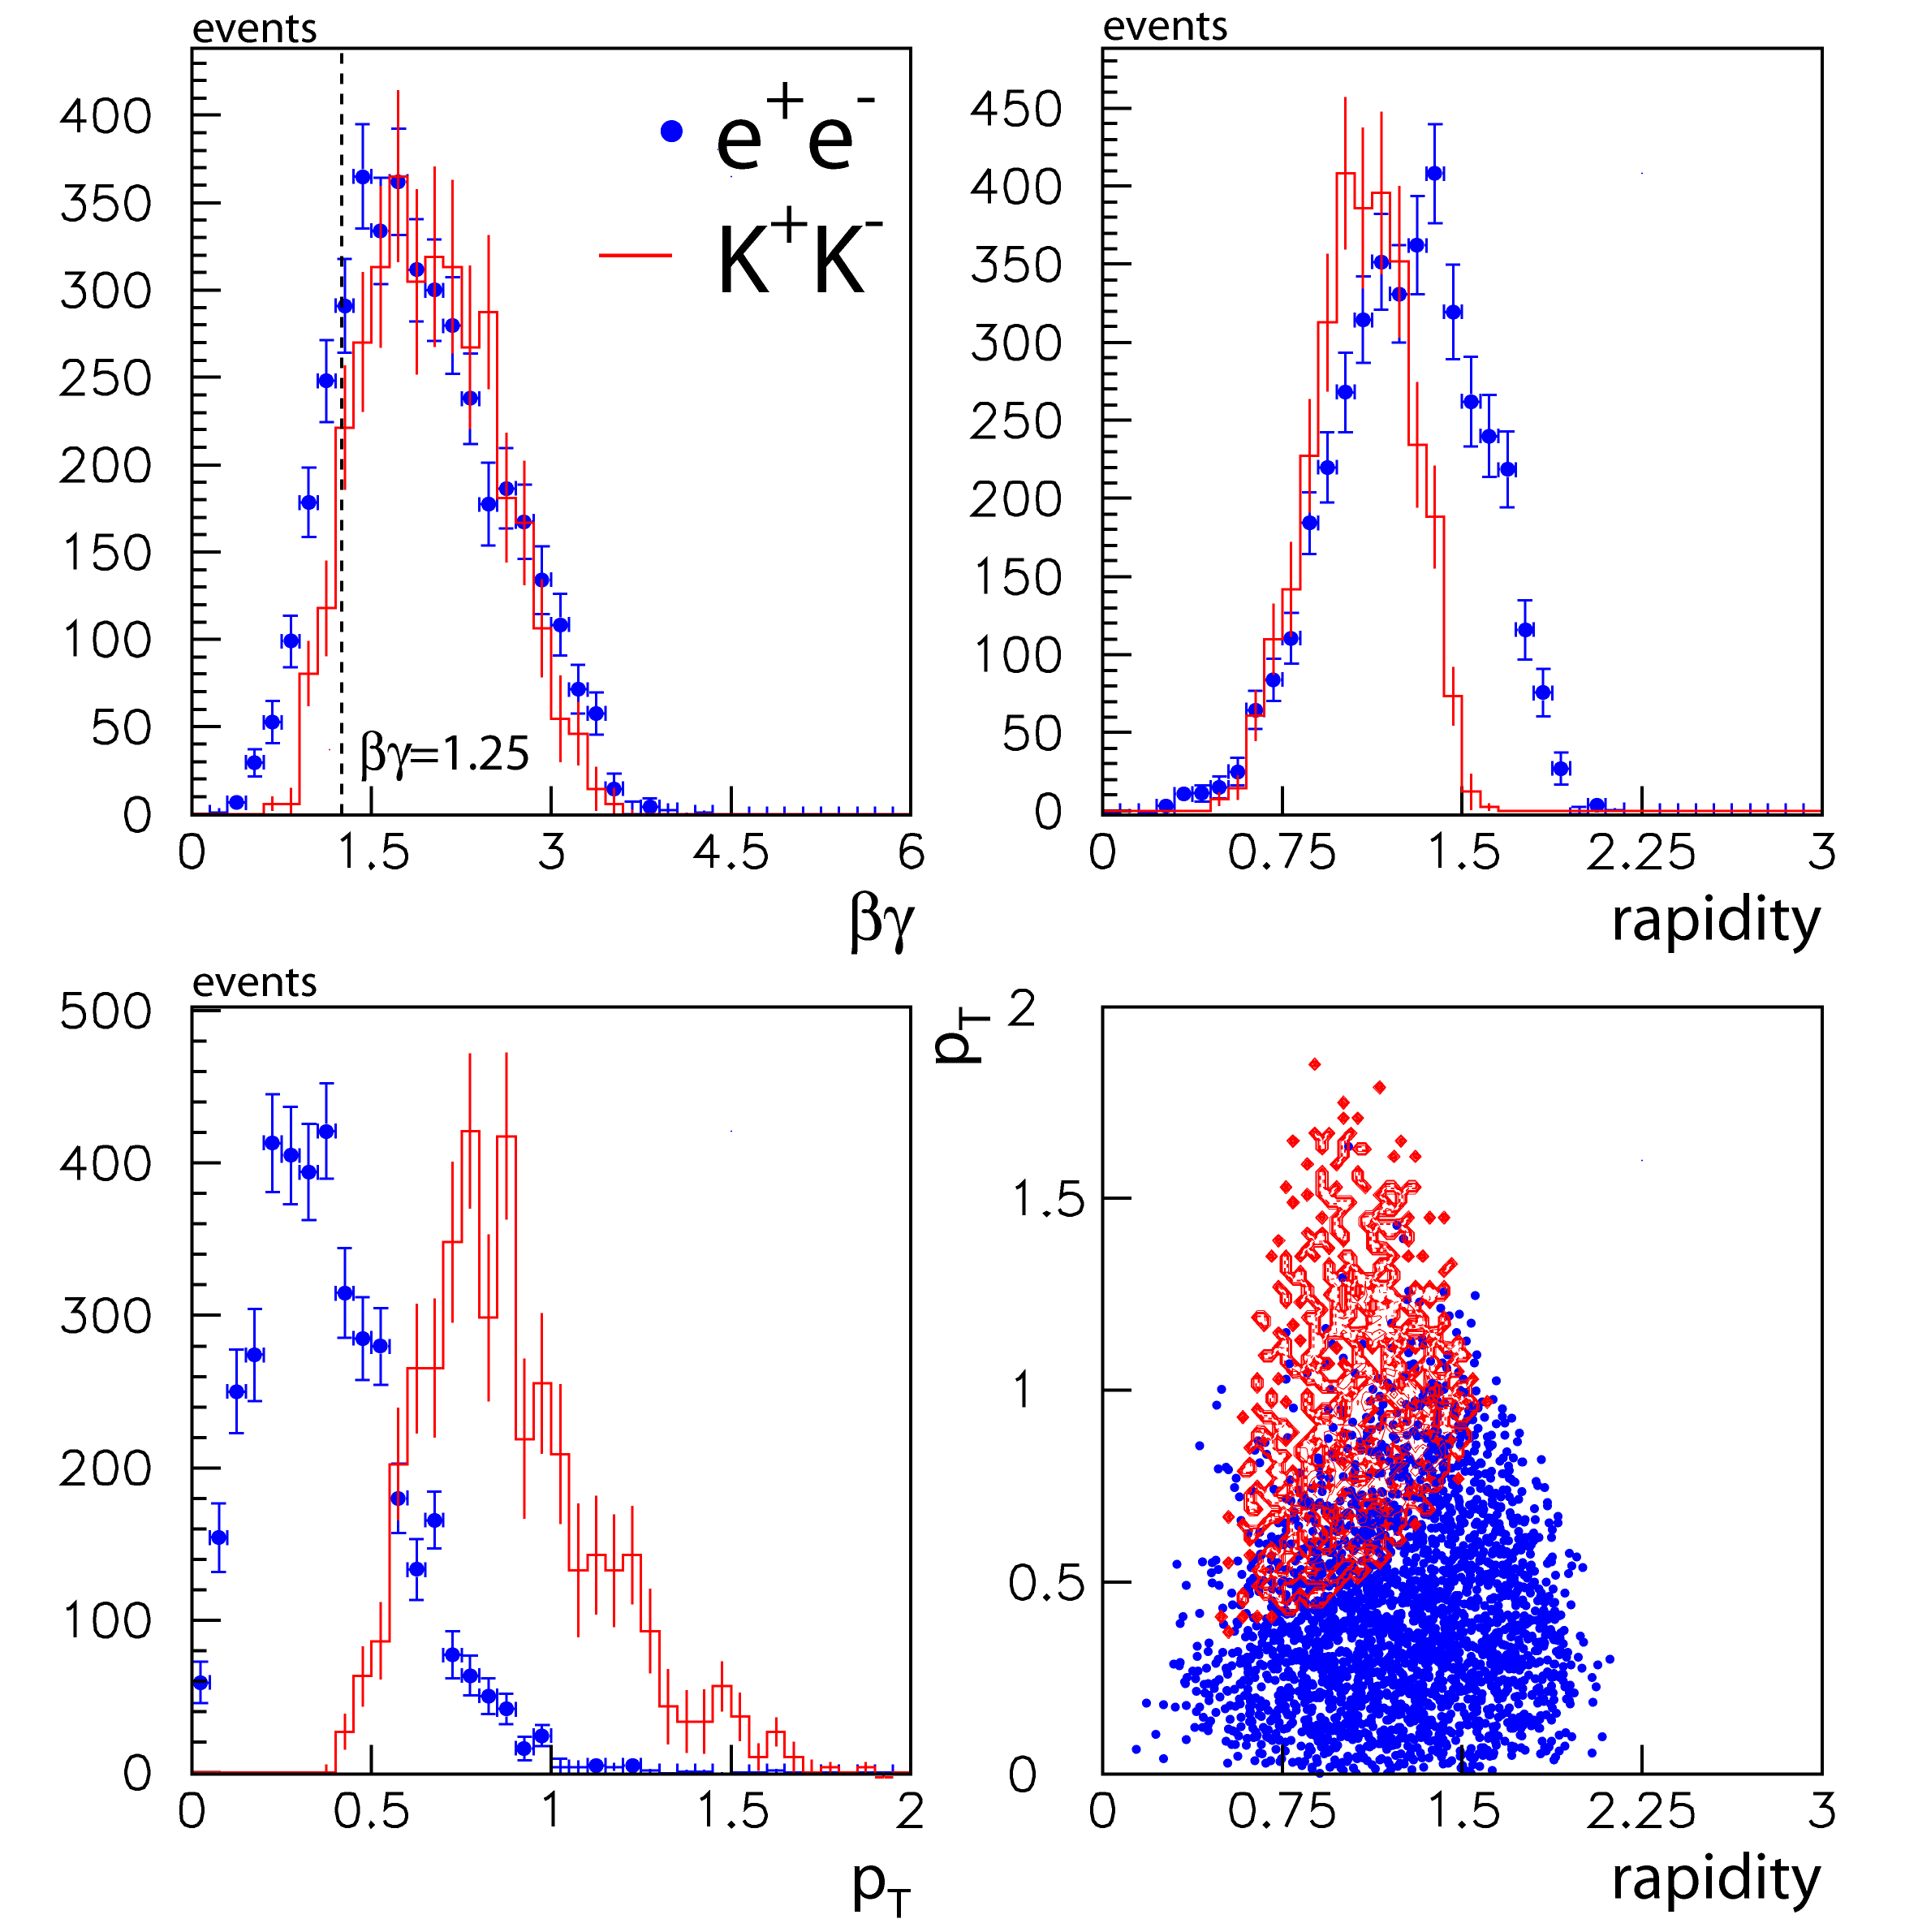
φ→e⁺e⁻/K⁺K⁻ acceptance
e-accepted (double-arm)
e-accepted (single-arm)
k-accepted (opposite-module pair)
k-accepted (same-module pair)
k-accepted (neighbor-module pair)
E325 acceptance
y
(LAB)
βγ
(LAB)
y
(CM)
βγ
(LAB)
p_{T}
(LAB)
pt vs. y
φ→e⁺e⁻
double-arm
p_{T}
(LAB)
pt vs. y
φ→K⁺K⁻
neighbor-side
Improvement of the acceptance overlap between e⁺e⁻ and K⁺K⁻

Slide 5
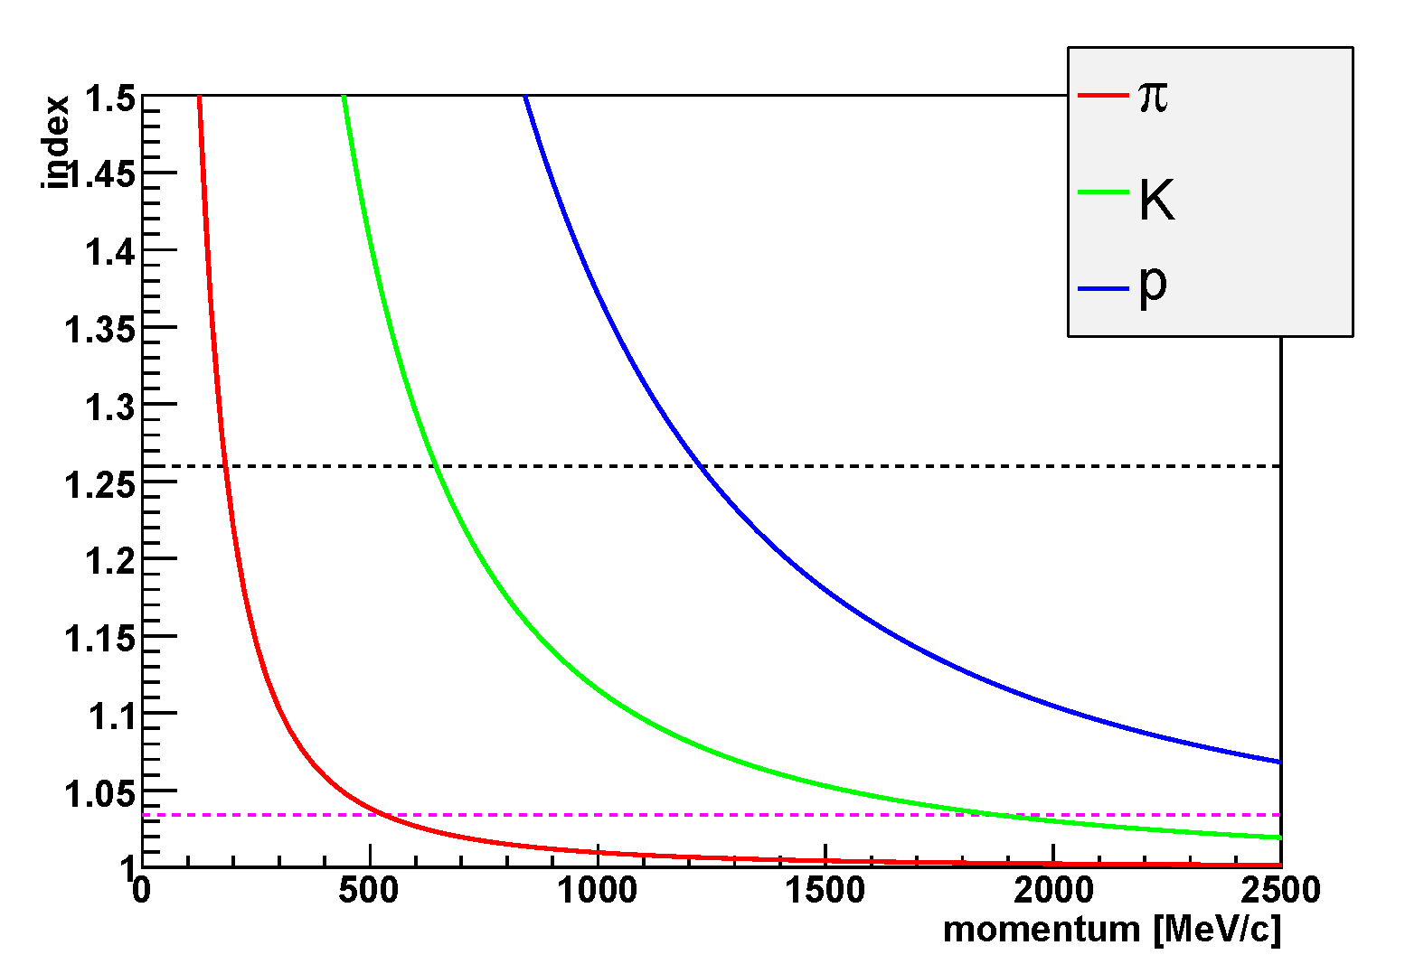
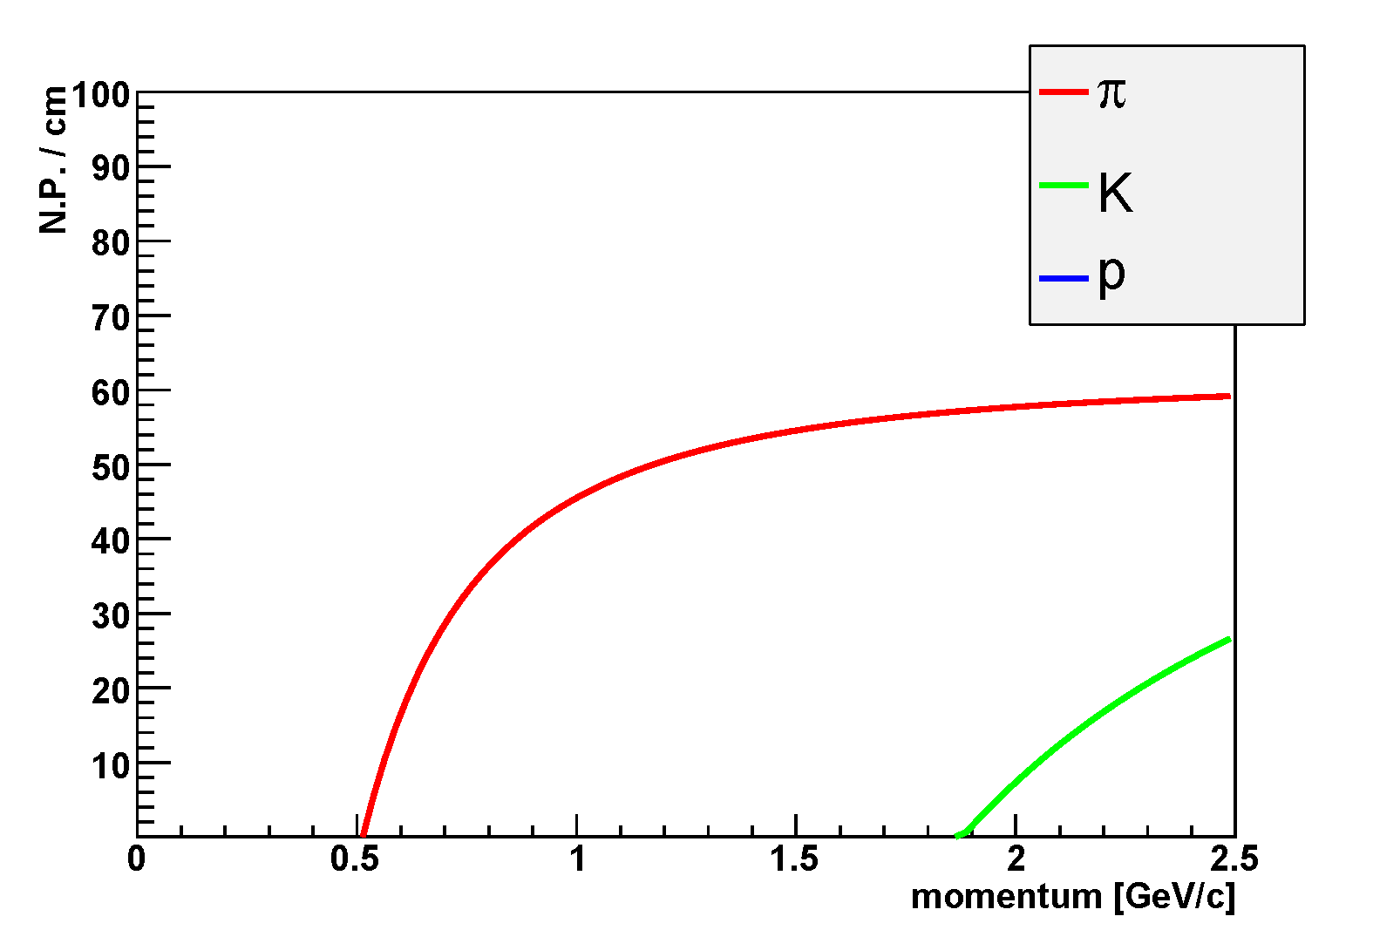
AC design
use n=1.034, as same as KEK-PS E325
60x60cm² divided by 6 (or 10) sectors
10cm
X 4 modules
60cm
index=1.034
index=1.034
readout
WLS + fiber + (FM)PMT
integration range :
300-800nm
Goal : construct a prototype of ¼ size module

Slide 6
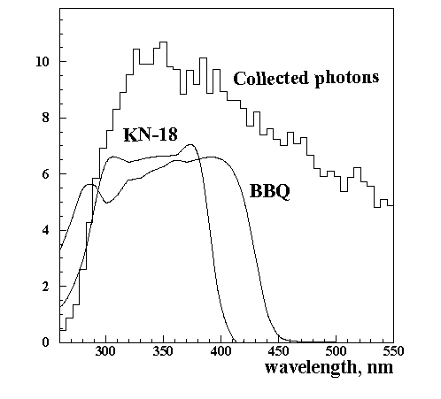
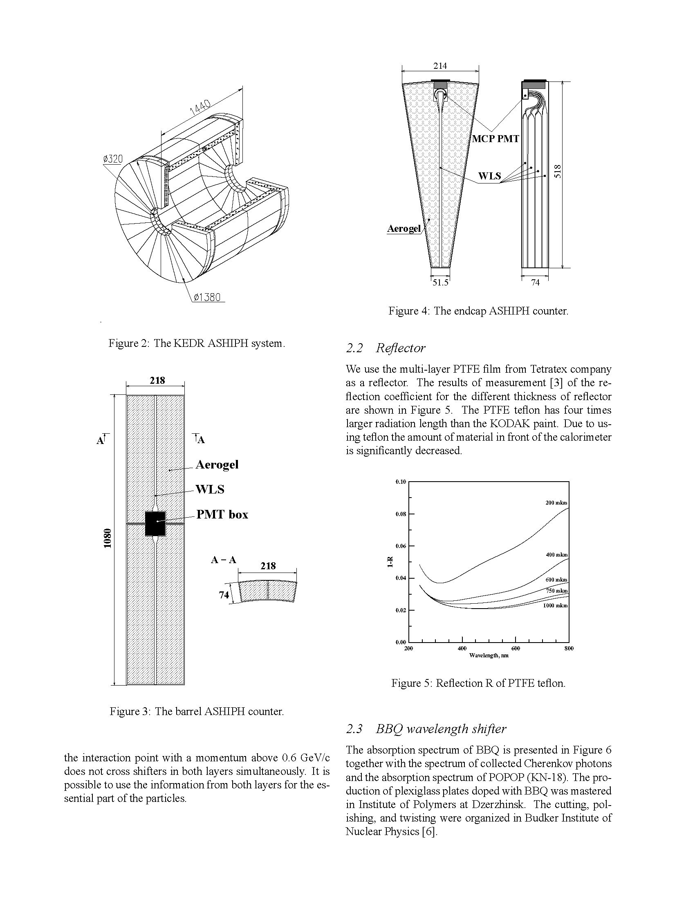
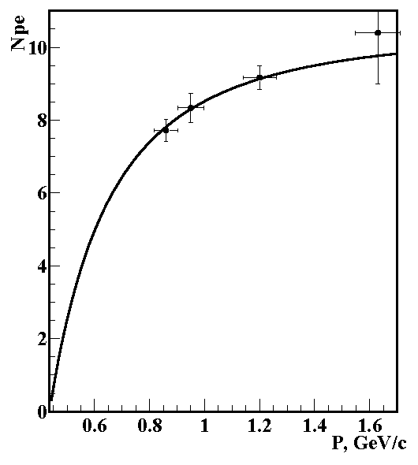
Some Hints in detector development in Russia?
arXiv:hep-ex/0106016
candidate for PEP-N detector @ SLAC
barrel
endcap
~8 p.e.
Aerogel : t74mm, n=1.05
WLS : BBQ
π momentum

Slide 7
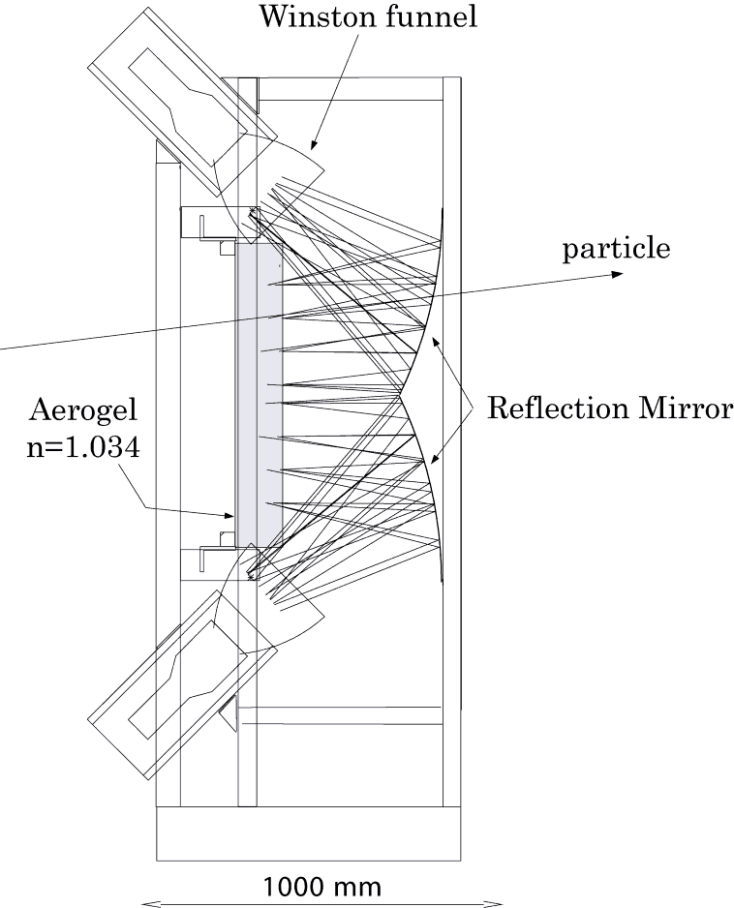
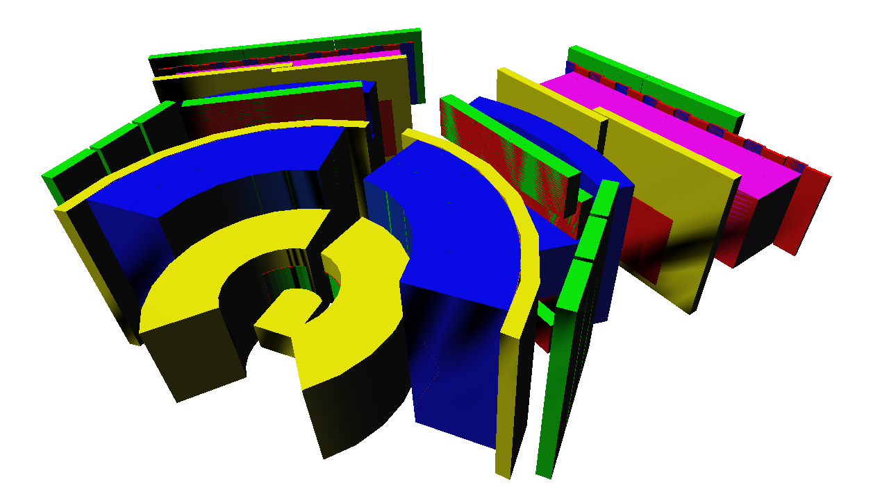
Minimum Goal : KEK-PS E325 AC
AC
n=1.034
12.5cm Aerogel
5 inch PMT (H6527)
π Rejection
: 1x10⁻²
@ 1.4GeV/c
M.Ishino et al., NIM A457, 581
1.1 p.e.
pion
8 p.e.
proton

Slide 8
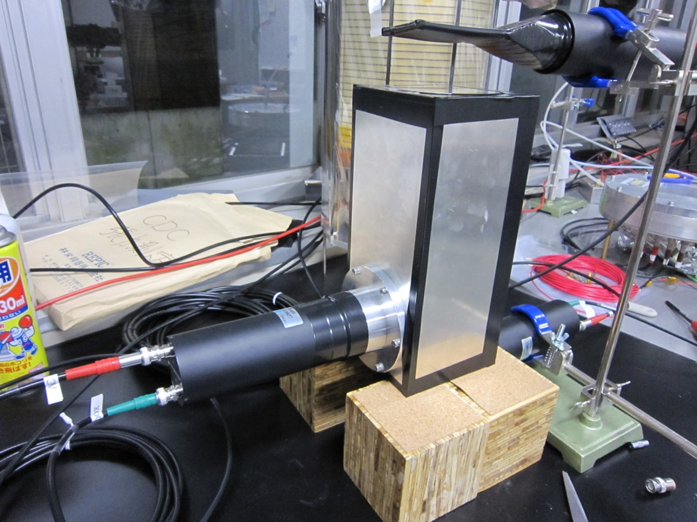
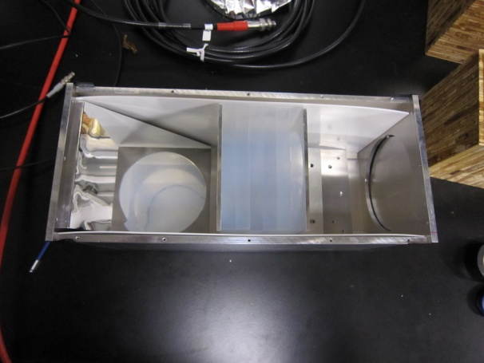
Aerogel
We have checked 3-types of the aerogel (n~1.034):
Panasonic-denko
KEK-PS E325
Chiba-U
10cm
10cm
Aerogel
H6410 (2”)
Mirror
Cosmic Ray

Slide 9
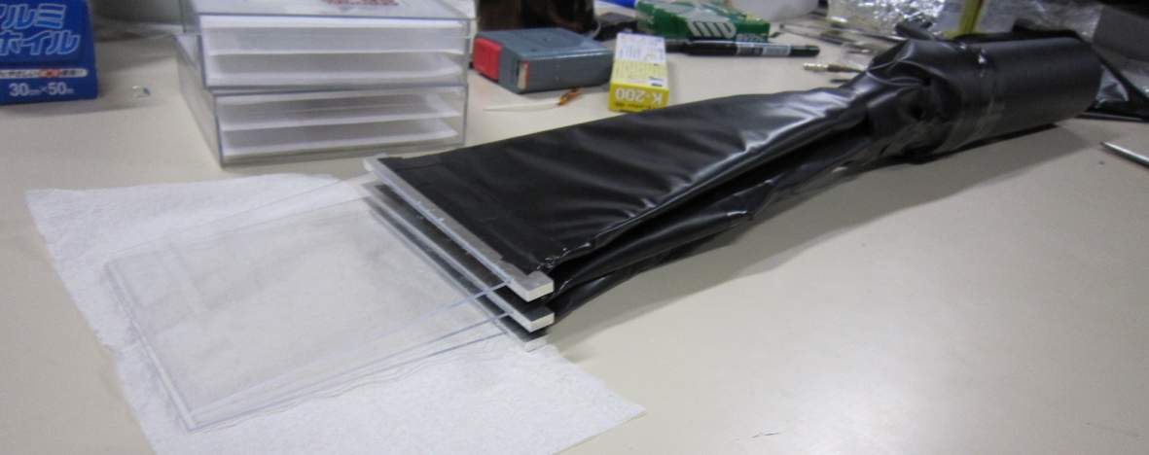
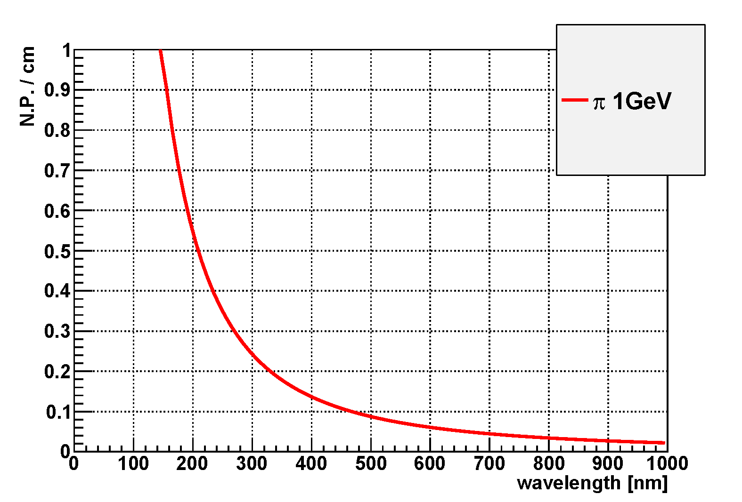
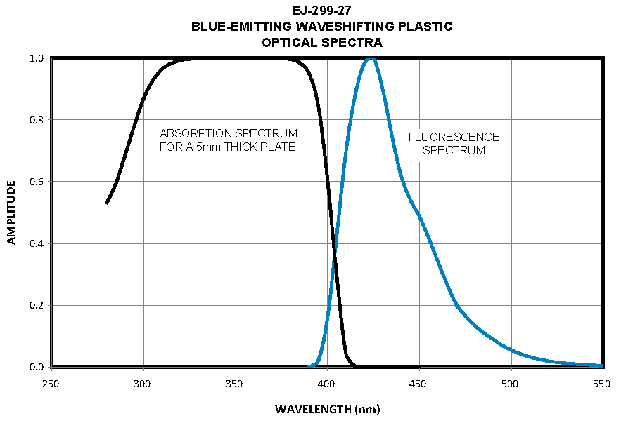
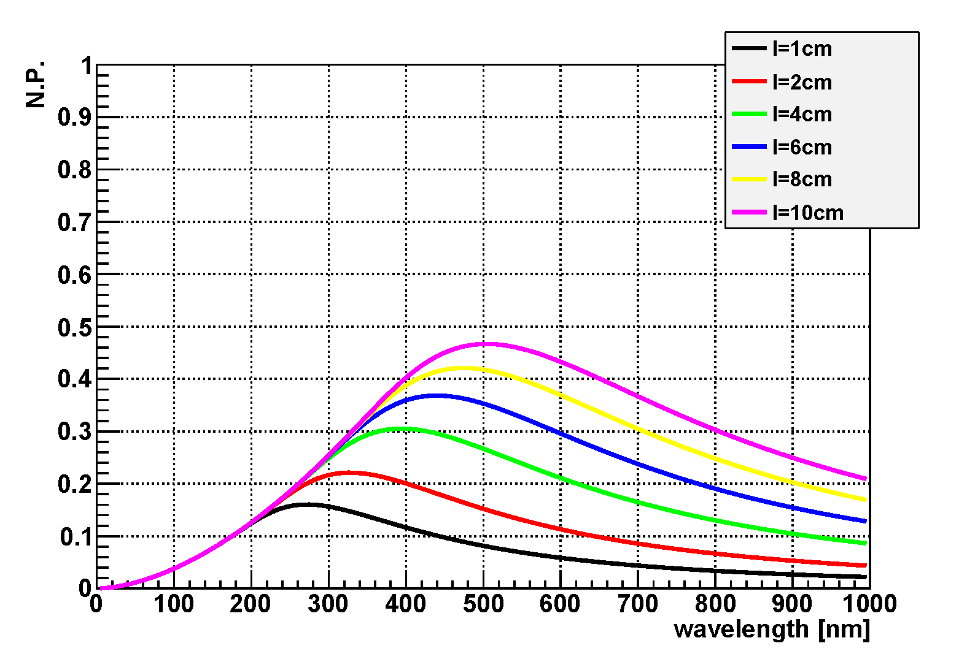
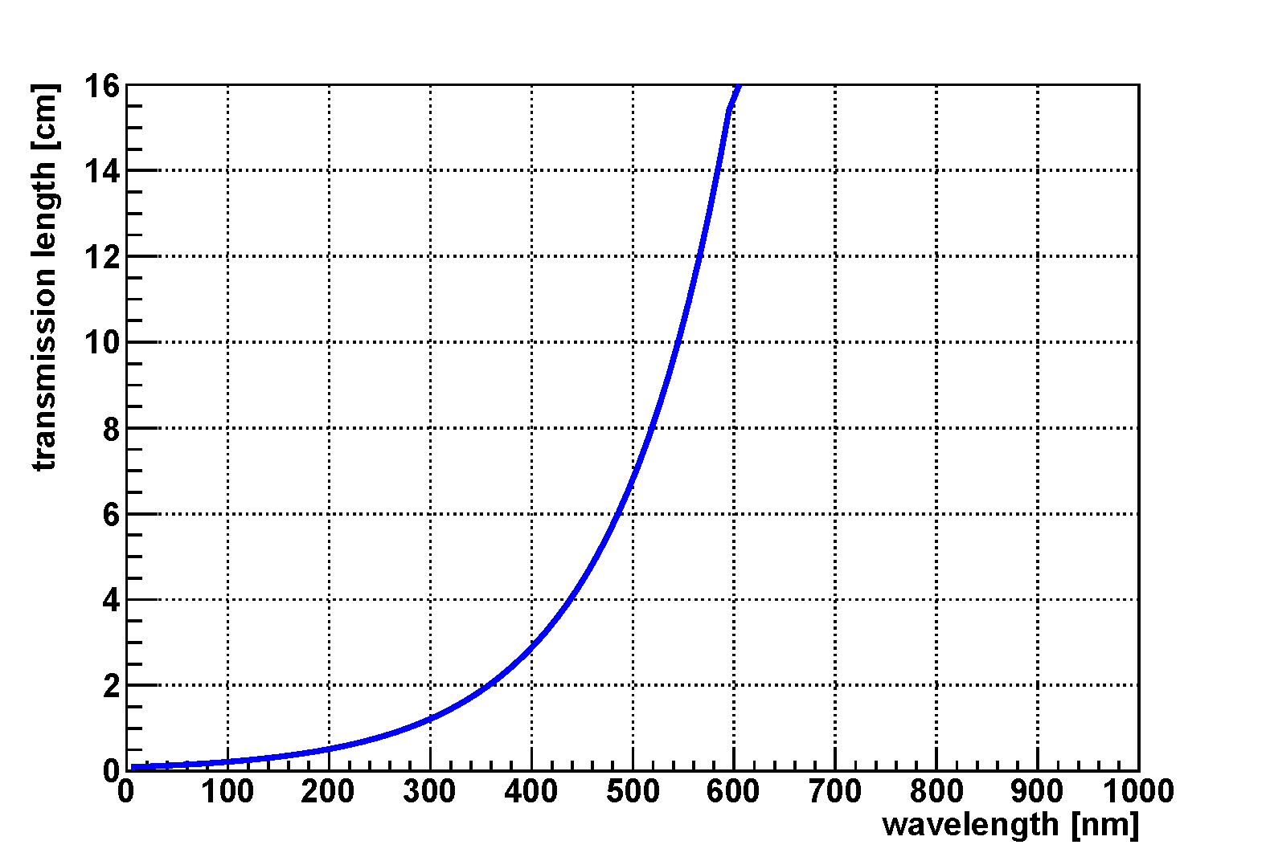
WLS
Aerogel (t2cm)
PMT
clear fiber x100
(φ1mm, single clad)
fiber x100
H6410
(2”)
WLS
30cm
Cosmic Ray
WLS (ELJEN
EJ-299-27, t1mm)
10cm
10cm
expected # of photon
@ 1GeV/c π & n=1.034
x
transmission length
n=1.034 (KEK)
WLS(blue)
PMT

Slide 10
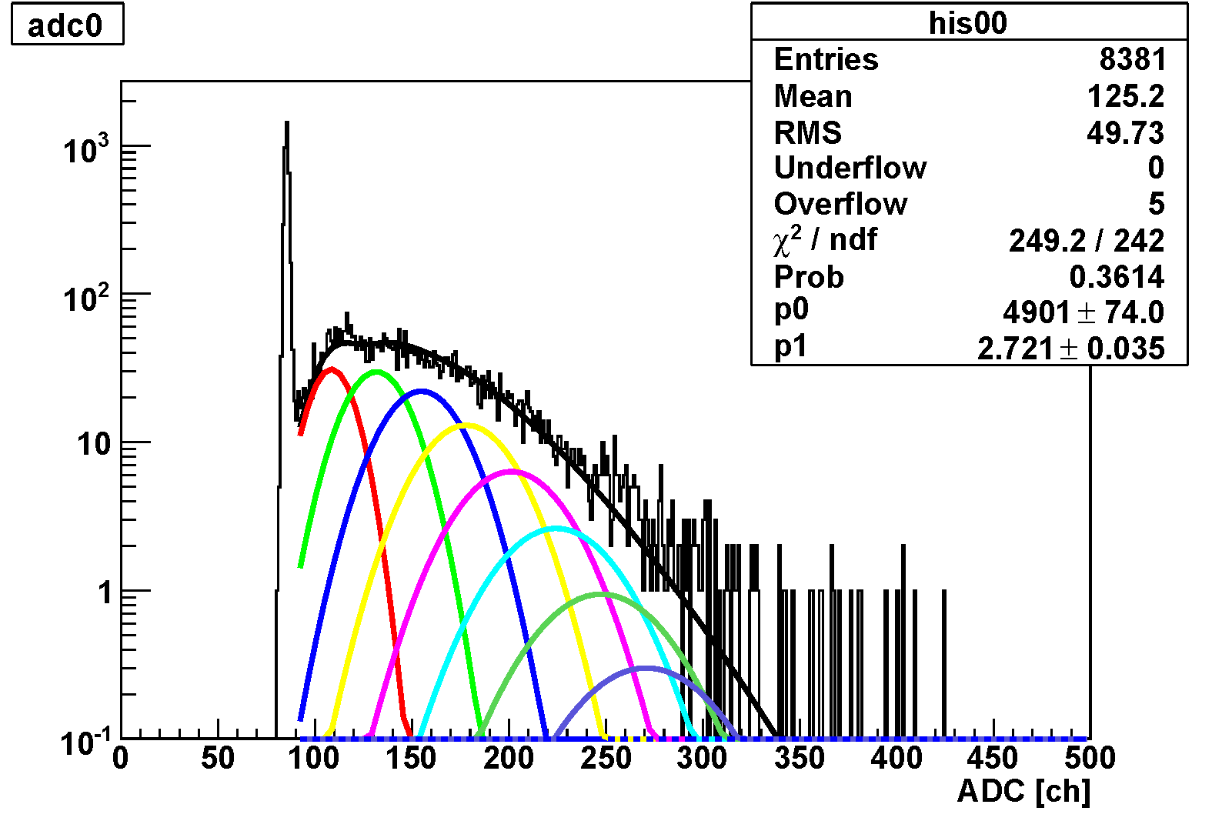
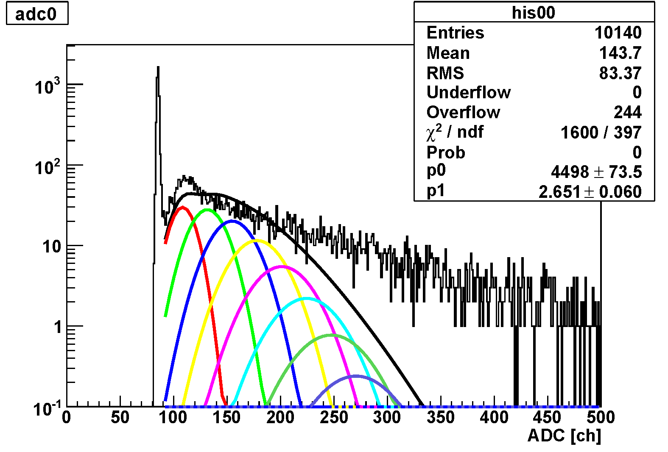
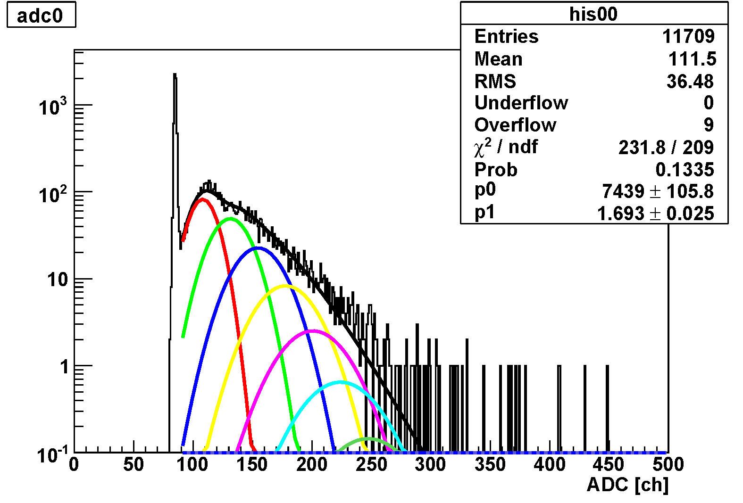
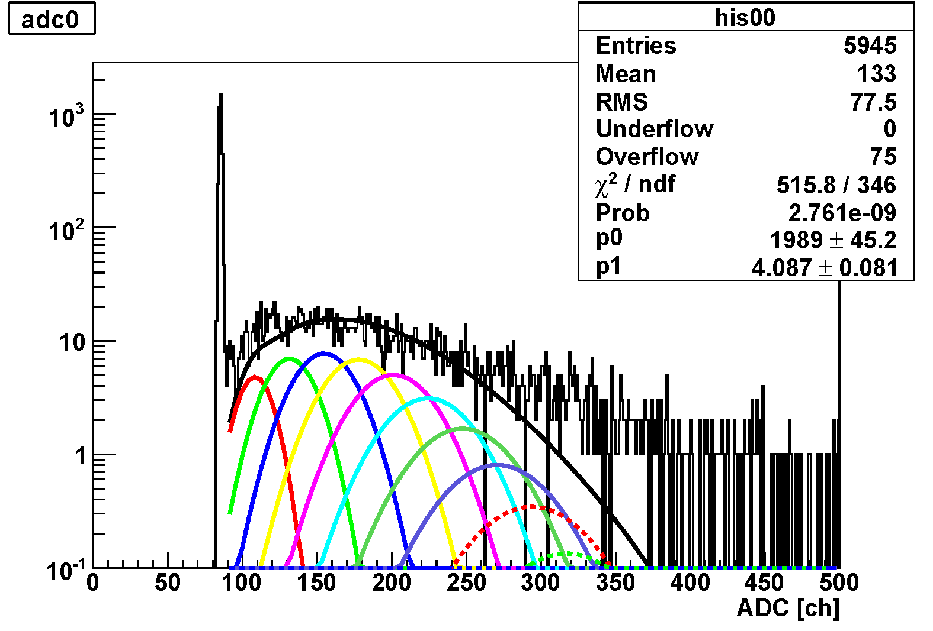
WLS (Cont’d)
1mm
2cm
2cm
1mm
1mm
w/ Aerogel
w/ Aerogel
fitting is failed…
w/o Aerogel
w/o Aerogel

Slide 11
WLS (Cont’d)
--- What we have learned ---
WLS (blue, t1mm) emits several photons with charged particles
→ We cannot install a large amount of WLS in detector acceptance
present method of WLS+fiber readout cannot collect Cherenkov light from the Aerogel
--- What we have to do ---
reconsider the configuration of the Aerogel and WLS
increase the fibers?
usage of blue and green WLS?

Slide 12
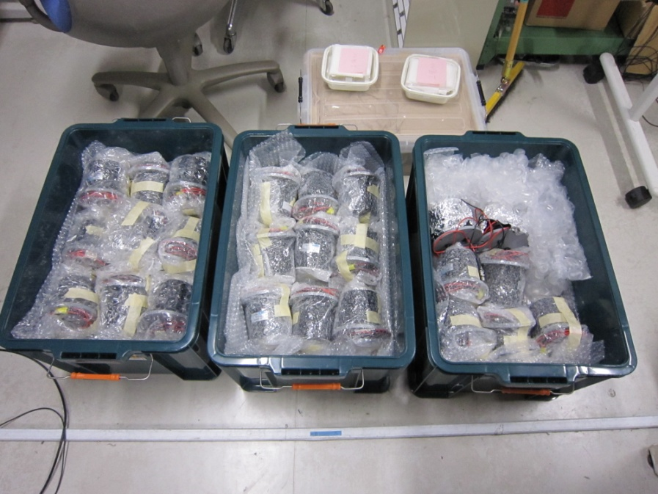
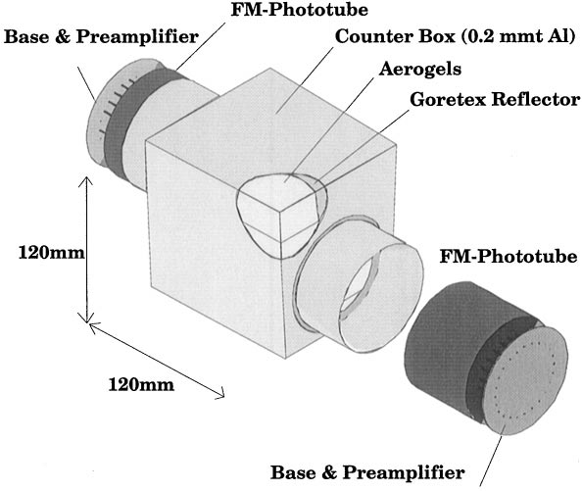
Other Ways …
development of a “normal type” Aerogel Cherenkov Counter with finemesh-PMTs such as BELLE AC.
development of a “reflection type” Aerogel Cherenkov Counter with optical mirrors such as E325 AC.
R5543 x 52 @ RIKEN
(from KEK-PS E325 GC)
E325 AC
NIM A457, 581
BELLE AC
NIM A453,321

Slide 13
Summary
We have been developing an Aerogel Cherenkov Counter for the E16 upgrade in order to measure K⁺K⁻ pair.
Development of WLS+fiber readout has been started, but we have to adjust the configuration of AC+WLS+fiber. Further study is required…

Slide 15
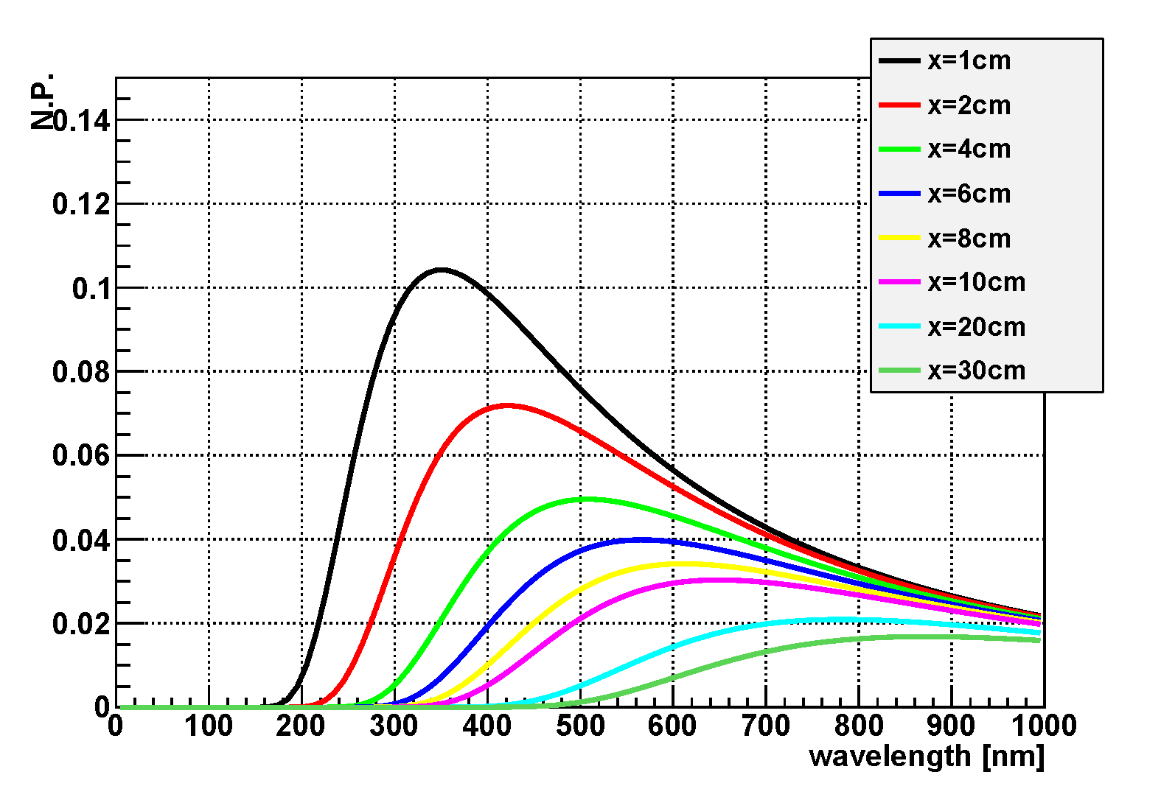
Expected Photon Spectra
expected # of photon
@ 1GeV/c π & n=1.034
transmission length
n=1.034 (E325)
π 1GeV/c
π 1GeV/c
l
x
Aerogel
Aerogel
Detection
Detection

Slide 16
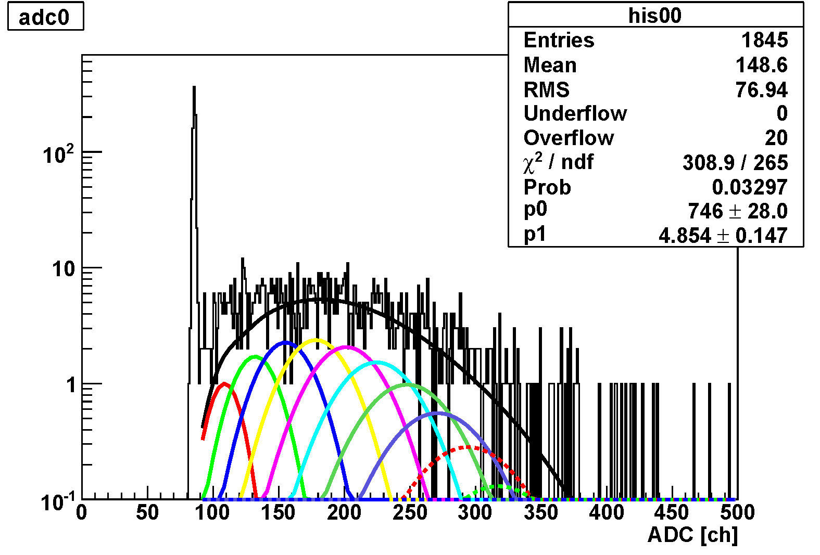
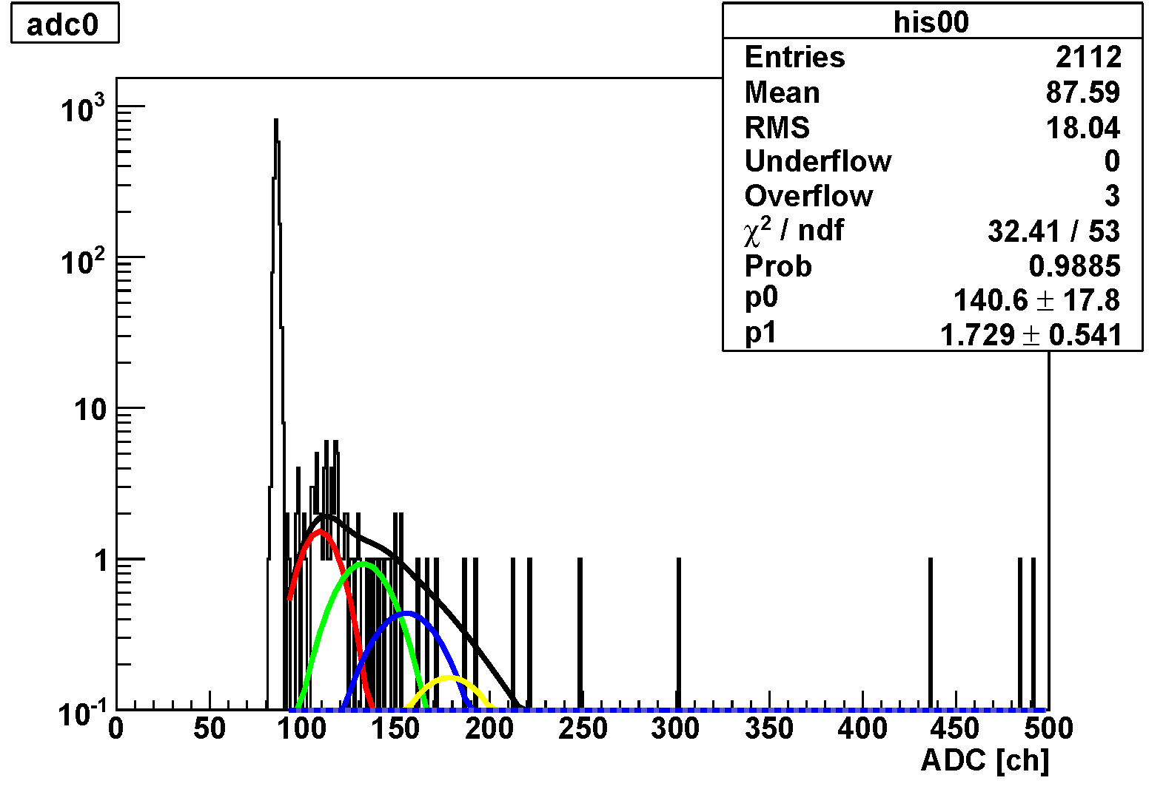
WLS (Cont’d)
Aerogel
6cm
H6410 (2”)
Aerogel
6cm
WLS
1mm

Slide 17
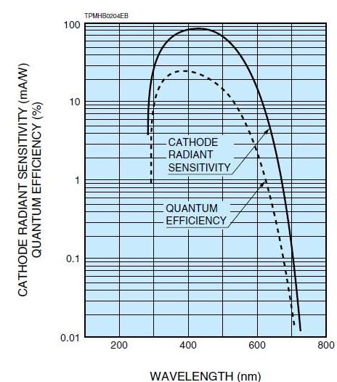
WLS (Cont’d)
WLS(blue)
π 1GeV/c
PMT
Aerogel
l
Detection
WLS
300~400nm
PMT
300~600nm

Slide 18
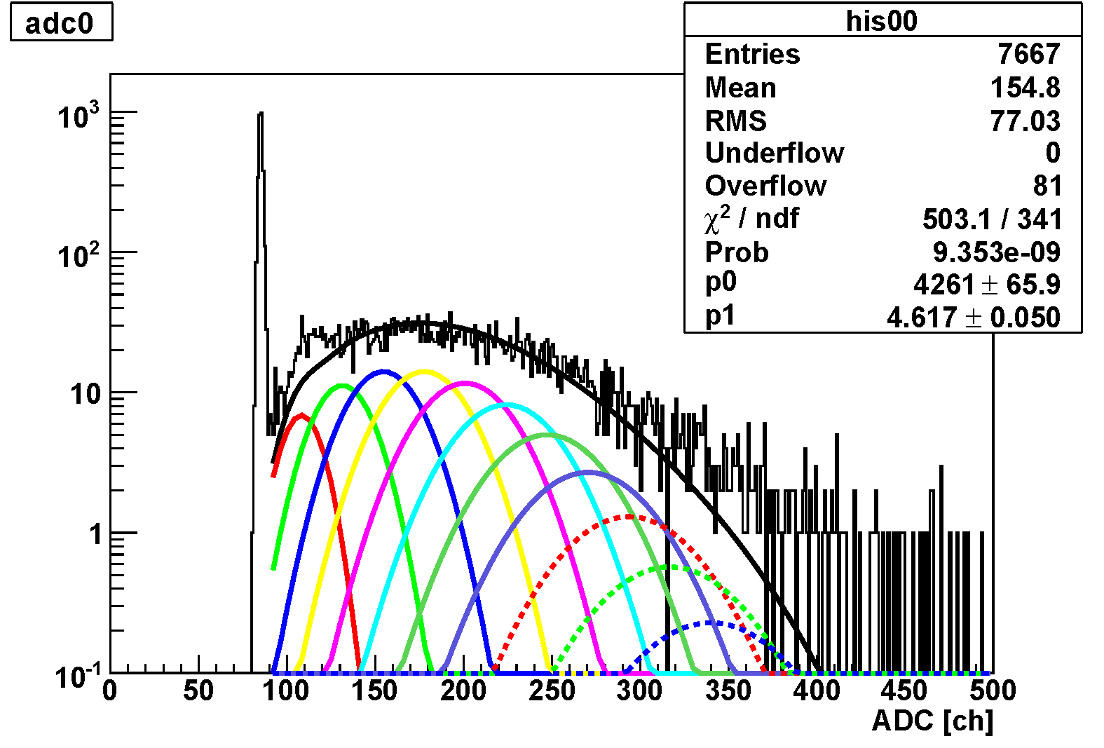
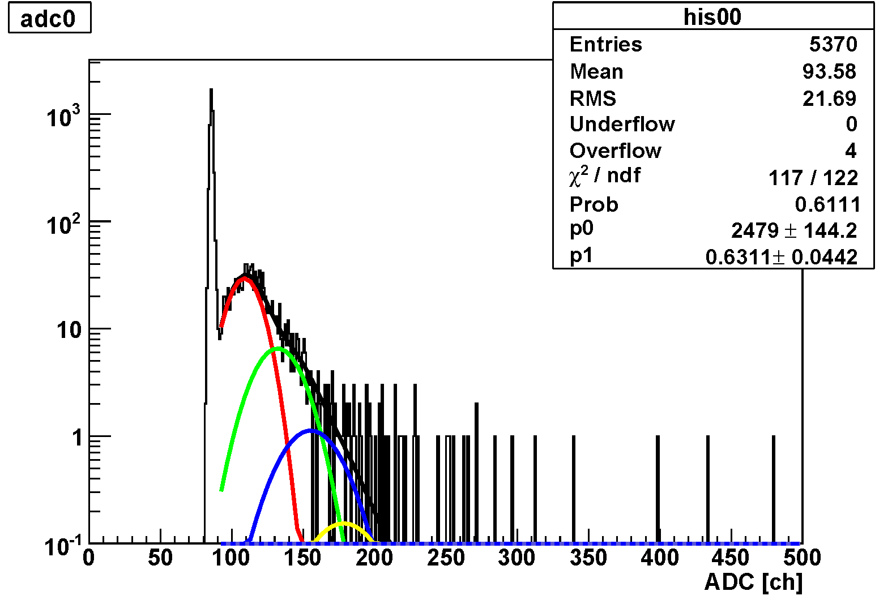
WLS (Cont’d)
trigger
Aerogel
9.4cm
H6410 (2”)
trigger
trigger
Aerogel
9.4cm
WLS
1mm
trigger

Slide 19
Photon Fitting
Poisson
Gaussian
C : normalized factor
λ : mean value of photoelectron
p₀ : pedestal peak
p₁ : distance of pedestal to single-photon
σ₁ : PMT resolution for single-photon
← parameter
← parameter
← constant
← constant
← constant

Slide 20
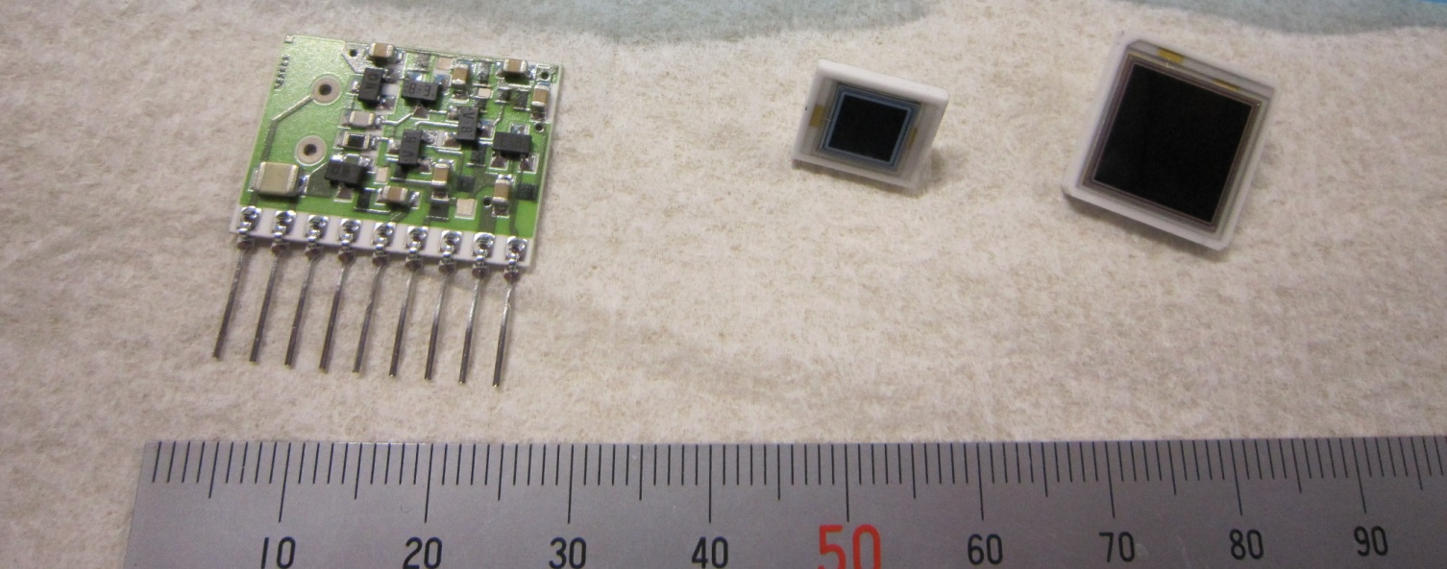
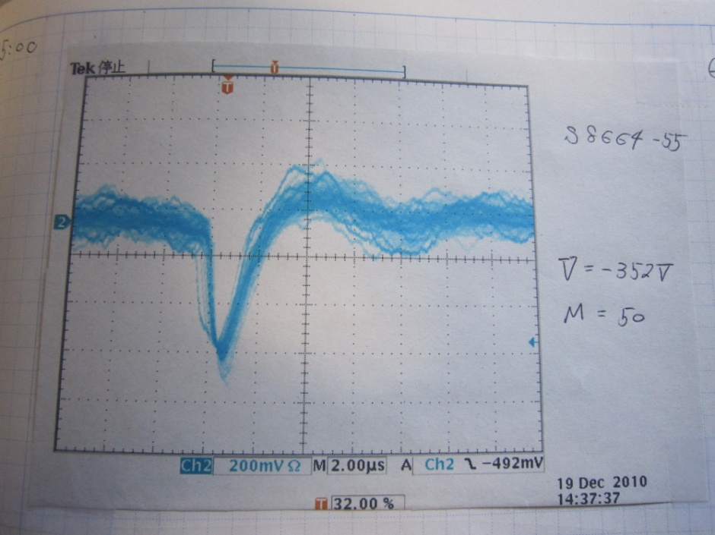
SiAPD
H4083
S8664-55
S8664-1010
We purchased and tested SiAPDs.
But we CANNOT see the signal of a few photons on SiAPD, because of read-out electronics noise!
what we have learned is …
“using low-gain devices for Cherenkov detection is
awful difficult!”
~7500 photons
(gain : x50)

Slide 21
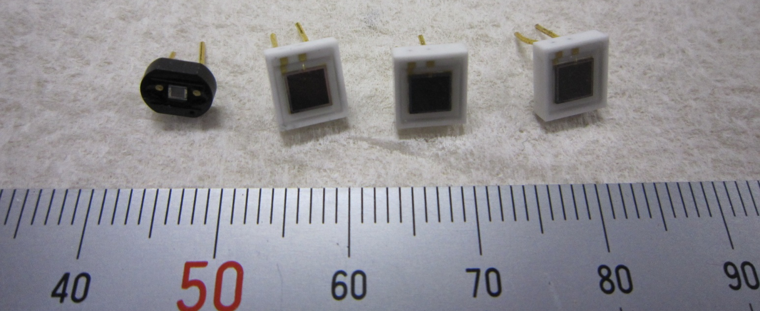
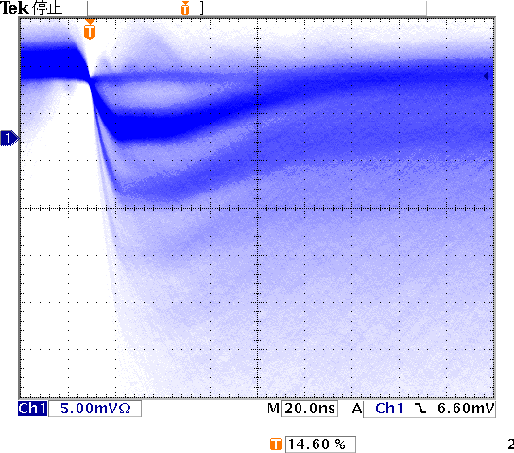
MPPC
S10362
-11-100C
S10362-33-050C
S10362
-33-025C
S10362-33-100C
We purchased and tested MPPCs.
The dark count signals of ~Mcps were confirmed as written in the product specification.
It seems that usage of the MPPCs for a single-photon detector
is too hard!
Several tens of photons are required.

Slide 23
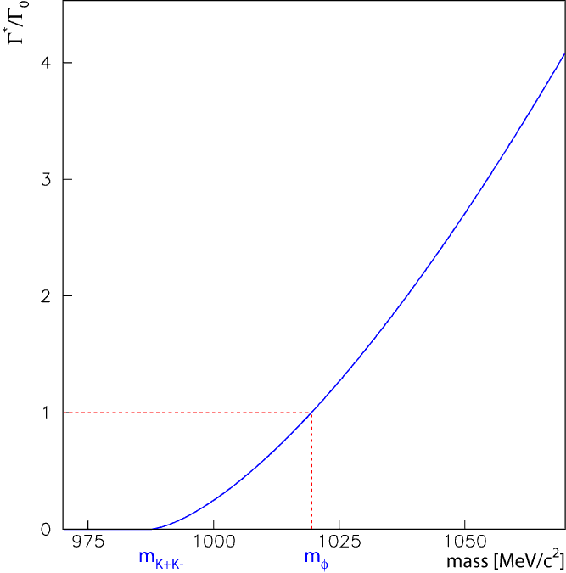
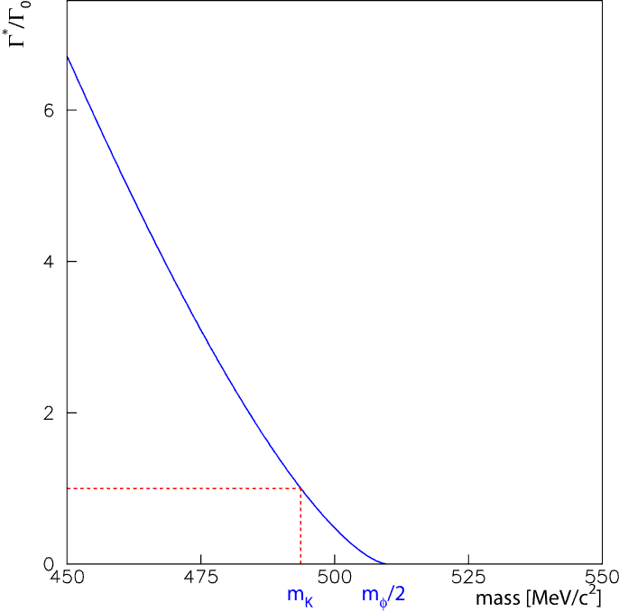
Vector Meson, φ
J.D.Jackson, Nuovo Cimento 34, 1644 (1964).
m_{φ}が変化
Γ*/Γ₀
φ mass
m_{K}が変化
Γ*/Γ₀
K mass

Slide 24
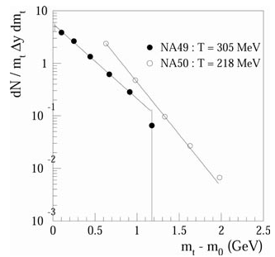
φ Puzzle
核物質中でのφまたはKのスペクトラル関数の変化によって、φ→ll/KKの崩壊幅が変化するのではないか?
theoretical predictions
D.Lissauer and V.Shuryak, PLB253,15(1991).
P.-Z. Bi and J.Rafelski, PLB262,485(1991).
J.P.Blaziot and R.M.Galain, PLB271,32(1991).
etc.
PLB262,485(1991).
Γ*(φ→KK)/Γ*(φ→ll) の増加
Γ*(φ→ll)
/Γ₀(φ→ll)
Γ*(φ→KK)/Γ*(φ→ll) の増加
Γ*(φ→KK)/Γ*(φ→ll) の減少
density (ρ_{CR}/ρ₀)
J.Phys.G27,355(2001).
dN/m_{t}Δydm_{t}
NA49/NA50@CERN-SPS
PLB491,59(2000).; PLB555,147(2003).; J.Phys,G27,355(2001).
φ→K⁺K⁻/μ⁺μ⁻, 158AGeV Pb+Pb
production CS’s are inconsistent
NA49/
NA50
φ→K⁺K⁻
φ→μ⁺μ⁻
m_{t}-m₀ (GeV)

Slide 25
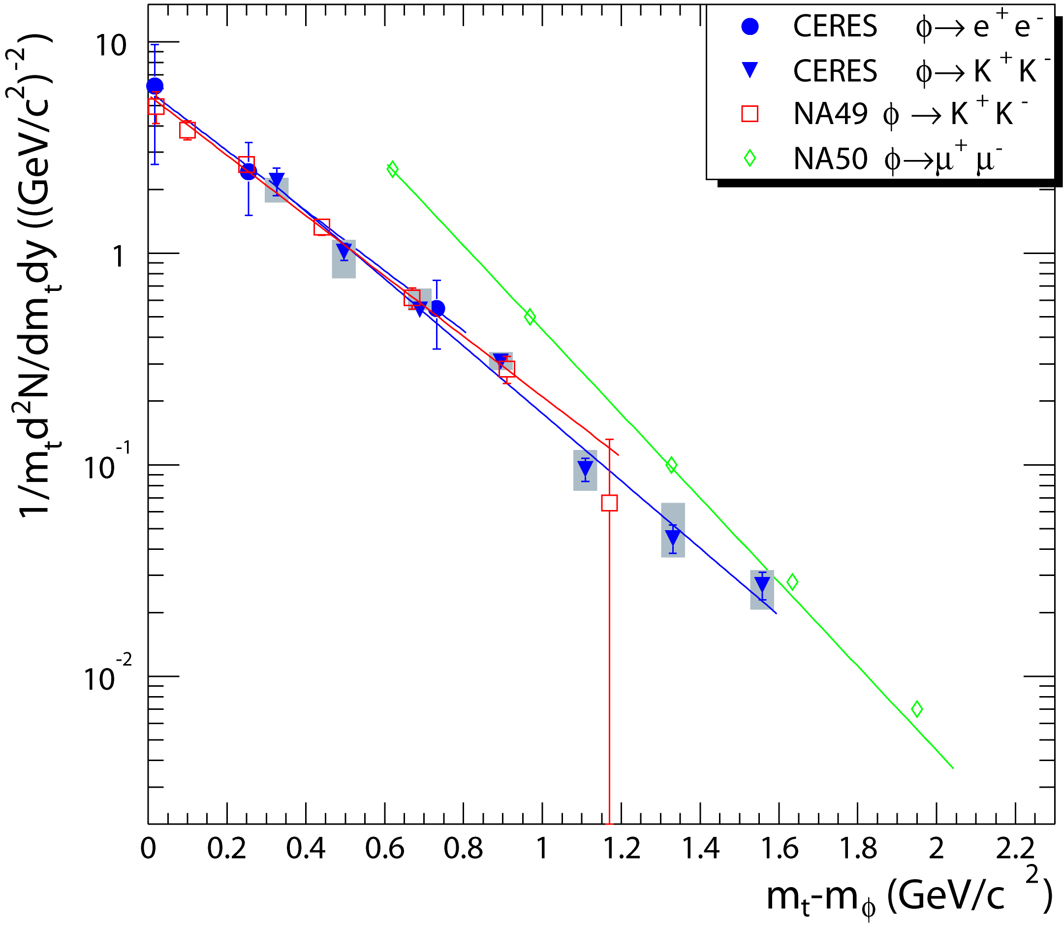
φ Meson Measurements
Hot Matter
CERES(NA45)@CERN-SPS
PRL96,152301(2006).
φ→e⁺e⁻/K⁺K⁻, 158AGeV Pb+Au
production CS’s are consistent
PHENIX@BNL-RHIC
EPJ,A31,836(2007).
φ→e⁺e⁻/K⁺K⁻, sqrt(s_{NN})=200GeV Au+Au
production CS’s are consistent
NA60@CERN-SPS
NPA830,753c(2009).
φ→μ⁺μ⁻/K⁺K⁻, 158AGeV In+In
production CS’s are consistent
CERES
PRL96,152301(2006).
NA60
Cold Matter
E325@KEK-PS
PRL98, 152302(2007).
φ→ e⁺e⁻/K⁺K⁻, 12GeV p+C/Cu
NPA830,753c(2009).

