Slide 1
ストレンジ・ダイバリオン探索実験に用いる 高時間分解能TOF検出器の開発
Development of a high-resolution TOF counter using MPPC array
for strange-dibaryon searches
科研費 若手研究(B) 26800158
理化学研究所 仁科加速器センター
佐久間 史典
RIKEN F.Sakuma
日本物理学会第71回年次大会 @ 東北学院大学 2016, 3/21

Slide 2
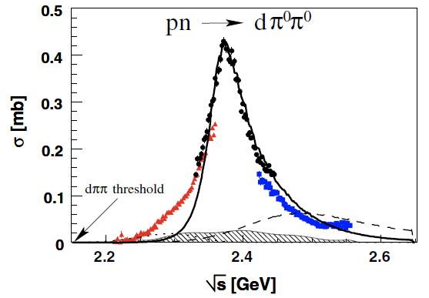
Di-baryon (S=0)
Discovery of d* di-baryon
WASA@COSY, PRL106(2011)242302
p n → d π⁰ π⁰ (T_{p}=1.0/1.2/1.4GeV)
d*: s-channel resonance
m = 2.37 GeV, Γ = 68 MeV
t-channel ΔΔ contribution

Slide 3
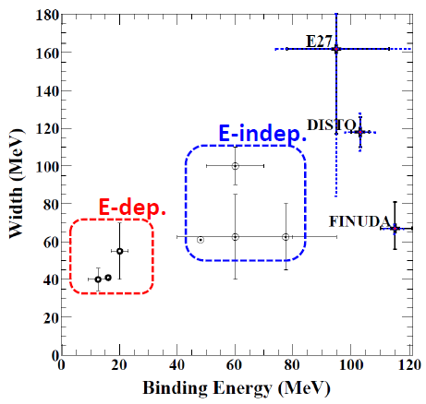
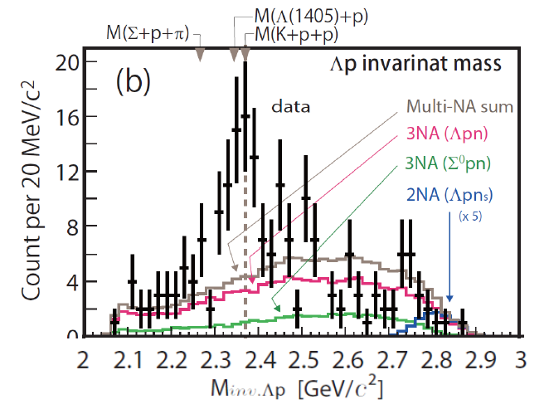
Di-baryon (S=-1)
K^{bar}NN bound state?
Still controversial…
E15?
Y. Sada, et al., arXiv:1601.06876 (PTEP accepted)
J-PARC E15： K⁻ ³He → Λ p n
(山我 21pAC-2)

Slide 4
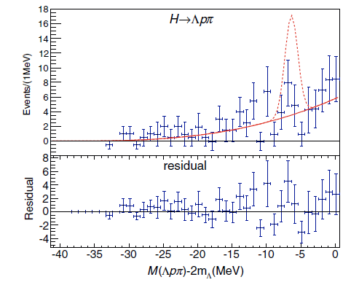
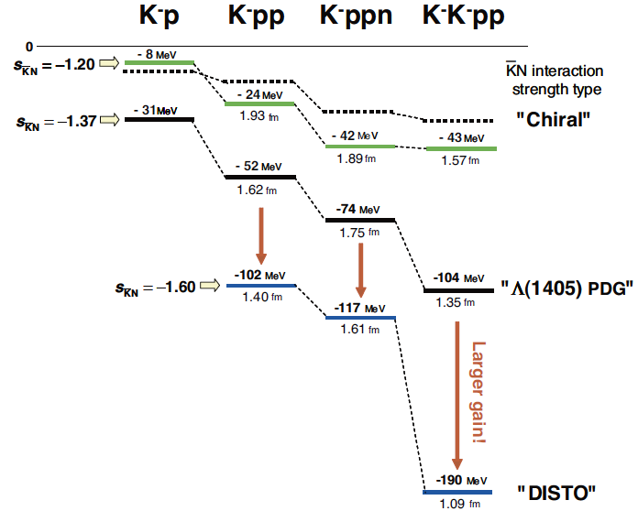
Di-baryon (S=-2)
Belle
PRL110,222022(2013).
H di-baryon? (resonance?)
Lattice-QCDs predict the existence, but…
No experimental evidence so far
K^{bar}K^{bar}NN bound state?
Theo. calcs. predict the existence
No experimental search has been performed
K
p
p
K
experimental search via
p^{bar} ³He → K⁺ K⁰ Λ Λ
S.Maeda, Y.Akaishi, T.Yamazaki
Proc. Jpn. Acad., B 89 (2013) 418.

Slide 5
ΛΛ Measurement
p^{bar}+³He annihilation at rest with 3NA processes:
$$\overline{p}+{}_{}^{3}{He}→Λ+Λ+X$$
aiming to search for
K^{bar}K^{bar}NN with deep bound energy:
$\overline{p}+{}_{}^{3}{He}→$
$K^{+}+K^{0}+K^{−}K^{−}pp+B.E.−109MeV$
H-dibaryon (resonance):
$\overline{p}+{}_{}^{3}{He}→K^{+}+K^{0}+H$
Gola of ΛΛ study
ΛΛ prod. rate
Study of IM(ΛΛ)
ΛΛ interaction
³He(stopped-p^{bar}, ΛΛ) measurement would provide hints of S=-2 di-baryon

Slide 6
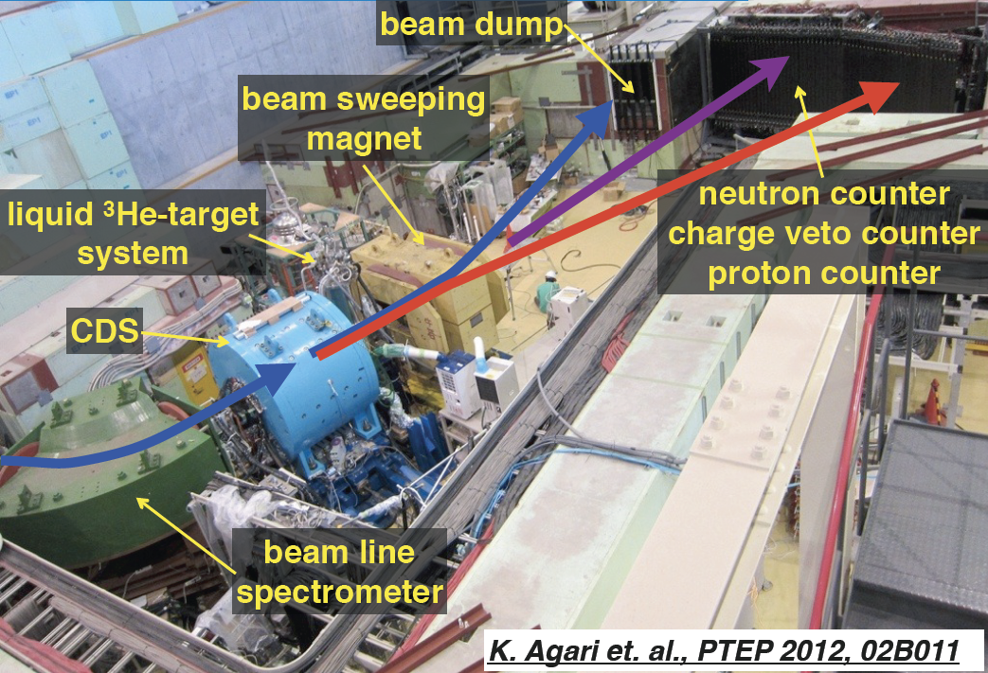
J-PARC K1.8BR
Experiments to explore K^{bar}N interaction
Below the K^{bar}N threshold:
Λ(1405)
K^{bar}NN
K^{bar}K^{bar}NN
At the K^{bar}N threshold:
K^{bar}-atom
→ E31
川﨑
21aAW-6
→ E62/E57
→ E15
山我
21pAC-2
Sensitive in different energy region & isospin
→ LoI
S.Ohnish et al., PRC93, 025207
K^{bar}N

Slide 7
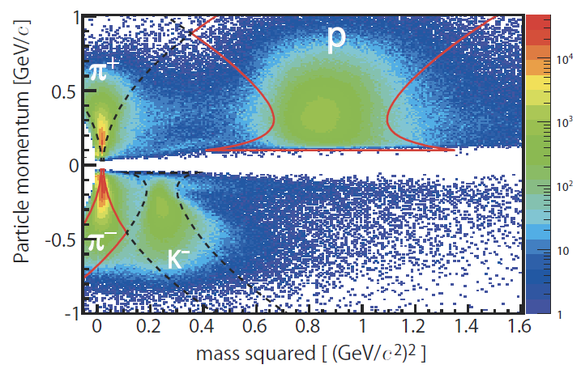
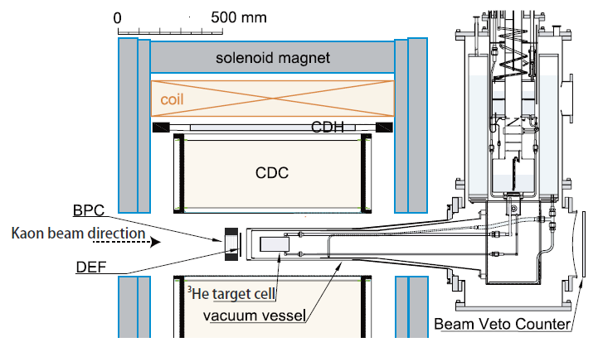
Cylindrical Detector System (CDS)
CDH
~80ps
AC
T0
DC
DEF
~1ns
~50ps
Improvement of PID in the CDS
TOF with T0-CDH → change to DEF-CDH for p/K^{stop} exp.
present DEF consists of WLS-fiber+MPPC (σ_{t}~1ns)
→ change to a high resolution detector (σ_{t}<100ps)
−

Slide 8
TOF Detector with MPPCs
Operation in magnetic field
Small & Compact
Cheep & Robust
High-Resolution (σ_{t}<100ps)
Plastic scint. with MPPC
Multi-MPPCs
Series connection
Direct connection btw scint. and MPPCs
Fast pre-amplifire
Solution
Pioneer works:
MEG2 upgrade
MPPC holder
(3 MPPCs in series)
Connect MPPC folder and scint. with thin wires
Rapping: ESR (3M)
S13360-3050CS
(3*3mm²)
Drill φ0.5mm holes in a plastic scint.(EJ-230)

Slide 9
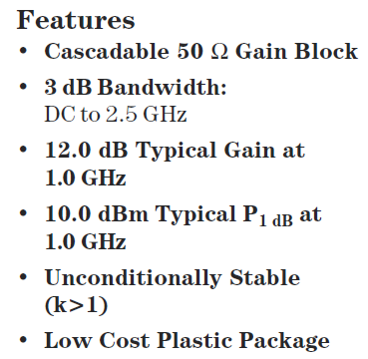
Fast Pre-Amplifier
Fuji Diamond International Inc. 1504-S2
1 ch/module
HP MSA-0385 (Cascadable Silicon Bipolar MMIC Amplifier) x 2
Pole Zero Cancellation
Bandwidth (3dB):
100kHz ~ 2GHz
Dynamic Range (output):
-2V ~ +2V
Gain: 10~16 (depend on PZC)
Noise: <10mV rms
HP MSA-0385
8cm
4.5cm
HV out
HV in
in
out
+12V
(140mA)

Slide 10
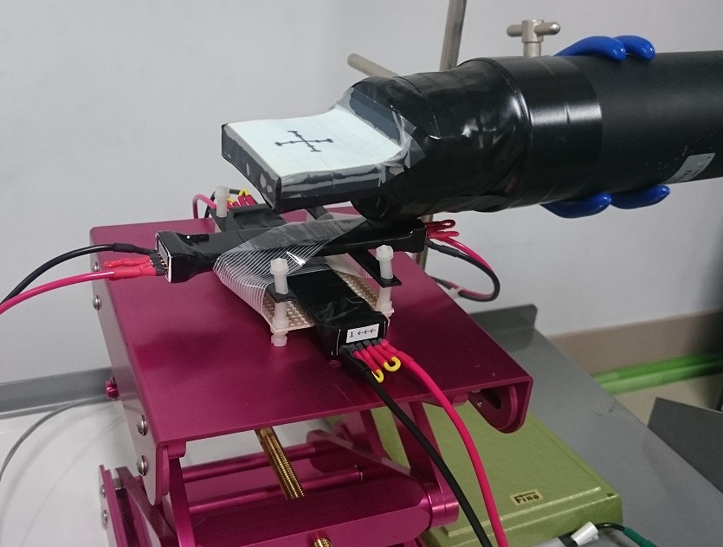
Pre-Test with Cosmic-Ray
2 types of MPPCs
2nd gen. MPPC (S12572-050C)
3rd gen. MPPC (S13360-3050CS)
CAMAC(ADC/TDC)+Kinoko
95mm
5mm
MPPC*3 (3mm²)
20mm
Cover Ratio: 27％
V_{max}
3rd gen. MPPC (S13360-3050C) has better performance

Slide 11
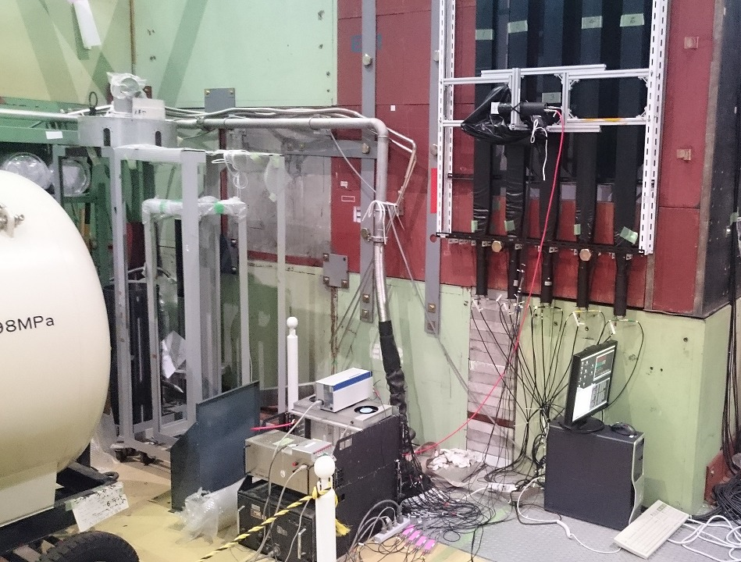
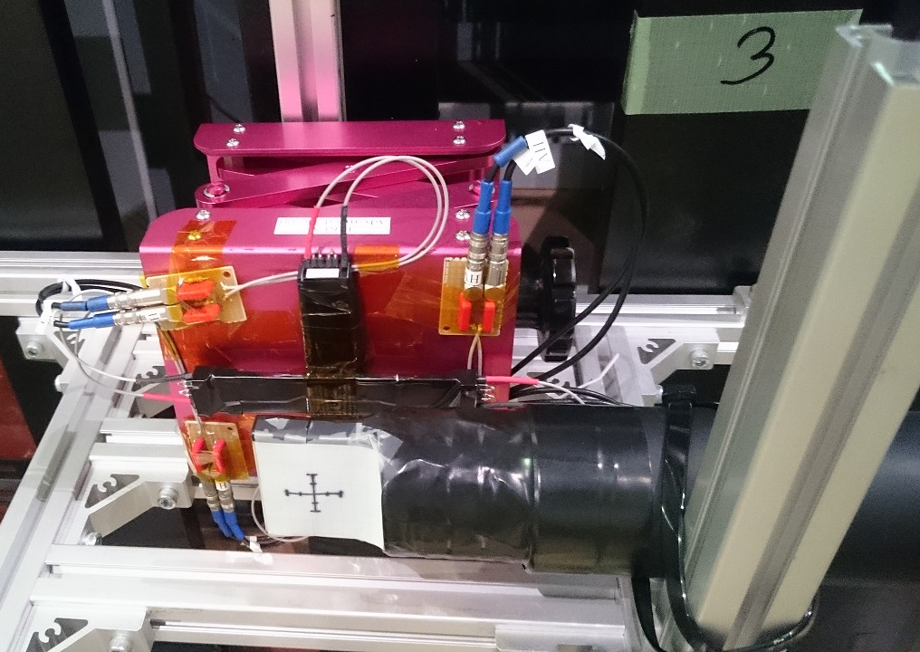
Beam-Test @ K1.8BR
Beam-test with 1 GeV/c π⁻ @ K1.8BR beam-dump in Nov.-Dec., 2015
length and thickness dependence
CAMAC(ADC/TDC)+Kinoko
~1000 trig./spill(5.5s)
[2*2mm²]

Slide 12
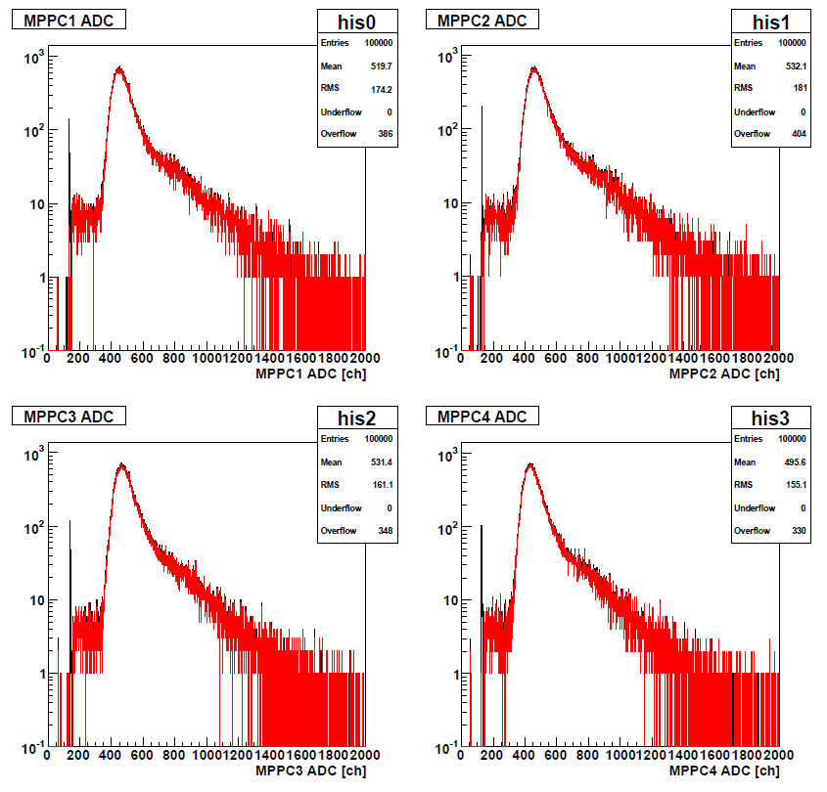
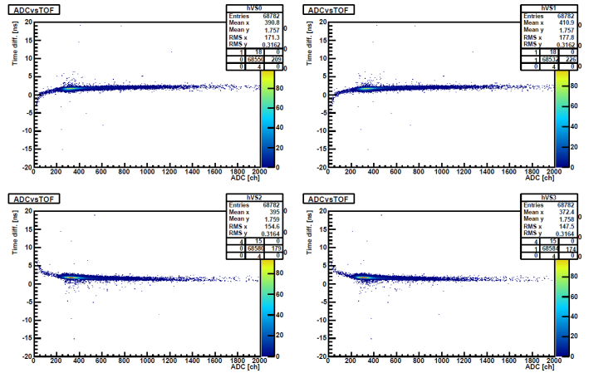
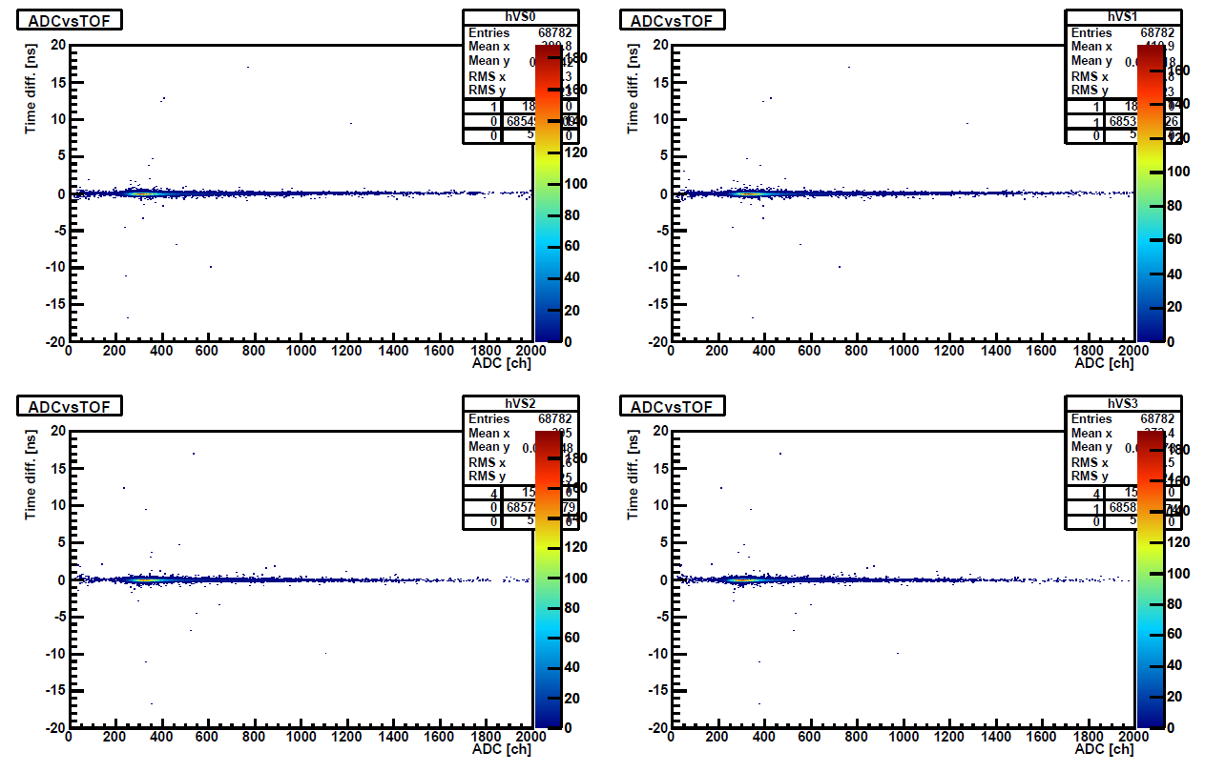
Beam-Test @ K1.8BR
Beam-test with 1 GeV/c π⁻ @ K1.8BR beam-dump in Nov.-Dec., 2015
length and thickness dependence
CAMAC(ADC/TDC)+Kinoko
~1000 trig./spill(5.5s)
[2*2mm²]
ADC
slewing correction

Slide 13
Results
New DEF
L mm
5or3mm
MPPC*3 (3mm²)
20mm
Cover Ratio: (t=5mm) 27％
(t=3mm) 45%
σ_{t}<80ps was achieved with the new DEF Counter
sum of # of N_{pe} > 100
no position dependence of σ_{t}
σ_{t}~80 ps was achieved with “l~200mm (t=5mm)”
σ_{t}~100ps is expected with “l=300mm (t=5mm)”

Slide 14
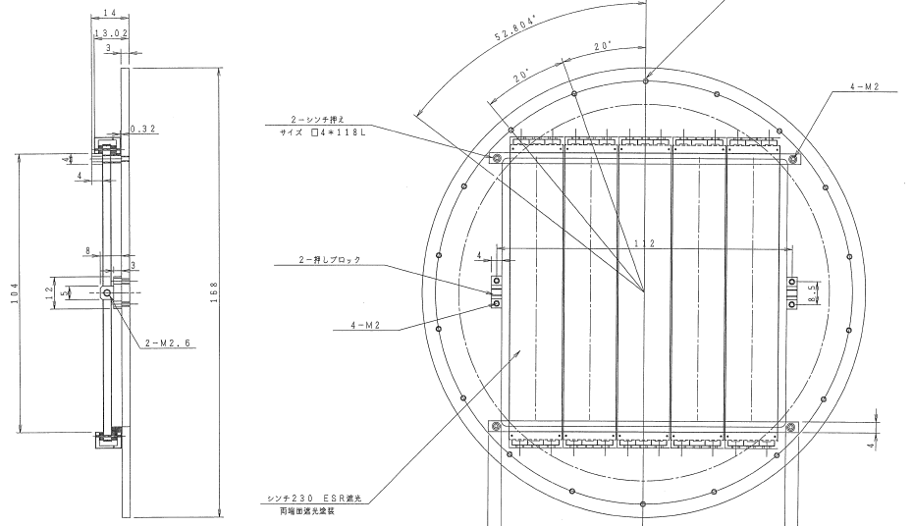
New DEF
Design of the new DEF was completed
all modules have been in hand
will be installed in this year?
depend on beam-time schedule @ K1.8BR
14mm
φ168mm
Effective area:
96*100mm²

Slide 15
Summary
A high-resolution TOF counter using MPPC array was developed for strange-dibaryon searches
K^{bar}NN (E15): K⁻ ³He → Λ p n
K^{bar}K^{bar}NN (LoI): p^{bar} ³He → K⁺ K⁰ Λ Λ
A new Beam-Definition-Counter (DEF) was fabricated and we confirmed σ_{t} to be <80ps
A plastic scintillator (3*20*115mm³) with 3 MPPCs in series connection
Also we achieved σ_{t}~80ps with a l=200mm (t=5mmm) counter
Outlook:
Pre-amplifire: integration in 1-module (~8 channels)
Counter: test of a large size detector for a neutron counter, etc.
c.f. NueLAND＠FAIR: 270*5*5cm³, 6mm²-MPPC*4, σ_{t}<150ps

Slide 17
Past Experiments of Double-Strangeness Production in Stopped-p^{bar} Annihilation
experiment | Channel | # of events | yield (x10⁻⁴)
DIANA@ITEP [p^{bar}+Xe] PLB464, 323 (1999). | K⁺K⁺X | 4 | 0.31+/-0.16
 | K⁺K⁰X | 3 | 2.1+/-1.2
OBELIX @CERN/LEAR [p^{bar}+⁴He] NPA797, 109 (2007). | K⁺K⁺Σ⁻Σ⁻p_{s} | 34+/-8 | 0.17+/-0.04
 | K⁺K⁺Σ⁻Σ⁺nπ⁻ | 36+/-6 | 2.71+/-0.47
 | K⁺K⁺Σ⁻Λn | 16+/-4 | 1.21+/-0.29
 | K⁺K⁺K⁻Λnn | 4+/-2 | 0.28+/-0.14
Double strangeness production-yield: Ο(10⁻⁴)
No result of ΛΛ measurement so far

Slide 18
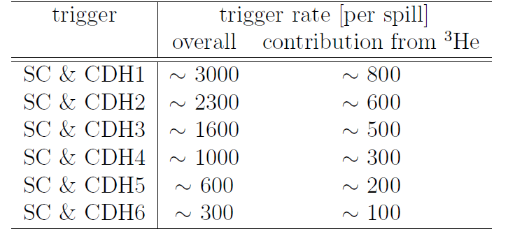
Trigger
Simple multiplicity trigger in the CDS
Estimated trigger rate at 50 kW with Geant4.10 QGSP BERT physics list.
SC: start counter
Trigger rate = ~1k/spill
NO problem!

Slide 19
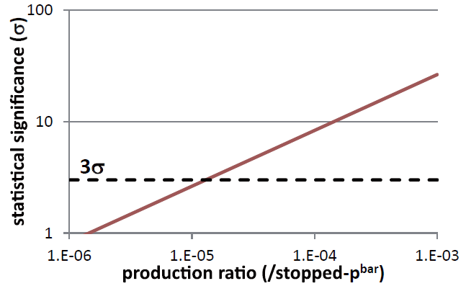
Expected Yield & Sensitivity
Expected yield @ 50kW:
10⁻⁴ [ΛΛ/p^{bar}] * 800 [p^{bar}/spill] * 655 [spill/h] * 21 [h]
~ 1100 [ΛΛ/day]
* 0.01 [acceptance*Λ→pπ⁻] * 0.7 [DAQ*ana] * 14 [days]
~ 110 [ΛΛ/2-weeks]
R(H/K⁻K⁻pp) = 10⁻⁵/p^{bar}
→ N(H/K⁻K⁻pp) ~ 10/2-weeks
Sensitivity of ΛΛ
*S/N of ΛΛ is assumed to be 2.5
ΛΛ I.M.
ΛΛ~10⁻⁴/p^{bar}
sensitivities of ~10⁻⁵ (3σ)

