Slide 1
Development of the Cylindrical Detector System for an experimental search for kaonic nuclei at J-PARC
Fuminori Sakuma, RIKEN
for the J-PARC E15 Collaboration
J-PARC E15 Experiment
Cylindrical Detector System
  Cylindrical Drift Chamber (CDC)
  Z-Vertex TPC
Summary
The Third Joint JPS/DNP Meeting (Hawaii 2009), Oct. 13-17, 2009

Slide 2
J-PARC E15 Experiment
search for K-pp bound state using ³He(K⁻,n) reaction
³He
neutron
K⁻
K⁻pp
cluster
Formation
Missing mass
Spectroscopy
via neutron
Decay
Mode to decay charged particles
Λ
p
exclusive measurement by
Missing mass spectroscopy
and
Invariant mass reconstruction
π⁻
Invariant mass reconstruction
p
at J-PARC

Slide 3
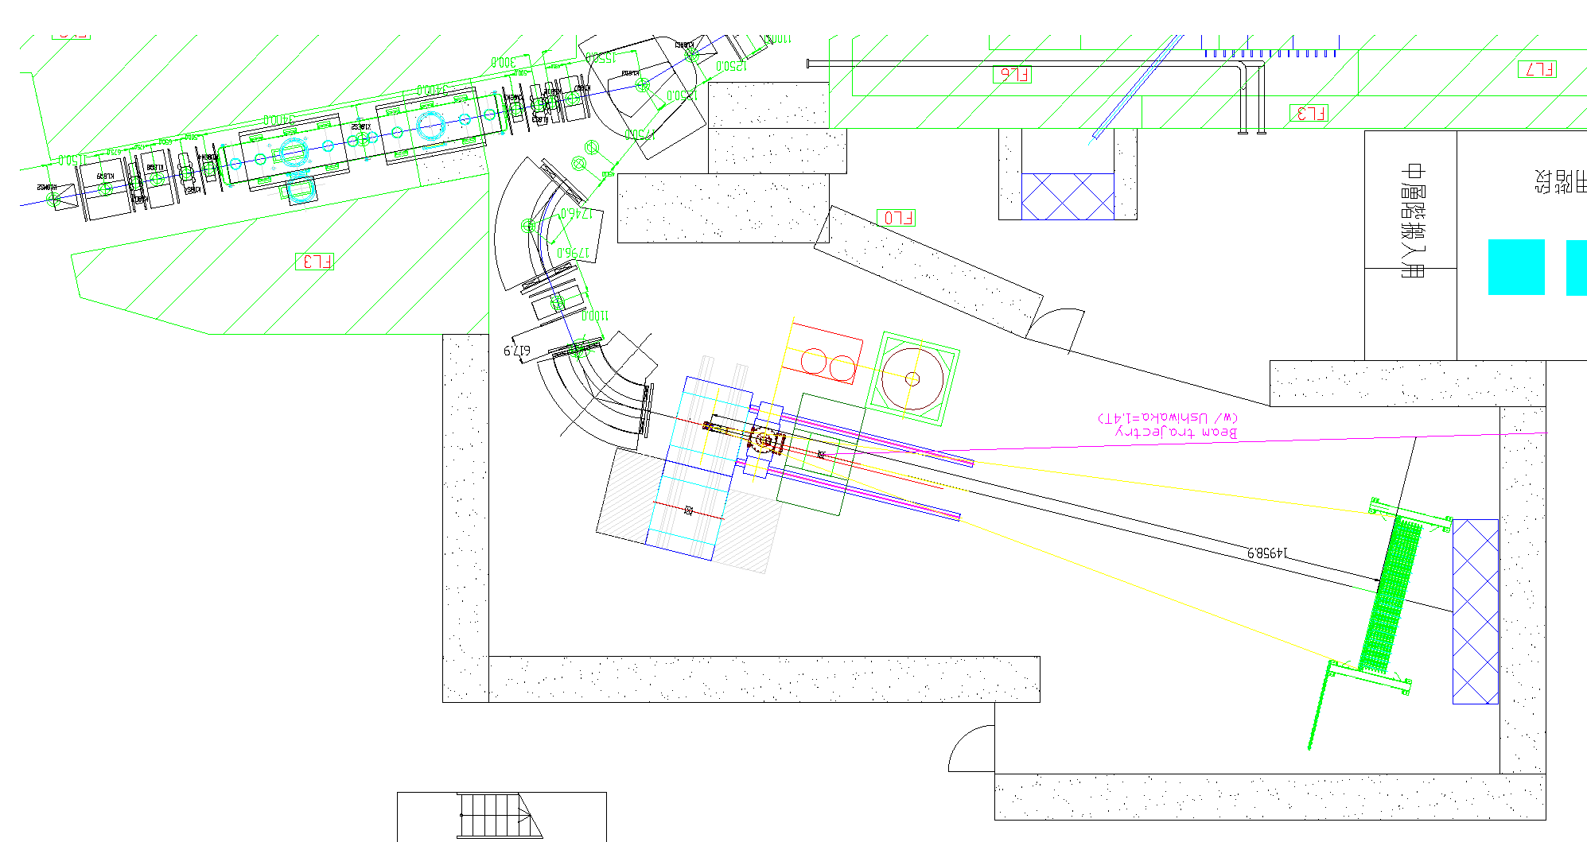
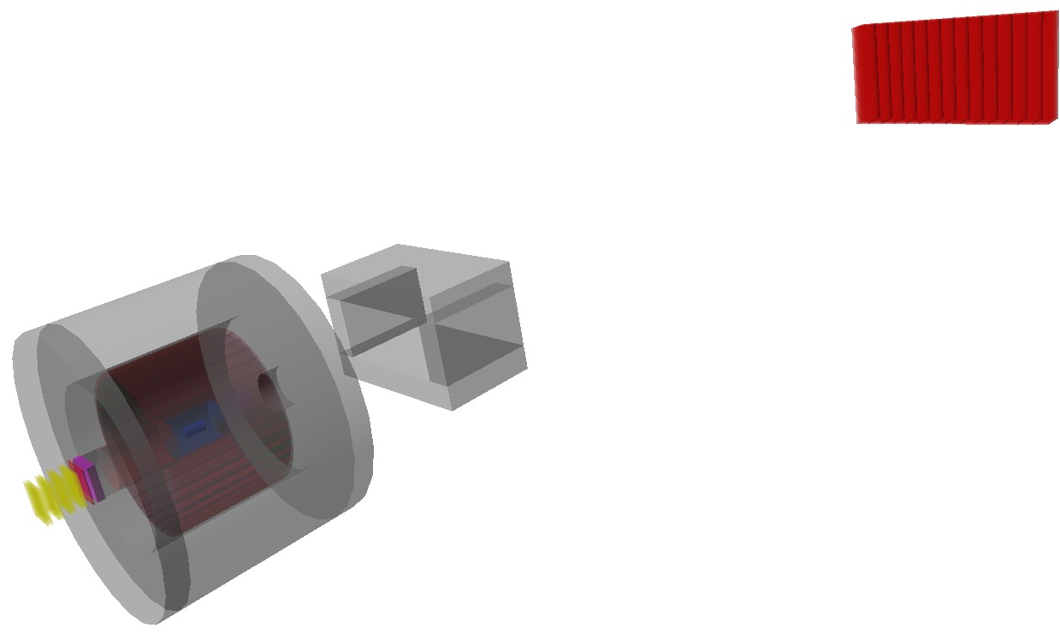
J-PARC E15 Setup
Beam Line
Spectrometer
Sweeping
Magnet
Beam trajectory
K1.8BR
Beam Line
CDS &
target
neutron
Neutron
Counter
Neutron
ToF Wall
flight length = 15m
p
n
Beam Sweeping
Magnet
mass resolution for K-pp
invariant mass
σ = 19MeV/c² (σ_{CDC} = 250μm)
missing mass (for 1.3GeV/c neutron)
σ = 9.2MeV/c² (σ_{ToF} = 150ps)
π⁻
Cylindrical
Detector
System
p
1GeV/c
K- beam

Slide 4
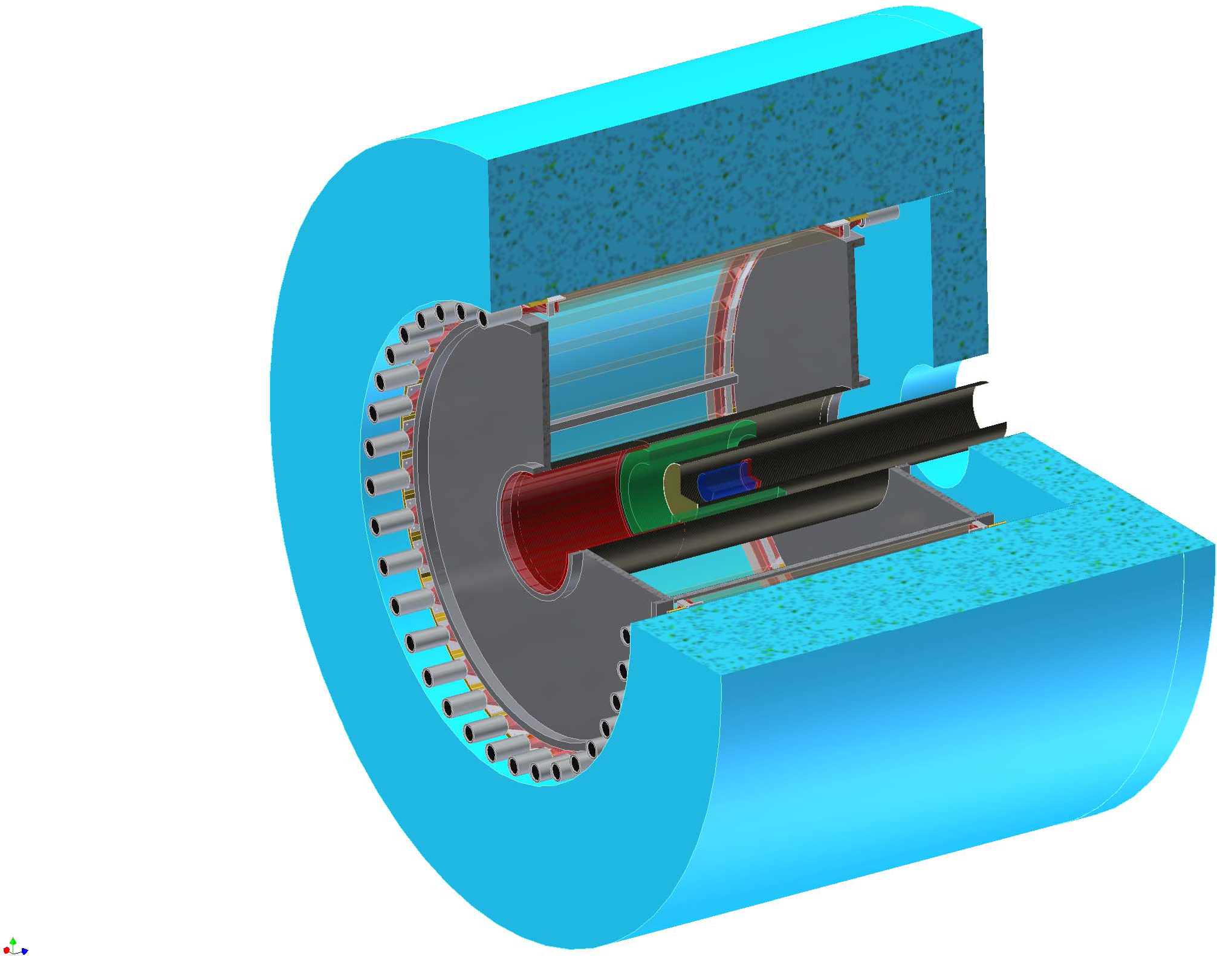
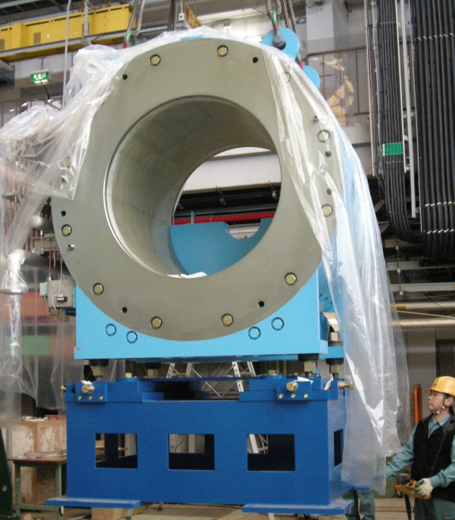
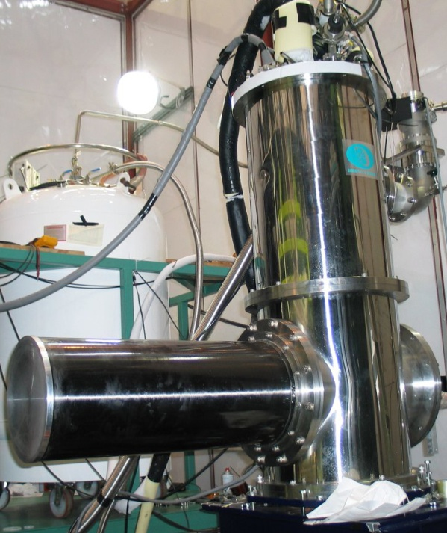
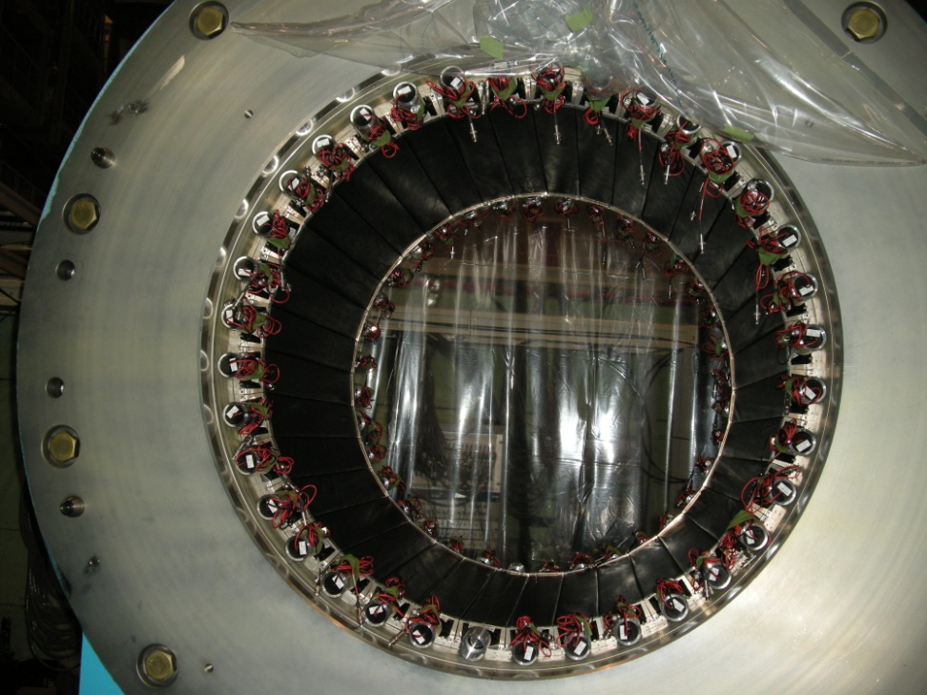
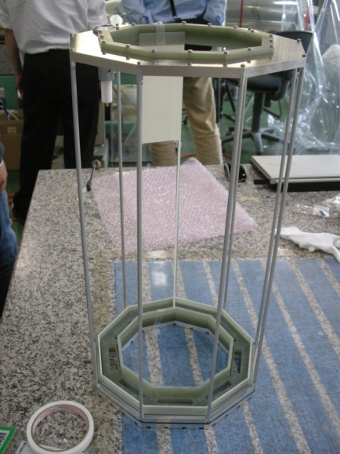
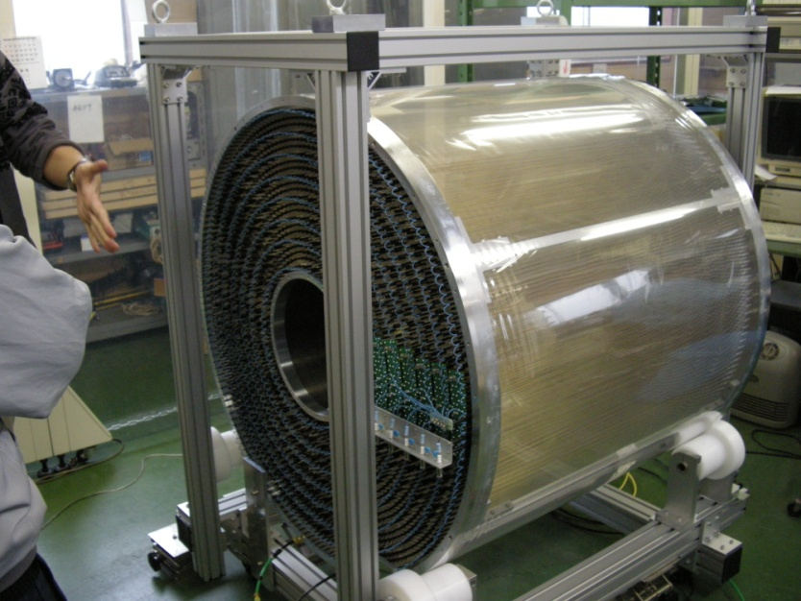
Cylindrical Detector System (CDS)
Solenoid Magnet
L³He Target System
B
Hodoscope Counter
Z-Vertex TPC
Cylindrical Drift Chamber

Slide 5
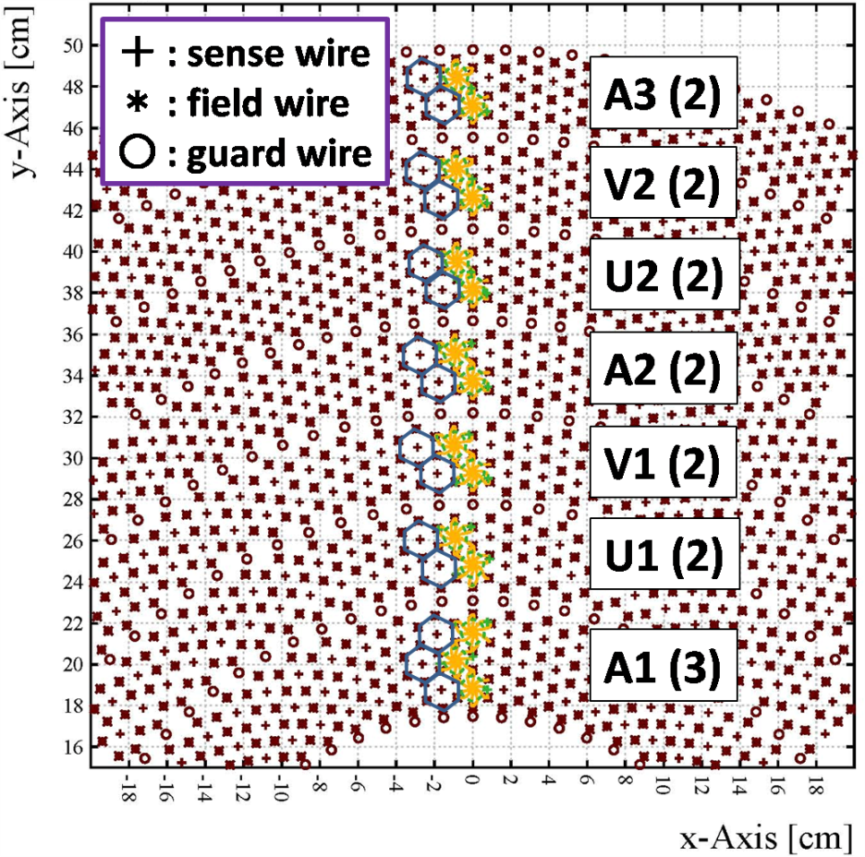
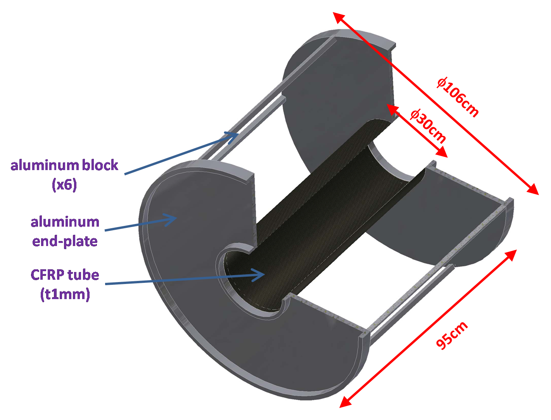
Cylindrical Drift Chamber (CDC)
made of Aluminum and CFRP
# of wires : 8136
(read-out : 1816ch)
solid angle = 2.6π
Ar:C₂H₆=50:50
hexagonal cell
(drift length ∼9mm)
15 layers
(r = 19.05∼48.45cm)
7 super layers
(AUVAUVA)

Slide 6
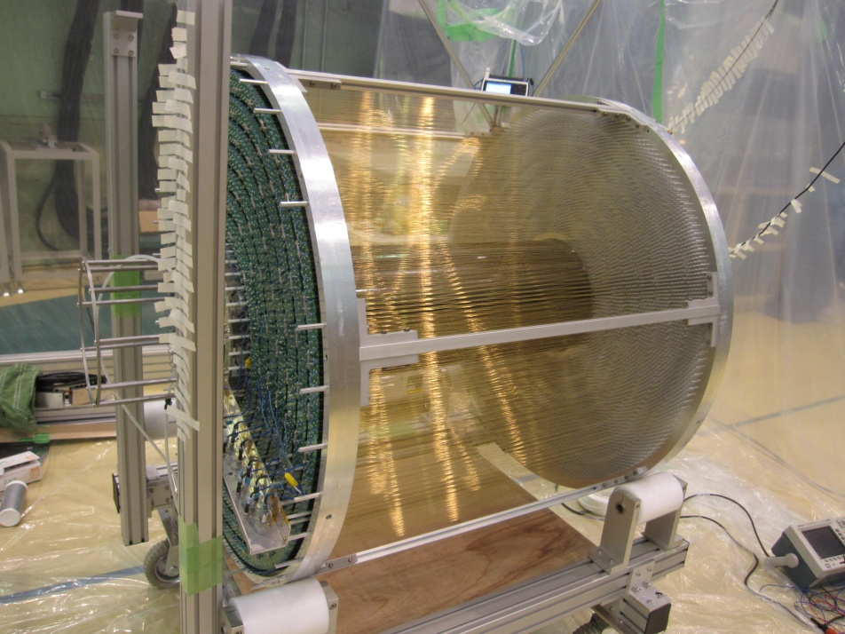
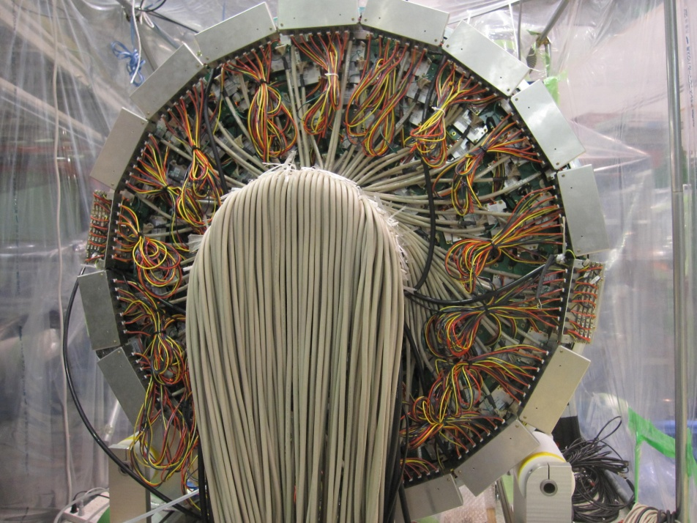
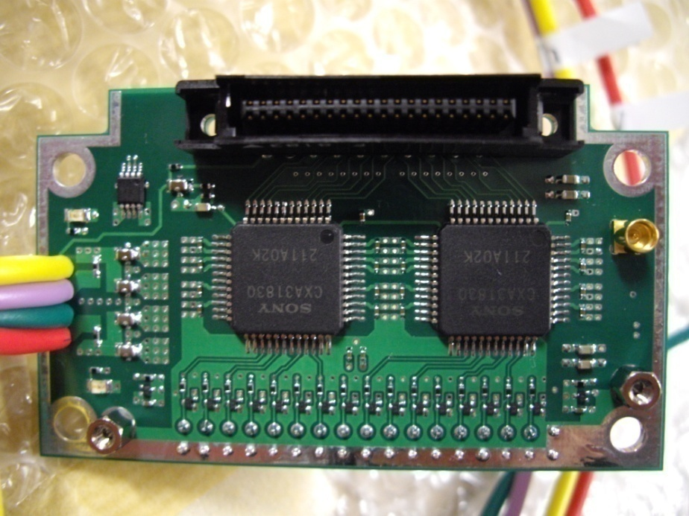
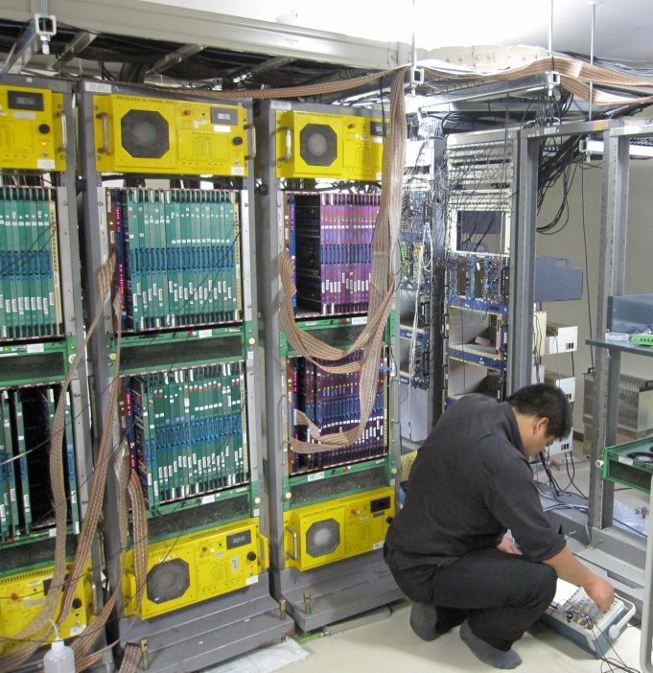
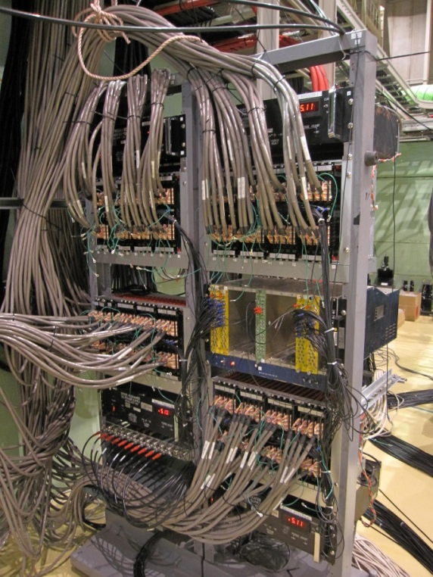
CDC (Cont’d)
preamp cards and cables are attached
TDC’s in the counting room
LVDS→ECL converters
at the exp. hall
  Chip : CXA3183Q
  (SONY, low noize ASD IC,
  τ=16nsec)
  Output : LVDS differential
  Gain : 0.8V/pC at preamp
ECL
LVDS
60m
cables
8m
cables

Slide 7
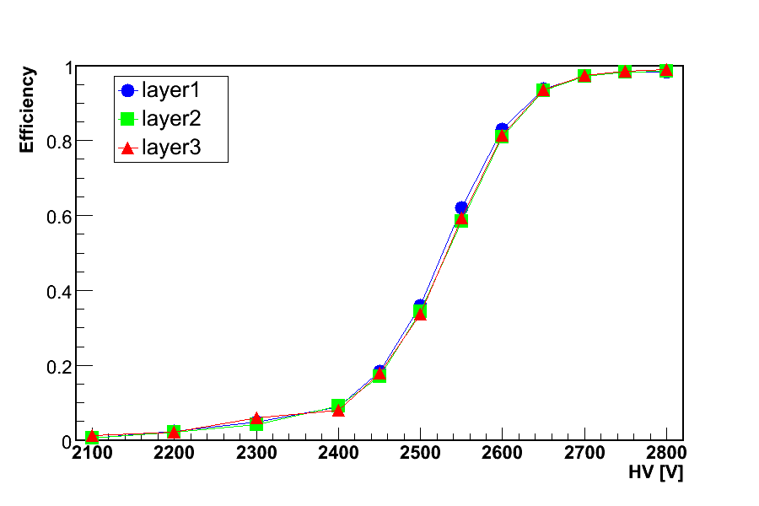
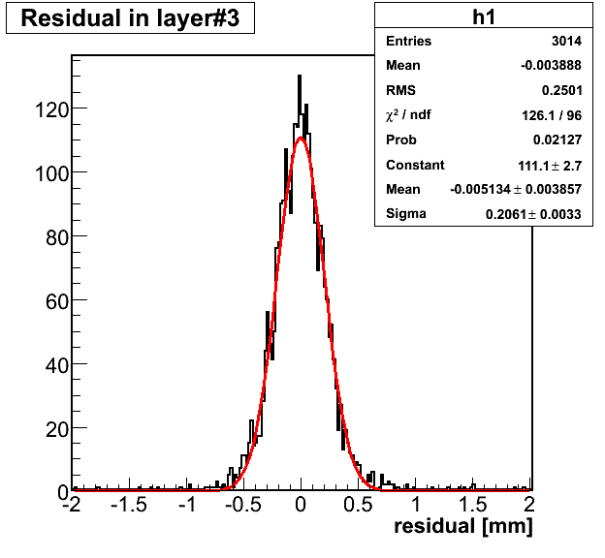
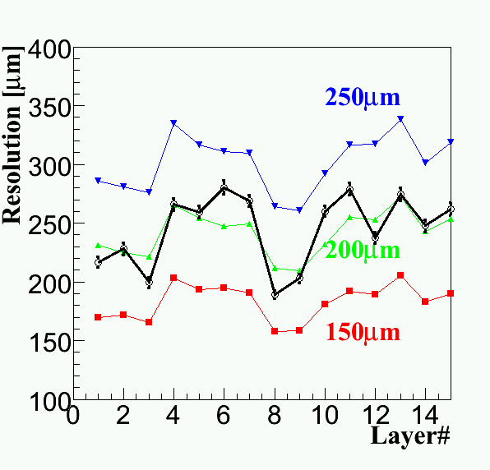
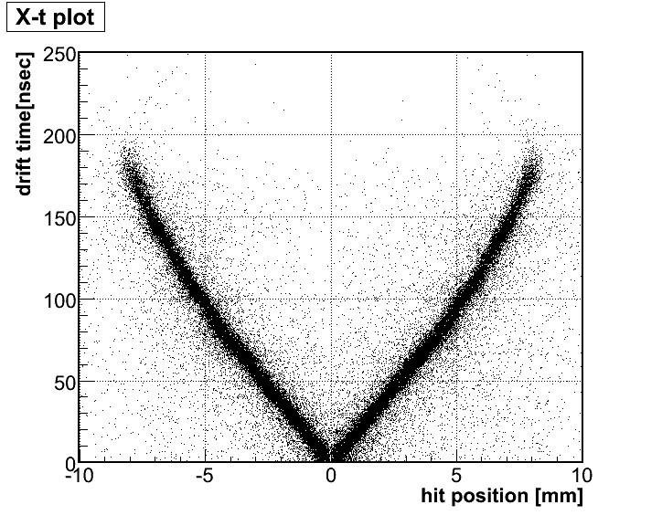
CDC Study with Cosmic-Ray
efficiency
residual
T.Hiraiwa (Kyoto-u)
K.Tsukada (RIKEN)
σ=206μm
resolution
(using ⁹⁰Sr)
--- cosmic-ray run
x-t correlation
stereo
stereo
Intrinsic spatial resolution ~200μm
CDC works good with expected performances

Slide 8
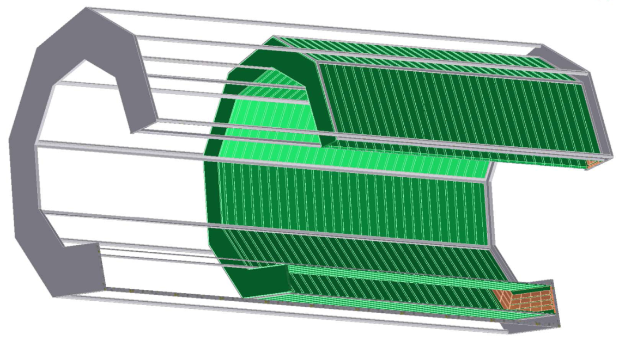
Z-Vetex TPC (Z-TPC)
expected resolution (w/o B-field)
To improve z-resolution,
Z-TPC is newly constructing
σ_{z}(Λ→pπ⁻): 7mm → 2mm
gas:P10 (150V/cm)
w/o
Z-TPC
w/
Z-TPC
however, rφ-resolution is limited by pad size, e.g., 20.0/sqrt(12) = 5.8mm
~500mm
readout-pad
  pad size:20x4mm
  # of pad:4x4x9=144
field strip
  double sided flexible print circuit board
  8mm strip
  10mm pitch
φ280mm
φ170mm
~300mm

Slide 9
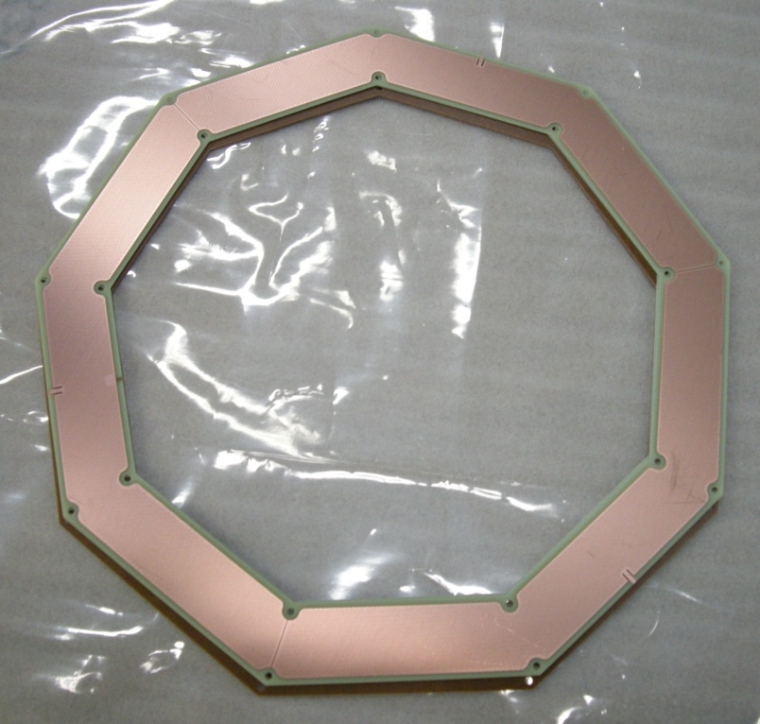
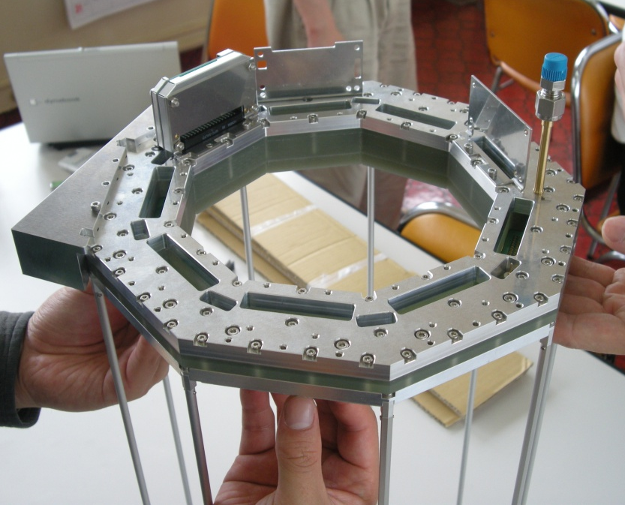
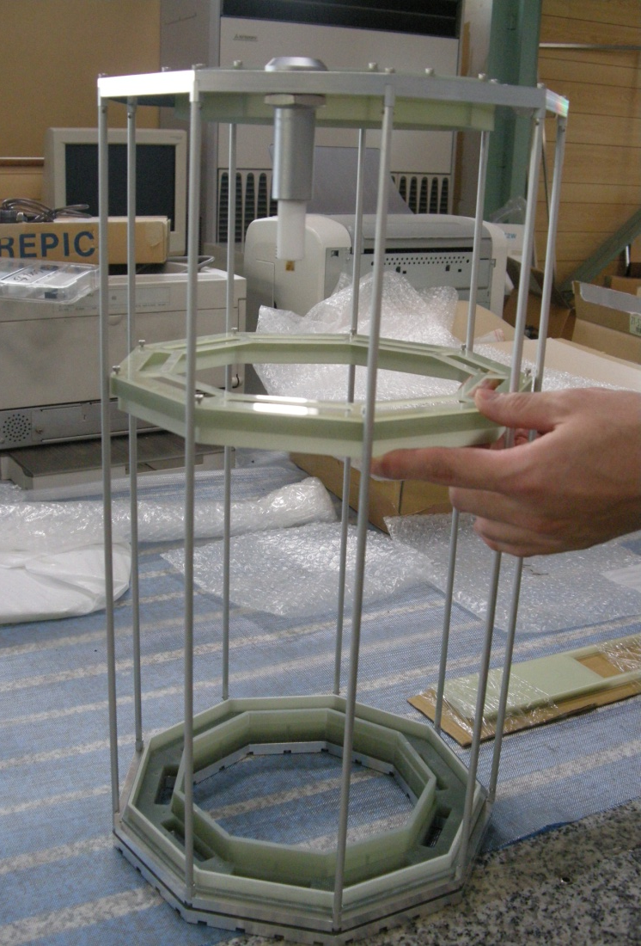
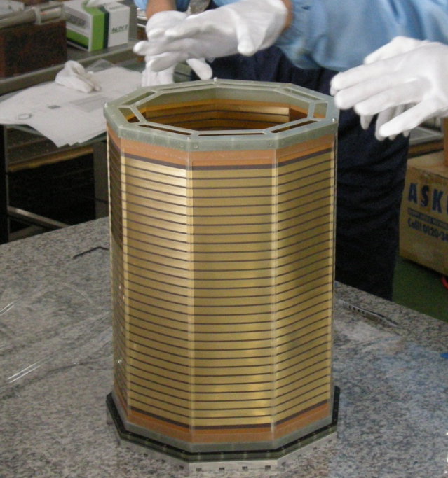
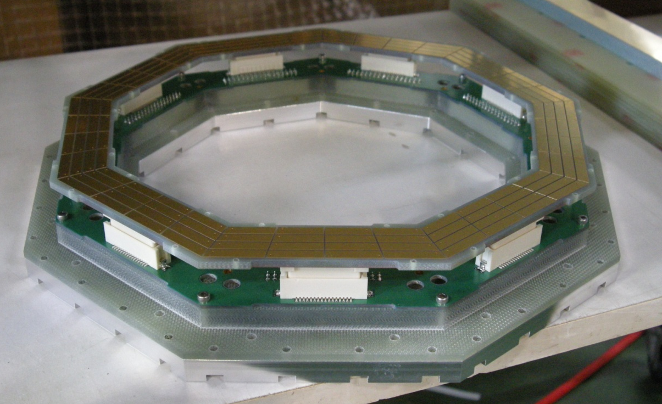
Z-TPC (Cont’d)
a double TGEM structure is used for amplification
Sony ASD chips are used for our preamp at first (No dE/dx)
in the future, fast FADC or ASDQ chips will be used to measure dE/dx
Z-TPC will be ready in this year
frame
TGEM for Z-TPC
preamps
readout part
field cage

Slide 10
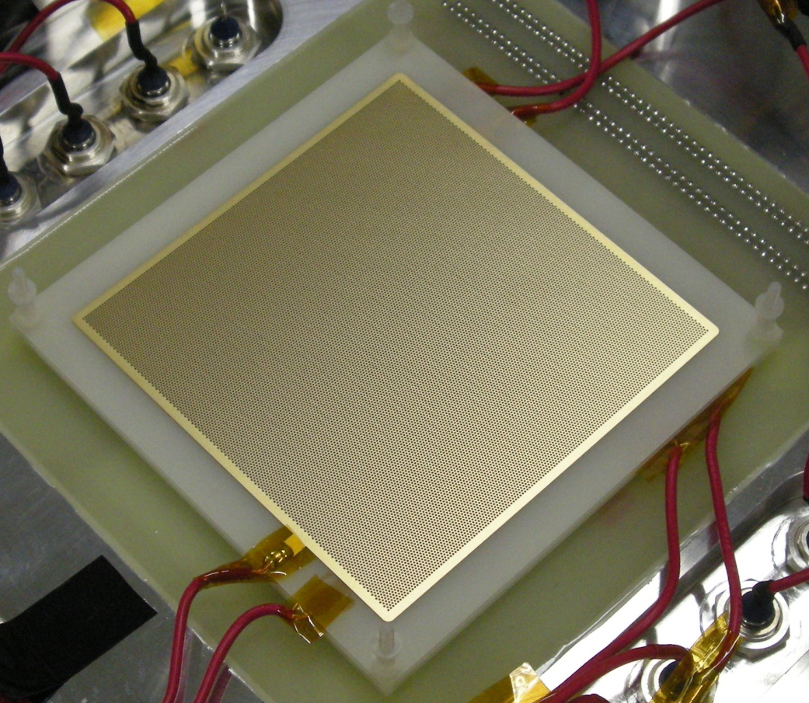
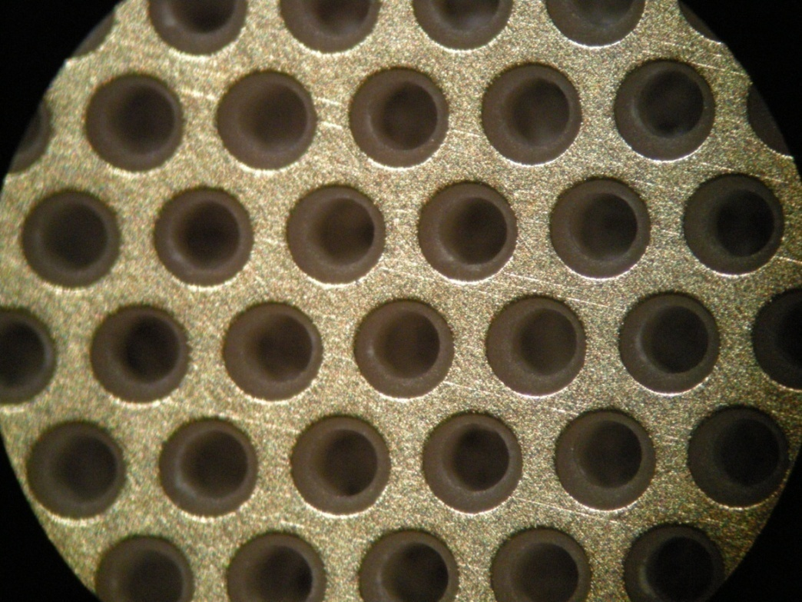
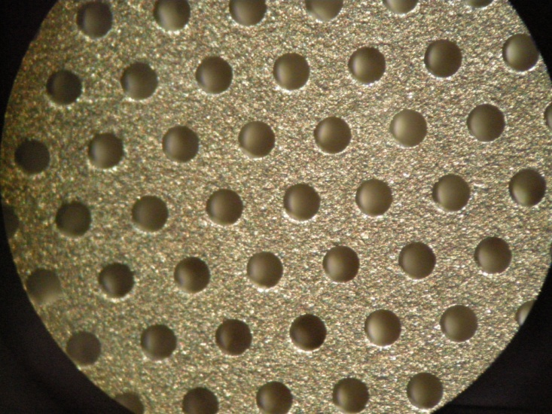
Thick-GEM @ RIKEN
Thick-GEM
a robust, simple to manufacture, high-gain gaseous electron multiplier
cost-effectively fabricated from double-clad G10 plates, using standard printed circuit board (PCB) techniques
holes are mechanically drilled (and the hole’s rim is chemically etched to prevent discharges)
easy to operate and feasible to cover large areas, compared to the standard foil GEM
10cm
10cm
HV
w/ Rims
setup
⁵⁵Fe
drift mesh
w/o Rims
11mm
E_{drift}
=150V/cm
TGEM #1
2mm
E_{trans}
=2.5*ΔV_{GEM} V/cm
TGEM #2
2mm
E_{trans}
=5*ΔV_{GEM} V/cm
R/O pad
→ ASD

Slide 11
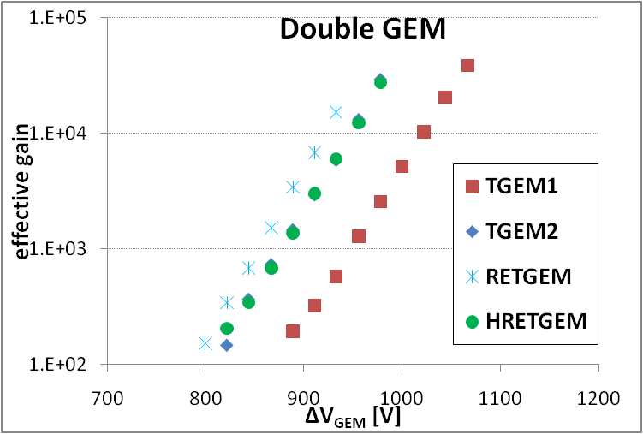
Thick-GEM Study
Type | Comment | φ_{hole} | d_{rim} | pitch | thick | size
TGEM1 | w/ rim | 0.3mm | 0.05mm | 0.6mm | 0.4mm | 100mm X 100mm
TGEM2 | w/o rim |  | X
RETGEM | Carbon |  | X
H-RETGEM | C+Cu hybrid |  | X
RETGEM: carbon electrodes
H-RETGEM: carbon and copper electrodes on each side
M.Tokuda (Tokyo-TECH)
goal ~10⁴
The TGEMs reach effective gain of ~10⁴, that is of practical use
  It seems that the RETGEMs and hybrid RETGEMs work good

Slide 12
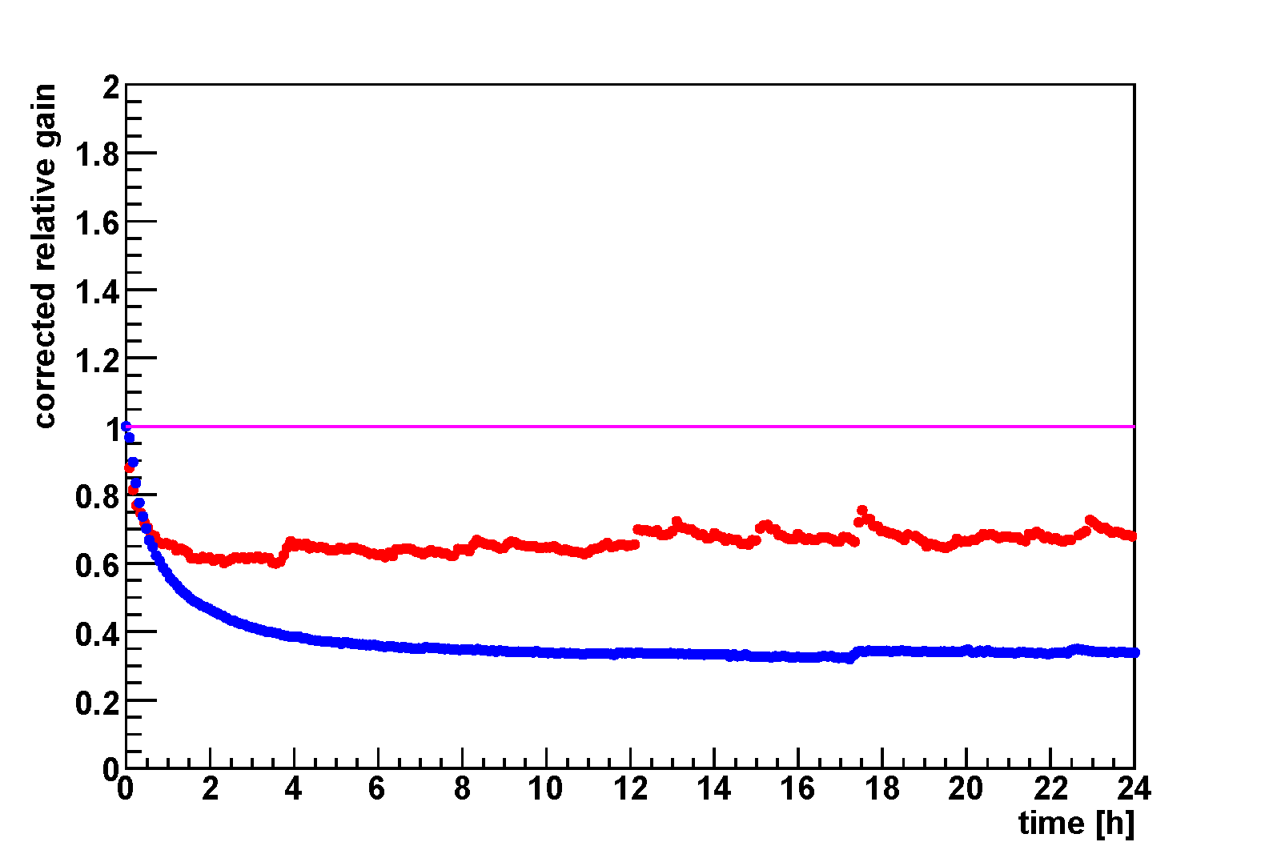
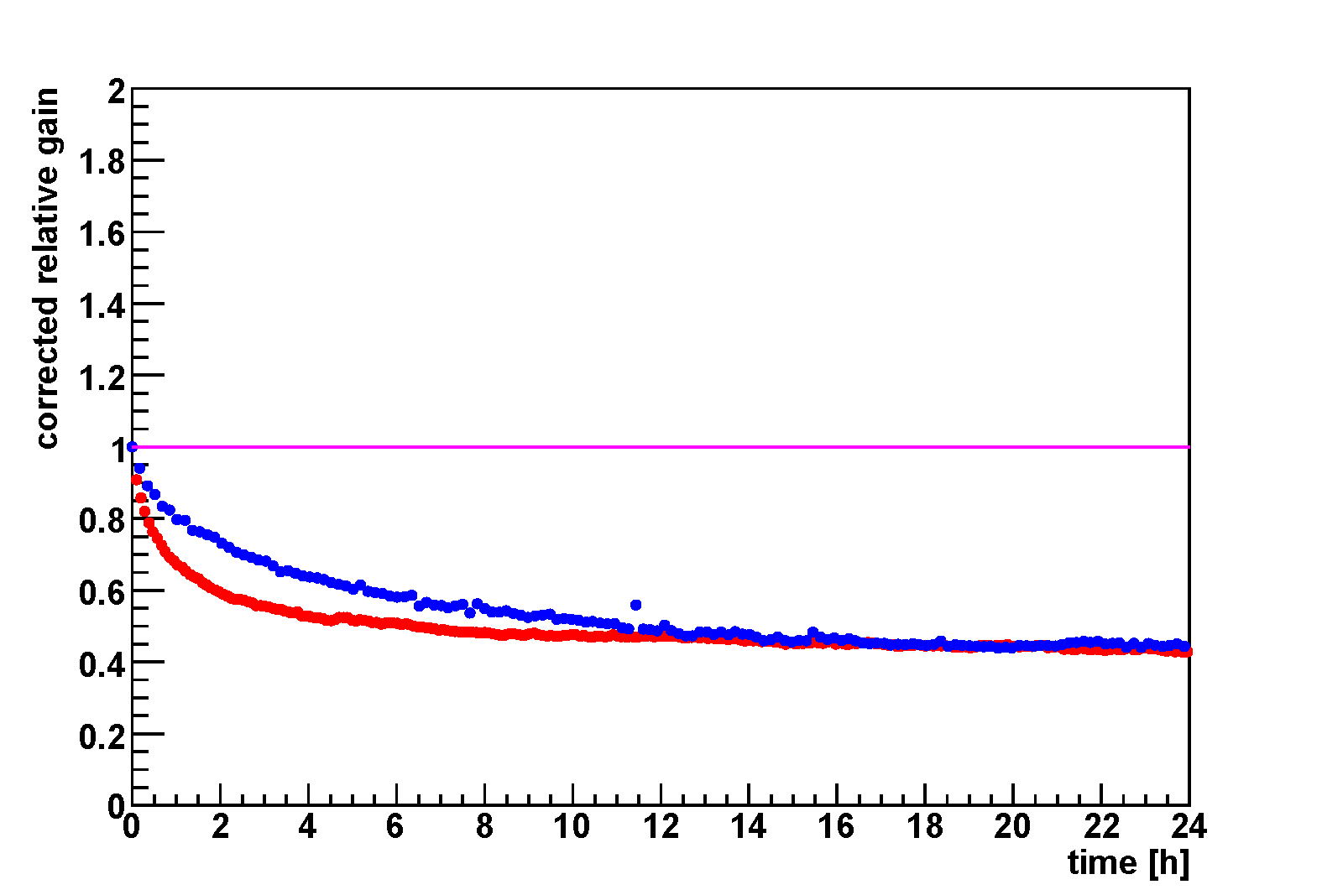
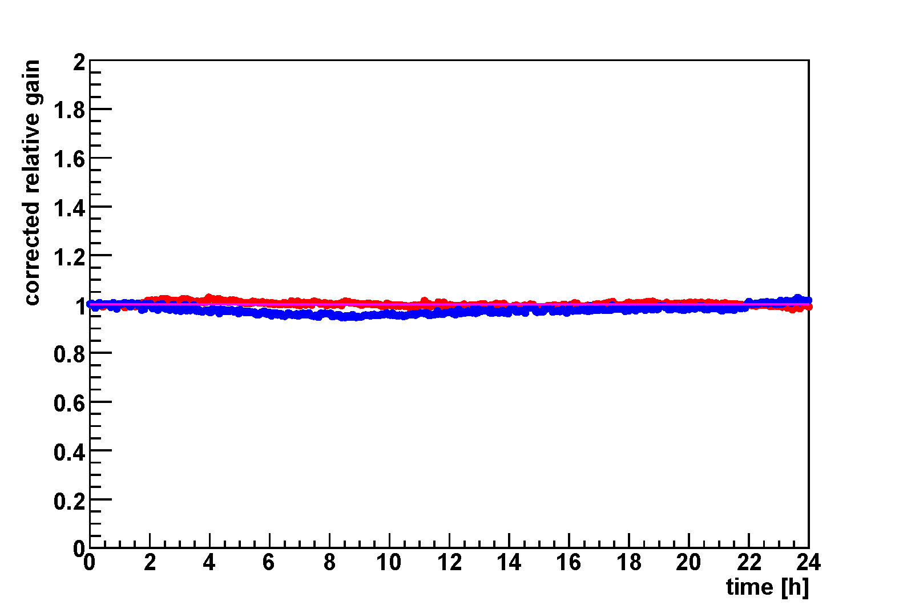
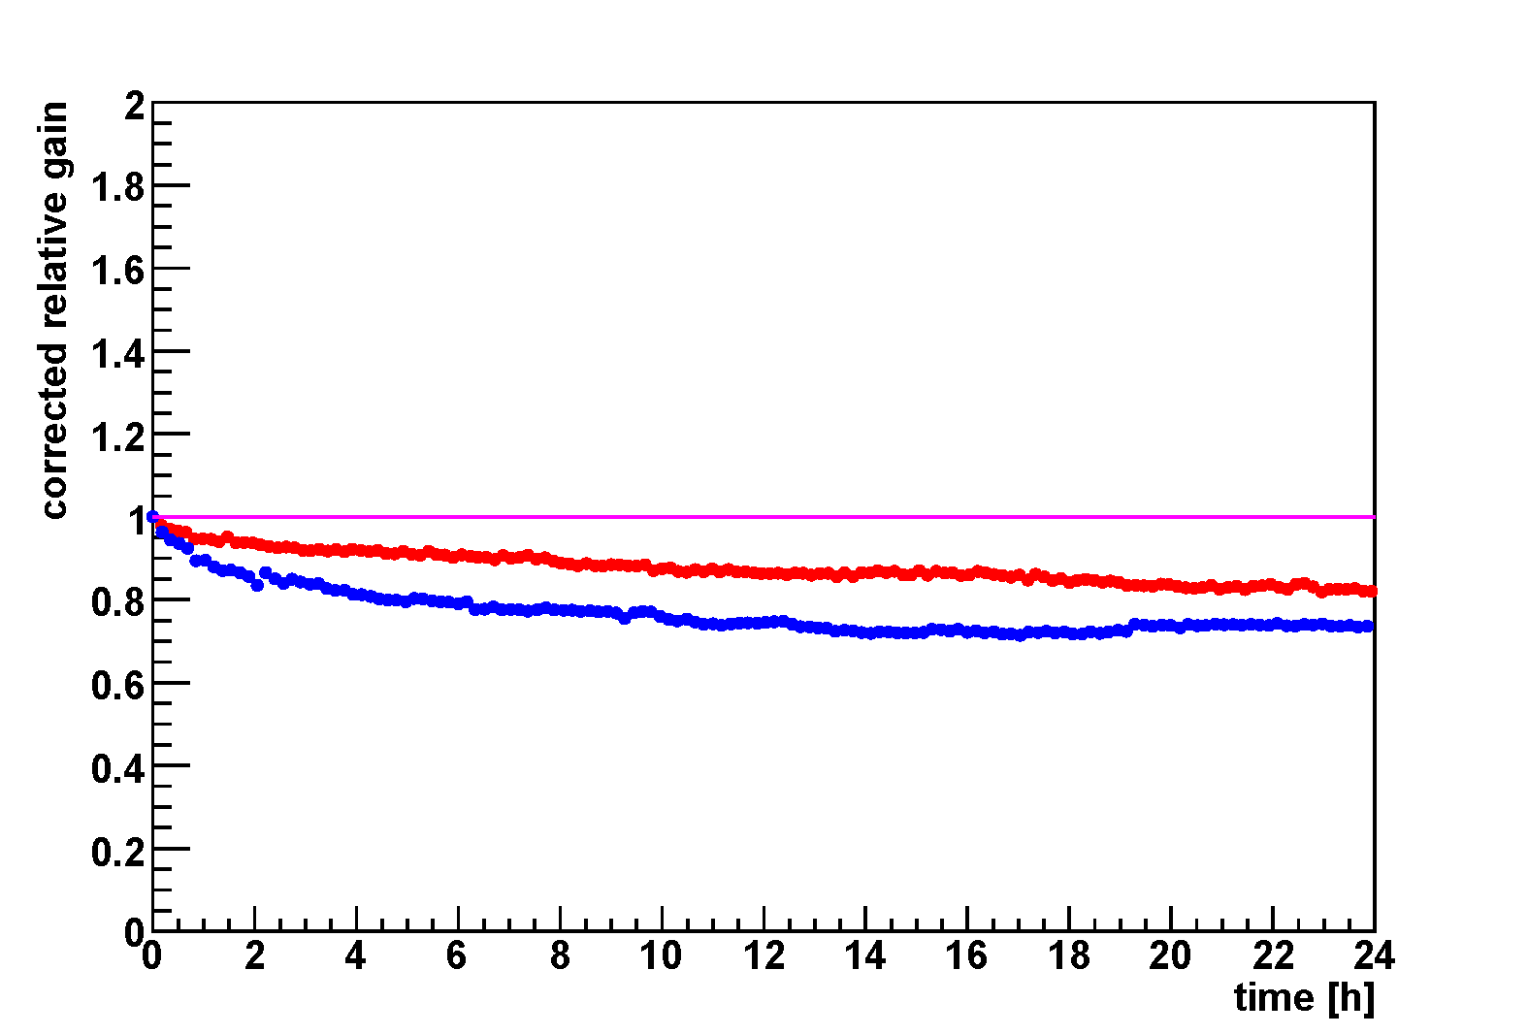
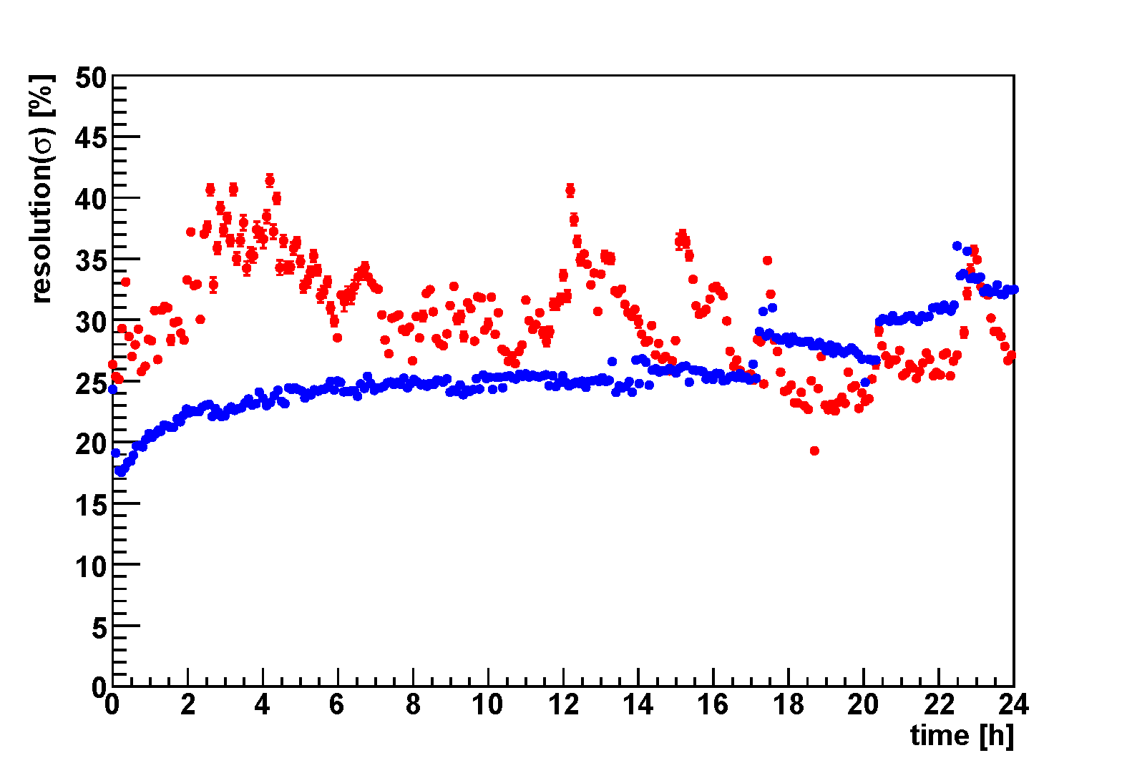
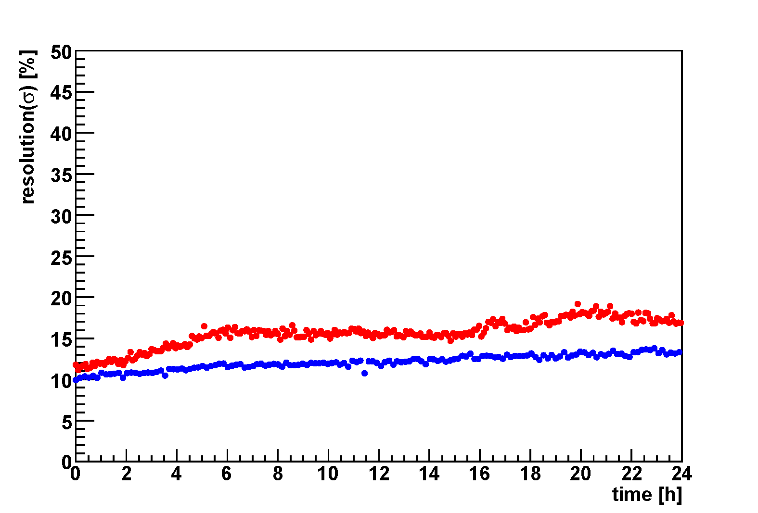
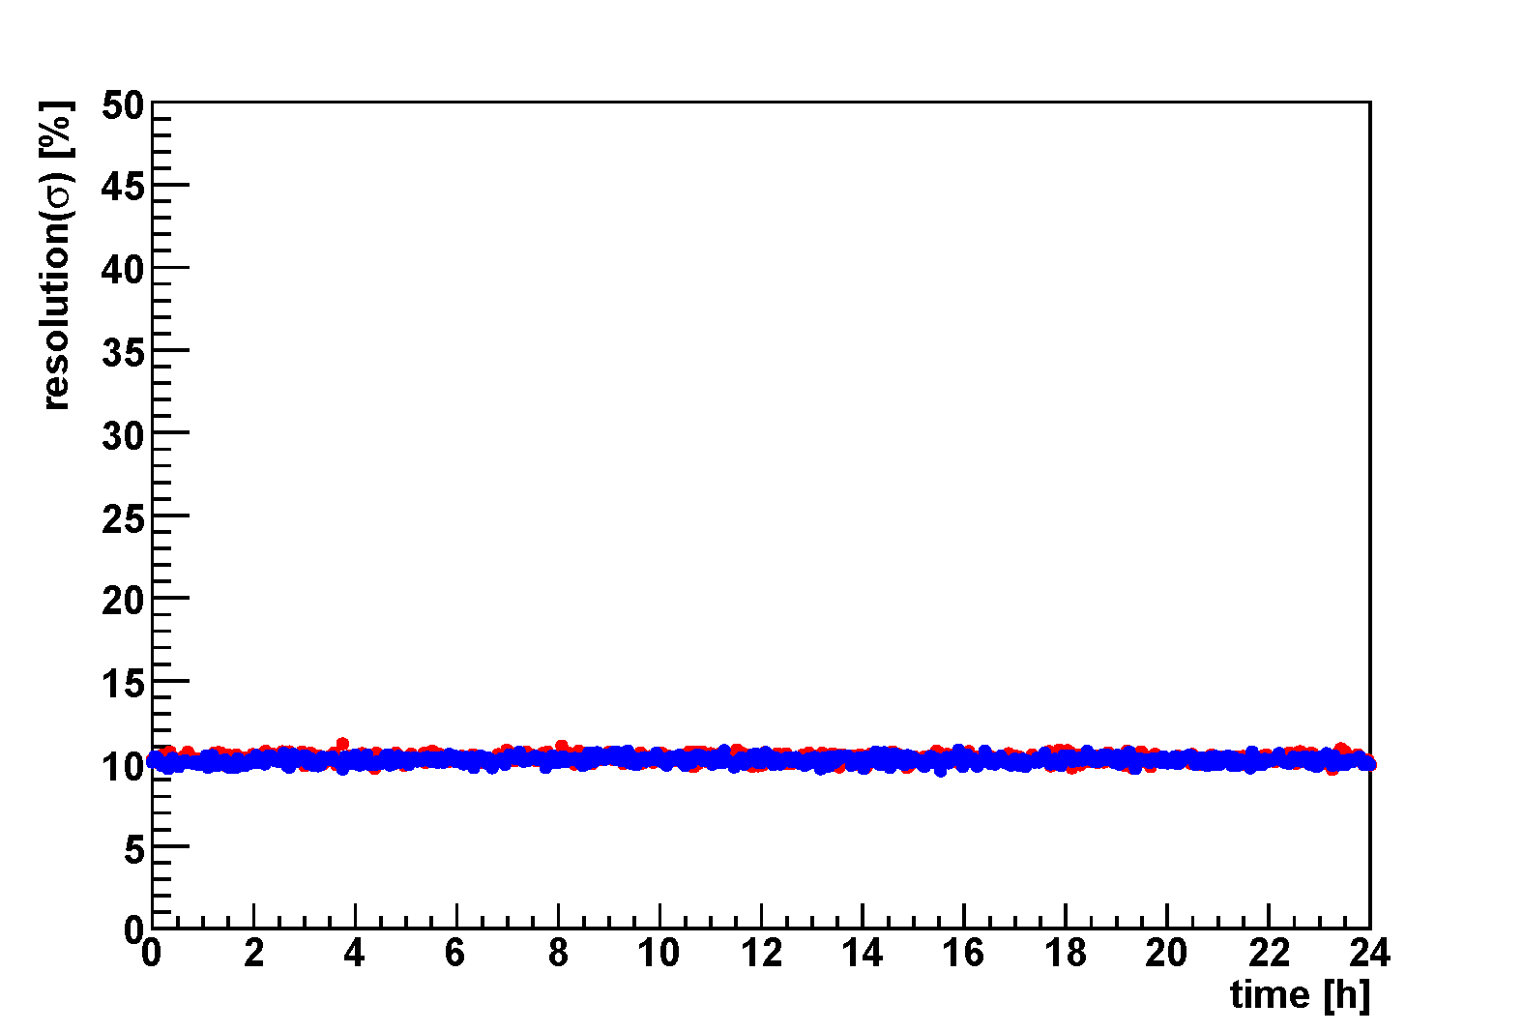
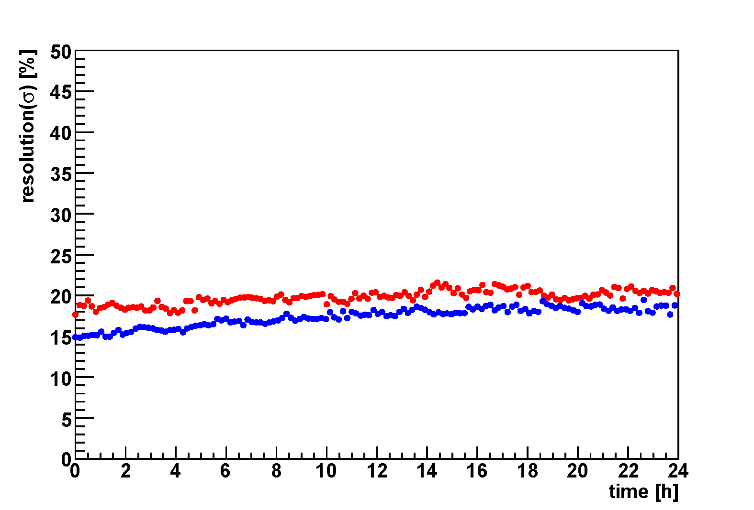
Thick-GEM Study
Type | Comment | φ_{hole} | d_{rim} | pitch | thick | size
TGEM1 | w/ rim | 0.3mm | 0.05mm | 0.6mm | 0.4mm | 100mm X 100mm
TGEM2 | w/o rim |  | X
RETGEM | Carbon |  | X
H-RETGEM | C+Cu hybrid |  | X
RETGEM: carbon electrodes
H-RETGEM: carbon and copper electrodes on each side
all TGEMs keep almost constant gain after initial gain drop
TGEM1
TGEM2
RETGEM
H-RETGEM
relative gain
relative gain
relative gain
relative gain
energy resolution
energy resolution
energy resolution
energy resolution
start gain ~ 2x10⁴
start gain ~ 2x10⁴
start gain ~ 4x10³
start gain ~ 2x10⁴
start gain ~ 4x10³
start gain ~ 4x10³
start gain ~ 2x10⁴
start gain ~ 4x10³
stable, but, there are no reproductive repeatability of the RETGEMs
instable

Slide 13
Thick-GEM Study
Type | Comment | φ_{hole} | d_{rim} | pitch | thick | size
TGEM1 | w/ rim | 0.3mm | 0.05mm | 0.6mm | 0.4mm | 100mm X 100mm
TGEM2 | w/o rim |  | X
RETGEM | Carbon |  | X
H-RETGEM | C+Cu hybrid |  | X
RETGEM: carbon electrodes
H-RETGEM: carbon and copper electrodes on each side
problems to be solved!
  instability in the TGEM with rims is caused by charge up of the insulator?
    lack of productive repeatability of RETGEM is caused by drilling process?
    …
  We have to study TGEM/REGEM in more detail

Slide 14
Summary
J-PARC E15 experiment
  Search for the simplest deeply-bound kaonic nuclear state, K⁻pp, by in-flight ³He(K-,n) reaction
Detector construction is in progress
  Solenoid Magnet, CDC, Z-TPC, CDH, ³He Target, and other detectors
  CDC works good with expected performances
  Z-TPC will be completed in this year
  TGEM study is ongoing…
    Instability of TGEM with rims
    Lack of productive repeatability of RETGEM
The goal is to develop the “stable” TGEM/RETGEM.

Slide 15
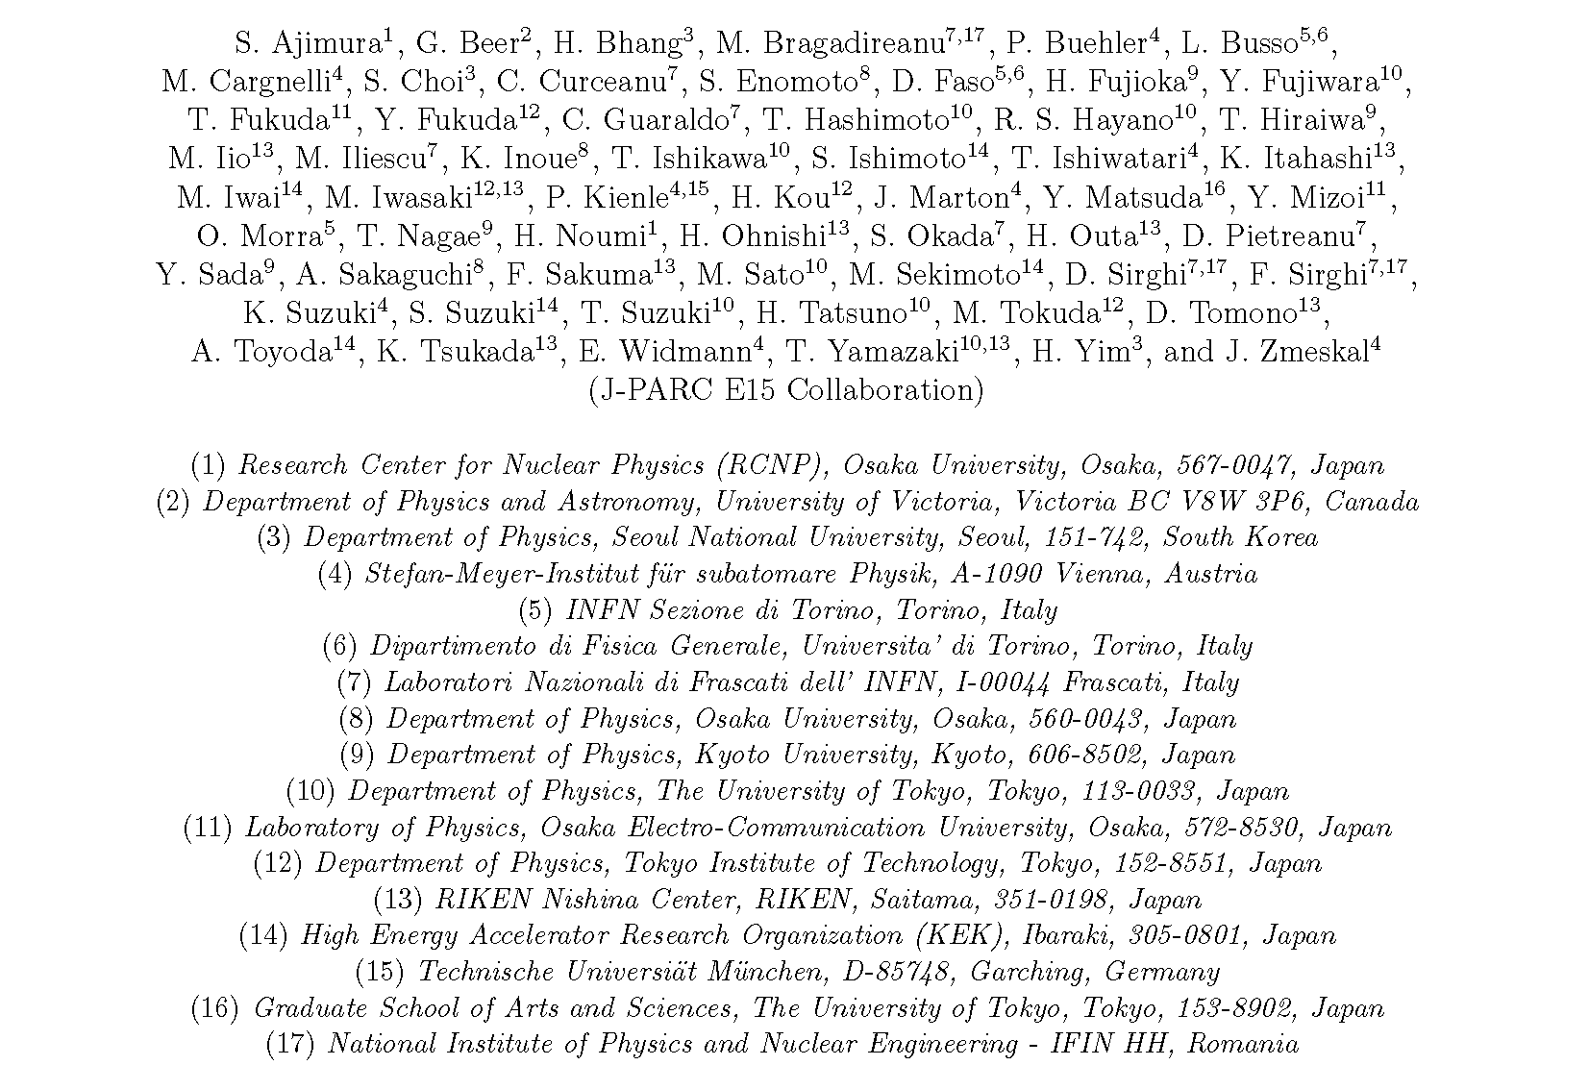
J-PARC E15 Collaboration

Slide 16
backup

Slide 17
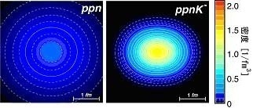
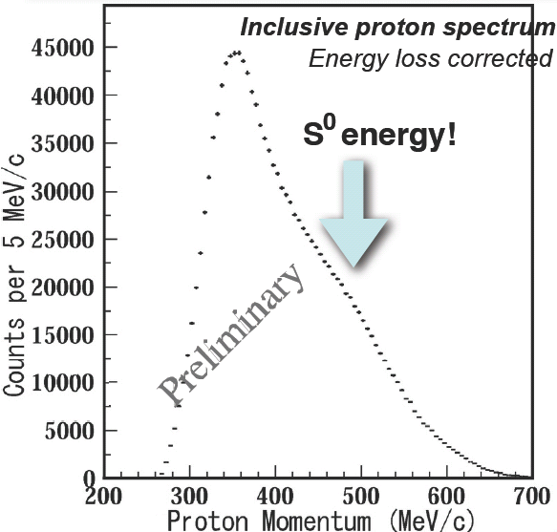
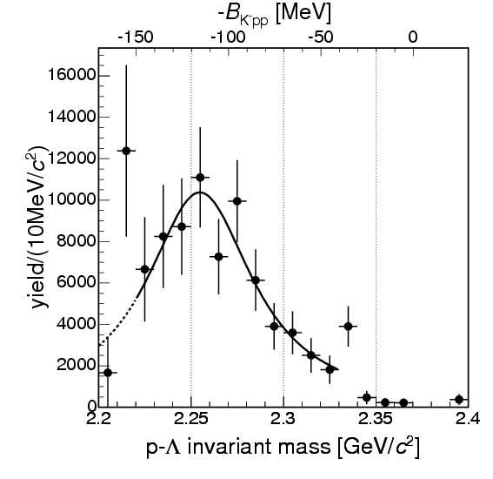
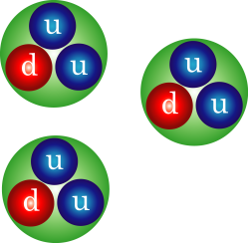
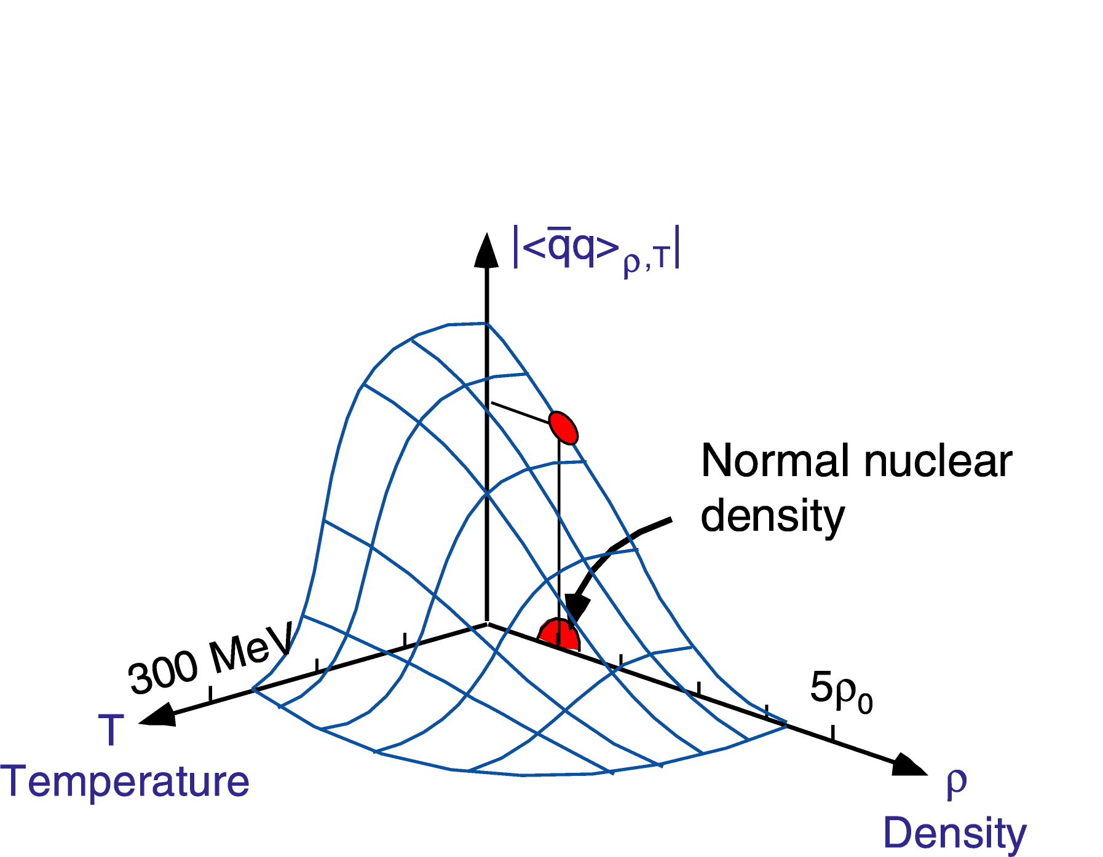

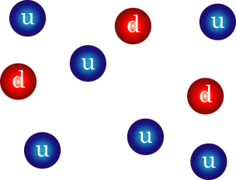
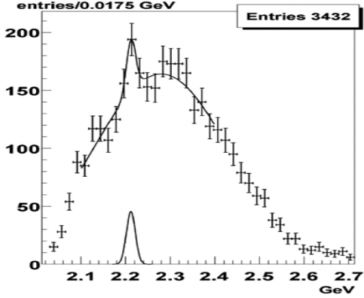
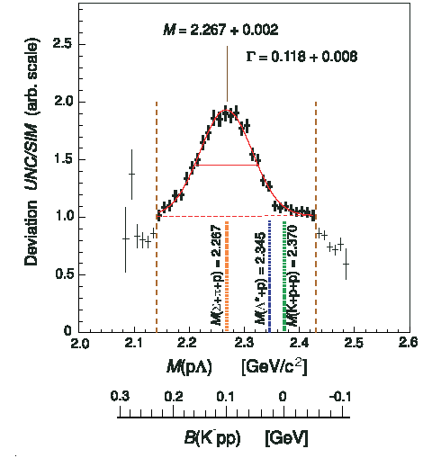
Physics Motivation
deeply-bound kaonic nuclear states exist?
T.Yamazaki, A.Dote, Y.Akiaishi PLB587,167(2004).
KEK-PS
SPS, RHIC, LHC
E549@KEK-PS
FINUDA@DAΦNE
QGP
OBELIX@CERN-LEAR
neutron
star
DISTO@SATUREN
We need conclusive evidence!
W.Weise NPA553, 59 (1993).

Slide 18
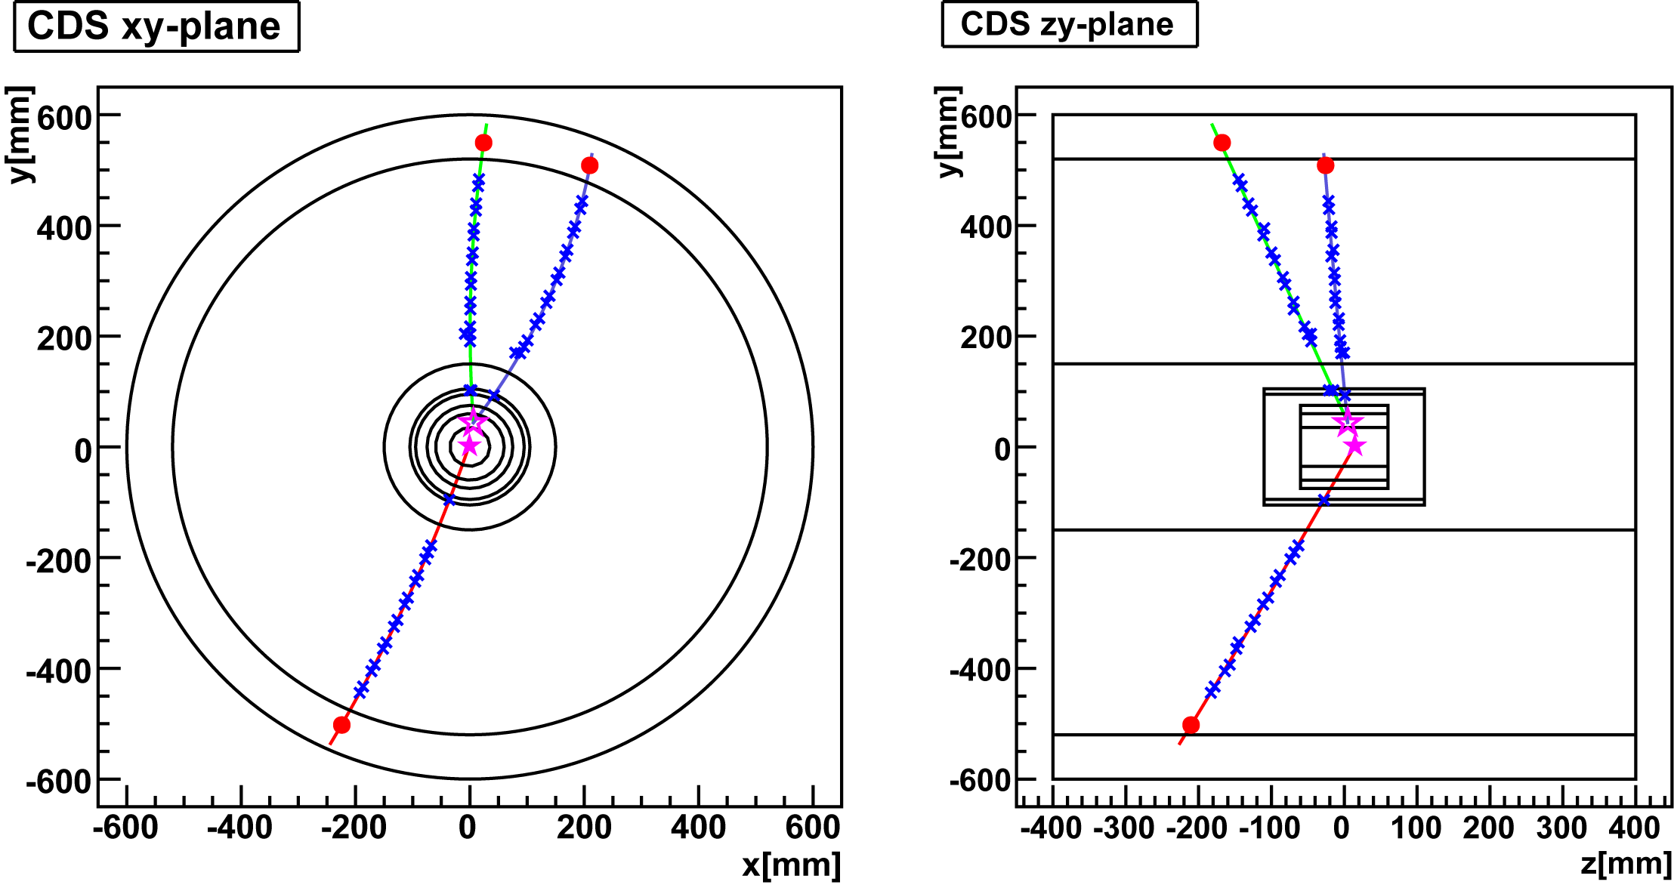
Expected Kinematics for K-pp Decay
binding energy = 100MeV/c²
Isotropic decay of K-pp
with forward neutron
Calculated using Geant4
p
p
π-
π-
~400MeV/c
~150MeV/c
n
Λ vtx
K-pp vtx
~1300MeV/c
p
p
~500MeV/c

Slide 19
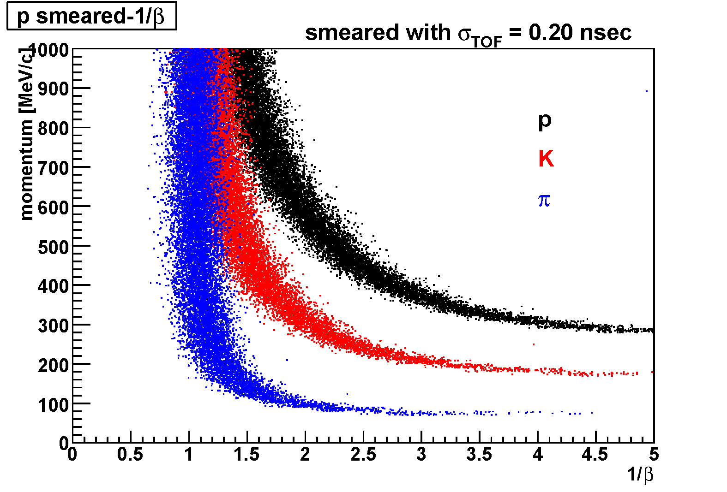
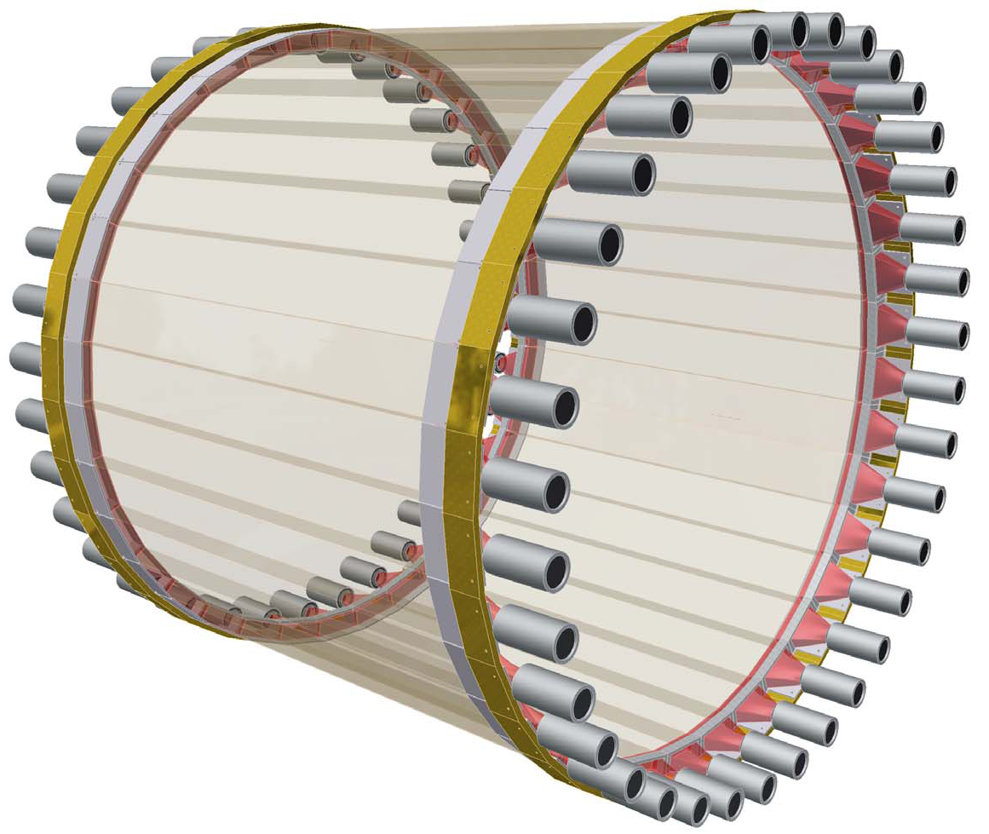
Hodoscope Counter (CDH)
CDH is used for the charged trigger and particle identification.
expected pID using ToF measurements
Feb. 2009
Plastic Scintillator :
99x30x700 mm³ （WＸTＸL）Configuration : 36 modules
PMT: Hamamatsu H8409 (fine mesh) x 72
σ_{int} = 76psec
CDH system has been mounted inside the Solenoid Magnet

Slide 20
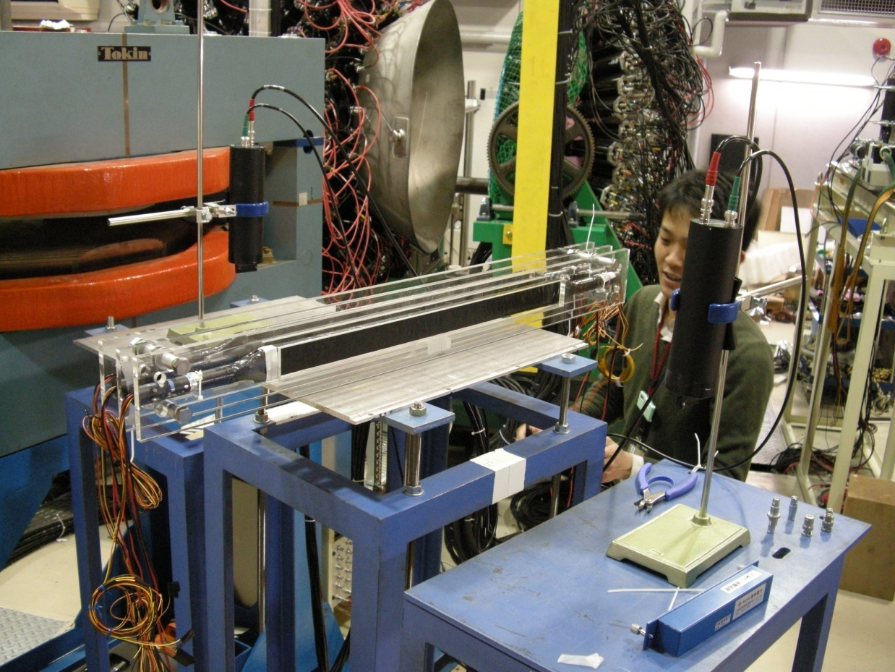


Kaon Decay Veto Counter
reduce fake triggers caused by decay of K- beam
requirements for the detector
    inside CDC & magnetic field
    small and compact
plastic scintillators embedded with wavelength shifting (WLS) fibers are in progress
Feb. 5-8, 2008
test experiment at
LNS, Tohoku Univ., Japan

Slide 21
Detailed Cell Configuration

Slide 22

Geometrical Acceptance
generated at the center of CDS
0<p<1 GeV/c, flat distribution
60<θ<120 degree, flat distribution
accepted = track with a CDH-hit
Calculated using Geant4
decay
magnetic field = 0.5T
energy loss
proton>250MeV/c, kaon>150MeV/c, pion>50MeV/c

Slide 23


Expected Spectrometer Performance
Calculated using Geant4
momentum resolution for π, K, p
we can distinguish the two non-mesonic decay modes for K-pp
  K-pp → Λp → pπ-p
  K-pp → Σ⁰p → γΛp → γpπ-p
Σ⁰ channel
Λ channel
Γ_{K-pp}= 60 MeV
invariant mass resolution for K-pp and Λ
Invariant mass of Λp (MeV)
mass resolution | K-pp→Λp | Λ◊pπ−
w/o chamber-resolution | 5.8 MeV/c² | 1.6MeV/c²
w/ chamber-resolution | 18.7MeV/c² | 2.5MeV/c²

