Slide 1
J-PARCにおけるK中間子原子核探索実験
による宇宙核物理学
Nuclear astrophysics at J-PARC with a search for deeply-bound kaonic nuclear states
佐久間 史典
理化学研究所・岩崎先端中間子研究室
F.Sakuma, RIKEN
Introduction
J-PARC E15 Experiment
Preparation Status
Summary

Slide 2
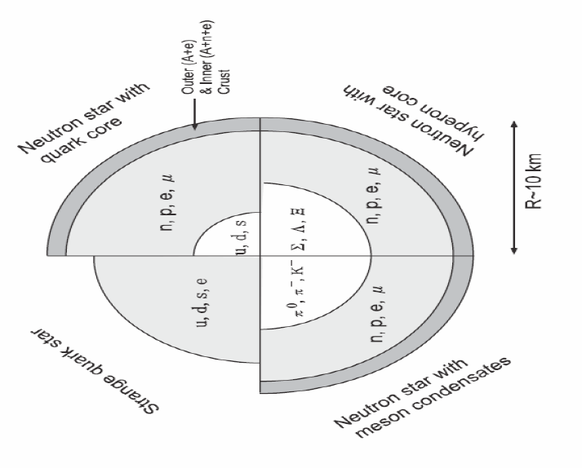
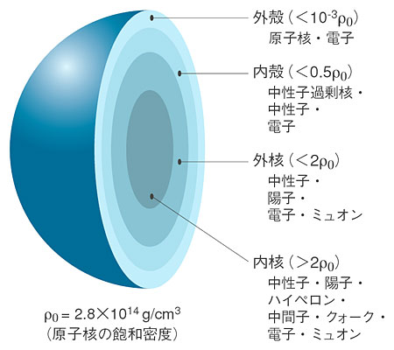
Introduction --- Neutron Star
the highest density matter in our familiar material is a nucleus
high-density matter above
the nuclear density?
p
ρ₀=0.17fm⁻³
=2.8x10¹⁷kg m⁻³
n
core material of neutron stars
~10⁻¹⁴m
--- the structure of neutron stars ---
Outer Crust
Inner Crust
→ 0.3-0.5ρ₀
Outer Core
→ 0.5-2ρ₀
Inner Core
→ 2-15ρ₀
possibility of the existence of a kaon condensed phase

Slide 3
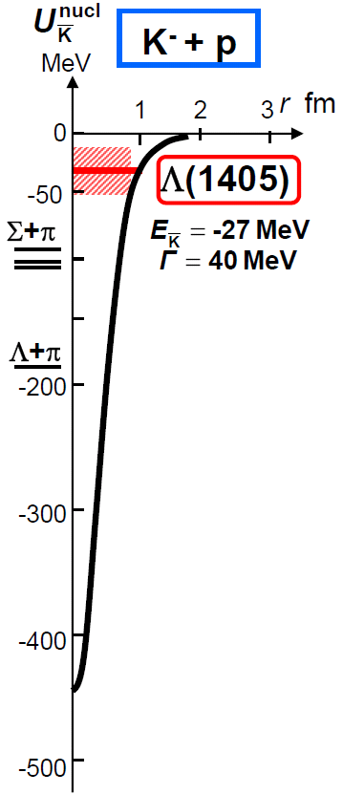
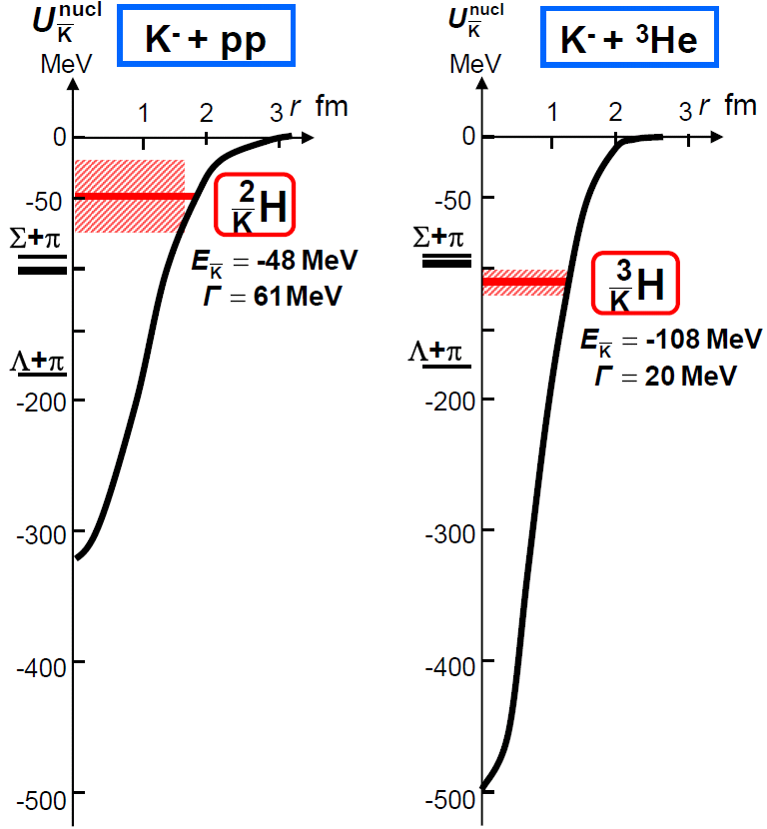
KN interaction
The possibility of kaon condensation is supported by …
theoretical investigations
various models predict kaon condensation
(mean field theories, effective interaction theories, …)
experimental results
Kaonic atom data indicates a strongly attractive KN interaction
(KpX@KEK, DEAR@DAΦNE)
this suggests
“the existence of relatively narrow deeply-bound K⁻-nuclei states”
Y.Akaishi & T.Yamazaki, PLB535, 70(2002).

Slide 4
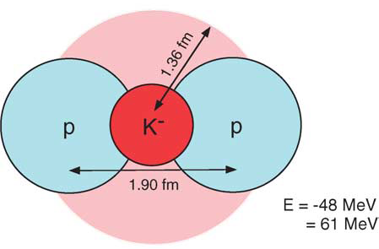
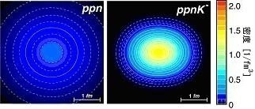
Deeply-Bound Kaonic Nuclei
if deeply-bound kaonic nuclear states exist …
the density of kaonic nuclei is predicted to be extreme high density
Kaonic Nuclei | Binding Energy [MeV] | Width [MeV] | Density
K⁻p | 27 | 40 | 3.5ρ₀
K⁻pp | 48 | 61 | 3.1ρ₀
K⁻ppp | 97 | 13 | 9.2ρ₀
K⁻ppn | 118 | 21 | 8.8ρ₀
T.Yamazaki, A.Dote, Y.Akiaishi PLB587,167(2004).
we will open new door to the condensed matter physics, like the inside of neutron stars

Slide 5
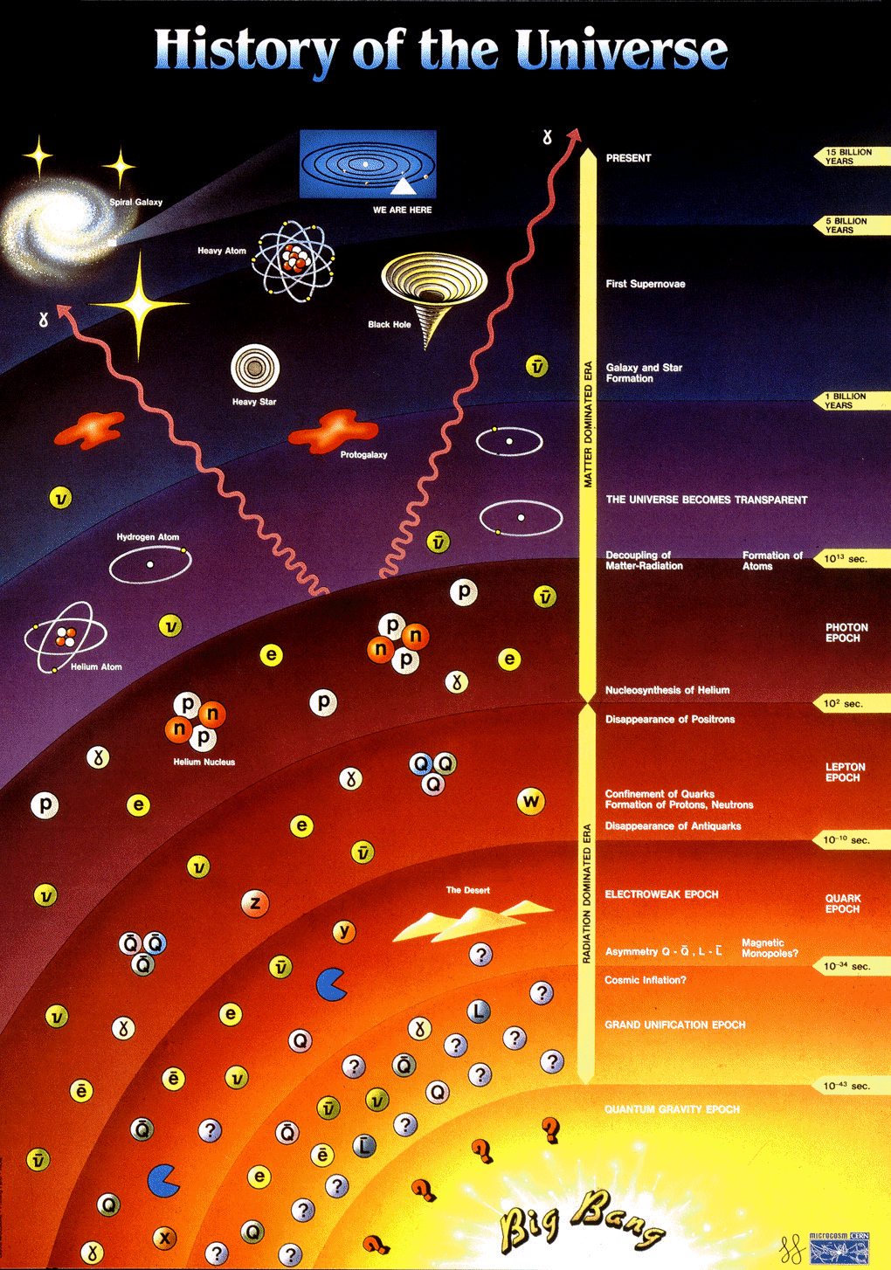
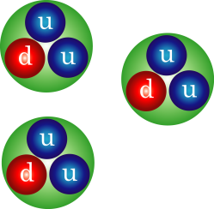
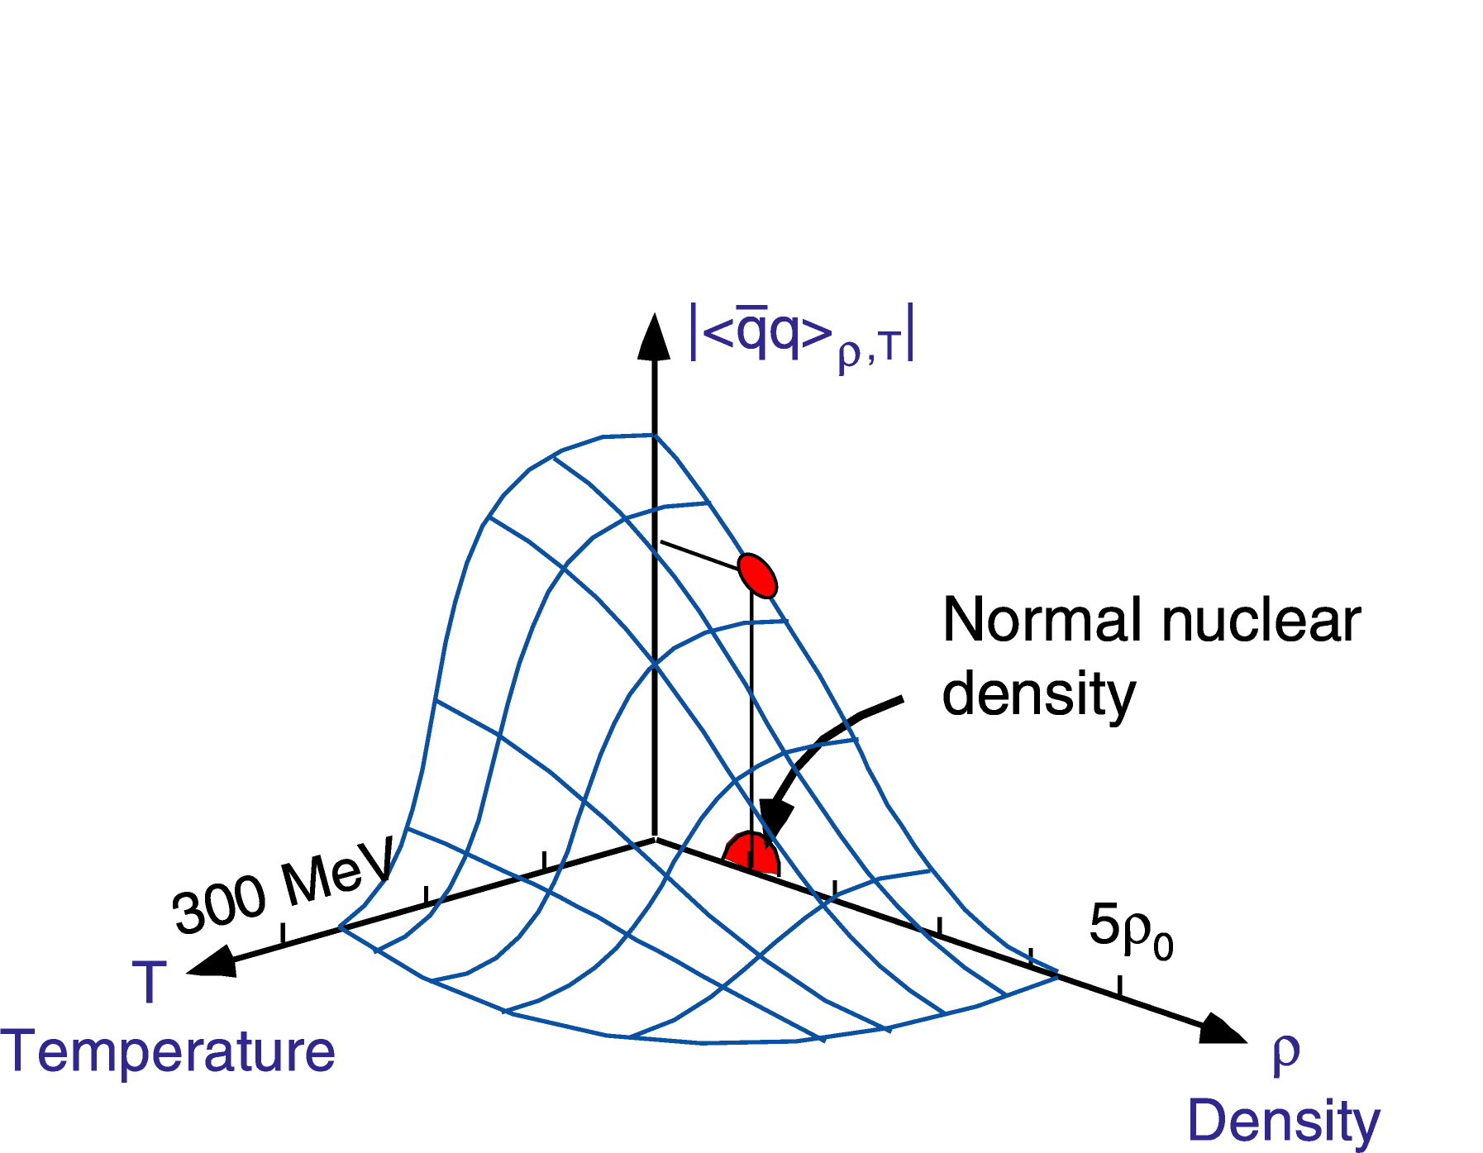
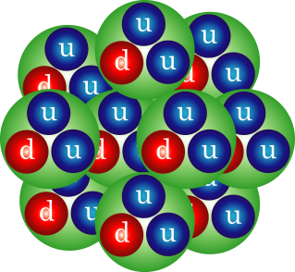
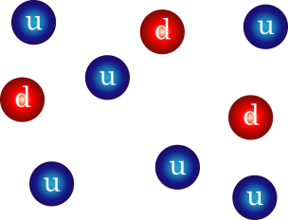
The Origin of Mass
we can investigate the origin of mass using the high density matter
W.Weise
NPA553, 59 (1993).
KEK-PS
J-PARC?
SPS, RHIC, LHC
most of the mass of matter are given by
Chiral Symmetry
Breaking
QGP
M_{u,d}~300MeV
neutron
star
Higgs Mechanism
M_{u,d}~3MeV
Mass-less Quark
exploring hadron properties in dense matter provides the key to the origin of mass
M_{u,d}=0MeV

Slide 6
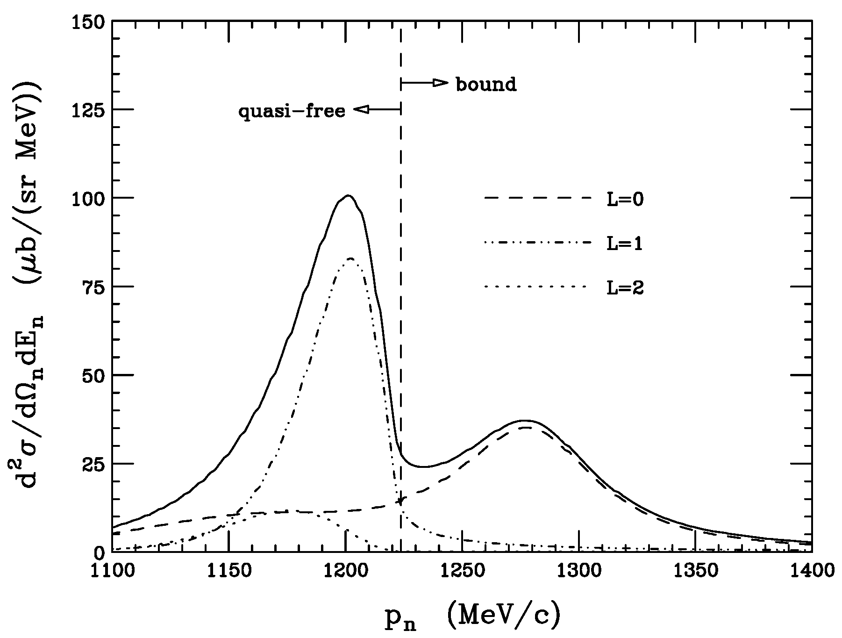
Deeply-Bound Kaonic Nuclei (Theory)
theoretical predictions for kaonic nuclei, e.g., K-pp
 | Method | Binding Energy (MeV) | Width (MeV)
Akaishi, Yamazaki PLB533, 70 (2002). | ATMS | 48 | 61
Shevchenko, Gal, Mares PRL98, 082301 (2007). | Faddeev | 55-70 | 90-110
Ikeda, Sato PRC76, 035203 (2007). | Faddeev | 79 | 74
Dote, Hyodo, Weise nucl-th/0802.0238 | chiral SU(3) | 19+/-3 | 40-70 (πΣN-decay)
whether the binding energy
is deep or shallow
how broad is the width ?
Koike, Harada
PLB652, 262 (2007).
DWIA
³He(K-,n)

Slide 7
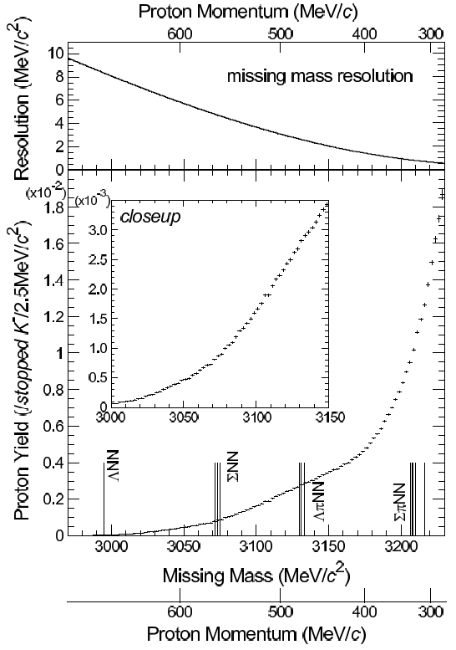
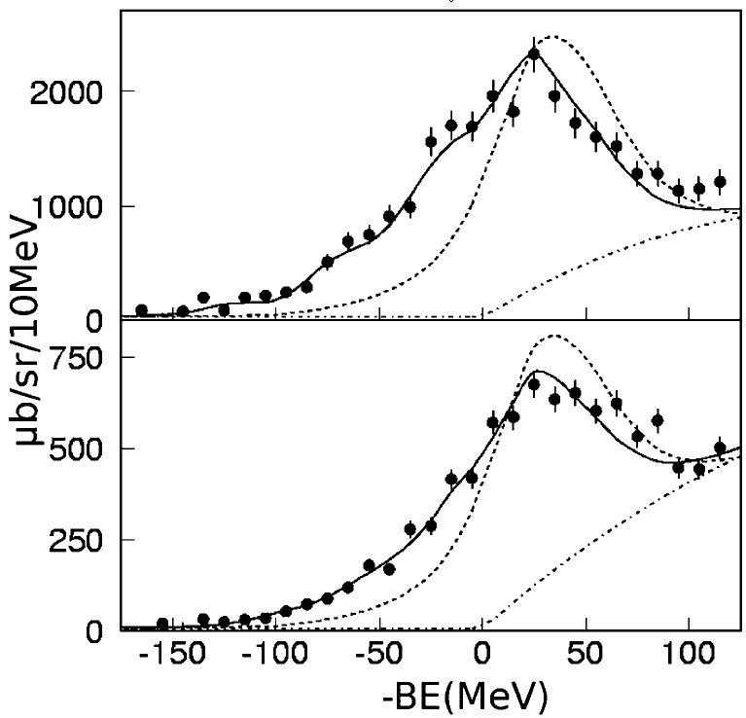
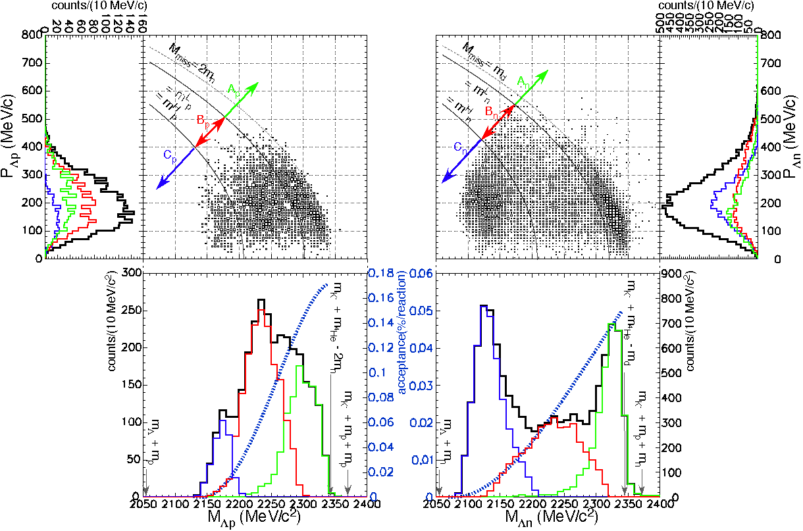
Deeply-Bound Kaonic Nuclei (Experiment)
E549@KEK-PS
E548@KEK-PS
⁴He（stopped K-,p)
¹²C(K⁻,n)
formation
K⁻pnn?
formation
¹²C(K⁻,p)
unknown strength between Q.F. & 2N abs.
missing mass
Prog.Theor.Phys.118:181-186,2007.
-
deep K-nucleus potential of ~200MeV
K⁻pp?
K⁻pn?
PLB 659:107,2008
⁴He（stopped K-,ΛN)
no “narrow” structure
formation
&
decay
arXiv:0711.4943

Slide 8
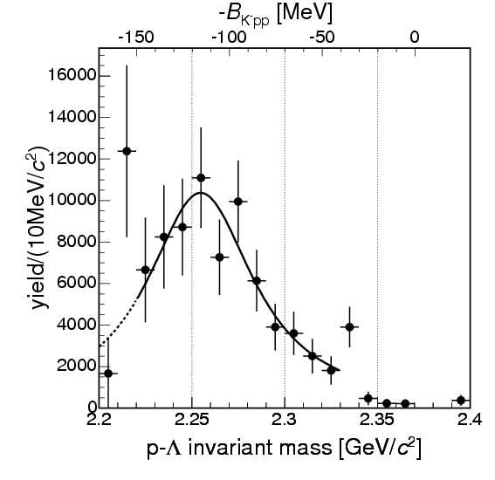
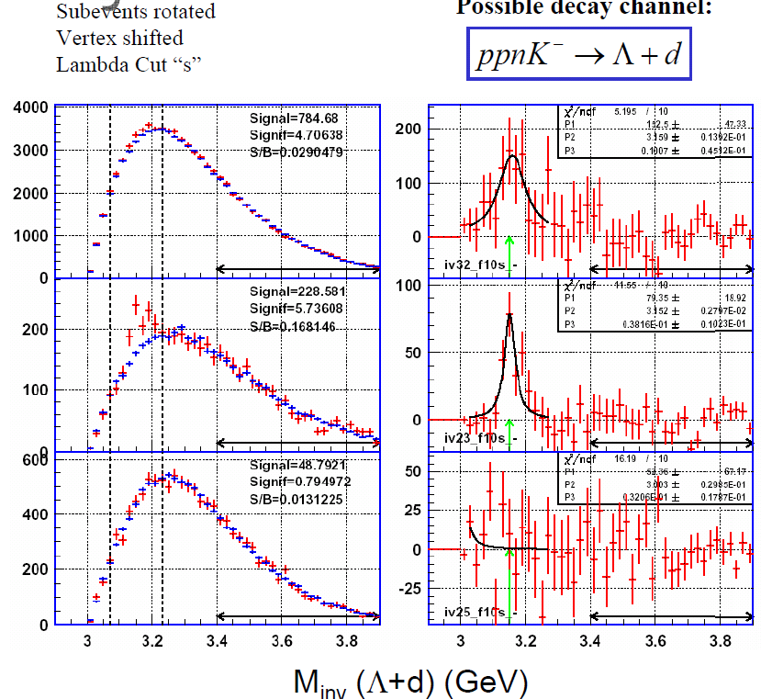
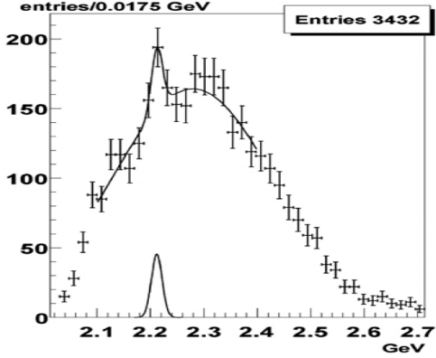
Deeply-Bound Kaonic Nuclei (Experiment)
decay
decay
decay
K⁻pp?
K⁻pp?
K⁻pp?
Λ-p invariant mass
FINUDA@DAΦNE
OBELIX@CERN-LEAR
FOPI@GSI
PRL, 94, 212303 (2005)
NP, A789, 222 (2007)
peak structure → signature of kaonic nuclei ?
each experiment measures only formation or decay
(except for E549 experiment)
the situation is still controversial !!!
We need conclusive evidence with
observation of formation and decay !

Slide 9
J-PARC E15 Experiment

Slide 10
Experimental Principle
search for K-pp bound state using ³He(K⁻,n) reaction
³He
neutron
K⁻
K⁻pp
cluster
Formation
Missing mass
Spectroscopy
via neutron
Decay
Mode to decay charged particles
Λ
p
exclusive measurement by
Missing mass spectroscopy
and
Invariant mass reconstruction
π⁻
Invariant mass reconstruction
p
at J-PARC

Slide 11
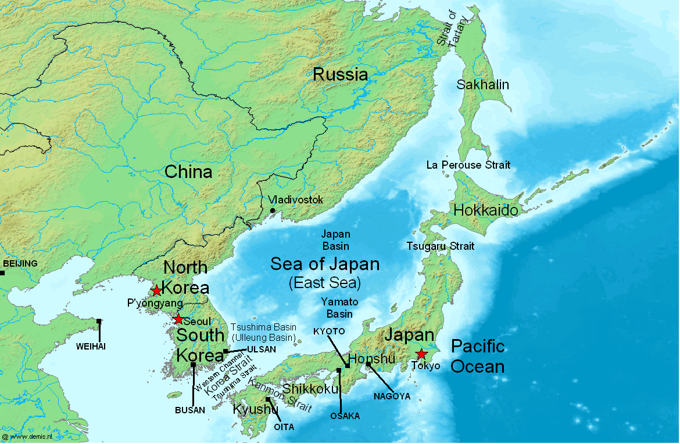
J-PARC (Japan Proton Accelerator Research Complex)
J-PARC
Tokai

Slide 12
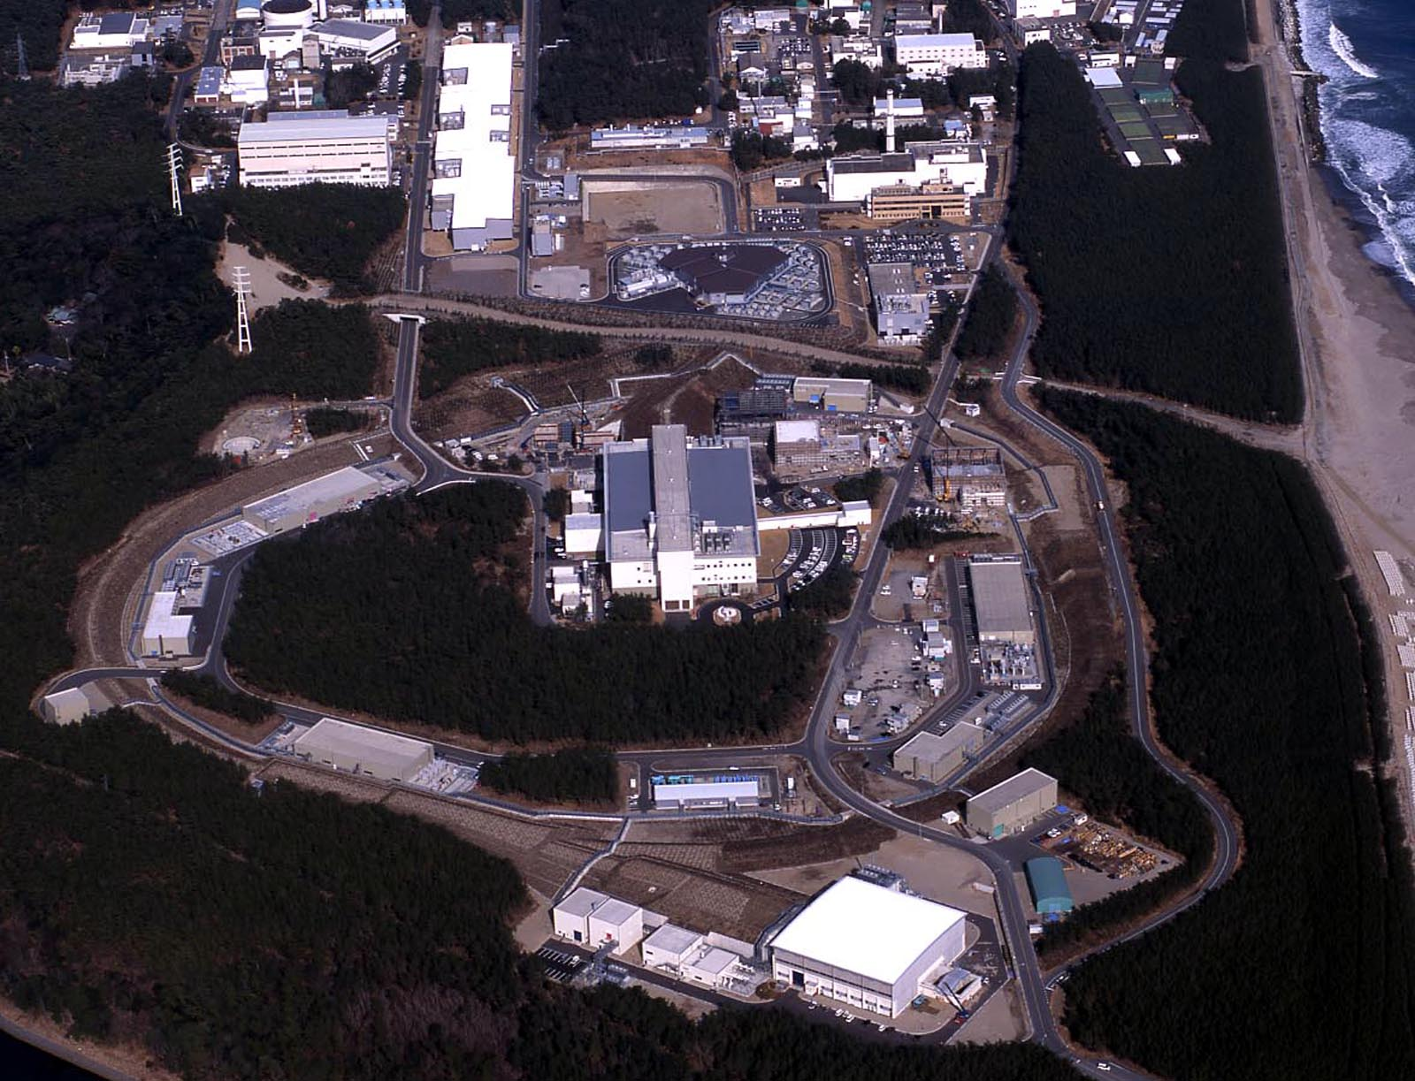
J-PARC (Japan Proton Accelerator Research Complex)
Bird’s eye photo in Feb. 2008
ＬＩＮＡＣ
RCS(3GeV)
ν
ＭＬＦ
50GeV-PS
Hadron
Hall
with the highest beam power (0.75MW) !

Slide 13
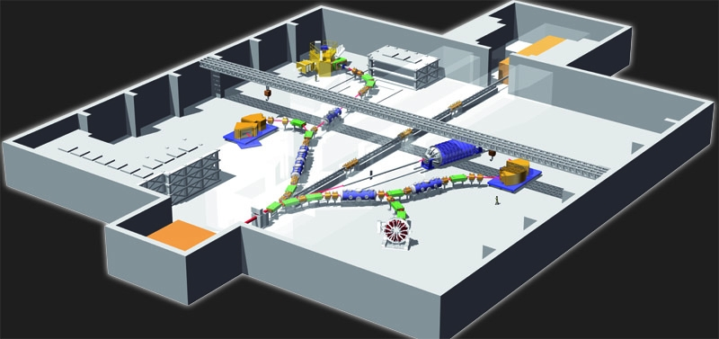
Hadron Experimental Hall @ J-PARC
Ξ-Hypernucleus
K1.8
(2009 Sep.)
Kaonic Nuclei
Kaon Rare Decay
K1.8BR
(2008 Dec.)
KL
(2010 Sep.)
Primary beams
(2011)
di-lepton
Production
Target (T1)
K1.1
(2010 Dec.)
Proton Beam
[30-GeV]
(Jan. 27th, 2009)
K1.1BR
(2010 Sep.)
T-violation

Slide 14
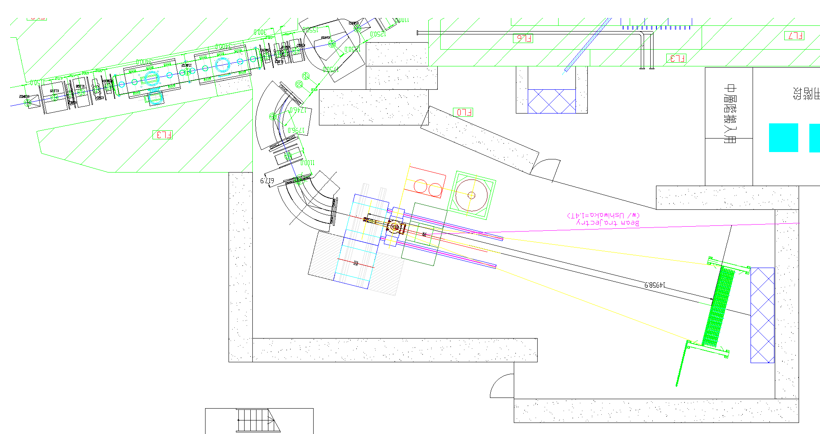
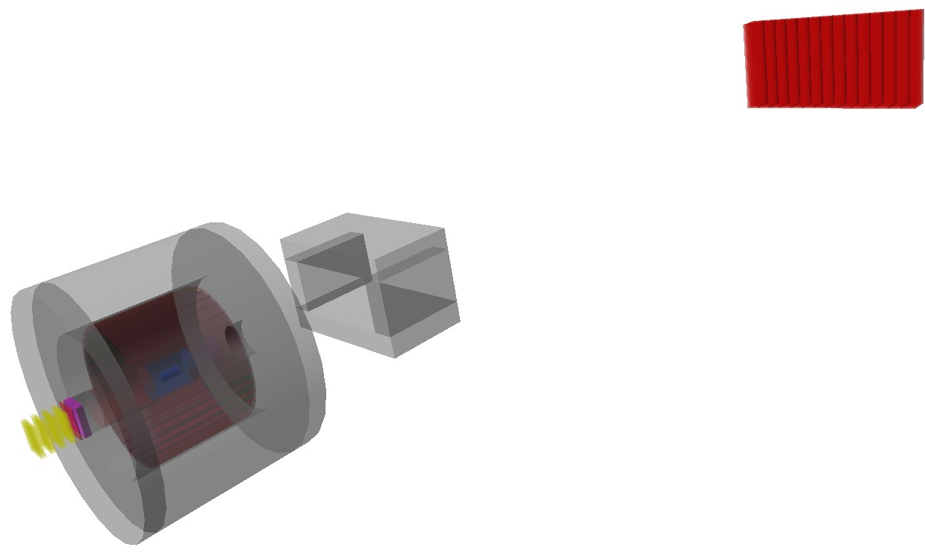
J-PARC E15 Setup
Beam Line
Spectrometer
Sweeping
Magnet
Beam trajectory
K1.8BR
Beam Line
CDS &
target
neutron
Neutron
Counter
Neutron
ToF Wall
flight length = 15m
p
n
Beam Sweeping
Magnet
mass resolution for K-pp
invariant mass
σ = 19MeV/c² (σ_{CDC} = 250μm)
missing mass (for 1.3GeV/c neutron)
σ = 9.2MeV/c² (σ_{ToF} = 150ps)
π⁻
Cylindrical
Detector
System
p
1GeV/c
K- beam

Slide 15
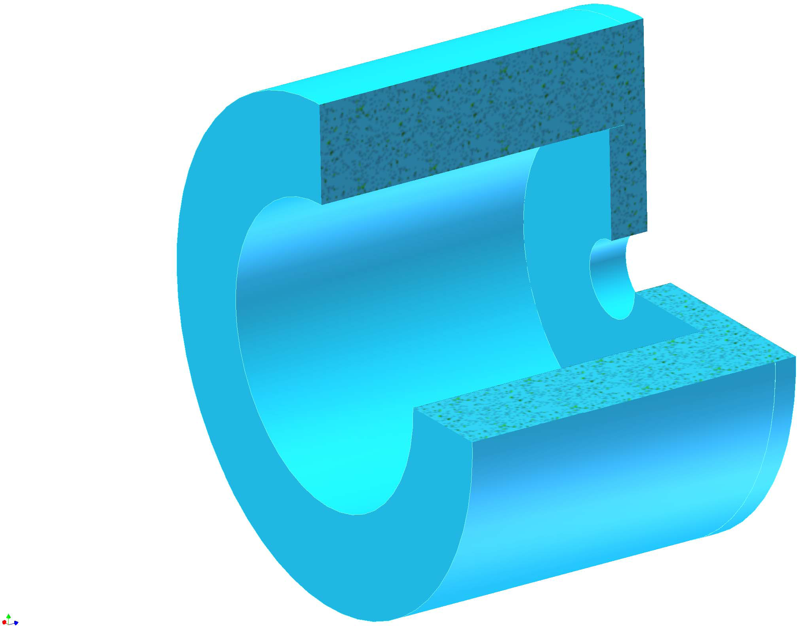
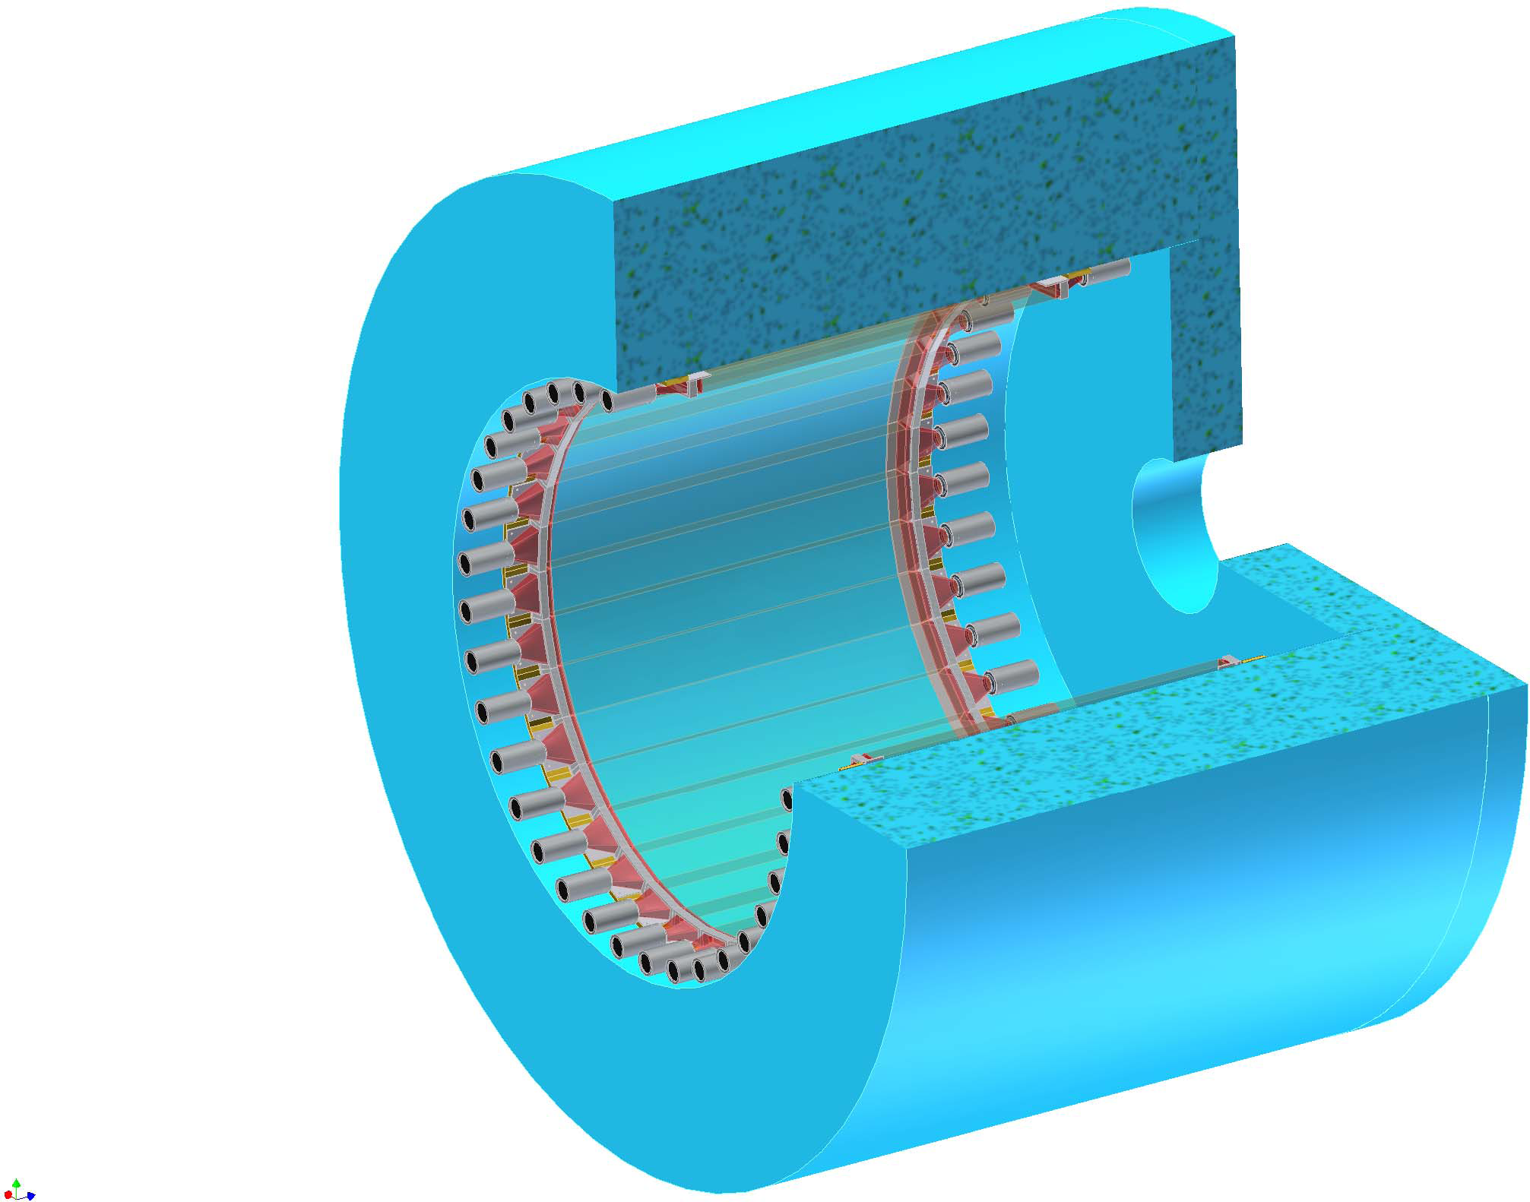
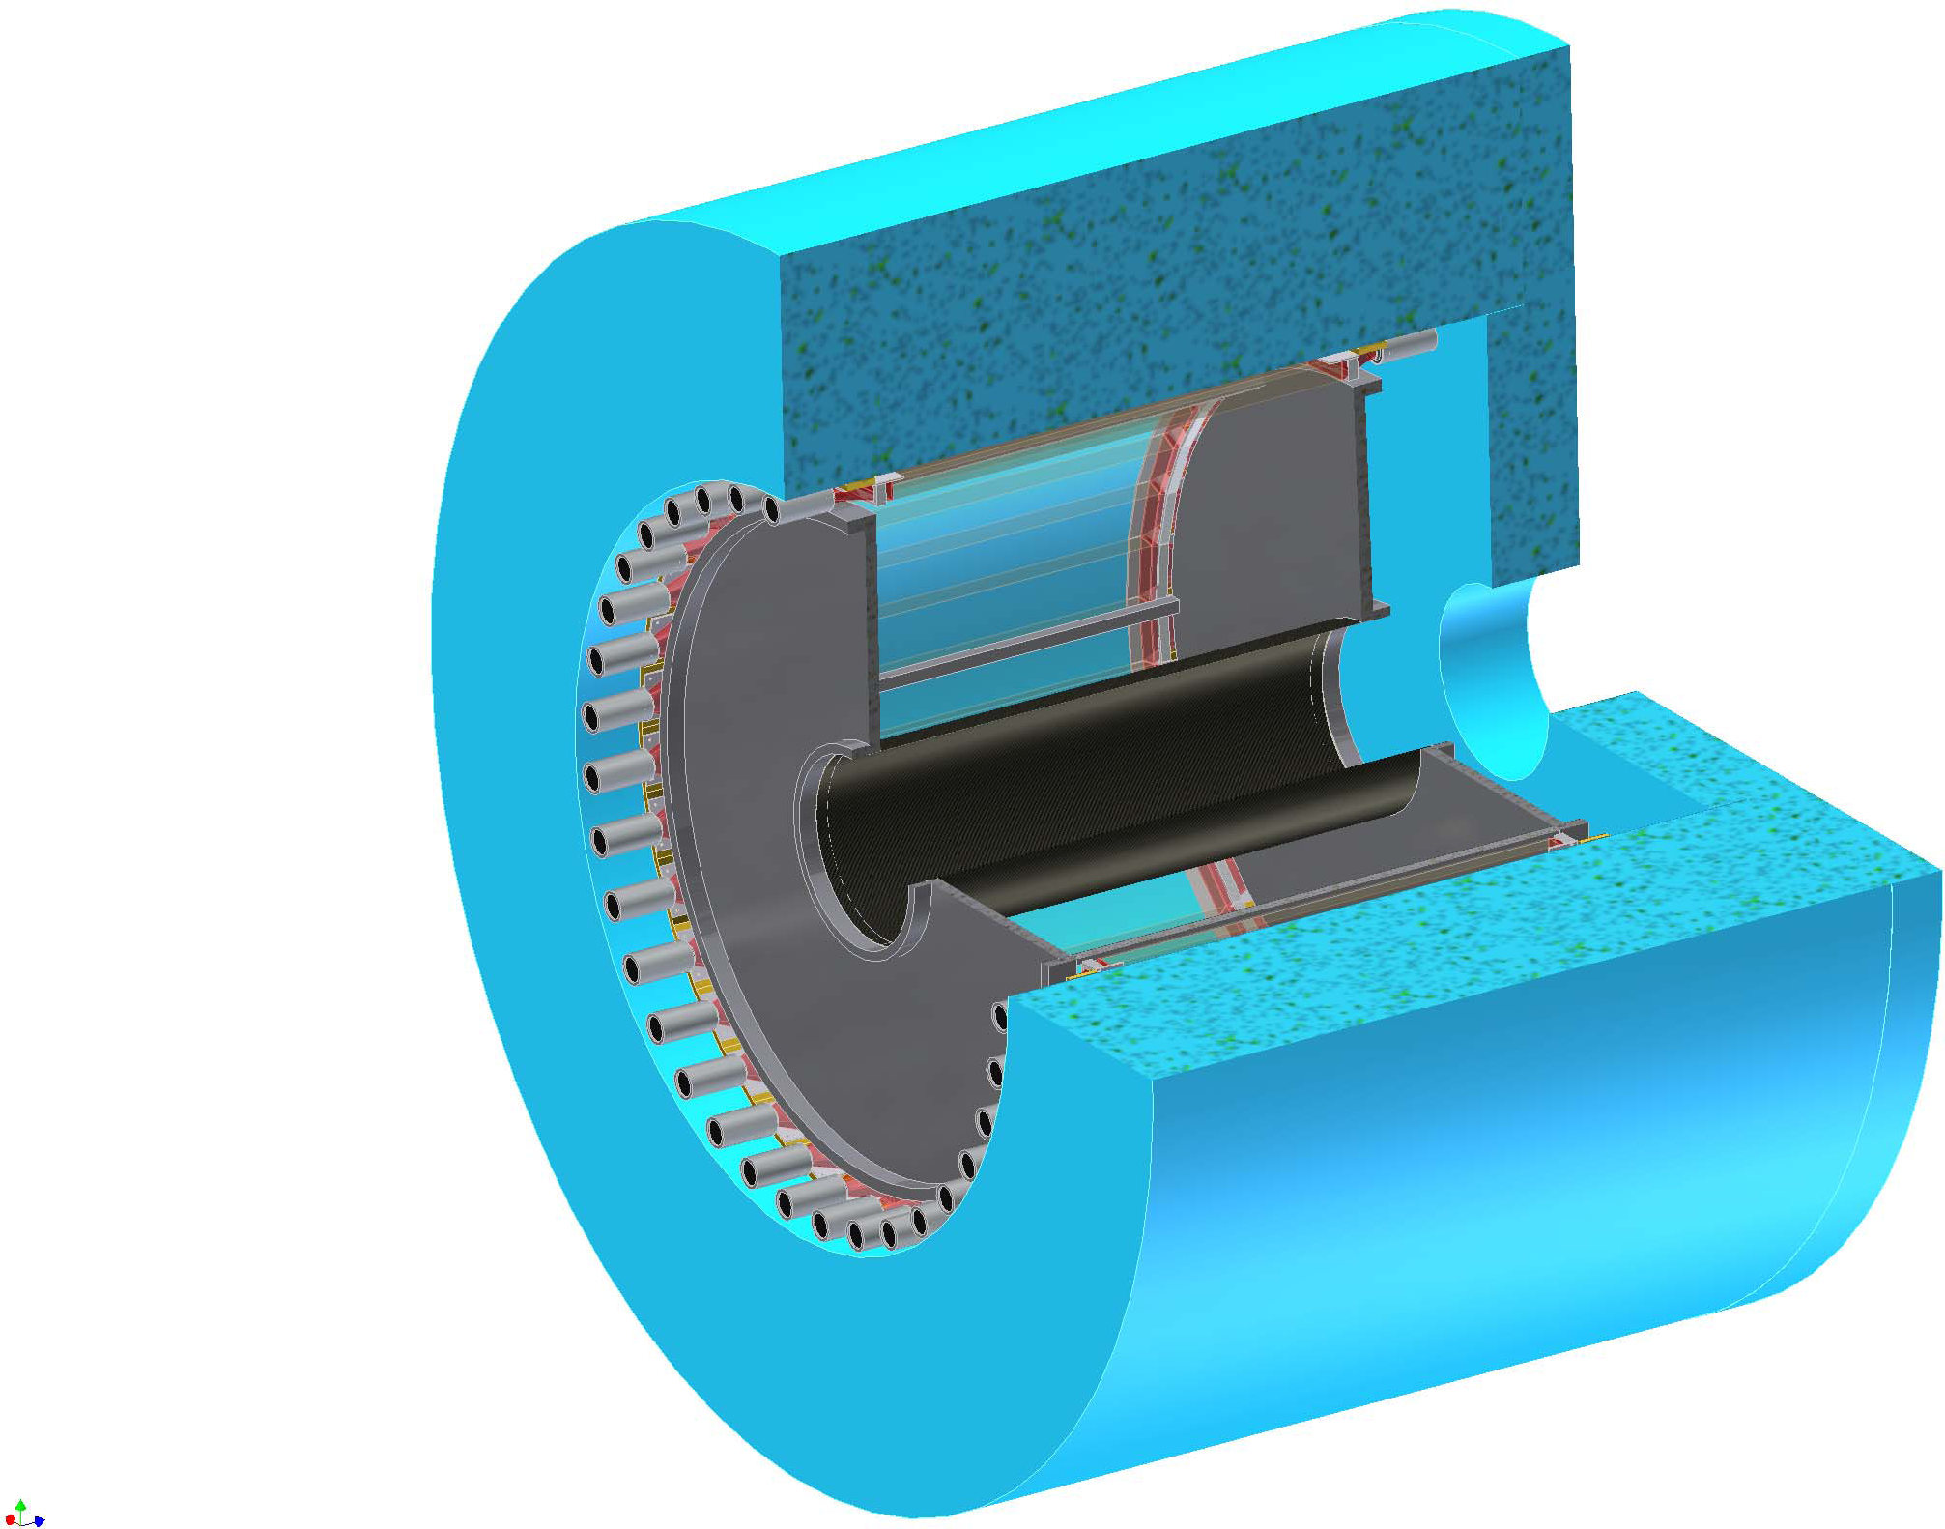
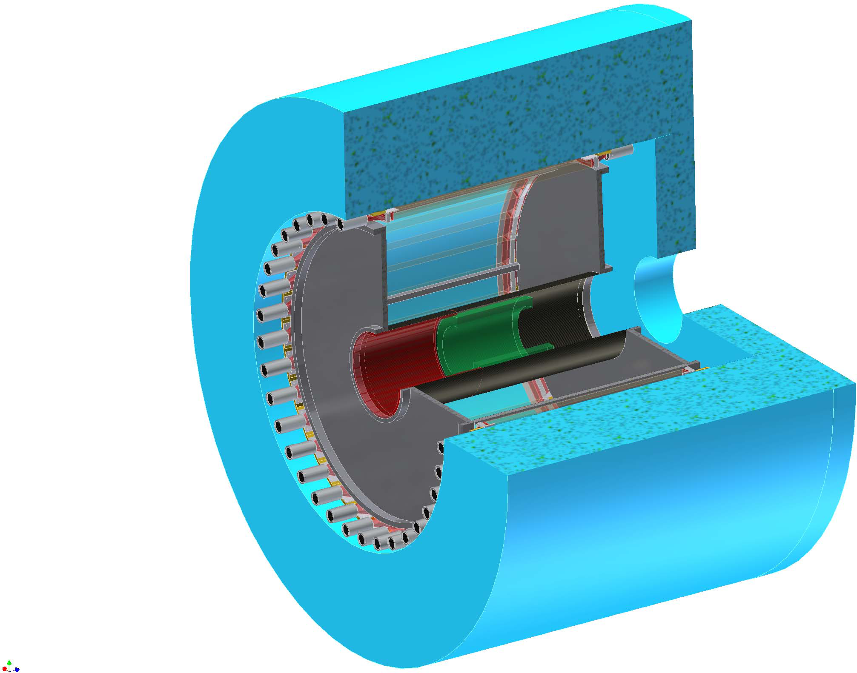
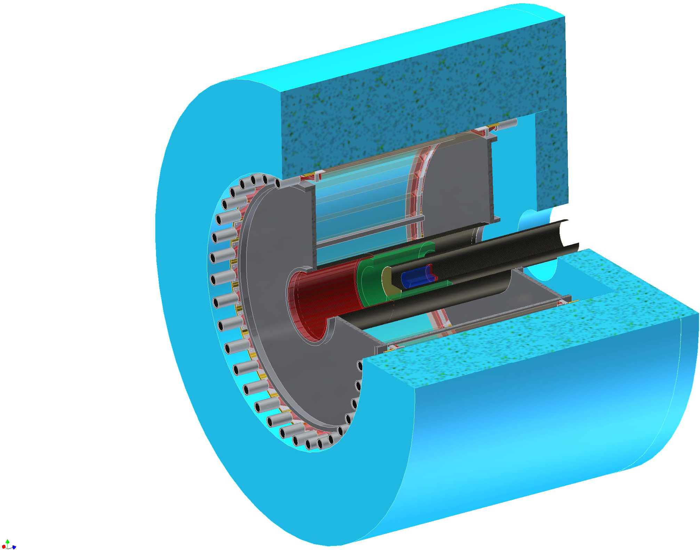
Cylindrical Detector System (CDS)
L³He Target
Solenoid
Magnet
Target
Chamber
Z-Vertex
Chamber
Charge Veto Counter
~2m
Kaon Decay Veto Counter
B=0.5T
Cylindrical
Drift Chamber
Hodoscope
Counter

Slide 16
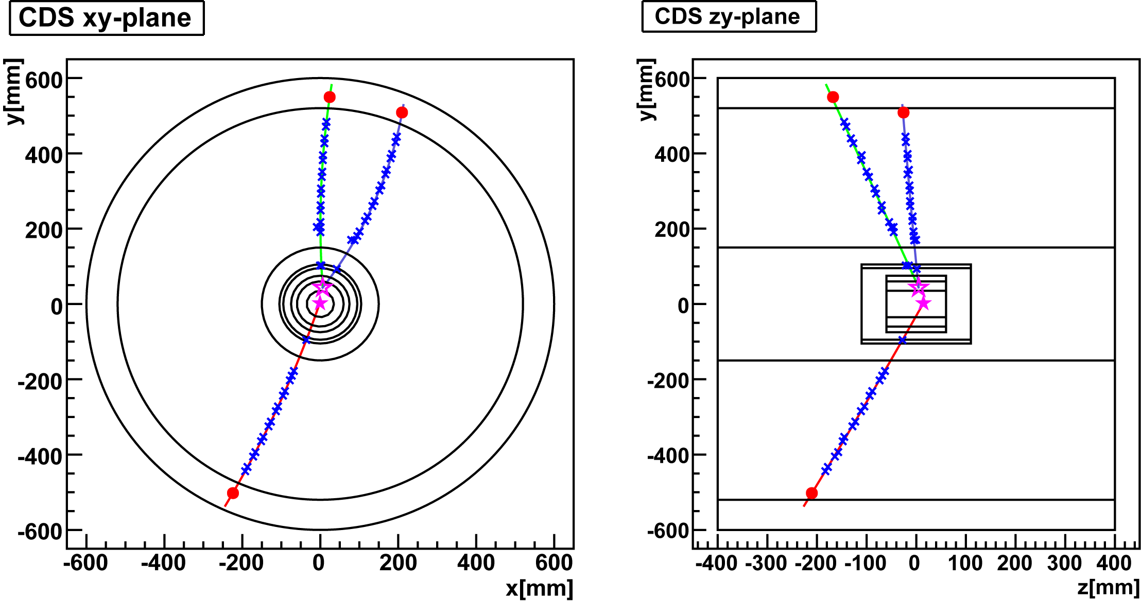
Expected Kinematics for K-pp Decay
binding energy = 100MeV/c²
Isotropic decay of K-pp
with forward neutron
Calculated using Geant4
p
p
π-
π-
~400MeV/c
~150MeV/c
n
Λ vtx
K-pp vtx
~1300MeV/c
p
p
~500MeV/c

Slide 17
Preparation Status

Slide 18
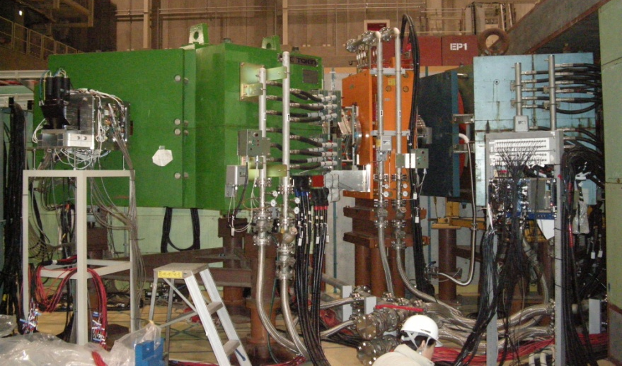
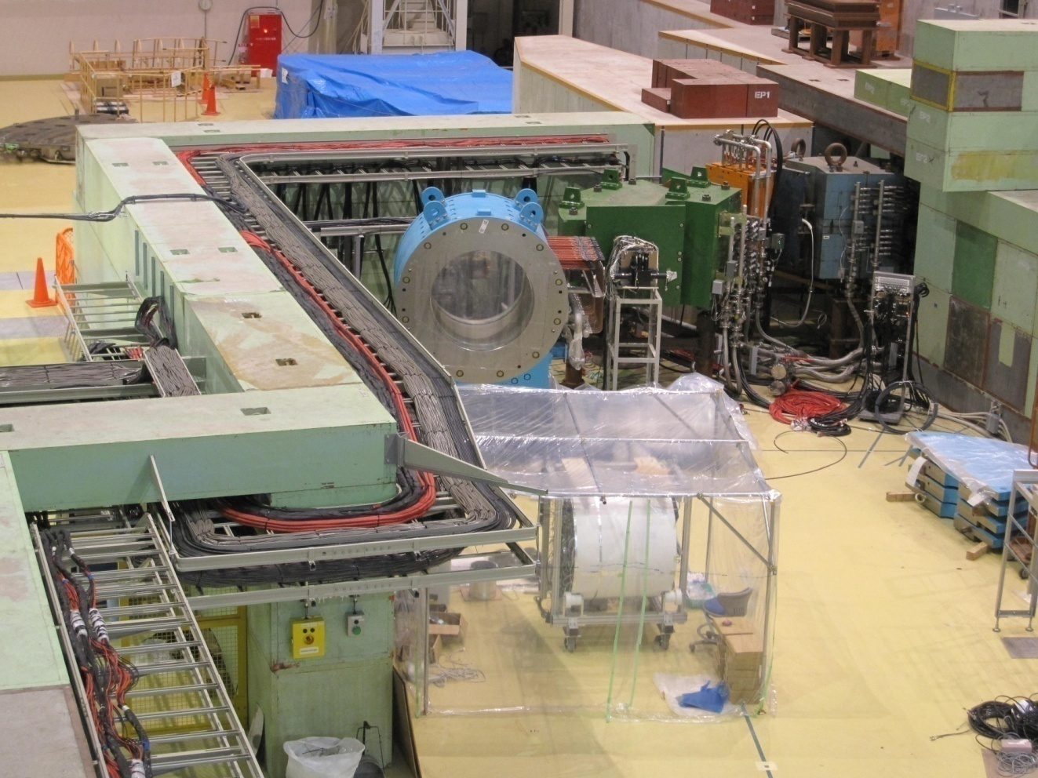
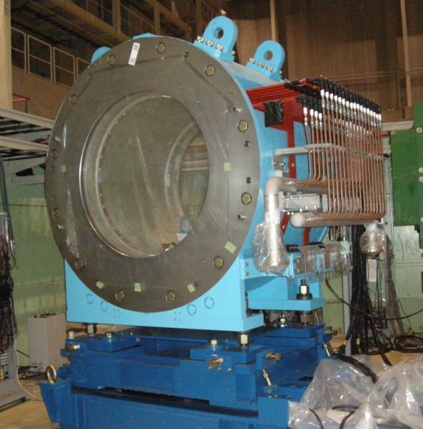
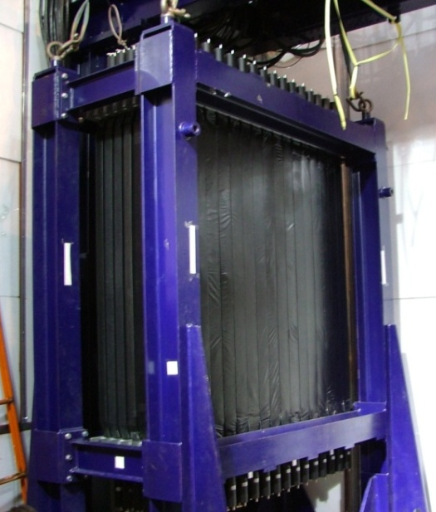
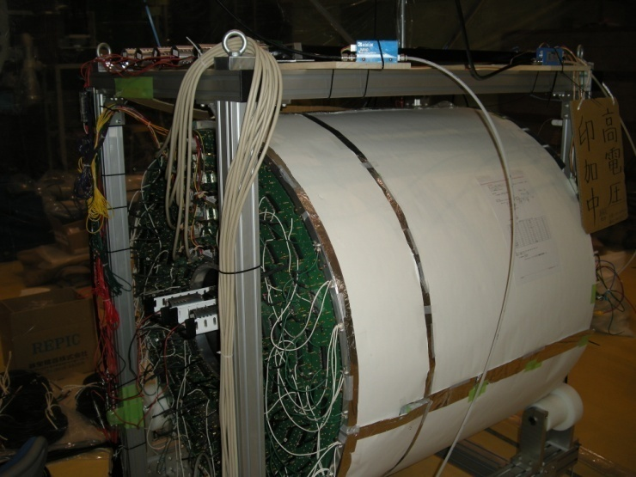
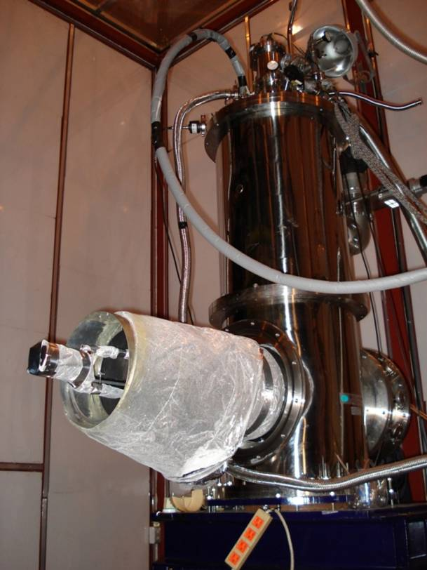
K1.8BR beamline
Beam-line Spectrometer
Neutron Counter
Solenoid Magnet
L³He
Target
Beam
Cylindrical Drift Chamber
+ Cylindrical Hodoscope

Slide 19
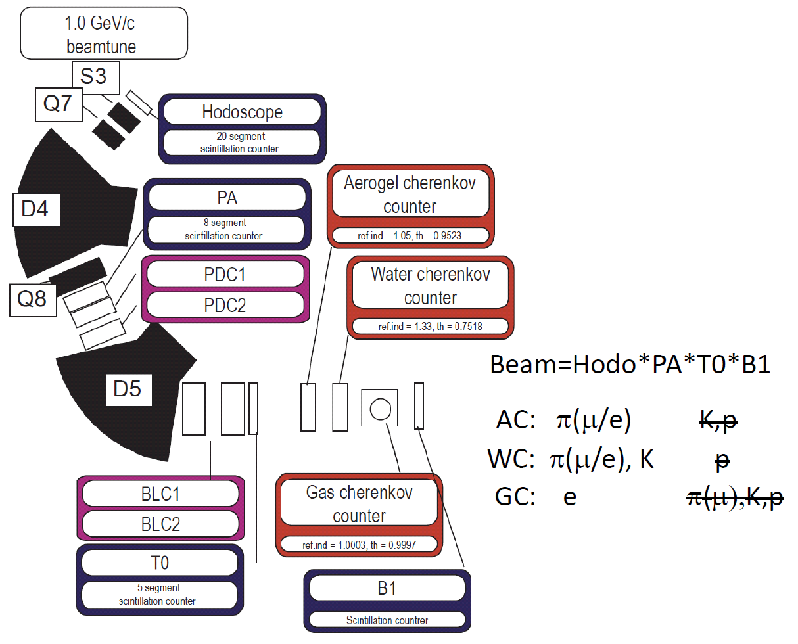
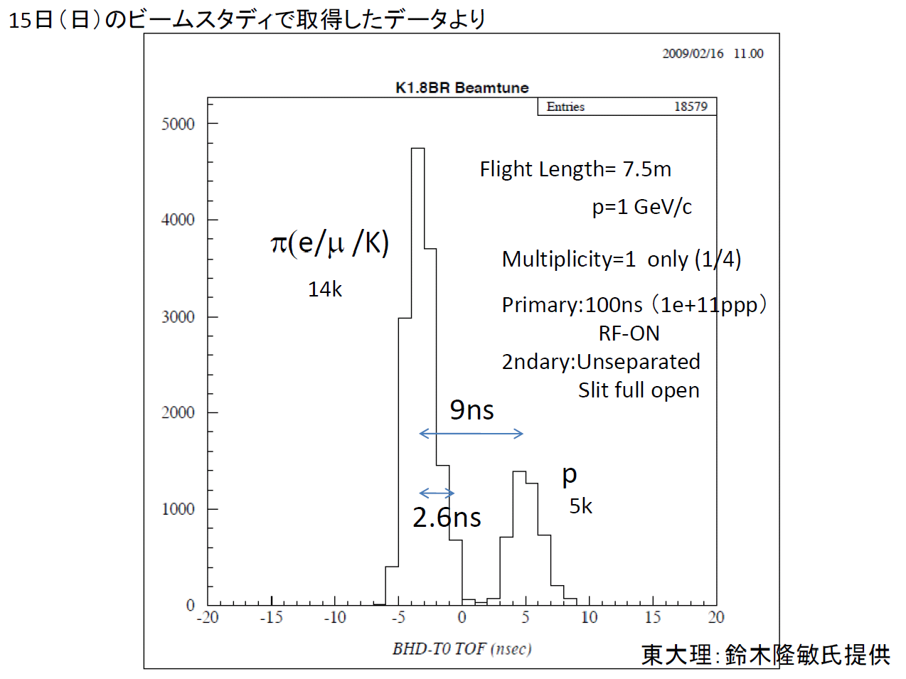
Beam-line Spectrometer
On Feb. 12th, 2009, the first beam was transported to K1.8BR beam-line!
K/π separation will be proceeded step by step from now on ...

Slide 20
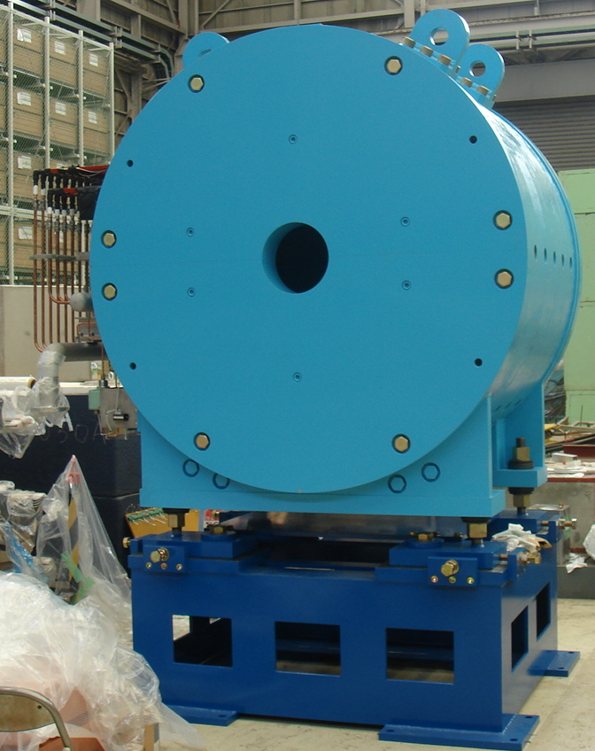
Solenoid Magnet
Solenoid magnet for E15 experiment
has been constructed.
  Field strength: upto 0.7T
  Space inside : Φ=1.2m, L=1.2m
  weight : 23 t
magnetic field map
φ1970mm
beam direction

Slide 21
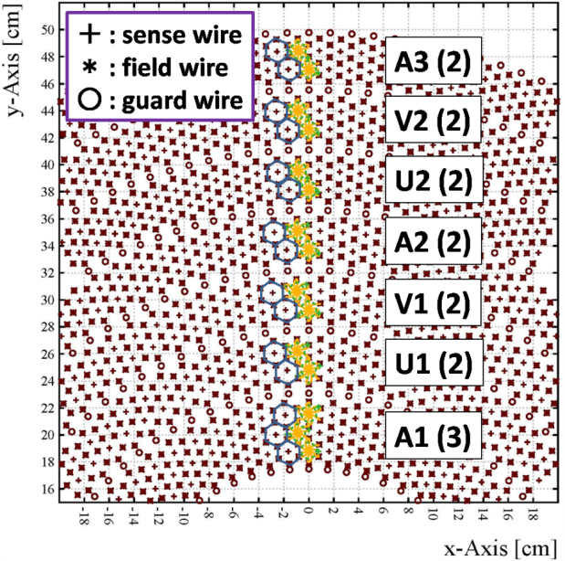
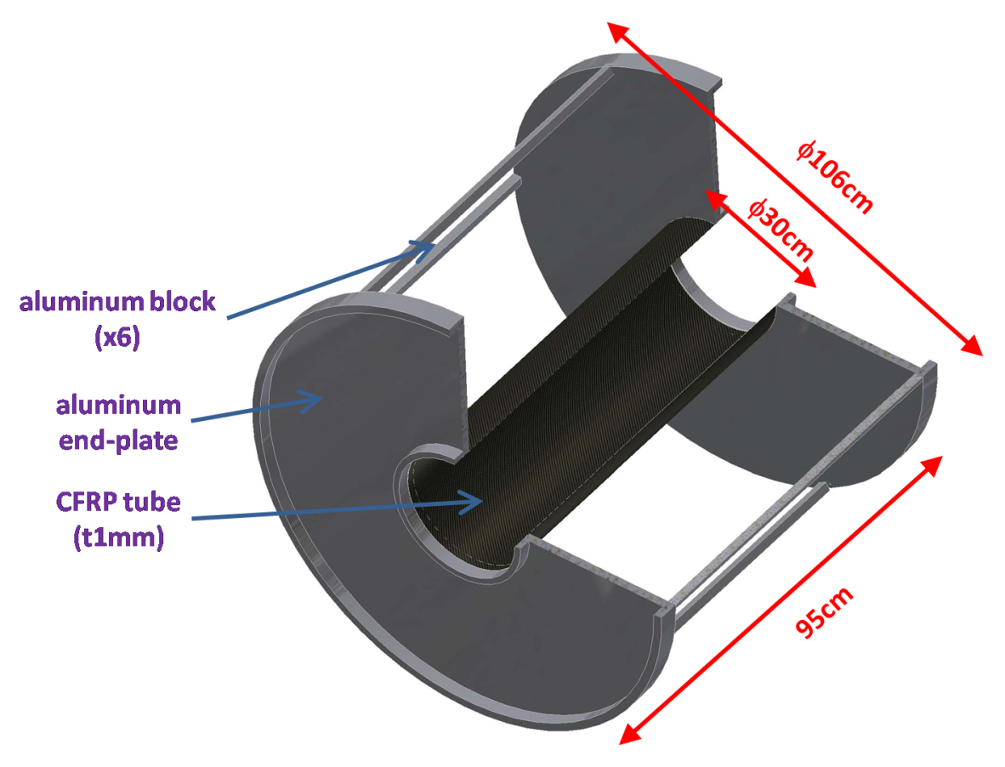
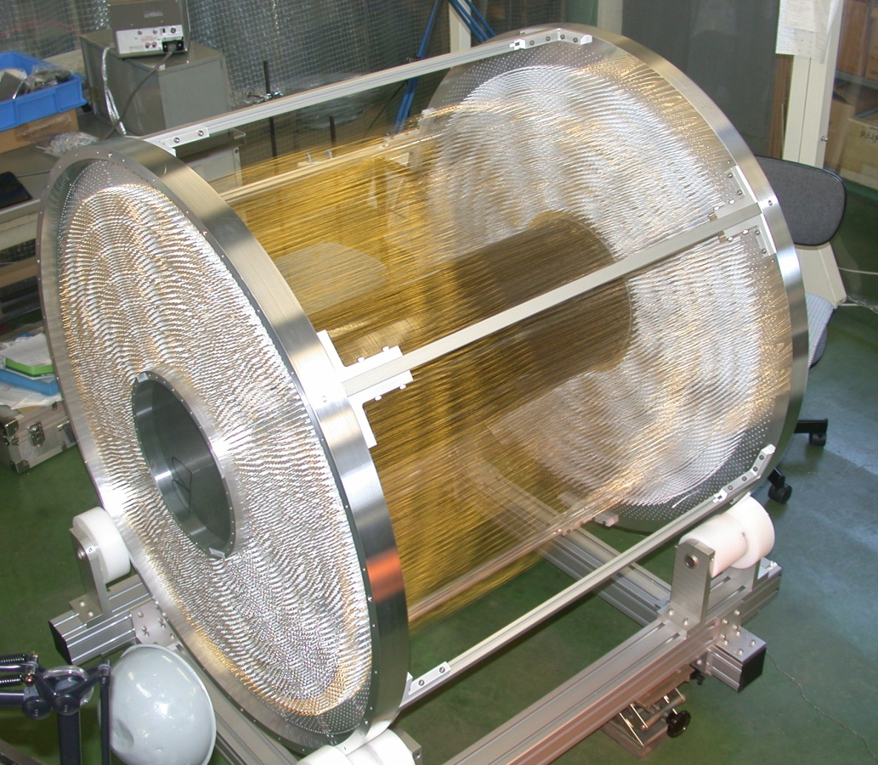
Cylindrical Drift Chamber (CDC)
made of Aluminum and CFRP
# of wires : 8136
(read-out : 1816ch)
solid angle = 2.6π
Ar:C₂H₆=50:50
hexagonal cell
(drift length ∼9mm)
15 layers
7 super layers
(AUVAUVA)

Slide 22

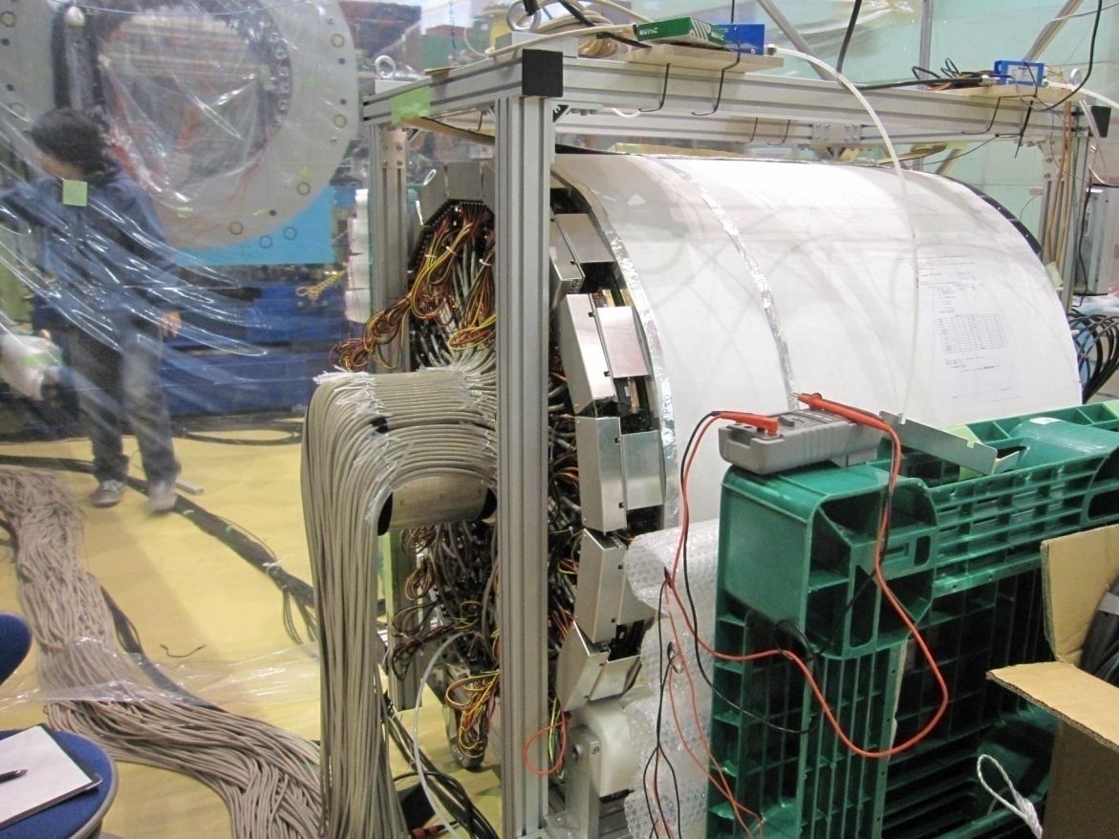
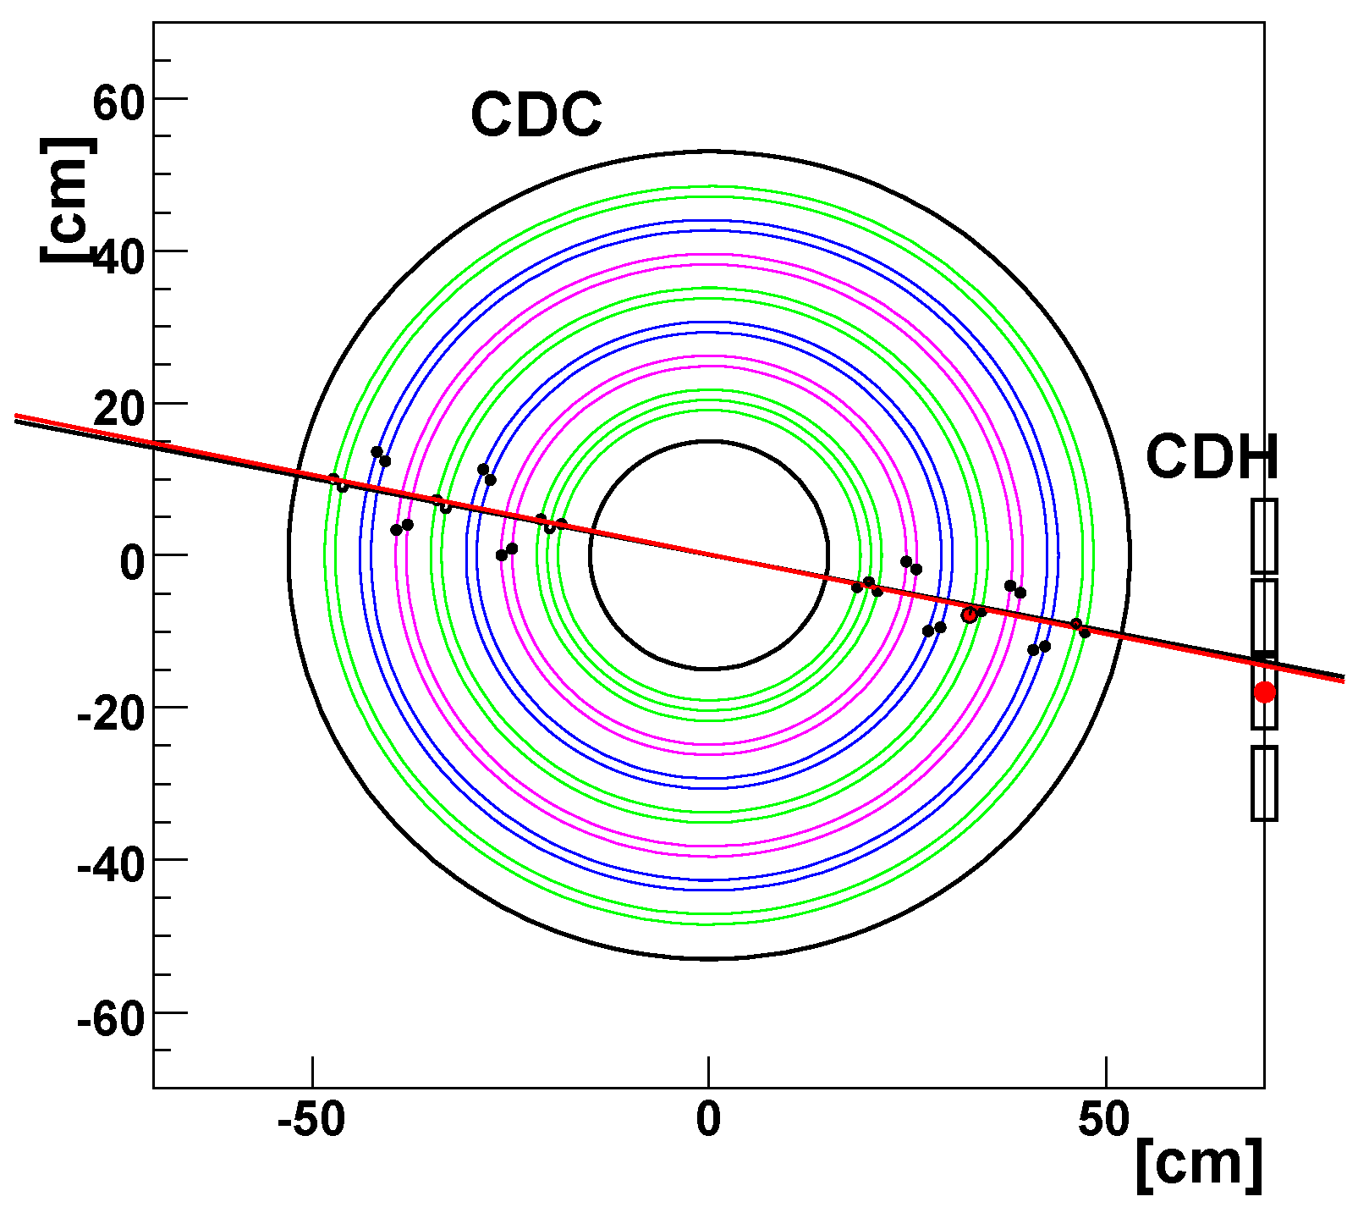
Cylindrical Drift Chamber (CDC)
Beam
calibration of CDC has started with the beam data
a first beam track in CDC !

Slide 23
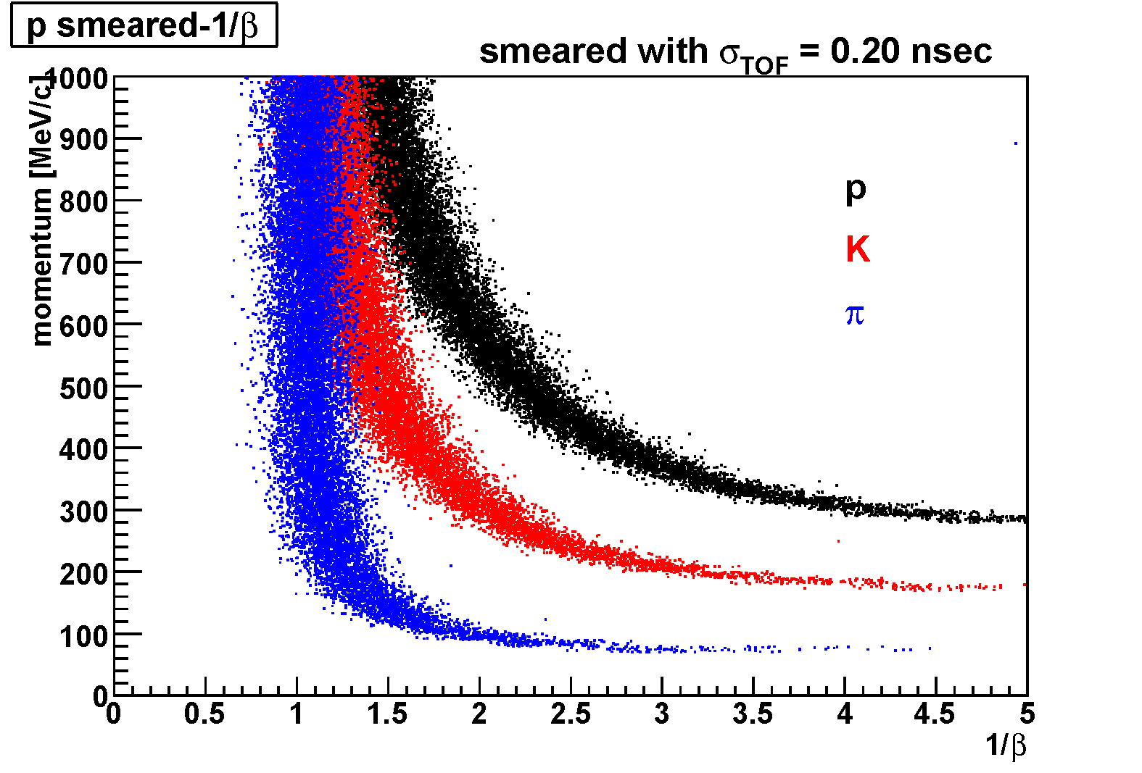
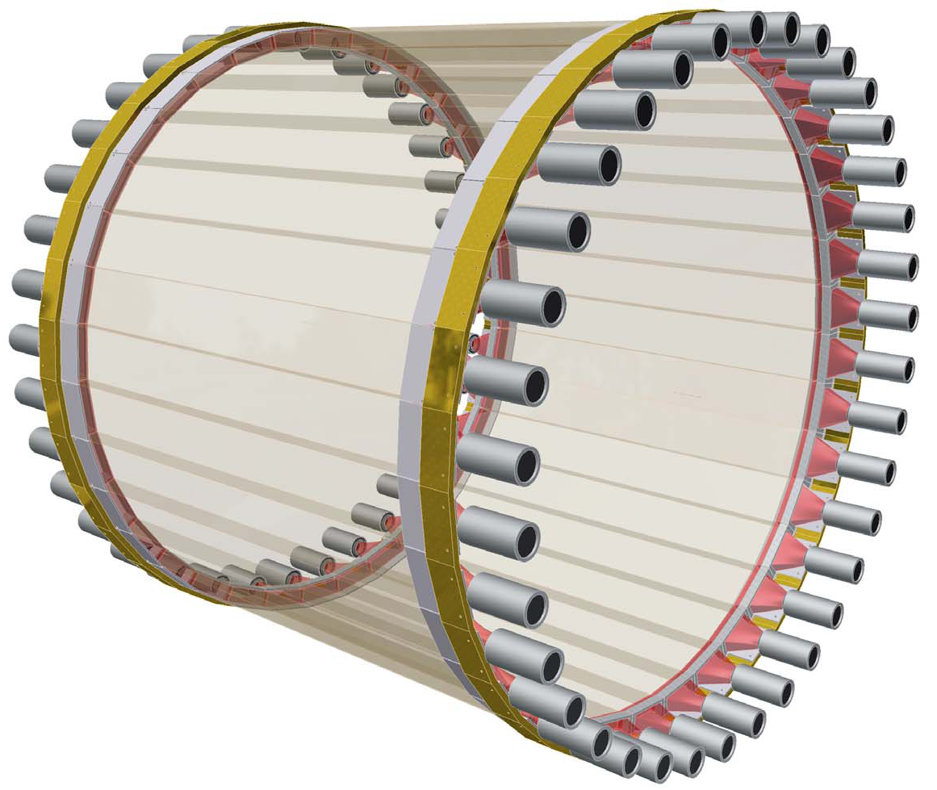
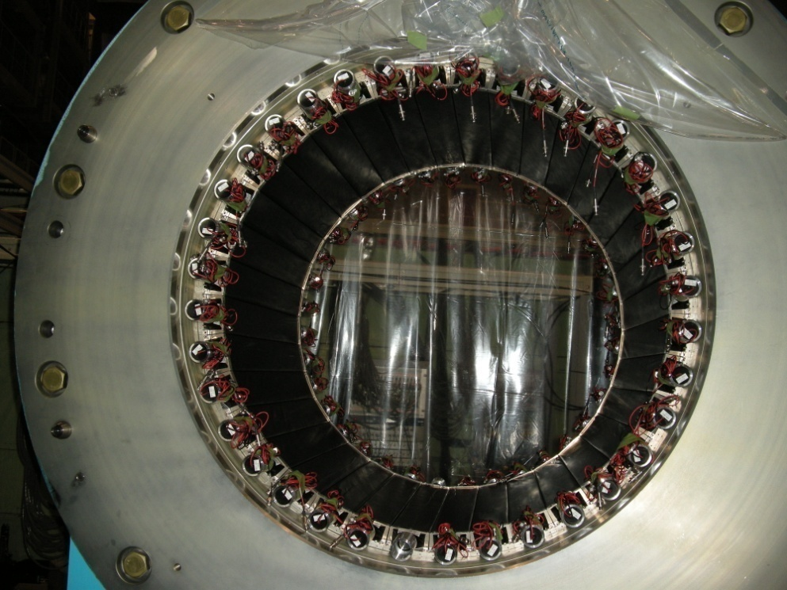
Hodoscope Counter (CDH)
CDH is used for the charged trigger and particle identification.
expected pID using ToF measurements
Feb. 3, 2009
Plastic Scintillator :
99x30x700 mm³ （WＸTＸL）Configuration : 36 modules
PMT: Hamamatsu H8409 (fine mesh) x 72
σ_{int} = 71psec
CDH system was mounted
inside the Solenoid Magnet !

Slide 24
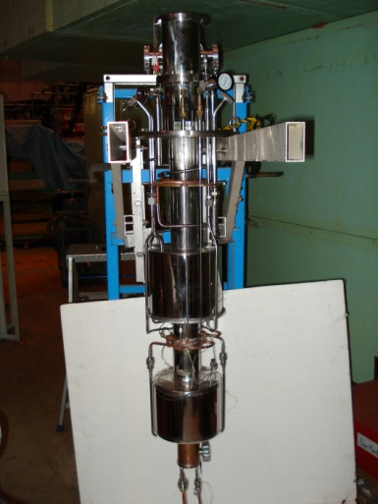
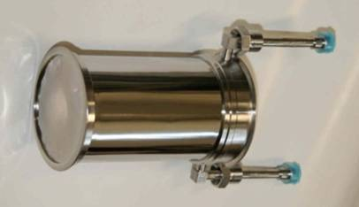
Liquid ³He Target System
Cooling test with ⁴He gas
³He liquefied system is completed
The x-ray detection device will be installed in the target this year
Temperature of the Target Cell | 1.25 K
Temperature of the 1K Tank | 1.24 K
Pressure in the 1K Tank | 1.2 Torr
Liq. ⁴He Consumption | 45 L/day
Heat Load of the 1K Tank | 0.18 W
E17 (kaonic ³He X-ray) will start in this year
(First experiment @J-PARC Hadron-Hall)

Slide 25

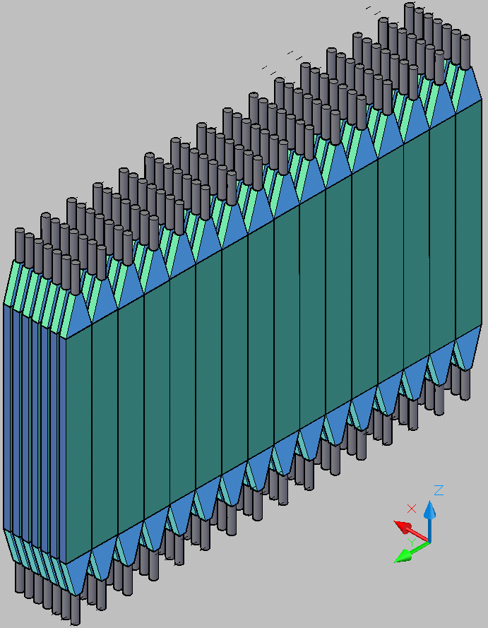
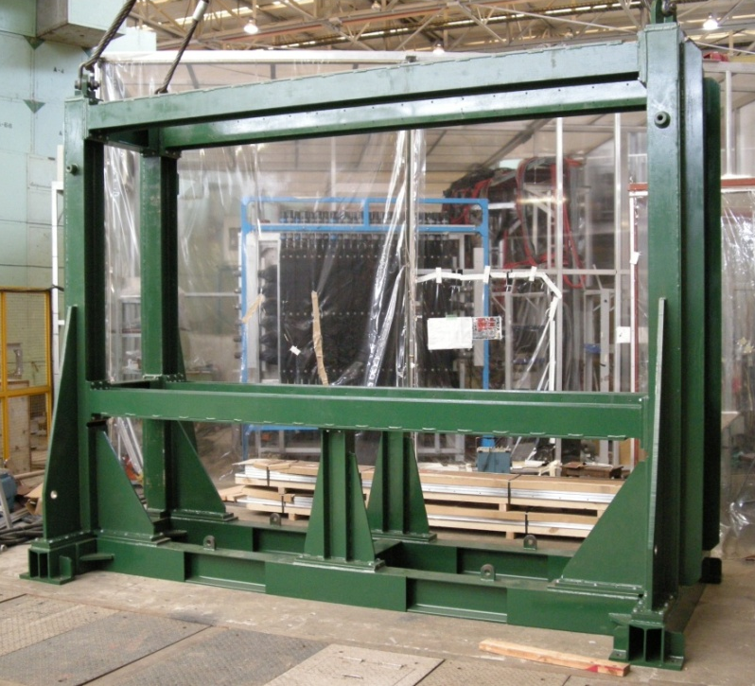
Neutron Counter
same neutron counter used for KEK-PS E549 experiment
E549 neutron counter
rearrange
3.2 m
1.5 m
20x5x150 cm³ Plastic Scintillator
Configuration : 16 (wide) x 7 (depth)
Surface area : 3.2m X 1.5m
new support frame

Slide 26
Summary
J-PARC E15 experiment
  Search for the simplest deeply-bound kaonic nuclear state, K⁻pp, by in-flight ³He(K-,n) reaction
Detector construction is in progress
Time table
Feb. 2009 | Started beam tune at K1.8BR beam line (J-PARC 50GeV PS first beam!)
end of 2009 | E17 will start (Kaonic Atom, Kaonic ³He X-ray spectroscopy)
2010 | E15 will start (Kaonic Nuclei)

Slide 27
The J-PARC E15/E17Collaboration
S.Ajimura¹, G.Beer², H.Bhang³, P.Buehler⁴, L.Busso^{5,6}, M.Cargnelli⁴, J.Chiba⁷, S.Choi³, C.Curceanu⁸, D.Faso^{5,6}, S.Enomoto¹, H.Fujioka¹⁶,Y.Fujiwara¹¹ T.Fukuda¹⁰, Y.Fukuda¹¹, C.Guaraldo⁸, T.Hanaki⁷, R.S.Hayano⁹, T.Hiraiwa¹⁶, A.Hirtl⁴, M.Iio¹², M.Iliescu⁸, T.Ishikawa⁹, S.Ishimoto¹³, T.Ishiwatari⁴, K.Itahashi¹², M.Iwasaki¹², P.Kienle^{4,14}, J.Marton⁴, Y.Matsuda¹², Y.Mizoi¹⁰, O.Morra^{5,15}, T.Nagae¹⁶, H.Ohnishi¹², S.Okada¹², H.Outa¹², D.Pietreanu⁸, A.Sada¹⁶, A.Sakaguchi¹, F.Sakuma¹², M.Sato¹¹, M.Sekimoto¹³, D.Sirghi⁸, F.Sirghi⁸, S.Suzuki¹³, T.Suzuki¹², H.Tatsuno⁹, M.Tokuda¹¹, D.Tomono¹², A.Toyoda¹³, K.Tsukada¹², E.Widmann⁴, T.Yamazaki^{9,12}, H.Yim³, J.Zmeskal⁴
¹Osaka University, Japan, ²University of Victoria, Canada, ³Seoul National University, South Korea, ⁴Stefan Meyer Institut fur subatomare Physik, Austria, ⁵INFN Sezione di Torino, Italy, ⁶Universita’ di Torino, Italy, ⁷Tokyo University of Science, Japan, ⁸Laboratori Nazionali di Frascati dell’INFN, Italy, ⁹University of Tokyo, Japan, ¹⁰Osaka Electro-Communication University, Japan, ¹¹Tokyo Institute of Technology, Japan, ¹²RIKEN, Japan, ¹³High Energy Accelerator Research Organization (KEK), Japan, ¹⁴Technische Universitat Munchen, Germany, ¹⁵INAF-IFSI, Sezione di Torino, Italy, ¹⁶Kyoto Univ., Japan

