Slide 1
A search for deeply-bound kaonic nuclear states by in-flight ³He(K⁻, n) reaction at J-PARC
F. Sakuma, RIKEN
for the J-PARC E15 collaboration
Introduction
The J-PARC E15 experiment
Preliminary results of 1st physics run
Summary
II International Symposium on Mesic Nuclei, Jagiellonian University Cracow, September 22 - 25, 2013

Slide 2
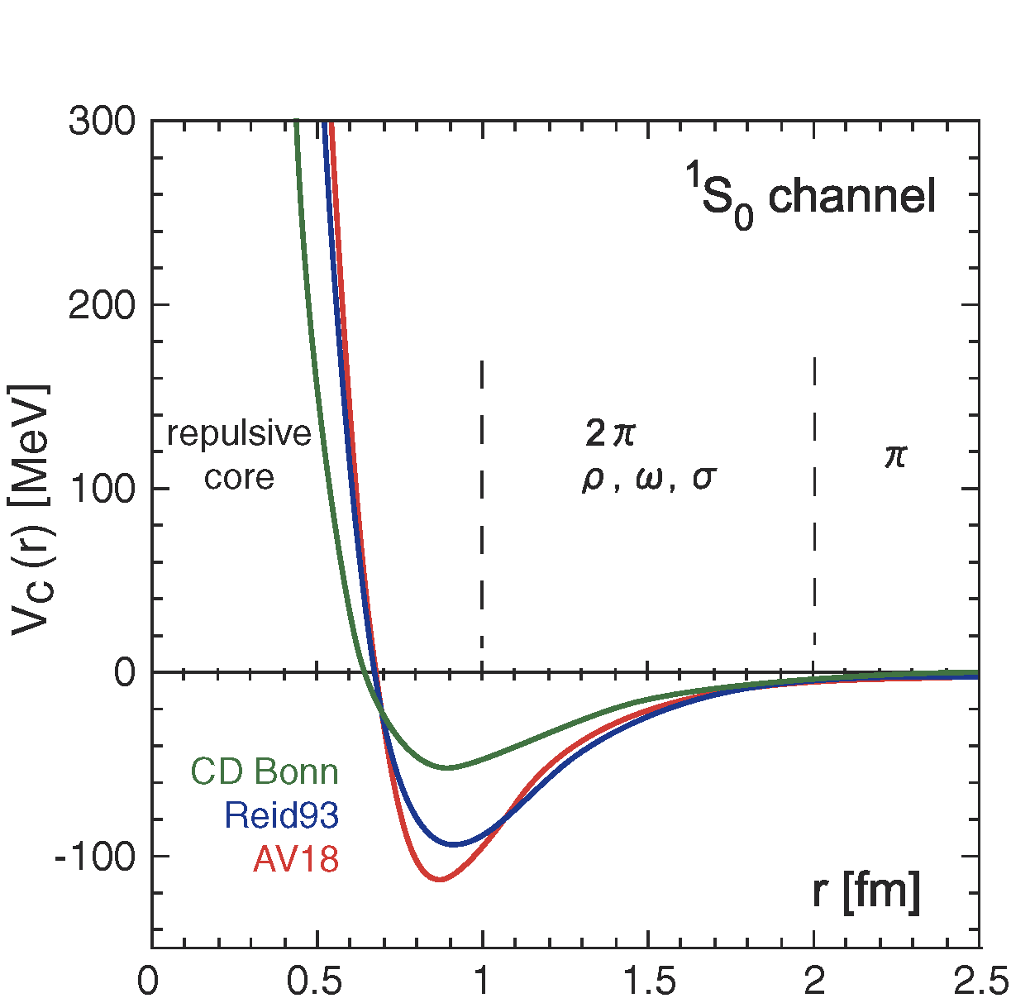
Motivation: Embedding K⁻ in Nucleus
Light mesons
play an important role in a nucleus as “glue”
Light S=-1 mesons?
Kaonic-atom experiments (KpX@KEK, DEAR/SIDDHARTA@DAΦNE) clarified strongly attractive K^{bar}-N interaction
What will happen when K^{bar} is embedded in nucleus?
K^{bar}-nucleus bound state?
high density?

Slide 3
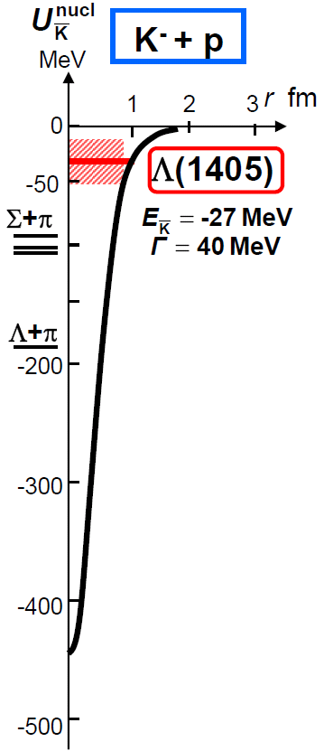
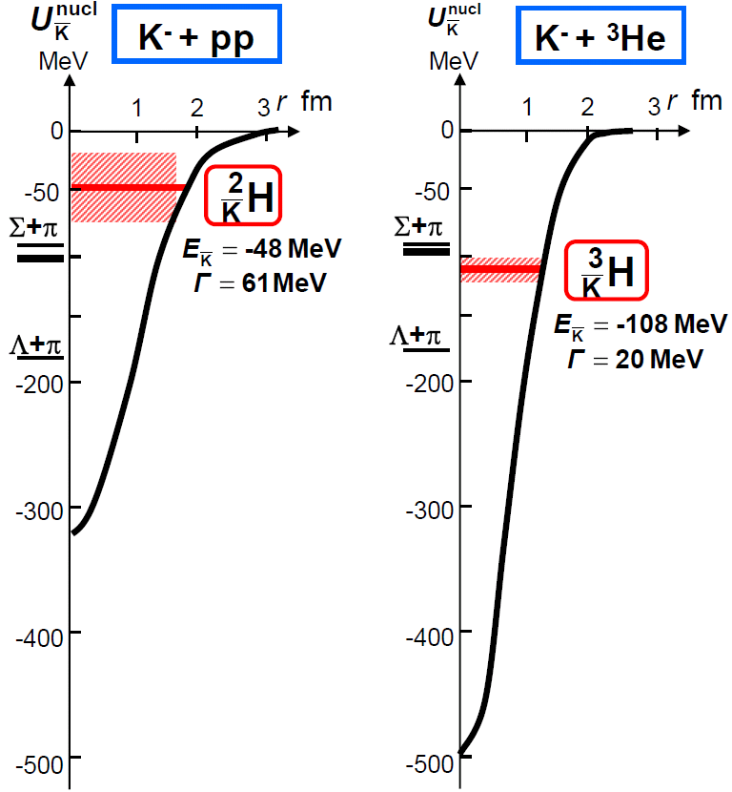
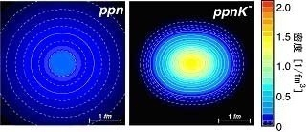
Kaonic Nuclei
Kaonic nucleus is a bound state of nucleus and anti-kaon (K^{bar}NN, K^{bar}NNN, K^{bar}K^{bar}NN, ...)
Density [1/fm³]
Y.Akaishi & T.Yamazaki, PLB535, 70(2002).
T.Yamazaki, A.Dote, Y.Akiaishi, PLB587, 167 (2004).

Slide 4
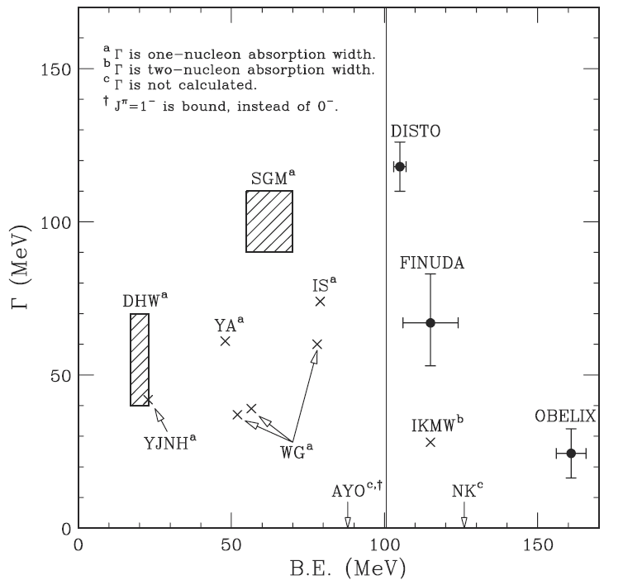
Theoretical Situation
K⁻pp : the simplest K^{bar}-nuclear state
Akaishi, Yamazaki [AY]
ATMS with phenomenological model
Dote, Hyodo, Wise [DHW]
Variational with chiral-SU(3) model
Ikeda, Sato [IS]
Faddeev with chiral-SU(3) model
Shevchenko, Gal, Mares [SGM]
Faddeev with phenomenoligical model
Wycech, Green [YG]
Variational with phenomenological model
Arai, Yasui, Oka [AYO]
Λ* model
Koike and Harada, PRC80(2019)055208
All studies predict existence of the K⁻pp
→ However, B.E. and Γ are controversial

Slide 5
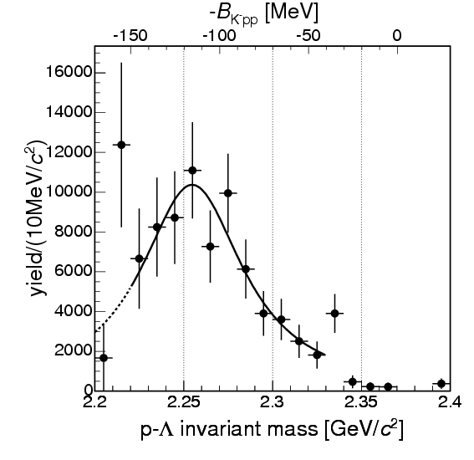
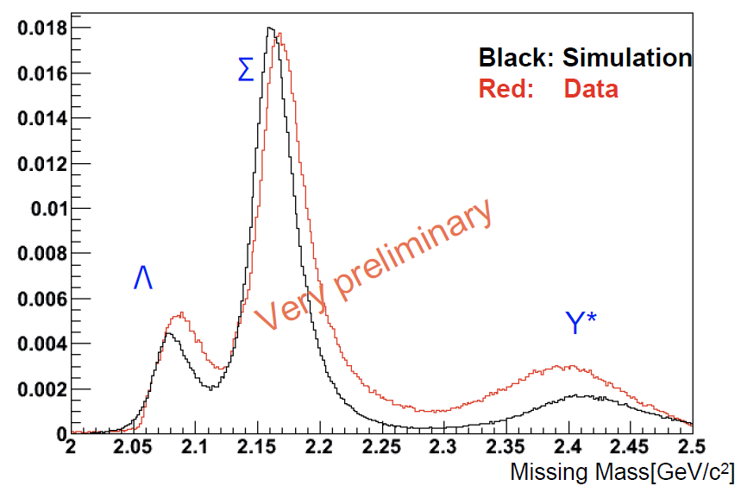
Experimental Situation
K⁻/π⁺ induced experiments
B.E. = 115MeV
Γ = 67MeV
K⁻pp→Λp?
K⁻pp search
FINUDA@DAΦNE
E27@J-PARC
PRL94(2005)212303
FB20 conference (2012)
A(stopped K⁻, Λp)
d(π⁺, K⁺) @ 1.7GeV/c

Slide 6
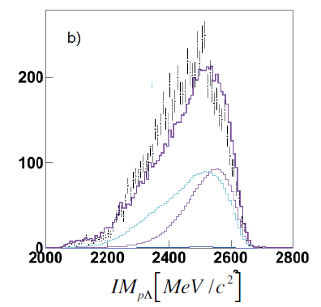
Experimental Situation [Cont’d]
p induced experiments
B.E. = 103MeV
Γ = 118MeV
K⁻pp search
K⁻pp→Λp?
Exp/Sim
DISTO@SATURNE
HADES@GSI
PRL104(2010)132502
NPA914(2013)60
p + p → (Λ + p) + K⁺ @ 2.85GeV
p + p → (Λ + p) + K⁺ @ 3.5GeV
We need more studies in various channels!

Slide 7
The J-PARC E15 Experiment

Slide 8
Experimental Principle
A search for the simplest kaonic nucleus, K⁻pp, using ³He(in-flight K⁻,n) reaction
two-nucleon absorption
hyperon decays
CAN be discriminated kinematically

Slide 9
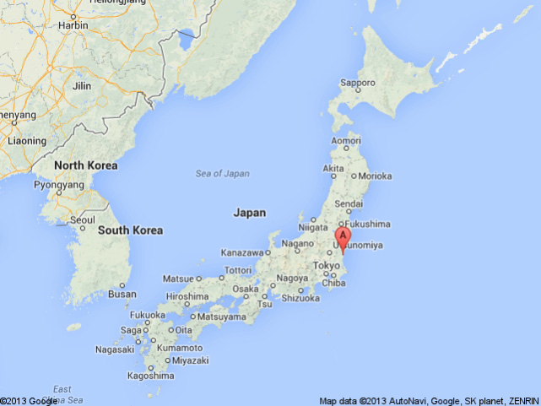
J-PARC (Japan Proton Accelerator Research Complex)
J-PARC
Tokyo
~130km
K1.8BR
E15/E17/E31

Slide 10
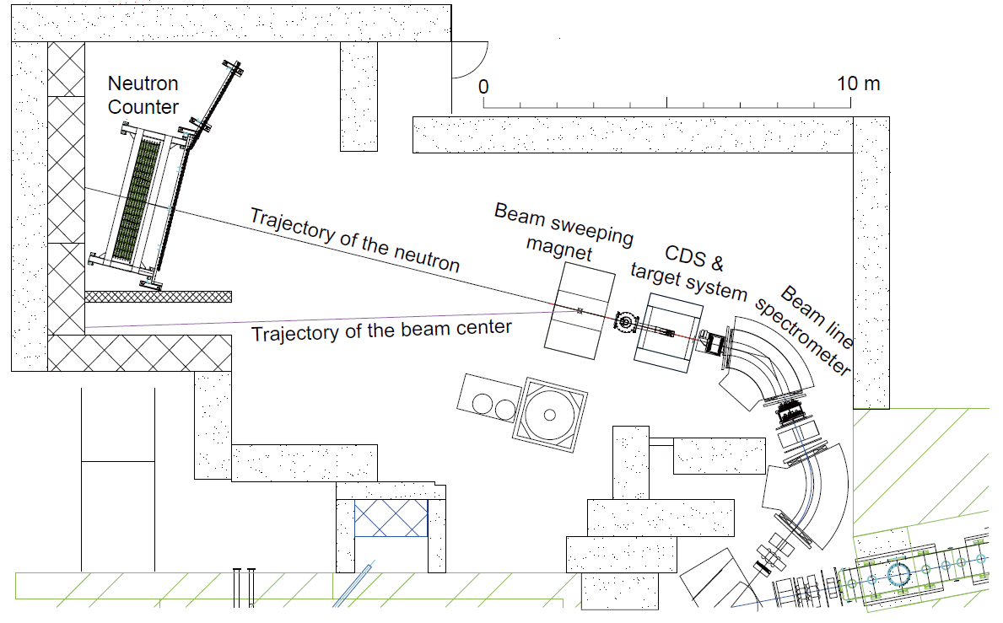
Experimental Setup
15m

Slide 11
The Goal of E15
To investigate the kaonic nuclei
Semi-Inclusive ³He(K⁻,n)
Inclusive ³He(K⁻,Λp)
Exclusive ³He(K⁻,Λpn)
Semi-Inclusive ³He(K⁻,p)
Multi-nucleon absorption process
Hits of exotic production?
Hyperon production
Nuclear dependence of Y* production

Slide 12
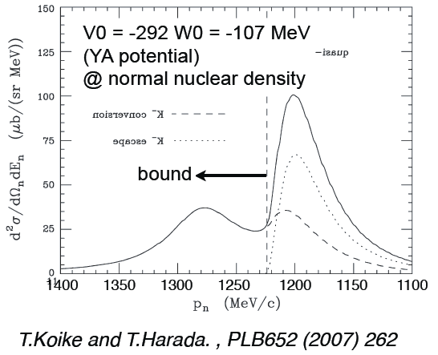
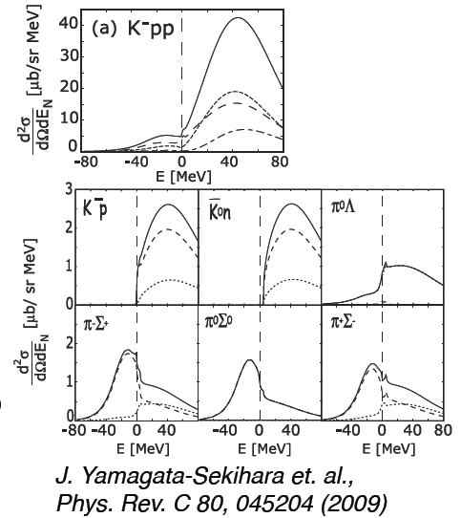
1: Semi-Inclusive ³He(K⁻,n)
Calculated formation-spectra for ³He(in-flight K-,n)
bound
Σ tag enhances
the bound
structure
integrated CS
~ 3.5 mb/sr
Quasi-free peak
If right, we can measure
the bound structure!

Slide 13
1: Semi-Inclusive ³He(K⁻,n) [Cont’d]
Expected spectrum from MC (Geant4)
All known K⁻N interactions are considered:
Cross-section [CERN-HERA-83-02]
Fermi-motion
Angular distribution
Simple assumptions:
σ_{tot} = 2*σ_{K-p} + σ_{K-n} (~150mb)
2N abs.: K⁻ ³He → Λ n p_{s}
σ/dΩ=1mb/sr, isotropic
K⁻pp prod.: K⁻ ³He → K⁻pp n
dσ/dΩ=1mb/sr, isotropic
K⁻pp →Λp(25%), Σ⁰p(25%), πΣp(50%)
³He(K⁻,n) M.M. spectrum
w/ 1-charged tag in the CDS
bound

Slide 14
1: Semi-Inclusive ³He(K⁻,n) [Cont’d]
Expected spectrum from MC (Geant4)
All known K⁻N interactions are considered:
Cross-section [CERN-HERA-83-02]
Fermi-motion
Angular distribution
Simple assumptions:
σ_{tot} = 2*σ_{K-p} + σ_{K-n} (~150mb)
2N abs.: K⁻ ³He → Λ n p_{s}
σ/dΩ=1mb/sr, isotropic
K⁻pp prod.: K⁻ ³He → K⁻pp n
dσ/dΩ=1mb/sr, isotropic
K⁻pp →Λp(25%), Σ⁰p(25%), πΣp(50%)
³He(K⁻,n) M.M. spectrum
w/ 1-charged tag in the CDS
bound
K-pp
B.E = 50MeV
Γ = 50MeV
2N abs

Slide 15
2: Inclusive ³He(K⁻,Λp)
FINUDA: stopped K⁻
Back-to-back Λp correlation
BG from multi-N absorption? / 2-step processes?
E15: in-flight K⁻
Λp correlation is NOT so simple
Give some hints of multi-N absorption and the K⁻pp production
B.E. = 115MeV
Γ = 67MeV
K⁻pp→Λp?
FINUDA@DAΦNE
PRL94(2005)212303
A(stopped K⁻, Λp)

Slide 16
2: Inclusive ³He(K⁻,Λp) [Cont’d]
Expected (simplified) spectrum from MC (Geant4)
All known K⁻N interactions are considered:
Cross-section [CERN-HERA-83-02]
Fermi-motion
Angular distribution
Simple assumptions:
σ_{tot} = 2*σ_{K-p} + σ_{K-n} (~150mb)
2N abs.: K⁻ ³He → Λ p n_{s}
σ/dΩ=1mb/sr, isotropic
3N abs.: K⁻ ³He → Λ p n
dσ/dΩ=1mb/sr, isotropic
K⁻pp prod.: K⁻ ³He → K⁻pp n
dσ/dΩ=1mb/sr, isotropic
K⁻pp →Λp(25%), Σ⁰p(25%), πΣp(50%)
Λp invariant mass spectrum
2N abs
K-pp
B.E = 50MeV
Γ = 50MeV
3N abs

Slide 17
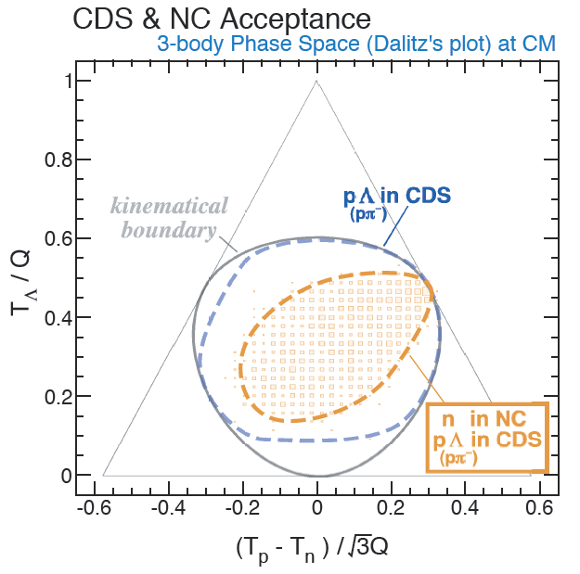
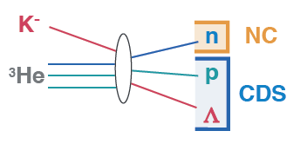
3: Exclusive ³He(K⁻,Λpn)
The main goal of the E15 measurement
Will pin down the signature of the K⁻pp
large statistics , i.e., large beam-time is needed!!!
Dalitz plot analysis helps us to investigate particle correlation

Slide 18
3: Exclusive ³He(K⁻,Λpn)
The main goal of the E15 measurement
Will pin down the signature of the K⁻pp
large statistics , i.e., large beam-time is needed!!!
Dalitz plot analysis helps us to investigate particle correlation
2N abs & Σ−Λ conversion

Slide 19
Preliminary Results of 1st Physics Run

Slide 20
1st Stage Physics Run
Jun.2006 | proposed and approved @ 1st PAC
Feb 2009 | first beam transportation to K1.8BR
Mar.11 2011 | the earthquake
May 2012 | completion of spectrometer construction
May 2013 | 1st physics run
May.23 2013 | the accident
Accumulated data in the 1st stage physics run
~1% of original proposal

Slide 21
Kaon-Beam Spectrometer
RUN in 2013 May
beam momentum | 1 GeV/c
momentum bite | ~ 3%
mom resolution @ 1 GeV/c | 2.2 MeV/c
Kaons / spill @ 24 kW | 150 k
total beam / spill @ 24 kW | 480 k
k/π ratio | 0.45
T1-FF length | 31.3 m

Slide 22
Cylindrical Detector System: pID
CDC (15 layers, 1816ch) + CDH (36 seg) + 0.7T
solid angle: 60% of 4π
π/K/p/d are clearly separated

Slide 23
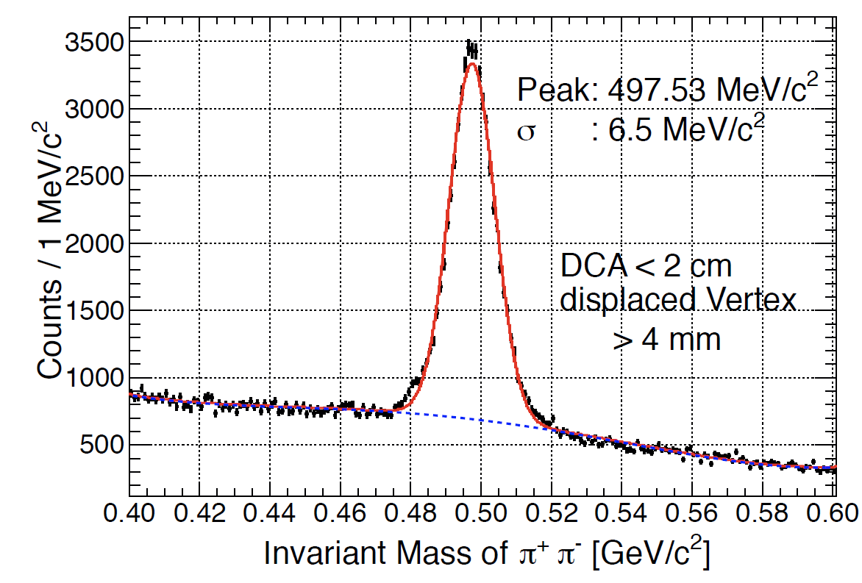
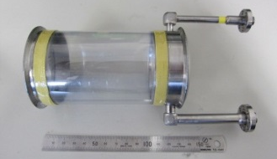
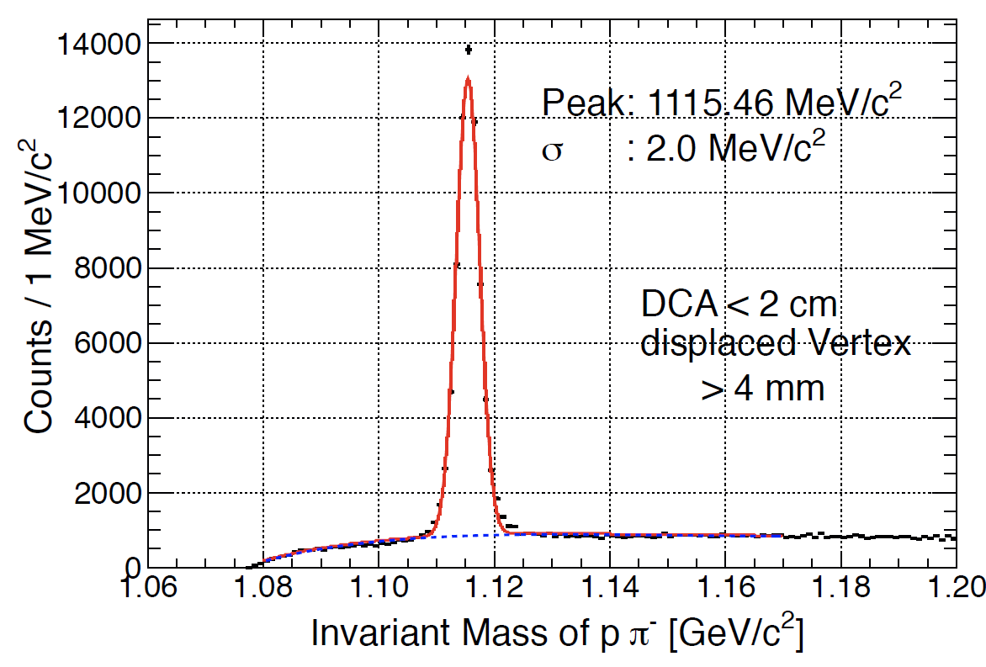
Cylindrical Detector System: Tracking
target image
K⁰_{S}→π⁺π⁻
Λ→pπ⁻
Designed performance was achieved
K⁰/Λ are reproduced by the MC
Resolution for K⁻pp→Λp reconstruction: ~10MeV/c²

Slide 24
Forward Neutral Particles
Neutron Counter
3.2m (W) * 1.5m (H) * 35cm (T) [5cm*7layers]
Efficiency: ~25% for 1 GeV/c n
Acceptance: 19.4msr
15m

Slide 25
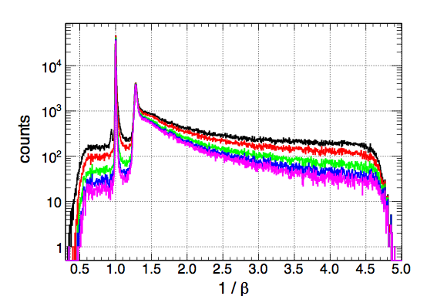
Forward Neutral Particles [Cont’d]
γ
Threshold
0 MeVee
2 MeVee
4 MeVee
6 MeVee
8 MeVee
n
accidental background
Set threshold to 5 MeVee
good S/N ratio of ~100 @ QF neutron peak
σ_{TOF} ~ 160ps → σ_{M.M.}~ 10MeV/c² for 1GeV/c n

Slide 26
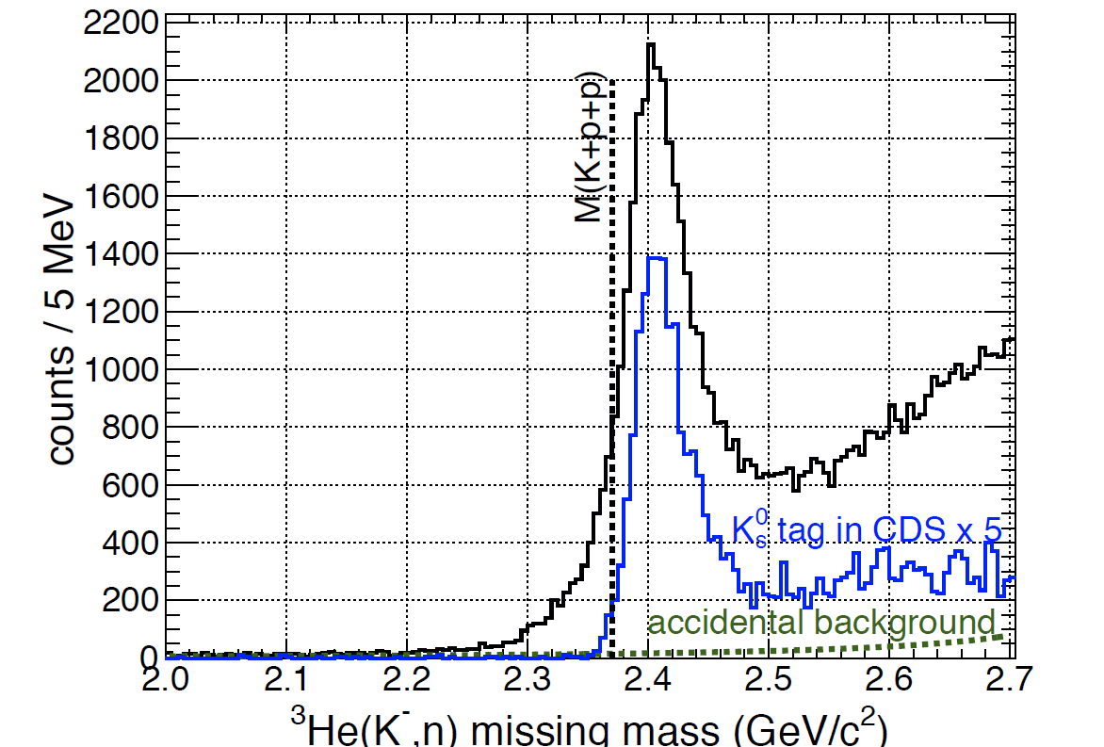
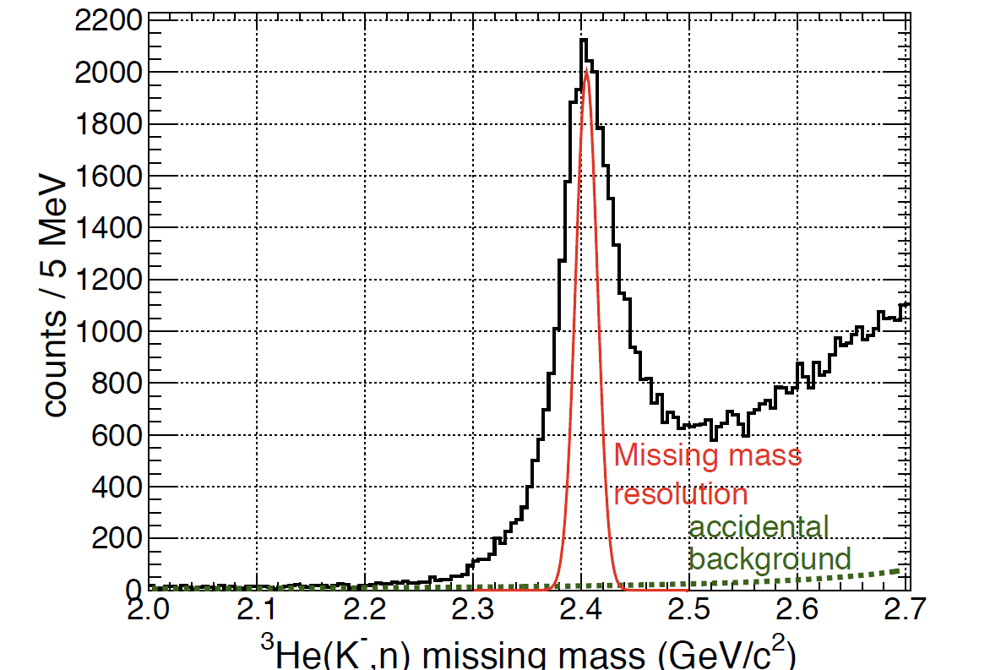
Preliminary Result 1: ³He(K⁻,n)
Semi-inclusive ³He(K⁻,n)
w/ charged-track tag in the CDS
~1.4*10⁵ events
preliminary
preliminary

Slide 27
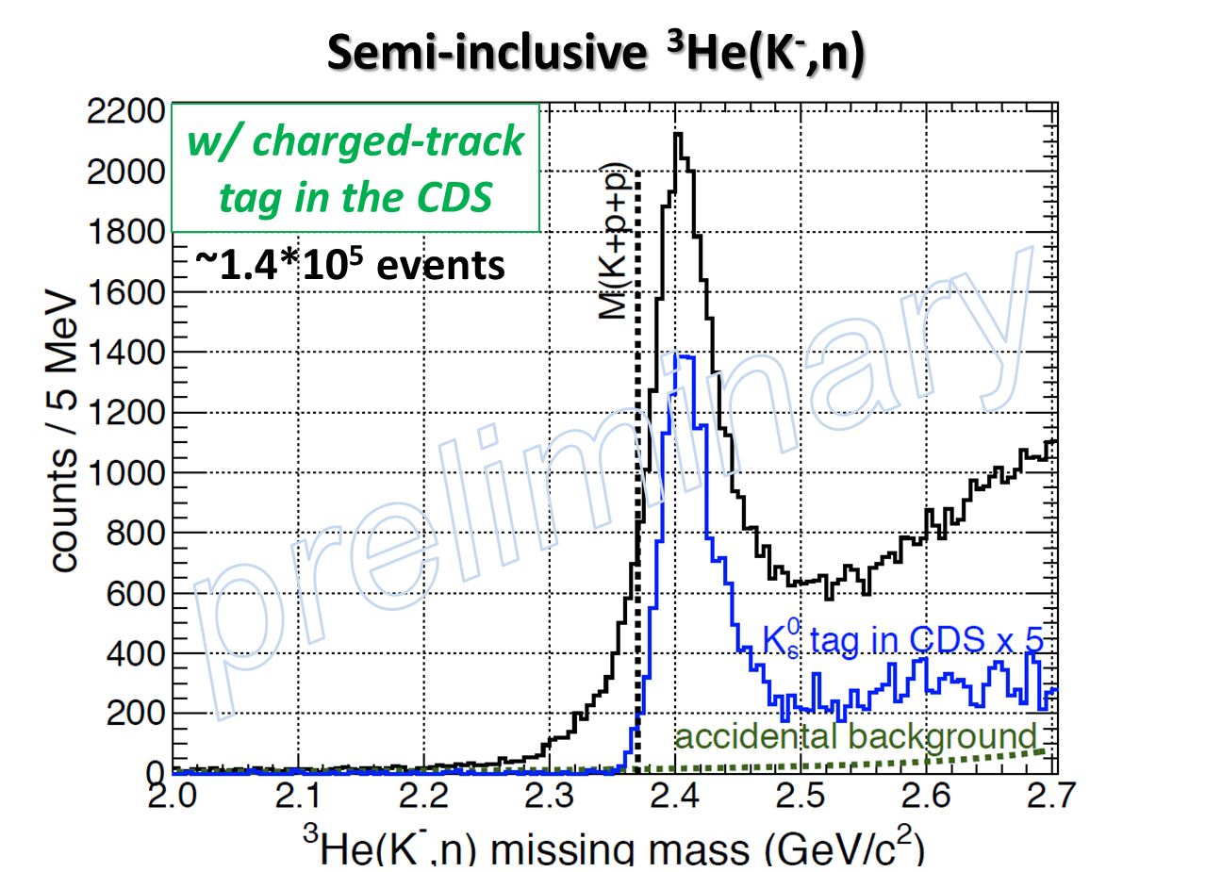
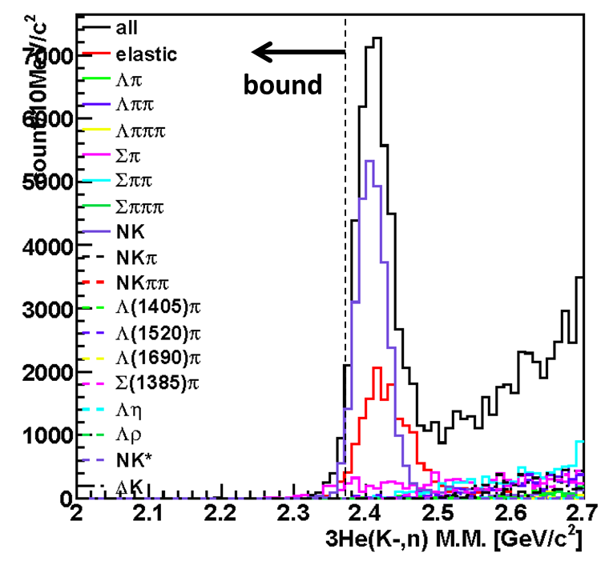
Preliminary Result 1: ³He(K⁻,n)
MC
Global shape is roughly understood by known processes.
Tail component is very interesting.
Careful analysis is in progress
Can be reproduced by known processes?

Slide 28
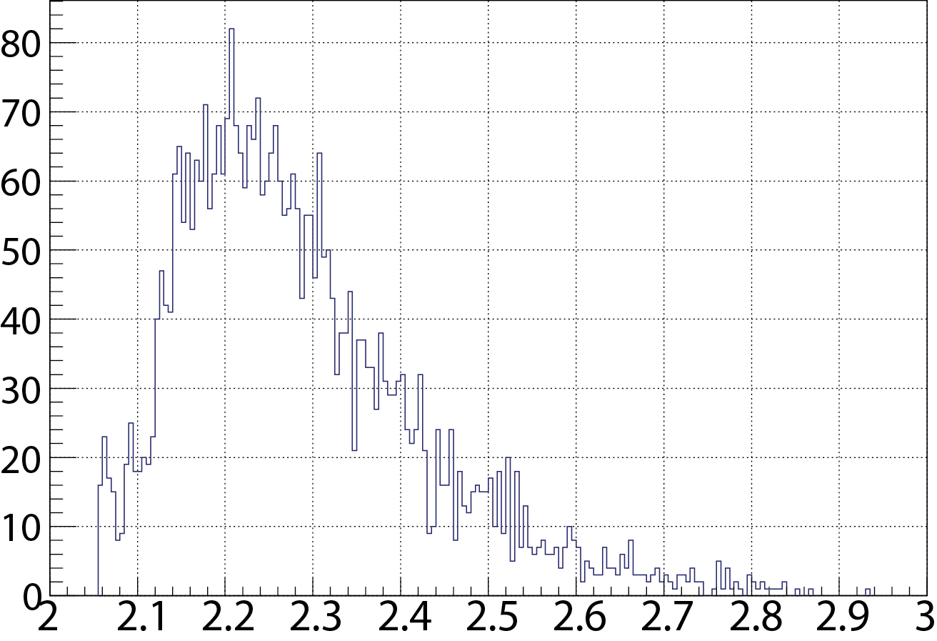
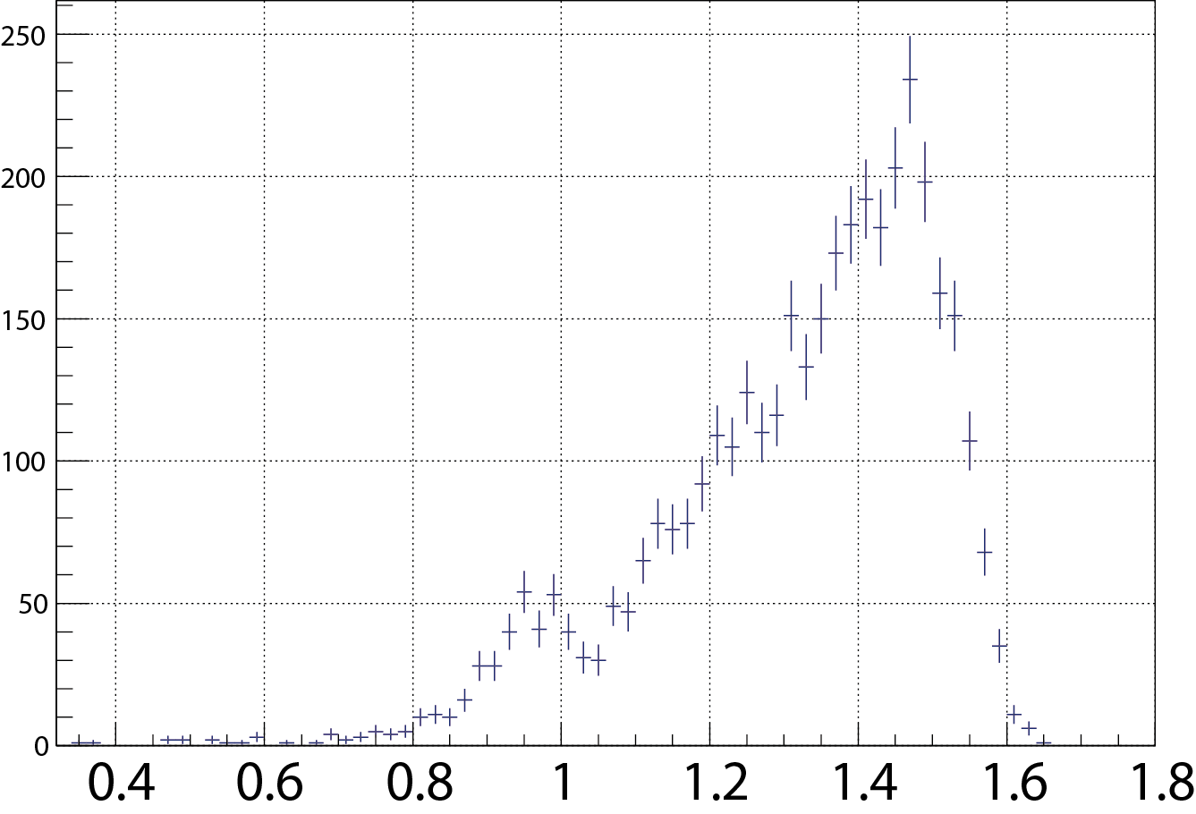
Preliminary Result 2: ³He(K⁻,Λp)
Λp invariant mass
³He(K⁻,Λp) missing mass
~3,000 events
M(K+p+p)
Count/5MeV/c²
preliminary
Count/20MeV/c²
n
Nπ/Nππ/Ν∗/Δ?
I.M. of Λp[GeV/c²]
M.M. of ³He(K⁻,Λp) [GeV/c²]
MC
Multi-N absorption processes exist.
Spectrum shape is NOT understood yet.
2N/3N-abs.?
2N-abs with multi-π?

Slide 29
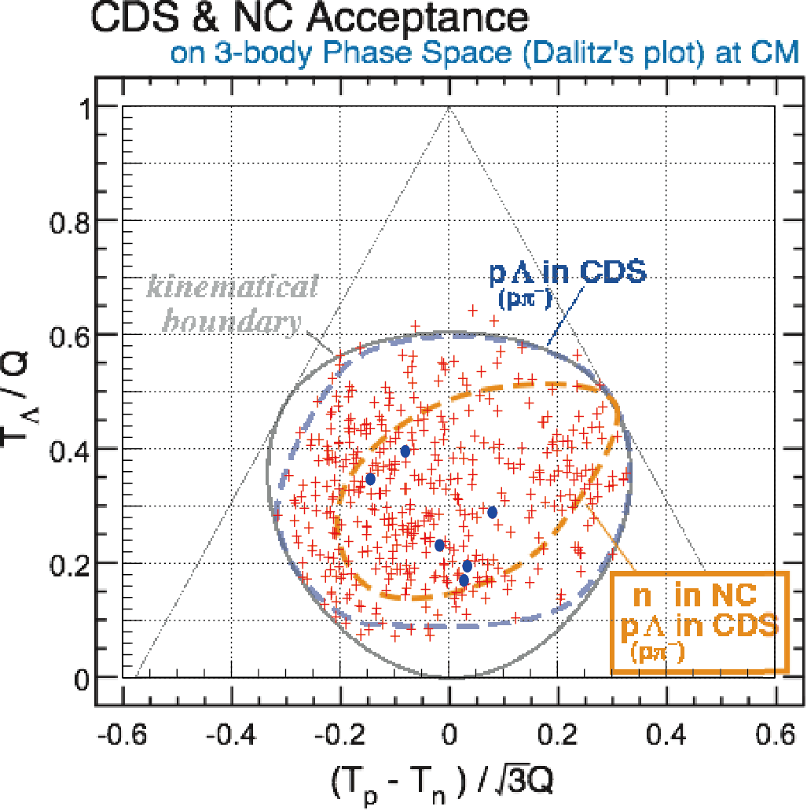
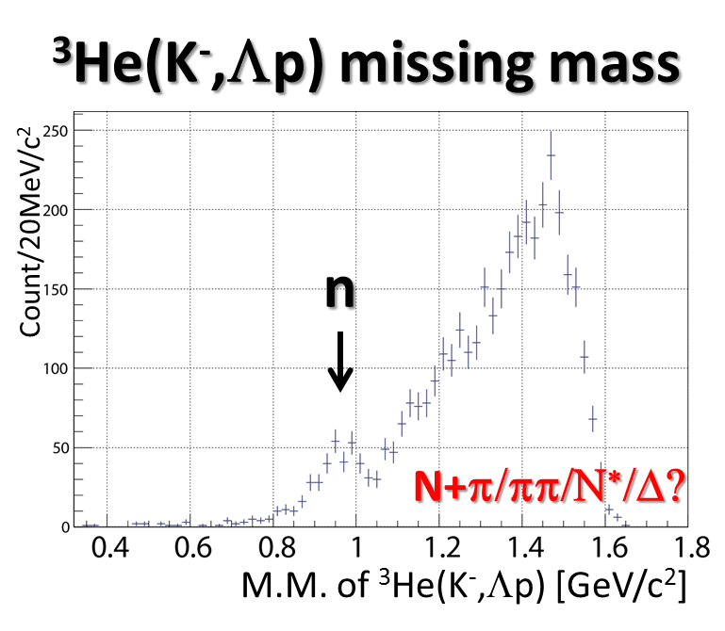
Preliminary Result 3: ³He(K⁻,Λpn)
Dalitz plot of Λpn
+ all events
w/ forward n in the NC
*including Σ⁰→γΛ events
preliminary
Some hints of 3N-abs/K⁻pp???
Further analysis is ongoing.
Opening angle of Λp,
Momentum/Angular dist., etc.
Number of n in the NC & Λp in the CDS events is less than 10
We need more beam-time!

Slide 30
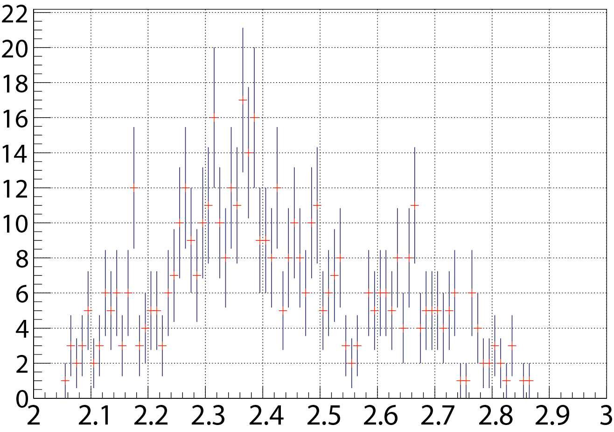
Preliminary Result 3: ³He(K⁻,Λpn)
Λp invariant mass w/ missing n
~400 events
*including Σ⁰→γΛ events
M(K+p+p)
Count/10MeV/c²
preliminary
I.M. of Λp[GeV/c²]
Some hints of 3N-abs/K⁻pp???
Further analysis is ongoing.
Opening angle of Λp,
Momentum/Angular dist., etc.
Number of n in the NC & Λp in the CDS events is less than 10
We need more beam-time!

Slide 31
Summary
We have performed 1st physics run of the J-PARC E15 experiment to search for the K⁻pp bound-state
~4*10⁹ kaons were incident on ³He
³He(K⁻,n) : ~1.4*10⁵ events
³He(K⁻,Λp) : ~3,000 events with the CDS
³He(K⁻,Λpn) : <10 events with the CDS & the NC
Further analyses will be reported soon
Finalization of the ³He(K⁻,n) spectrum
Detailed analysis of exclusive Λpn events
Comparison of ³He(K⁻,n/p) spectra
…

Slide 32
The J-PARC E15 Collaboration

