Slide 1

³ΛH lifetime measurement with ³He(K⁻, π⁰)³ΛH Reaction
New experiment using the existing detector system
@ K1.8BR
F.Sakuma, RIKEN
on behalf of the P73 Collaboration
“Strange Matter Workshop - Strangeness studies in Italy and Japan“
Laboratori Nazionali di Frascati INFN
16-17 October 2019

Slide 2
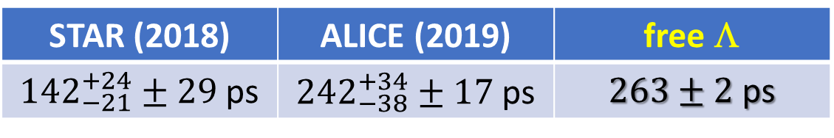
Lifetime of Hyper-triton
Recent heavy-ion experiments reported different lifetime of hyper-triton, ³_{Λ}H:
τ(³_{Λ}H)~τ(free Λ) is naively expected, because ³_{Λ}H is known to be very loosely bound system (~0.13MeV)
STAR (2018) | ALICE (2019) | free Λ
${142}_{−21}^{+24}±29$ ps | ${242}_{−38}^{+34}±17$ ps | $263±2$ ps
Gal, Garcilazo PLB791(2019)48
→ need to clarify the situation using different experimental technique

Slide 3
Heavy-Ion Experiment
Heavy-ion experiment
STAR, ALICE, HypHI
Invariant mass reconstruction
  Difficult to use ³_{Λ}H information in ct~0cm region
  Huge combinatorial BG
ALICE
determined with
mainly 3 points
No data in ct~0cm
S.Bufalino @ SQM2019
0

Slide 4
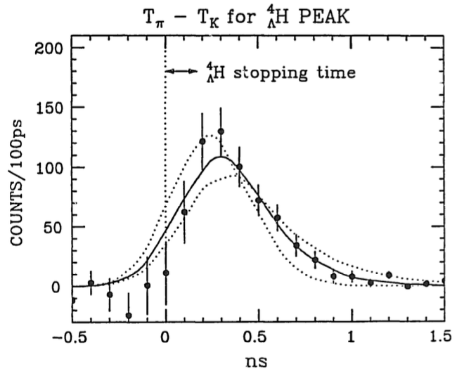
Direct Lifetime Measurement
Heavy-ion experiment
STAR, ALICE, HypHI
Invariant mass reconstruction
  Difficult to use ³_{Λ}H information in ct~0cm region
  Huge combinatorial BG
ALICE
Direct measurement of ⁴_{Λ}H
complementary
H. Outa, et al.,
NPA547(1992)109c
determined with
mainly 3 points
No data in ct~0cm
S.Bufalino @ SQM2019
0
Direct measurement
NO counter experiment so far
→ P73
Delayed time of π⁻ in mesonic weak decay ~ at rest
  Wide-range fitting is possible
  Quasi-free Y→π⁻N is dominant BG

Slide 5
Experimental Principle
①
calorimeter
³He
³_{Λ}H
K⁻
Formation
π⁰
0<θ_{lab}<8º
γ
γ
1.0 GeV/c
~0.9 GeV/c
Eγ>600MeV
We can select “forward-going FAST π⁰”
→ ONLY from “signal” & “QF BG”
Decay
charged 2-body decay “almost” at rest
Momentum and TOF are measured
→ Delayed time information
Tag high-energy γ
Detect mono-energic π⁻
Measure ³_{Λ}H lifetime via π⁻ delay time
³He
π⁻
②
CDS
mono-energetic
~114 MeV/c
45<θ_{lab}<135º

Slide 6
PbF₂ Calorimeter
we can perform on-line discrimination of γ and π
  Hadron blind with ΔE cut
  Radiation hardness (x10 times more resistive than Pb glass)
π
e(γ)
~10⁴ rad / month
Radiation length | Moliere radius | Density | Resolution | Signal length
0.93 cm | 2.22 cm | 7.77 g/cm³ | 5% | 2ns
A: before radiation
B: after 3x10⁵ rad n and 1x10⁵ rad γ
C: after 3x10⁶ rad n and 1x10⁶ rad γ

Slide 7

Experimental Setup
Cylindrical Detector System (CDS)
CDH
T0
π⁻
1 GeV/c
K⁻ beam
0.7 T
calorimeter
CDC
γ
L³He target
Charge
Veto

Slide 8
Experimental Setup
Beam spectrometer & CDS
→ Ready
CDS@E57
Cylindrical Detector System (CDS)
CDH
T0
π⁻
1 GeV/c
K⁻ beam
calorimeter
CDC
γ
L³He target
Charge
Veto

Slide 9
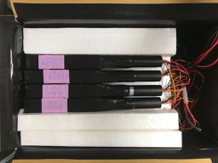
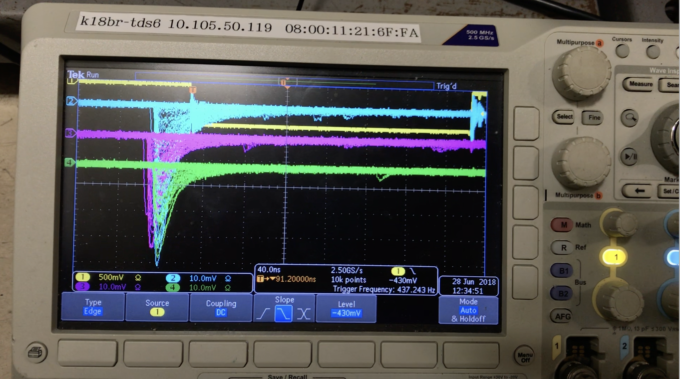
Experimental Setup
Beam spectrometer & CDS
→ Ready
CDS@E57
Cylindrical Detector System (CDS)
CDH
PbF2 Calorimeter
→ 40 sets on hand & Will be ready by the beginning of 2020
T0
Charge
Veto
π⁻
1 GeV/c
K⁻ beam
CDC
calorimeter
γ
L³He target

Slide 10
Experimental Setup
Beam spectrometer & CDS
→ Ready
L³He target@E62
CDS@E57
Cylindrical Detector System (CDS)
CDH
PbF2 Calorimeter
→ 40 sets on hand & Will be ready by the beginning of 2020
T0
Charge
Veto
π⁻
1 GeV/c
K⁻ beam
CDC
calorimeter
γ
L³He target
L³He target system
→ 500l ³He in hand & Will be ready by the beginning of 2020

Slide 11
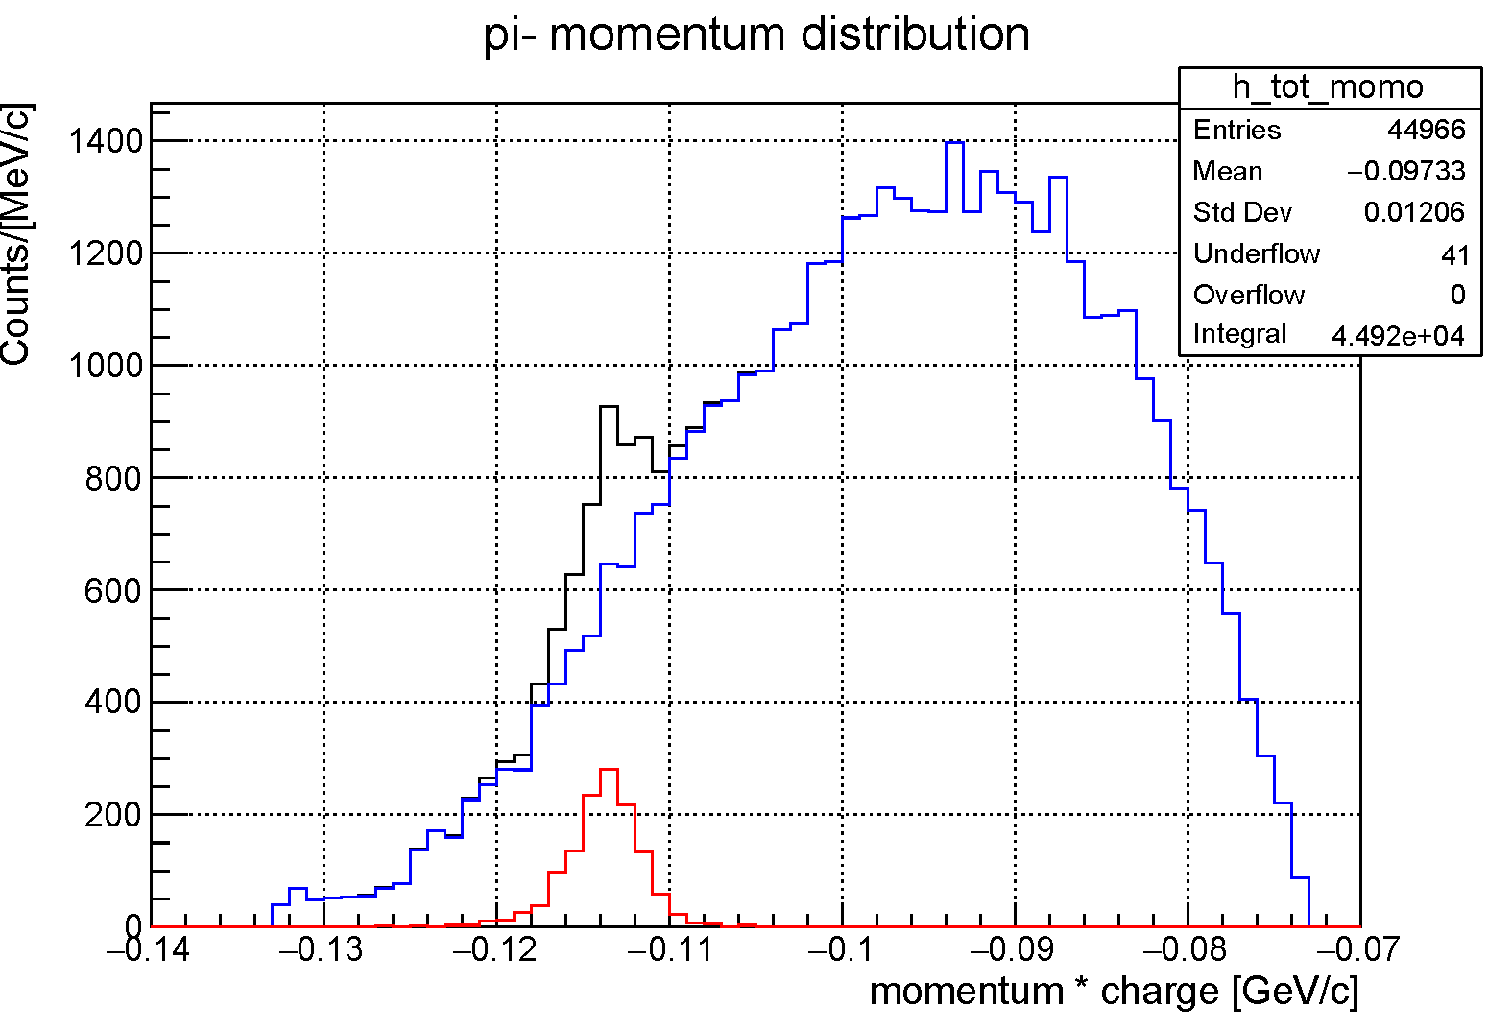
Expected π⁻ Spectrum of ³_{Λ}H
SIM
Signal
(~114MeV/c)
BG from QF
Λ→π⁻p decay
Expected Signal
(theoretical CS)
Sim. BG
with Geant4
momentum * charge [GeV/c]
The spectrum with ~4 weeks data taking at 50kW
  # of expected signal is ~1k
  BG is estimated with MC based on Geant4 using K⁻ + p reactions.
    K⁻p→Λπ⁰ ~ 3.5 mb is dominant
    K⁻p→Σ⁰π⁰ ~ 0.9 mb and K⁻n→Σ⁻π⁰ ~ 0.9 mb are suppressed by ΔE cut of the calorimeter (>600MeV)

Slide 12


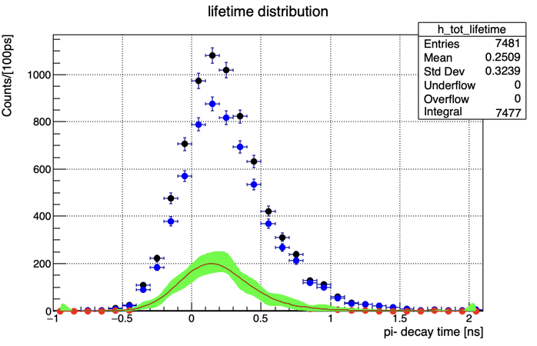
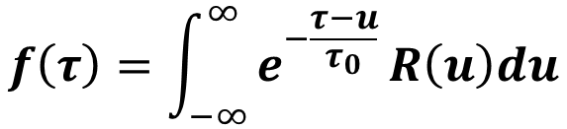



Lifetime Evaluation
SIM
BG subtraction
w/ side-band
delayed decay time τ:
$$T_{CDH}−T_{0}=t_{beam}+t_{π^{−}}+τ$$
SIM
Total
The lifetime τ₀ is derived with the exp(-τ/τ₀) function convoluted with the CDS response function $R()$
Side-band BG
Signal
$$f\left(τ\right)=\int_{−∞}^{∞}{e^{−\frac{τ−u}{τ_{0}}}}R\left(u\right)du$$
$$τ$$

Slide 13
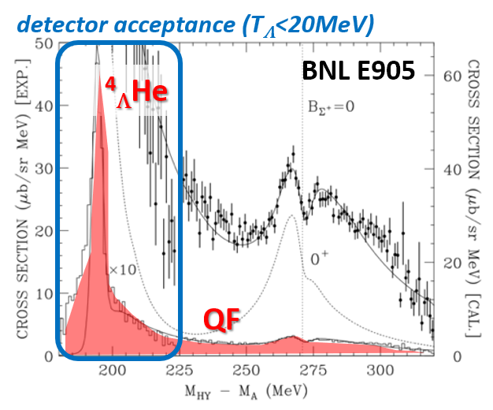
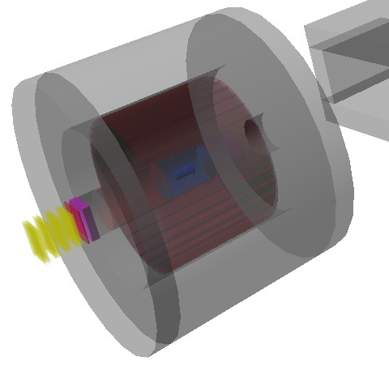
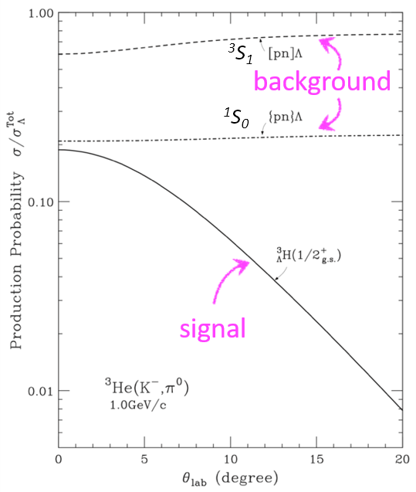
Expected S/BG Ratio with Different Models
Signal yield is assumed to be ~ 1k in all cases (4w, 50kW)
from Geant4 CS
from BNL E905 CS
from theoretical CS
S/BG ~ 1/42
S/BG ~ 1/16
S/BG ~ 1/6
Worst case
S/BG ~ 1/20 will be realistic estimation
Best case
⁴He(K⁻,π⁻) @ 0.6 GeV/c
T. Nagae, PLR80(98)1605
T. Harada, PRL81(98)5287
Geant4.10.0
(QGSP_BERT_HP)
³He(K⁻,π⁰) @ 1.0 GeV/c

Slide 14
⁴_{Λ}H pilot run for BG evaluation
Signal
(~133MeV/c)
SIM
BG from QF
Λ→π⁻p decay
Expected Signal
(~ BNL E905 CS)
Sim. BG
with Geant4
momentum * charge [GeV/c]
The spectrum with ~6 days data taking at 50kW
  # of expected signal is ~1k
    N(³_{Λ}H) is expected to be ~ N(⁴_{Λ}H) x1/3 [CS] x1/2 [Br(2-body)]
  BG is estimated as with ³He.
Based on theoretical CS & BNL E905 results

Slide 15
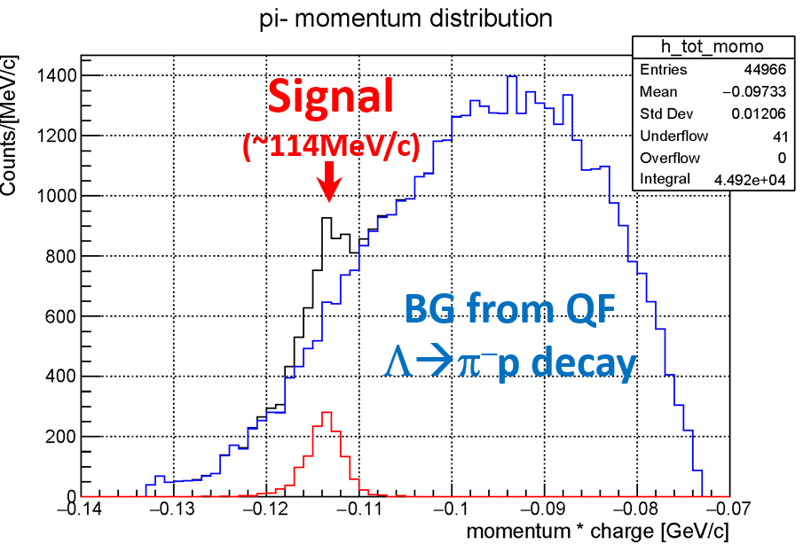
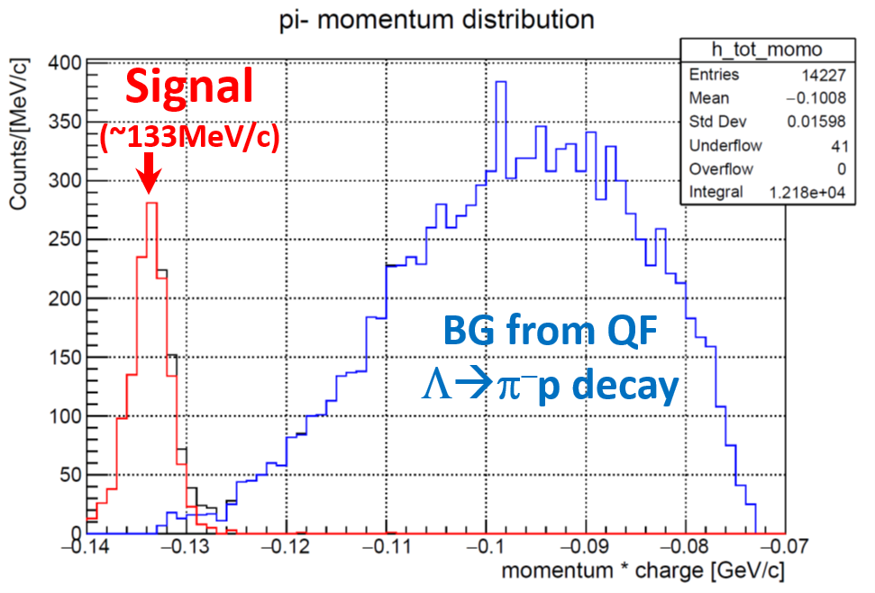
Realistic Estimation using ⁴He Data
K⁻ + ³He
K⁻ + ⁴He
~6 days
~4 weeks
scaled
S x ~1
B x ~4
We can do an realistic estimation of the ³_{Λ}H measurement using the BG in K⁻ + ⁴He data
  BG will be almost the same between ³He and ⁴He

Slide 16
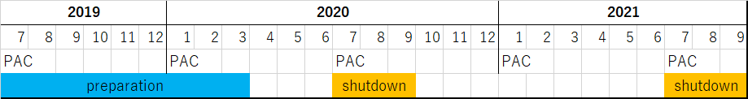
Schedule
To perform the experiment before the long shutdown scheduled in 2021, we would like to conduct the pilot run in 2020 ( = accepted as “test run” at the previous PAC).
We are here
Experiment
ready
Pilot run (~1w)
in 2020 spring
Physics run (~4w)
before
the long shutdown
Request for stage-2 approval

Slide 17
Summary of the P73 Experiment
Direct measurement of the hypertriton (³_{Λ}H) lifetime using (K⁻,π⁰) reactions.
The experiment will be ready at K1.8BR in early 2020.
1 week beamtime for ⁴_{Λ}H has been accepted as “test run”.
  after feasibility study with ⁴_{Λ}H, we would like to request the ³_{Λ}H physics run (~4 weeks, 50kW equiv.).
P73 expected
[ALICE collaboration]

Slide 18
P73 Collaboration

Slide 19
Backup Slides

Slide 20

(K⁻,π⁰) and (π⁻,K⁰)
 | P73 | P74
Reaction | ³He(K⁻,π⁰)³_{Λ}H | ³He(π⁻,K⁰) ³_{Λ}H
Measurement | Delayed π⁻ from ³_{Λ}H decay
Decay mode | 2-body | 2- and 3-body
³_{Λ}H identification | mono-energetic π⁻ | (π⁻,K⁰) missing mass
Beamline | K1.8BR | K1.1
Beam | 2x10⁵ 1.0 GeV/c K⁻ | 1x10⁷ 1.05 GeV/c π⁻
main spectrometer | CDS | SKS + vertex
L³He target | In hand | -
Expected yield | ~1k/month | ~0.6k/month
Trigger tag | γ from π⁰ for BG suppression | π⁺π⁻ from K⁰ for ³_{Λ}H identification
Main BG | QF | QF + K⁰-reconst.

Slide 21
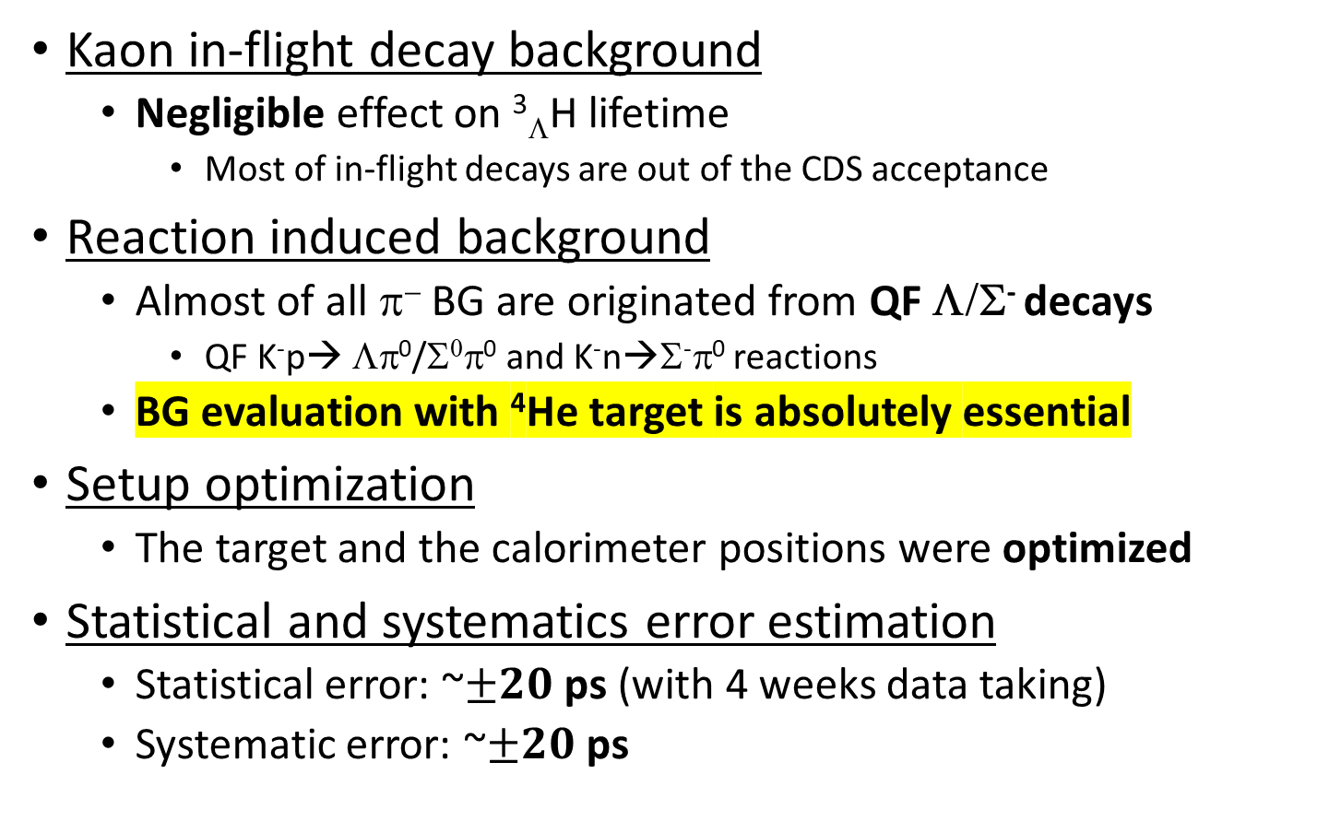
Reported Issues in the Previous (27th) PAC
(based on 26th PAC comments)
Kaon in-flight decay background
  Negligible effect on ³_{Λ}H lifetime
    Most of in-flight decays are out of the CDS acceptance
Reaction induced background
  Almost of all π⁻ BG are originated from QF Λ/Σ⁻ decays
    QF K⁻p→ Λπ⁰/Σ⁰π⁰ and K⁻n→Σ⁻π⁰ reactions
  BG evaluation with ⁴He target is absolutely essential
Setup optimization
  The target and the calorimeter positions were optimized
Statistical and systematics error estimation
  Statistical error: ~$±20$ ps (with 4 weeks data taking)
  Systematic error: ~$±20$ ps

Slide 22
Answer to the 27th PAC Comments
Syst. err. will be mainly originated from two types of errors:
Time Zero Alignment
  Estimated with the E15 (K⁻ + ³He) data
Background subtraction
  Guesstimated from the previous experiment of ⁴_{Λ}H at KEK
  Have to be confirmed with real data analysis with the pilot-run data of K- + ⁴He
<5 ps
← Next page
~20 ps

Slide 23
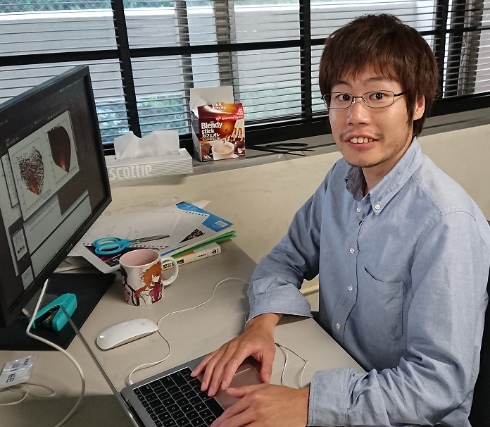
Time Zero Alignment Estimation with the E15 Data
Time difference between measured and calculated TOF(T0-CDH) for π⁻ @ E15
Dr. Yamaga,
RIKEN
+10 ps
-10 ps
2015/11/19
2015/12/18
E15-2nd data (Run65, ³He(K⁻,π⁻)X)
  Time zero can be determined within 5 ps
Error propagated from the time zero alignment is estimated to be <5 ps with MC simulation

Slide 24
Answer to the 27th PAC Comments
Syst. err. will be mainly originated from two types of errors:
Time Zero Alignment
  Estimated with the E15 (K⁻ + ³He) data set
Background subtraction
  Guesstimated from the previous experiment of ⁴_{Λ}H at KEK
  Have to be confirmed with real data analysis with the pilot-run data of K- + ⁴He
We strongly request the ⁴He pilot run
for (K⁻,π⁰) background investigation
<5 ps
← Next page
~20 ps

Slide 25
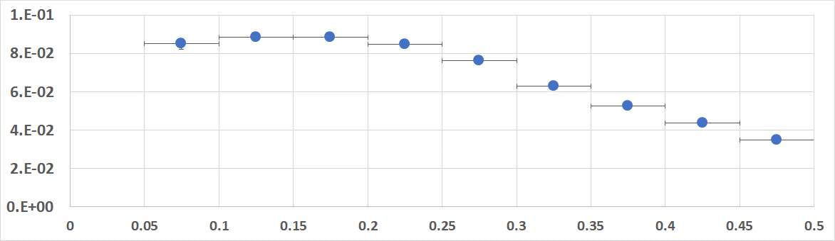
“free K⁰_{S}” Lifetime with the E15 Data
In stead of Λ, we evaluated K⁰_{S} lifetime with K⁰_{s}→π⁺π⁻ reconstruction
K⁰_{S} selection
p_{K0s} distribution
π⁻ delay time fitting
0.15<p_{pπ−}<0.16 GeV/c
0.15<p_{Λ}<0.16 GeV/c
E15 data
E15 data
E15 data
IM(π⁺π⁻)
selected
side-band BG
subtracted
ns
K⁰_{S} lifetime 89.7 ps
within ~ 5% → ~ 13ps @ 263ps
E15 data
τ₀ [ns]
We obtained the K⁰_{S} lifetime correctly
Due to large ct of K⁰_{S}
K⁰_{S} momentum [GeV/c]

Slide 26
“free Λ” Lifetime Evaluation with the E15 Data
The main BG in P73 is ~100 MeV/c Λ, whose decay p CANNOT be detected by the CDS.
Λ selection
p_{Λ} distribution
π⁻ delay time fitting
0.25<p_{pπ−}<0.26 GeV/c
0.25<p_{Λ}<0.26 GeV/c
E15 data
E15 data
E15 data
IM(pπ⁻)
selected
side-band BG
subtracted
ns
We tried to obtain the lifetime using Λ→pπ⁻ event sample
However, we found that there are difficulties after Λ→pπ⁻ reconstruction with the proposed method at this moment
  low “proton” efficiency in low p_{Λ} region → large τ₀
  large ct in high p_{Λ} region → small τ₀
←need efficiency correction

Slide 27
Trigger Scheme
Main trigger is “K⁻-beam* CDH-1hit * E-cal”
  will be <<1k/spill estimated from E15 trigger (“K*CDH1*γ/n”)
  up to ~5k/spill is acceptable by keeping ~95% eff. (HUL & HD-DAQ)
R(τ) is obtained with calibration trigger of (π⁻,π⁻)
  “π⁻-barm * CDH-1hit” trigger
← “prompt” π⁻ is dominant
σ~150ps
R(τ) obtained with the E15 data
[ΔTOF(T0-CDH) using (K⁻,π⁻)]

Slide 28
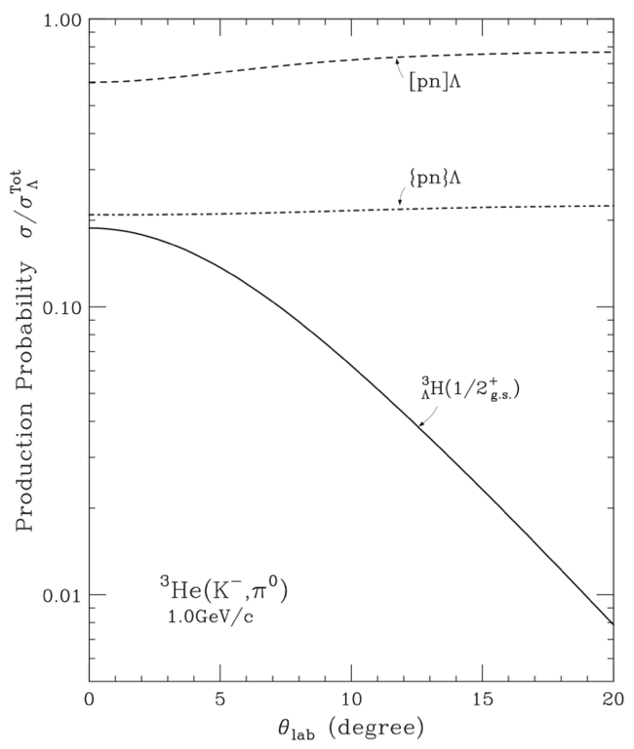

Background from Theoretical Calculation
Sim. BG
with Geant4
(using theoretical CS)
Expected Signal
(theoretical CS)
³S₁
background
¹S₀
SIM
signal
BG from QF
Λ→π⁻p decay
³He(K⁻,π⁰) @ 1.0 GeV/c
Expected BG yield is much different btw “Geant4-CS” and “theoretical-CS”

Slide 29
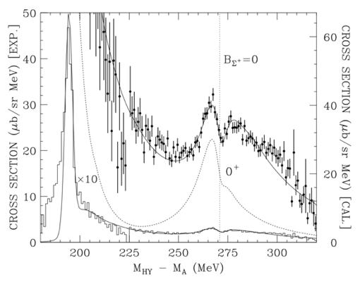
Background from BNL ⁴He(K⁻,π⁻) Exp.
Sim. BG
with Geant4
(using Exp. CS)
⁴He(K⁻,π⁻) @ 0.6 GeV/c
Expected Signal
(theoretical CS)
T. Nagae, PLR80(98)1605
T. Harada, PRL81(98)5287
detector acceptance (T_{Λ}<20MeV)
BNL E905
⁴_{Λ}He
SIM
BG from QF
Λ→π⁻p decay
QF
Expected BG yield is less than that based on “Geant4-CS”
  S/BG~1/0.5 @ ⁴He(K⁻,π⁻), 0.6 GeV/c
  S/BG~1/2 @ ⁴He(K⁻,π⁰), 1.0 GeV/c
    mom-transfer 50→100 MeV (x~1/4)
S/BG~1/16 @ ³He(K⁻,π⁰), 1.0 GeV/c
  σ(³_{Λ}H) ~ 1/3 x σ(⁴_{Λ}H)
  BR(³_{Λ}H-2body) ~ 1/4, BR(Λ→pπ⁻) ~ 2/3

Slide 30
Background Estimation w/o ΔE cut
E15 Data
γ tag w/ NC
H₂ Sim
γ tag w/ CAL
π⁻ from Λ
π⁻ from Σ⁻
including low-energy γ (π⁰)
  can be reject with ΔE cut
E15 data favors H₂ simulation
  thus we employ H₂ sim.
³He Sim
γ tag w/ CAL

Slide 31
⁴_{Λ}H Lifetime @ KEK
⁴He(stopped K⁻, π⁻)⁴_{Λ}Η reaction
The lifetime was obtained from a fitting with a simulated spectrum
Sideband BG subtraction
& fitting with MC spectrum
H. Outa, D-thesis
⁴_{Λ}H lifetime
For cross-check, we will apply the same procedure to the ³_{Λ}H analysis.

Slide 32
Binding Energy of ³_{Λ}H?
The STAR experiment also reported rather large binding energy of ~0.4 MeV
However, the lifetime is expected not to be shorten so much, even if the binding energy is as large as the START reported
0.13MeV
STAR, arXiv:1904.10520

Slide 33
Slides from the 27th PAC

Slide 34

Performance estimation: yield estimation
Target: liquid 3He, 10cm | 1.6×10²³/cm²
K- intensity @ 1GeV/c | 2×10⁵/5.2s
σ of ³𝚲H g.s. | 0.0126 mb
Accelerator up time | 80%
Beam acceptance | 60%
DAQ efficiency | 90%
³𝚲H→³He+π- b.r. | 25%
π- & π0 acceptance | 6%
³𝚲H signal yield | ~1000 events/4 weeks
⁴𝚲H signal yield (same target cell):
~3(cross section)×2(π⁻ branching ratio)×³𝚲H signal yield
==> ~1000 events/1 week

Slide 35
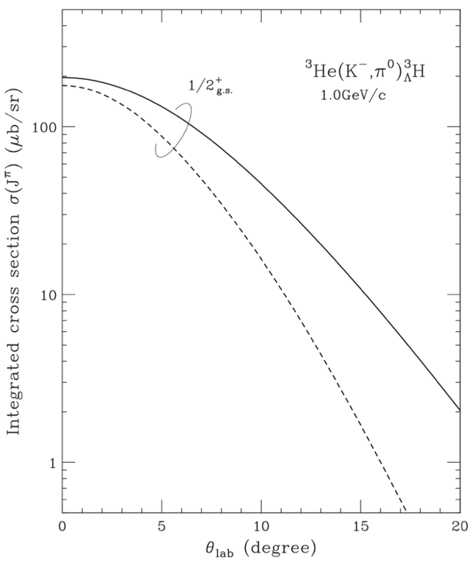
Performance estimation: ³𝚲H cross section
signal
BG
³S₁
¹S₀
w/o recoil
w/ recoil
Integrated ³𝚲H cross section:
0.0126 mb (0~20 deg)
Integrated 𝚲 cross section:
0.184 mb (0~20 deg)
³He(K⁻, π⁰)³𝚲H cross section calculated by Prof. Harada, using the CDCC (continuum discretized coupled-channels) method and DWIA
Private communication with Prof. T. Harada

Slide 36
Performance estimation: ⁴𝚲H cross section
No direct calculation available
for ⁴He(K⁻, π⁰)⁴𝚲H reaction at 1GeV/c
  1, for ⁴He(K⁻, π⁻)⁴𝚲He reaction, σ~3.5mb/sr at 0.6GeV/c, 4deg
  2, taking into account isospin coupling factor of ½
  3, considering recoiling momentum and n(K⁻, π⁻)𝚲 elementary cross section between 0.6 and 1.0 GeV/c K- beam
T. Harada, Phys. Rev. Lett., 81, 5287, (1998)
Elementary CS @ 0 degree is almost the same
K⁻n→Λπ⁻: ~2.5mb @ 0.6GeV/c (q~50MeV/c)
K⁻p→Λπ⁰: ~2.5mb @ 1.0GeV/c (q~100MeV/c)
⁴He(K⁻, π⁰)⁴𝚲H @ 1.0 GeV, 4deg: ~0.44mb (scaled)
³He(K⁻, π⁰)³𝚲H @ 1.0 GeV, 4deg: ~0.15mb (calc.)
⁴𝚲H cross section estimated to be ~3 times of ³𝚲H

Slide 37
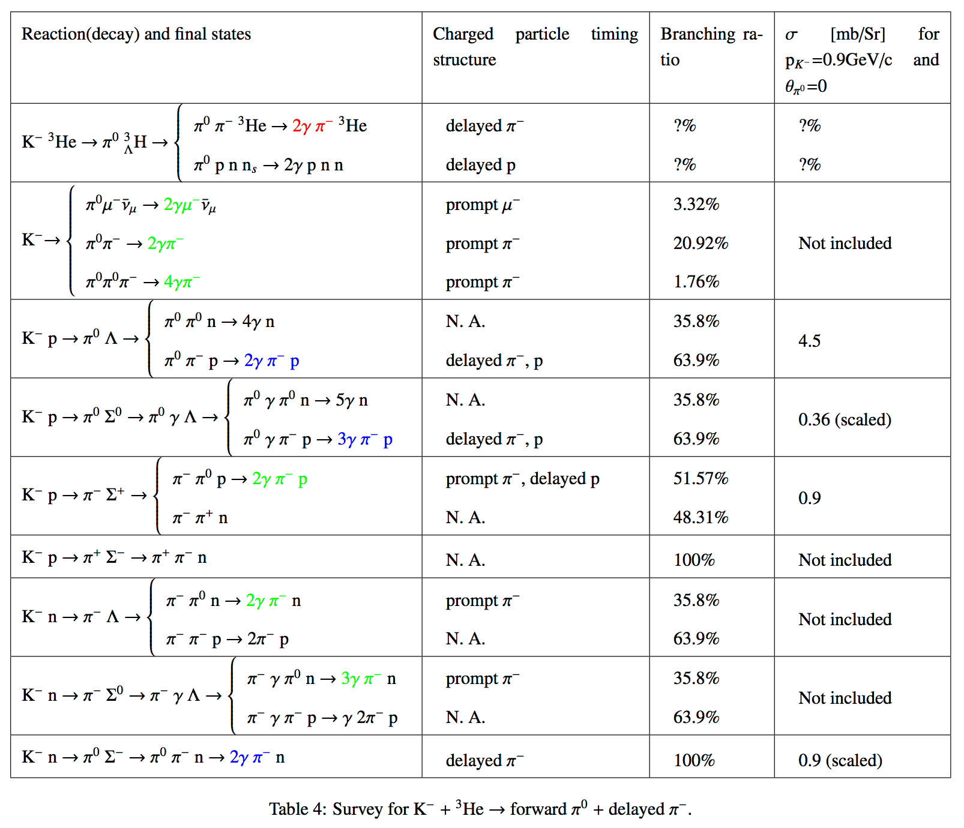

Part I: Performance estimation
out of
pi0⊕pi-
acceptance

Slide 38
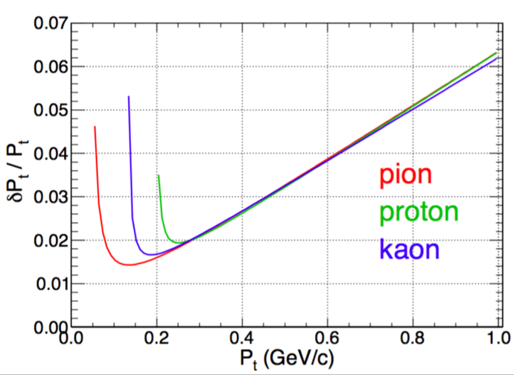
Performance estimation: pi- resolution
114MeV/c
According to GEANT4 simulation,
~2% momentum resolution is achieved for total π⁻
momentum (pt + pl) after energy loss correction.
T. Hashimoto PhD thesis, University of Tokyo, 2013

Slide 39
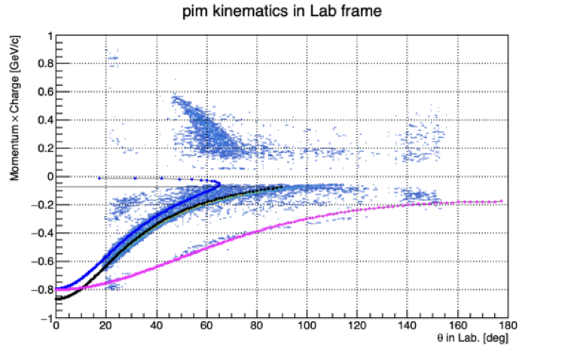
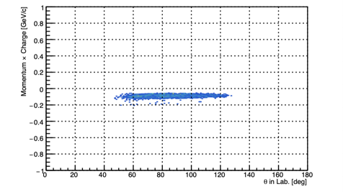



Kaon in-flight decay background
  dE veto counter <= 0.2 MeV && PbF2 calorimeter >= 600 MeV
  IH == 1 && CDS charged track == 1
  CDS tracking mass >= 0 && <= 0.3 GeV/c²
  DCA <= 5mm && fiducial cut
  From Monte Carlo information, only hyperon and hypernucleus events survived the event selection --> effective trigger and analysis method
pim
Kaon —> pim + pi0
kaon
Kaon + p —> Kaon + p
signal region
signal region
muon
Kaon —> muon + nu
Before event selection
After event selection

Slide 40
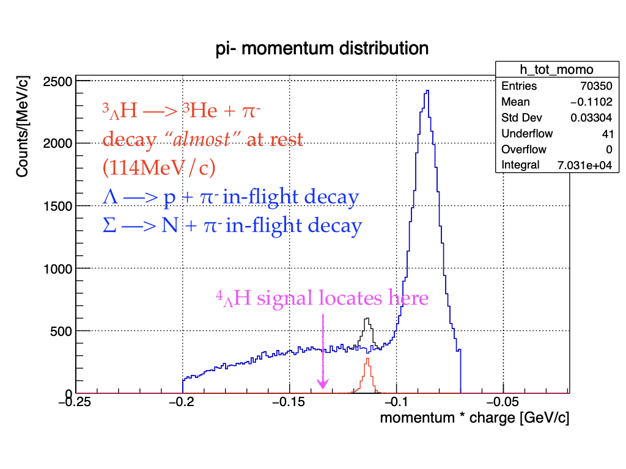
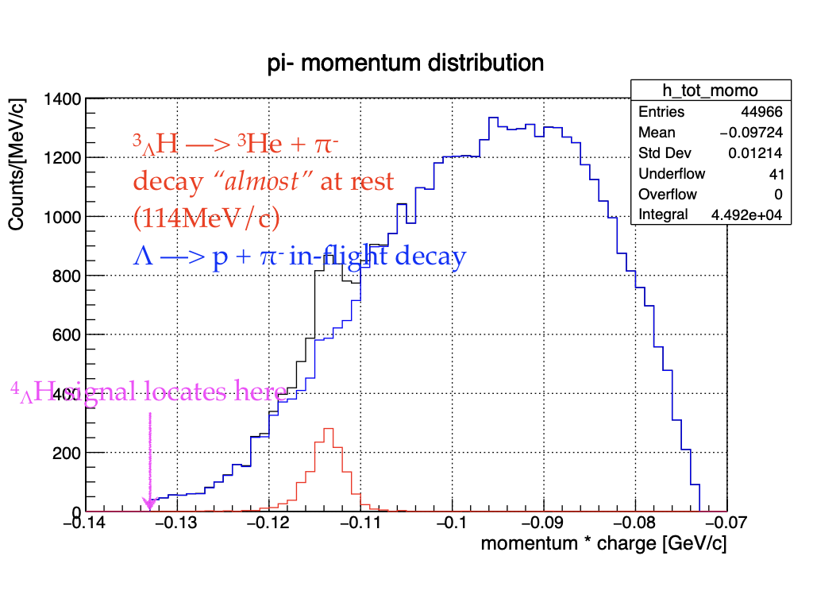
Reaction induced background
³He SIM
H₂ SIM
True background shape may be somewhere in between these two cases (an open question)
Even for the high background case(Hydrogen), we still can identify the signal region
⁴ΛH signal locates ~130MeV/c, which will have better S/N ratio for both cases: one week beam time(50kW) with ⁴He target can tell us the feasibility

Slide 41
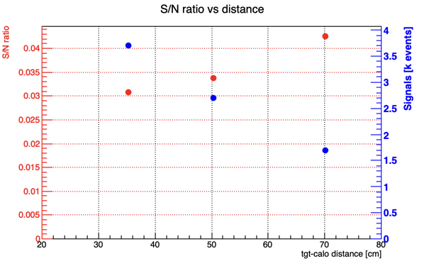

Setup optimization
background
signal
Current setup:
PbF2 calorimeter is separated by 70cm
from target center
A balance between S/N and statistical error
Leave PbF2 calorimeter away from CDS spectrometer to avoid contamination and magnetic field effect on PMT

Slide 42
PbF2 calorimeter
Crystal size: 2.5cm x 2.5cm x 13cm
In total: 36 segments, 6x6
--- 40 pieces in stock
PMT: H6612 (¾ inch PMT)
--- 40 pieces in stock
Signal calibration will be performed this year (2019)
Ready to run by the beginning of 2020

Slide 43
PbF2 calorimeter test @ ELPH
the 2nd experimental room in ELPH
We are planning to conduct calorimeter test using ~ GeV γ or positron at ELPH, Tohoku-U in the end of this year (2019)
  Gain-uniformity/Position-dependence/Energy-dependence/…

Slide 44
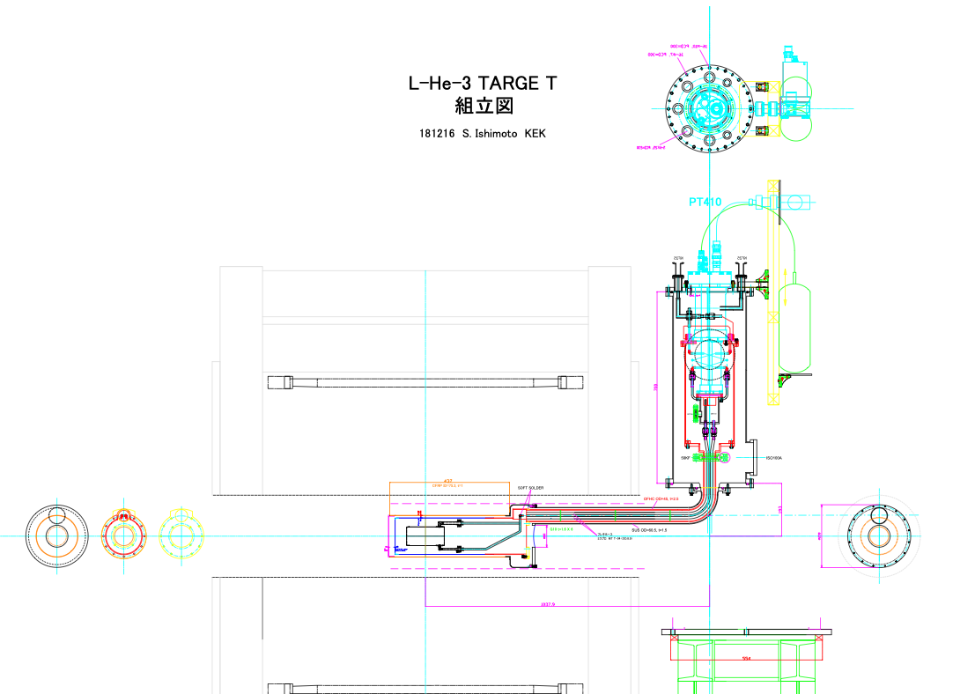

liquid ^{3,4}He target
PbF2
calorimeter
Be cell for E15 is used
Liquefaction system is changed from “syphon type with L⁴He refrigerant” to “Pulse tube refrigerator”
Designed by Dr. Ishimoto and Dr. T. Hashimoto
Ready to run by the beginning of 2020

Slide 45
p(K⁻,π)Y Cross Section
K⁻p→π⁰Λ: ~ 2.5 mb/Sr @ 1.0 Gev/c, θ_{π} = 0 degree

Slide 46
Recoil of ³_{Λ}H
calculated with the SRIM package
Stopping power of liquid ³He target for recoiling ³_{Λ}H
Slowing down of recoiling ³_{Λ}H within liquid 3He target
³_{Λ}H stops after 200ps within 1mm;
the recoiling effects on lifetime and π⁻ momentum is negligible

Slide 47
Backup Slides (2)

Slide 48
(K⁻,π⁰), (π⁻,K⁰), and (K⁻,π⁻) at K1.8BR
 | (K⁻,π⁰) | (π⁻,K⁰) | (K⁻,π⁻)
Target | L³He | L³He | ⁷Li
Detector based on CDS | γ calorimeter | Ushiwaka + forward π⁺π⁻ spectrometer | Ushiwaka + forward π⁻ spectrometer
Beam | 2x10⁵ K⁻ | ~10⁷ π⁻ | 2x10⁵ K⁻
Remark | P73 | Present BL cannot accept 10⁷ beam | Trigger study is needed

Slide 49
Human Resource
for preparation and analysis at K1.8BR over the next few years
 | RIKEN | JAEA | KEK (target) | Osaka-U | In total
Staff | 5 | 1 | 2 | 2 | 10
Student | 1+x | 0+x | 0 | 1+x | 2+x
In total | 6+x | 1+x | 2 | 3+x | 12+x

