Slide 1

Recent results from
J-PARC E15/E31
F. Sakuma, RIKEN
on behalf of the J-PARC
E15/E31 collaboration
Symposium, Jul. 10-11, 2017, LNF-INFN

Slide 2
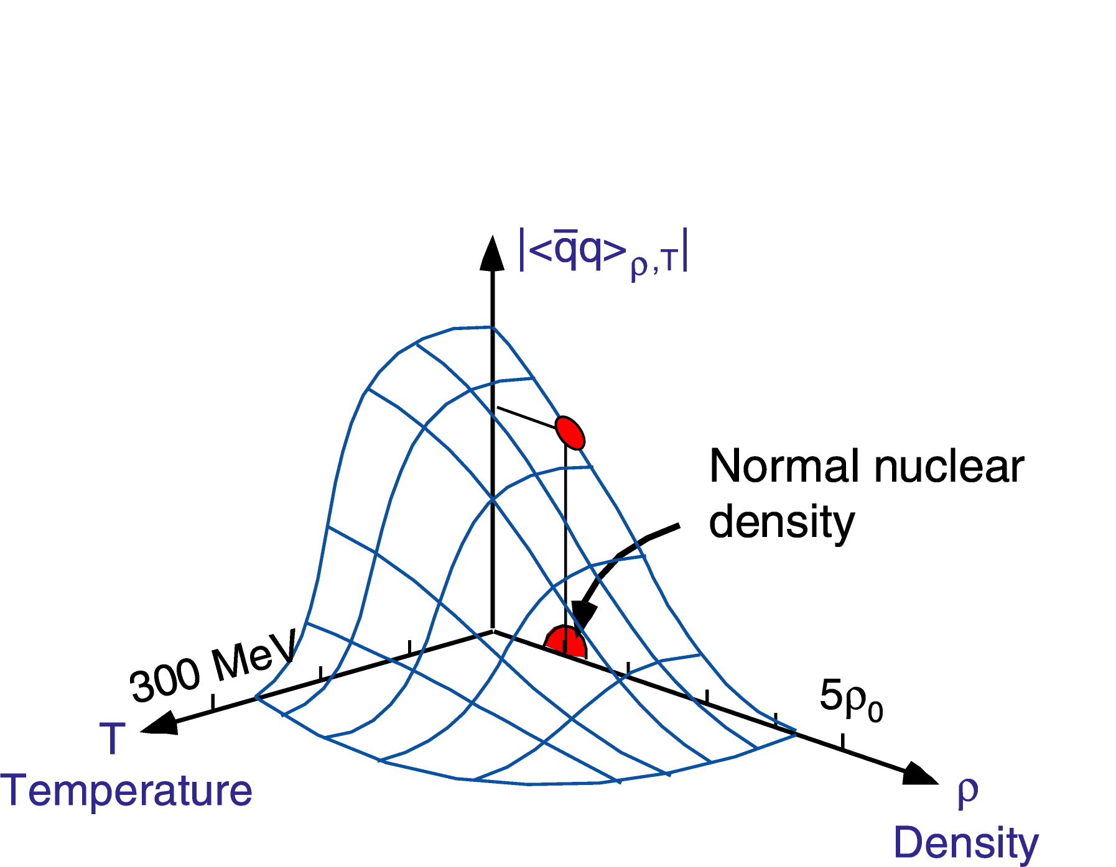
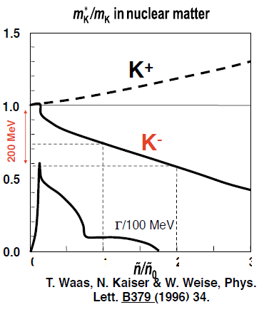
Physics Motivation
Meson properties change in nuclear media?
K^{bar}N interaction : attractive in I=0
→ A good probe for low energy QCD
0
1
2
3
W.Weise NPA553, 59 (1993).
provide new insight on M-B interaction in media

Slide 3
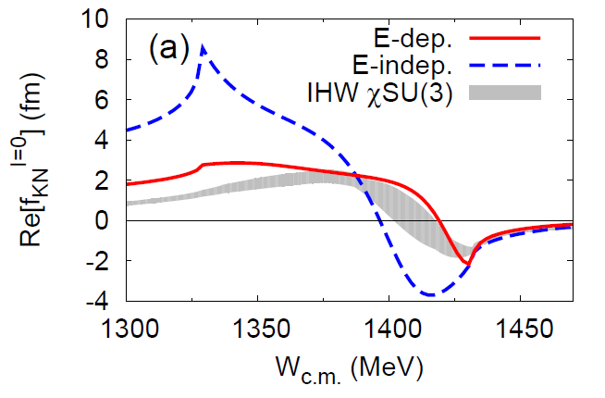
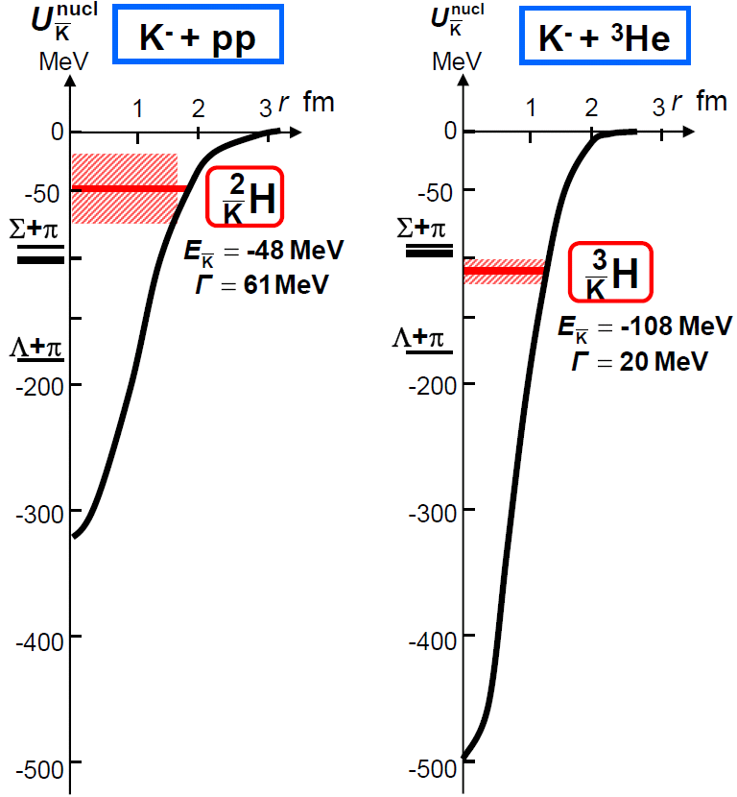
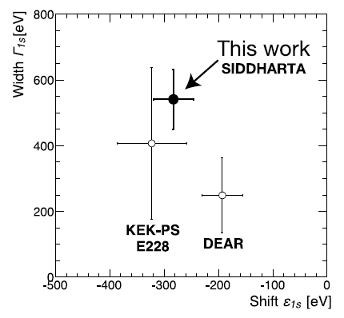
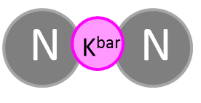

Investigation of K^{bar}N int. @ J-PARC
S.Ohnish et al.,PRC93(2016) 025207
Calculation on
K^{bar}N amplitude
in I = 0
?
K^{bar}N
M. Bazzi et al.,
(SIDDHARTA Coll.),
Phys. Lett. B704(2011)113
K^{bar}NN: E15
Λ(1405): E31
K-atom: E62/E57
πΣ
‾ＫＮ
$$I=\frac{1}{2}, J^{P}=0^{−}$$
- Sensitive in different energy region & isospin -
expected to be produced as a
Λ(1405)p doorway

Slide 4
Λ(1405) Measurement

Slide 5

K^{bar}N Interaction below the threshold
K^{bar}N int. plays an important role for Λ(1405)
Λ(1405) or Λ(1420)
  Depending on K^{bar}N int. model
s
$$J^{P}={\frac{1}{2}}^{−}$$
Moriya et al., (CLAS Coll.),
Phys. Rev. Lett. 112(2014)082004
K^{bar}N molecular from LQCD
J.M.M. Hall et al.,
Phys. Rev. Lett. 114(2015)132002.
?
S.Ohnish et al.,PRC93(2016) 025207
K^{bar}N

Slide 6


Spectral Shape of Λ(1405)?
γ/p-induced experiments
  Spectral shape is still controversial
$$pp→K^{+}pπ^{−}Σ^{+}{, K}^{+}pπ^{+}Σ^{−}$$
$$γp→K^{+}π^{−}Σ^{+},K^{+}π^{0}Σ^{0}{, K}^{+}π^{+}Σ^{−}$$
CLAS collaboration: PRC87, 035206
HADES collaboration: PRC87, 025201

Slide 7




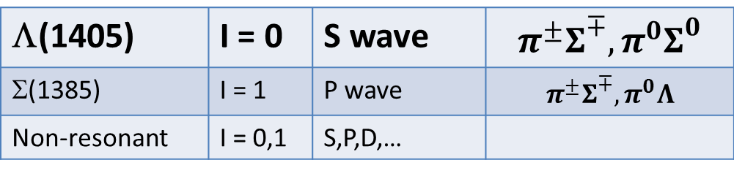

J-PARC E31 Experiment
Measurement of Λ(1405) line shape via K^{bar}N→πΣ
K⁻
n
$$N$$
$$\overline{K}$$
$$π^{∓,0}$$
d
$$Σ^{±,0}$$
$$N$$
d(K⁻,n)πΣ reactions at θ_{n}~0 degree
K-
d
Λ(1405)
~0.25 GeV/c
n
1 GeV/c
~1.25 GeV/c
Σ
π
n
π
Decomposition of I=0 and 1 amplitudes by identifying final state
Λ(1405) | I = 0 | S wave | $$π^{±}Σ^{∓}, π^{0}Σ^{0}$$
Σ(1385) | I = 1 | P wave | $$π^{±}Σ^{∓}, π^{0}Λ$$
Non-resonant | I = 0,1 | S,P,D,…

Slide 8
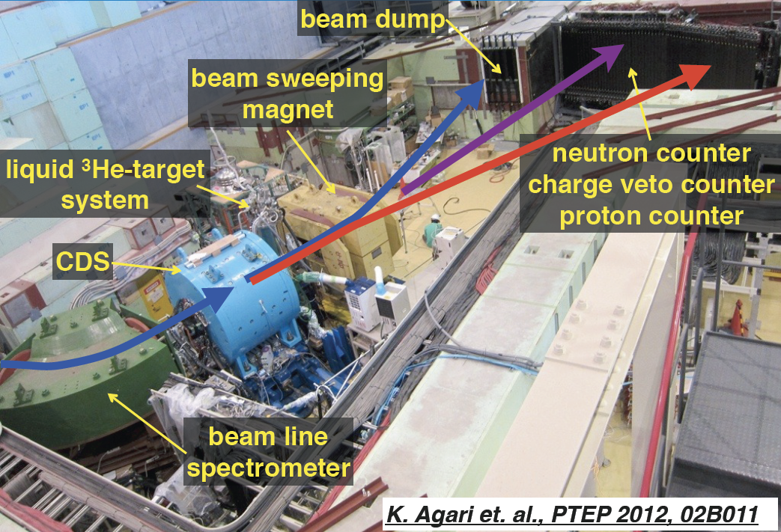
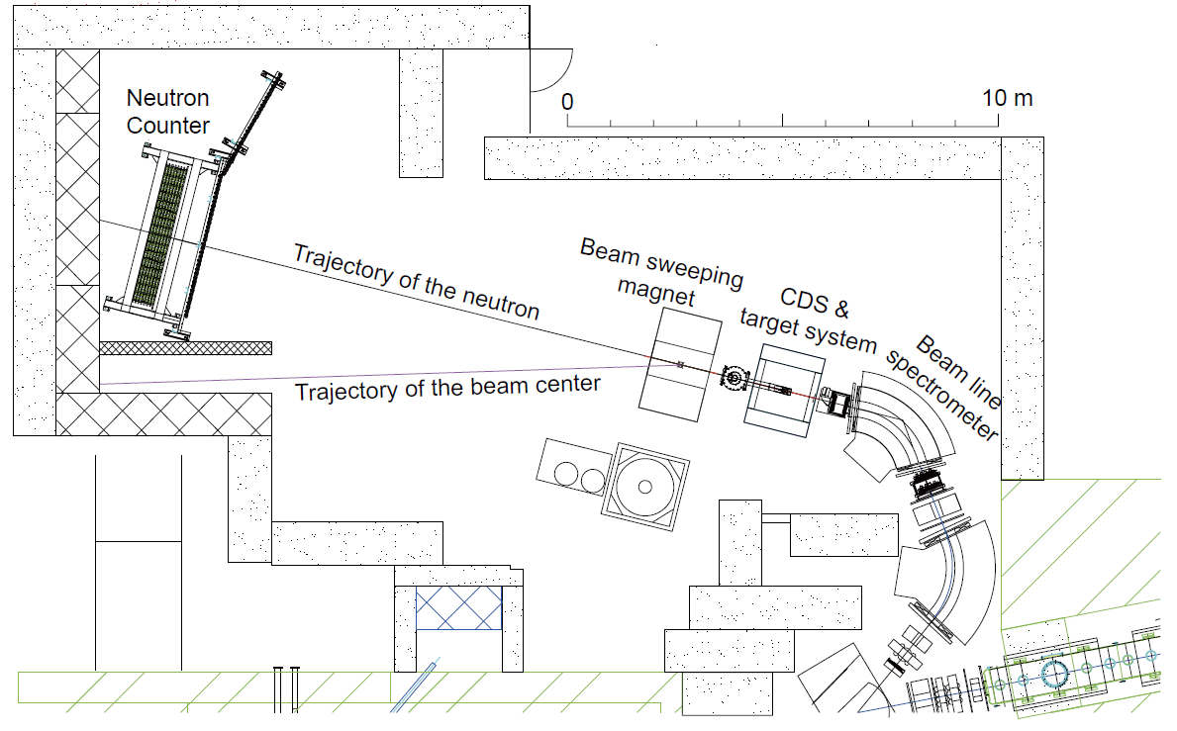
Experimental Setup for E15/E31
15m

Slide 9
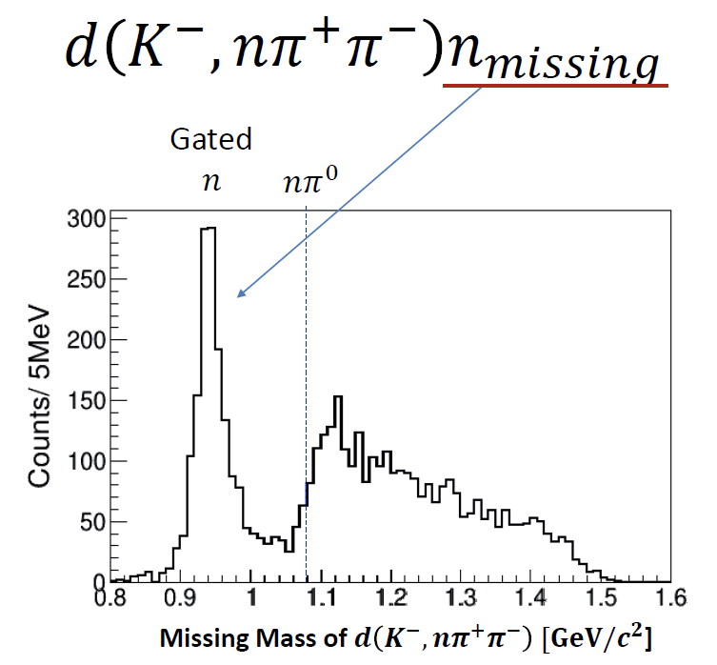
π±π∓n“n” Final States Selection
K-
d
n
NC
1 GeV/c
n
π⁺
π⁻
CDS
π±π∓n“n” final states can be identified clearly

Slide 10
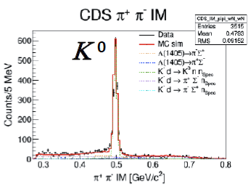
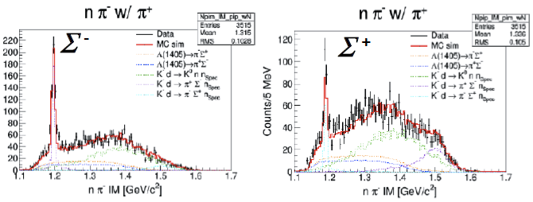
Signal & Background in π±π∓n“n”
K-
d
Λ(1405)
~0.25 GeV/c
n
NC
Signal
(Λ* production)
1 GeV/c
~1.25 GeV/c
Σ
π
n
π
CDS
n_{spectator}
CDS
n
NC
Background
(K⁰ production)
π⁻
K⁰
π⁺
n_{spectator}
NC
Σ±
n
Background
(Σ production)
π ∓
π ±
CDS

Slide 11
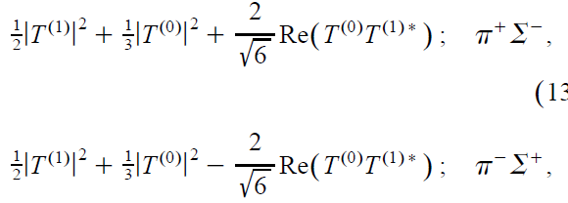
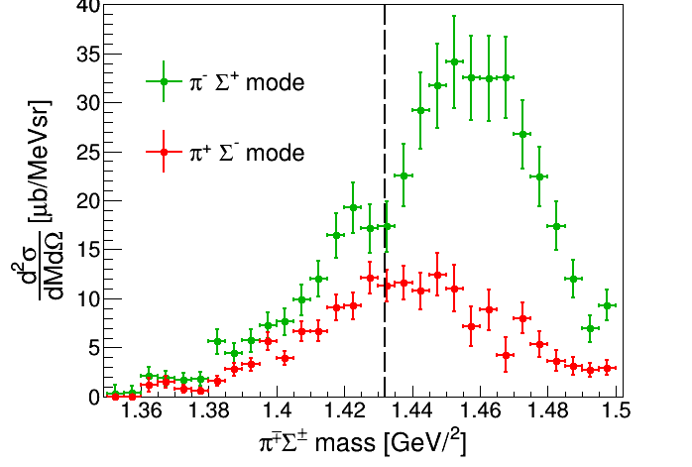
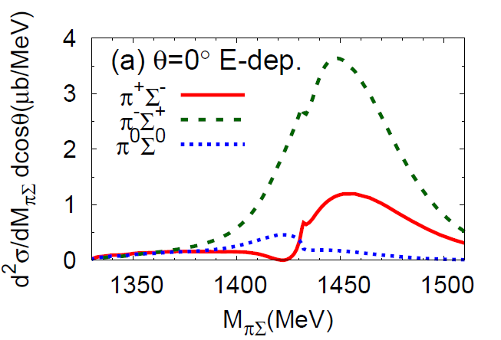
I = 0, 1 Mode (π±Σ∓)
  c.f.
  Faddeev calc. (AGS)
S.Ohnishi et al.,
PRC93(2016)025207
w/ angular dependence
K⁻p
preliminary
interference between the I = 0 and 1 terms of the πΣ scattering amplitudes is observed

Slide 12
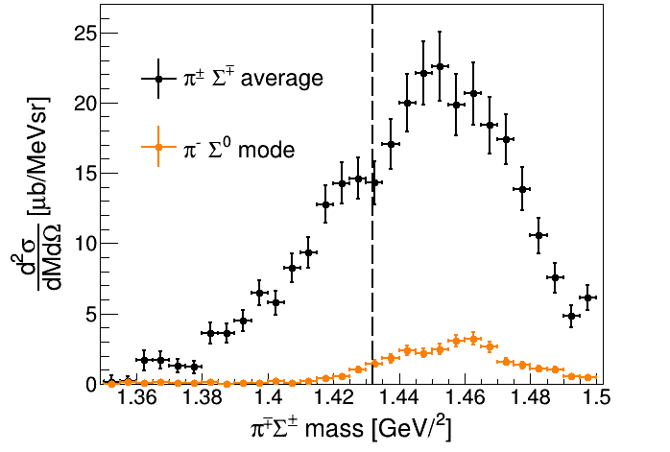
Comparison between
I = 0, 1 (π±Σ∓) & I = 1 (π⁻Σ⁰)
preliminary
I = 0 dominant below the threshold
  |T⁽⁰⁾|²/|T⁽¹⁾|² ~ 100

Slide 13
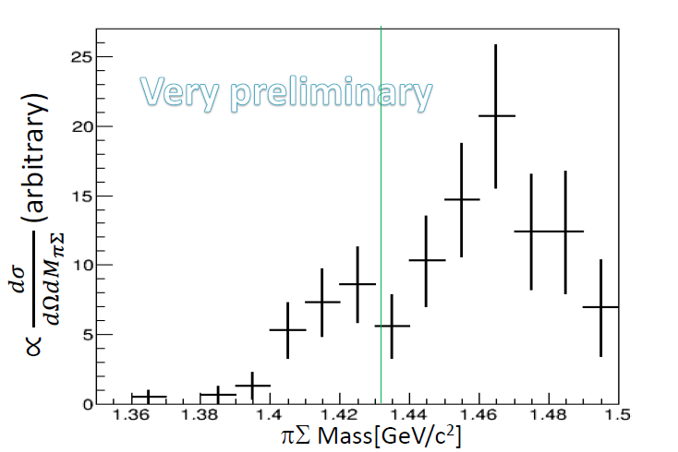

I = 0 Mode (π⁰Σ⁰)
preliminary
The pure I = 0 channel is observed
For further statistics:
  E31-2nd will be performed in this autumn/winter

Slide 14
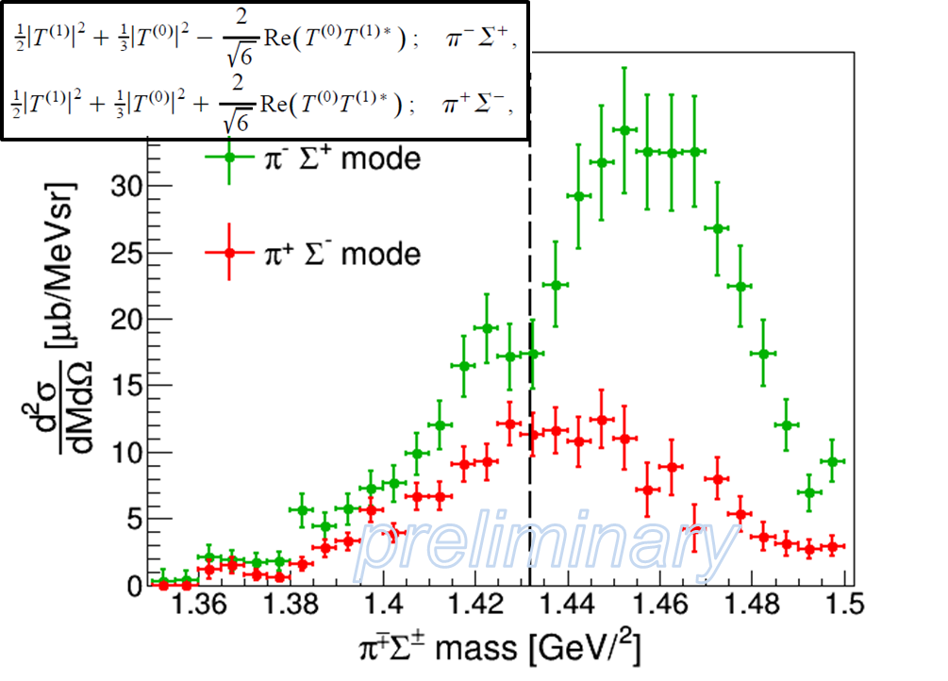
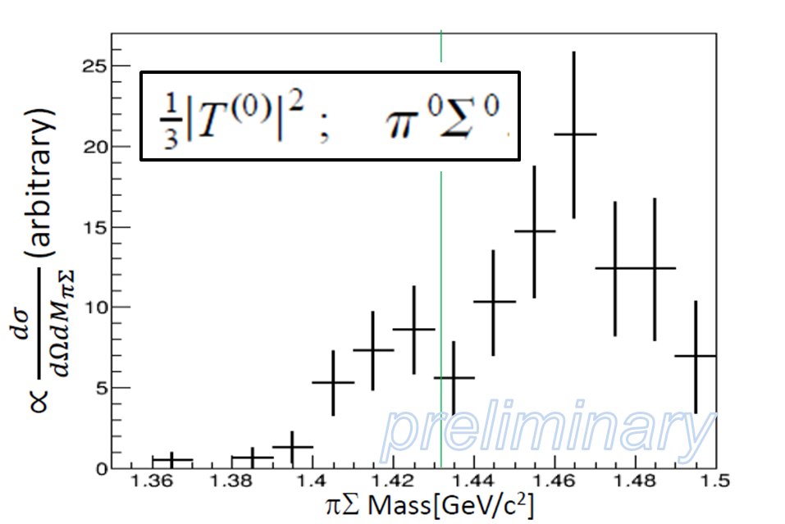
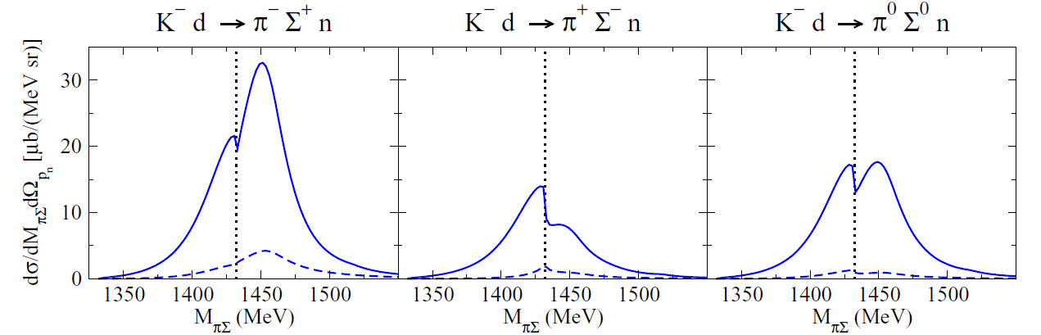
E31 vs. a Theoretical Calculation
full results
S-wave of K^{bar}N-ex
  DCC model calc.
H.Kamano, T.S.Lee,
PRC94(2016)065205
p_{K}=1GeV/c, θ_{n}=0º
Model-B
Good agreement with a theoretical calculation!

Slide 15
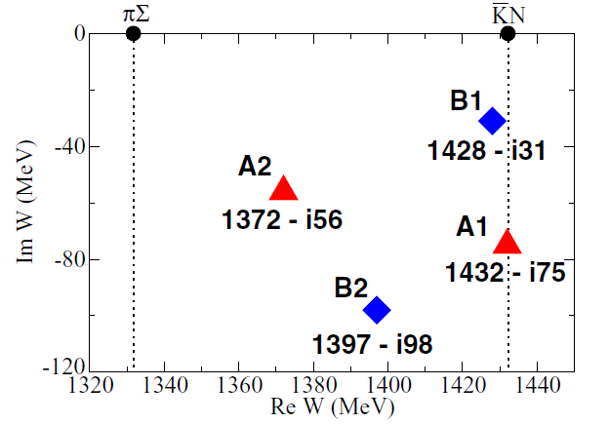
Kamano & Lee Calculation
Off-shell amplitudes generated from Dynamical Coupled-Channels (DCC) model are used.
  Parameters (potentials) were obtained by fitting more than 17,000 data of K⁻p→K^{bar}N/πΣ/πΛ/ηΛ/KΞ reactions
    two parameter sets: Model A & B
H.Kamano, T.S.Lee,
PRC94(2016)065205
Calculated pole position of Λ(1405)
Two pole resonance similar to chiral unitary models
Good agreement btw E31 & calc.
E31 results fever Λ(1420)!?
More statistics are needed.

Slide 16
Kaonic-Nuclei Search

Slide 17
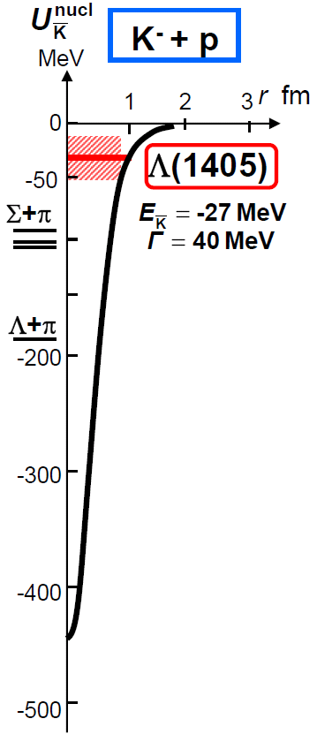

Kaonic Nuclei
Bound states of nucleus and anti-kaon
Predicted as a consequence of attractive K^{bar}N interaction in I=0
the simplest kaonic nuclei:
$$I=\frac{1}{2}, J^{P}=0^{−}$$
?
K^{bar}N
Y.Akaishi & T.Yamazaki, PLB535, 70(2002).

Slide 18
Theoretical Calculations on K^{bar}NN
K^{bar}N int. | Chiral SU(3) (energy dependent) |  |  | Phenomenological (energy independent)
Method | Variational |  | Faddeev | Variational |  | Faddeev
 | Barnea, Gal, Liverts | Dote, Hyodo, Weise | Ikeda, Kamano, Sato | Yamazaki, Akaishi | Wyceck, Green | Shevchenko, Gal, Mares | Ikeda, Sato
B (MeV) | 16 | 17-23 | 9-16 | 48 | 40-80 | 50-70 | 60-95
Γ (MeV) | 41 | 40-70 | 34-46 | 61 | 40-85 | 90-110 | 45-80
K^{bar}N interaction model:
  Chiral SU(3) [energy dependent]
  Phenomenological [energy independent]
Calculation method:
  Almost the same results = depending on K^{bar}N interaction
→ B.E. ~ 20 MeV
→ B.E. ~ 40-70 MeV

Slide 19
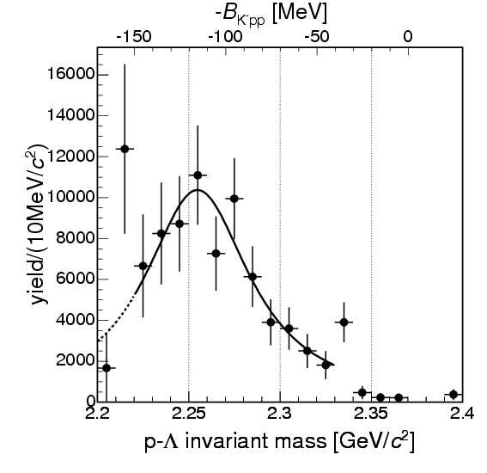
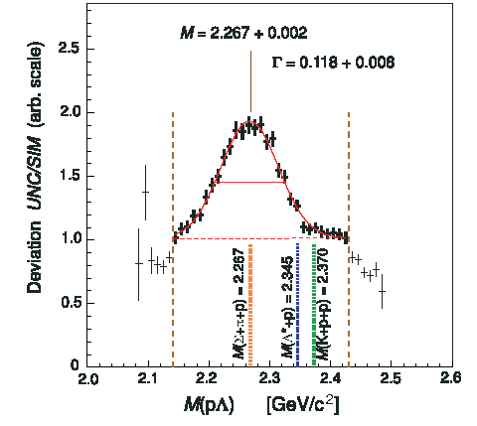
Pioneering Experiments on K^{bar}NN
B.E. = 115MeV
Γ = 67MeV
B.E. = 103MeV
Γ = 118MeV
“K⁻pp”→Λp?
Exp/Sim
FINUDA@DAΦNE
DISTO@SATURNE
PRL94(2005)212303
PRL104(2010)132502
⁶Li+⁷Li+¹²C(stopped K⁻, Λp)
p + p → (Λ + p) + K⁺ @ 2.85GeV
2NA followed by FSI?
PRC74(2006)025206
PRC82(2010)034608 etc.
pp→p(N*)→p(ΛK⁺)?
PRC92(2015)044002
vs.
K.Suzuki, HYP2015 talk

Slide 20
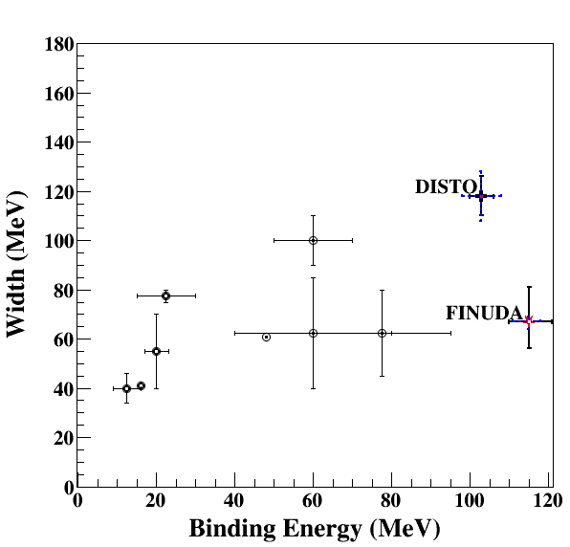
Comparison between Calcs. and Exps.
Binding energy
  Chiral:
  B.E. ~ 20MeV
  Phenomenological:
  B.E. ~ 40-80MeV
  FINUDA/DISTO (if K^{bar}NN):
  B.E. ~ 100MeV
Width
  almost agreement in Γ~40-100MeV
    Theor.: mesonic decay
    Exp.: non-mesonic decay
Chiral
Phenomenological
Upper limits were also obtained:
LEPS@SPring8 [Inclusive d(γ, K⁺π⁻)X]
HADES@GSI [Exclusive pp→pΛK⁺]

Slide 21
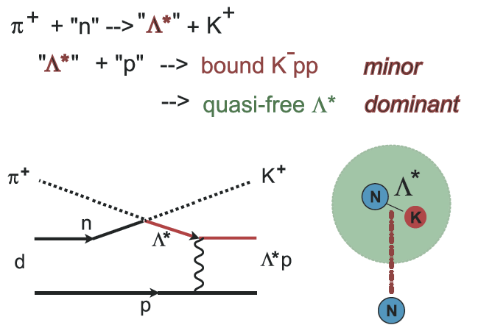
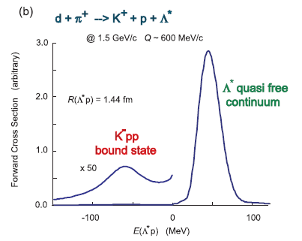
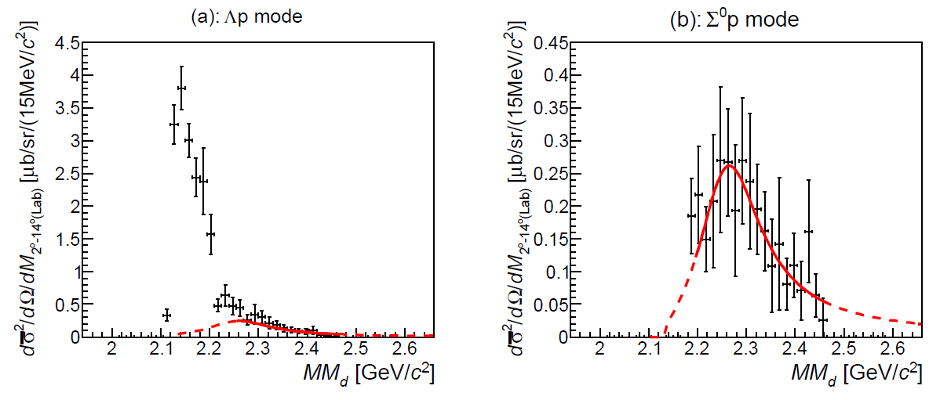
Measurement at J-PARC E27
Exclusive π⁺d→K⁺Yp
  p_{π+} = 1.69 GeV/c
  Δp/p ~ 2x10⁻³
  ΔΩ ~ 100 msr
  final-state is identified by MM[d(π⁺,K⁺pp)X]
Bump structure in Σ⁰p decay mode:
  Mass
  Binding energy
  Width
M(π+Σ+N)
Σ⁰p
M(K+p+p)
Y. Ichikawa et al., PTEP (2015) 021D01.

Slide 22
Measurement at J-PARC E27
Y. Ichikawa et al., PTEP (2015) 021D01.
Decay branch:
Σ⁰p
Theor. Cal. on Y*N→YN : Γ_{Λp}/Γ_{Σ0p} = 1.2
Sekihara, Jido, Kanda-En’yo PRC79(2009)062201(R).
dσ/dΩ_{“K-pp”→Σ0p}:
dσ²/dΩ/dM_{2-14 deg.(Lab)} [μb/sr/(15MeV/c²)]
Λp
Y.Ichikawa, PhD-thesis. Kyoto-U (2015)
M(π+Σ+N)
p(π⁻,K⁰)Λ(1405) @ 1.69GeV/c:
dσ/dΩ_{Λ(1405)}=36.9μb/sr
M(K+p+p)
BNL, NPB56(1973)15
preliminary
= (dσ/dΩ_{”K-pp”→Yp}) / (dσ/dΩ_{Λ(1405)}) ~ 7-8%
→ large prob. of Λ(1405)p→“K⁻pp”
c.f., large prob. in DISTO, but < 50% in HADES
T.Nagae

Slide 23
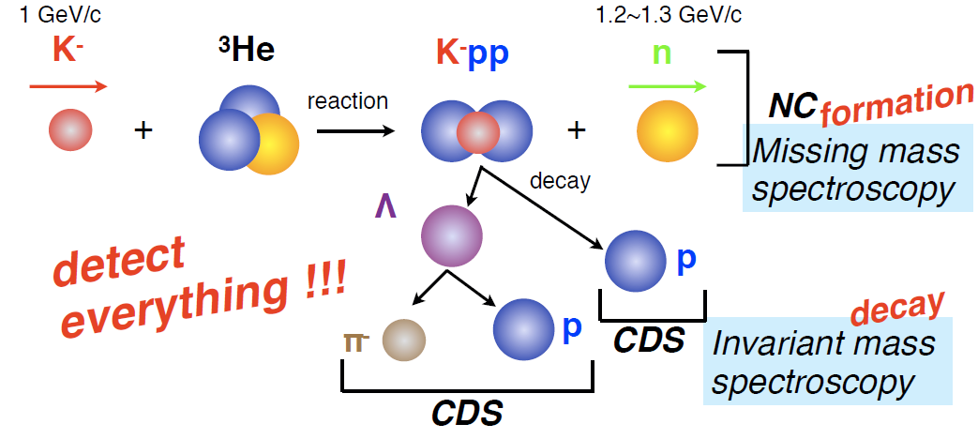
J-PARC E15 Experiment
³He(in-flight K⁻,n) reaction @ 1.0 GeV/c
  2NA processes and Y decays can be discriminated kinematically
semi-inclusive ³He(K⁻,n)
T. Hashimoto et al., PTEP (2015) 061D01.
exclusive (K⁻,Λp)n_{missing}
Y. Sada et al., PTEP (2016) 051D01.

Slide 24
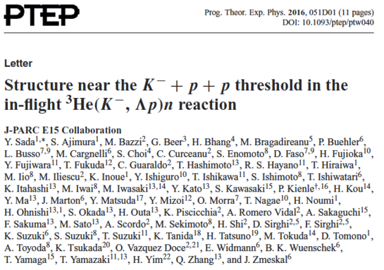
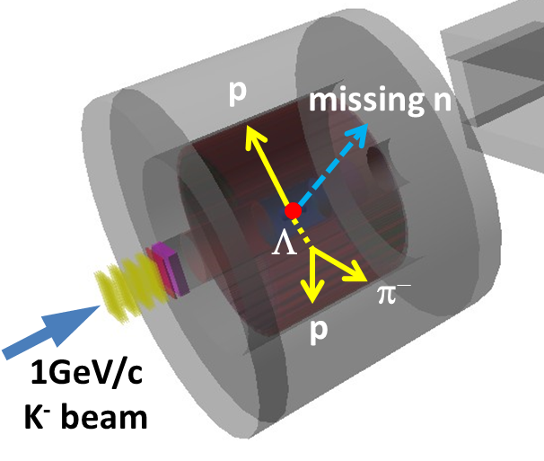
Exclusive ³He(K⁻,Λp)n
--- result of E15-1st in 2013 ---
Y.Sada et al., PTEP (2016) 051D01.

Slide 25
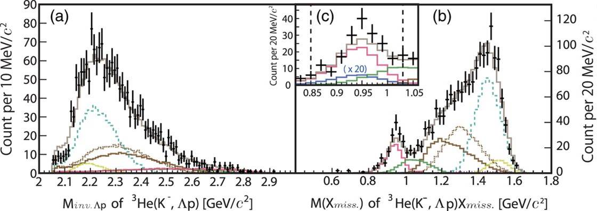

n-ID from Inclusive ³He(K⁻,Λp)X
Y. Sada et al., PTEP (2016) 051D01.
Σ⁰pn
Λpn
Λpn_{s}
(2NA)
x20
Λpn
Σ⁰pn
YNNππ
YNNππ
YNNπ
YNNπππ
YNNπ
YNNπππ
Global fit both in Λp invariant- and missing-mass
  σ ~ 10 MeV/c²
  w/ simulated spectra of 2NA/3NA
Neutron was identified by kinematics
  ³He(K⁻, Λp)n_{missing}
3NA(Λpn):
  # of Λpn events: ~200
  Σ⁰pn contamination: ~20%

Slide 26
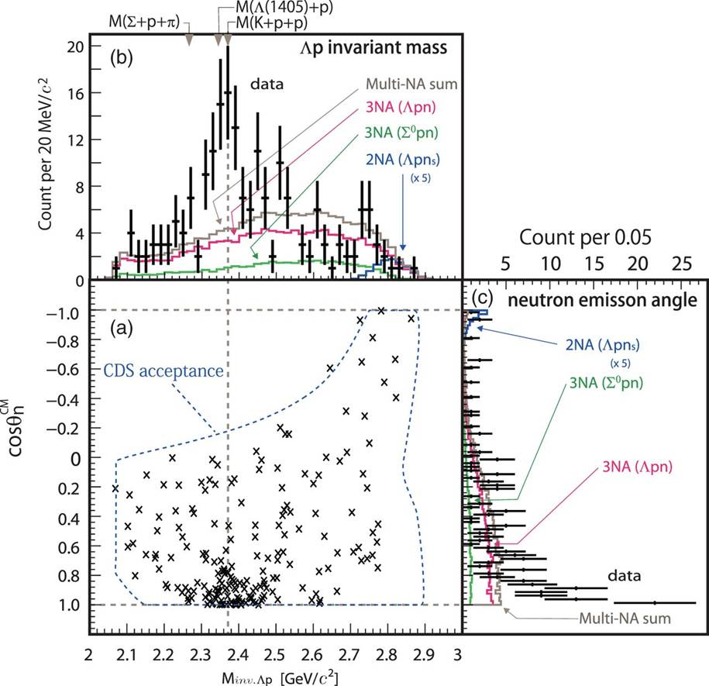
Exclusive ³He(K⁻,Λp)n
A bump structure exists near the K-pp threshold
Prefers Smaller momentum transfer to Λp (0.8<cosθ^{CM}_{n})
  S=-1 dibaryon?
    Λ*N?
    K^{bar}NN?
    …
Y. Sada et al., PTEP (2016) 051D01.

Slide 27
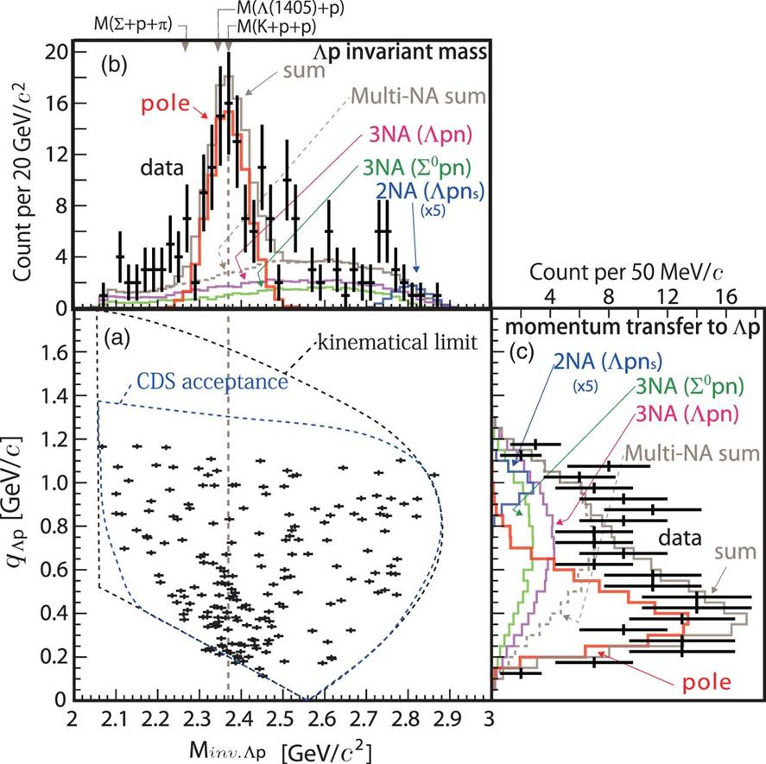

Assuming a Breit-Wigner
χ2-test with pole & 3NA(Ypn)
– S-wave Breit-Wigner pole
– w/ Gaussian form-factor
  [B.E = 15 MeV/c²]
Y. Sada et al., PTEP (2016) 051D01.

Slide 28
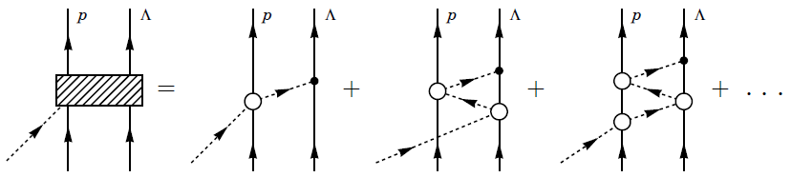
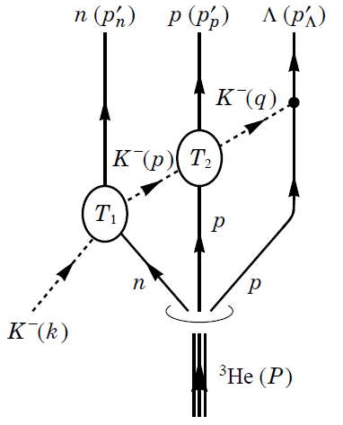
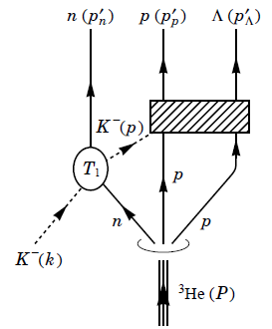
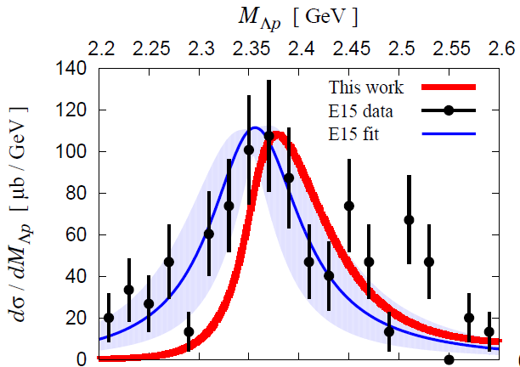
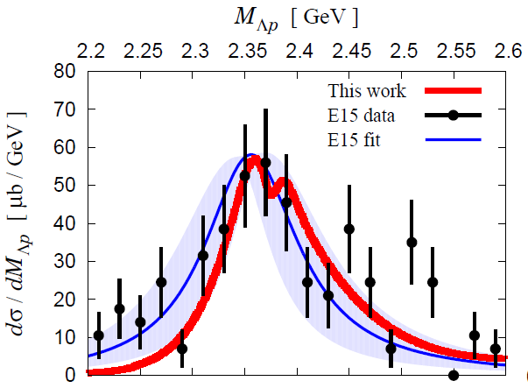
A Theoretical Interpretation
Sekihara, Oset, Ramos, PTEP(2016)123D03.
Chiral unitary approach
Sekihara
Uncorrelated
Λ(1405)p
state
quasi-elastic
kaon
scattering
K^{bar}NN
bound-state
B=16MeV
Γ=72 MeV
Opt.A (Watson)
Opt.A (Watson)
M[K+p+p]
M[K+p+p]

Slide 29
E15-2nd Experiment
--- completed in Dec. 2015 ---
What is the structure observed in E15^{1st} data?
 | E15-1st in 2013 | E15-2nd in 2015
data-taking | 4 days | 3 weeks
(K⁻,n) | ~7 times more data
(K⁻,Λp) | ~30 times more data*
* dedicated trigger was introduced for (K-,Λp)
Will be published as “T.Yamaga et al., XXX (2017) XXX.”

Slide 30
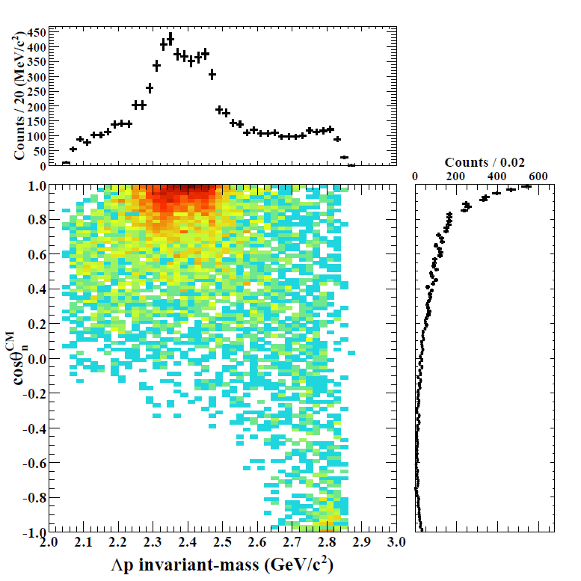
Results of ³He(K⁻,Λp)n [E15-2nd]
IM(Λp)
Structures around the Kpp threshold can be seen
= bound-state + QF
M(K+p+p)
preliminary
Structures are concentrated in forward-n region
= small momentum-transfer
detector
acceptance
cos(θ_{n})

Slide 31
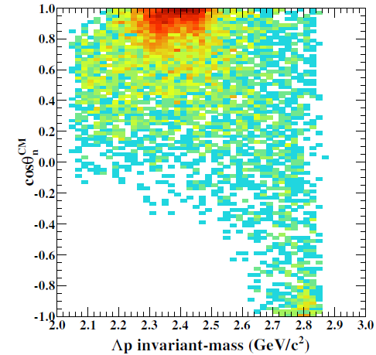
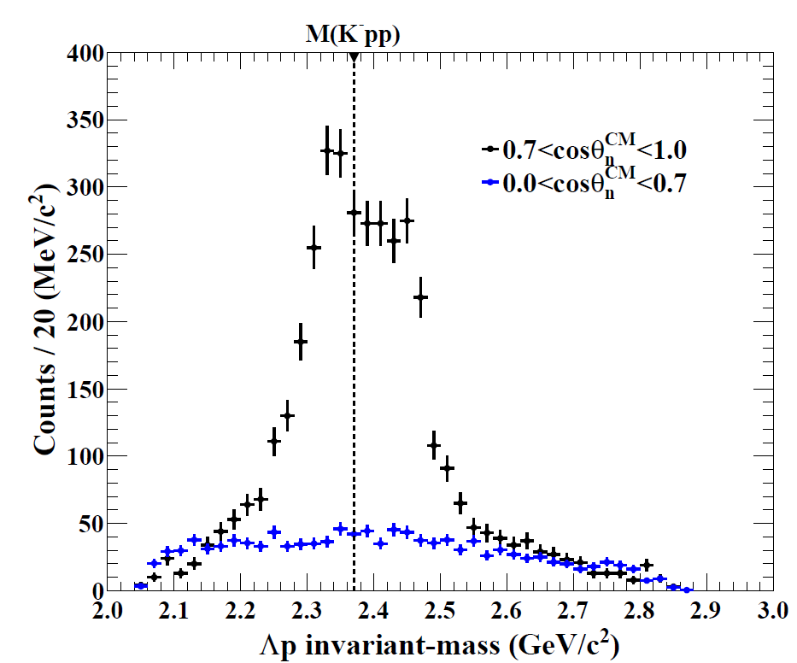
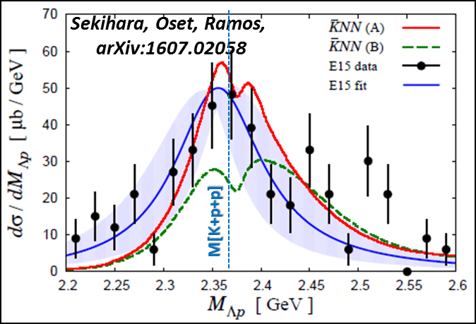
Results of ³He(K⁻,Λp)n [E15-2nd]
𝟎.𝟕<𝐜𝐨𝐬𝜽_{𝒏}^{𝑪𝑴}<𝟏.𝟎
𝟎.𝟎<𝐜𝐨𝐬𝜽_{𝒏}^{𝑪𝑴}<𝟎.𝟕
Above M(Kpp)
→ QF = [Quasi-elastic K] x [KNN→Λp]
Below M(Kpp)
→ Bound-State!?
detector
acceptance
𝟎.𝟕<𝐜𝐨𝐬𝜽_{𝒏}^{𝑪𝑴}<𝟏.𝟎
missing acceptance
preliminary
Flat distribution
prop. to phase space
→ Point like 3NA?
(𝟎.𝟎<𝐜𝐨𝐬𝜽_{𝒏}^{𝑪𝑴}<𝟎.𝟕)
×𝟎.𝟒𝟕

Slide 32
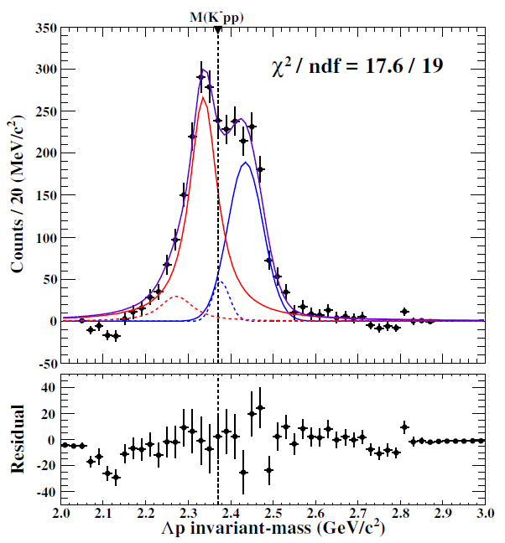
Results of ³He(K⁻,Λp)n [E15-2nd]
Simple fitting w/o 3NA
  B.S.: Breit-Wigner
  QF: Gaussian
  w/ Σ⁰p contamination
Well reproduce the spectrum
  B.E ~ 34 MeV/c²
  Γ ~ 75 MeV/c²
preliminary
← Fermi-mom. Eff.
← from MM(³He(K⁻,Λp)X)
preliminary

Slide 33
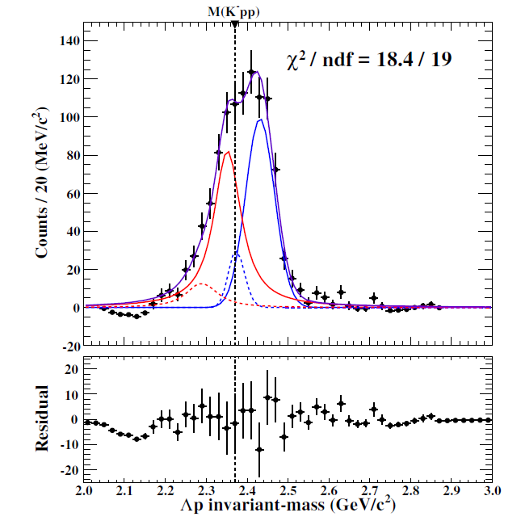
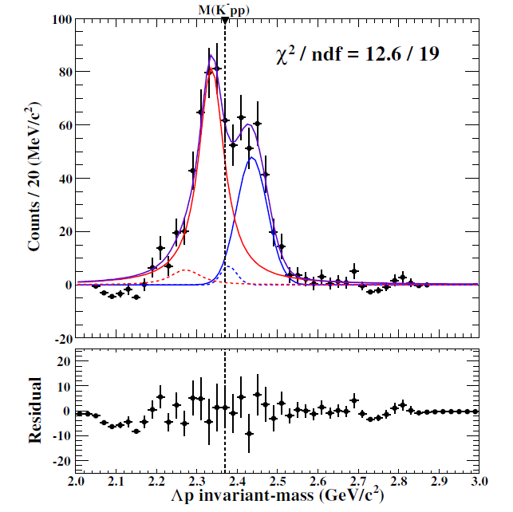
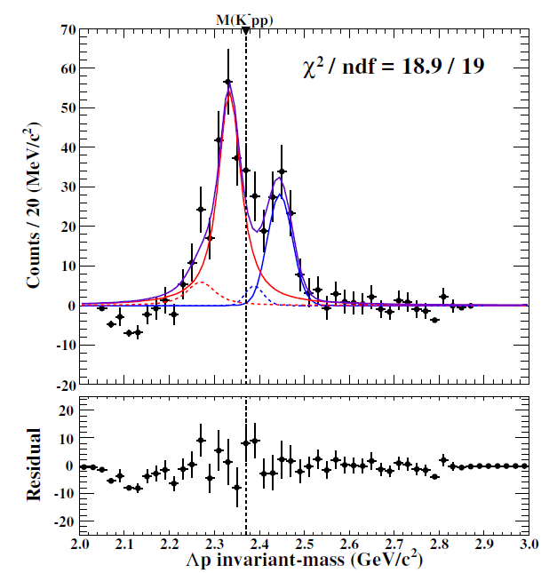
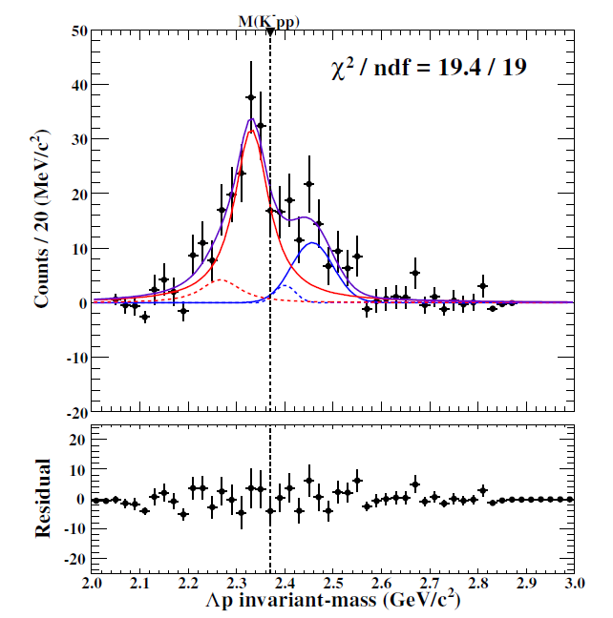

Results of ³He(K⁻,Λp)n [E15-2nd]
cosθ_{n} dependence
𝟎.𝟕5<𝐜𝐨𝐬𝜽_{𝒏}^{𝑪𝑴}<𝟏.𝟎
preliminary
0.95<cosθ_{n}<1.0
0.90<cosθ_{n}<0.95
detector
acceptance
0.85<cosθ_{n}<0.90
0.80<cosθ_{n}<0.85
0.75<cosθ_{n}<0.80

Slide 34



Results of ³He(K⁻,Λp)n [E15-2nd]
Peak position
Width
Gaussian
Breit-Wigner
Above M(K-pp):
  peak shift by recoil kaon energy
Below M(K-pp):
  peak is independent to cosθ_{n}
  ( ~ momentum transfer)
Similar tendency as a theoretical calc., but QF seems to be originated from recoil kaon
QF
B.S.
Sekihara, Oset, Ramos,
PTEP(2016)123D03

Slide 35

Present Status of K^{bar}NN
Exp. CANDIDATES
  Upper limit
    LEPS/HADES
  B.E ~ 10-40 MeV
    E15
  B.E. ~ 100 MeV
    FINUDA/DISTO/E27
Theor. calculations.
  Difficult to reproduce deeply bound state using normal K^{bar}N int.
E15-2nd
?
Chiral
Phenomenological
For further understanding:
Λ(1405) production ◊ Λ∗N doorway
πΣN decay channel → new info. of K^{bar}NN

Slide 36

Summary
To investigate the K^{bar}N interaction,
various experiments are proposed/conducting at J-PARC K1.8BR
- Sensitive in different energy region & isospin -
Kaonic-atom: E62/E57
  will start in 2018/2019
Λ(1405): E31
  1st: analysis will be finalized
  2nd: will start soon
K^{bar}NN: E15
  fruitful results were obtained in E15^{1st}
  analysis of E15^{2nd} data is going on
  E15^{3rd} be discussed

Slide 37

The E15/E31 Collaborations

Slide 38
Spares

Slide 39
K^{bar}NN or NOT? --- Other Possibilities
A structure near K^{bar}NN threshold
Λ(1405)N bound state
  loosely-bound system, I=1/2, J^{π}=0⁻
  various decay modes, ΛN/ΣN/πΣN
πΛN-πΣN dibaryon
  structure near πΣN threshold
  I=3/2, J^{π}=2⁺ → no Λp decay (I=1/2)?
Double-pole K^{bar}NN
  loosely-bound K^{bar}NN, &
  broad resonance near the πΣN threshold → πΣN decay
Partial restoration of Chiral symmetry
  enhancement of the K^{bar}N interaction in dense nuclei
T. Uchino et al., NPA868(2011)53.
A structure near πΣN threshold
H. Garcilazo, A. Gal, NPA897(2013)167.
A. Dote, T. Inoue, T. Myo, PTEP (2015) 043D02.
S. Maeda, Y. Akaishi, T. Yamazaki, Proc. Jpn. Acad., B89(2013)418.

Slide 40


K^{bar}N Interaction below the threshold
Λ(1405) plays an important role
s
$$J^{P}={\frac{1}{2}}^{−}$$
Moriya et al., (CLAS Coll.),
Phys. Rev. Lett. 112(2014)082004.
K^{bar}N molecular from LQCD
J.M.M. Hall et al.,
Phys. Rev. Lett. 114(2015)132002.
S.Ohnish et al.,PRC93(2016) 025207
K^{bar}N

Slide 41


Recent Measurement at LEPS
A.O. Tokiyasu et al., Phys. Lett. B 728 (2014) 616.
Inclusive d(γ, K⁺π⁻)X
  E_{γ} = 1.5-2.4 GeV
  cosθ^{lab}_{K+/π-} > 0.95
  σ_{MM} ~ 10 MeV
BG: γN→K⁺π⁻Λ/Σ/Λ(1520)
NO peak structure
  U.L.: 0.17-2.9 μb
  (= 1.5-26% CS of γd→K⁺π⁻Y)
M[K+p+p]
◊ LEPS2 (4π measurement)

Slide 42


Recent Measurement at HADES
G. Agakishiev et al., Phys. Lett. B 742 (2015) 242
Kpp th
Exclusive pp→pΛK⁺
  E = 3.5 GeV
Bonn–Gatchina PWA
  Well reproduces the data with N* resonances
    pp→pN*→pΛK⁺
NO peak structure
  U.L.: 0.7-4.2 μb
  (= 2-12% CS of pp→pK⁺Λ)
  Λ(1405) production = 9.2 μb
  → σ(X=K^{bar}NN)/σ(Λ*) < ~50%
PRC87(2013)025201
vs.
DISTO: σ(X) > σ(Λ(1405)) @ 2.85GeV
◊ Combined analysis with COSY-TOF/DISTO/HOPI/HADES (pp→pK⁺Λ)

Slide 43

E15: Publications
E15^{1st} experiment:
Only 4days data-taking in 2013
inclusive ³He(K⁻,n)X
exclusive ³He(K⁻,Λp)n
T. Hashimoto et al., PTEP (2015) 061D01.
Y. Sada et al., PTEP (2016) 051D01.

Slide 44


Semi-Inclusive ³He(K⁻,n)X
DATA
sub-threshold
excess
(Y* and/or K^{bar}NN?)
Quasi Elastic
K⁻ + ³He → K⁻ + n + p_{s} + p_{s}
dσ/dΩ_{θ=0deg} ~ 6mb/sr
MC
Charge-Exchange
K⁻ + ³He → K⁰ + n + d_{s}
dσ/dΩ_{θ=0deg} ~ 11mb/sr
T. Hashimoto et al., PTEP (2015) 061D01.

Slide 45


Semi-Inclusive ³He(K⁻,n)X
NO bump structure
FINUDA/DISTO/
E27
T. Hashimoto et al., PTEP (2015) 061D01.

Slide 46

Assuming a Breit-Wigner
Y. Sada et al., PTEP (2016) 051D01.
phase space
Breit-Wigner
form factor
B.E = 15⁺⁶₋₈ (stat.) ± 12(syst.) MeV/c²
= 110⁺¹⁹₋₁₇(stat.) ± 27(syst.) MeV/c²
Q = 400⁺⁶⁰₋₄₀ MeV/c

Slide 47


Experimental Setup
Beamline spectrometer
  1.0 GeV/c K⁻
  Δp/p: 0.2%
Target System
  ~0.5l Liquid 3He @ 1.4K
    ρ = 0.081 g/cm³
Cylindrical Detector System
  Acceptance: 54<θ<126 deg.
    59% of 4π
  Δp_{t}/p_{t}: 5.3% p_{t} + 0.5%/β
Neutron Counter
  Acceptance: 20 msr
  Δp/p for 1.2GeV/c n: 0.7%

Slide 48

A Theoretical Interpretation
Sekihara, Oset, Ramos, arXiv:1607.02058
Chiral unitary approach
Sekihara, Tue. A-1
K^{bar}NN state
Sekihara, Oset, Ramos,
arXiv:1607.02058
A: Watson app.
B: Faddeev app.
B=16MeV, Γ=72 MeV
quasi-elastic kaon
scattering
M[K+p+p]
K^{bar}NN bound-state picture reproduces the data
→ The data CANNOT be explained with uncorrelated Λ(1405)p

Slide 49


E15 1st vs 2nd
Y. Sada et al., PTEP (2016) 051D01.
E15-2nd

Slide 50

Exclusive ³He(K⁻,Λp)n
The events widely distribute in the phase space
  Contribution from 2NA processes seem to be small
Event concentration is seen at T^{CM}_{n}/Q^{CM}~0.4

Slide 51

Exclusive ³He(K⁻,Λp)n
E15^{1st}
E15^{2nd}
preliminary

Slide 52



Exclusive ³He(K⁻,Λp)n
Small cos(θ_{n})
M[K+p+p]
preliminary
sliced
Large cos(θ_{n})
Sekihara, Oset, Ramos,
arXiv:1607.02058
Smaller momentum transfer is preferred

Slide 53


³He(K⁻,Λp)n: Decay Channel
Λp
M[K+p+p]
preliminary
Λp
Σ⁰p
sliced
Λp
Σ⁰p
Λp~Σ⁰p
Σ⁰p
πYN
Σ⁰p~πYN
Γ(Λp) > Γ(Σ⁰p) !?

Slide 54

³He(K⁻,Λp)n: q-dependence
M[K+p+p]
preliminary
Kinematical
Limit

Slide 56


E27: Experimental Setup
SKS spectrometer
K1.8 beam line spectrometer
  1.69 GeV/c π⁺
  Δp/p ~ 2x10⁻³
SKS spectrometer
  0.8-1.3 GeV/c K⁺
  Δp/p ~ 2x10⁻³
  ΔΩ ~ 100 msr
Target : liquid deuterium (1.99 g/cm²)
K⁺
π⁺
K1.8 beam line
spectrometer
p_{π} = 1.69 GeV/c
Y.Ichikawa

Slide 57


E27: Inclusive d(π⁺,K⁺)X
Y. Ichikawa et al., PTEP (2014) 101D03.
expected spectrum
“K⁻pp” signal is hidden by QF!?
+ data
- expected
ΣN-ΛN cusp
Y* mass shift?
Ichikawa, Tue. A-1
Tokiyasu, Fri. E-1
T.Nagae

Slide 58


E27: Experimental Setup
SKS spectrometer
K1.8 beam line spectrometer
  1.69 GeV/c π⁺
  Δp/p ~ 2x10⁻³
SKS spectrometer
  0.8-1.3 GeV/c K⁺
  Δp/p ~ 2x10⁻³
  ΔΩ ~ 100 msr
Target : liquid deuterium (1.99 g/cm²)
K⁺
π⁺
Range Counter Arrays
Range Counter Arrays (RCA)
  5 layers of Plastic scinti.
  39-122 deg. (L+R)
  50 cm TOF
Y.Ichikawa

Slide 59


E27: One-Proton Coincidence
Y. Ichikawa et al., PTEP (2015) 021D01.
p_{p} > 250 MeV/c
  QFs are suppressed
ΣN-ΛN cusp is clearly seen @ 2.13 GeV/c²
Broad enhancement is observed @ 2.28 GeV/c²
< 1p coincidence spectrum >
< 1p coincidence probability >
=
< Inclusive spectrum >
ΣN-ΛN cusp
Broad bump

Slide 60


E27: Two-Proton Coincidence
Y. Ichikawa et al., PTEP (2015) 021D01.
p_{p} > 250 MeV/c
  QFs are suppressed
ΣN-ΛN cusp is clearly seen @ 2.13 GeV/c²
Broad enhancement is observed @ 2.28 GeV/c²
< 2p coincidence spectrum >
< 2p coincidence probability >
=
Y.Ichikawa, PhD-thesis.
Kyoto-U (2015)
< Inclusive spectrum >
ΣN-ΛN cusp
Broad bump
Y.Ichikawa

Slide 61

E27: Decay Mode Separation
Y. Ichikawa et al., PTEP (2015) 021D01.
①
②
③
Decay mode can be separated with MM[d(π⁺,K⁺pp)X]
  two-protons in final state: K⁺Λp, K⁺Σ⁰p, K⁺Yπp
①
②
③

Slide 62

E27: “K-pp”-like Structure
Y. Ichikawa et al., PTEP (2015) 021D01.
Detector Acceptance
“K-pp”-like structure in Σ⁰p decay mode:
  Mass
  Binding energy
  Width
Relativistic Breit-Wigner
M(π+Σ+N)
Σ⁰p
M(K+p+p)
T.Nagae

