Slide 1
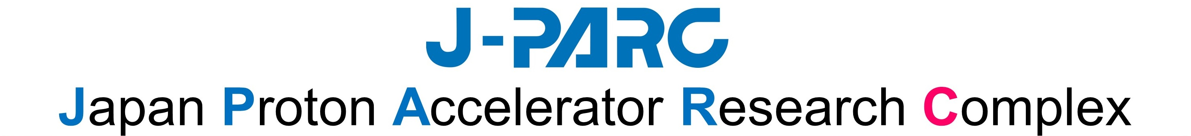




The J-PARC Hadron Experimental Facility Extension Project
F.Sakuma, RIKEN on behalf of HEF-ex TF
1,000m
Hadron
Experimental
Facility
3-GeV
Synchrotron
Main Ring
Synchrotron
sakuma@ribf.riken.jp
Linac
HADRON2023, Jun.5-9, 2023
Neutrino Experimental Facility
Material and Life Science Experimental Facility

Slide 2
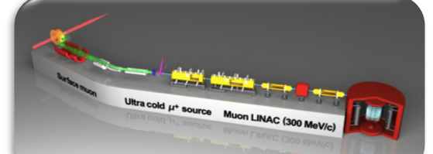
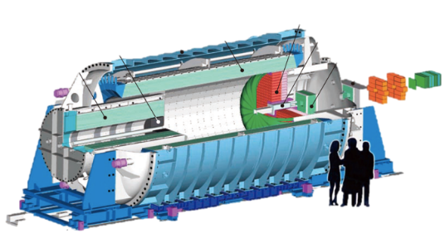
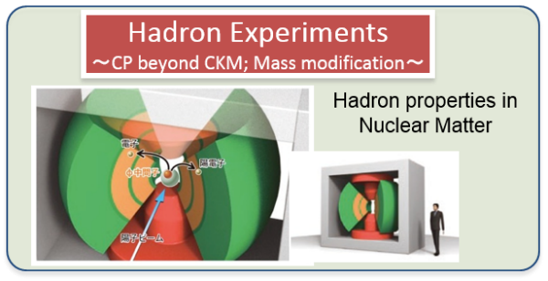
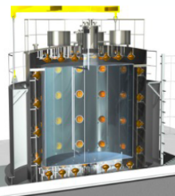


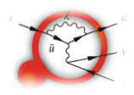

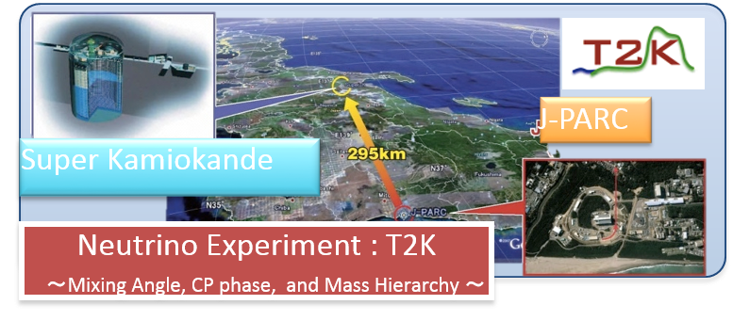

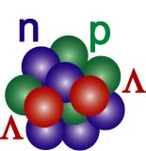
Particle and Nuclear Physics @ J-PARC
1,000m
Hadron
Experimental
Facility
Deviation from SM?
3-GeV
Synchrotron
Main Ring
Synchrotron
g_{μ}-2/μEDM
new particle ν_{s}?
CPV beyond CKM
Hyper-nuclear physics
Linac
Neutron star
Strangeness in Nuclei
Role of strange quark in extreme high density matter?
Neutrino Experimental Facility
Material and Life Science Experimental Facility

Slide 3





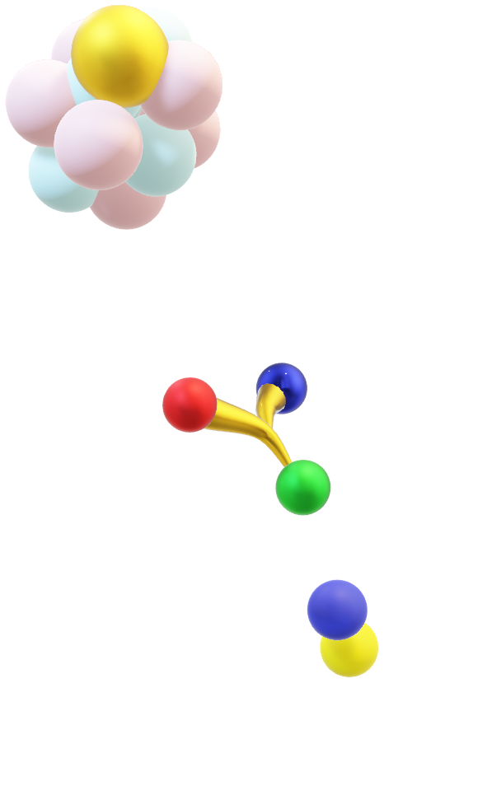

Origin & Evolution of Matter
Matter-Antimatter Symmetry
Flavor Physics
$$\overline{q}$$
Kaon rare decays
μ→e conversion
CP violation
weak interaction
→ new physics
$$q$$
matter dominated universe
$$q$$
Hadron Physics
Origin of Matter Creation
quark interactions
hadron mass-generation mechanism
$$q$$
formation of hadrons from quarks
$$q$$
Hadron spectroscopy
Meson in nuclei
Strangeness Nuclear Physics
Matter in Extreme Conditions
hadron interactions
hadronic many-body systems
dense matter in neutron stars
Hyperon-Nucleon scattering
Hypernuclear spectroscopy
$$Λ$$

Slide 4
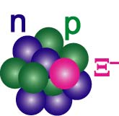
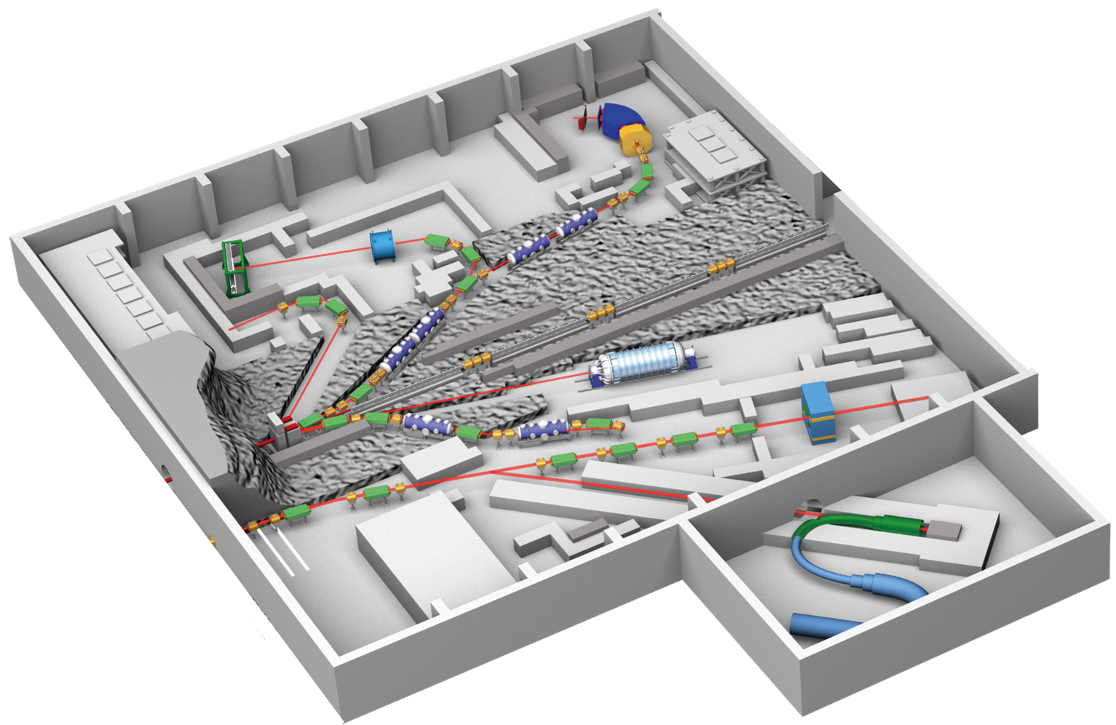
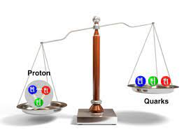

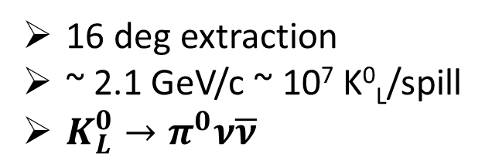
Present Hadron Experimental Facility (HEF)
< 2.0 GeV/c
~ 10⁶ K⁻/spill
S=-1 and S=-2 hypernuclei
< 1.1 GeV/c
~ 5x10⁵ K⁻/spill
Kaon in nuclei
K1.8
56 m
K1.8BR
16 deg extraction
~ 2.1 GeV/c ~ 10⁷ K⁰_{L}/spill
${K_{L}^{0}→π}^{0}ν\overline{ν}$
KL
charged
Au Target
< 95 kW
T1 target
high-p
launched in 2020
neutral
30 GeV proton ~ 10¹⁰
< 31 GeV/c unsepa. π ~ 10⁷
Hadron physics
primary 30GeV
muon
30 GeV proton beam
65kW (7x10¹³ ppp, 5.2s)
[as of 2021, June]
COMET
μ⁻ beam
μ-e conversion
started in 2023

Slide 5
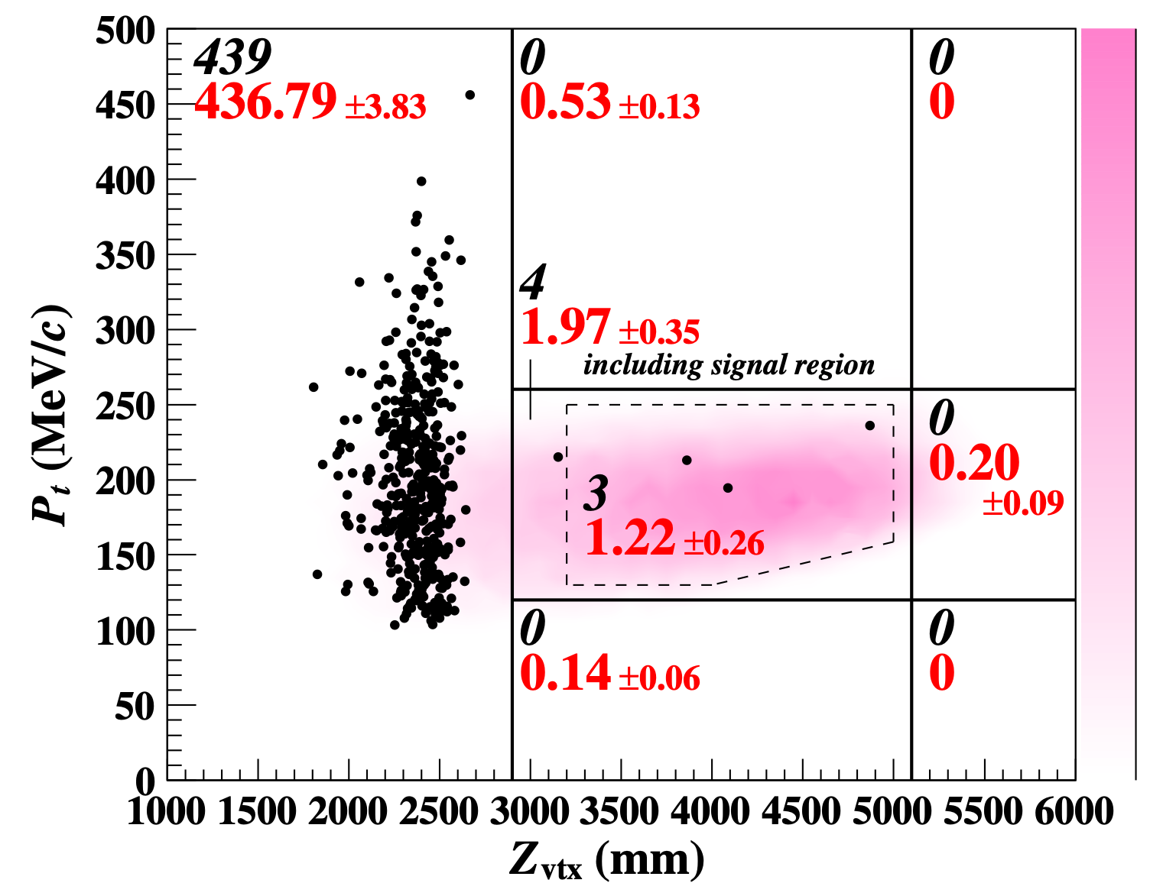
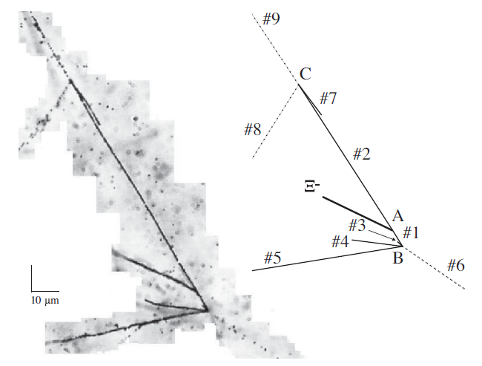
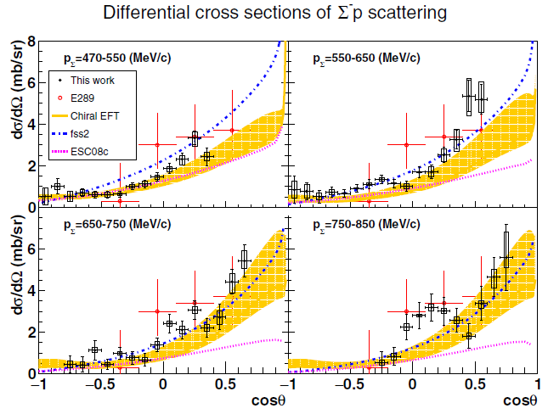
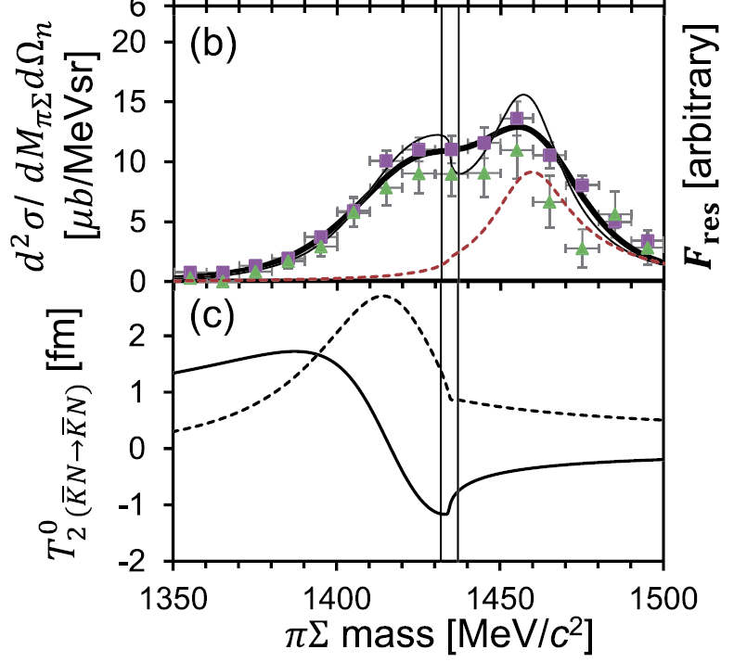
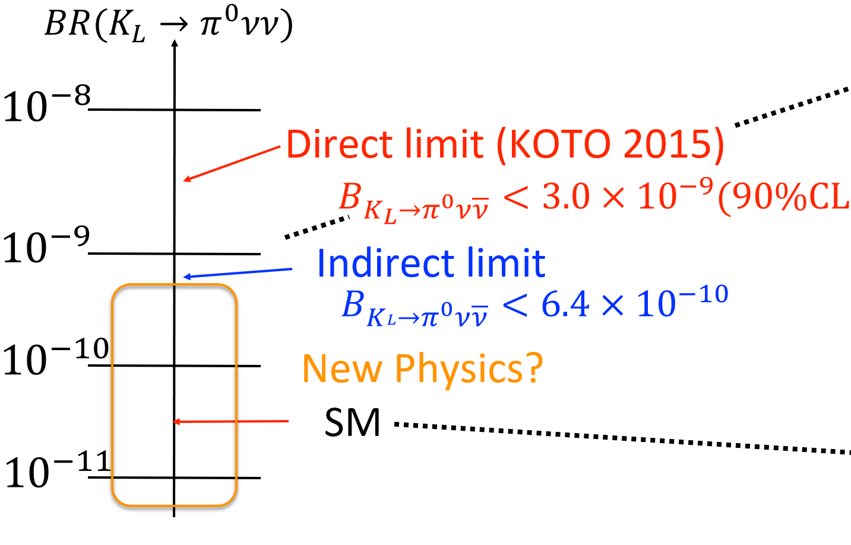
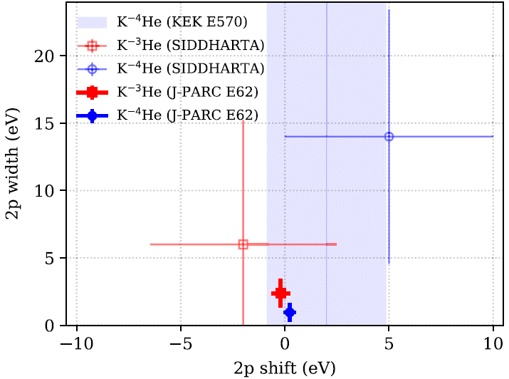
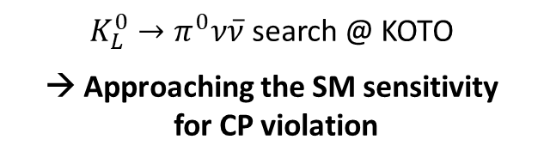
Achievements in research at the Hadron Experimental Facility
Flavor Physics
Hadron Physics
Strangeness Nuclear Physics
${K_{L}^{0}→π}^{0}ν\overline{ν}$ search @ KOTO
→ Approaching the SM sensitivity
for CP violation
Observation of an exotic hadron bound system including K⁻ meson
→ Established a new direction to understand meson-baryon int.
A lot of progress in hypernuclear research
Clarified attractive S=−2 ΞN interaction and deepened S=−1 ΛN, ΣN interactions
KOTO 2016-18
Observation of
Ξ hypernuclei
KOTO 2015
Single Event Sensitivity =
3 × 10⁻⁹
Kaonic nuclei,
”K-pp”
First precise hyperon-nucleon scattering
Pole position of Λ(1405)
Ultra-precise measurement of kaonic atoms
Charge-symmetry breaking in the
ΛN interaction

Slide 6
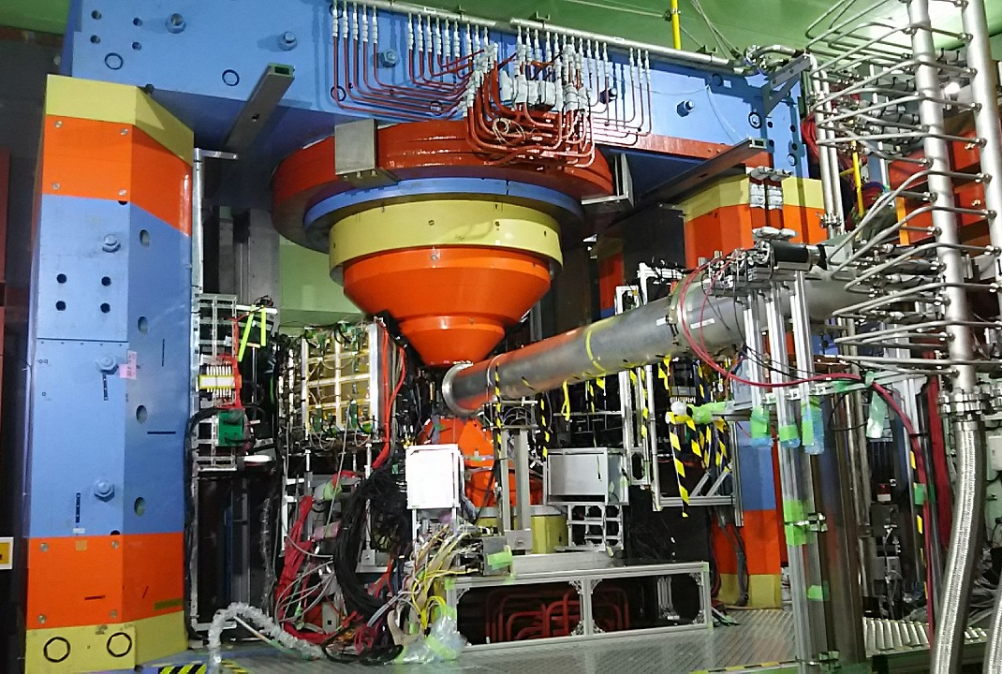
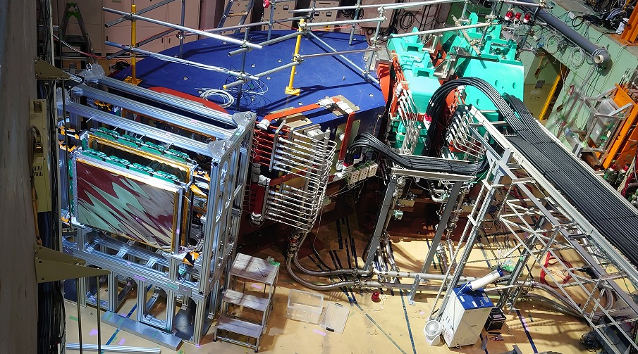
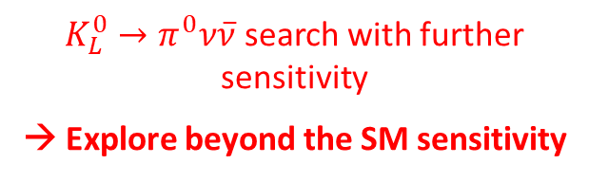
Further research directions at the Hadron Experimental Facility
Flavor Physics
Hadron Physics
Strangeness Nuclear Physics
Search for μ→e conversion @ COMET (2023~)
→ Search for charged lepton flavor violation
Measurement of spectral modification of φ meson in nuclei (2020~)
→ Attack mass-generation mechanism of hadrons
High-resolution spectroscopic study of
S=−2 Ξ-hypernuclei (2023~)
→ Provide accurate and systematic information on ΞN, ΛΛ interactions
Futher research
Futher research
Futher research
${K_{L}^{0}→π}^{0}ν\overline{ν}$ search with further sensitivity
→ Explore beyond the SM sensitivity
Charmed and muti-strange baryon spectroscopies
→ Establish diquark in baryon
Ultra-precise spectroscopy of S=−1 hypernuclei with a state-of-the-art spectrometer
→ Extract density dependence of ΛN int.

Slide 7
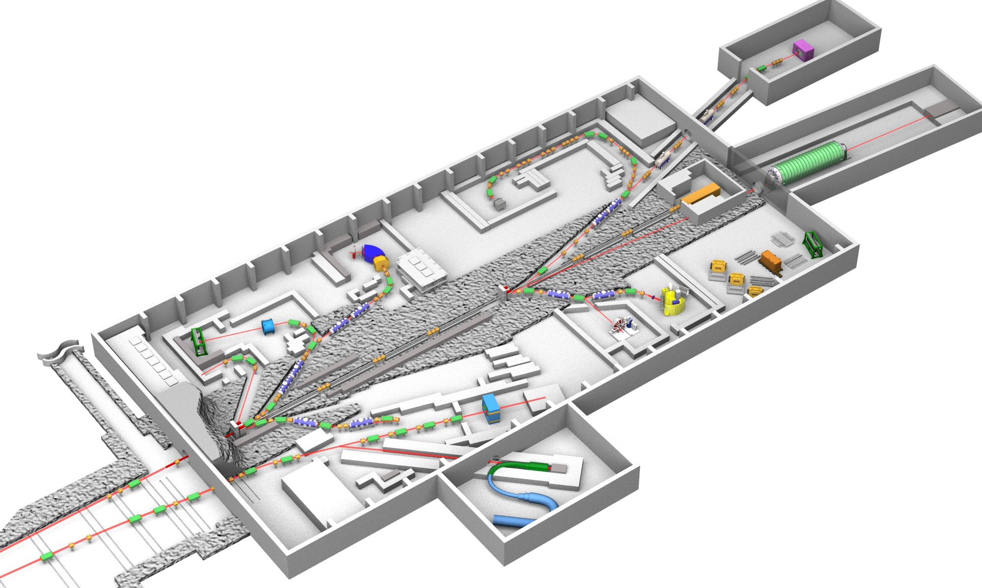
Hadron Experimental Facility extension (HEF-ex) Project
expand research programs
at the Hadron Experimental Facility
to further explore
Origin & Evolution of Matter
Present HEF
(2009～)
Extended HEF
K10
HIHR
K1.8
K1.8BR
K1.8
KL2
KL
T2
K1.8BR
T1
High-p
K1.1/K1.1BR
Test-BL
30 GeV
primary
proton beam
T1
High-p (π20)
COMET
Extended hall
1 production target (T1)
1 secondary-charged beamline (K1.8/K1.8BR)
1 neutral beamline (KL)
1 primary beamline (High-p)
1 muon beamline (COMET)
COMET
＋
1 new production target (T2)
4 new beamlines (HIHR, K1.1/K1.1BR, KL2, K10)
2 updated beamlines (High-p (π20), Test-BL)
＋
＋

Slide 8

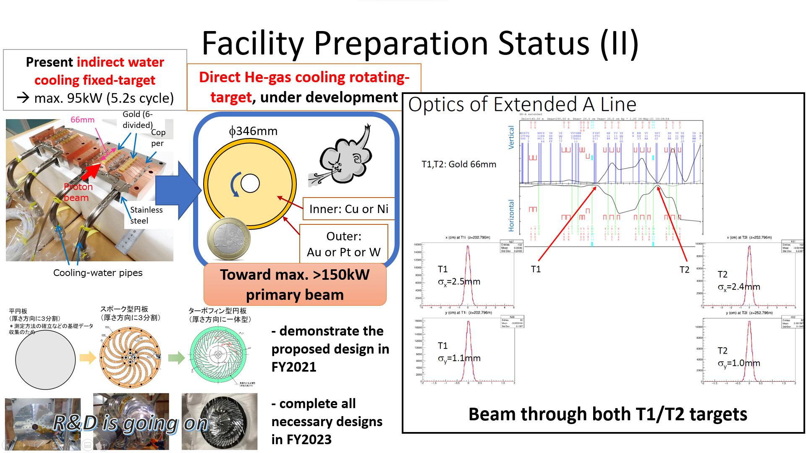
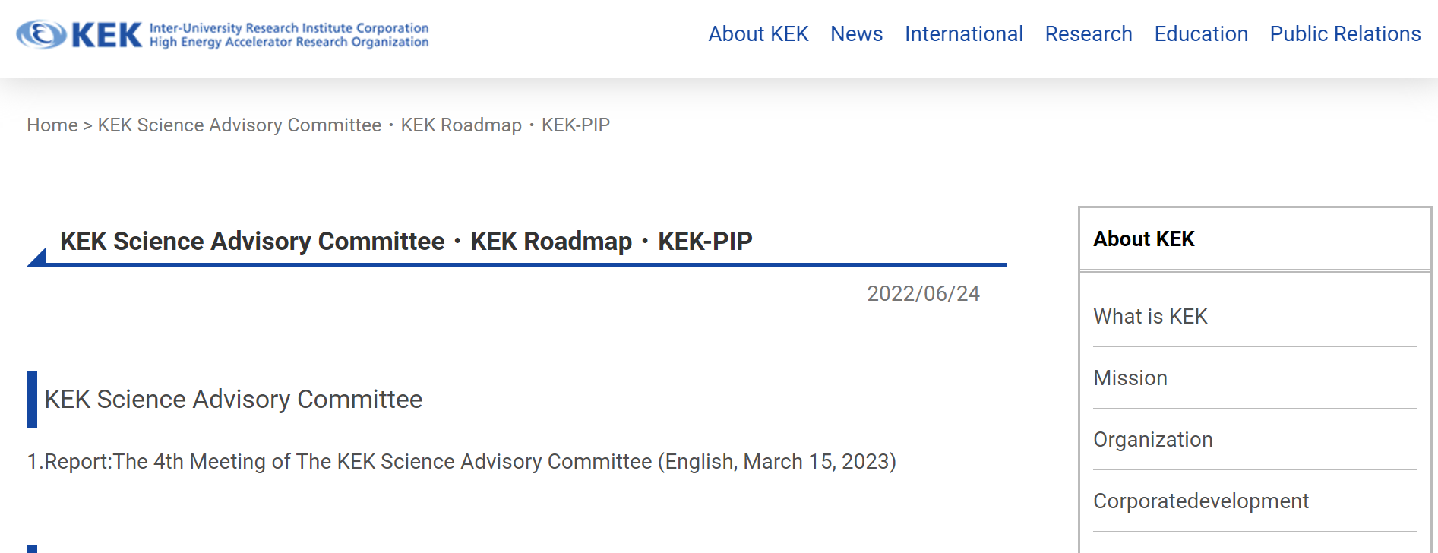
Present Status of the Extension Project
listed as a candidate for government funding:
  MEXT Roadmap 2020
  Science Council of Japan Master Plan 2020
2012, 2014
2011, 2014, 2017
The project was selected as the top-priority project to be budgeted in the KEK's mid-term plan (FY2022-26) at KEK-PIP2022 (Project Implementation Plan)
https://www.kek.jp/en/roadmap-en/
The project will soon start in full swing!

Slide 9
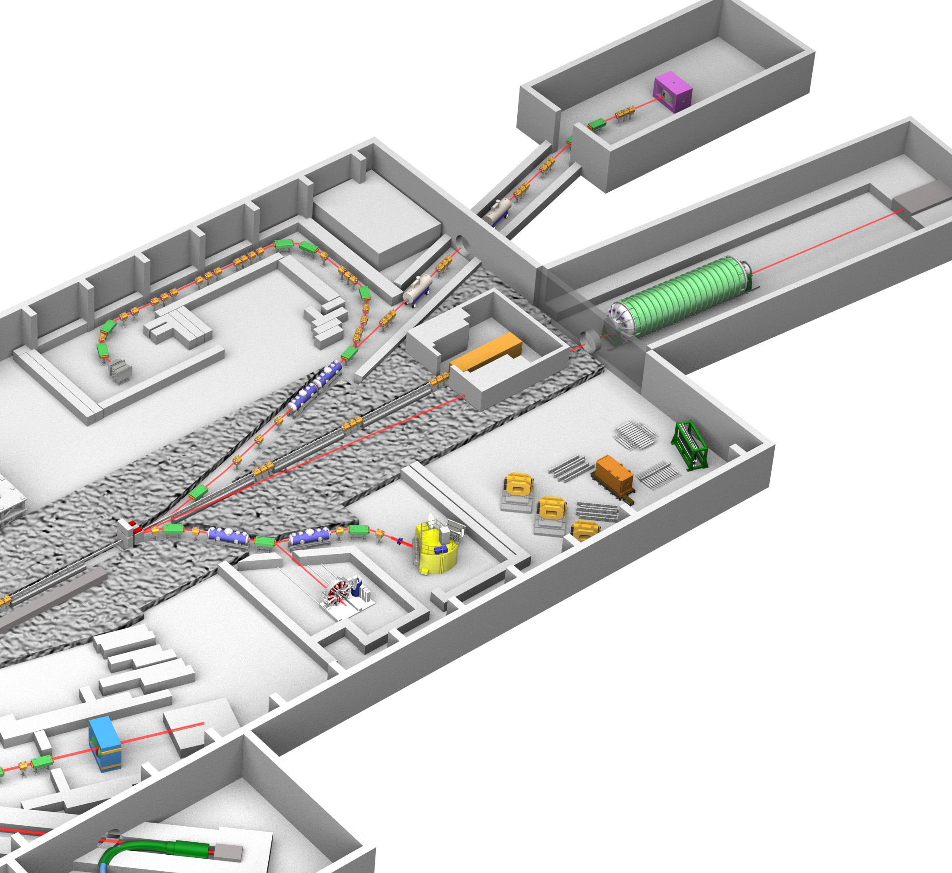

Expanded Research Programs at the Extended Facility
Extract density dependent ΛN interaction
HIHR
Ultra-high-resolution Λ hypernuclei spectroscopy
  intense dispersion matched π beam
Systematic ΛN scattering measurement
  intense polarized Λ beam
K10
K1.1
HIHR
Investigate diquarks in baryons
high-p
(π20)
High-resolution charm baryon spectroscopy
  intense high-momentum π beam
High-resolution multi-strange baryon spectroscopy
  intense high-momentum separated K beam
KL2
K10
Search for new physics beyond the SM
K1.1
KL2
Most sensitive ${K_{L}^{0}→π}^{0}ν\overline{ν}$ measurement
  intense neutral K beam
high-p (π20)

Slide 10

Expanded Research Programs at the Extended Facility
Extract density dependent ΛN interaction
HIHR
Ultra-high-resolution Λ hypernuclei spectroscopy
  intense dispersion matched π beam
Systematic ΛN scattering measurement
  intense polarized Λ beam
K10
K1.1
HIHR
Investigate diquarks in baryons
high-p
(π20)
High-resolution charm baryon spectroscopy
  intense high-momentum π beam
High-resolution multi-strange baryon spectroscopy
  intense high-momentum separated K beam
KL2
K10
Search for new physics beyond the SM
K1.1
KL2
Highest-sensitive ${K_{L}^{0}→π}^{0}ν\overline{ν}$ measurement
  intense neutral K beam
high-p (π20)

Slide 11
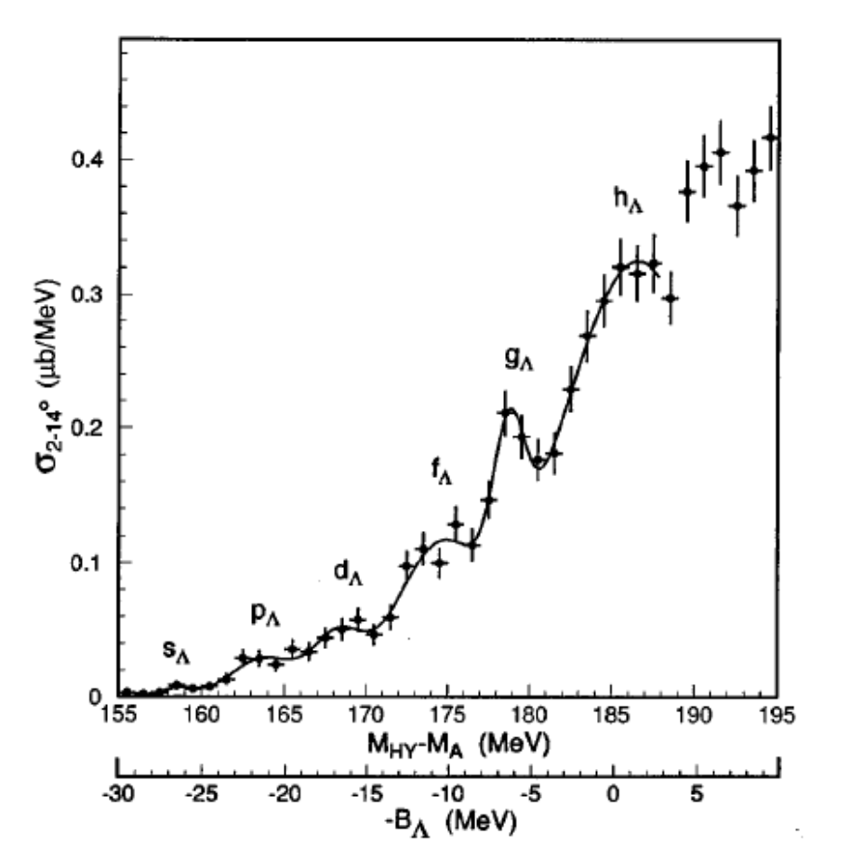
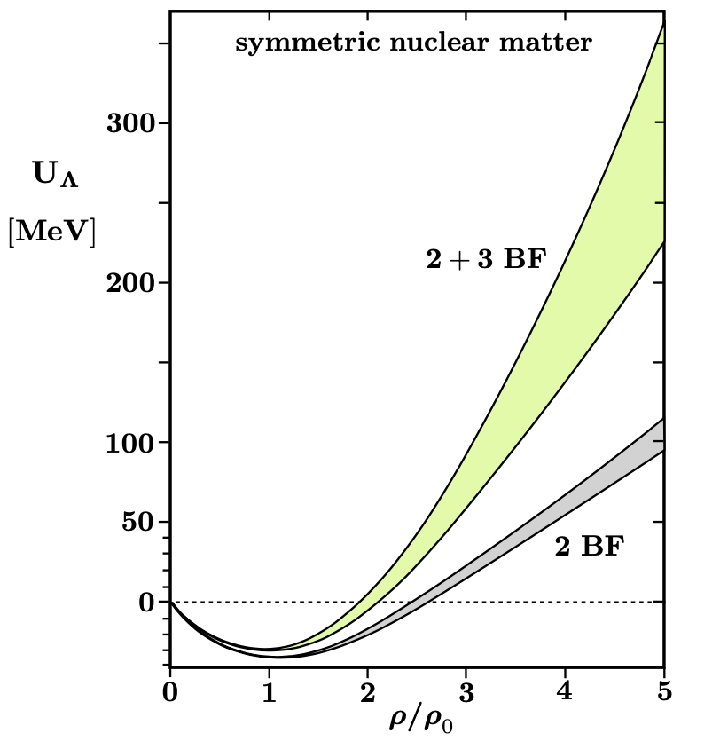
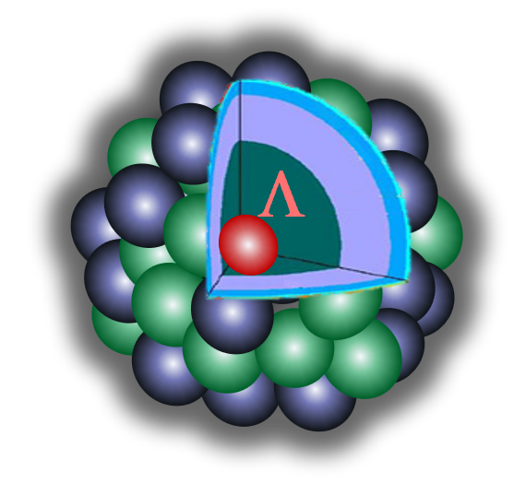
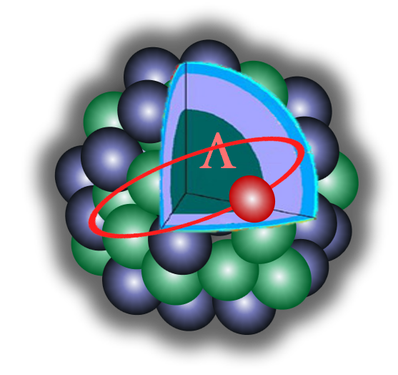
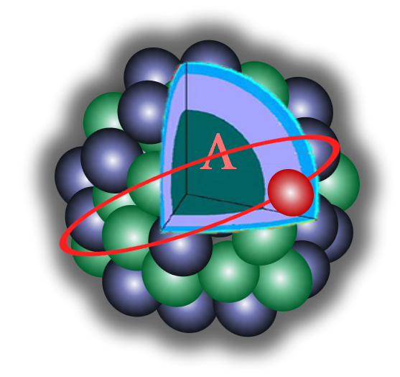
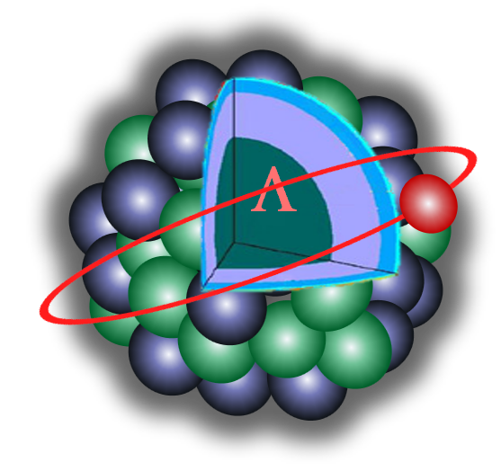
Strangeness Nuclear Physics: Hyperon in Dense Environment
Why can heavy neutron stars exist?
Hyperons (Λ, Ξ, ...) emerge in dense neutron star matter?
ΛNN 3 Baryon Force is a key
Past measurement @ KEK-PS
Low
High density
²⁰⁸_{Λ}Pb
ΔE ~ 2.2 MeV
heavy Λ-hypernuclei :
No sufficient resolution
D. Gerstung et al., Eur. Phys. J. A(2020) 56:175
Λ binding energies (B_{Λ})
→ density dependent ΛN interaction
→ We need precise measurements
Repulsive
Λ
neutron
We need to determine
a tiny fraction of 3 Baryon Force effects
proton
High density
Low density
Notes:
One of the biggest issues in strangeness nuclear physics is to solve the hyperon puzzle in neutron stars.
Important question is “What is the particle composition in the extremely high density in neutron star ? Do hyperons appear in neutron star ?”.
The hyperon’s appearance is a reasonable scenario to reduce the huge Fermi energy of neutrons.
However, the hyperon’s appearance also leads to the reduction of the pressure and makes it difficult to support the gravity of the massive neutron star.
Our purpose is to elucidate neutron stars from a microscopic approach in nuclear physics by incorporating a density-dependent LN interaction derived from L hypernuclei.
For this purpose, first, we have to establish the two-body LN interaction in free space, which is still uncertain due to the lack of Lp scattering data.
In the K1.1 beam line, we proposed precise measurement of differential cross sections and spin observables with a highly polarized L beam.
Then we will establish a reliable LN interaction in a collaboration with theorists.
Second, in order to determine the density-dependent LN interaction, high-resolution L hypernuclear spectroscopy is crucial and this is also proposed.
The nuclear density changes from the deep inside to the surface of the nucleus and each L orbital state includes the density dependence of LN interaction.
To deduce the density dependence, the clear separation of each L orbital state is necessary.
In the past measurement, the resolution was not enough for the separation.
In HIHR, by introducing the momentum dispersion-matching technique, the world-best resolution can be achieved and precise determination of L binding energy becomes possible for the first time.
By comparing the measured L binding energy with the theoretical calculation based on the reliable LN interaction from the scattering experiment, the density-dependent LN interaction will be determined.
Then we will attack the hyperon puzzle in neutron stars.

Slide 12
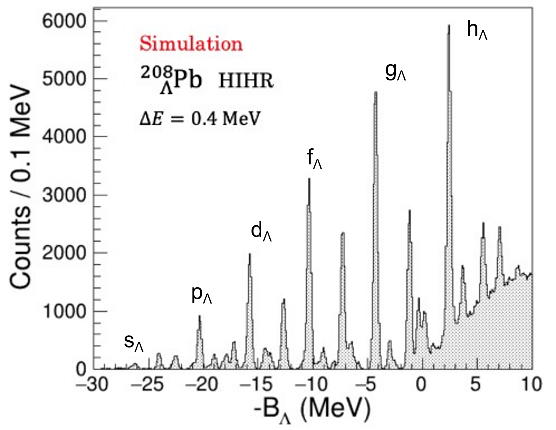

Strangeness Nuclear Physics: Hyperon in Dense Environment
Why can heavy neutron stars exist?
Hyperons (Λ, Ξ, ...) emerge in dense neutron star matter?
Need separation of each Λ orbital state
Past measurement @ KEK-PS
²⁰⁸_{Λ}Pb
ΔE ~ 2.2 MeV
No sufficient resolution
Λ
Λ
neutron
neutron
proton
proton
High density
Low density
High density
Low density
Notes:
One of the biggest issues in strangeness nuclear physics is to solve the hyperon puzzle in neutron stars.
Important question is “What is the particle composition in the extremely high density in neutron star ? Do hyperons appear in neutron star ?”.
The hyperon’s appearance is a reasonable scenario to reduce the huge Fermi energy of neutrons.
However, the hyperon’s appearance also leads to the reduction of the pressure and makes it difficult to support the gravity of the massive neutron star.
Our purpose is to elucidate neutron stars from a microscopic approach in nuclear physics by incorporating a density-dependent LN interaction derived from L hypernuclei.
For this purpose, first, we have to establish the two-body LN interaction in free space, which is still uncertain due to the lack of Lp scattering data.
In the K1.1 beam line, we proposed precise measurement of differential cross sections and spin observables with a highly polarized L beam.
Then we will establish a reliable LN interaction in a collaboration with theorists.
Second, in order to determine the density-dependent LN interaction, high-resolution L hypernuclear spectroscopy is crucial and this is also proposed.
The nuclear density changes from the deep inside to the surface of the nucleus and each L orbital state includes the density dependence of LN interaction.
To deduce the density dependence, the clear separation of each L orbital state is necessary.
In the past measurement, the resolution was not enough for the separation.
In HIHR, by introducing the momentum dispersion-matching technique, the world-best resolution can be achieved and precise determination of L binding energy becomes possible for the first time.
By comparing the measured L binding energy with the theoretical calculation based on the reliable LN interaction from the scattering experiment, the density-dependent LN interaction will be determined.
Then we will attack the hyperon puzzle in neutron stars.

Slide 13
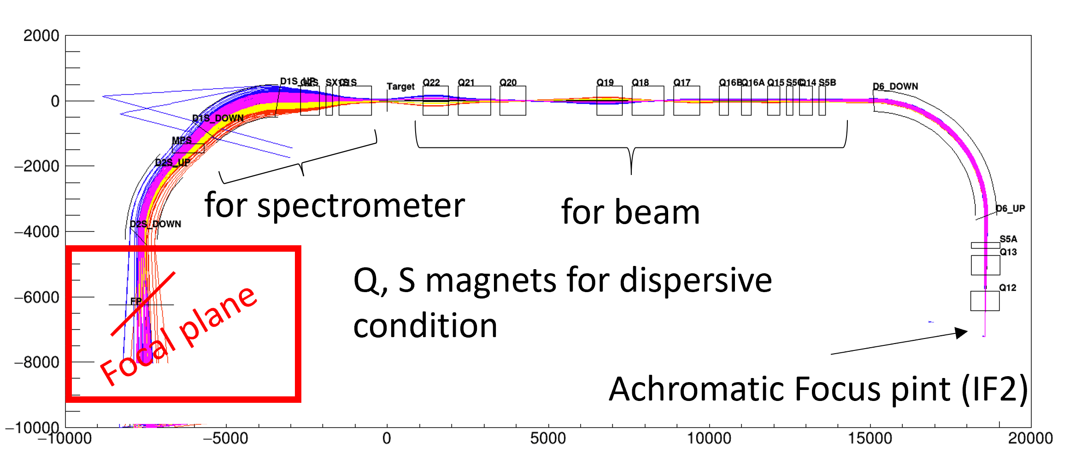
Strangeness Nuclear Physics: Hyperon in Dense Environment
Why can heavy neutron stars exist?
Hyperons (Λ, Ξ, ...) emerge in dense neutron star matter?
Ultra-high-resolution Λ-hyp. spectroscopy
HIHR beam line
(High-Intensity High-Resolution)
First dispersion-matching beam line in GeV energy
(π⁺,K⁺)
Δp/p = 10^{-4}
Achromatic Focus point
up to 2 GeV/c
Λ
No need for beam tracking
Intense π beam of > 10⁸ /pulse
Break through the resolution limit:
～2.2 MeV → better than ～0.4 MeV (FWHM)
neutron
proton
High density
Low density
Notes:
One of the biggest issues in strangeness nuclear physics is to solve the hyperon puzzle in neutron stars.
Important question is “What is the particle composition in the extremely high density in neutron star ? Do hyperons appear in neutron star ?”.
The hyperon’s appearance is a reasonable scenario to reduce the huge Fermi energy of neutrons.
However, the hyperon’s appearance also leads to the reduction of the pressure and makes it difficult to support the gravity of the massive neutron star.
Our purpose is to elucidate neutron stars from a microscopic approach in nuclear physics by incorporating a density-dependent LN interaction derived from L hypernuclei.
For this purpose, first, we have to establish the two-body LN interaction in free space, which is still uncertain due to the lack of Lp scattering data.
In the K1.1 beam line, we proposed precise measurement of differential cross sections and spin observables with a highly polarized L beam.
Then we will establish a reliable LN interaction in a collaboration with theorists.
Second, in order to determine the density-dependent LN interaction, high-resolution L hypernuclear spectroscopy is crucial and this is also proposed.
The nuclear density changes from the deep inside to the surface of the nucleus and each L orbital state includes the density dependence of LN interaction.
To deduce the density dependence, the clear separation of each L orbital state is necessary.
In the past measurement, the resolution was not enough for the separation.
In HIHR, by introducing the momentum dispersion-matching technique, the world-best resolution can be achieved and precise determination of L binding energy becomes possible for the first time.
By comparing the measured L binding energy with the theoretical calculation based on the reliable LN interaction from the scattering experiment, the density-dependent LN interaction will be determined.
Then we will attack the hyperon puzzle in neutron stars.

Slide 14
Strangeness Nuclear Physics: Hyperon in Dense Environment
Why can heavy neutron stars exist?
Hyperons (Λ, Ξ, ...) emerge in dense neutron star matter?
Ultra-high-resolution Λ-hyp. spectroscopy
HIHR beam line
(High-Intensity High-Resolution)
First dispersion-matching beam line in GeV energy
very precise
Λ-binding energies @ HIHR
&
2-body ΛN interaction @ K1.1
Density dependent ΛN interaction
(π⁺,K⁺)
Δp/p = 10^{-4}
Achromatic Focus point
up to 2 GeV/c
Λ
No need for beam tracking
Intense π beam of > 10⁸ /pulse
Break through the resolution limit:
～2.2 MeV → better than ～0.4 MeV (FWHM)
neutron
→ new understanding of neutron star matter
proton
High density
Low density
Notes:
One of the biggest issues in strangeness nuclear physics is to solve the hyperon puzzle in neutron stars.
Important question is “What is the particle composition in the extremely high density in neutron star ? Do hyperons appear in neutron star ?”.
The hyperon’s appearance is a reasonable scenario to reduce the huge Fermi energy of neutrons.
However, the hyperon’s appearance also leads to the reduction of the pressure and makes it difficult to support the gravity of the massive neutron star.
Our purpose is to elucidate neutron stars from a microscopic approach in nuclear physics by incorporating a density-dependent LN interaction derived from L hypernuclei.
For this purpose, first, we have to establish the two-body LN interaction in free space, which is still uncertain due to the lack of Lp scattering data.
In the K1.1 beam line, we proposed precise measurement of differential cross sections and spin observables with a highly polarized L beam.
Then we will establish a reliable LN interaction in a collaboration with theorists.
Second, in order to determine the density-dependent LN interaction, high-resolution L hypernuclear spectroscopy is crucial and this is also proposed.
The nuclear density changes from the deep inside to the surface of the nucleus and each L orbital state includes the density dependence of LN interaction.
To deduce the density dependence, the clear separation of each L orbital state is necessary.
In the past measurement, the resolution was not enough for the separation.
In HIHR, by introducing the momentum dispersion-matching technique, the world-best resolution can be achieved and precise determination of L binding energy becomes possible for the first time.
By comparing the measured L binding energy with the theoretical calculation based on the reliable LN interaction from the scattering experiment, the density-dependent LN interaction will be determined.
Then we will attack the hyperon puzzle in neutron stars.

Slide 15
Expanded Research Programs at the Extended Facility
Extract density dependent ΛN interaction
HIHR
Ultra-high-resolution Λ hypernuclei spectroscopy
  intense dispersion matched π beam
Systematic ΛN scattering measurement
  intense polarized Λ beam
K10
K1.1
HIHR
Investigate diquarks in baryons
high-p
(π20)
High-resolution charm baryon spectroscopy
  intense high-momentum π beam
High-resolution multi-strange baryon spectroscopy
  intense high-momentum separated K beam
KL2
K10
Search for new physics beyond the SM
K1.1
KL2
Highest-sensitive ${K_{L}^{0}→π}^{0}ν\overline{ν}$ measurement
  intense neutral K beam
high-p (π20)

Slide 16
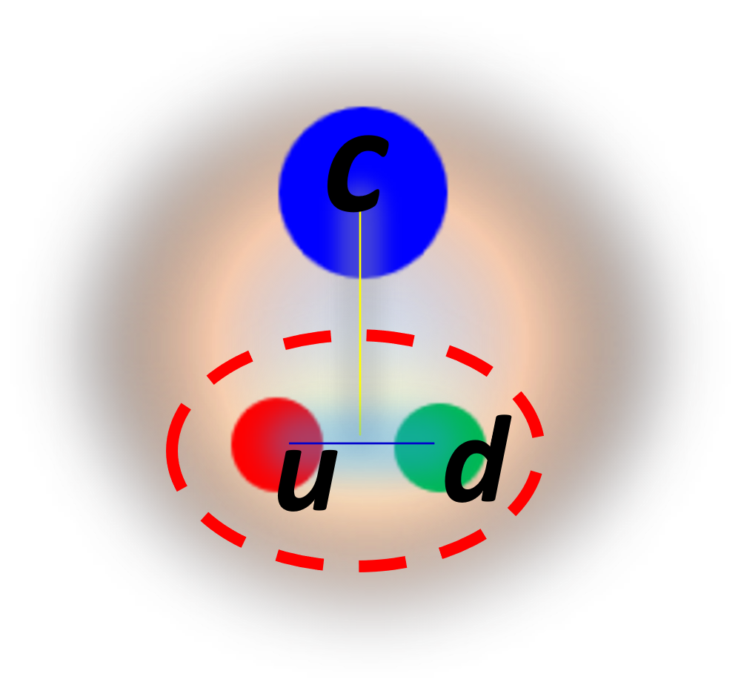
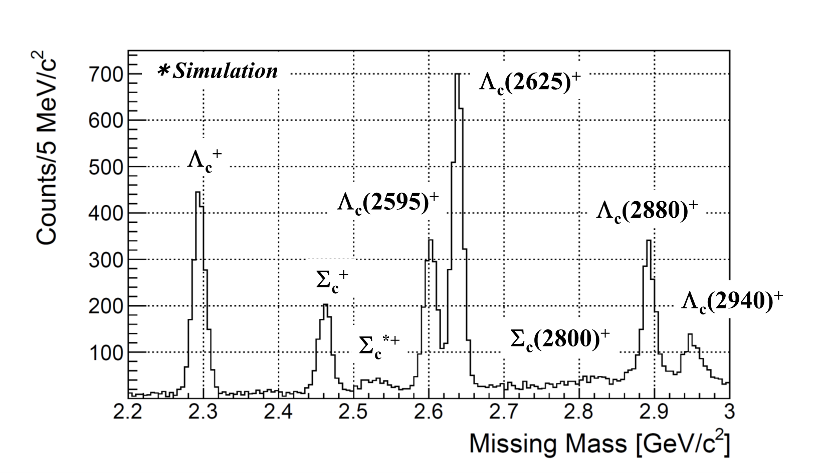
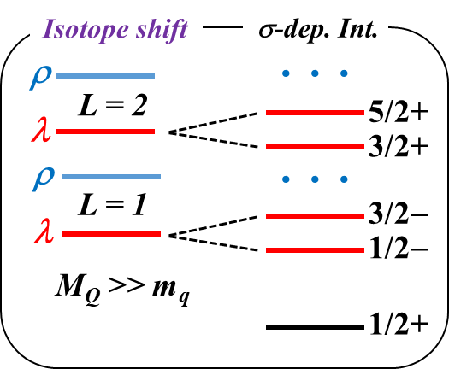
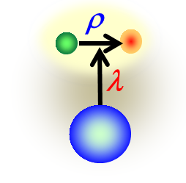
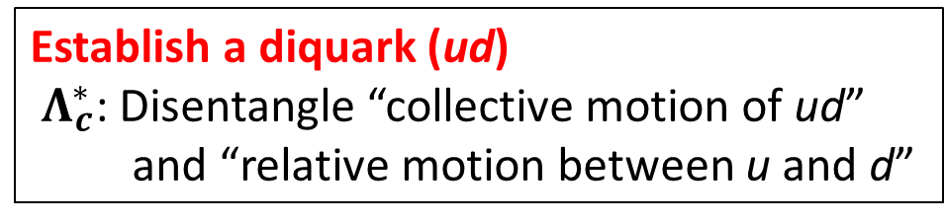

Hadron Physics: Diquarks in Baryons
Behaver of non-perturbative QCD in low energy regime
How quarks build hadrons?
Investigate diquarks in baryons toward understanding of dense quark matter
Charm Baryon Spectroscopy
using intense high-momentum π beam @ High-p (π20)
$$Λ_{c}^{∗}$$
Establish a diquark (ud)
$Λ_{c}^{∗}$: Disentangle “collective motion of ud” and “relative motion between u and d”
diquark
ud
p(π⁻,D*⁻)X
Diquark
Production rate of charm baryon
Charm quark
“production rate” and “decay rate”
will give us information about diquark
Mass of charm baryon

Slide 17
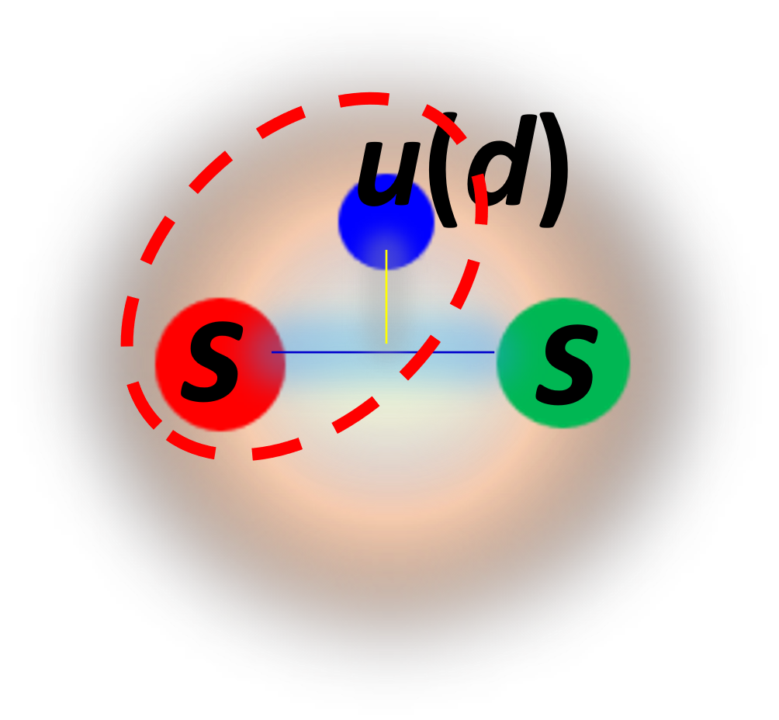
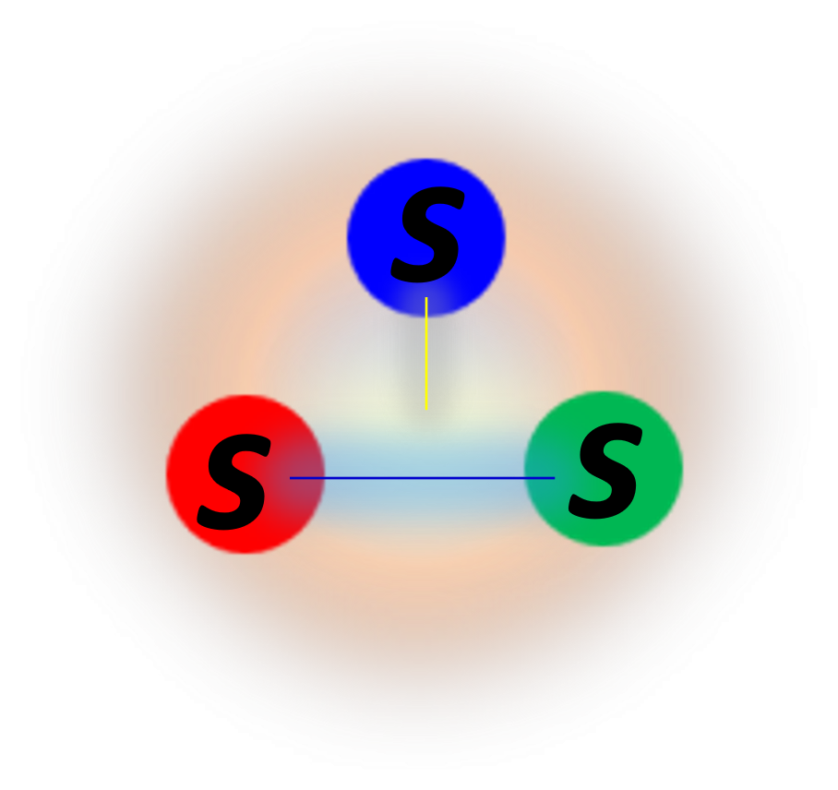
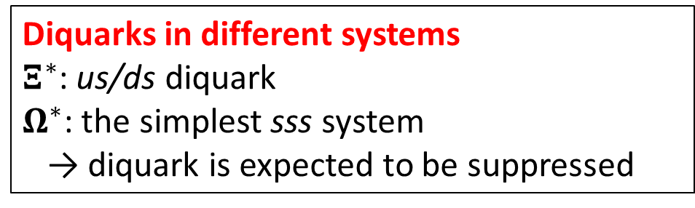
Hadron Physics: Diquarks in Baryons
Behaver of non-perturbative QCD in low energy regime
How quarks build hadrons?
Investigate diquarks in baryons toward understanding of dense quark matter
Charm Baryon Spectroscopy
using intense high-momentum π beam @ High-p (π20)
$$Λ_{c}^{∗}$$
Establish a diquark (ud)
$Λ_{c}^{∗}$: Disentangle “collective motion of ud” and “relative motion between u and d”
diquark
Multi-Strange Baryon Spectroscopy
ud
using intense high-momentum K beam @ K10
us/ds
$$Ξ^{∗}$$
$$Ω^{∗}$$
    Diquarks in different systems
    $Ξ^{∗}$: us/ds diquark
    $Ω^{∗}$: the simplest sss system
    → diquark is expected to be suppressed
diquark
Systematic measurements will reveal
the internal structure of baryons through the diquarks

Slide 18
Expanded Research Programs at the Extended Facility
Extract density dependent ΛN interaction
HIHR
Ultra-high-resolution Λ hypernuclei spectroscopy
  intense dispersion matched π beam
Systematic ΛN scattering measurement
  intense polarized Λ beam
K10
K1.1
HIHR
Investigate diquarks in baryons
high-p
(π20)
High-resolution charm baryon spectroscopy
  intense high-momentum π beam
High-resolution multi-strange baryon spectroscopy
  intense high-momentum separated K beam
KL2
K10
Search for new physics beyond the SM
K1.1
KL2
Highest-sensitive ${K_{L}^{0}→π}^{0}ν\overline{ν}$ measurement
  intense neutral K beam
high-p (π20)

Slide 19
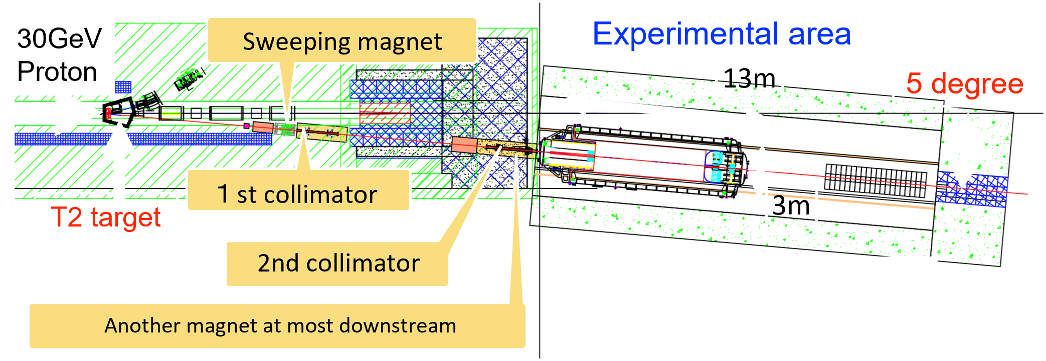

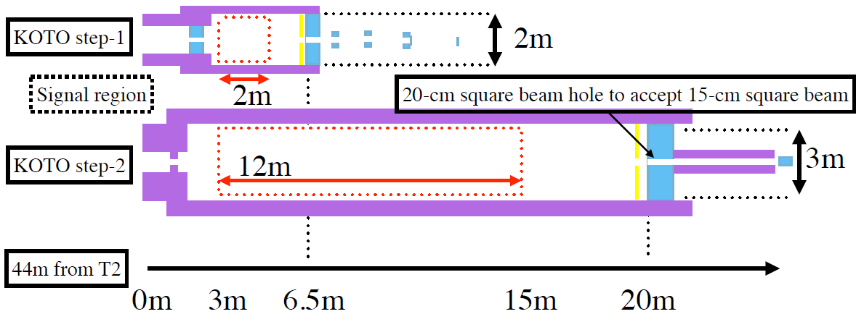

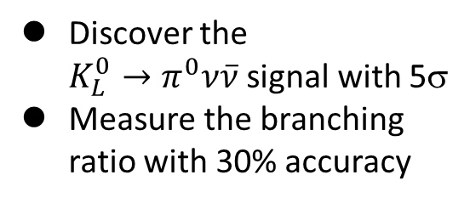
Flavor Physics: New Physics Search at KOTO Step-2
Is there new physics beyond the Standard Model?
Rare kaon decay: ${K_{L}^{0}→π}^{0}ν\overline{ν}$
Directly break CP symmetry
Suppressed in the SM → Branching ratio 〜 3×10⁻¹¹
Small theoretical uncertainties (〜2%)
One of the best probes for new physics searches
Step-2
New physics search with
world’s highest sensitivity
more than 100 times
Extraction angle:
16 deg → 5 deg
Intense neutral kaon beam @KL2 (~x2.6)
Discover the ${K_{L}^{0}→π}^{0}ν\overline{ν}$signal with 5σ
Measure the branching ratio with 30% accuracy
Indicate new physics, if deviation form the SM > 40%
Ultra-high sensitivity detector (~x70)

Slide 20
Summary of the Extension Project of the J-PARC Hadron Experimental Facility
Unique research programs both in particle and nuclear physics at high-intensity frontier
K10
HIHR
World’s leading research programs in the fields of strangeness-nuclear/hadron/flavor physics
K1.8
KL2
Top-priority project in the KEK's mid-term plan (FY2022-26) / Progress in facility-side preparation
→ The project will start soon
T2
K1.8BR
K1.1/K1.1BR
Test-BL
T1
High-p (π20)
Extended hall
Stay tuned!
COMET
Notes:
OK, so now, we summarize the talk.
At the J-PARC hadron experimental facility, unique research programs have been conducted both in particle and nuclear physics at the high-intensity frontier.
There, the world’s leading research programs in the fields of strangeness-nuclear physics, hadron physics, and flavor physics have been promoted.
We obtained a high evaluation from the international review committee, and facility-side preparation has progressed.
Therefore, the project can start in 2023.

Slide 21
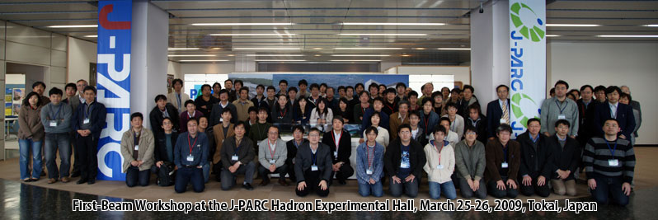



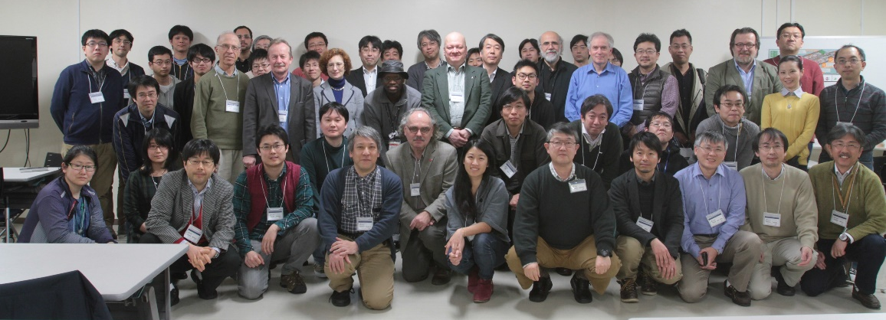
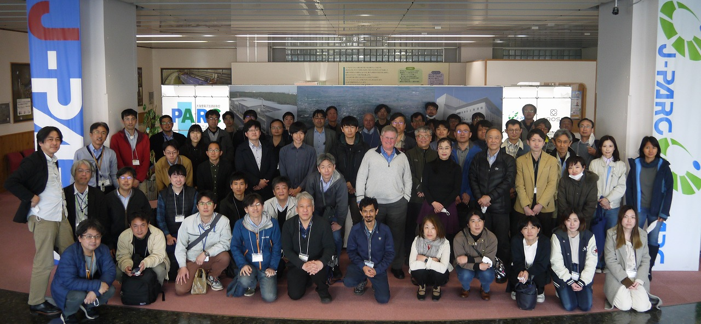

Thank you for your attention!
https://www.rcnp.osaka-u.ac.jp/~jparchua/en/hefextension.html
International WS on the Extension Project for the J-PARC Hadron Experimental Facility (J-PARC HEF-ex WS), 7-9 July 2021, online
2nd International WS on the Extension Project for the J-PARC Hadron Experimental Facility (2nd J-PARC HEF-ex WS), Feb.16-18 2022, online
First-Beam WS at the J-PARC Hadron Experimental Hall
25-26 March 2009, IQBRC, Tokai
3rd International WS on the Extension Project for the J-PARC Hadron Experimental Facility (3rd J-PARC HEF-ex WS), Mar.14-16 2023, J-PARC
International WS on physics
at the extended hadron experimental facility of J-PARC
5-6 March 2016, KEK Tokai Campus
International WS on the project for
the extended hadron experimental facility of J-PARC
26-28 March 2018, KEK Tokai Campus
Extension workshops are held annually → We are planning the 4th WS for next Feb-Mar.

Slide 23

(Fastest) Timeline of the Project
 | FY2022 | FY2023 | FY2024 | FY2025 | FY2026 | FY2027 | FY2028 | FY2029 | FY2030 | FY2031
Hadron Hall
MR accelerator
Upgrade
Start of HK
construction parallel to beam operation in the first 4 years,
beam-suspension in the next 2.5 years
Start of
budget
request
The Extension Project of Hadron Experimental Facility (7 years)
Current Programs
with SX Power towards 100kW
Hall Extension
Expanded Programs
We will soon start the project
→ We are working on getting the timeline consistent with current programs

