Slide 1




New Kaonic Nuclei Project at J-PARC
– from the $\overline{K}N$ to $\overline{K}NNNN$ systems –
F. Sakuma, RIKEN
on behalf of
the J-PARC E15/E73/T77/E80/P89 collaboration
ECT*, SPICE, May 13-17, 2024

Slide 2
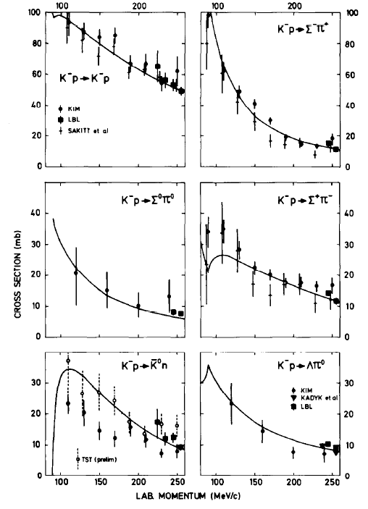
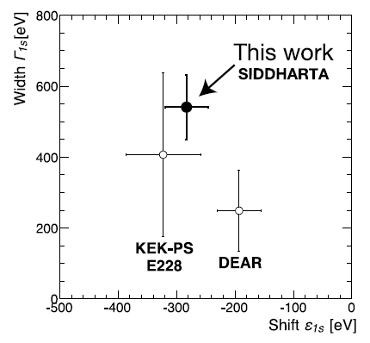

Physics Goal
Reveal the meson properties inside nuclei via the $\overline{K}N$ interaction
A powerful probe to understand low energy QCD
Strongly attractive in I=0 from extensive measurements
Kaonic nuclei can access
$\overline{K}N$ int. below the threshold
"K⁻pp" @ E15
PLB789(2019)620.
PRC102(2020)044002.
K⁻N scattering
NPB179(1981)33.
K⁻p atom
PLB704(2011)113.

Slide 3

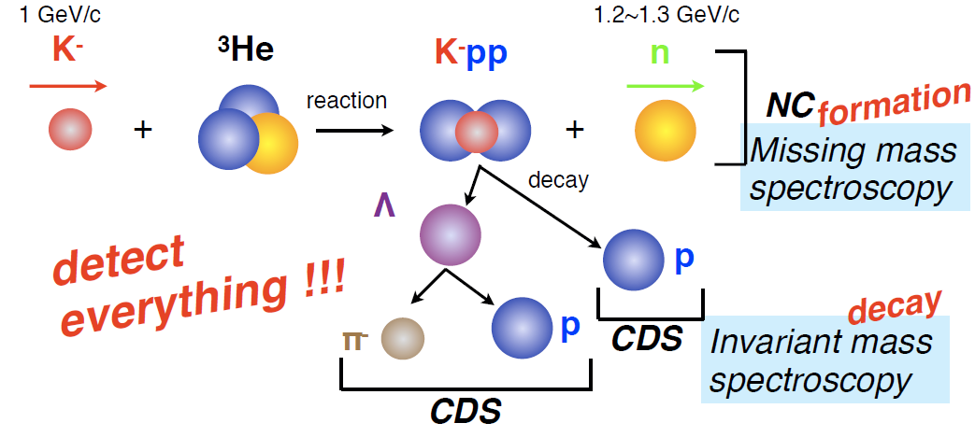
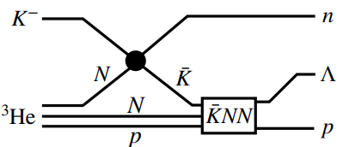

“K⁻pp” Search ＠ J-PARC E15
³He(in-flight K⁻,n) reaction @ 1.0 GeV/c
  multi-NA and Y decays can be discriminated kinematically
with intense K⁻ bean @ J-PARC
Low momentum $\overline{K}$

Slide 4
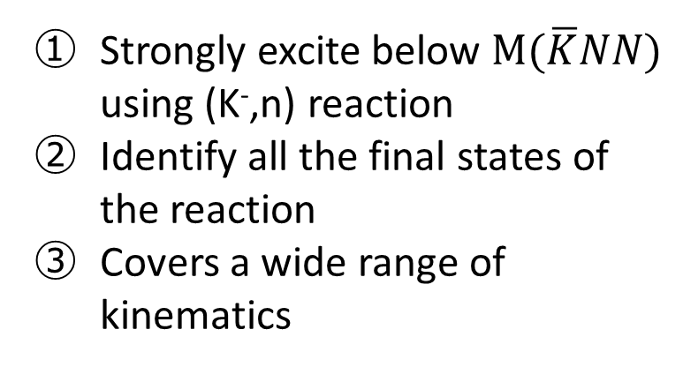
“K⁻pp” Search ＠ J-PARC E15
³He(in-flight K⁻,n) reaction @ 1.0 GeV/c
  multi-NA and Y decays can be discriminated kinematically
semi-inclusive ³He(K⁻,n)
PTEP (2015) 061D01.
Key points of the experiment
Strongly excite below $M(\overline{K}NN)$ using (K⁻,n) reaction
Identify all the final states of the reaction
Covers a wide range of kinematics
exclusive (K⁻,Λp)n_{missing}
PTEP (2016) 051D01.,
PLB789(2019)620., PRC102(2020)044002.

Slide 5
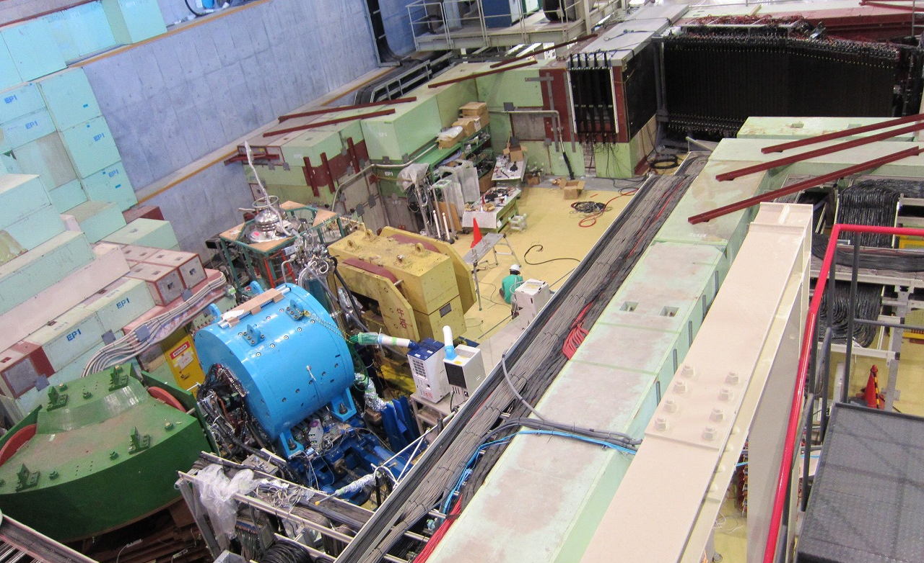
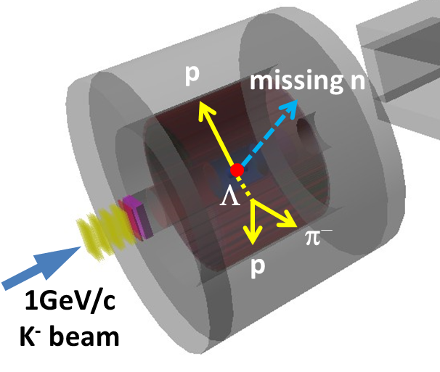
Experimental Setup @ K1.8BR
K.Agari et, al., PTEP(2021)02B011
Beam Dump
Beam Sweeping Magnet
Neutron Counter
Charge Veto Counter
Proton Counter
Liquid ³He-target System
Cylindrica Detector System
(CDS)
Beam Line
Spectrometer

Slide 6
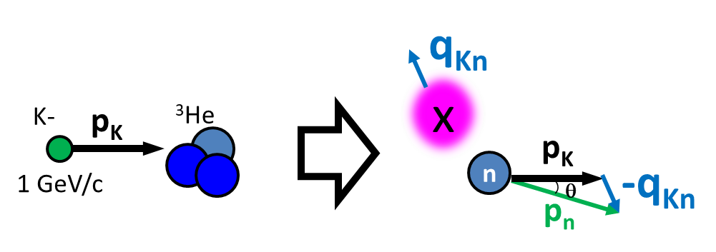
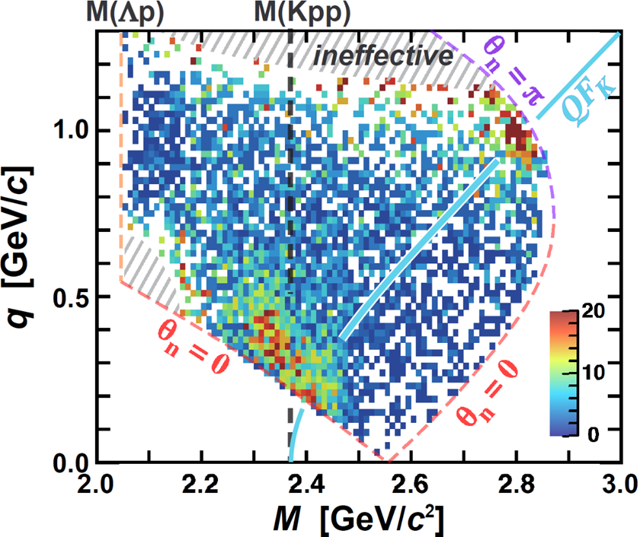
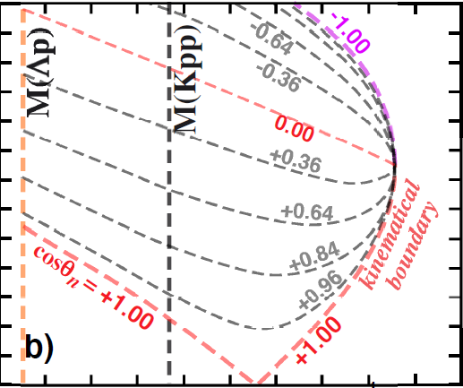
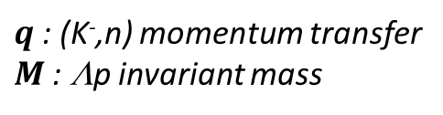
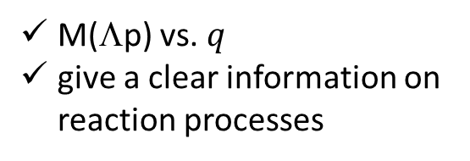
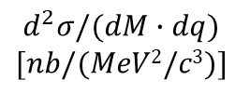
“K⁻pp” Search w/ Momentum Transfer Analysis
$$d^{2}σ/(dM∙dq)$$
$$[nb/(MeV2/c3)]$$
K⁻
³He
1 GeV/c
Bound
Un-bound
“x”
n
p
Momentum transfer analysis using the (K⁻,n) reaction
n
acceptance &
efficiency
corrected
Λ
  M(Λp) vs. $q$
  give a clear information on reaction processes
If a bound state exists, there is a peak structure independent of q below the M(Kpp)
$q$: (K⁻,n) momentum transfer
$M$: Λp invariant mass

Slide 7
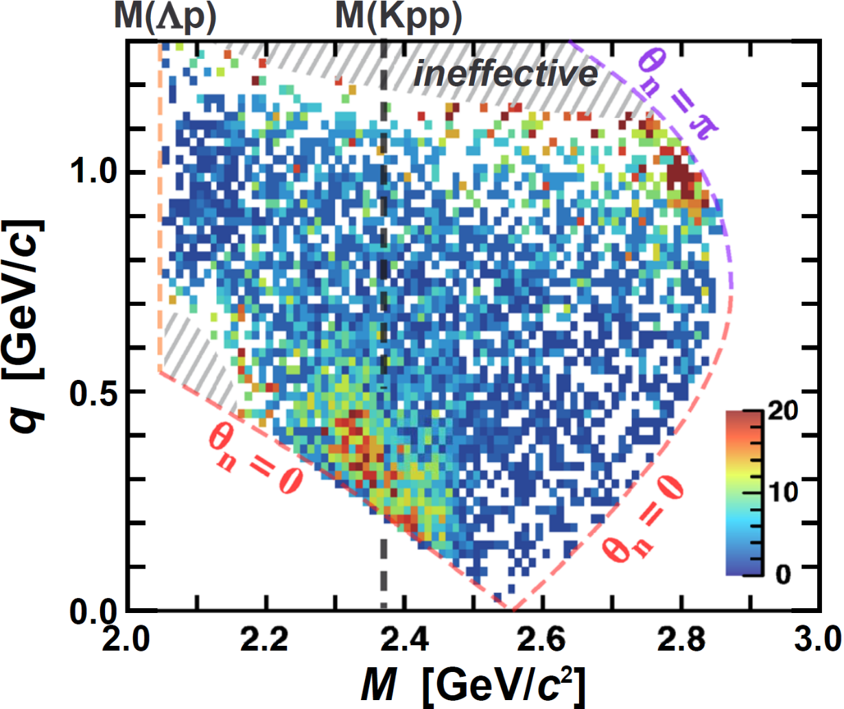
“K⁻pp” Search w/ Momentum Transfer Analysis
PLB789(2019)620., PRC102(2020)044002.
$$d^{2}σ/(dM∙dq)$$
$$[nb/(MeV2/c3)]$$
K⁻
³He
1 GeV/c
Bound
Un-bound
“x”
n
p
Momentum transfer analysis using the (K⁻,n) reaction
n
acceptance &
efficiency
corrected
Λ
  M(Λp) vs. $q$
  give a clear information on reaction processes
A peak structure independent of q =
A bound state exists
$q$: (K⁻,n) momentum transfer
$M$: Λp invariant mass

Slide 8
“K⁻pp” Search w/ Momentum Transfer Analysis
Quasi-free K⁻ scattering
（+2NA absorption）
PLB789(2019)620., PRC102(2020)044002.
$$d^{2}σ/(dM∙dq)$$
$$[nb/(MeV2/c3)]$$
K⁻
³He
1 GeV/c
Bound
Un-bound
p
K⁻
n
p
p
Momentum transfer analysis using the (K⁻,n) reaction
n
acceptance &
efficiency
corrected
Λ
  M(Λp) vs. $q$
  give a clear information on reaction processes
A peak structure independent of q =
A bound state exists
$q$: (K⁻,n) momentum transfer
$M$: Λp invariant mass

Slide 9

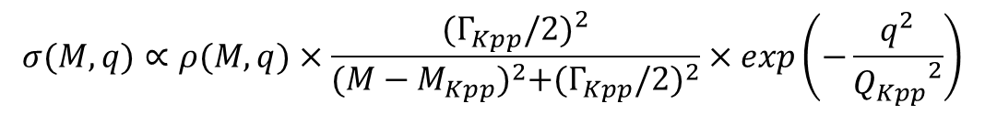
A PWIA-based Interpretation
Energy term (BW type) from time integral
Momentum term from spatial integral
Plane Wave Impulse Approximation
$$σ(M,q)∝ρ(M,q)×\frac{{(Γ_{Kpp}/2)}^{2}}{{(M−M_{Kpp})}^{2}+{(Γ_{Kpp}/2)}^{2}}×exp\left(−\frac{q^{2}}{{Q_{Kpp}}^{2}}\right)$$
Fit with PWIA
PRC102(2020)044002.
Deep binding = Strong K^{bar}N int.
Large Q = Suggest a compact system
B_{Kpp}(BW) ~ 40 MeV, Γ_{Kpp}(BW) ~ 100 MeV
Q_{kpp} ~ 400 MeV
Binding energy
Decay width
Form factor

Slide 10
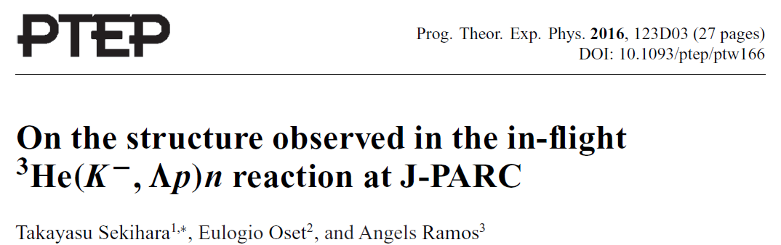
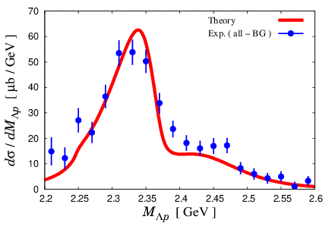
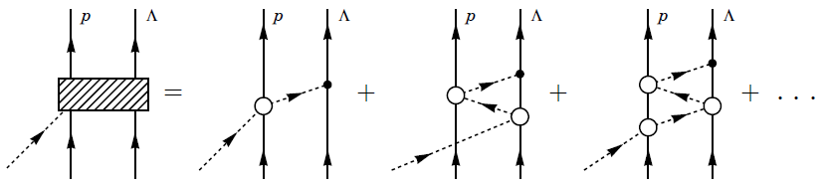
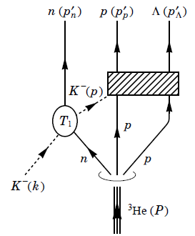

A Theoretical Interpretation
A calculation based on chiral unitary approach reproduces the data well using the $\overline{K}NN$ bound state
K^{bar}NN
bound state
Quasi-free K⁻ scattering
（+2NA absorption）
M(Kpp)
Theoretical investigations are indispensable!
(BG subtracted)
T.Sekihara 2022

Slide 11
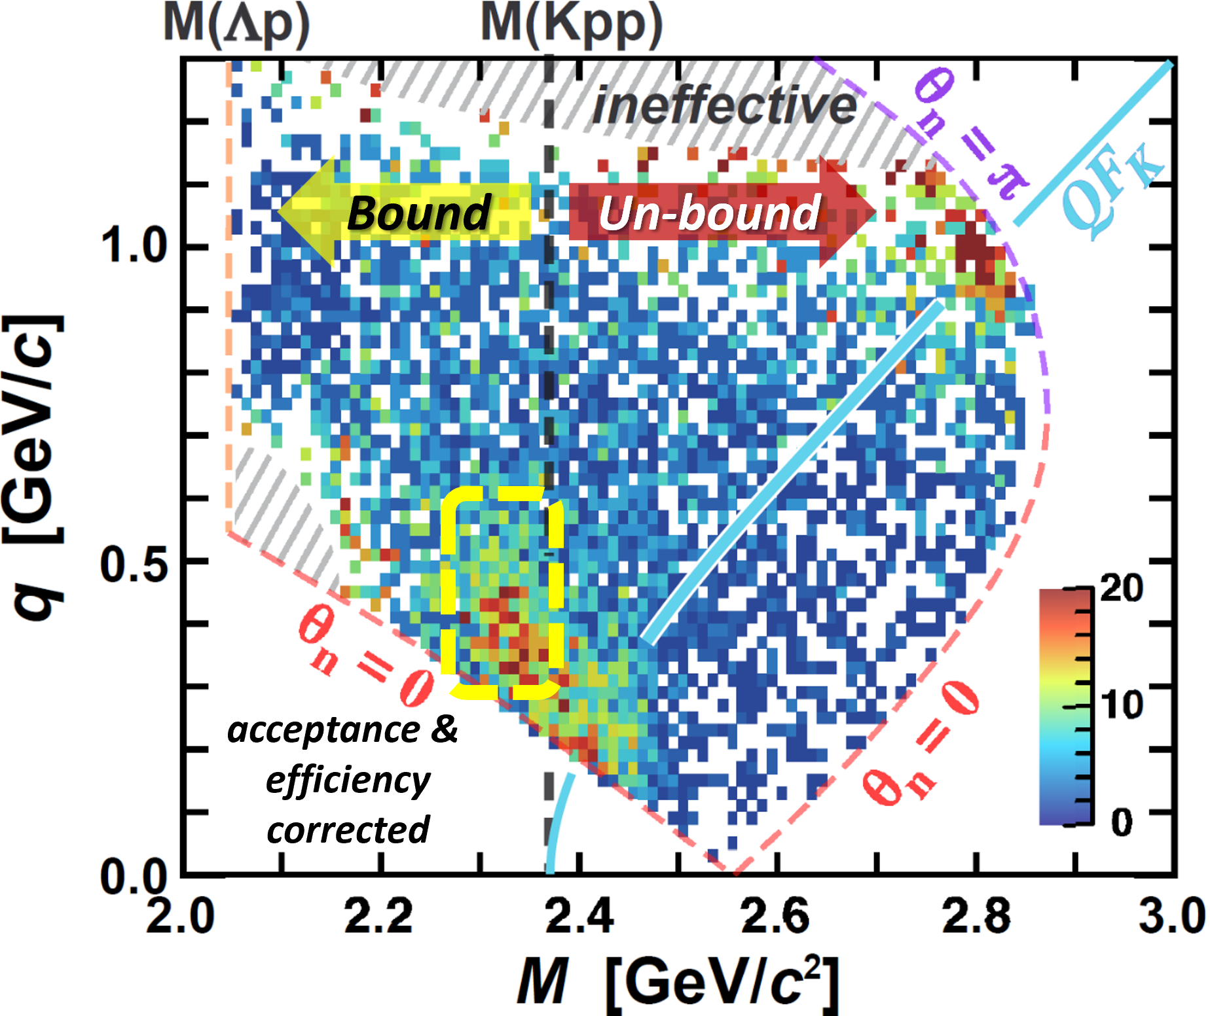
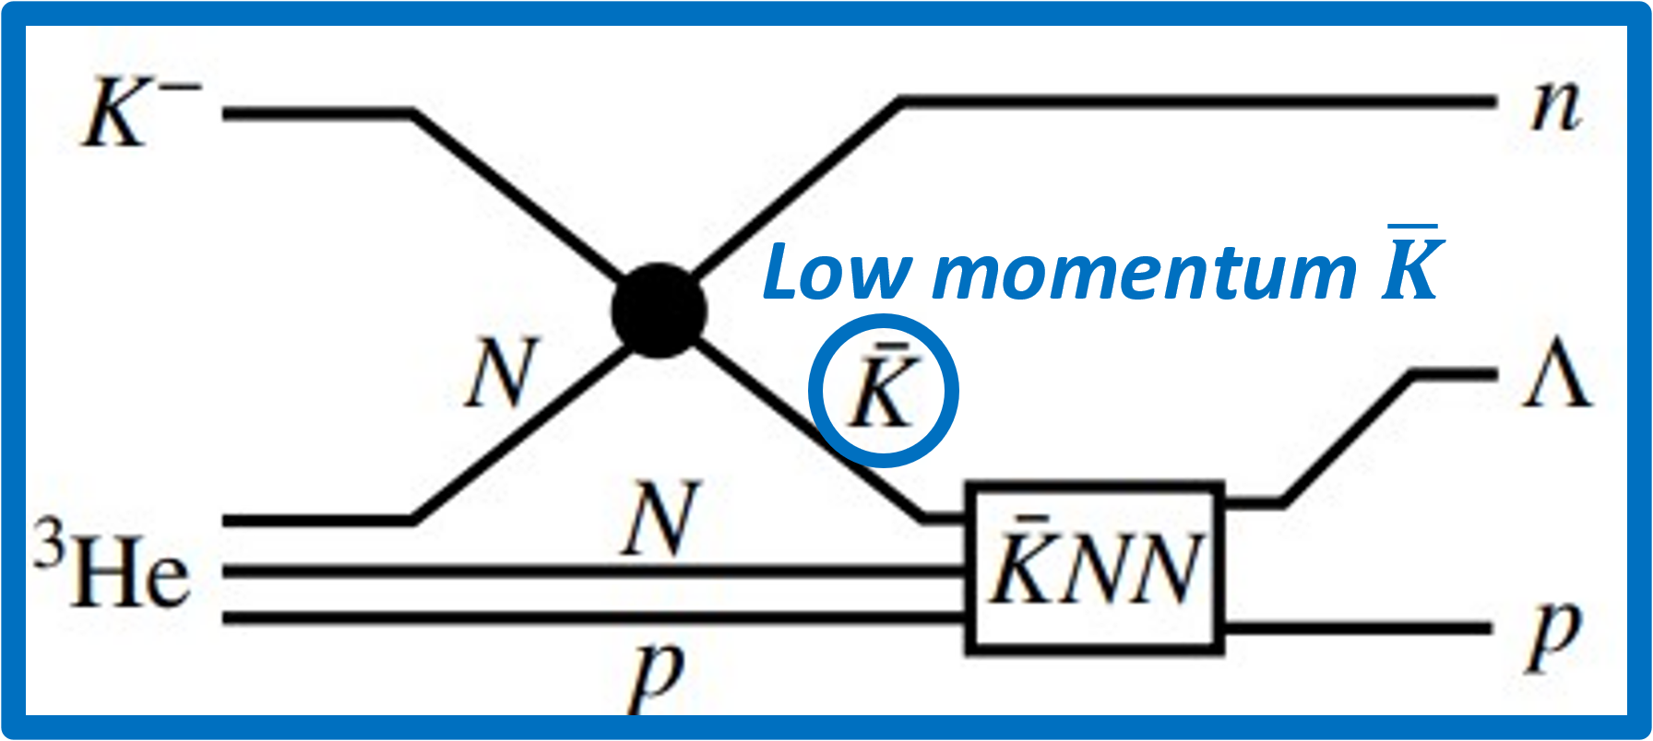
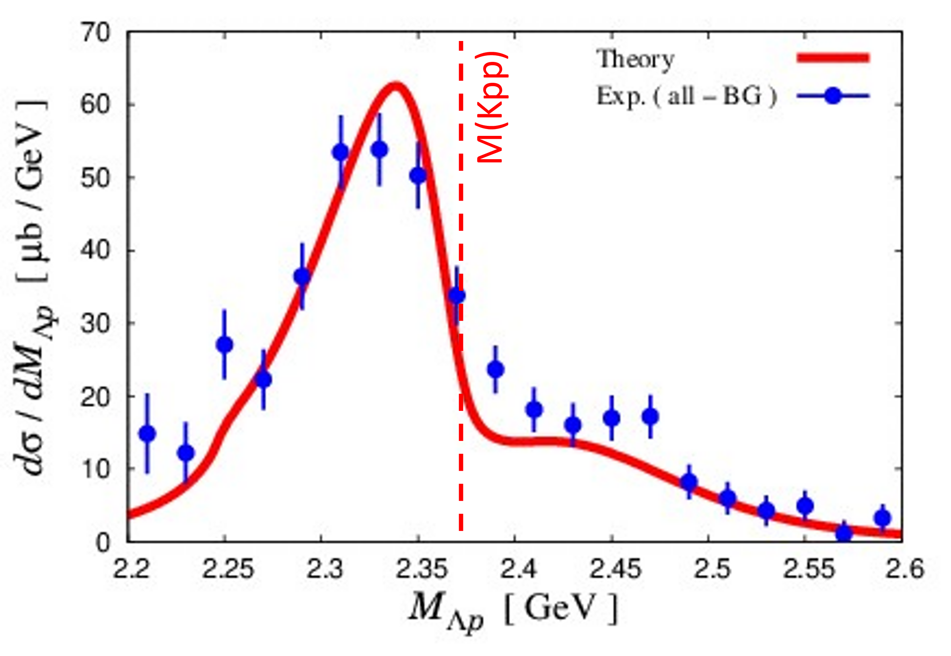
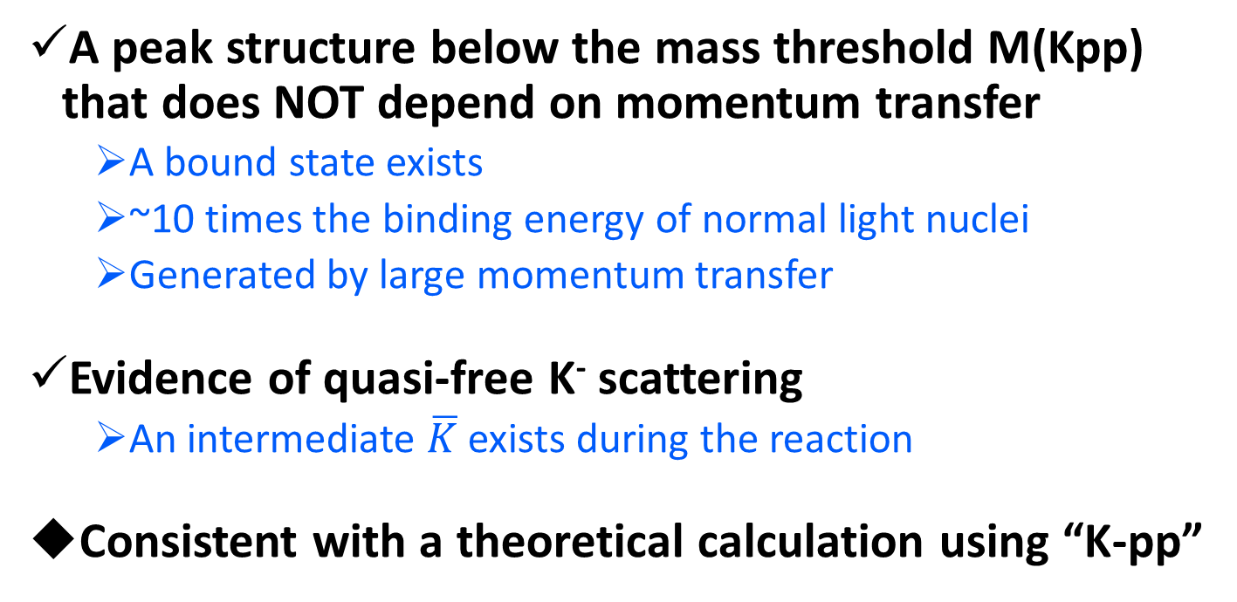
What We Observed at E15 [Discussion]
A peak structure below the mass threshold M(Kpp) that does NOT depend on momentum transfer
  A bound state exists
  ~10 times the binding energy of normal light nuclei
  Generated by large momentum transfer
Evidence of quasi-free K⁻ scattering
  An intermediate $\overline{K}$ exists during the reaction
Consistent with a theoretical calculation using “K-pp”
Observed bound state = “K-pp” bound state
→ Suggests possibility of being in a compact system

Slide 12
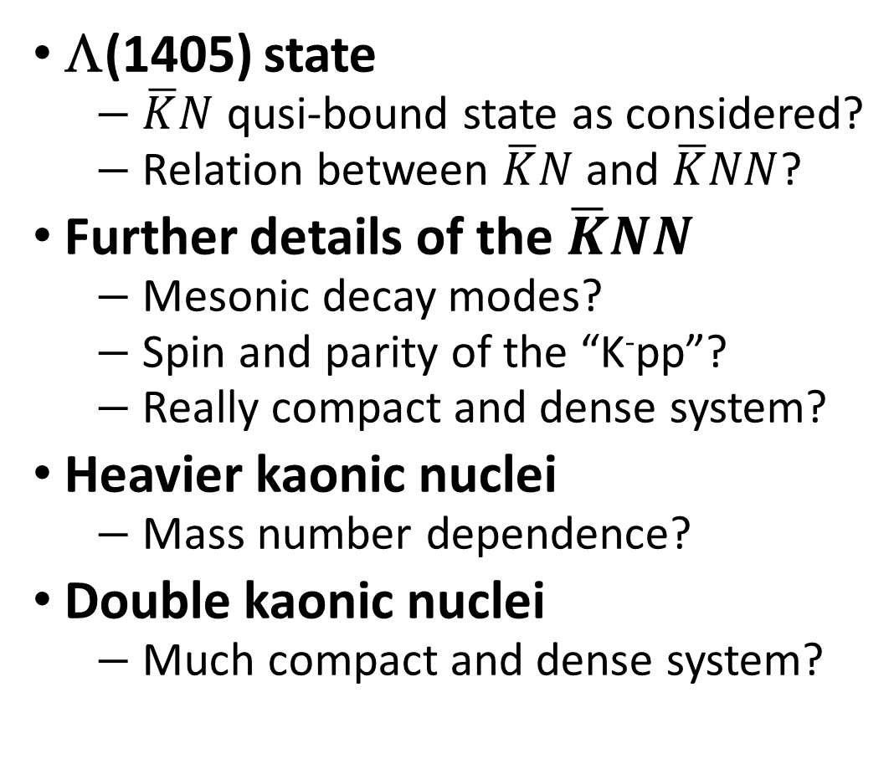
Need Further Investigations
to establish the kaonic nuclei
Λ(1405) state
  $\overline{K}N$ qusi-bound state as considered?
  Relation between $\overline{K}N$ and $\overline{K}NN$?
Further details of the $\overline{K}NN$
  Mesonic decay modes?
  Spin and parity of the “K⁻pp”?
  Really compact and dense system?
Heavier kaonic nuclei
  Mass number dependence?
Double kaonic nuclei
  Much compact and dense system?
K⁻K⁻pp

Slide 13
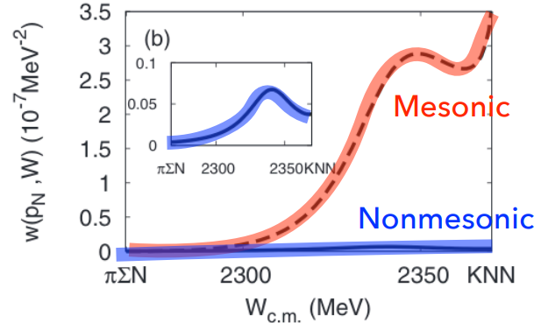
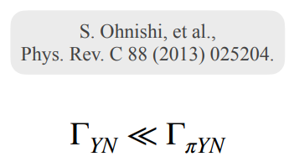
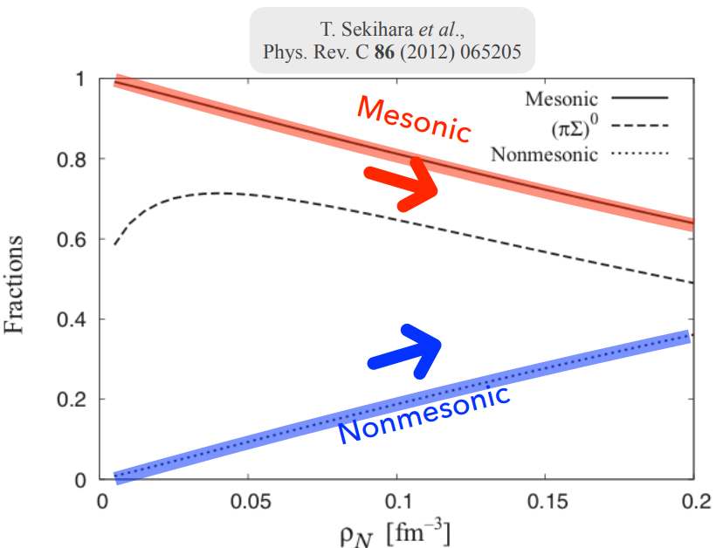
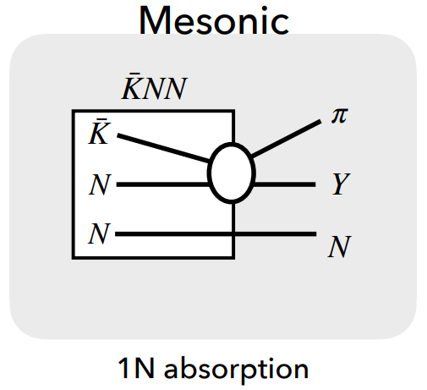
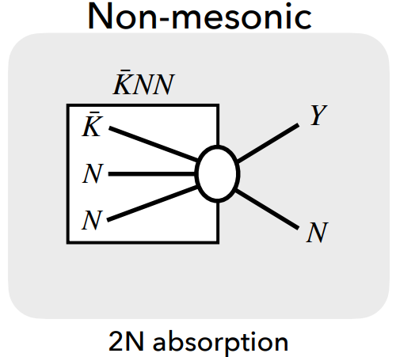
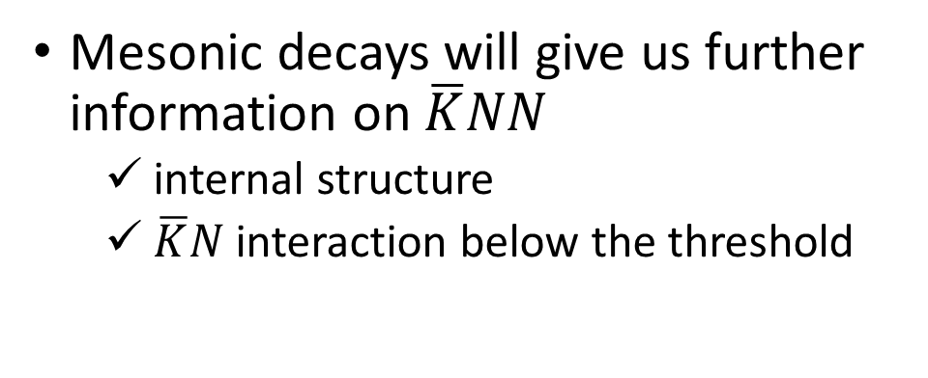

Mesonic Decay Modes of $\overline{K}NN$
Mesonic decays will give us further information on $\overline{K}NN$
  internal structure
  $\overline{K}N$ interaction below the threshold
Mesonic
Non-mesonic

Slide 14
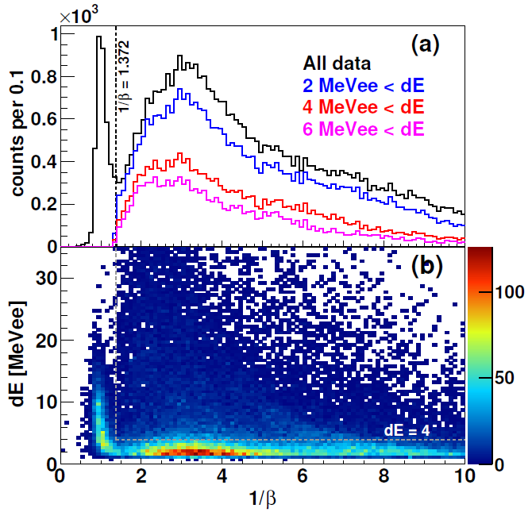
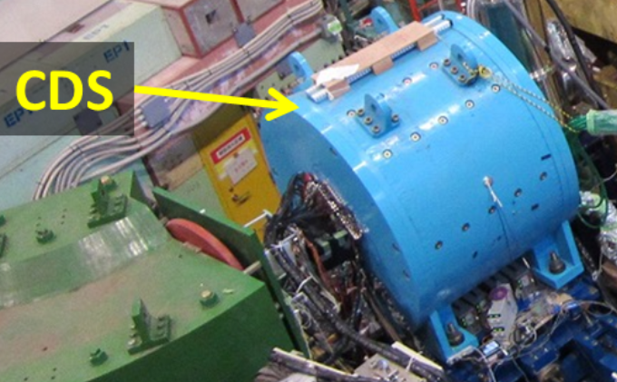
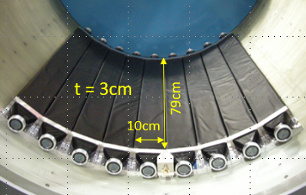

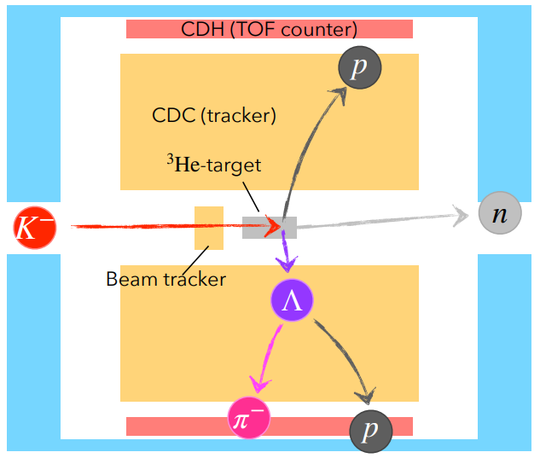
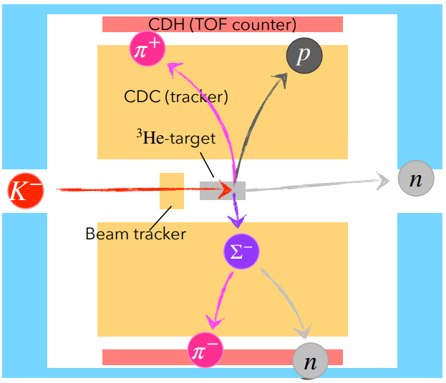
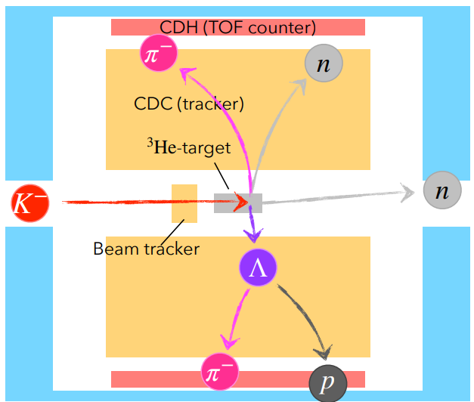




Mesonic Decay Analysis with the E15 Data
T.Yamaga et.al., arXiv:2404.01773 [nucl-ex]
with neutron detection using a thin scintillation counter array (CDH)
  small efficiency (3~9%)
  BG from the inner wall of the magnet
$$"K^{−}pp"→Λp$$
$$"K^{−}pp"→π^{±}Σ^{∓}p$$
$$"K^{−}pp"→π^{+}Λn$$
$$"{\overline{K}}^{0}nn"→π^{−}Λp$$
+

Slide 15
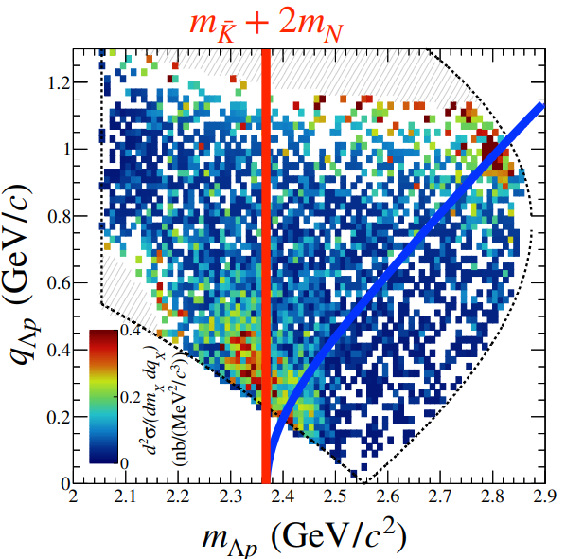
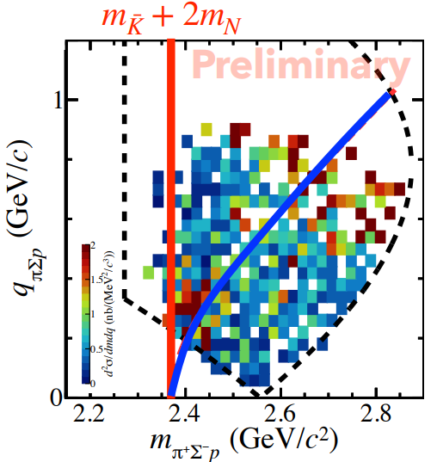
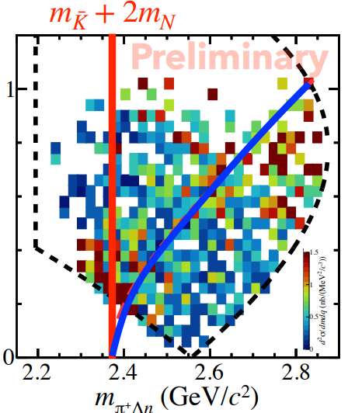
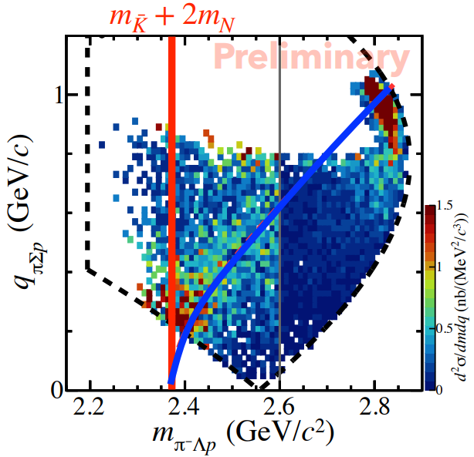
Mesonic Decay Analysis with the E15 Data
T.Yamaga et.al., arXiv:2404.01773 [nucl-ex]
with neutron detection using a thin scintillation counter array (CDH)
  small efficiency (3~9%)
  BG from the inner wall of the magnet
$$"K^{−}pp"→Λp$$
$$"K^{−}pp"→π^{±}Σ^{∓}p$$
$$"K^{−}pp"→π^{+}Λn$$
$$"{\overline{K}}^{0}nn"→π^{−}Λp$$
2NA w/ p_{Fermi}
x1/5
Similar but not clear peak below M(KNN) due to the phase space

Slide 16
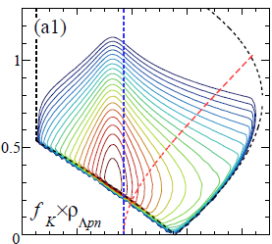
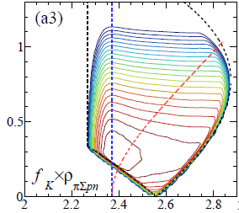
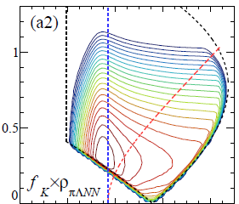
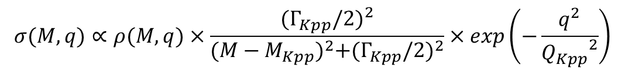
Mesonic Decay Analysis with the E15 Data
T.Yamaga et.al., arXiv:2404.01773 [nucl-ex]
Phase space
Momentum term from spatial integral
Plane Wave Impulse Approximation
$$σ(M,q)∝ρ(M,q)×\frac{{(Γ_{Kpp}/2)}^{2}}{{(M−M_{Kpp})}^{2}+{(Γ_{Kpp}/2)}^{2}}×exp\left(−\frac{q^{2}}{{Q_{Kpp}}^{2}}\right)$$
Fit with PWIA
Energy term (BW type) from time integral
$$"K^{−}pp"→Λp$$
$$"K^{−}pp"→π^{±}Σ^{∓}p$$
$$"K^{−}pp"→π^{+}Λn$$
$$"{\overline{K}}^{0}nn"→π^{−}Λp$$
Employ the same model func. for KNN & QF, with each phase space

Slide 17
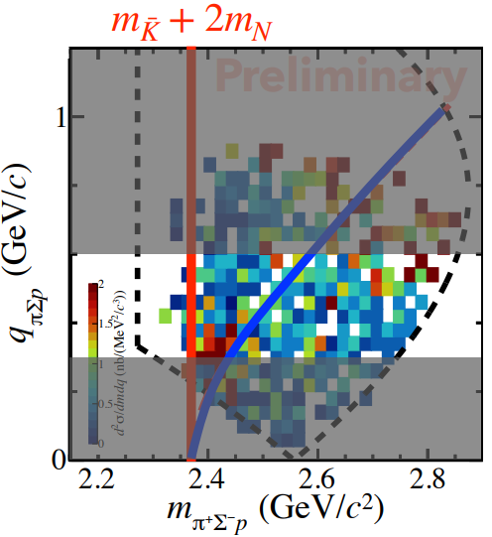
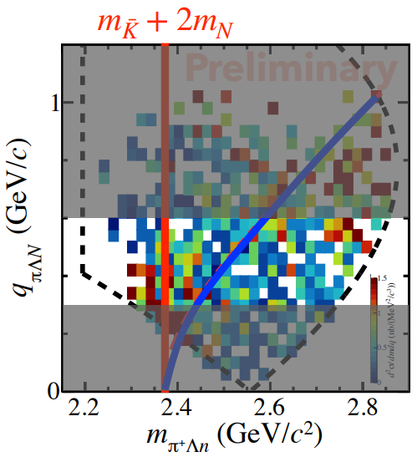
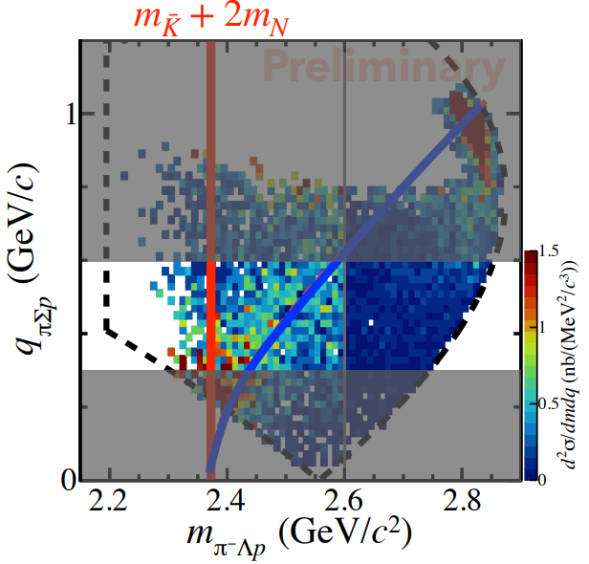
Mesonic Decay Analysis with the E15 Data
T.Yamaga et.al., arXiv:2404.01773 [nucl-ex]
Phase space
Momentum term from spatial integral
Plane Wave Impulse Approximation
$$σ(M,q)∝ρ(M,q)×\frac{{(Γ_{Kpp}/2)}^{2}}{{(M−M_{Kpp})}^{2}+{(Γ_{Kpp}/2)}^{2}}×exp\left(−\frac{q^{2}}{{Q_{Kpp}}^{2}}\right)$$
Fit with PWIA
Energy term (BW type) from time integral
$$"K^{−}pp"→Λp$$
$$"K^{−}pp"→π^{±}Σ^{∓}p$$
$$"K^{−}pp"→π^{+}Λn$$
$$"{\overline{K}}^{0}nn"→π^{−}Λp$$
Fit the 1D spectra in 0.3<q<0.6 with the same model func.

Slide 18
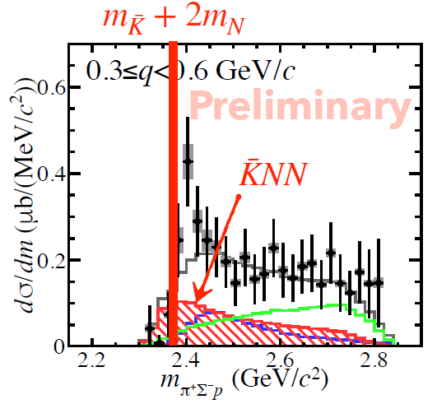
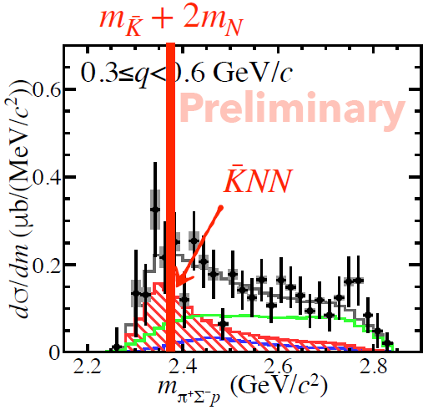
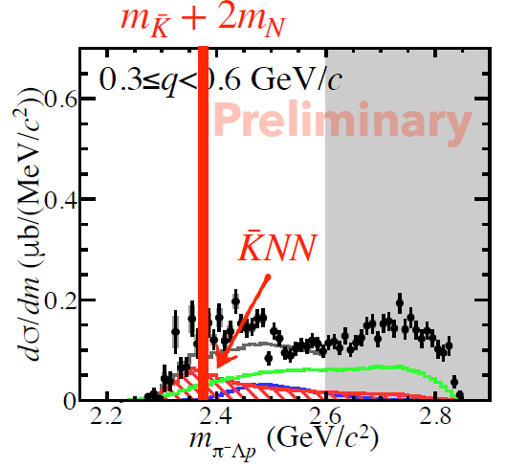

Mesonic Decay Analysis with the E15 Data
T.Yamaga et.al., arXiv:2404.01773 [nucl-ex]
Phase space
Momentum term from spatial integral
Plane Wave Impulse Approximation
$$σ(M,q)∝ρ(M,q)×\frac{{(Γ_{Kpp}/2)}^{2}}{{(M−M_{Kpp})}^{2}+{(Γ_{Kpp}/2)}^{2}}×exp\left(−\frac{q^{2}}{{Q_{Kpp}}^{2}}\right)$$
Fit with PWIA
Energy term (BW type) from time integral
$$"K^{−}pp"→Λp$$
$$"K^{−}pp"→π^{±}Σ^{∓}p$$
$$"K^{−}pp"→π^{+}Λn$$
$$"{\overline{K}}^{0}nn"→π^{−}Λp$$
With the model func., the spectra are consistently explained.

Slide 19









Mesonic Decay Analysis with the E15 Data
T.Yamaga et.al., arXiv:2404.01773 [nucl-ex]
Γ_{YN} << Γ_{πYN} : mesonic decay is dominant
Γ_{πΣN} ~ Γ_{πΛN} : significant contribution of the I_{KN} = 1 as well as I_{KN} = 0
Γ_{π+Λn} / Γ_{π−Λp} ~ 2 : if we assume Br_{K-pp→π+Λn} = Br_{K0nn→π−Λp}→ σ_{K-pp} / σ_{K0nn} ~ 2
$$"K^{−}pp"→Λp$$
$$"K^{−}pp"→π^{+}Σ^{−}p$$
$$"K^{−}pp"→π^{+}Λn$$
$$"{\overline{K}}^{0}nn"→π^{−}Λp$$
$$σ_{\overline{K}NN}^{tot}×Br \left(μb\right)=$$
$9.3±{0.8}_{−1.0}^{+1.4}$ [all]
$5.5±{0.5}_{−0.6}^{+0.8}$ [<M(KNN)]
$$σ_{\overline{K}NN}^{tot}×Br \left(μb\right)=$$
$38±3±3$ [all]
$3.2±0.2±0.2$ [<M(KNN)]
$$σ_{\overline{K}NN}^{tot}×Br \left(μb\right)=$$
$62±11±9$ [all]
$15.5±2.7±2.1$ [<M(KNN)]
$$σ_{\overline{K}NN}^{tot}×Br \left(μb\right)=$$
$29±3±3$ [all]
$7.2±0.6±0.$7 [<M(KNN)]
$$"K^{−}pp"→Σ^{0}p$$
$$"K^{−}pp"→π^{−}Σ^{+}p$$
$$σ_{\overline{K}NN}^{tot}×Br \left(μb\right)=$$
$5.3±{0.4}_{−0.6}^{+0.8}$ [all]
$3.1±{0.2}_{−0.4}^{+0.5}$ [<M(KNN)]
More precise measurements and theoretical investigations are needed
$$σ_{\overline{K}NN}^{tot}×Br \left(μb\right)=$$
$110±8±8$ [all]
$9.4±0.4±0.$7 [<M(KNN)]

Slide 20
Need Further Investigations
to establish the kaonic nuclei
Λ(1405) state
  $\overline{K}N$ qusi-bound state as considered?
  Relation between $\overline{K}N$ and $\overline{K}NN$?
Further details of the $\overline{K}NN$
  Mesonic decay modes?
  Spin and parity of the “K⁻pp”?
  Really compact and dense system?
Heavier kaonic nuclei
  Mass number dependence?
Double kaonic nuclei
  Much compact and dense system?
K⁻K⁻pp

Slide 21


Mass Number Dependence of Kaonic Nuclei
B.E.
the larger nuclei → the larger B.E.
Γ
→similar width
(mesonic only)
= without multi-N absorption
AY: PRC65(2002)044005, PLB535(2002)70.
WG: PRC79(2009)014001.
BGL: PLB712(2012)132.
OHHMH: PRC95(2017)065202.
Kanada: EPJA57(2021)185.
Systematic measurements will provide more conclusive evidence of the kaonic nuclei

Slide 22

K⁻⁴He → Λdn Analysis with the T77 Data
An analysis of the Λdn final state with K⁻⁴He reaction at 1 GeV/c has been conducted
  T77: lifetime measurement of ⁴_{Λ}H in 2020
The results will be updated with a part of the E73 controlled data
  E73: lifetime measurement of ³_{Λ}H in 2024 (now in beam time!)
4
d
Experiment | K⁻ on target
E15 (³He) | ~42 x 10⁹
T77 (⁴He) | ~6 x 10⁹
E73 (⁴He) | ~6 x 10⁹

Slide 23




K⁻⁴He → Λdn Analysis with the T77 Data
q
q
T77
E15
M(Kppn)
M(Kpp)
PLB789(2019)620
Preliminary
before acceptance correction
before acceptance correction
Two distributions are quite similar
structure below the threshold (seems q-independent), QF-K, BG

Slide 24




K⁻⁴He → Λdn Analysis with the T77 Data
2D fit on the (M,q) space with similar shapes to E15:
Breit-Wigner wtih Gaus. form factor (PWIA), QF-K⁻, and Broad BG
$$σ(M,q)∝ρ(M,q)×\frac{{(Γ_{X}/2)}^{2}}{{(M−M_{X})}^{2}+{(Γ_{X}/2)}^{2}}×exp\left(−\frac{q^{2}}{{Q_{X}}^{2}}\right)$$
M(Kppn)
Preliminary
0.3 <q_{x} < 0.6 GeV/c
Preliminary
$$B_{X} = 64±11\left(stat\right) MeV$$
$$Γ_{X} =\sim 100 MeV$$
$$σ_{X→Λd} \sim 4 μb$$

Slide 25






K⁻⁴He → Λdn Analysis with the T77 Data
What is the observed structure? [Discussion]
“X”→Λd decay mode is unique evidence of I_{”X”} = 0
  I(J^{P}) : Λ = 0(1/2⁺), d = 0(1⁺), K⁻ = 1/2(0⁻), ³He = 1/2(1/2⁺) , ⁴He = 0(0⁺)
“X”=“K⁻ppn” with J_{”X”} = 1/2 would be likely, considering the isospin and spin combination in S-wave interaction
  J_{”X”} = 1/2: ⁴He initial state is I(J) = 0(0) and low-momentum intermediate $\overline{K}$ would react with remaining NNN [I(J) = 1/2(1/2)] in S-wave
  Exclusion of Y*(I=1)NN: probability of “X”→Λd decay would be suppressed because spin/isospin flip is needed to reconfigure NN [I(J) = 1(0)] into deuteron [I(J) = 0(1)]
    Λpn decay would be dominant
BE (MeV)
0
$$M(\overline{K}NNN)$$
27
$${M(Λ}^{∗}NN)$$
50
${M(Σ}^{∗}NN$)
100
$$M(πΣNN)$$
180
$$M(πΛNN)$$
4
“X”
n
d

Slide 26

K⁻⁴He → Λdn Analysis with the T77 Data
What is the observed structure? [Discussion]
If “X” is “K⁻ppn”
More precise measurements
(especially of decay branches)
and theoretical investigations are needed
The binding energy is compatible with some theoretical predictions
The width is larger than theoretical predictions

Slide 27

New Kaonic Nuclei Project at J-PARC
– from the $\overline{K}N$ to $\overline{K}NNNN$ systems –

Slide 28



Strategy
 | Reaction | Decays | Key | Experiment
$$\overline{K}N$$ | d(K⁻,n) | π^{±0}Σ^{∓0} | n/γ identification | Future
$$\overline{K}NN$$ | ³He(K⁻,N) | Λp/Λn | polarimeter | P89
$$\overline{K}NNN$$ | ⁴He(K⁻,N) | Λd/Λpn | large acceptance | E80
$$\overline{K}NNNN$$ | ⁶Li(K⁻,d) | Λt/Λdn | many body decay | Future
$$\overline{K}NNNNN$$ | ⁶Li(K⁻,N) | Λα/Λdd/Λdpn | many body decay | Future
$$\overline{K}NNNNNN$$ | ⁷Li(K⁻,N) | Λαn/Λddn | many body decay | Future
$$\overline{K}\overline{K}NN$$ | $\overline{p}$ + ³He | ΛΛ | $\overline{p}$ beam yield | Future (LoI)
← A first step
To realize the systematic measurements, we need
  a large acceptance spectrometer
    detect/identify all particles to specify the reaction
  high-intensity kaon beam
    more K⁻ yield than the existing beamline
← new CDS
← improved K1.8BR
We take a step-by-step approach

Slide 29



$\overline{K}NNN$ @ E80
via ⁴He(1 GeV/c K⁻, n) reaction
T77 data
(~3 days)
q
Establish the existence of $\overline{K}NNN$
  “K-ppn”→Λd 2-body decay
Study the multi-particle decay mode of $\overline{K}NNN$ toward understanding its internal structure
  “K-ppn”→Λpn 3-body decay
Feasibility study of spin-spin correlation measurement for P89
  e.g., installing a prototype module of a polarimeter
0.3 <q < 0.6 GeV/c
M(Kppn)
acceptance
not corrected
Preliminary
all
“K-ppn”
BG
QF_{KA}
Beam intensity | 90kW
Beam time | 1+1+3 weeks
the sign of the “K⁻ppn”

Slide 30


New Cylindrical Detector System (CDS)
Present CDS
New CDS
Superconducting Solenoid
Neutron Counter
Cylindrical Drift Chamber
  Solid angle: x1.6 (59% → 93%)
  Neutron eff.: x6~7 (3% → 15%x1.6)

Slide 31



Superconducting Solenoid Magnet
SHI FA-50
(air cooling)
Same design as “the detector solenoid magnet” for COMET-I
3.3m x 3.3m x 3.9m, ~108t in total
Max. field of 1.0T @ center
  189A – 10V
NbTi/Cu SC wire, 98km in total
Conduction-cooling with GM*3
Semi-active quench-back system
Will be completed in FY2024
SHI RDE-418D4
being constructed in cooperation with
the J-PARC Cryogenics Section
Completed in FY2023
Completed in FY2022

Slide 32






Cylindrical Drift Chamber
2,680mm
The same design of the present end-cap
  New CDC is 3 times the length of the existing CDC
wire stringing work has been finished
Will be completed next month, and commissioning starts
Wire length = 2.55m
(Almost the same length as the longest wire of the Belle2-CDC)
existing CDC
Signal board
ASD preamplifier board

Slide 33



Neutron Counter
scintillator array: 2 layers, 12cm thickness
ELJEN EJ-200: (T)60mm, (W)60mm, (L)3,000mm
1.5-inch FM-PMT [H8409(R7761)] & MPPC array [S13361-6050AE-04]
Neutron detection efficiency of 12~36%
Design work is on going
Will be fabricated in FY2024
Position dependence of
time resolution
2,600mm
Prototype @ Tohoku University
Test exp. using a prototype @ ELPH Oct.2023

Slide 34



K1.8BR Upgrade
We have proposed a new configuration of the beam line
  K- yield is expected to increase by ~ 1.4 times @ 1.0 GeV/c
before
with π/K ~ 2
Shorten the beamline (~2.5m) by removing the final D5 magnet
after
Relative beam-line length (beam yield) | D5 | D4
Present CDS | 0 (x1) | -3.7m (x1.6)
New CDS | +1.2m (x0.9) | -2.5m (x1.4)

Slide 35




Schedule
now

Slide 36


Summary
We observed the “K⁻pp” bound state in ³He(K⁻,Λp)n
  PLB789(2019)620., PRC102(2020)044002.
We also obtained hints of mesonic decays of “K-pp”
  arXiv:2404.01773 [nucl-ex]
We observed the sign of the “K⁻ppn” in ⁴He(K⁻,Λd)n
  will be published soon with twice statistics
New project has started from E80, “K⁻ppn”, aiming at the systematic study of the kaonic nuclei
  Constructing a large solenoid spectrometer
  Modify the K1.8BR to improve kaon yield
FY2026 to be completed
Hope to modify around FY2025

Slide 37








J-PARC E80 Collaboration
We're looking for new collaborators!

Slide 38


Thank you for your attention!
High intense K beam
New large CDS
ÖWA/Harald Ritsch
New era of kaonic nuclei
A first step of the project
via in-flight ⁴He(K⁻,N)

Slide 40


T.Yamaga et.al., arXiv:2404.01773 [nucl-ex]

Slide 41
M.Iwasaki, ECT*2023

Slide 42

M.Iwasaki, ECT*2023

Slide 43

M.Iwasaki, ECT*2023

Slide 44

M.Iwasaki, ECT*2023

Slide 45

M.Iwasaki, ECT*2023

Slide 46





Hadron Experimental Facility (HEF)
< 2.0 GeV/c
~ 10⁶ K⁻/spill
S=-1 and S=-2 hypernuclei
< 1.1 GeV/c
~ 5x10⁵ K⁻/spill
Kaon in nuclei
K1.8
56 m
K1.8BR
16 deg extraction
~ 2.1 GeV/c ~ 10⁷ K⁰_{L}/spill
${K_{L}^{0}→π}^{0}ν\overline{ν}$
KL
charged
Au Target
< 95 kW
T1 target
high-p
launched in 2020
neutral
30 GeV proton ~ 10¹⁰
< 31 GeV/c unsepa. π ~ 10⁷
Hadron physics
primary 30GeV
muon
30 GeV proton beam
80kW (7x10¹³ ppp, 4.2s)
[as of 2024, May]
COMET
μ⁻ beam
μ-e conversion
will start in 2023

Slide 47
Hadron Experimental Facility (HEF)
< 2.0 GeV/c
~ 10⁶ K⁻/spill
S=-1 and S=-2 hypernuclei
< 1.1 GeV/c
~ 5x10⁵ K⁻/spill
Kaon in nuclei
K1.8
56 m
K1.8BR
16 deg extraction
~ 2.1 GeV/c ~ 10⁷ K⁰_{L}/spill
${K_{L}^{0}→π}^{0}ν\overline{ν}$
KL
charged
Au Target
< 95 kW
T1 target
high-p
launched in 2020
neutral
30 GeV proton ~ 10¹⁰
< 31 GeV/c unsepa. π ~ 10⁷
Hadron physics
primary 30GeV
muon
30 GeV proton beam
80kW (7x10¹³ ppp, 4.2s)
[as of 2024, May]
COMET
μ⁻ beam
μ-e conversion
will start in 2023

Slide 48






“K⁻pp” Bound State Searches - History
?
?
?
Despite of many “K-pp” searches, NO conclusive results
  Complex reactions & difficult to understand background

Slide 49






$\overline{K}NNN$ Searches so far
E471/E549@KEK
FINUDA@DAΦNE
FOPI@GSI
⁴He(stopped-K⁻,p/n/Yd)
  Li/C(stopped-K⁻,Λd)
  Λd in Ni+Ni
MM(K-,p)
MM(K-,n)
PLB659(2008)107, PLB688(2010)43,
IM(Λd)
PLB654(2007)80
PRC76(2007)068202
EXA05 Conference (2005)
Σ0d
Λd
No conclusive results.
multi-N absorption in stopped-K reaction makes interpretation difficult

Slide 51


Expected Yield of $\overline{K}NNN$
N_{beam} = 100 G K- on target
  MR beam power of 90 kW
  3 weeks data taking (90% up-time)
 | Λd / Λpn
σ(K⁻ppn)*Br | 5 μb
N(K⁻ on target) | 100 G
N(target) | 2.56 x 10²³
ε(DAQ) | 0.92
ε(trigger) | 0.98
ε(beam) | 0.72
Ω(CDC) | 0.23 / 0.059
ε(CDC) | 0.6 / 0.3
N(K⁻ppn) | 12 k / 1.5 k
$$σ\left(K^{−}ppn\right)∙Br\left(Λd\right) \sim 5 μb$$
$$σ\left(K^{−}ppn\right)∙Br\left(Λpn\right) \sim 5 μb$$
from the T77 preliminary result and an assumption
N(K⁻ppn→Λd) ~ 1.2 x 10⁴
N(K⁻ppn→Λpn) ~ 1.5 x 10³
  c.f. 1.7 x 10³ “K⁻pp”→Λp accumulated in E15-2nd (40 G K⁻)

Slide 52
Expected Spectrum of K⁻+⁴He
@ 3 weeks, 90kW
K⁻+⁴He→Λd+n
K⁻+⁴He→Λpn+n
M(K⁻ppn)
M(K⁻ppn)
B_{Kppn} ~ 40 MeV
Γ_{Kppn} ~ 100 MeV
Q_{kppn} ~ 400 MeV/c
σ(K⁻ppn)*Br ~ 5 μb
σ(QF) ~ 5 μb
σ(BG) ~ 10 μb
Similar parameters obtained with the K⁻³He→Λpn (PRC102(2020)044002.) are adopted to K-ppn/QF/BG shapes
K-ppn signal [q-independent] can be seen clearly

Slide 53


Expected Spectrum of K⁻+⁴He
@ 3 weeks, 90kW
K⁻+⁴He→Λd+n
K⁻+⁴He→Λpn+n
M(K⁻ppn)
M(K⁻ppn)
B_{Kppn} ~ 40 MeV
Γ_{Kppn} ~ 100 MeV
Q_{kppn} ~ 400 MeV/c
σ(K⁻ppn)*Br ~ 5 μb
σ(QF) ~ 5 μb
σ(BG) ~ 10 μb
The signals can be enhanced by selecting 0.3 < q < 0.6 GeV/c
K-ppn signal can be seen clearly

Slide 54



Special Size Extraction using Dalitz Plots
It has been pointed out that it is possible to extract a space size using the Λpn 3-body decay of "K-ppn"
Utilize Dalitz plots → Differences in distribution
PLB632(2006)187
Compact case
Broad case
Widely distributed in the plane
Decays involving 3-nucleons
L,p,n all high momentum
Distributed in parts of the plane
Decays mainly in two nucleons
Remaining 1 nucleon has low momentum

Slide 55







Collaboration
Experiment
Theory
RIKEN
SC-Solenoid, Beam line, CDC, Data Analysis
F.Sakuma（Spokes Person)
M.Iwasaki, H.Asano, T.Yamaga, R.Murayama,
Y.Ma, K.Itahashi, H.Outa, Post.Doc., Students
TITECH
Structure
D.Jido, Post.Doc., Students
Kyoto Pref. U
Reaction
T.Sekihara, Students
JAEA
DAQ, Target,
Data Analysis
T.Hashimoto, Students
Osaka-U
Beam line, Data Analysis
H.Noumi, K.Shirotori,
K.Inoue, S.Kawasaki, Students
Tohoku-U
NC, Data Analysis
H.Ohnishi, Y.Sada, C.Yoshida, Students
Osaka Elec. U
Reaction
T.Harada, Students
KEK
SC-Solenoid, Beam line,
Target
M.Iio, S.Ishimoto,
S.Suzuki, K.Ozawa,
Students
SMI
Data Analysis
E.Widmann, J.Zmeskal,
P.Buehler, Students
INFN-LNF
Data Analysis
C. Curceanu, M.Bazzi,
A. Clozza, R.De Grande,
C.Guarldo, K. Piscicchia,
A. Scordo, D. Sirghi,
F. Sirghi, Students
KEK
Structure
A.Dote, O.Morimatsu, Students
Kyoto-U
Data Analysis
T.Nagae, Students
RIKEN
Lattice-QCD
T.Hatsuda, T.Doi, Students
TITECH
Data Analysis
H.Fujioka, Students

Slide 56
実験研究(J-PARC E80/P89)
理論研究
理化学研究所
中性子検出器、CDC、ポラリメーター
佐久間史典、山我拓巳、
岩崎雅彦、村山理恵、馬越、
板橋健太、應田治彦、ポスドク
京産大
反応・構造計算
山縣淳子、ポスドク
東工大
相互作用計算
格子QCD計算
慈道大介、
村上耕太郎
京都府立大
反応・構造計算
関原隆泰、+α
INFN-LNF(伊)
中心飛跡検出器検討
C. Curceanu, M.Bazzi,
A. Clozza, R.De Grande,
C.Guarldo, K. Piscicchia,
A. Scordo, D. Sirghi,
F. Sirghi, +α
JAEA
CDC, DAQ, 液体標的
七村拓野、橋本直
KEK
超伝導電磁石, 液体標的
飯尾雅実、石元茂、
鈴木祥仁、+α
KEK
構造計算
土手昭伸、
森松治、+α
東北大学
円筒形ホドスコープ
大西宏明、佐田優太、+α
大阪電通大
反応計算
原田融、+α
SMI(墺)
カロリメーター検討
J. Zmeskal, E. Widmann,
M.Cargnelli, +α
東工大
中心飛跡検出器検討
藤岡宏之、+α
東京都立大
構造計算
兵藤哲雄、+α
大阪大学
CDC
野海博之、井上謙太郎、
川﨑新吾、+α
理化学研究所
格子QCD計算
土井琢身、+α

Slide 57

Setup@K1.8BR
Present CDS ~ before summer of FY2024
  E73 (³_{Λ}H lifetime) 25d@80kW
Hyp-TPC ~ before summer of FY2025
  E72 (Λ*) 14d@80kW
New CDS with K1.8BR modification
  E80 (K⁻ppn→Λd/Λpn) ~14+21d@90kW
  P89 (J^{P}(K⁻pp)) 56d@90kW
  E57 (K⁻d atm) 7d@80kW → ~30d@80kW
need 9 months
need 1 year

Slide 58
Cylindrical Detector System

Slide 59

Overview
Large acceptance solenoid spectrometer
  Superconducting solenoid magnet
  CDC (Cylindrical Drift Chamber)
  CNC (Cylindrical Neutron Counter)
  VFT (Vertex Fiber Tracker)
Significantly improved performance compared to the existing CDS
  Solid angle: x1.6 (59% → 93%)
  Neutron eff.: x12 (3% → 15%x1.6)
Resolution will retain the existing CDS performance
  $5.3\%p_{T}⨁0.5\%/β$
  σ[TOF(T0-CNC)] ~ 160ps

Slide 60




Acceptance for K⁻⁴He reaction
Λd in CDS
Λpn in CDS
M(Kppn)
M(Kppn)

Slide 61
Superconducting Solenoid Magnet

Slide 62

Superconducting Coil
14 solenoid coils
Copper wire is formed on each coils for the quench protection heater
Purchased in FY2022

Slide 63
Quench Protection
Semi-active quench-back system similar to the MuSIC @ RCNP
  coils are connected in series
  copper quench-back heaters are connected in parallel to the coils via diodes
If the quench is detected,
  the power supply is immediately shutdown
  the current in the coils is bypassed into the heater path
  almost all the energy stored in the magnet (4.2MJ) is dumped in the cold mass

Slide 64




Quench Protection
Current decay time ~ 10s
Max. heater voltage at both ends ~ 450V
Max. quench spot temperature ~ 150K
safely and reversibly protected

Slide 65
Fast Control
From Iio-san’s slides
PS is constructing in FY2022
  200A – 10V
  AC200V
  air cooling

Slide 66

Vacuum Vessel and Return Yoke
Vacuum Vessel
Bore dia. = φ1.8m, length = 3.3m
Outer dia. = φ2.7m
Weight = 5.9t
Constructing in FY2023-24
Return Yoke
Square shaped
3.3m x 3.3m x 4.1m
~115t
Constructed in FY2022
Cable port x8
Refrigerator port

Slide 67


Magnetic Field Calculation
Full 3D-model simulation using OPERA-3D
3T
Z-Y cross section @ X=0
2T
1T
1T
max. ~2.3T
0T

Slide 68



Magnetic Field around GM-port
50mT
x = 1518mm
the center of the motors is less than 20 mT
→ below the operational limit (50 mT)
X=1518, Y=-1190: motor head
0T

Slide 69


Structural Calculation (EM force)
(17)
(14)
(13)
(12)
component name | Fx [N] | Fy [N] | Fz [N]
(9) bottom down | -36 | 22,811 | -153,692
(10) bottom middle | 160 | 622 | -250
(11) bottom up | -28 | 22,564 | 153,750
(12) top down | 6 | -13,595 | -110,830
(13) top middle | 17 | -876 | -17
(14) top up | 4 | -13,672 | 110,961
(5)
(16)
(15)
(6)
(1)
(8)
(2)
(7)
(4)
(3)
(11)
(20)
(10)
(19)
(18)
(9)
component name | Fx [N] | Fy [N] | Fz [N]
(15) left down | -7,508 | -9,926 | -64,584
(16) left middle | -525 | 39 | -166
(17) left up | -7,512 | -9,660 | 63,407
(18) right down | 7,603 | 692 | -79,596
(19) right middle | 619 | 22 | 13
(20) right up | 7,602 | 730 | 79,782
component name | Fx [N] | Fy [N] | Fz [N]
(1) cap down bottom | 2 | 25,452 | -759,143
(2) donut down bottom | 107 | 19 | 206,973
(3) cap down up | 29 | -25,644 | -776,760
(4) donut down up | 107 | 19 | 206,973
(5) cap up bottom | 22 | 25,536 | 757,753
(6) donut up bottom | 131 | -356 | -206,821
(7) cap up up | 116 | -25,293 | 777,720
(8) donut up up | 131 | -356 | -206,821
force that pulls the end-caps inward is about 100t
component name | Fx [N] | Fy [N] | Fz [N]
all coils (Lorentz force) | -390 | 226 | -103

Slide 70



Structural Calculation (Stress & Displacement)
analysis was performed by applying a force of 500kN per the upper and lower end-cap to a single point near the center
500kN
500kN
Max. stress on a bolt is about 224Mpa
→ covered by using SCM435 M36 bolts
Max. displacement is about 1.3 mm near the center

Slide 71

Test, Magnetic Field Measurement, etc.
Cooling and extension test will be performed without the return yoke at a manufactory
Quench test (= power cutoff test) will be performed at manufactory
Magnetic field measurement will be performed by passing a 3D Hall probe from the outside through small holes provided in the end-caps
  magnetic field scan with respect to the beam-axis direction at several positions in the (x,y) plane
  compared with the calculated values

Slide 72
Cylindrical Drift Chamber

Slide 73


Structure
Resolution will retain the existing CDC performance
  $5.3\%p_{T}⨁0.5\%/β$
7 super layers (AUVAUVA) and 15 layers
1,816 ch with hexagonal cells
8,064 wires are supported by feedthroughs
c.f. ~3.5 deg. @ existing CDC

Slide 74
Cylindrical Neutron Counter

Slide 75

Neutron ID
Neutron will be identified using absence of CDC tracks in front of the neutron hit
At E15, we successfully identified neutron from Σ decay using 3cm thickness scintillator (CDH)
δt ~100ps → δz ~2cm (CDH result)
We need δt ~100ps for the CNC
  Being in performance test using cosmic rays
Light velocity of CDH: ~15cm/ns
Resolution will retain the existing CDS performance
  σ[TOF(T0-CNC)] ~ 160ps

Slide 77
Analysis of K⁻⁴He → Λdn at T77
We have conducted a prompt analysis on Λdn final state of K⁻⁴He reaction at 1 GeV/c
  66 hours under 51 kW corresponding to 140 kW*days
T77 experiment used the present CDS (Cylindrical Detector System)
4
d
K.Agari et al.,
PTEP, 2012, 02B011

Slide 78
Preliminary result
q
q
T77
E15
M(Kppn)
M(Kpp)
PLB789(2019)620
Preliminary
before acceptance correction
before acceptance correction
Two distributions are quite similar
structure below the threshold (seems q-independent), QF-K, BG

