Slide 1
K^{bar}NN bound state search at J-PARC E15
F. Sakuma, RIKEN
on behalf of the J-PARC
E15 collaboration
ASTRA: Advances and open problems in low-energy nuclear and hadronic STRAngeness physics,
ECT*, Trento, 23-27 October 2017

Slide 2
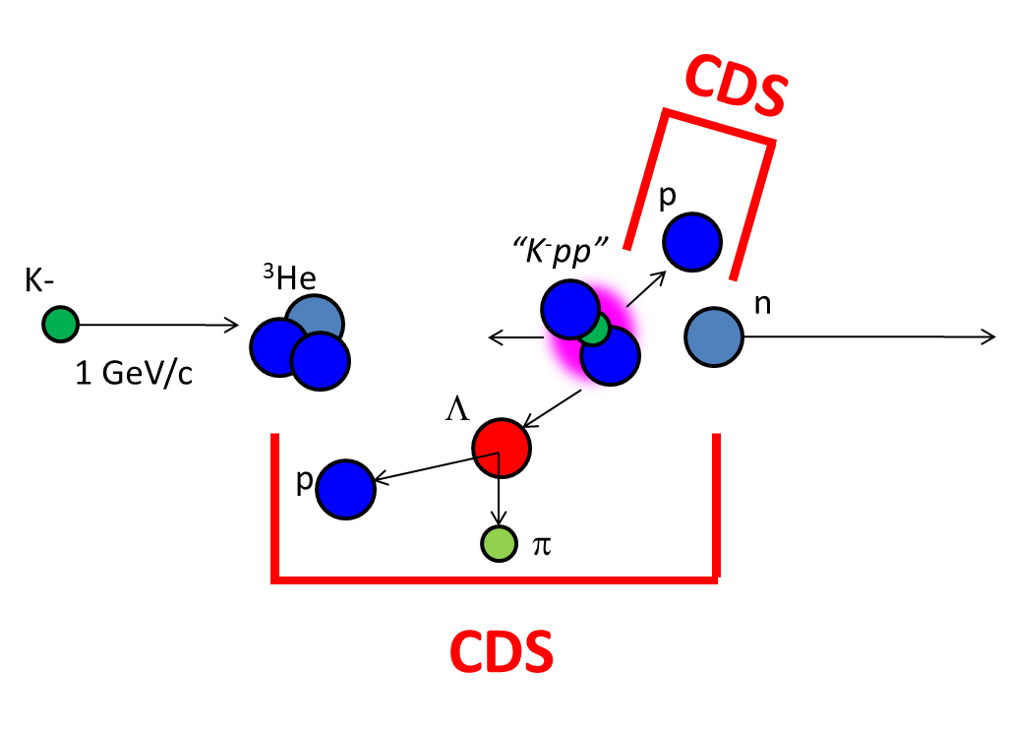
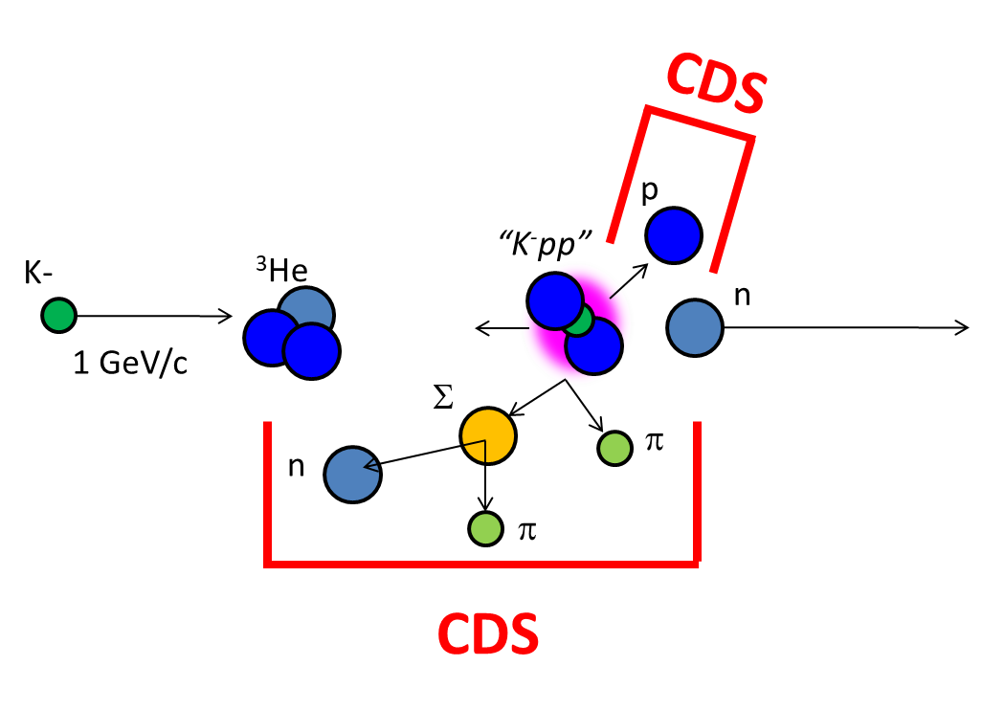
Outline of the Talk
1. K^{bar}NN search via Λp channel
→ Non-mesonic channel
2. K^{bar}NN search via πΣp channel
→ Mesonic channel

Slide 3
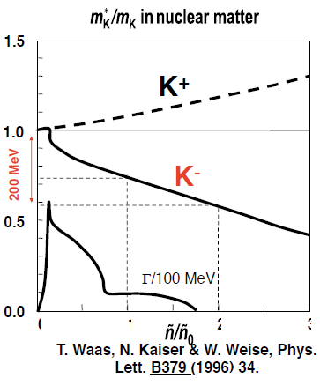
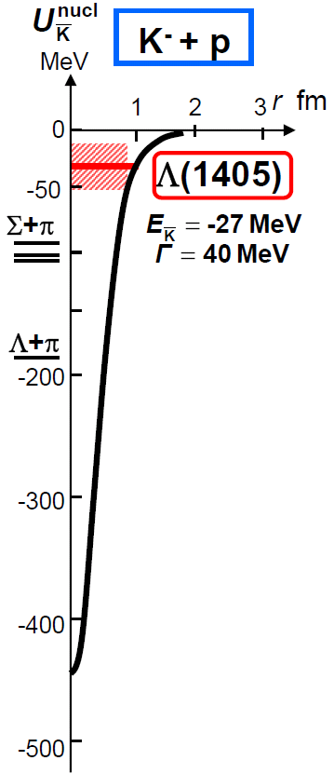
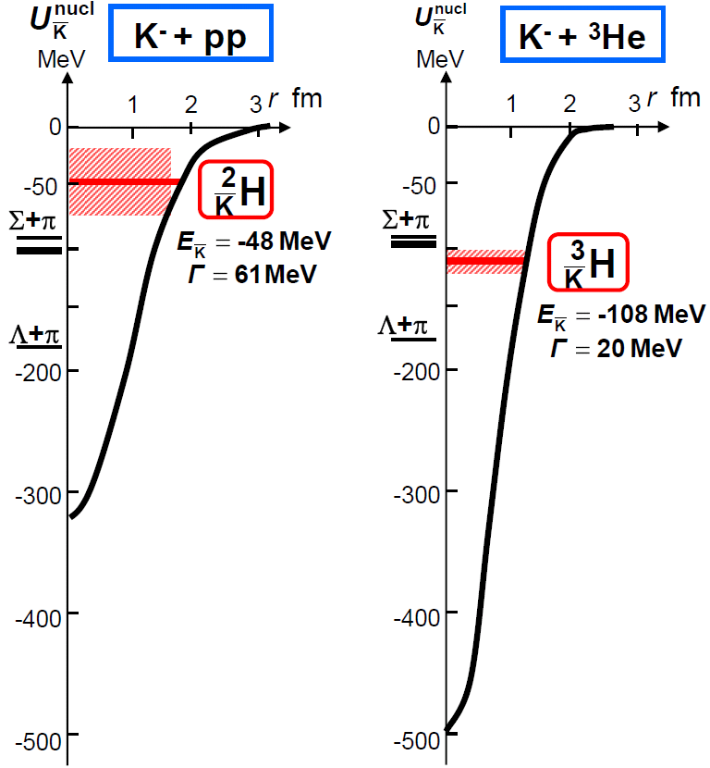
Kaonic Nuclei
Bound states of nucleus and anti-kaon
Predicted as a consequence of attractive K^{bar}N interaction in I=0
Meson properties would
change in nuclear media
Y.Akaishi & T.Yamazaki, PLB535, 70(2002).
0
1
2
3
Will provide new insight of low energy QCD

Slide 4
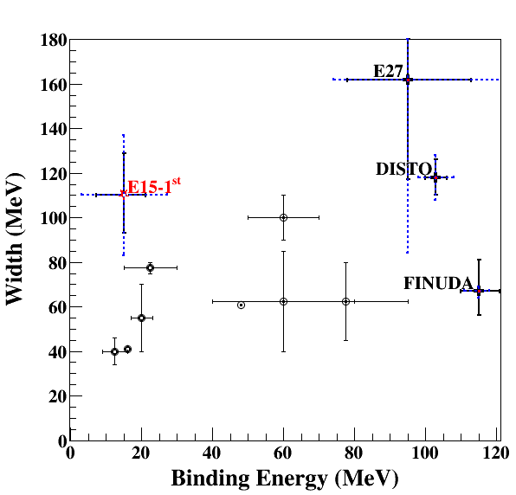
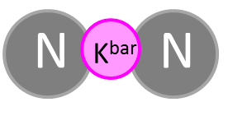
Present Status of K^{bar}NN
Binding energy
Chiral:
B.E. ~ 20MeV
Phenomenological:
B.E. ~ 40-80MeV
FINUDA/DISTO/E27
(if K^{bar}NN):
B.E. ~ 100MeV
Width
almost agreement in Γ~40-100MeV
Theor.: mesonic decay
Exp.: non-mesonic decay
Chiral
Phenomenological
Upper limits were also obtained:
LEPS@SPring8 [Inclusive d(γ, K⁺π⁻)X]
HADES@GSI [Exclusive pp→pΛK⁺]

Slide 5
J-PARC E15 Experiment
³He(in-flight K⁻,n) reaction @ 1.0 GeV/c
2NA processes and Y decays can be discriminated kinematically
semi-inclusive ³He(K⁻,n)
T. Hashimoto et al., PTEP (2015) 061D01.
exclusive (K⁻,Λp)n_{missing}
Y. Sada et al., PTEP (2016) 051D01.

Slide 6
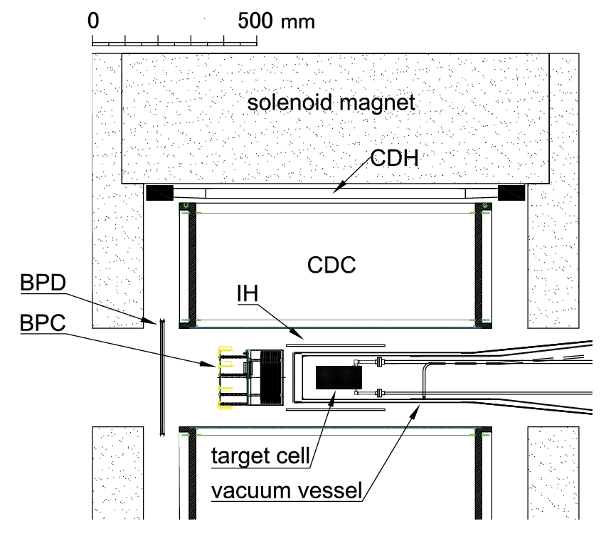
Experimental Setup for E15
15m

Slide 7
Outline of the Talk
1. K^{bar}NN seach via Λp channel
→ Non-mesonic channel
2. K^{bar}NN seach via πΣp channel
→ Mesonic channel

Slide 8
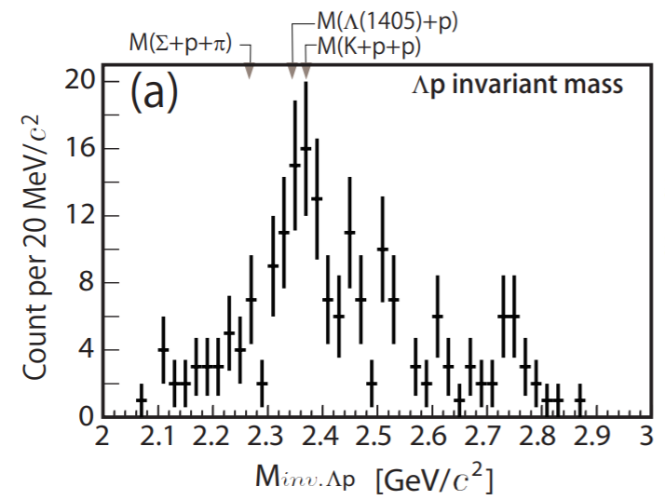
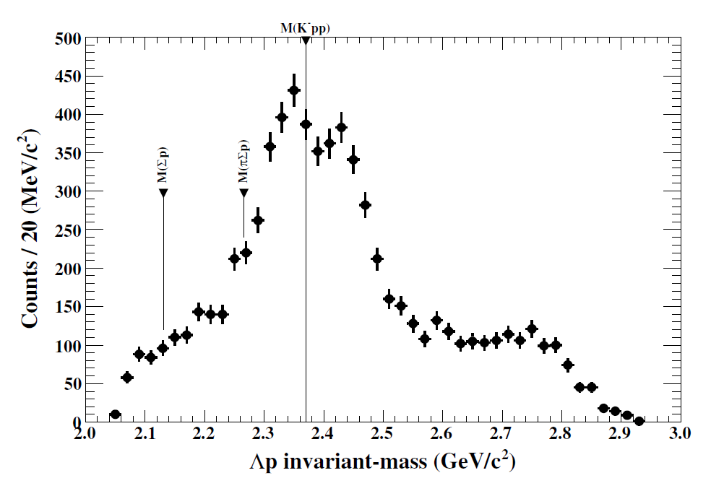
Exclusive ³He(K⁻,Λp)n in E15-2nd
T.Yamaga’s Ph.D work (Osaka-U)
E15^{1st}
→ ~30 times more data*
E15^{2nd}
preliminary
Y.Sada et al.,
PTEP (2016) 051D01.
* dedicated trigger was introduced for (K⁻,Λp)

Slide 9
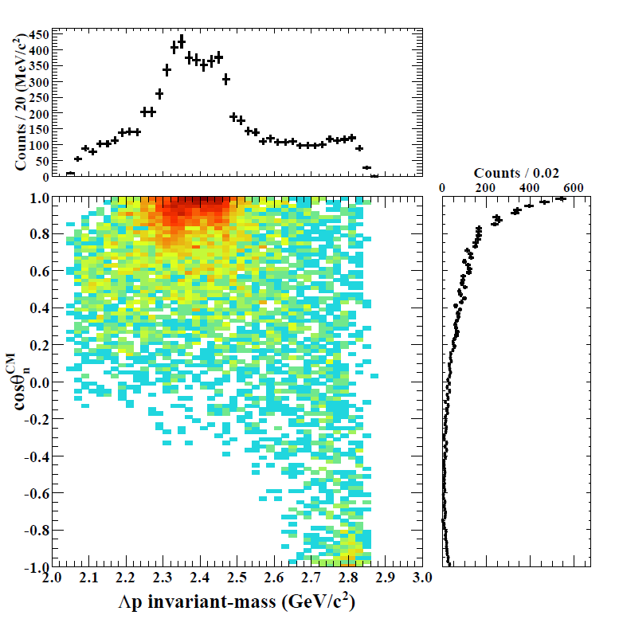
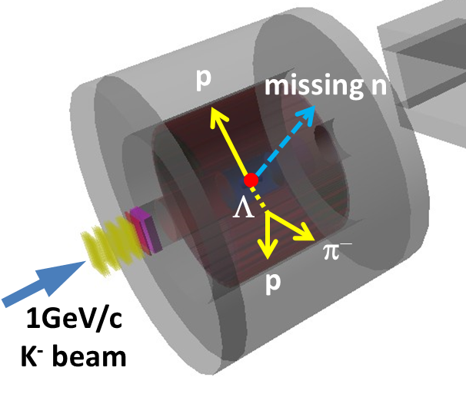
Exclusive ³He(K⁻,Λp)n [E15-2nd]
IM(Λp)
Structures around the Kpp threshold can be seen
= bound-state + QF
M(K+p+p)
preliminary
Structures are concentrated in forward-n region
= small momentum-transfer
detector
acceptance
cos(θ_{n})

Slide 10
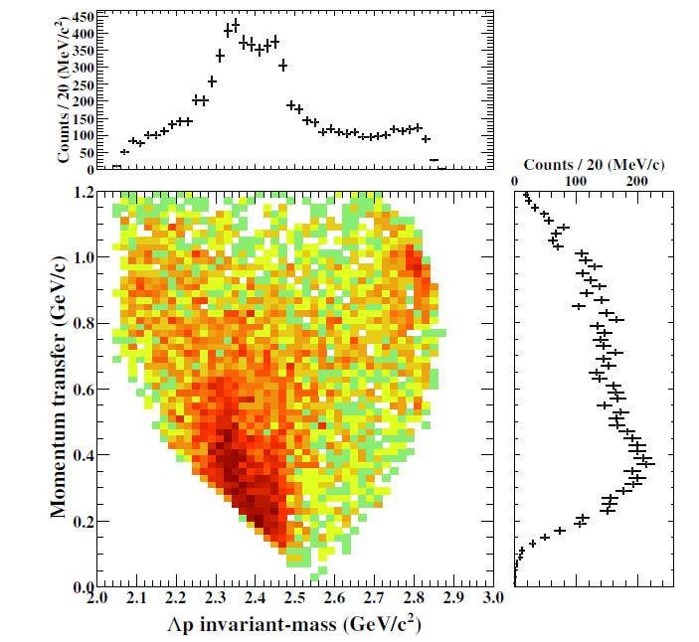
Momentum Transfer
IM(Λp)
Momentum transfer ranges from ~300 to ~600 MeV/c
for sub-threshold structure
M[K+p+p]
preliminary
c.f. E15^{1st}
Kinematical
Limit
q_{Λp}
Consistent with E15^{1st}

Slide 11
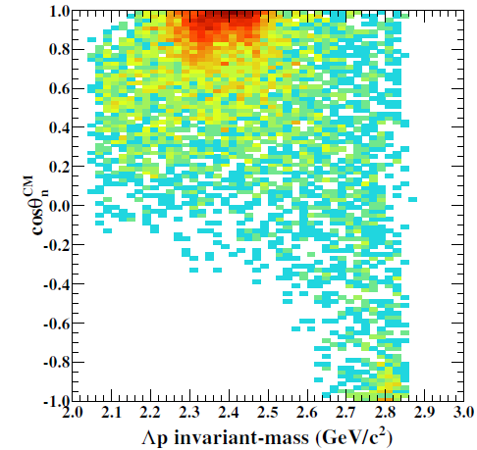
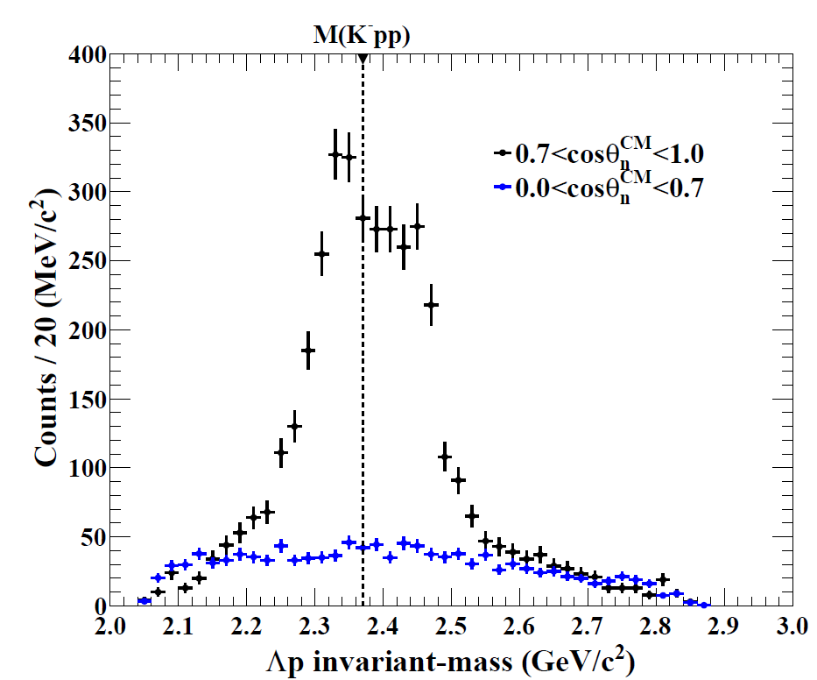
Structures in Forward-n Region
𝟎.𝟕<𝐜𝐨𝐬𝜽_{𝒏}^{𝑪𝑴}<𝟏.𝟎
𝟎.𝟎<𝐜𝐨𝐬𝜽_{𝒏}^{𝑪𝑴}<𝟎.𝟕
Above M(Kpp)
→ QF = [Quasi-elastic K] x [KNN→Λp]
Below M(Kpp)
→ Bound-State!
detector
acceptance
𝟎.𝟕<𝐜𝐨𝐬𝜽_{𝒏}^{𝑪𝑴}<𝟏.𝟎
missing acceptance
preliminary
Flat distribution
prop. to phase space
→ Point like 3NA
(𝟎.𝟎<𝐜𝐨𝐬𝜽_{𝒏}^{𝑪𝑴}<𝟎.𝟕)
×𝟎.𝟒𝟕

Slide 12
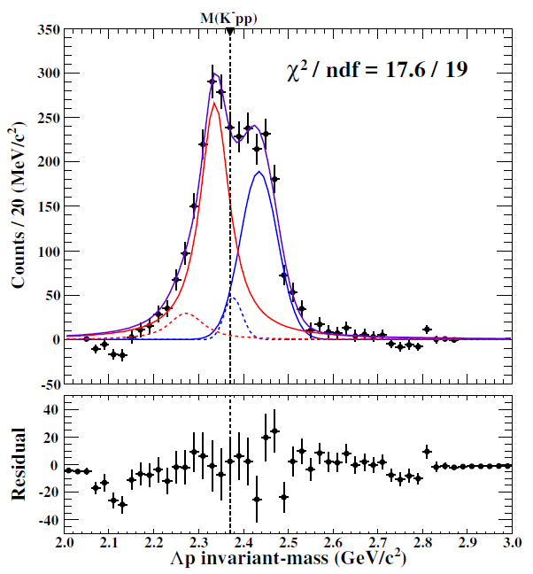
Fitting with BW and Gaussian
Simple fitting after BG subtraction
BS: Breit-Wigner
QF: Gaussian
w/ Σ⁰p contamination
Fit values that reproduce the spectrum
B.E ~ 35 MeV/c²
Γ ~ 75 MeV/c²
preliminary
← Fermi-mom. Eff.
← from MM(³He(K⁻,Λp)X)
Fitting region
preliminary

Slide 13
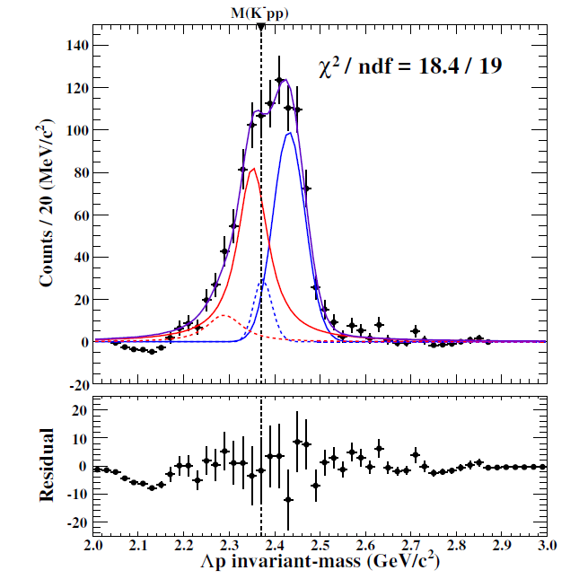
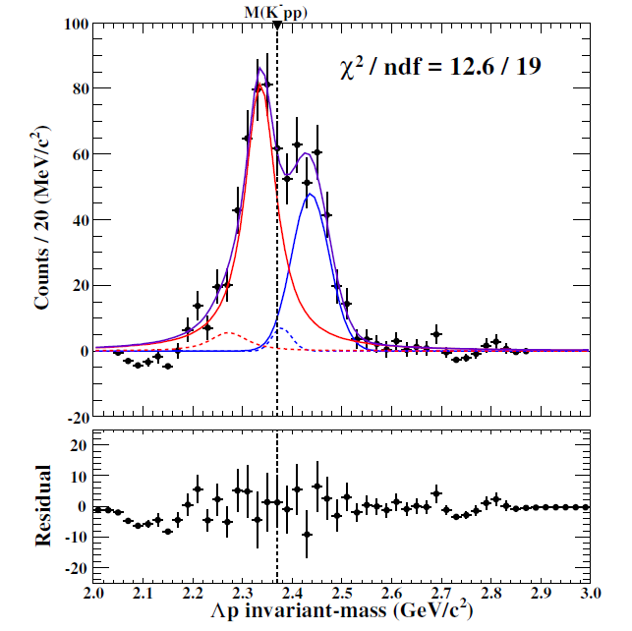
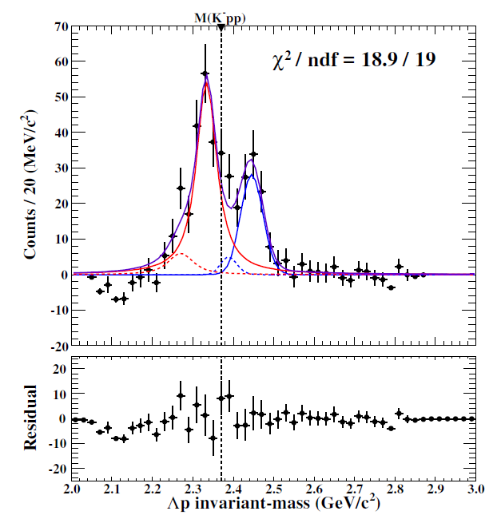
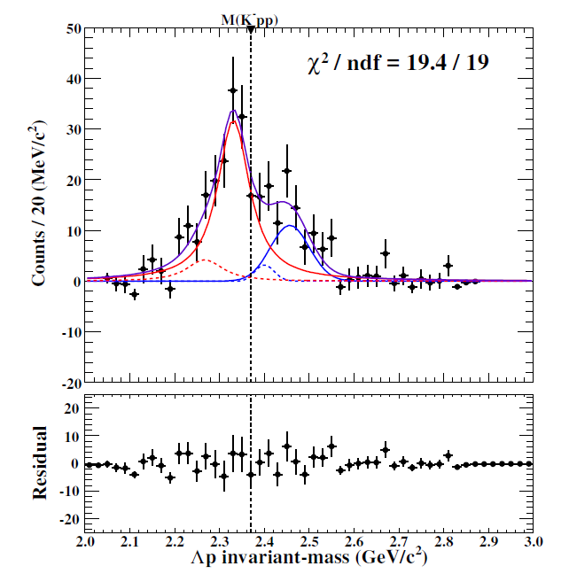
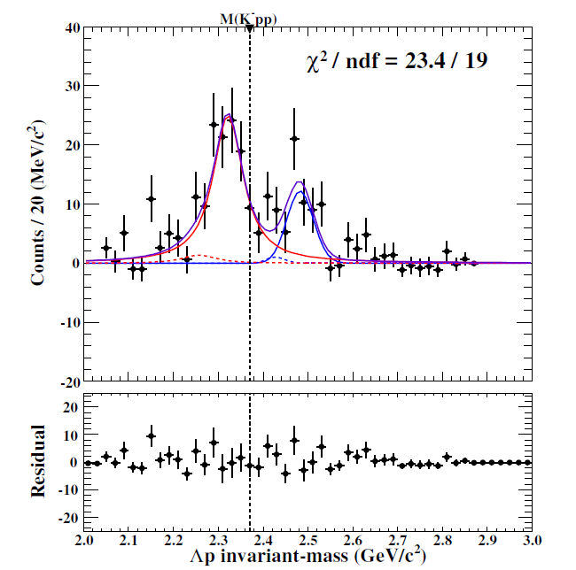
Sliced by Reaction Angle
cosθ_{n} dependence
𝟎.𝟕5<𝐜𝐨𝐬𝜽_{𝒏}^{𝑪𝑴}<𝟏.𝟎
preliminary
0.95<cosθ_{n}<1.0
0.90<cosθ_{n}<0.95
detector
acceptance
0.85<cosθ_{n}<0.90
0.80<cosθ_{n}<0.85
0.75<cosθ_{n}<0.80

Slide 14
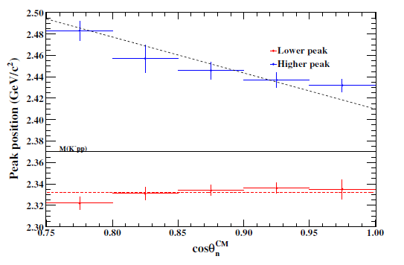
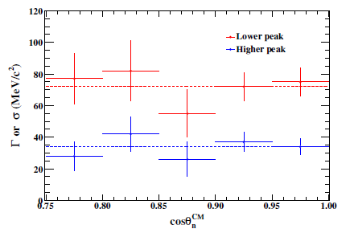
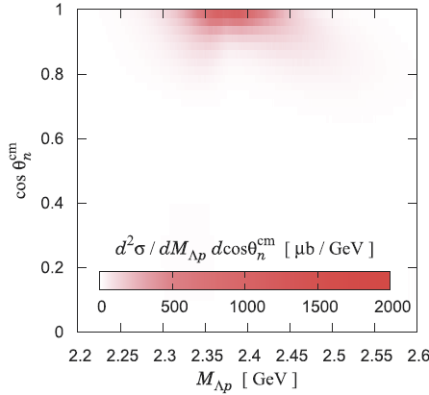
Reaction Angle Dependence
Peak position
Width
Gaussian
Breit-Wigner
Above M(K⁻pp):
peak shift by recoil kaon energy
Below M(K⁻pp):
peak is independent of cosθ_{n} ~ q_{Λp}
→ would be S=-1 di-baryon
Similar tendency as in a theoretical calculation
QF
B.S.
Sekihara, Oset, Ramos,
PTEP(2016)123D03

Slide 15
Present Status of K^{bar}NN
Exp. CANDIDATES
Upper limit
LEPS/HADES
B.E ~ 10-40 MeV
E15
B.E. ~ 100 MeV
FINUDA/DISTO/E27
Theor. calculations.
Difficult to reproduce deeply bound state using normal K^{bar}N int.
E15-2nd
Chiral
Phenomenological
For further understanding:
Λ(1405) production ◊ Λ∗N doorway
πΣN decay channel → new info. of K^{bar}NN

Slide 16
Outline of the Talk
1. K^{bar}NN seach via Λp channel
→ Non-mesonic channel
2. K^{bar}NN seach via πΣp channel
→ Mesonic channel

Slide 17
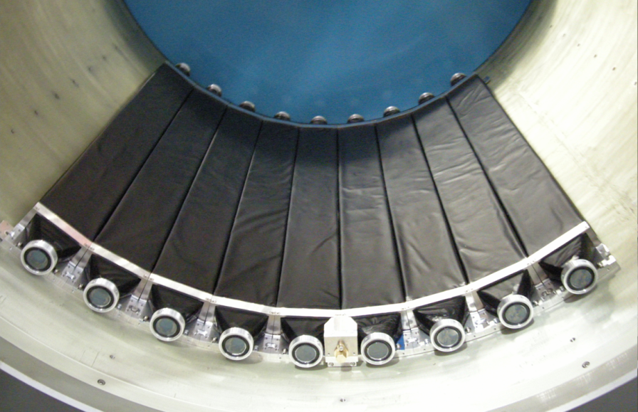
K⁻ ³He → πΣpn @ E15
CDS
Exclusive measurement of $π^{±}Σ^{∓}pn$ final state in K⁻+³He
p
“K⁻pp”
K-
³He
n
1 GeV/c
Σ
π
n
π
CDS
Experimental challenge of neutron detection with thin scintillation counter (t=3cm)
t = 3cm
79cm
10cm
n detection efficiency ~ 3%

Slide 18
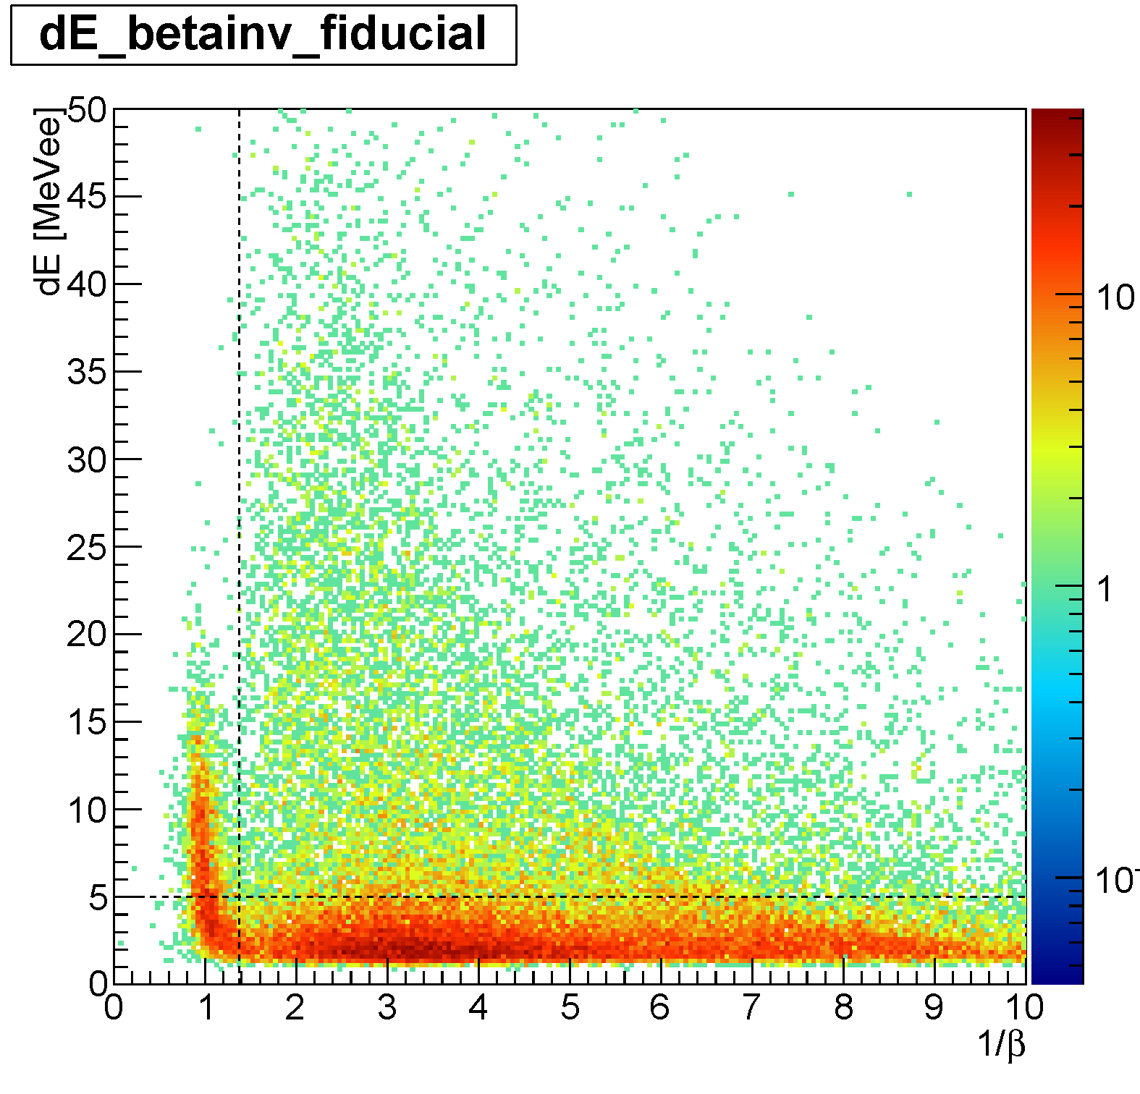
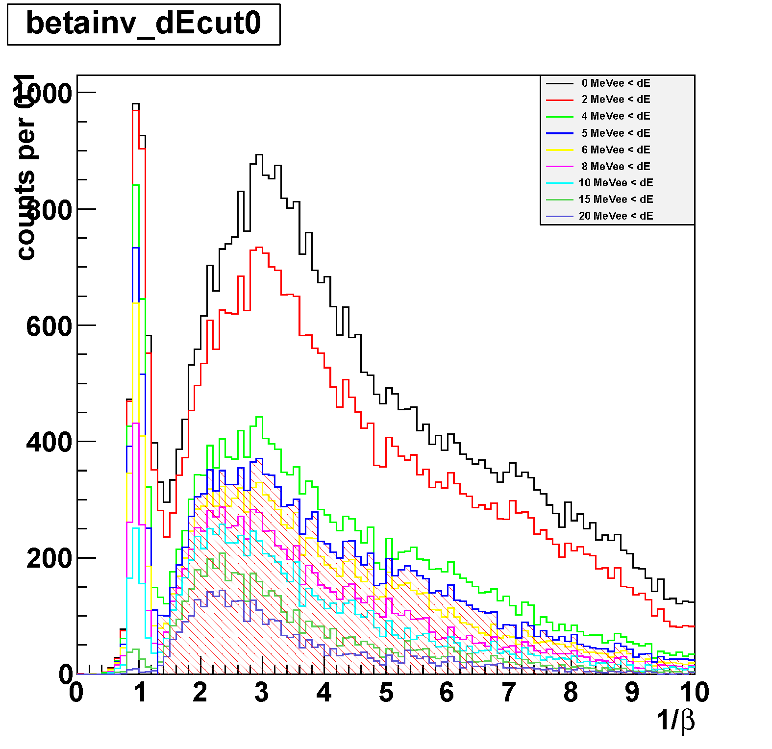
Neutron ID with CDS
π⁺π⁻p events (3 tracks) in CDS with 4 CDH hits are selected
a CDH hit with CDC-veto (outer-layer) is applied to identify the “neutral hit”
dE vs. 1/β
dE-cut dependence
1.372 < 1/β
(p_{n}<1GeV/c)
neutron ID
5MeVee < dE
Neutron can be identified with CDS

Slide 19
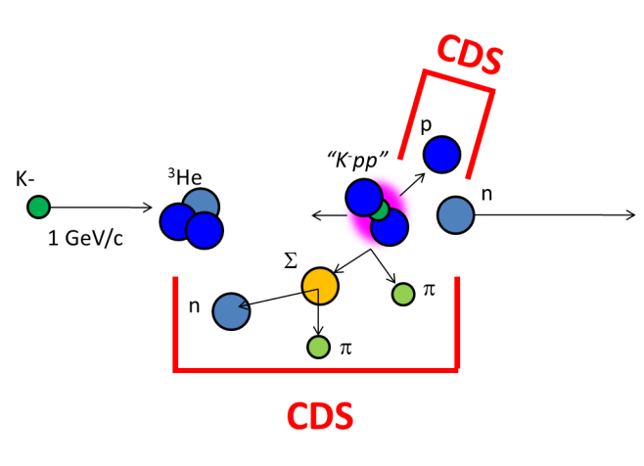
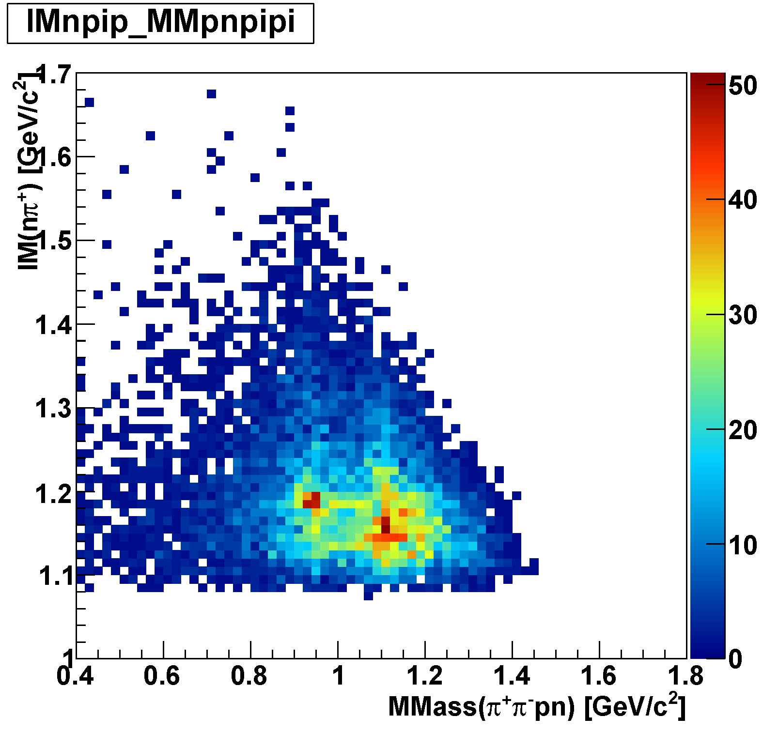
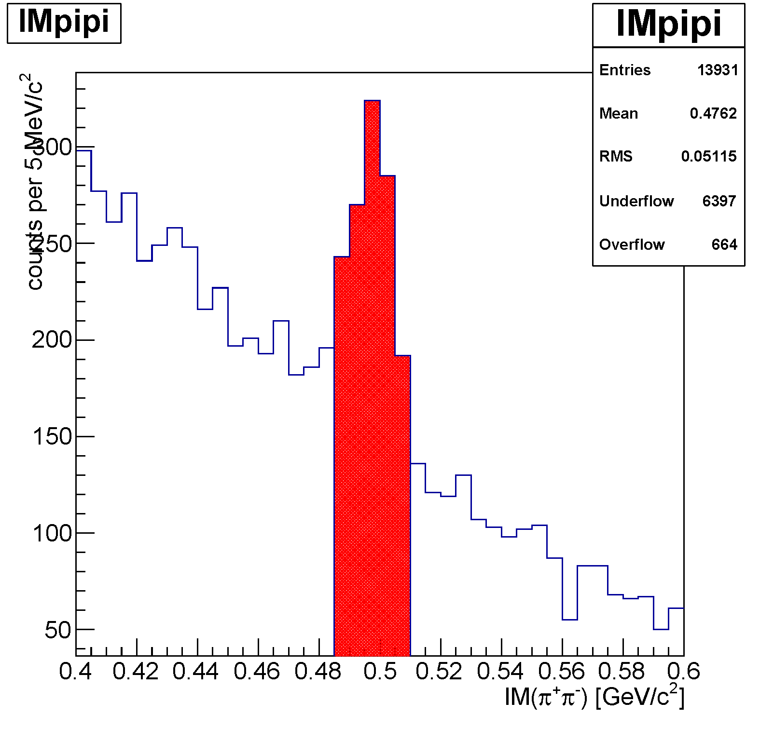
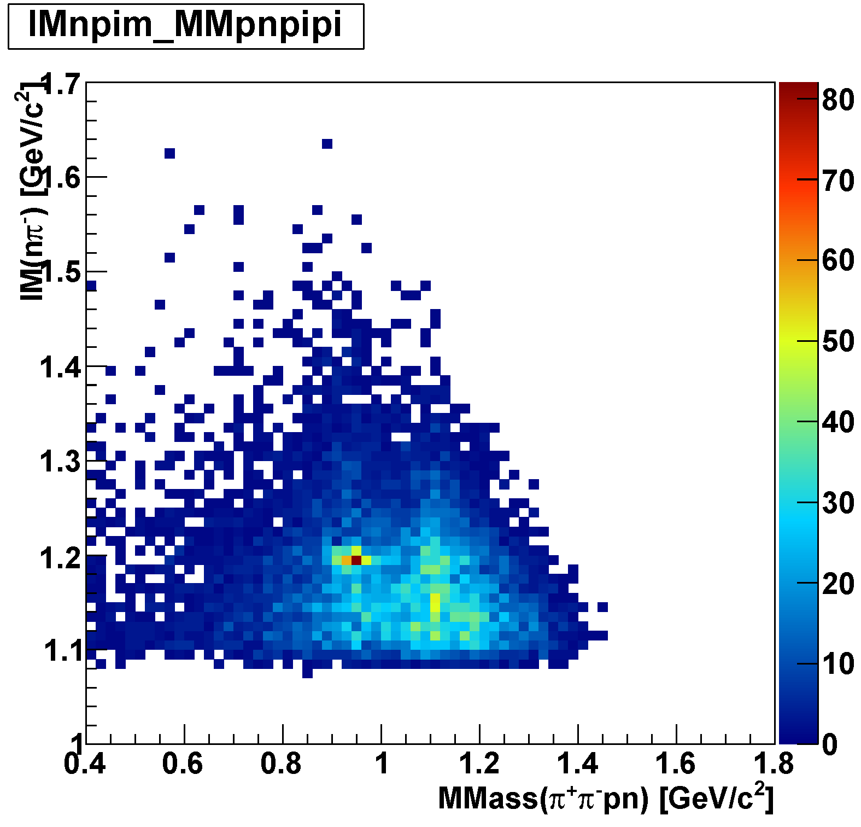
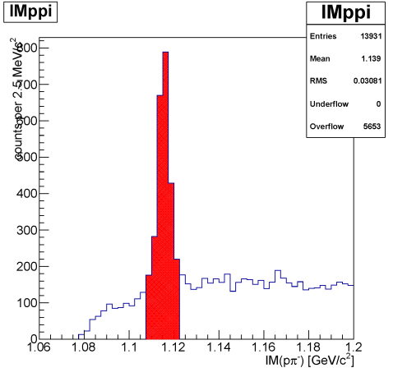
πΣpn Events
IM(nπ⁺) vs MM(π⁺π⁻pn)
π⁻Σ⁺p n_{miss}
K⁰→π⁺π⁻
IM(nπ⁻) vs MM(π⁺π⁻pn)
removed
π⁺Σ⁻p n_{miss}
Λ→pπ⁻
M(n)
M(Λ)
removed

Slide 20
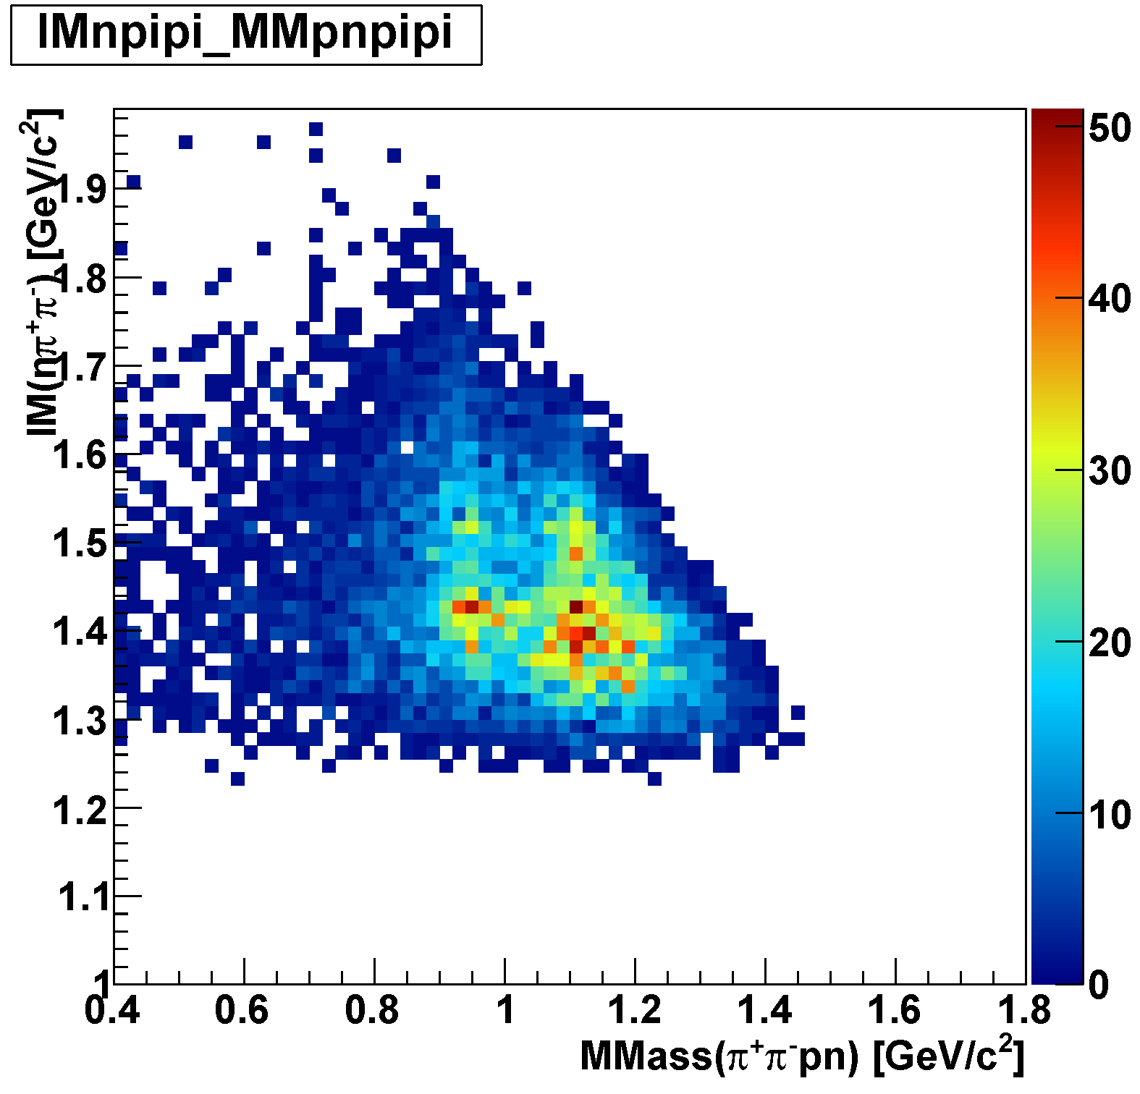
Λ*pn Events
IM(nπ⁺π⁻) vs MM(π⁺π⁻pn)
M(n)
M(Λ)
Λ(1520)p n_{miss}
Λ(1405)p n_{miss}

Slide 21
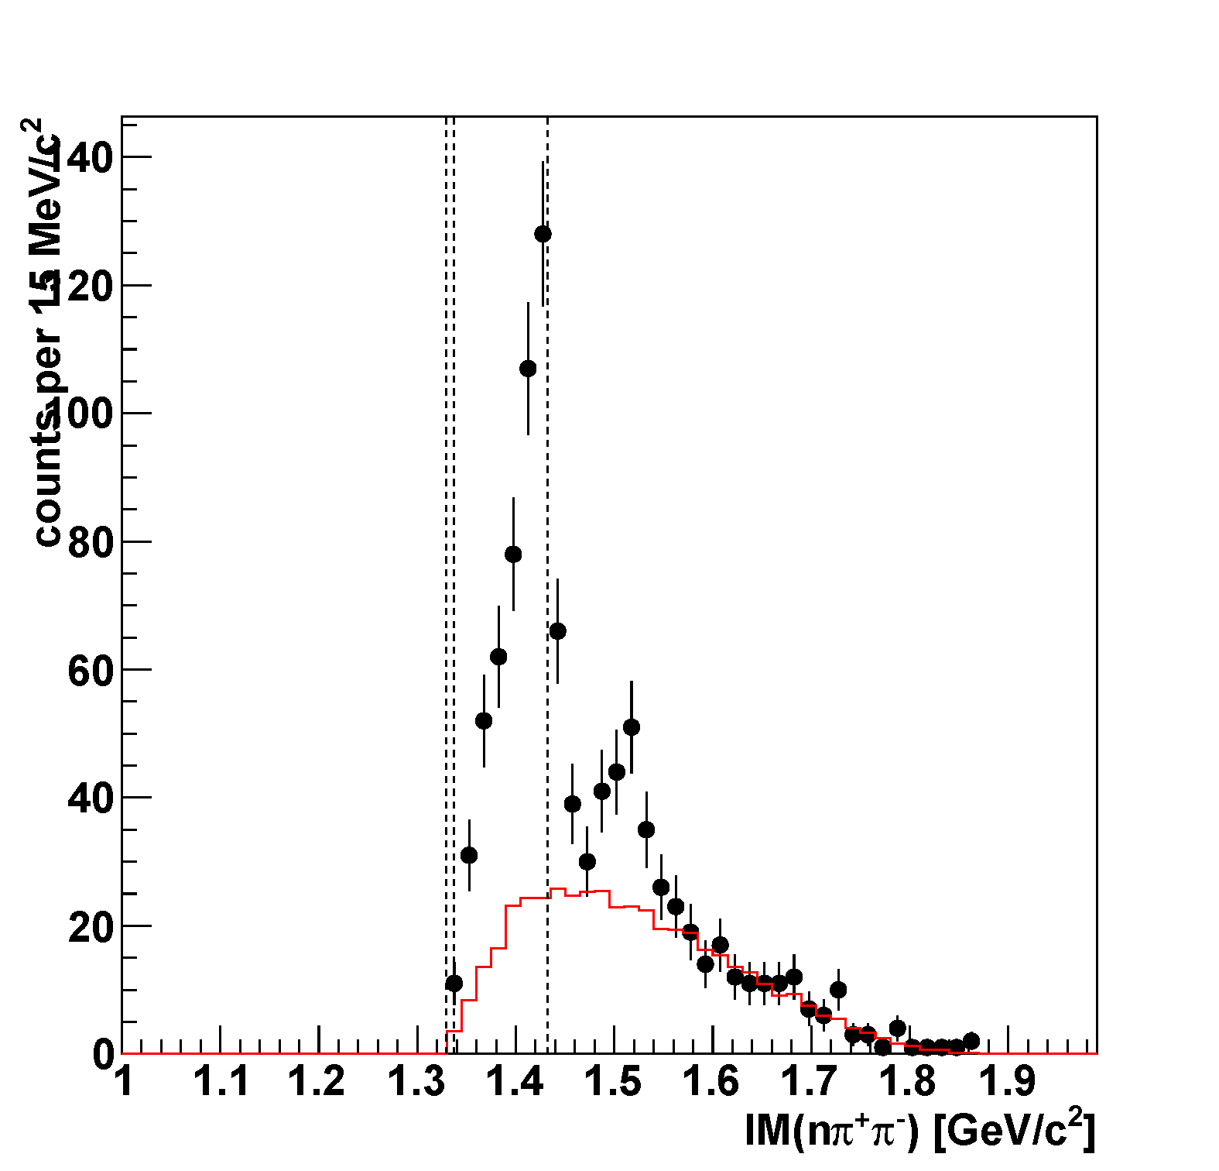
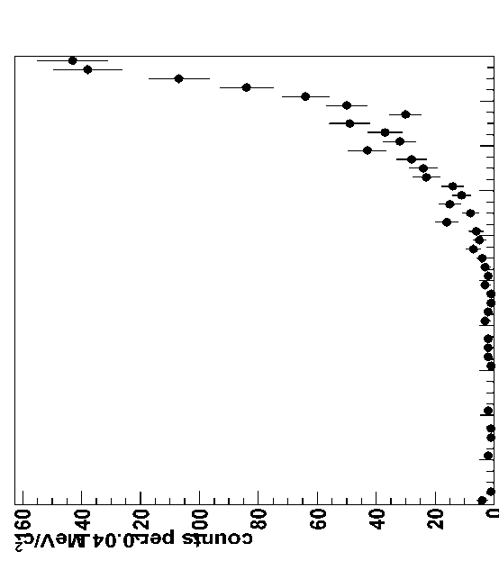
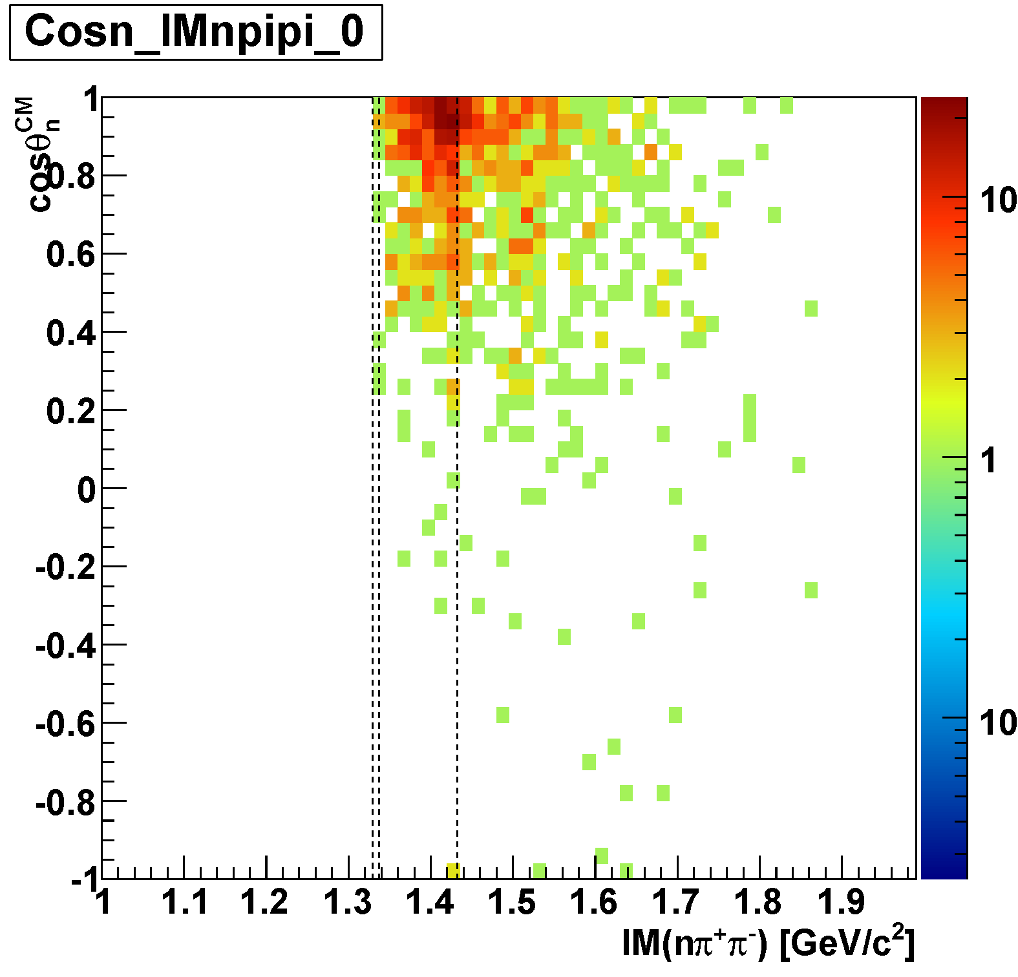
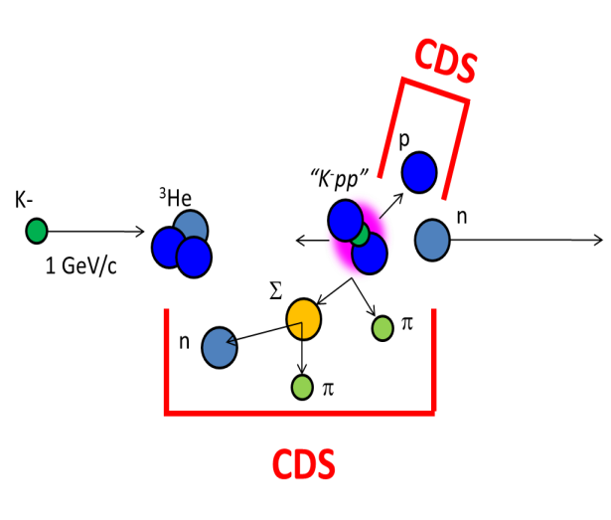
$π^{±}Σ^{∓}$p n_{miss} Final-State [IM($π^{±}Σ^{∓}$)]
Σ(1385)/Λ(1405)
Event Selection
Missing n:
0.85 < MM(π⁺π⁻pn) <1.03 GeV/c²
Σ mass:
1.18 < IM(nπ⁻) < 1.20 GeV/c² for Σ⁻
1.19 < IM(nπ⁺) < 1.21 GeV/c² for Σ⁺
IM($π^{±}Σ^{∓}$)
Λ(1520)
“Simple” PS-Background
$π^{±}Σ^{∓}pn$ phase-space with the detector acceptance
preliminary
cos(θ_{n-miss})
concentrated in forward-n region
M(πΣ)
M(K⁻p)

Slide 22
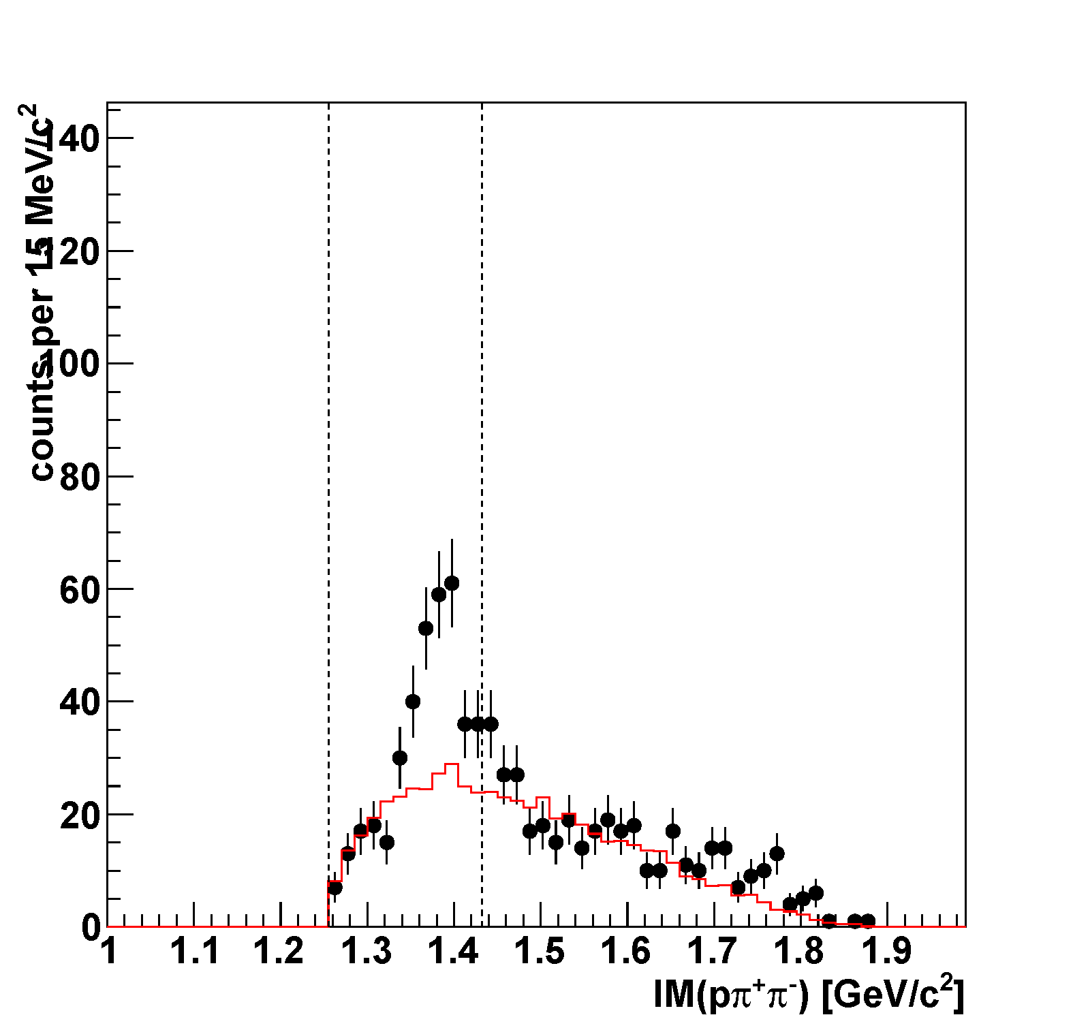
($π^{±}Σ^{∓}$)p n_{miss} vs. ($π^{+}Λ$)n n_{miss}
$π^{+}Λ$n n_{miss} final state was obtained as with $π^{±}Σ^{∓}$p n_{miss}
Σ(1385)/Λ(1405)
M(πΣ)
M(K⁻p)
M(πΛ)
IM($π^{±}Σ^{∓}$)
IM($π^{+}Λ$)
I = 0 dominant
Σ(1385)→πΣ/πΛ: 12%/87%
preliminary
preliminary
Σ(1385)⁺
Λ(1520)
M(πΣ)
M(K⁻p)
“Simple” PS-BG
“Simple” PS-BG
I =0 and 1 mode
I = 1 mode
Discrimination of Λ(1405) and Σ(1385) is under way
→ Careful investigation of the backgrounds is needed

Slide 23
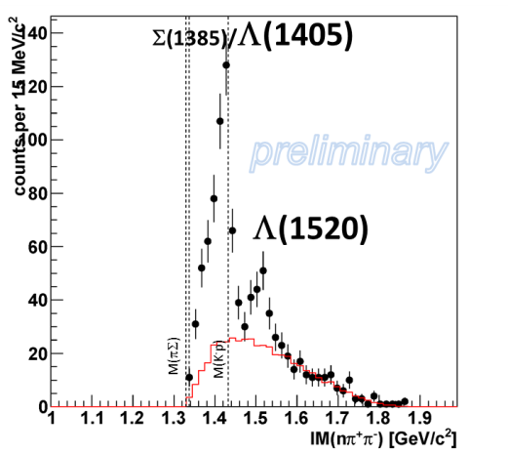
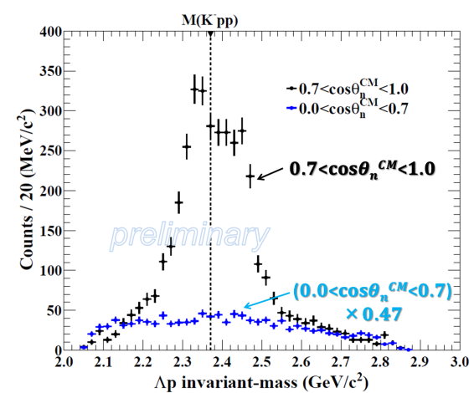
Production of Λ* and “K⁻pp”
Λ(1405)
K-
³He
n
1 GeV/c
p
“free” Λ*
“K⁻pp” formation
p
p
“K⁻pp”
n
n
Λ
Λ(1405)
IM($π^{±}Σ^{∓}$)
IM(Λp)
Comparison of each CS would give us important hints!

Slide 24
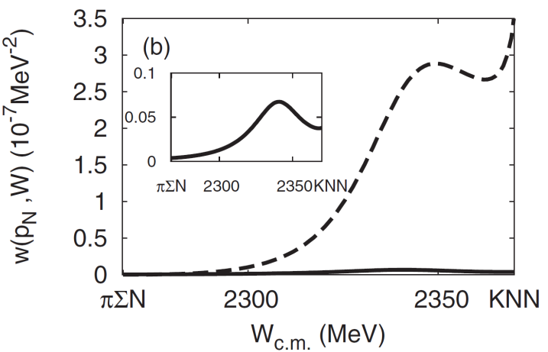
“K⁻pp”→πΣN Decay Channel
S.Ohnish et al.,PRC88(2013)025204
Theoretically,
πΣN decay is expected to be
the dominant channel
kaon absorption probability
of Λ*N→πΣN/ΛN
πΣN channel
ΛN channel
CDS
p
“K⁻pp”
K-
³He
n
1 GeV/c
Σ
π
n
π
CDS

Slide 25
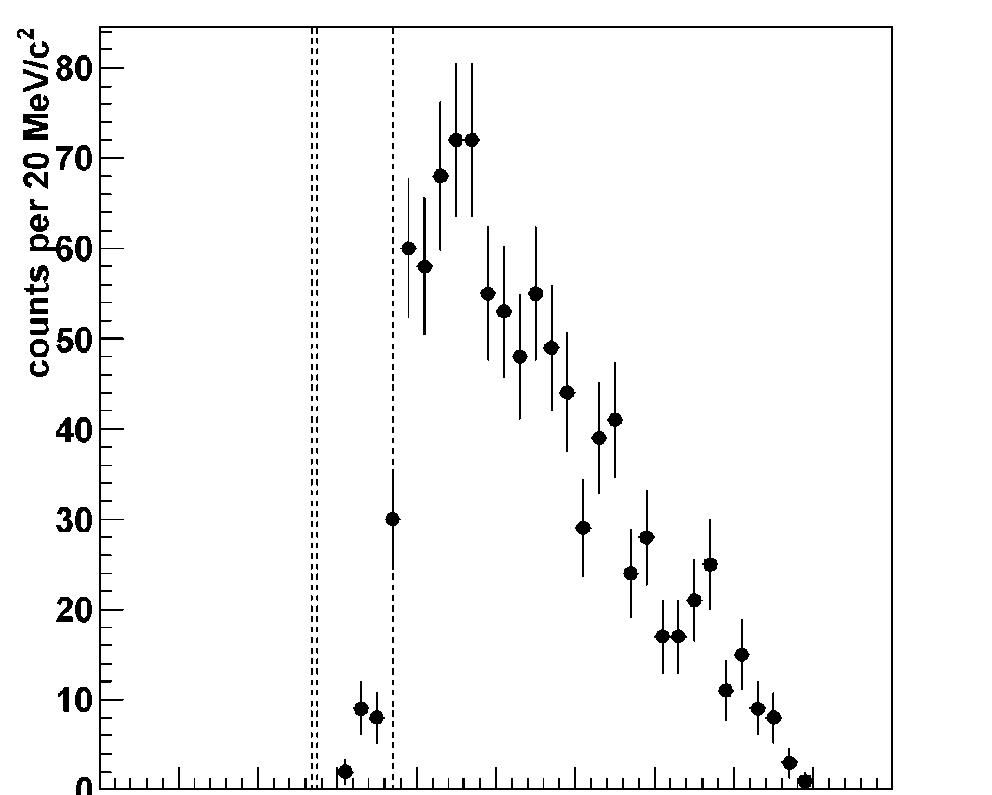
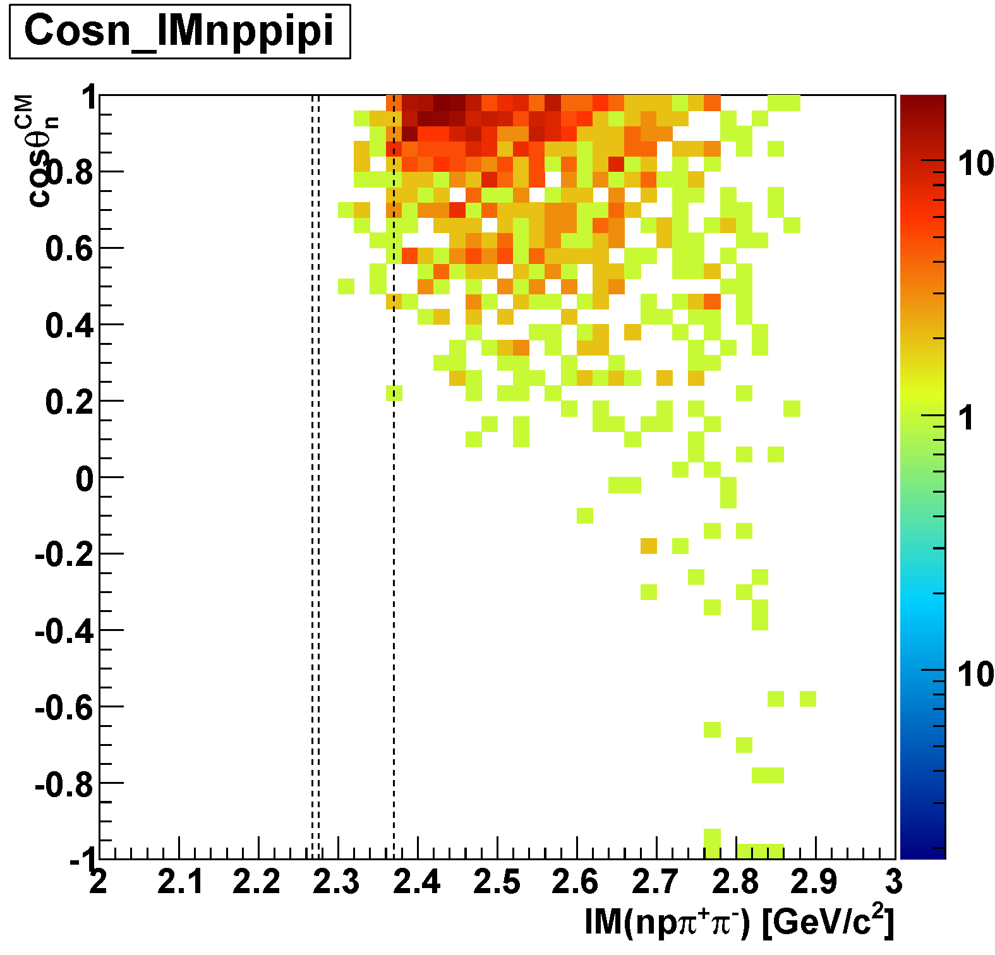
$π^{±}Σ^{∓}$p n_{miss} Final-State [IM($π^{±}Σ^{∓}p$)]
Event Selection
Missing n:
0.85 < MM(π⁺π⁻pn) <1.03 GeV/c²
Σ mass:
1.18 < IM(nπ⁻) < 1.20 GeV/c² for Σ⁻
1.19 < IM(nπ⁺) < 1.21 GeV/c² for Σ⁺
IM($π^{±}Σ^{∓}p$)
M(πΣp)
M(K⁻pp)
Subthreshold events seem to be suppressed!
preliminary
cos(θ_{n-miss})

Slide 26
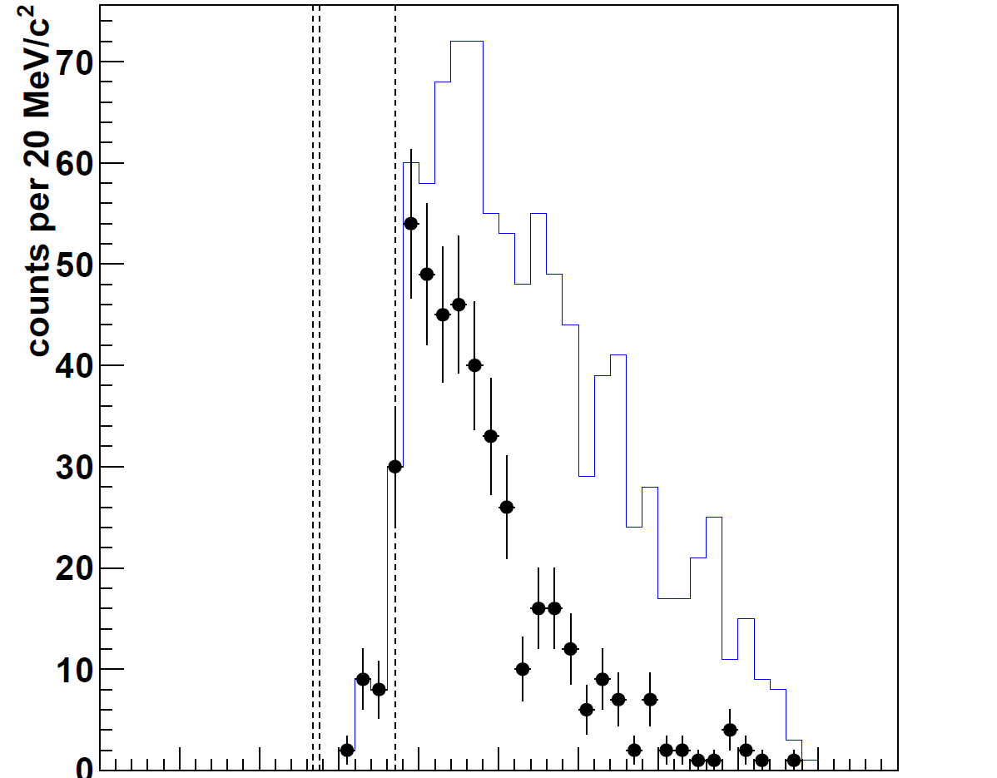
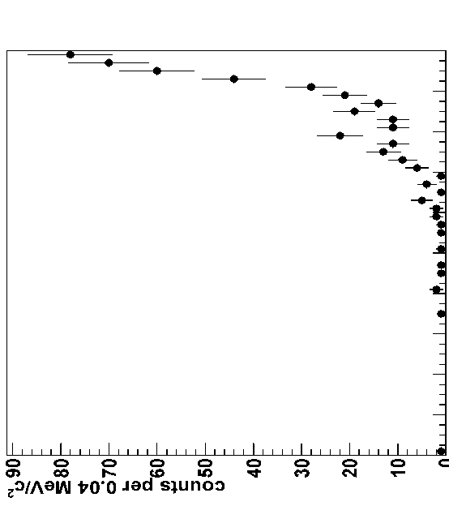
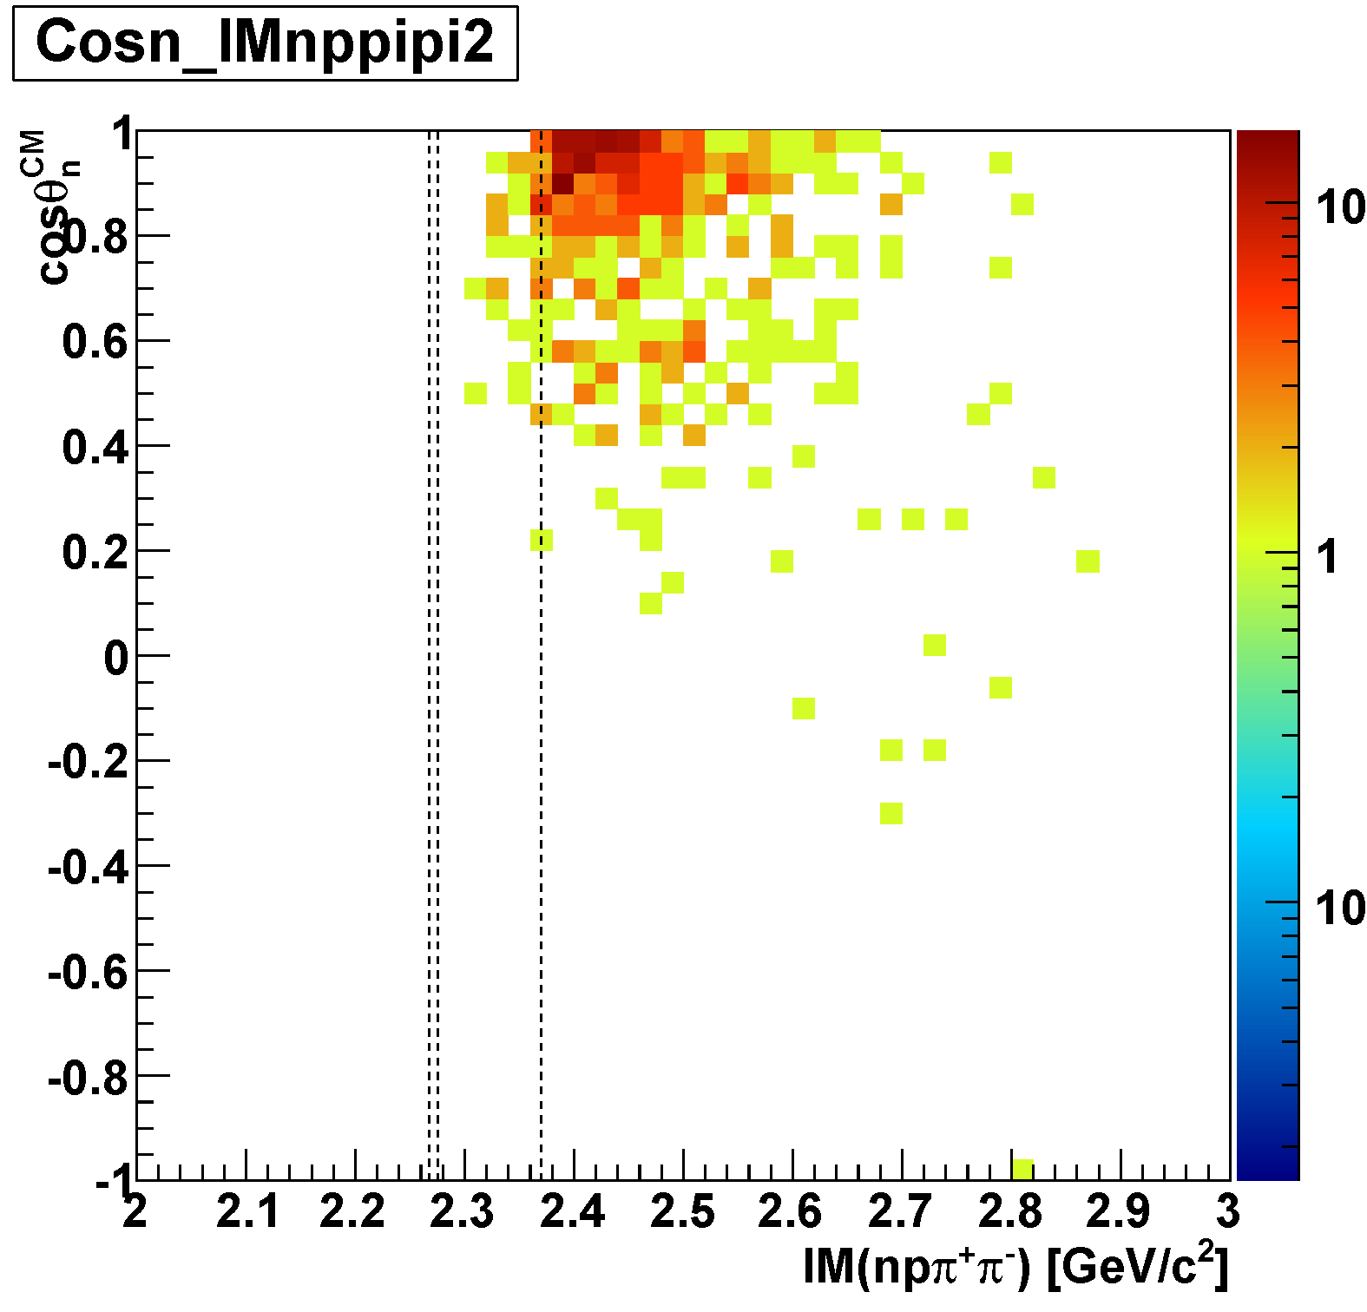
$π^{±}Σ^{∓}$p n_{miss} in Λ(1405) Region
Λ(1405) region is selected
[IM(nπ⁺π⁻)<M(K⁻p)]
M(πΣp)
M(K⁻pp)
IM($π^{±}Σ^{∓}p$)
M(πΣ)
preliminary
− No selection
− Λ(1405) region
M(K⁻p)
IM($π^{±}Σ^{∓}$)
preliminary
cos(θ_{n-miss})

Slide 27
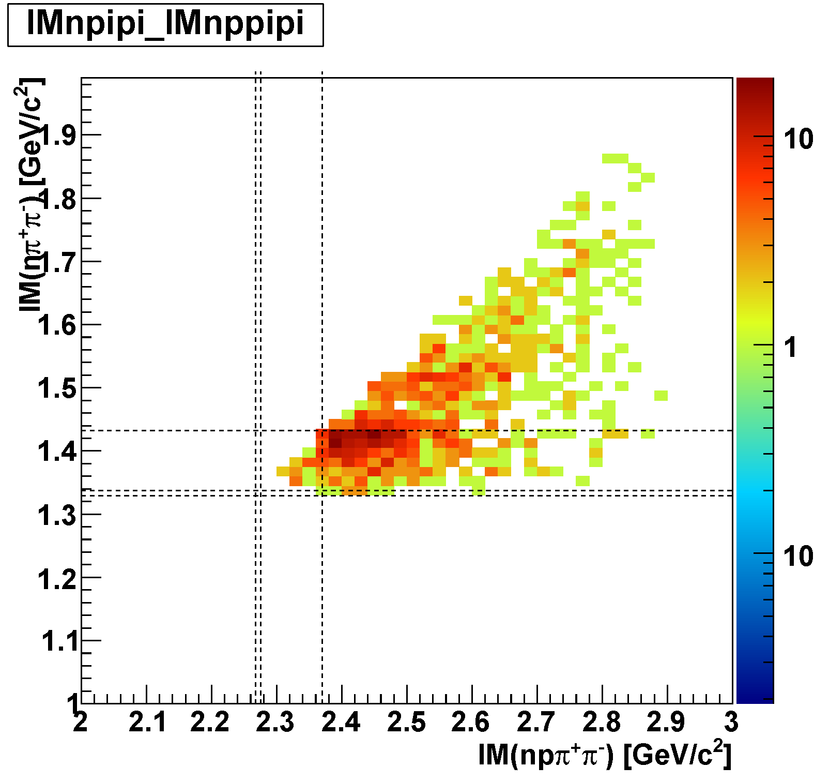
IM($π^{±}Σ^{∓}$) vs. IM($π^{±}Σ^{∓}p$)
Λ(1405) and QF are strongly correlated
= consistent with K⁻+N quasi-free followed by K⁻+N_{s}N_{s}→Λ*p
preliminary
kinematical limit
Λ(1405)
M(K⁻p)
Bound Region
M(πΣ)
M(πΣp)
M(K⁻pp)
QF
small phase-space of “K⁻pp”→πΣN

Slide 28
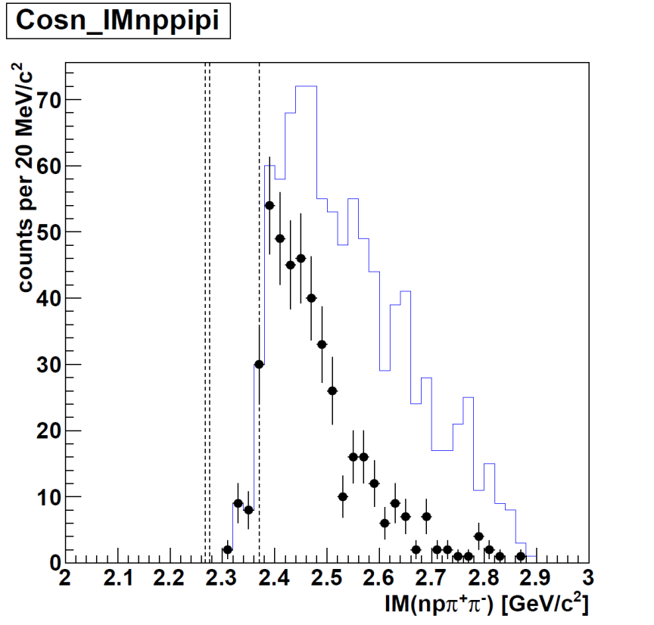
Λp vs. πΣp
M(Λp)
$$Λp$$
preliminary
$$π^{±}Σ^{∓}p$$
The same structure or not!?
M(πΣp)
M(K⁻pp)
− all region
− Λ(1405) region
preliminary

Slide 29
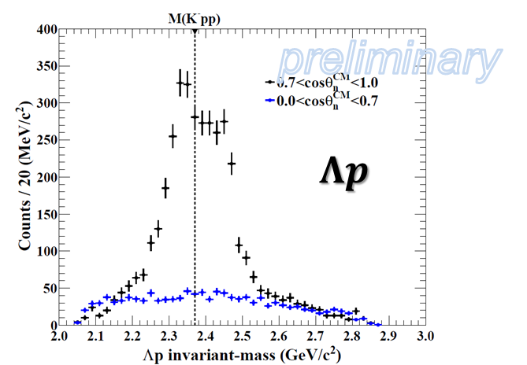
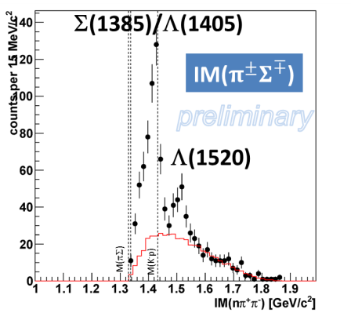
Conclusion
Structures around the K⁻pp threshold were found in ³He(K⁻,Λp)n
above M(K⁻pp): K⁻N quasi-free followed by K⁻N_{s}N_{s}→Λp
below M(K⁻pp): would be S=-1 di-baryon decaying to Λp
Γ(Λ(1405)) < Γ(measured “di-baryon”)
Λ(1405) was clearly observed in $π^{±}Σ^{∓}$p n_{miss} final state
Important hints of “K⁻pp” production mechanism would be obtained
Weak structure below the K⁻pp threshold was seen in ³He(K⁻,$π^{±}Σ^{∓}$p)n
Suppression of “K⁻pp” → πΣN channel?
or
Limitation of detector acceptance / statistics?
preliminary
$$π^{±}Σ^{∓}p$$
need further investigation of “K⁻pp” → πΣN

Slide 30
The E15 Collaborations

Slide 31
Λp vs. πΣp
Detector acceptance is different between Λp and πΣp
At cosθ_{n}~1:
Λp: flat acceptance
πΣp: limited acceptance below the threshold
$$Λp$$
preliminary
detector
acceptance
$$π^{±}Σ^{∓}p$$
M(K⁻pp)
M(πΣp)
cf. $π^{±}Σ^{∓}pn$-PS MC
w/ detector acceptance
M(πΣp)
M(K⁻pp)
preliminary
detector
acceptance

Slide 32
Acceptance of K^{bar}NN Bound-State
$$Λp$$
$$π^{±}Σ^{∓}p$$
T.Hashimoto

