Slide 1
Search for double strangeness dibaryons at J-PARC
F.Sakuma, RIKEN
Strangeness in the Universe @ ECT*, 21-25, Oct, 2013.

Slide 2
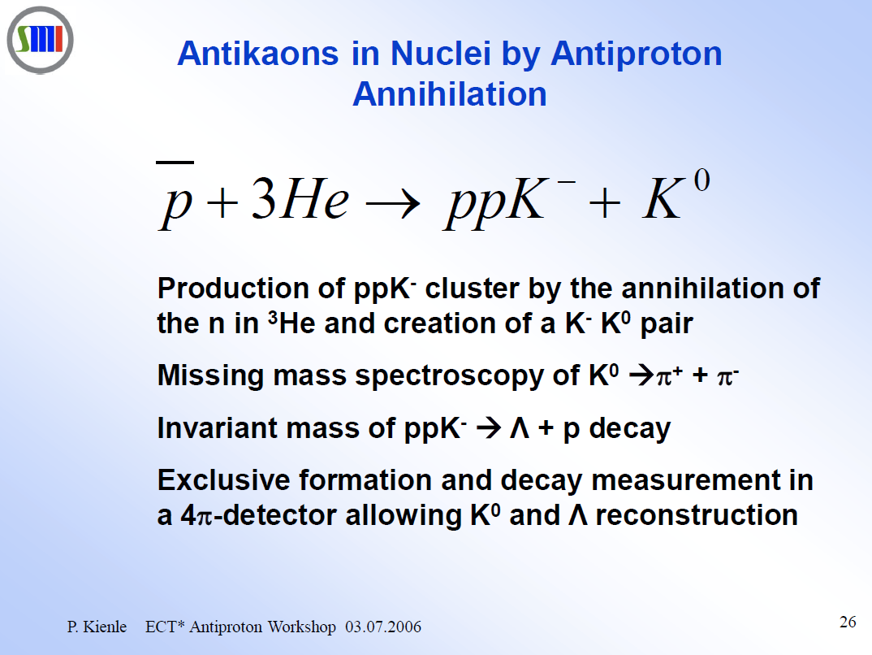
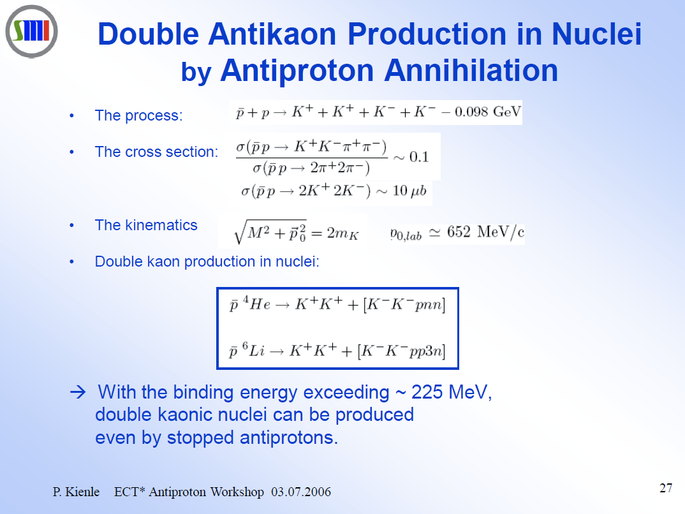
Idea from Prof. P. Kienle
P.Kienle, ECT* 2006

Slide 3
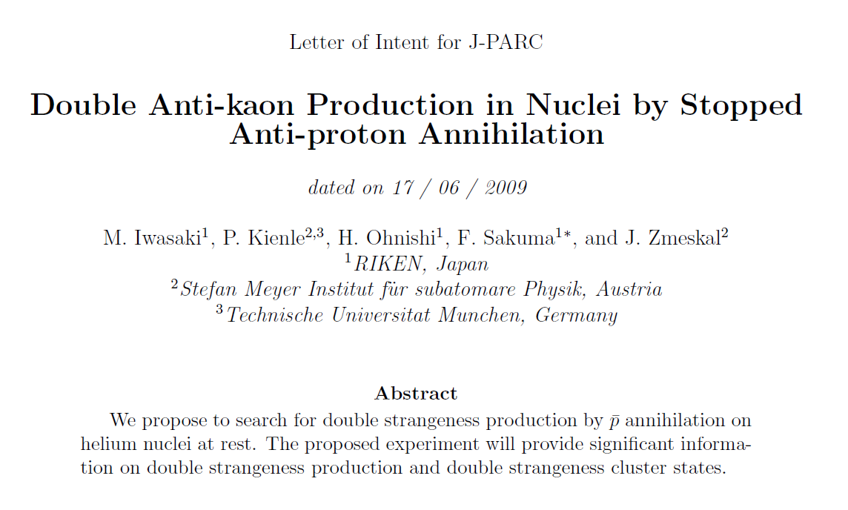

Slide 4
Outline
S=-2 dibaryon
  double kaonic nuclear state, K⁻K⁻pp
  H-dibaryon
Experimental search at J-PARC
  p^{bar}+³He annihilation at rest
Summary

Slide 5
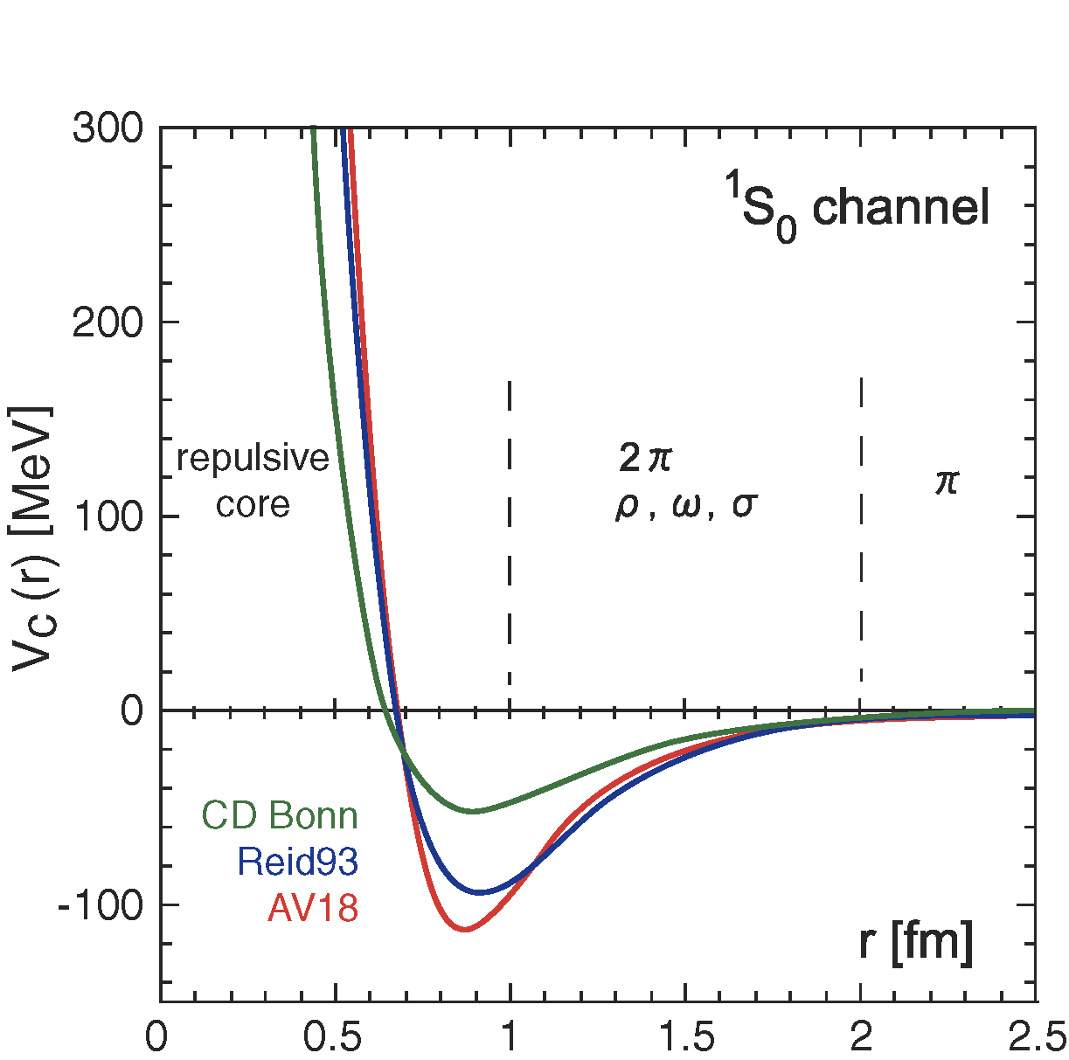
Motivation: Embedding strangeness (K⁻) in Nucleus
Light mesons
  play an important role in a nucleus as “glue”
Light S=-1 mesons?
  Kaonic-atom experiments (KpX@KEK, DEAR/SIDDHARTA@DAΦNE) clarified strongly attractive K^{bar}-N interaction
  What will happen when K^{bar} is embedded in nucleus?
    K^{bar}-nucleus bound state?
    high density?

Slide 6
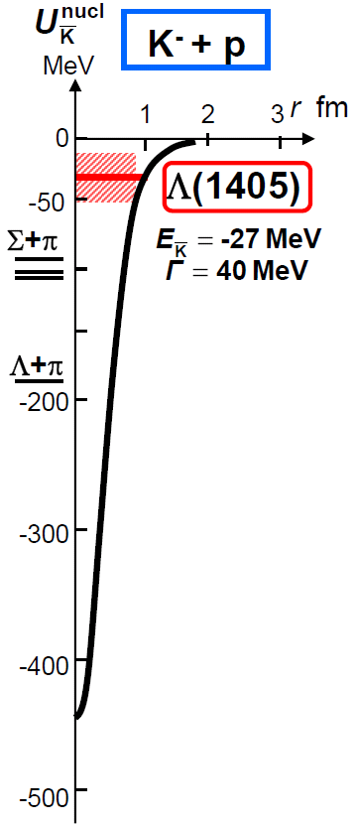
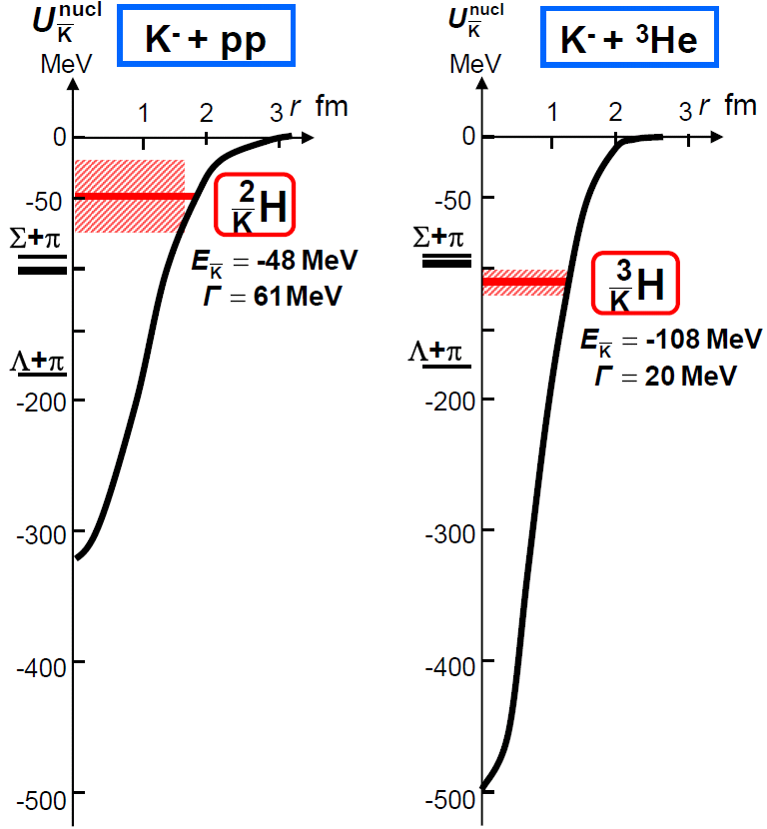
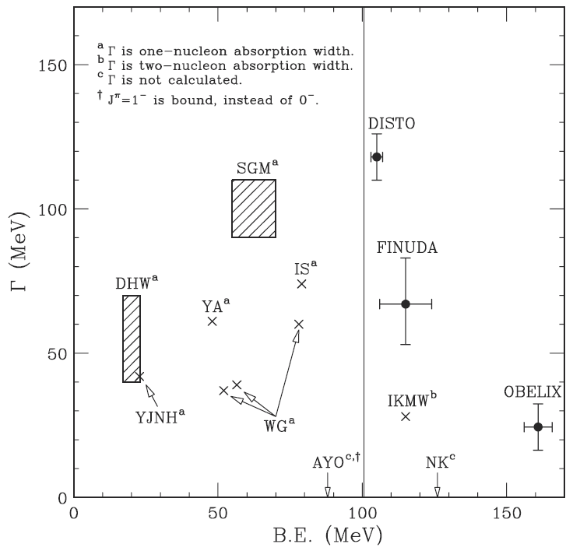
Kaonic Nuclear Cluster (KNC)
Kaonic nucleus is a bound state of nucleus and anti-kaon (K^{bar}NN, K^{bar}NNN, K^{bar}K^{bar}NN, ...)
Koike and Harada, PRC80(2019)055208
Y.Akaishi & T.Yamazaki, PLB535, 70(2002).
All works predict existence of the K⁻pp
→ However, B.E. and Γ are NOT converged yet.

Slide 7
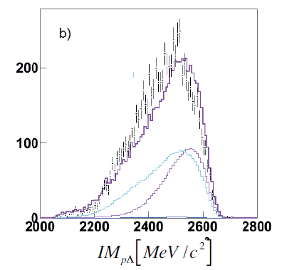
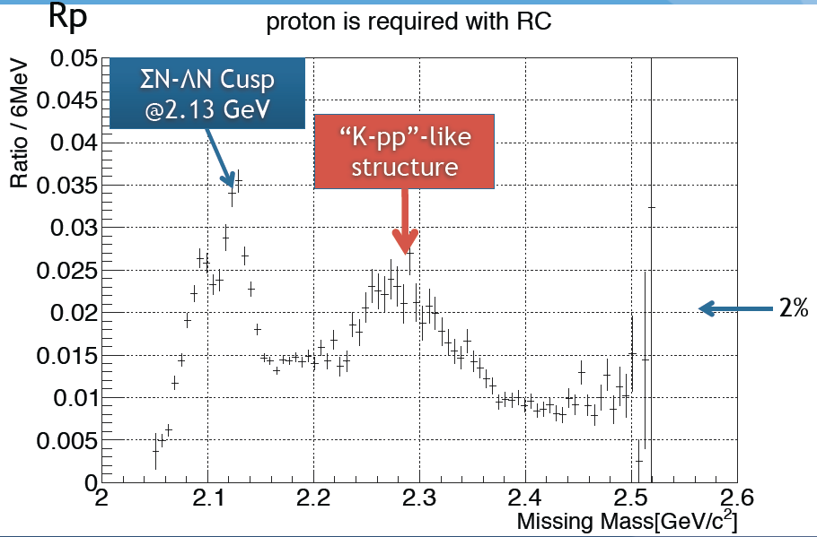
Recent Experimental Results
In addition to the FINUDA & DISTO results,
K⁻pp search
Ratio of proton tag / inclusive
HADES@GSI
E27@J-PARC
NPA914(2013)60
17th PAC meeting (Sep. 2013)
p + p → (Λ + p) + K⁺ @ 3.5GeV
d(π⁺, K⁺) @ 1.7GeV/c
Experimental situation is also controversial !!!

Slide 8
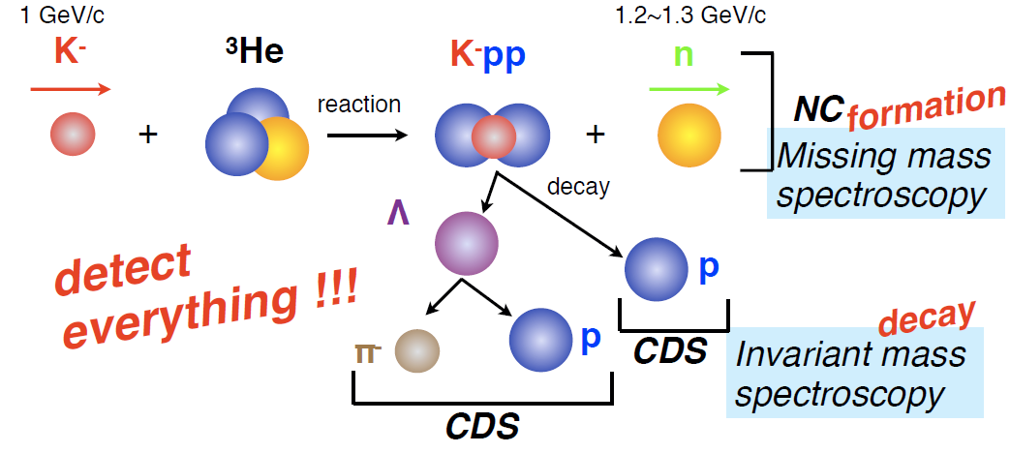
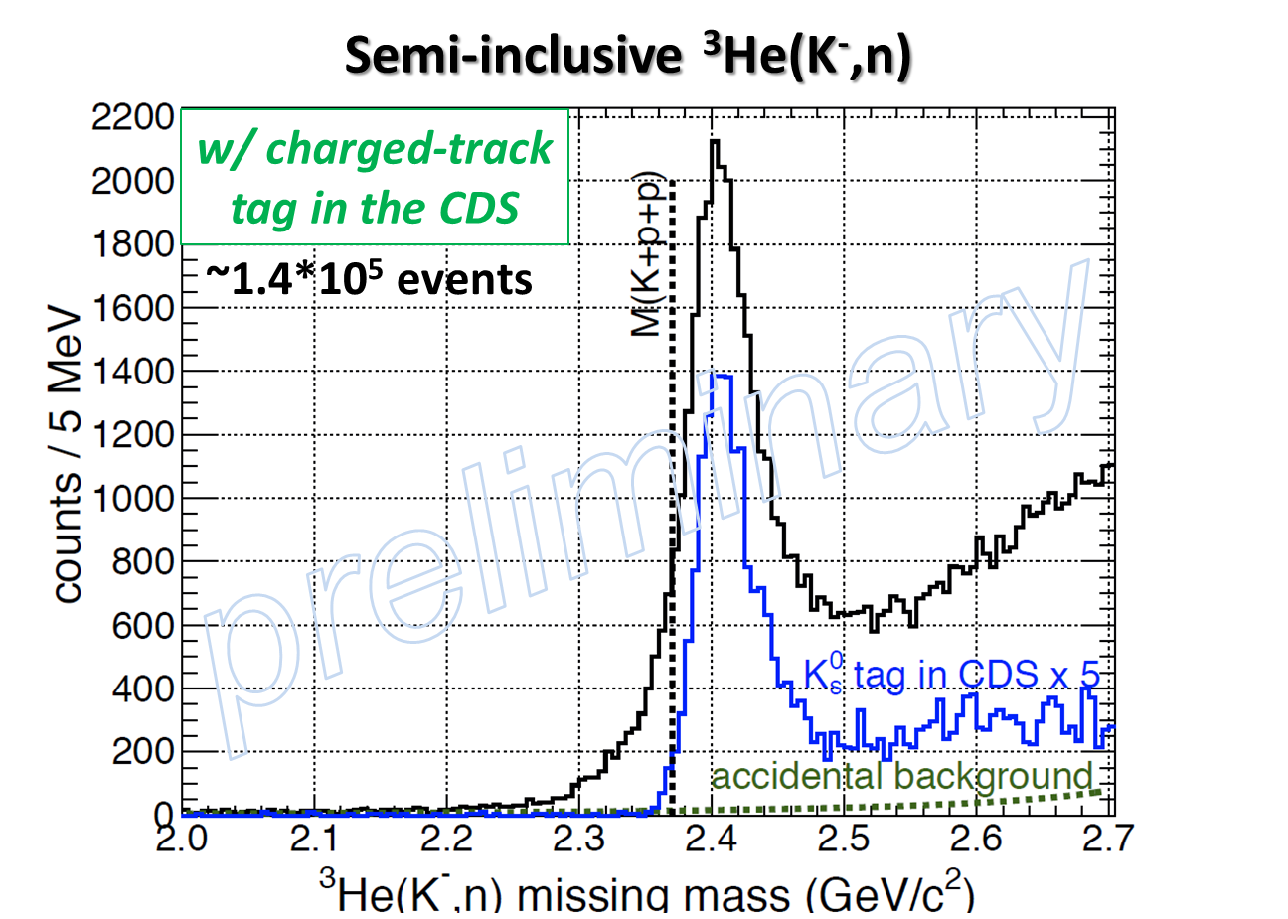
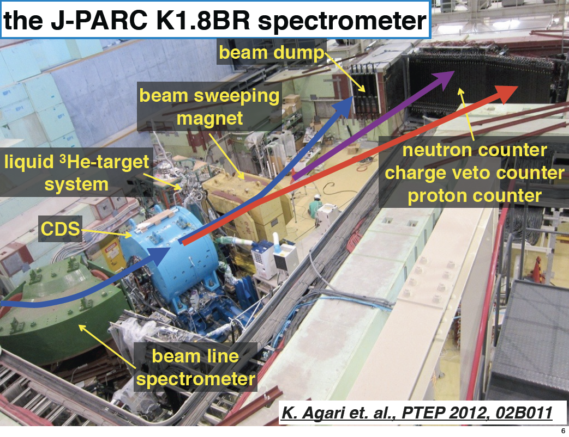
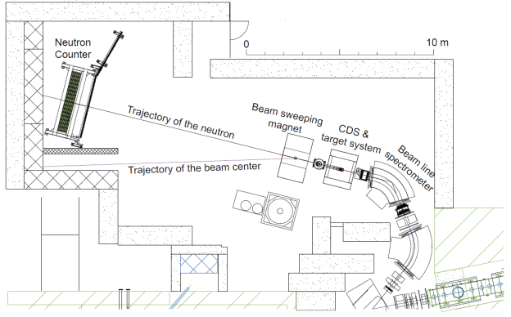
J-PARC E15 Experiment
search for the K⁻pp using ³He(in-flight K⁻,n) reaction
The latest results were given in
M.Sato’s talk

Slide 9
What will happen to put one more kaon
in the kaonic nuclear cluster?
“Double-Kaonic
Nuclear Cluster”

Slide 10
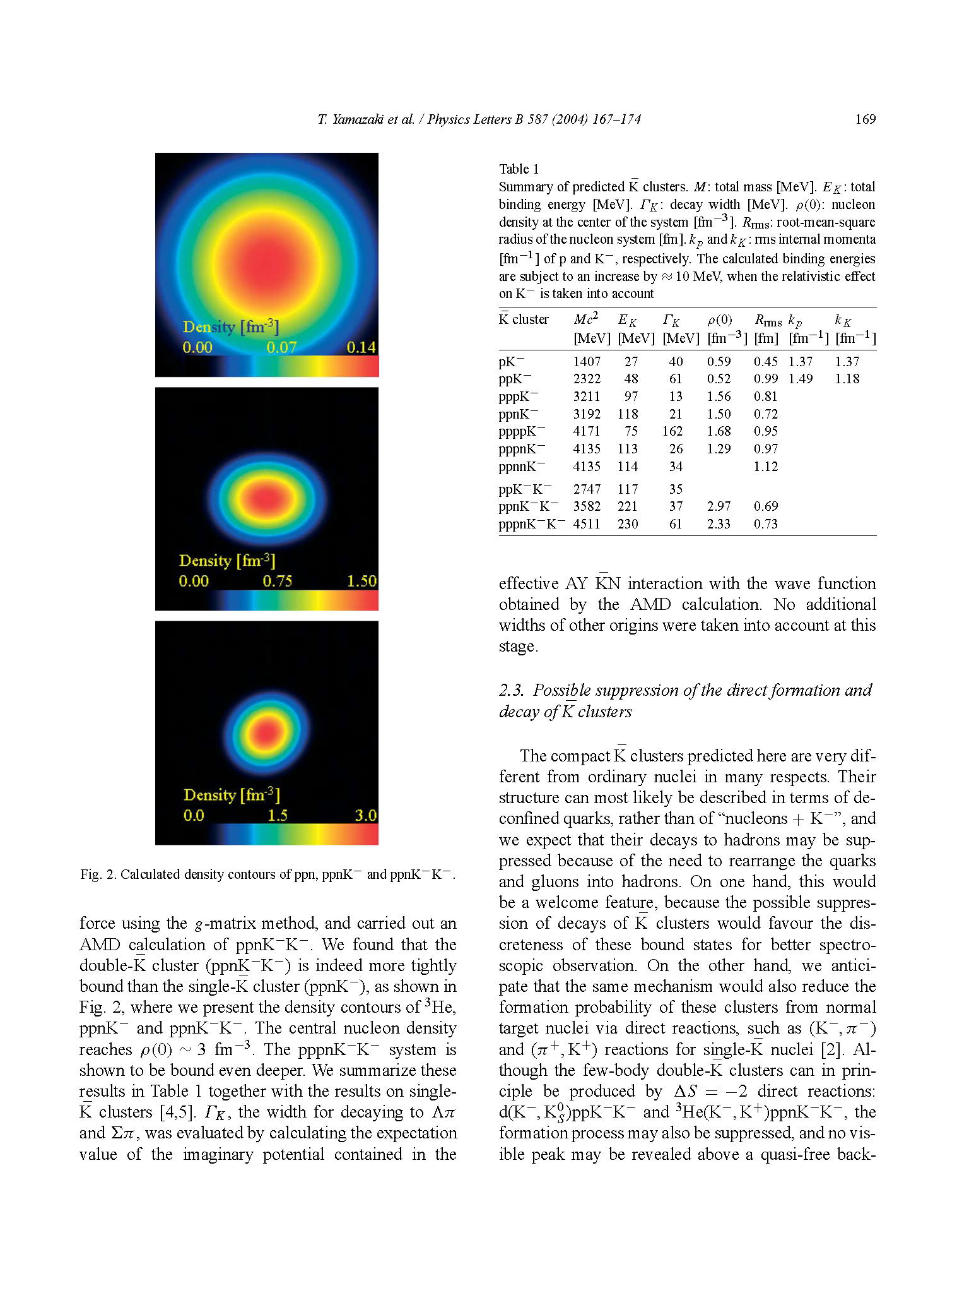
Double-Kaonic Nuclear Cluster (DKNC)
ppn
The double-kaonic nuclear clusters were also predicted theoretically.
ppnK⁻
PL,B587,167 (2004).
ppnK⁻K⁻
The double-kaonic clusters have
much stronger binding energy
much higher density
than single ones. (AMD calc.)

Slide 11
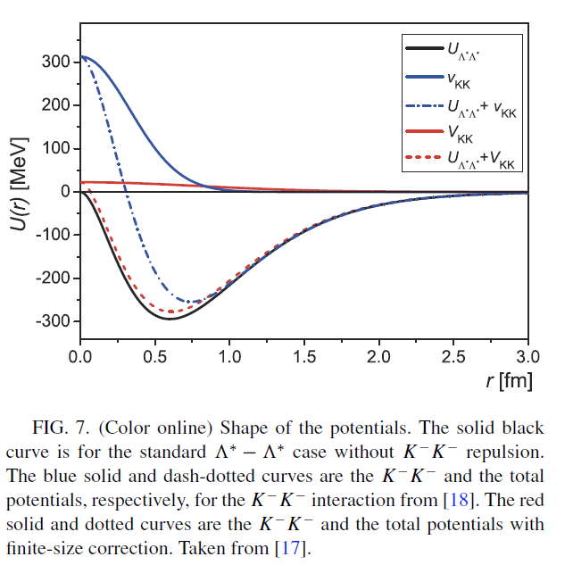
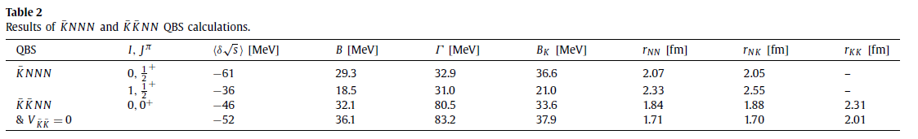
Theoretical Calculations
M.Hassanvand, Y.Akaishi,
T.Yamazaki
Λ* ansatz
Variational Calc.
PRC84(2011)015204,
Proc.Jpn.Acad.Ser.B87(2011)362
Deeply bound & Compact
B=50~200MeV, Γ~75MeV
N.Barnea, A.Gal, E.Z.Liverts
PLB712(2012)137.
Chiral Model
Hyperspherical basis
NOT Deeply bound & NOT Compact
B~30MeV, Γ~80MeV

Slide 12
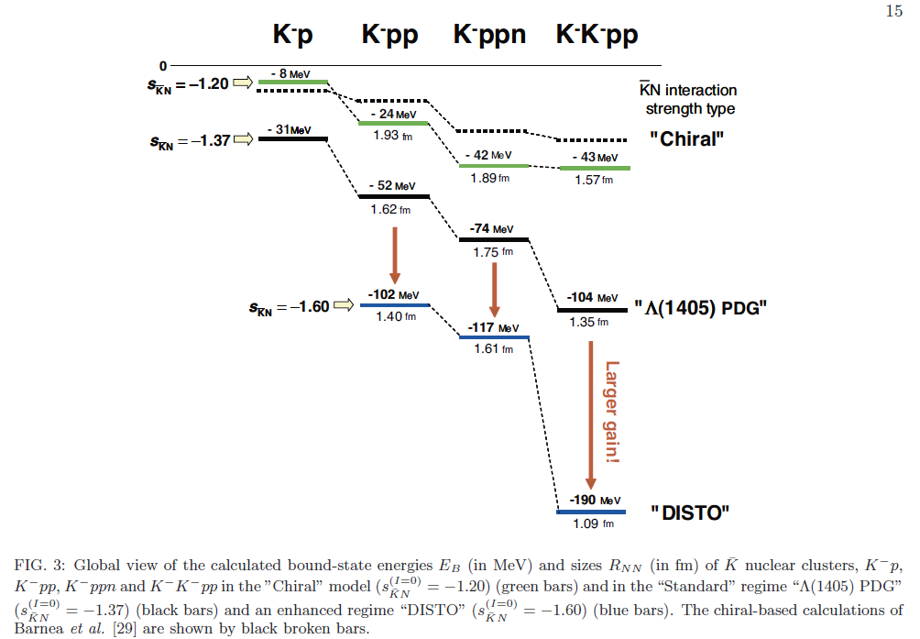
Theoretical Calculations (Cont’d)
S.Maeda, Y.Akaishi, T.Yamazaki
Λ* ansatz
Faddeev Calc.
arXiv:1307.3957
Deeply bound & Compact
B=100~200MeV

Slide 13
S=-2 Dibaryon State?
Loosely bound K⁻K⁻pp
Deeply bound K⁻K⁻pp
?
K
p
K
p
p
p
K
K
=
?
?
d
d
s
u
s
u
s
s
u
d
u
d
H-dibaryon
Excited H (H*)
the K⁻K⁻pp is loosely or deeply bound state?
the H-dibaryon exists also?

Slide 14
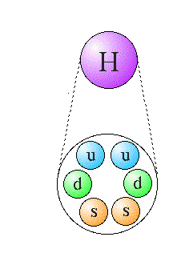
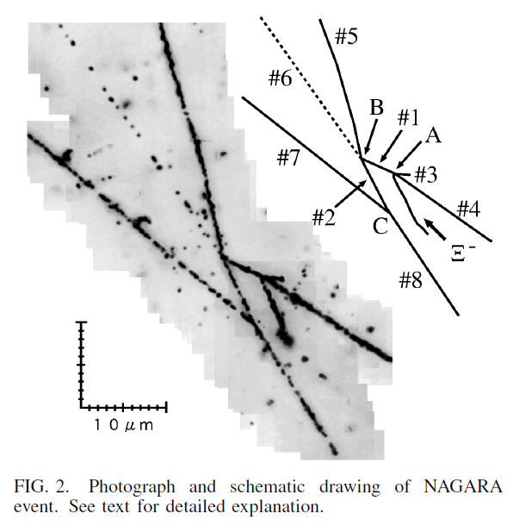
H-dibaryon
  Stable SU(3)_{f} singlet 6-quark (uuddss) state
  proposed by R.Jaffe in 1977
The existence is NOT confirmed experimentally
  Many experimental searches were performed
  Several candidate dibaryon decays were observed but not confirmed in the 1990s
From the results of several double-Λ hypernuclear events, the H is suggested to be very loosely bound (<7MeV) or unbound (~2m_{Λ}) state

Slide 15
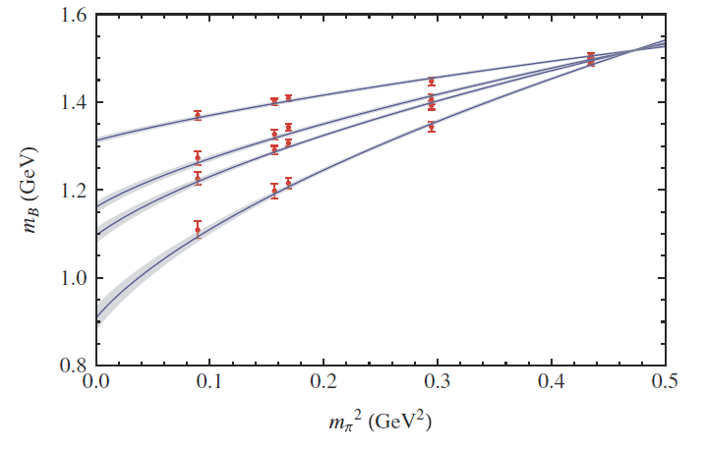
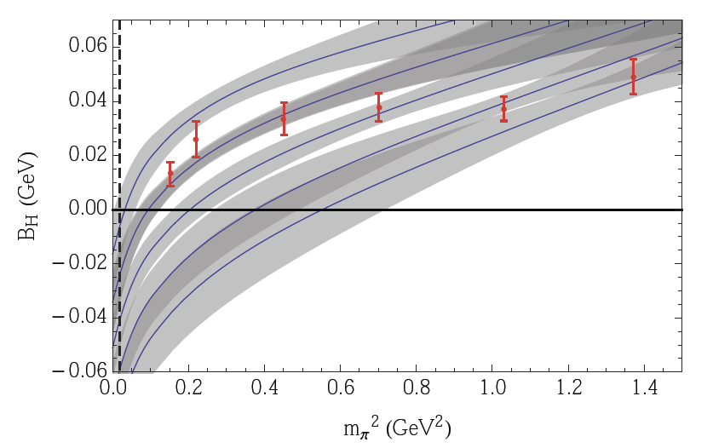
Lattice-QCD Calculations
Recent lattice-QCD calculations have reported evidence for the existence of the H
  NPLQCD Collab. PRL106, 162001(2011).
  HAL Collab. PRL106,162002(2011).
However, B.E. is depend on physical quark masses
P. E. Shanahan, A.W. Thomas, and R. D. Young, PRL107,092004(2011)., arXiv:1308.1748
loosely bound state or unbound state ~m_{ΛΛ}?

Slide 16
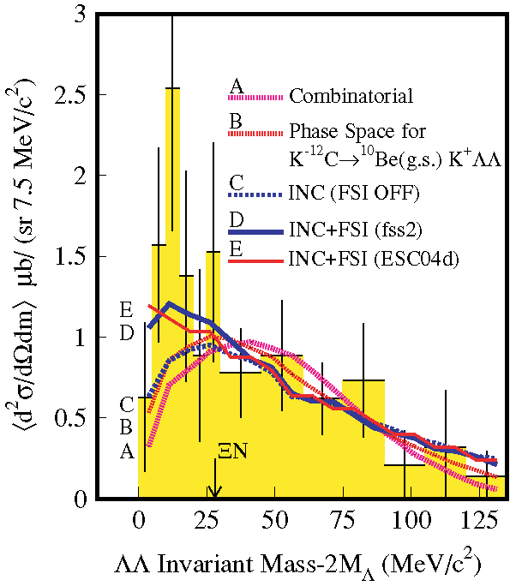
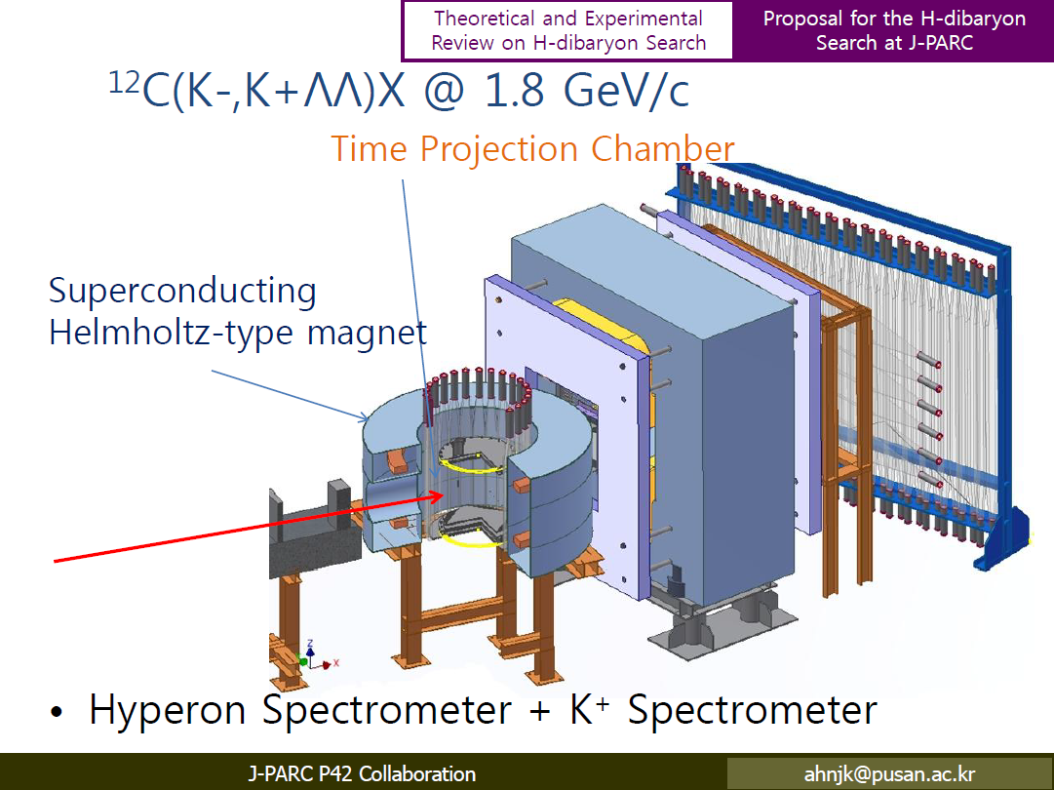
H search @ (K⁻,K⁺)
KEK-PS E522
¹²C(K⁻, K⁺ΛΛ)X @ 1.67GeV/c
PRC75,022201(R) (2007).
incoming experiment @ J-PARC
J-PARC E42
15th PAC
Hints of the H-dibaryon as a ΛΛ resonance?

Slide 17
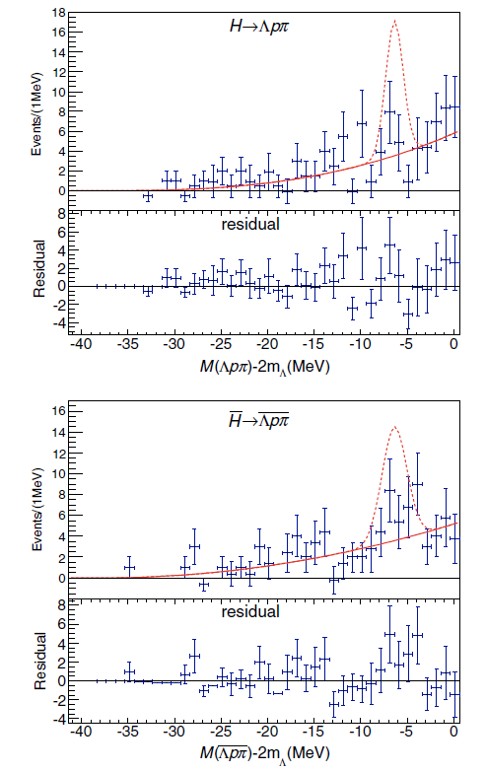
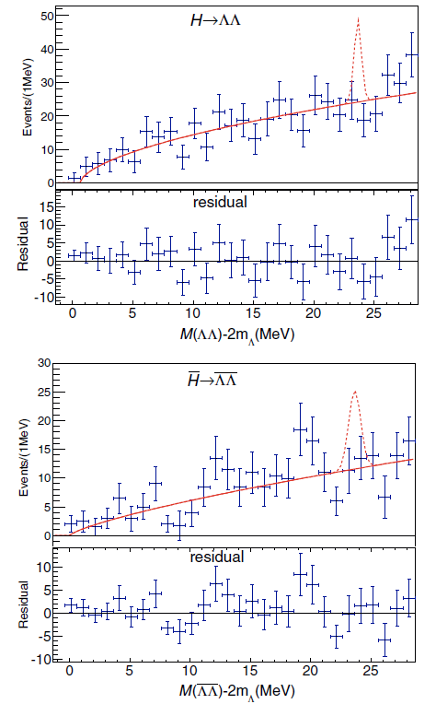
H search @ B-factory
Belle
Inclusive Υ(1s)Υ(2s) decays
PRL110,222022(2013).
B.R. is less than ~10⁻⁶ @ 90% C.L.

Slide 18
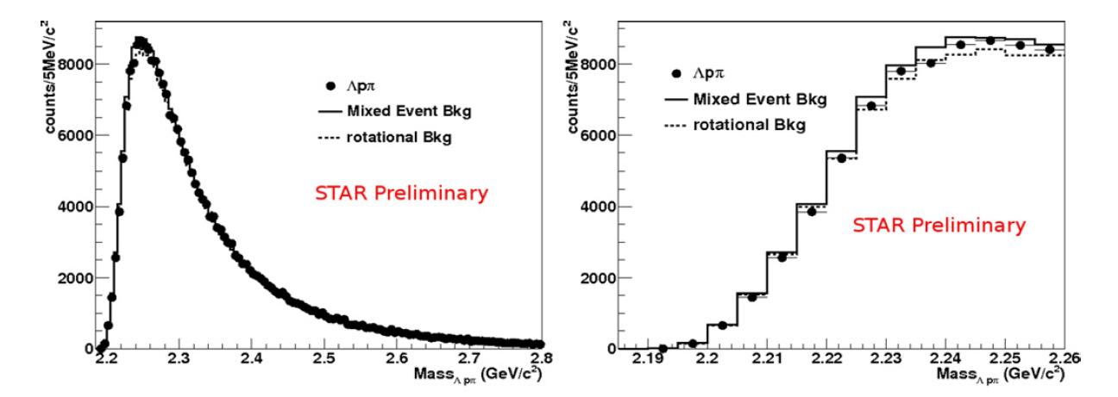
H search @ HI-collision
STAR @ RHIC
Au+Au @ sqrt(s_{NN}) = 200GeV
NPA914,410(2013).
non-existence of bound H-dibaryon?

Slide 19
Experimental Approaches to Search for S=-2 dibaryons
How to produce the S=-2 dibaryons?
        (K⁻,K⁺) reaction
        Heavy-ion collision
        Heavy-meson decay
        p+p reaction
        p^{bar}A annihilation
        d^{bar}A annihilation
J-PARC
RHIC/LHC
BELLE
J-PARC?
J-PARC/FAIR
J-PARC?
We perform exotic states search
using p^{bar}A annihilation at J-PARC

Slide 20
“S=-2 Dibaryon” Search
  Using
  p^{bar}+³He annihilation at rest

Slide 21
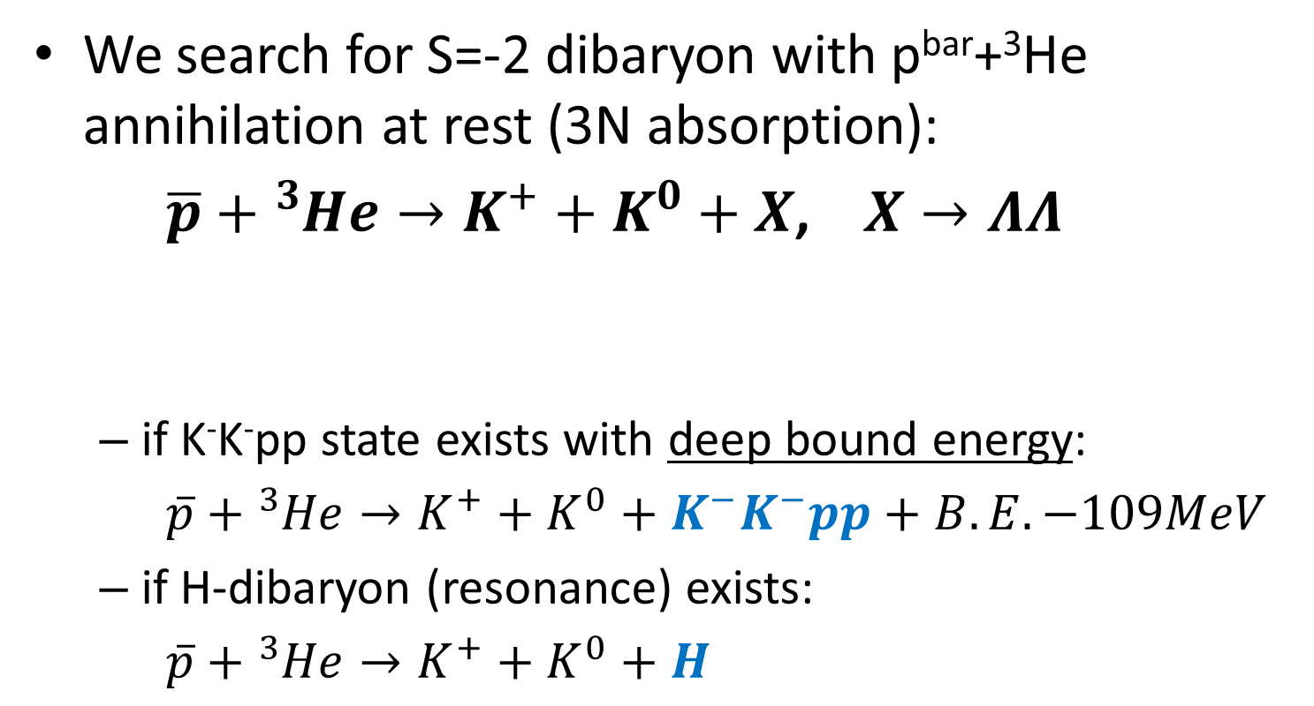
Experimental Principle
We search for S=-2 dibaryon with p^{bar}+³He annihilation at rest (3N absorption):
  $\overline{p}+{}_{}^{3}{He}→K^{+}+K^{0}+X$, $X→ΛΛ$
  if K⁻K⁻pp state exists with deep bound energy:
  $\overline{p}+{}_{}^{3}{He}→K^{+}+K^{0}+K^{−}K^{−}pp+B.E.−109MeV$
  if H-dibaryon (resonance) exists:
  $\overline{p}+{}_{}^{3}{He}→K^{+}+K^{0}+H$
final state:
π⁺
π⁻
p
π⁻
p
π⁻
We can investigate S=-2 dibaryon
with inclusive or exclusive measurement

Slide 22
Past Experiments of Double-Strangeness Production in Stopped-p^{bar} Annihilation
several groups reported double-strangeness production
in p^{bar}+A annihilation
hydrogen bubble-chamber experiment @ BNL
H-dibaryon search
They did NOT observe any double-strangeness event in
p^{bar} - C, Ti, Ta, Pb annihilation (~80,000 events, p < 400 MeV/c)
[Phys.Lett., B144, 27 (1984).]
Reaction | Frequency (90% C.L.)
p^{bar}A→Λ⁰Λ⁰X | <4x10⁻⁴
p^{bar}A→Λ⁰K⁻X | <5x10⁻⁴
p^{bar}A→K⁺K⁺X | <5x10⁻⁴
p^{bar}A→HX | <9x10⁻⁵

Slide 23
Past Experiments of Double-Strangeness Production in Stopped-p^{bar} Annihilation
experiment | Channel | # of events | yield (x10⁻⁴)
DIANA@ITEP [p^{bar}+Xe] PLB464, 323 (1999). | K⁺K⁺X | 4 | 0.31+/-0.16
 | K⁺K⁰X | 3 | 2.1+/-1.2
OBELIX @CERN/LEAR [p^{bar}+⁴He] NPA797, 109 (2007). | K⁺K⁺Σ⁻Σ⁻p_{s} | 34+/-8 | 0.17+/-0.04
 | K⁺K⁺Σ⁻Σ⁺nπ⁻ | 36+/-6 | 2.71+/-0.47
 | K⁺K⁺Σ⁻Λn | 16+/-4 | 1.21+/-0.29
 | K⁺K⁺K⁻Λnn | 4+/-2 | 0.28+/-0.14
Although observed statistics are small,
their results have indicated a high yield of ~10⁻⁴

Slide 24
Expected K⁻K⁻pp Cross-Section?
--- the K⁻K⁻pp is assumed to be
produced by Λ*Λ* collision ---
double-strangeness production yield in p^{bar}A: ~ 10⁻⁴
free Λ* production yield: ~ Λx0.1
free Λ*Λ* production yield: ~ (Λx0.1)x(Λx0.1)
Λ*Λ* production yield in p^{bar}A: ~ 10⁻⁶
even if all Λ*Λ* become the K⁻K⁻pp state,
K⁻K⁻pp production yield in p^{bar}A: ~ 10⁻⁶
small production yield is expected …
moreover, Q-value of Λ*Λ* production in p^{bar3}He reaction is negative (Q = -55MeV)

Slide 25
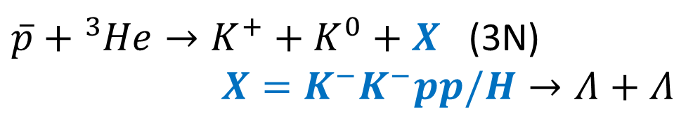
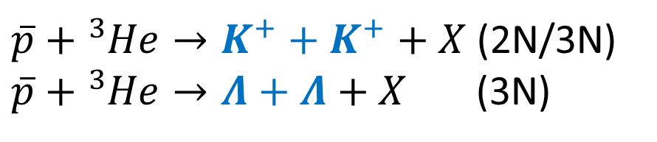
Experimental Strategy
present situation of the double-strangeness production in p^{bar}+A (A>1) annihilation at rest:
NO results with a dedicated spectrometer and high intensity beam except for bubble chamber experiments.
high-statistics measurement is NOT performed!
investigation of “double-strangeness production” in p^{bar}+³He annihilation at rest
$\overline{p}+{}_{}^{3}{He}→K^{+}+K^{+}+X$ (2N/3N)
$\overline{p}+{}_{}^{3}{He}→Λ+Λ+X$ (3N)
toward search for “S=-2 dibaryons” in p^{bar}+³He annihilation at rest
$\overline{p}+{}_{}^{3}{He}→K^{+}+K^{0}+X$ (3N)
$X=K^{−}K^{−}pp/H→Λ+Λ$

Slide 26
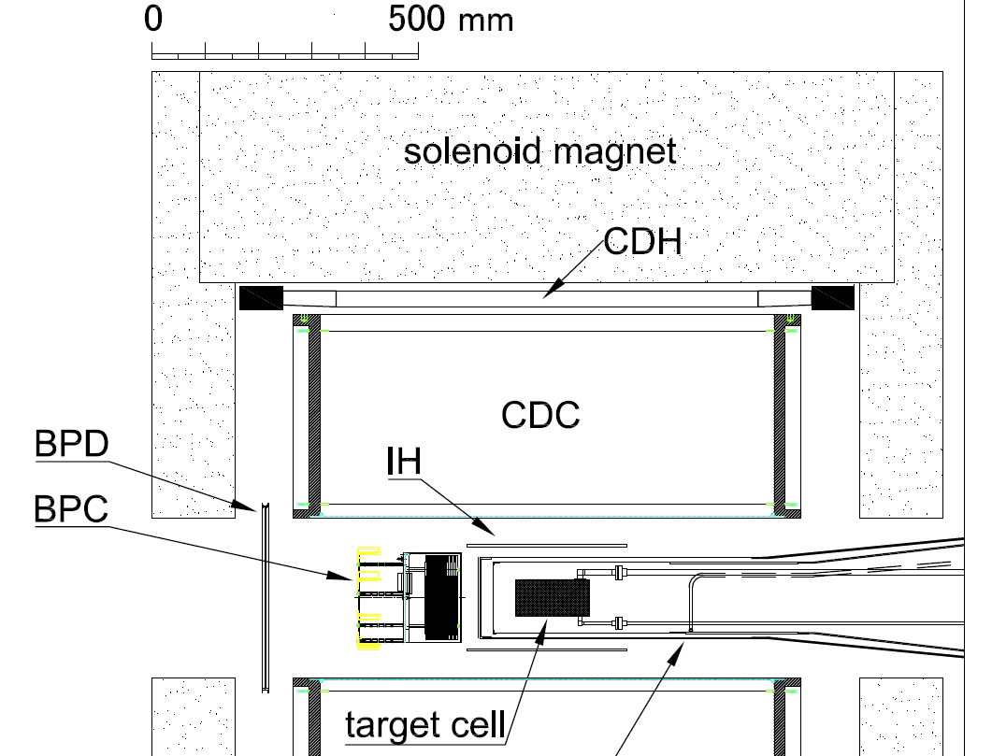
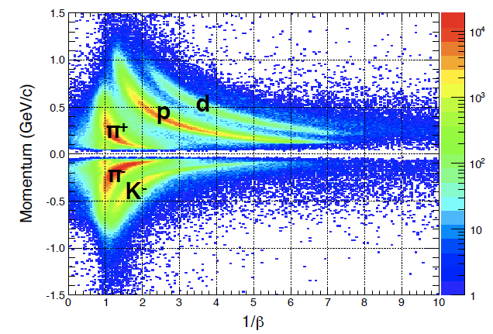
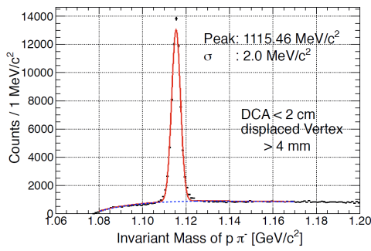
Experimental Setup
We will perform the experiment at J-PARC K1.8BR beam line
pID
Λ→pπ⁻
stopped-p^{bar} beam
initial beam mom. of 0.7GeV/c w/ tungsten degrader (t=31mm)
~750/spill(6s) @ 50kW, Au-target

Slide 27
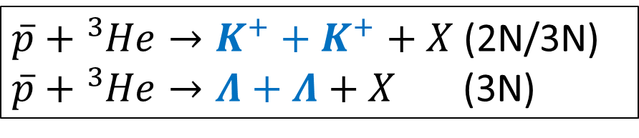
Double-Strangeness Measurement
$\overline{p}+{}_{}^{3}{He}→K^{+}+K^{+}+X$ (2N/3N)
$\overline{p}+{}_{}^{3}{He}→Λ+Λ+X$ (3N)
acceptances of K⁺K⁺ and ΛΛ
evaluated using GEANT4 toolkit
Many-body decay are considered to be isotropic decay.
branching ratios of K⁰→K⁰_{S}/K⁰_{S}→π⁺π⁻/Λ→pπ⁻ are considered.
acceptance is defined by IH and CDC mid layer (R<350mm)
e.g. acceptance of IH+CDC(R<350mm)
K⁺K⁺X channel |  | ΛΛX channel
K⁺K⁺ detection | 20% | ΛΛ detection | 6.8%

Slide 28
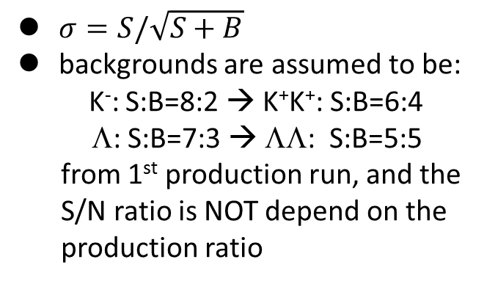
Double-Strangeness Measurement (Cont’d)
sensitivity
50kW, 2weeks
$σ=S/\sqrt{S+B}$
backgrounds are assumed to be:
K⁻: S:B=8:2 → K⁺K⁺: S:B=6:4
Λ: S:B=7:3 → ΛΛ: S:B=5:5
from 1st production run, and the S/N ratio is NOT depend on the production ratio
DIANA/OBELIX
K⁺K⁺: ~540
ΛΛ: ~160
uptime of the accelerator and apparatus : 21h/24h
DAQ and analysis eff. : 0.7
pID
Λ→pπ⁻
1st production run (2013, May.)

Slide 29
Experimental Strategy
present situation of the double-strangeness production in p^{bar}+A (A>1) annihilation at rest:
NO results with a dedicated spectrometer and high intensity beam except for bubble chamber experiments.
high-statistics measurement is NOT performed!
investigation of “double-strangeness production” in p^{bar}+³He annihilation at rest
$\overline{p}+{}_{}^{3}{He}→K^{+}+K^{+}+X$ (2N/3N)
$\overline{p}+{}_{}^{3}{He}→Λ+Λ+X$ (3N)
toward search for “S=-2 dibaryons” in p^{bar}+³He annihilation at rest
$\overline{p}+{}_{}^{3}{He}→K^{+}+K^{0}+X$ (3N)
$X=K^{−}K^{−}pp/H→Λ+Λ$

Slide 30
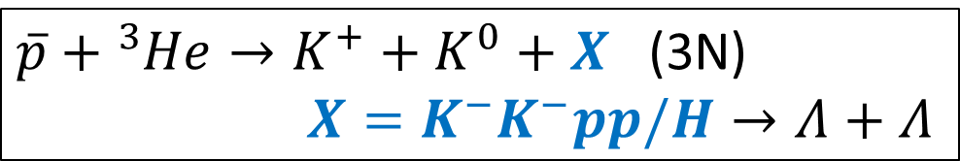
Procedure of S=-2 Dibaryons Search
$\overline{p}+{}_{}^{3}{He}→K^{+}+K^{0}+X$ (3N)
$X=K^{−}K^{−}pp/H→Λ+Λ$
possible methods of the measurement
(inclusive) ΛΛ invariant mass
(inclusive) K⁰K⁺ missing-mass w/ Λ-tag
(exclusive) K⁰K⁺ΛΛ measurement
e.g. acceptance of IH+CDC(R<350mm)
acceptance
K⁻K⁻pp B.E. = 120MeV Γ = 100MeV 100% ΛΛ |  | H m = m_{ΛΛ}+10MeV Γ = 10MeV 100% ΛΛ
ΛΛ detection | 14.5% | ΛΛ detection | 3.6%
K⁺K⁰Λ | 0.8% | K⁺K⁰Λ | 3.6%
K⁺K⁰ΛΛ | 0.3% | K⁺K⁰ΛΛ | 0.4%
evaluated using GEANT4 toolkit
isotropic decay
branching ratios of K⁰→K⁰_{S}/K⁰_{S}→π⁺π⁻/Λ→pπ⁻ are considered.

Slide 31
Background Assumptions
2N abs.
  K⁺ K⁺ K⁻ Λ/Σ⁰ n_{s}
  K⁺ K⁺ K^{0bar} Σ⁻ n_{s}
  K⁺ K⁺ K⁻ Σ⁻ p_{s}
  K⁺ K⁺ Ξ⁻ n_{s}
  K⁺ K⁰ K^{0bar} Λ/Σ⁰ n_{s}
  K⁺ K⁰ K⁻ Σ⁺ n_{s}
  K⁺ K⁰ K⁻ Λ/Σ⁰ p_{s}
  K⁺ K⁰ K^{0bar} Σ⁻ p_{s}
  K⁺ K⁰ Ξ⁰ n_{s}
  K⁺ K⁰ Ξ⁻ p_{s}
3N abs.
  K⁺ K⁺ Λ Σ⁻ / Σ⁰ Σ⁻
  K⁺ K⁰ Λ Λ / Λ Σ⁰
  K⁺ K⁰ Σ⁰ Σ⁰ / Σ⁺ Σ⁻
  K⁺ K⁰ Λ Λ π⁰ / Λ Σ⁰ π⁰
  K⁺ K⁰ Σ⁰ Σ⁰ π⁰ / Σ⁺Σ⁻ π⁰
Production ratios are assumed to be:
  2N:3N = 4:1, and total ratio = 5*10⁻⁴ (upper lim.)
    2N abs.: 4*10⁻⁴
    3N abs.: 1*10⁻⁴
  exotics: parameter
6weeks @ 50kW, Au-target (50%)
  uptime = 21h/24h
  detector/trig. eff. = 0.7
* Not consider ΞN→ΛΛ

Slide 32
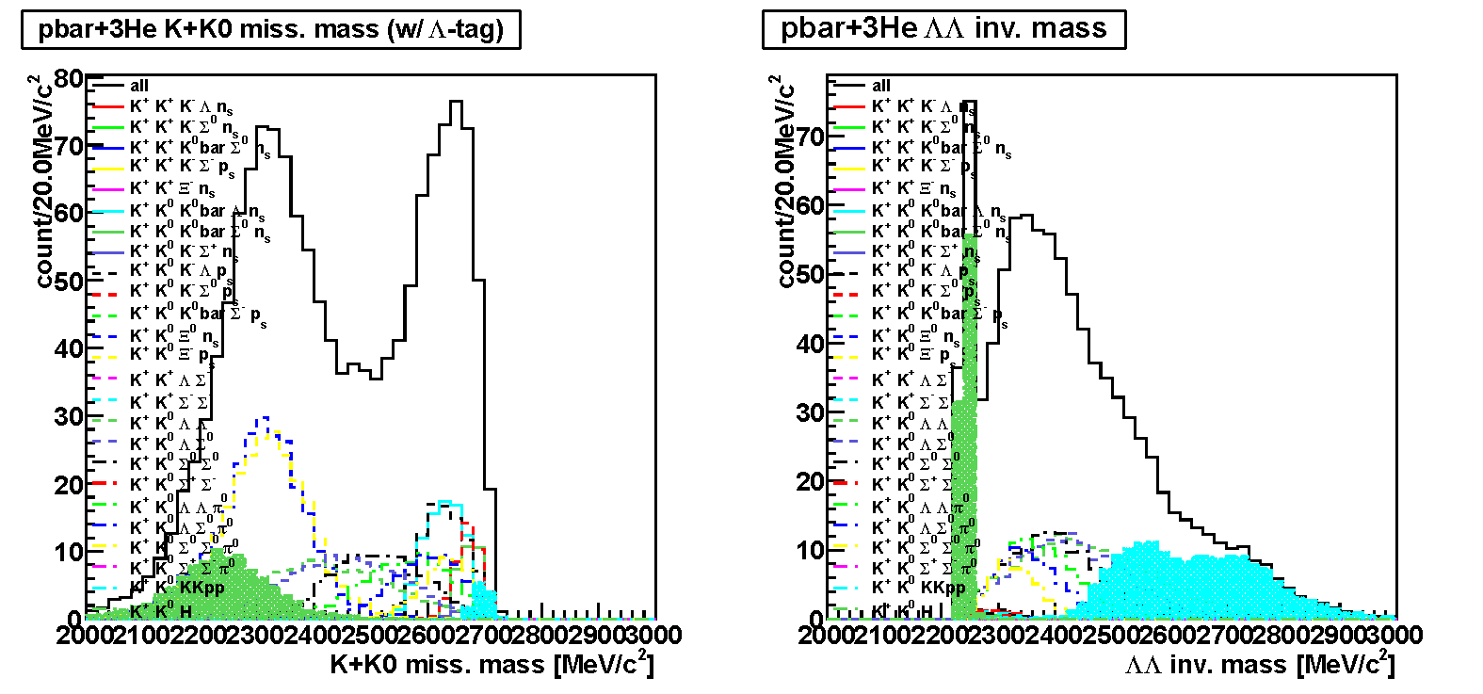
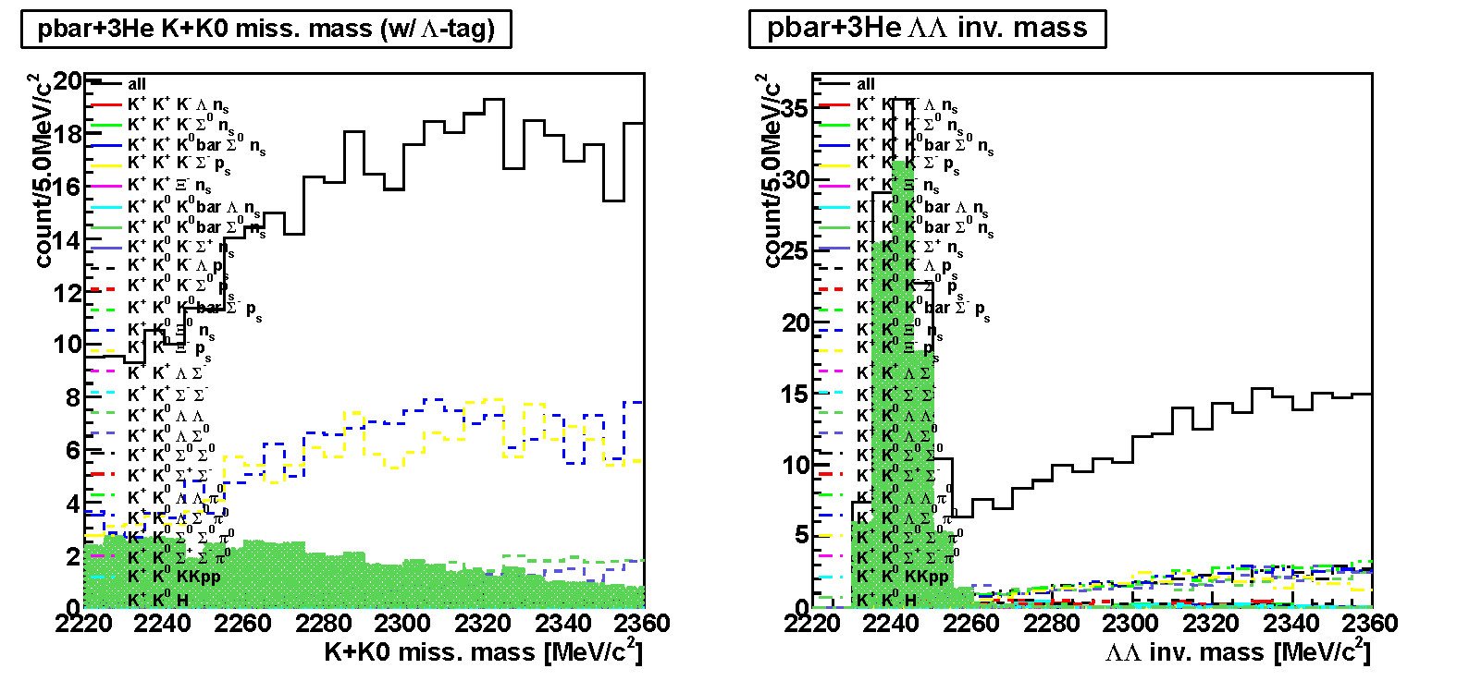
Expected Spectra w/ IH+CDC(R<350mm)
K⁺K⁰ M.M.
ΛΛ I.M.
H→ΛΛ decay would be
observed clearly
K⁻K⁻pp 10⁻⁵/stopped-p^{bar} B.E. = 120MeV Γ = 100MeV ΛΛ:Σ⁰Σ⁰:ππΣΣ = 1:1:2 | H 10⁻⁵/stopped-p^{bar} m = m_{ΛΛ}+10MeV Γ = 10Mev 100% ΛΛ

Slide 33
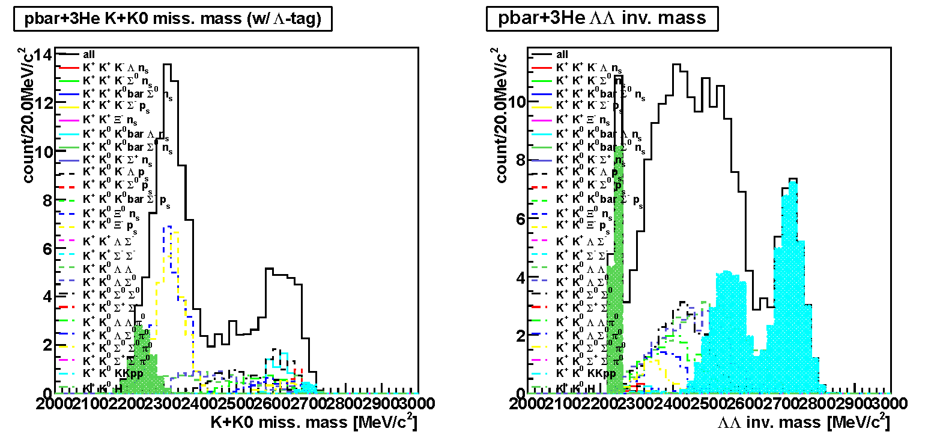
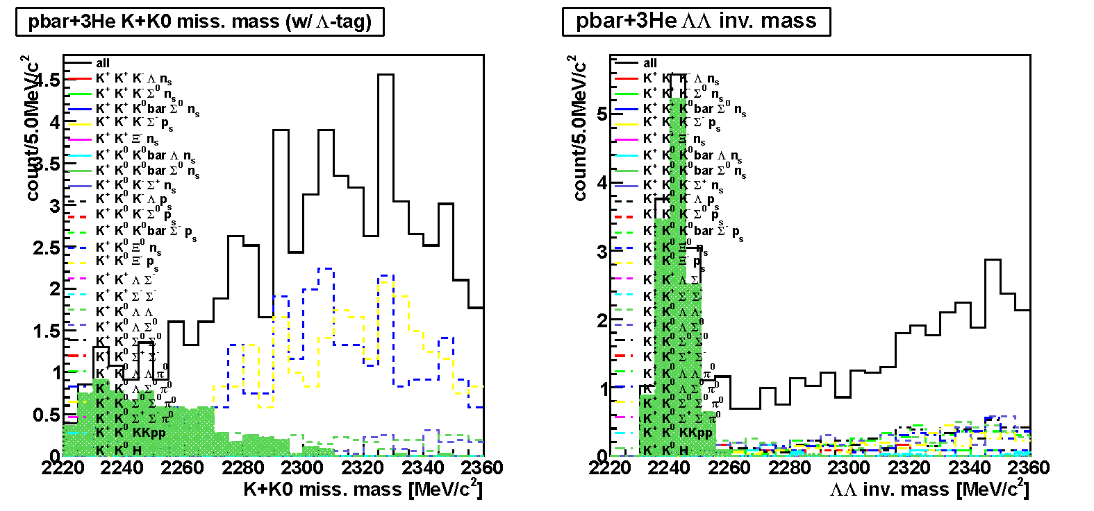
Expected Spectra w/ full-CDC
K⁺K⁰ M.M.
ΛΛ I.M.
H/K⁻K⁻pp→ΛΛ decays
would be observed clearly
K⁻K⁻pp 10⁻⁵/stopped-p^{bar} B.E. = 120MeV Γ = 100MeV ΛΛ:Σ⁰Σ⁰:ππΣΣ = 1:1:2 | H 10⁻⁵/stopped-p^{bar} m = m_{ΛΛ}+10MeV Γ = 10Mev 100% ΛΛ

Slide 34
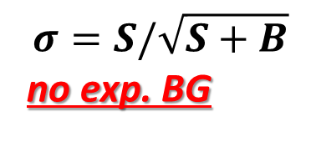
Sensitivity
$$σ=S/\sqrt{S+B}$$
no exp. BG
inclusive ΛΛ measurement
50kW, 6weeks
K⁻K⁻pp B.E. = 120MeV Γ = 100MeV ΛΛ:Σ⁰Σ⁰:ππΣΣ = 1:1:2 | H m = m_{ΛΛ}+10MeV Γ = 10Mev 100% ΛΛ
We would reach sensitivities of less than 10⁻⁵ (3σ)
[Expected: K⁻K⁻pp ~ 10⁻⁶ / H < 9*10⁻⁵]

Slide 35
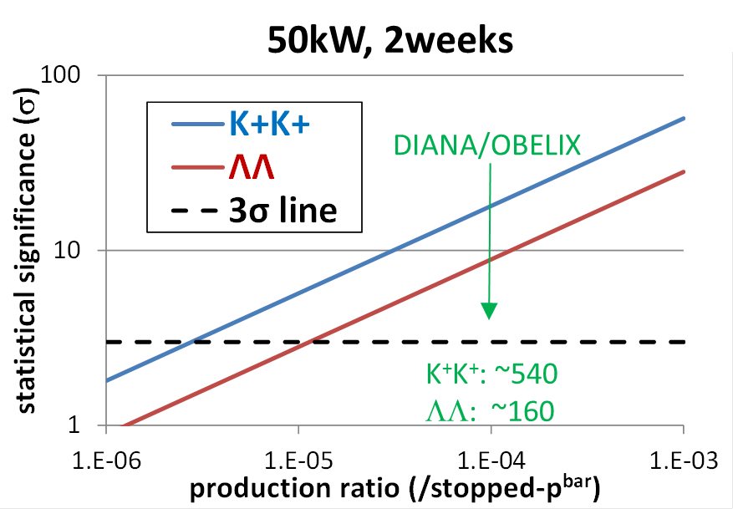
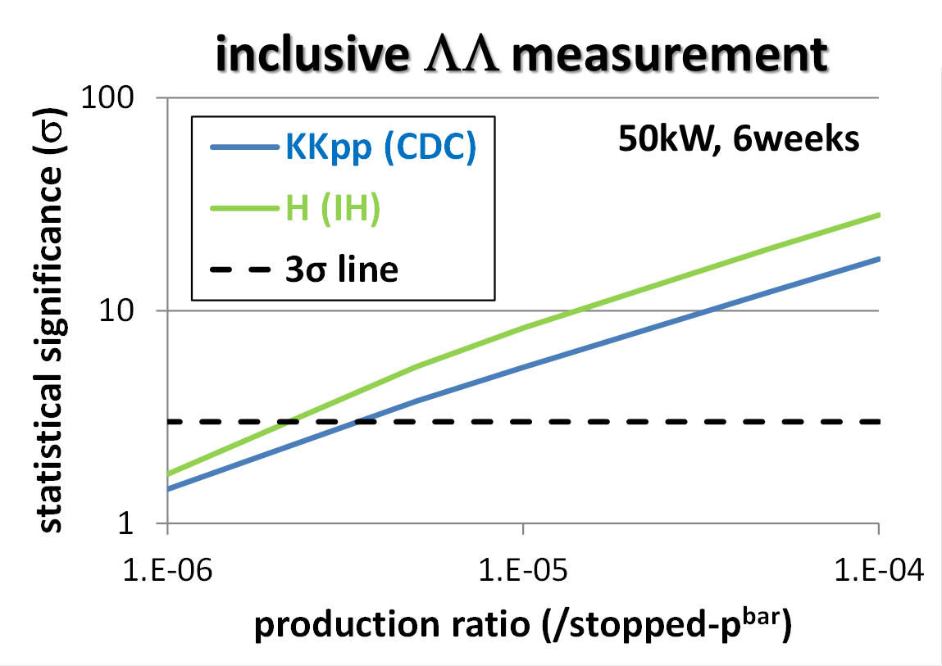
Summary
S=-1 Dibaryon Search by ³He(in-flightK⁻,n)K⁻pp:
The E15 experiment started 1st-stage physics-run.
S=-2 Dibaryon Search in p^{bar}+³He annihilation at rest:
double-strangeness measurement will be conducted as a first step
measurement of ³He(p^{bar}, ΛΛ)X reaction would give us some hints of the K⁻K⁻pp/H productions

