Slide 1
The search for deeply-bound kaonic nuclear states at J-PARC
F.Sakuma, RIKEN
S.Ajimura¹, G.Beer², H.Bhang³, P.Buehler⁴, L.Busso^{5,6}, M.Cargnelli⁴, J.Chiba⁷, S.Choi³, C.Curceanu⁸, D.Faso^{5,6}, H.Fujioka¹⁶,Y.Fujiwara¹¹ T.Fukuda¹⁰, Y.Fukuda¹¹, C.Guaraldo⁸, T.Hanaki⁷, R.S.Hayano⁹, T.Hiraiwa¹⁶, A.Hirtl⁴, M.Iio¹², M.Iliescu⁸, T.Ishikawa⁹, S.Ishimoto¹³, T.Ishiwatari⁴, K.Itahashi¹², M.Iwasaki¹², P.Kienle^{4,14}, J.Marton⁴, Y.Matsuda¹², Y.Mizoi¹⁰, O.Morra^{5,15}, T.Nagae¹⁶, H.Ohnishi¹², S.Okada¹², H.Outa¹², D.Pietreanu⁸, A.Sakaguchi¹, F.Sakuma¹², M.Sato¹¹, M.Sekimoto¹³, D.Sirghi⁸, F.Sirghi⁸, S.Suzuki¹³, T.Suzuki¹², H.Tatsuno⁹, M.Tokuda¹¹, D.Tomono¹², A.Toyoda¹³, K.Tsukada¹², E.Widmann⁴, T.Yamazaki^{9,12}, H.Yim³, J.Zmeskal⁴
¹Osaka University, Japan, ²University of Victoria, Canada, ³Seoul National University, South Korea, ⁴Stefan Meyer Institut fur subatomare Physik, Austria, ⁵INFN Sezione di Torino, Italy, ⁶Universita’ di Torino, Italy, ⁷Tokyo University of Science, Japan, ⁸Laboratori Nazionali di Frascati dell’INFN, Italy, ⁹University of Tokyo, Japan, ¹⁰Osaka Electro-Communication University, Japan, ¹¹Tokyo Institute of Technology, Japan, ¹²RIKEN, Japan, ¹³High Energy Accelerator Research Organization (KEK), Japan, ¹⁴Technische Universitat Munchen, Germany, ¹⁵INAF-IFSI, Sezione di Torino, Italy, ¹⁶Kyoto Univ., Japan
Motivation and Introduction
J-PARC E15 Experiment
Preparation Status
Summary

Slide 2
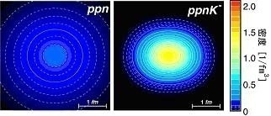
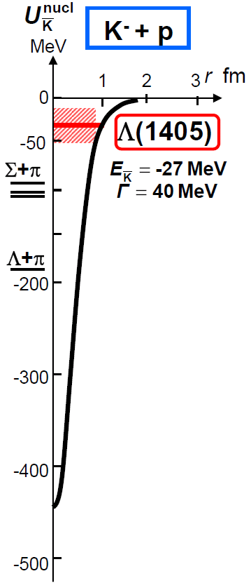
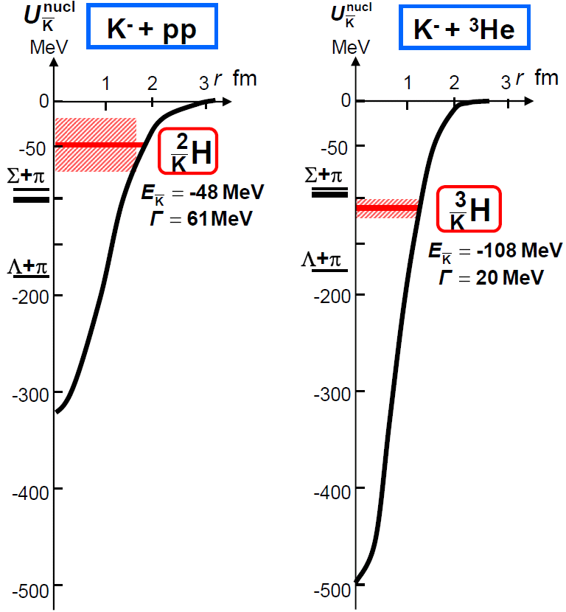
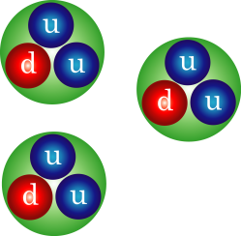
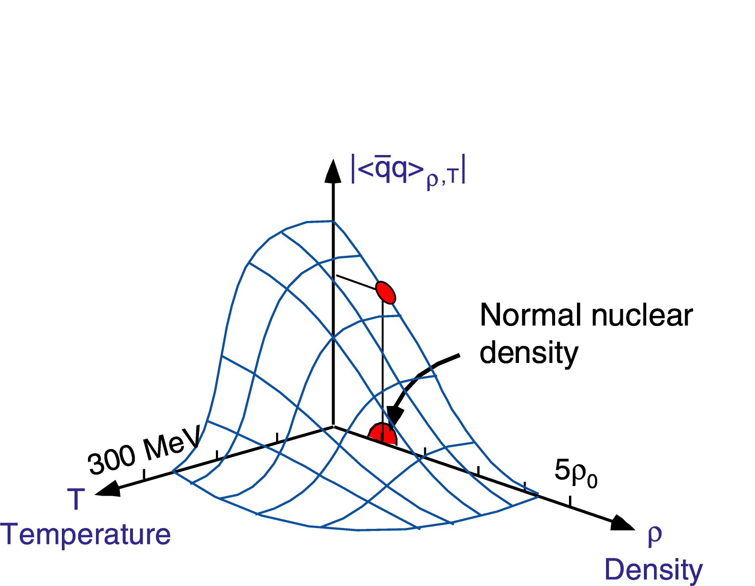
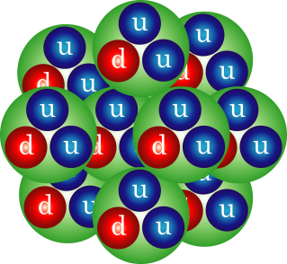
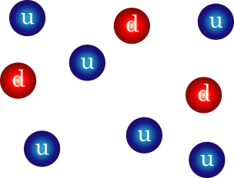
Physics Motivation
deeply-bound kaonic nuclear states exist?
T.Yamazaki, A.Dote, Y.Akiaishi PLB587,167(2004).
KEK-PS
J-PARC?
SPS, RHIC, LHC
Y.Akaishi & T.Yamazaki, PLB535, 70(2002).
QGP
neutron
star
we will open new door to
the condensed matter physics
W.Weise NPA553, 59 (1993).

Slide 3
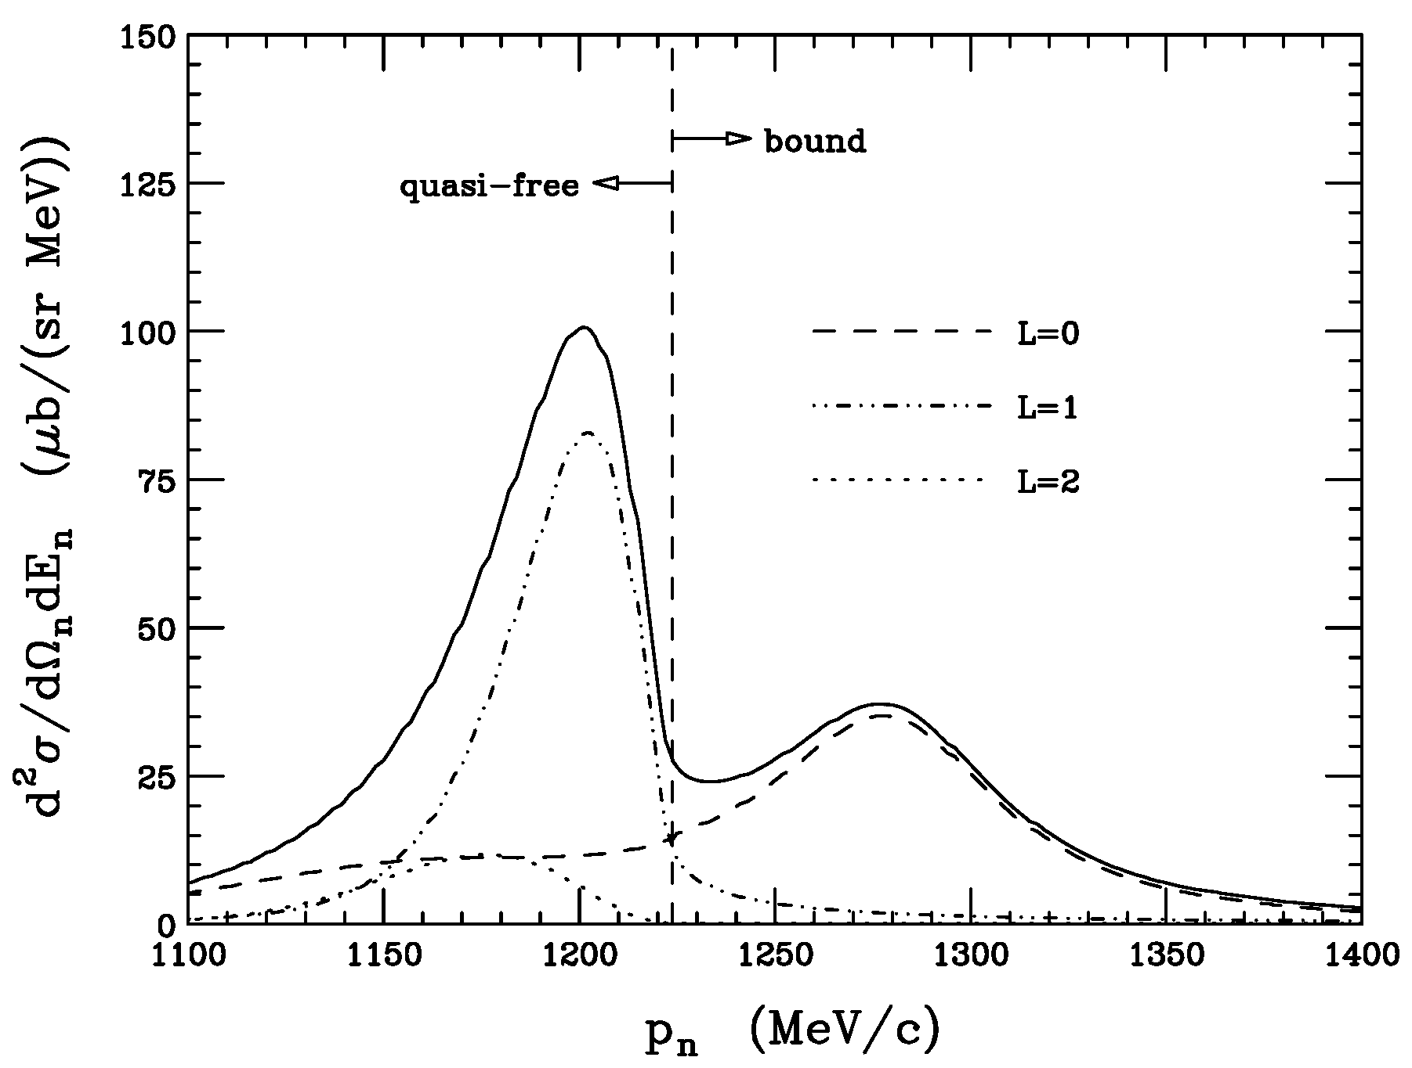
Deeply-Bound Kaonic Nuclei (Theory)
various theoretical predictions for kaonic nuclei, e.g., K-pp
 | Method | Binding Energy (MeV) | Width (MeV)
Akaishi, Yamazaki PLB533, 70 (2002). | ATMS | 48 | 61
Ivanov, Kienle, Marton, Widmann nucl-th/0512037 | Chiral Lagrangian | 118 | 58 (non-mesonic)
Shevchenko, Gal, Mares PRL98, 082301 (2007). | Faddeev | 55-70 | 90-110
Ikeda, Sato PRC76, 035203 (2007). | Faddeev | 79 | 74
Dote, Hyodo, Weise nucl-th/0802.0238 | chiral SU(3) | 19+/-3 | 40-70 (πΣN-decay)
whether the binding energy
is deep or shallow
how broad is the width ?
Koike, Harada
PLB652, 262 (2007).
DWIA
³He(K-,n)

Slide 4
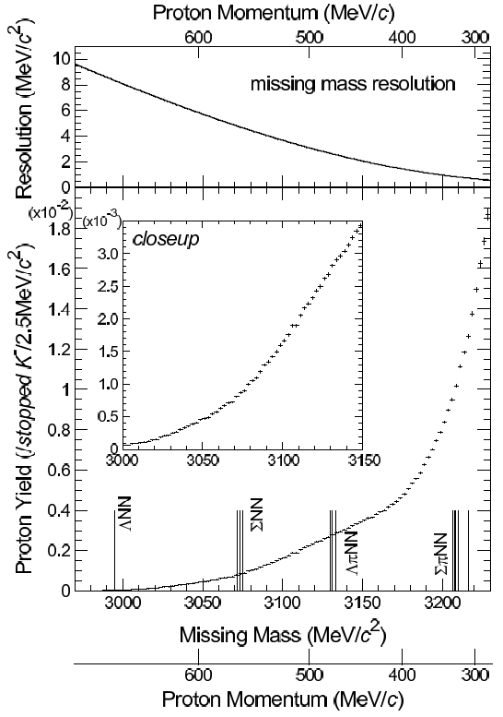
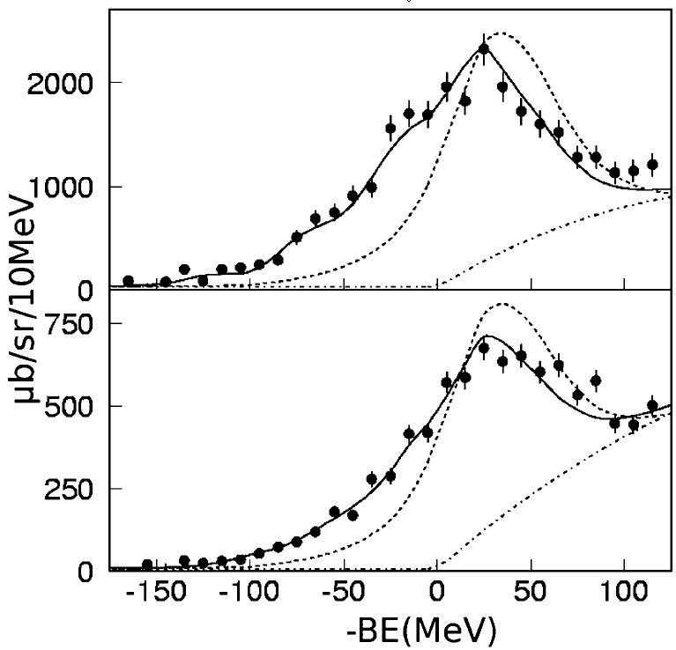
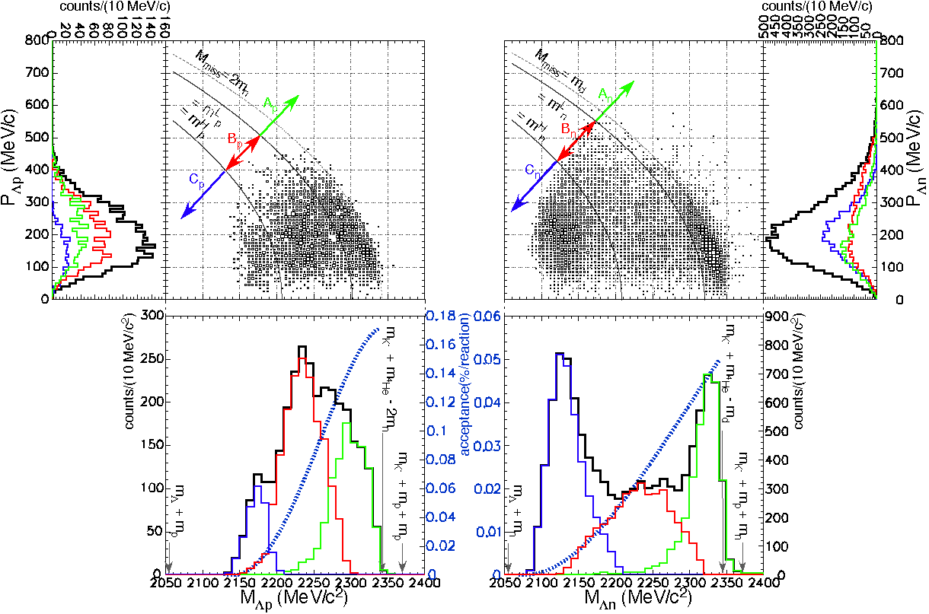
Deeply-Bound Kaonic Nuclei (Experiment)
E549@KEK-PS
E548@KEK-PS
⁴He（stopped K-,p)
¹²C(K⁻,n)
formation
formation
¹²C(K⁻,p)
unknown strength between Q.F. & 2N abs.
missing mass
Prog.Theor.Phys.118:181-186,2007.
-
deep K-nucleus potential of ~200MeV
PLB 659:107,2008
⁴He（stopped K-,ΛN)
no “narrow” structure
formation
&
decay
arXiv:0711.4943

Slide 5
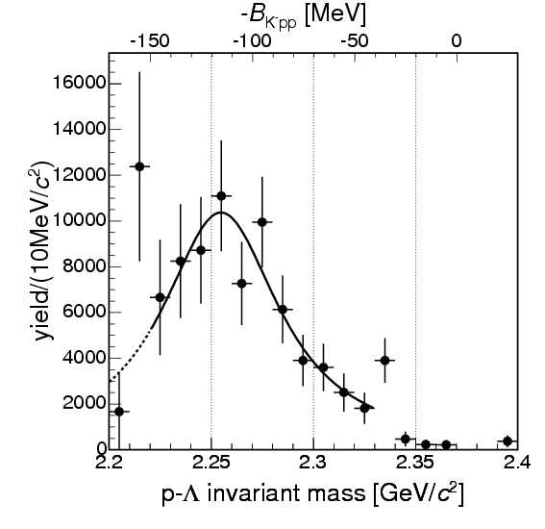
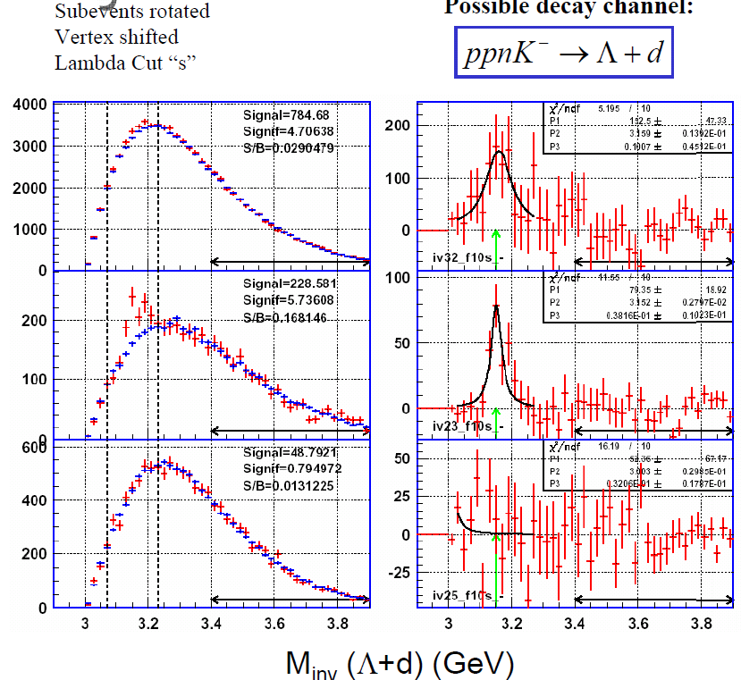
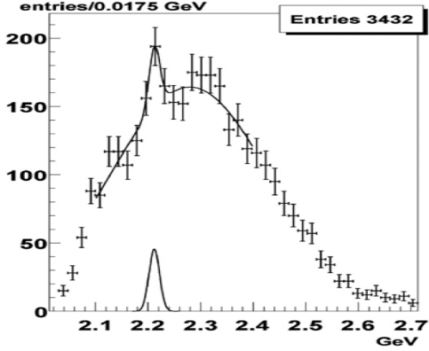
Deeply-Bound Kaonic Nuclei (Experiment)
decay
decay
decay
Λ-p invariant mass
FINUDA@DAΦNE
OBELIX@CERN-LEAR
FOPI@GSI
PRL, 94, 212303 (2005)
NP, A789, 222 (2007)
signature of kaonic nuclei
each experiment measures only formation or decay
(except for E549 experiment)
the situation is still controversial !!!
We need conclusive evidence with
observation of formation and decay !

Slide 6
J-PARC E15 Experiment

Slide 7
Experimental Principle
search for K-pp bound state using ³He(K⁻,n) reaction
³He
neutron
K⁻
K⁻pp
cluster
Formation
Missing mass
Spectroscopy
via neutron
Decay
Mode to decay charged particles
Λ
p
exclusive measurement by
Missing mass spectroscopy
and
Invariant mass reconstruction
π⁻
Invariant mass reconstruction
p
at J-PARC

Slide 8
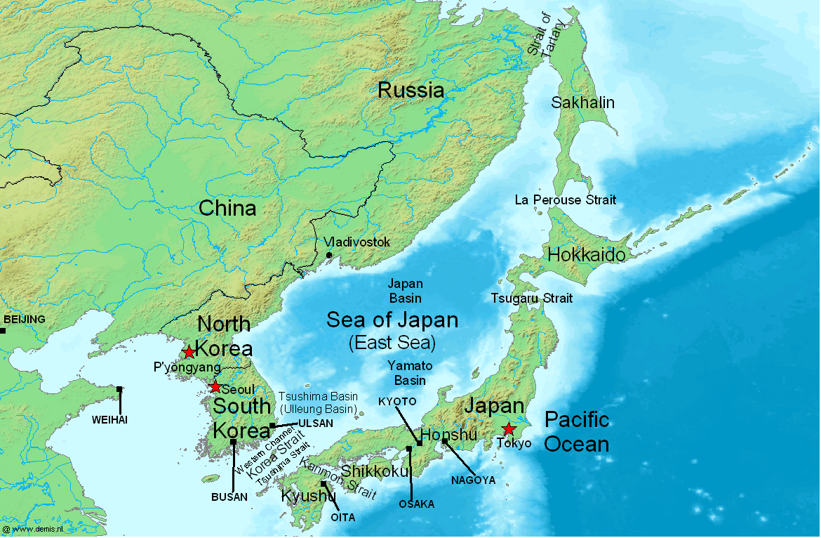
J-PARC (Japan Proton Accelerator Research Complex)
J-PARC
Tokai

Slide 9
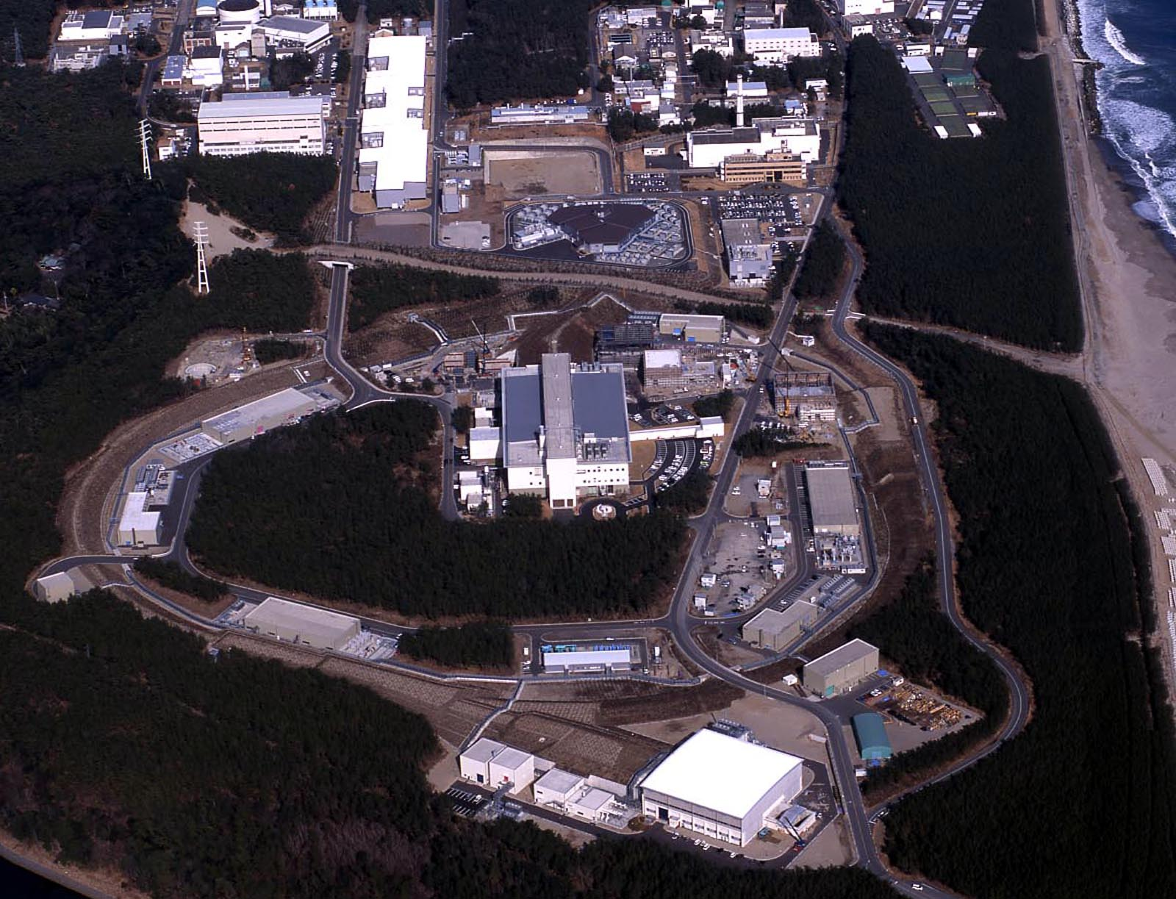
J-PARC (Japan Proton Accelerator Research Complex)
Bird’s eye photo in Feb. 2008
ＬＩＮＡＣ
RCS(3GeV)
ν
ＭＬＦ
50GeV-PS
Hadron
Hall
with the highest beam power (0.75MW) !

Slide 10
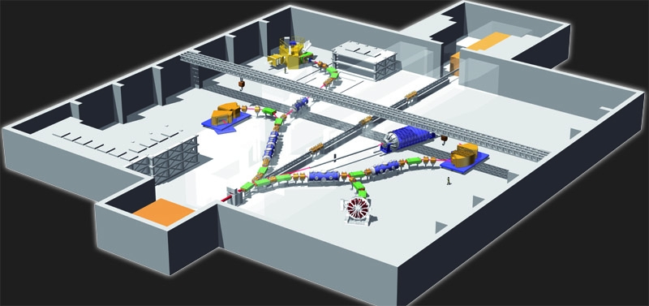
Hadron Experimental Hall @ J-PARC
Ξ-Hypernucleus
K1.8
(2009 Sep.)
Kaonic Nuclei
Kaon Rare Decay
K1.8BR
(2008 Dec.)
KL
(2010 Sep.)
Primary beams
(2011)
di-lepton
Production
Target (T1)
K1.1
(2010 Dec.)
Proton Beam
[30-GeV]
(2008 Dec.)
K1.1BR
(2010 Sep.)
T-violation

Slide 11
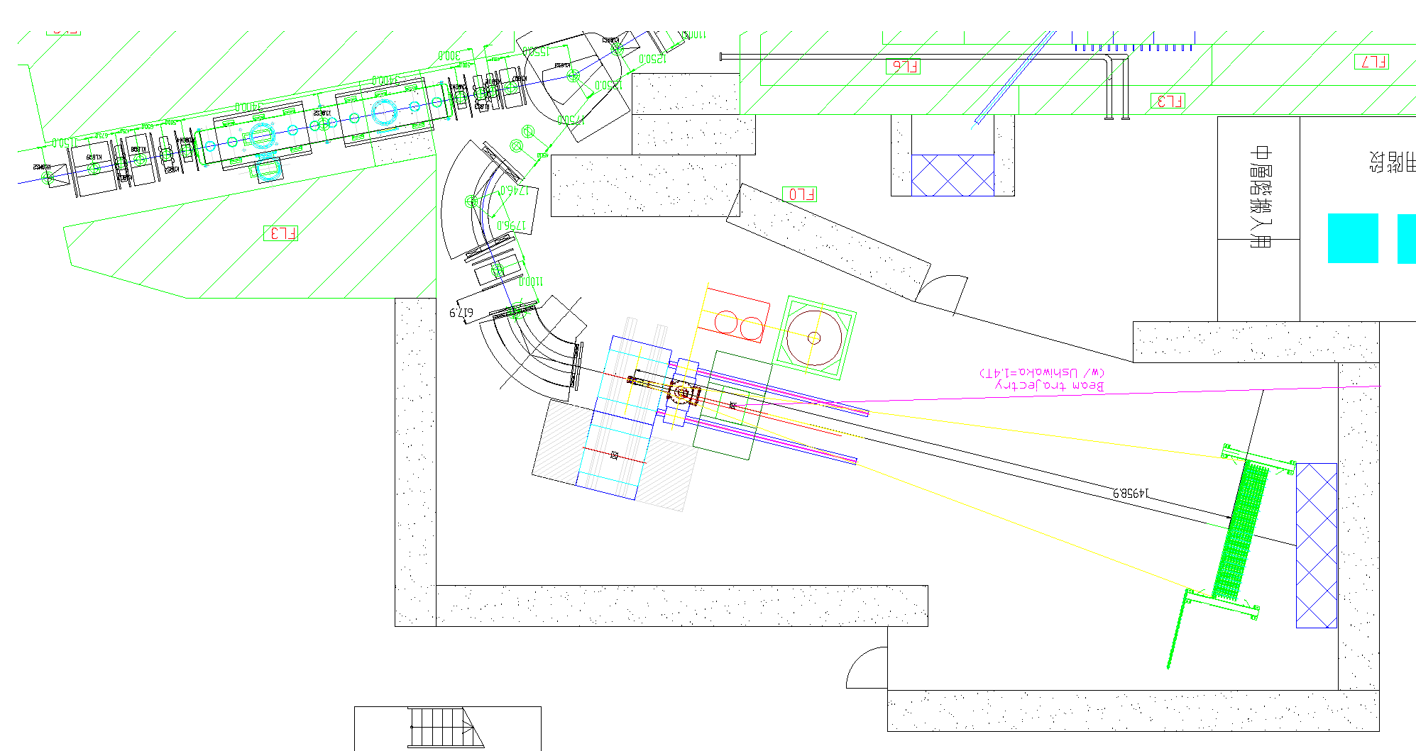
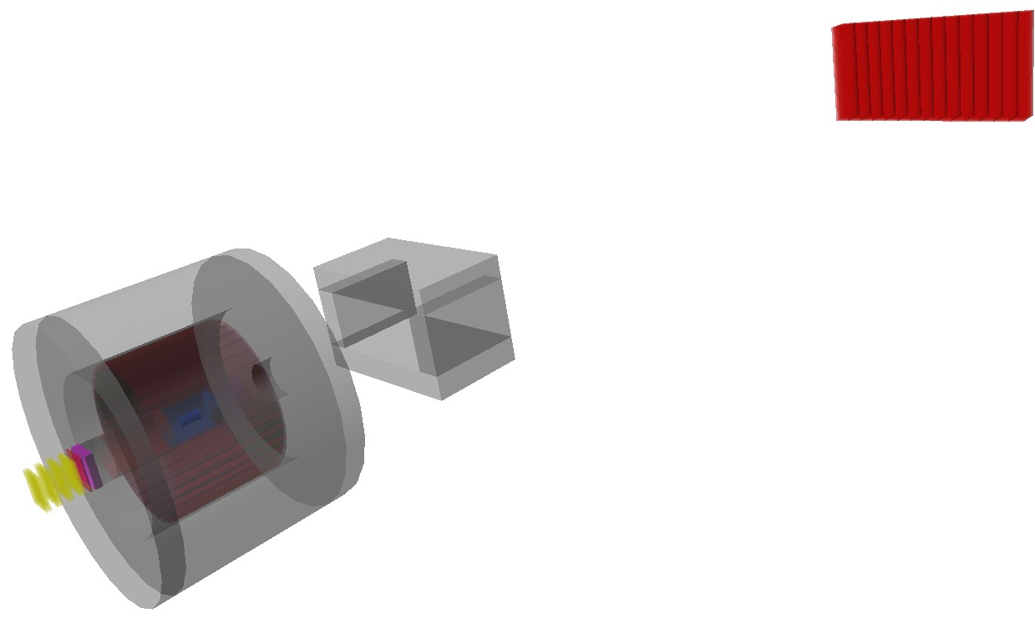
J-PARC E15 Setup
Beam Line
Spectrometer
Sweeping
Magnet
Beam trajectory
K1.8BR
Beam Line
CDS &
target
neutron
Neutron
Counter
Neutron
ToF Wall
flight length = 15m
p
n
Beam Sweeping
Magnet
mass resolution for K-pp
invariant mass
σ = 19MeV/c² (σ_{CDC} = 250μm)
missing mass (for 1.3GeV/c neutron)
σ = 9.2MeV/c² (σ_{ToF} = 150ps)
π⁻
Cylindrical
Detector
System
p
1GeV/c
K- beam

Slide 12
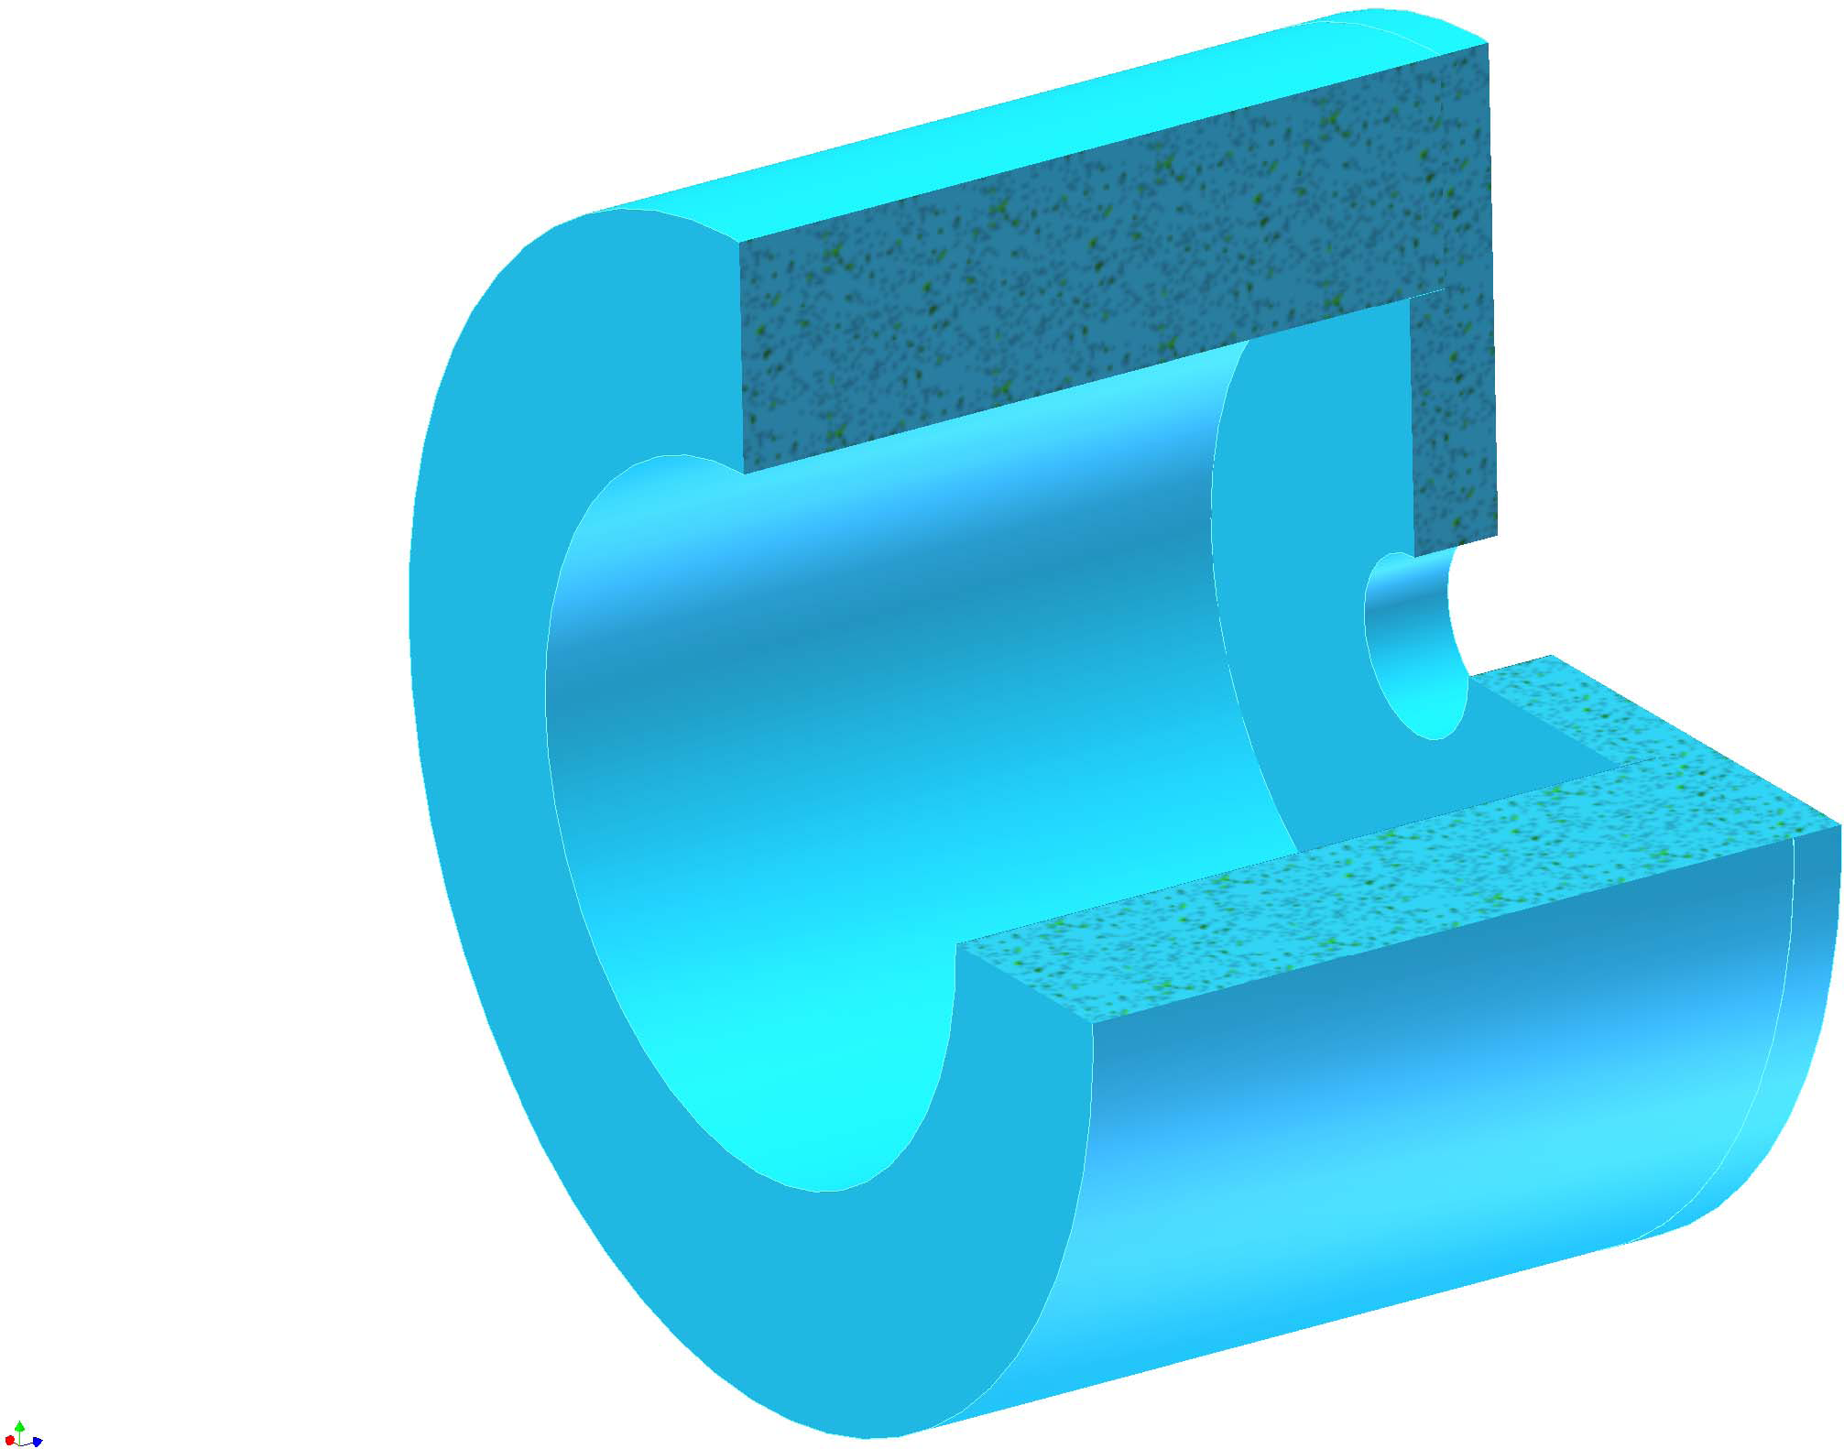
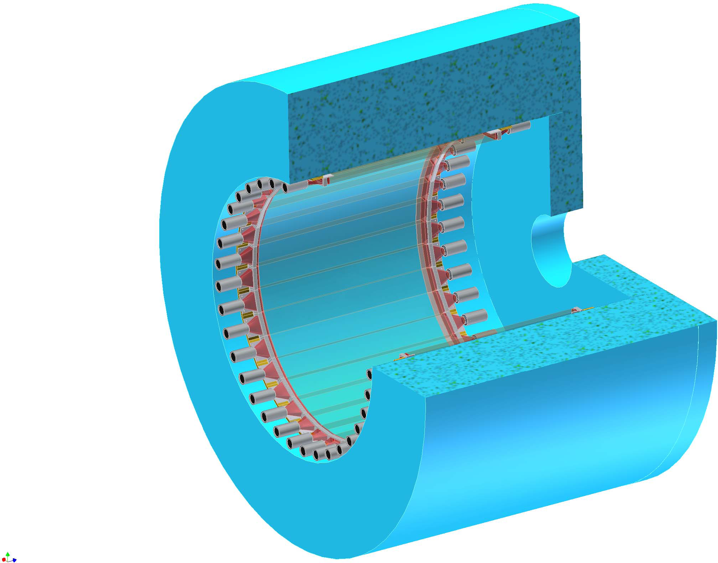
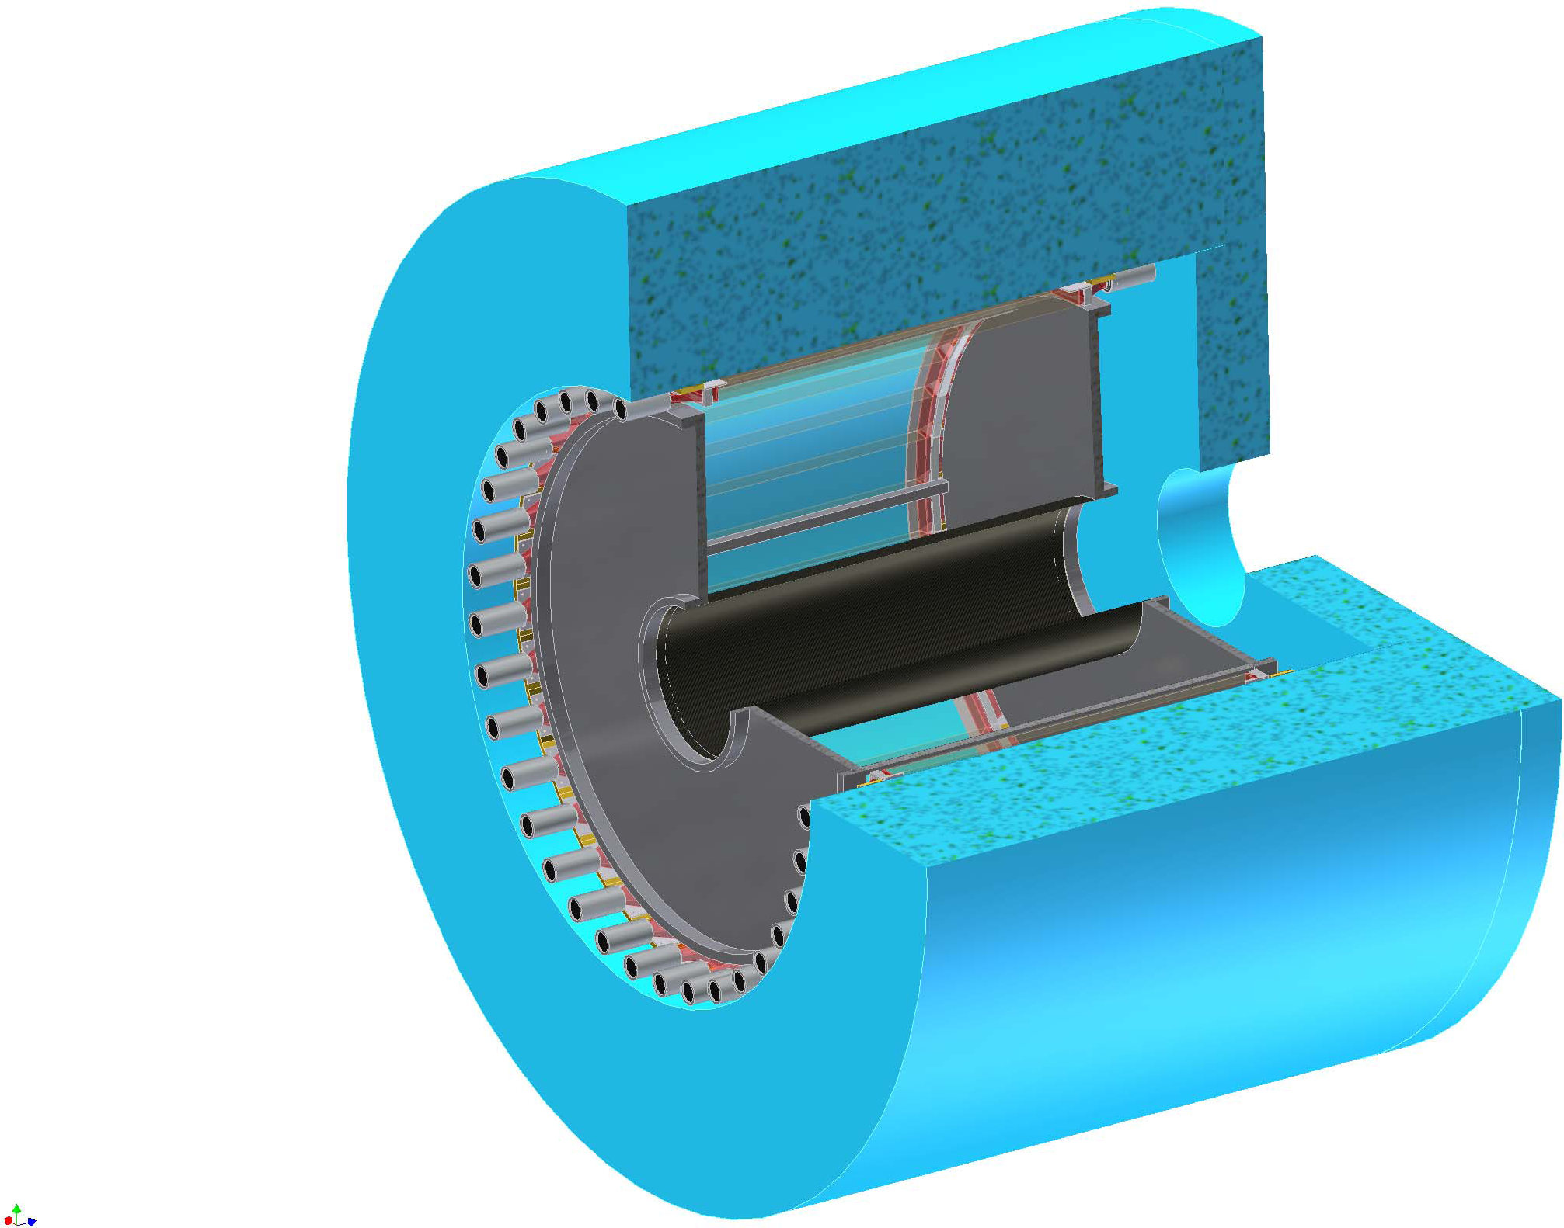
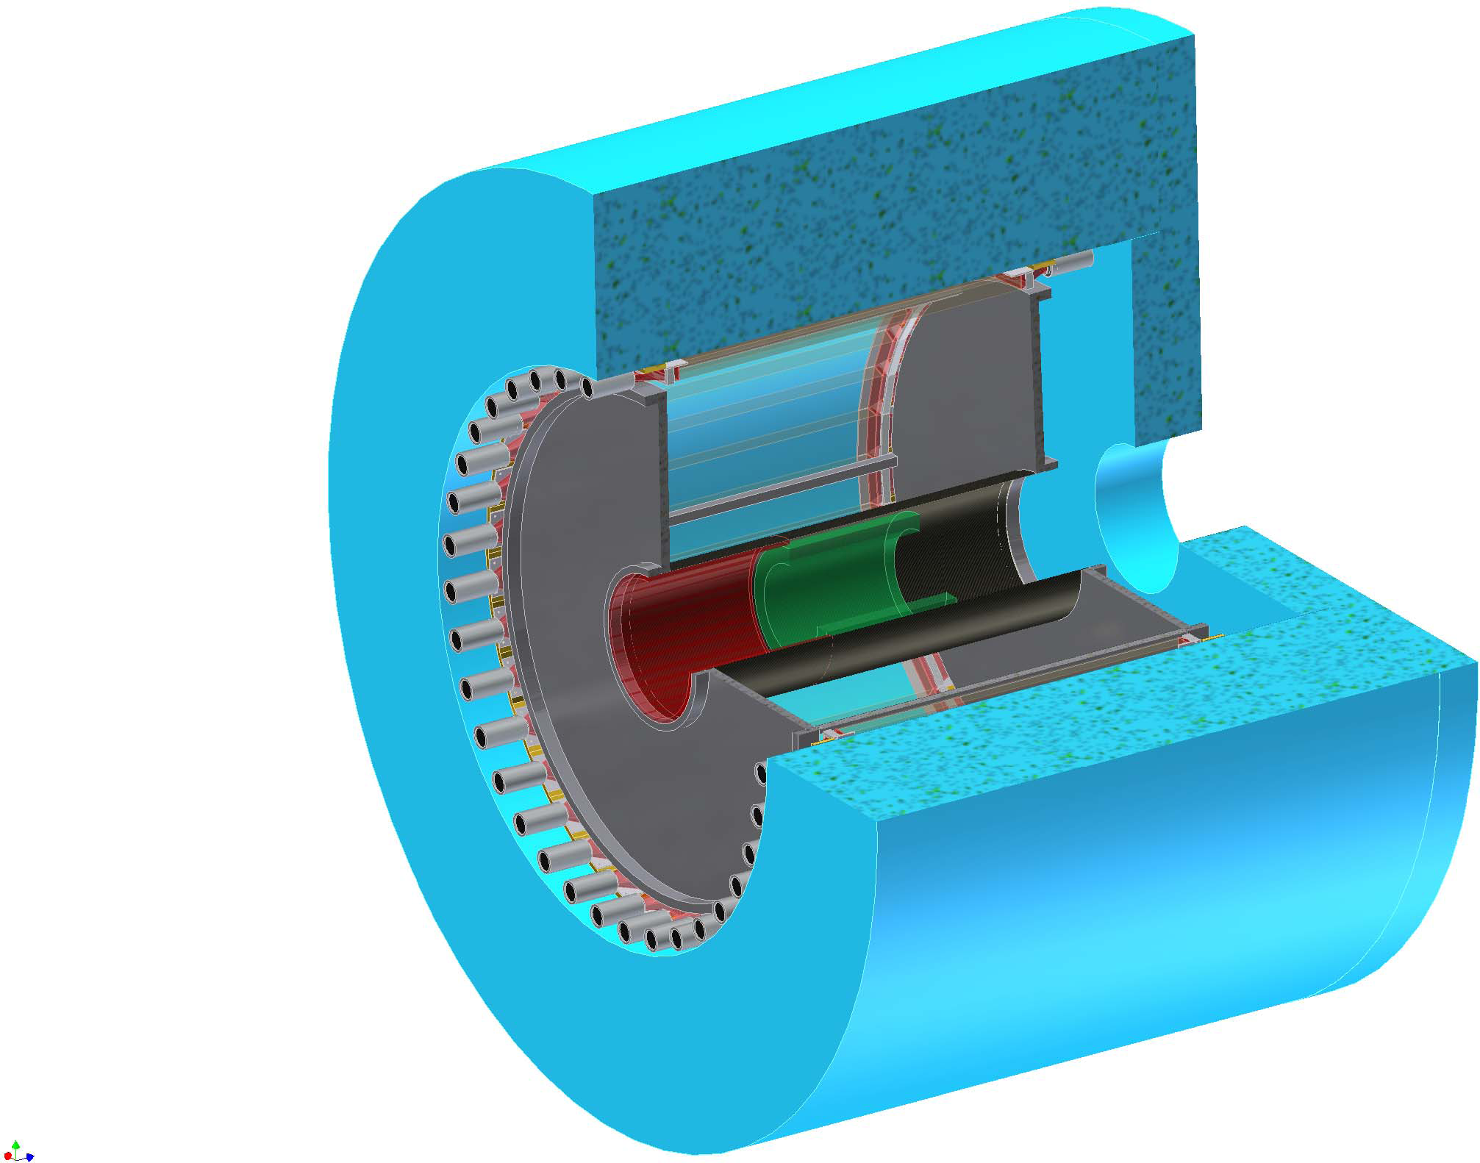
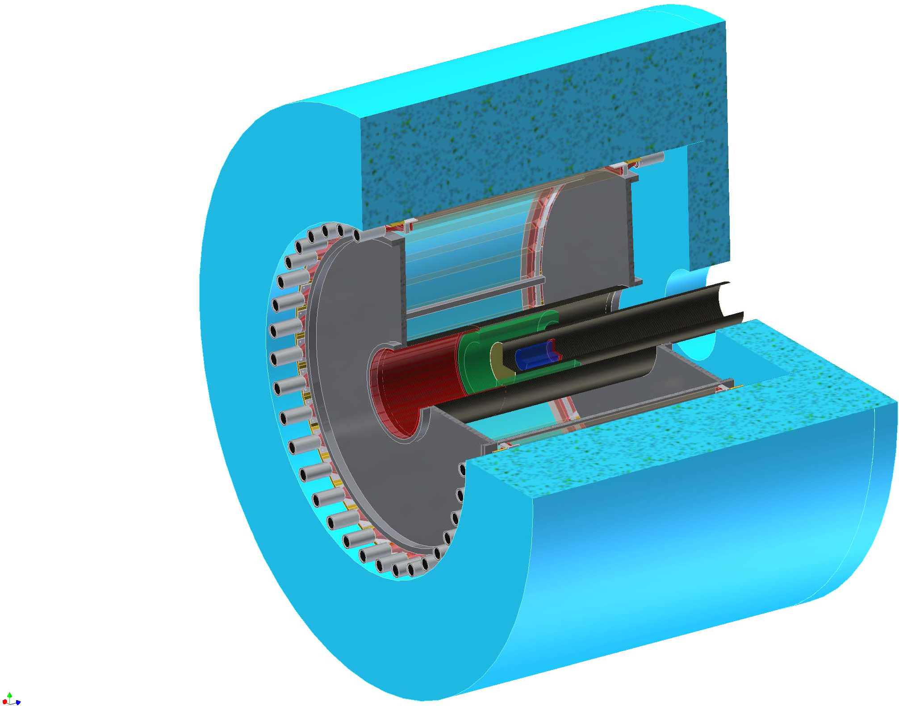
Cylindrical Detector System (CDS)
L³He Target
Solenoid
Magnet
Target
Chamber
Z-Vertex
Chamber
Charge Veto Counter
~2m
Kaon Decay Veto Counter
B
Cylindrical
Drift Chamber
Hodoscope
Counter

Slide 13
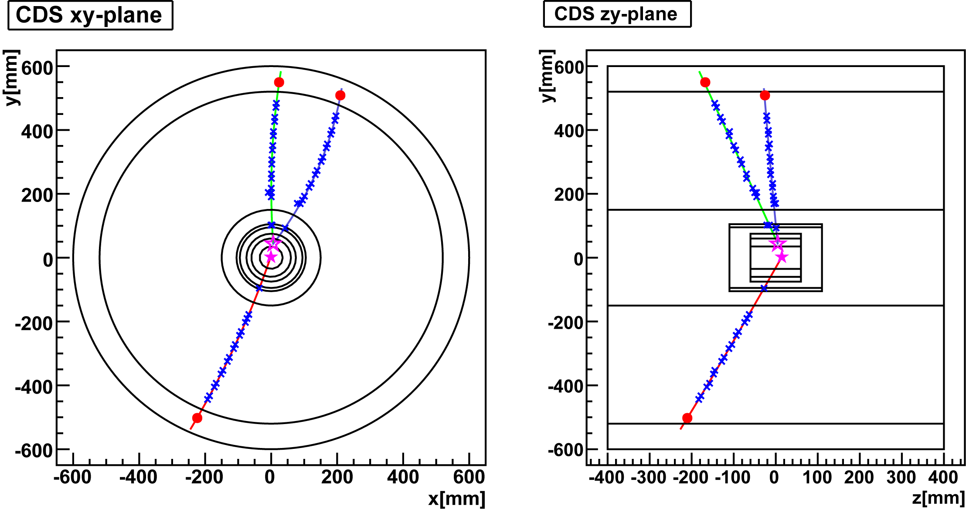
Expected Kinematics for K-pp Decay
binding energy = 100MeV/c²
Isotropic decay of K-pp
with forward neutron
Calculated using Geant4
p
p
π-
π-
~400MeV/c
~150MeV/c
n
Λ vtx
K-pp vtx
~1300MeV/c
p
p
~500MeV/c

Slide 14
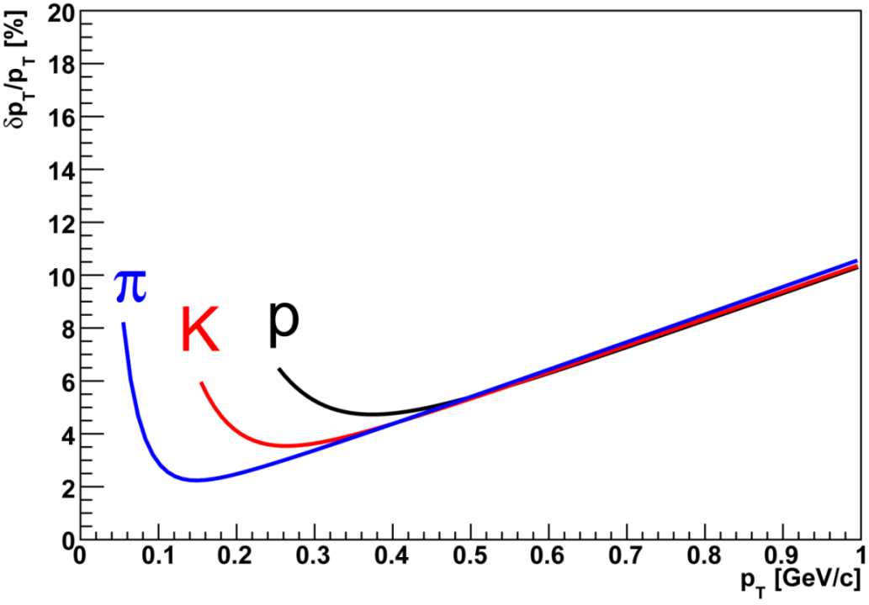
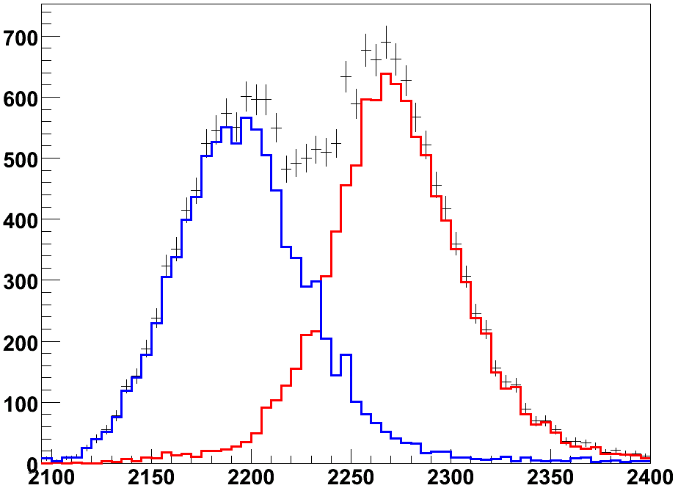
Expected Spectrometer Performance
Calculated using Geant4
momentum resolution for π, K, p
we can distinguish the two non-mesonic decay modes for K-pp
  K-pp → Λp → pπ-p
  K-pp → Σ⁰p → γΛp → γpπ-p
Σ⁰ channel
Λ channel
Γ_{K-pp}= 60 MeV
invariant mass resolution for K-pp and Λ
Invariant mass of Λp (MeV)
mass resolution | K-pp→Λp | Λ◊pπ−
w/o chamber-resolution | 5.8 MeV/c² | 1.6MeV/c²
w/ chamber-resolution | 18.7MeV/c² | 2.5MeV/c²

Slide 15
Preparation Status

Slide 16
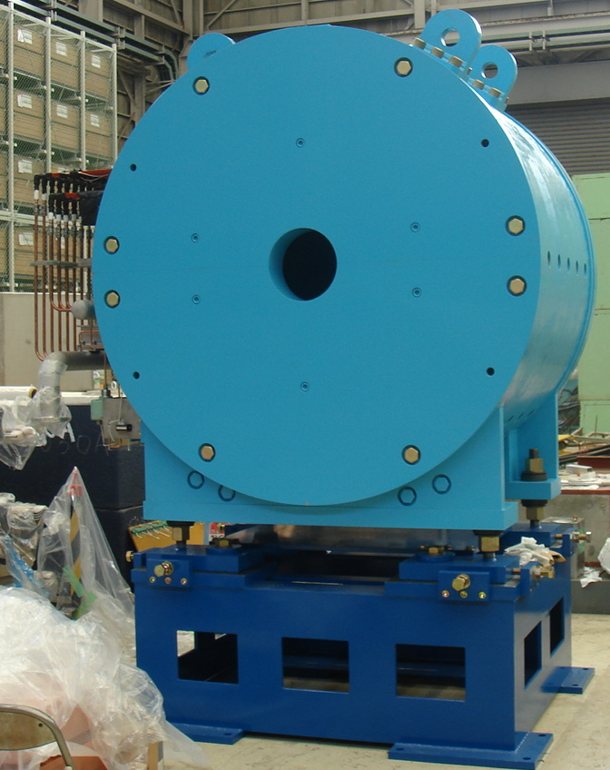
Solenoid Magnet
Solenoid magnet for E15 experiment
has been constructed.
  Field strength: upto 0.7T
  Space inside : Φ=1.2m, L=1.2m
  weight : 23 t
magnetic field map
φ1970mm
beam direction

Slide 17
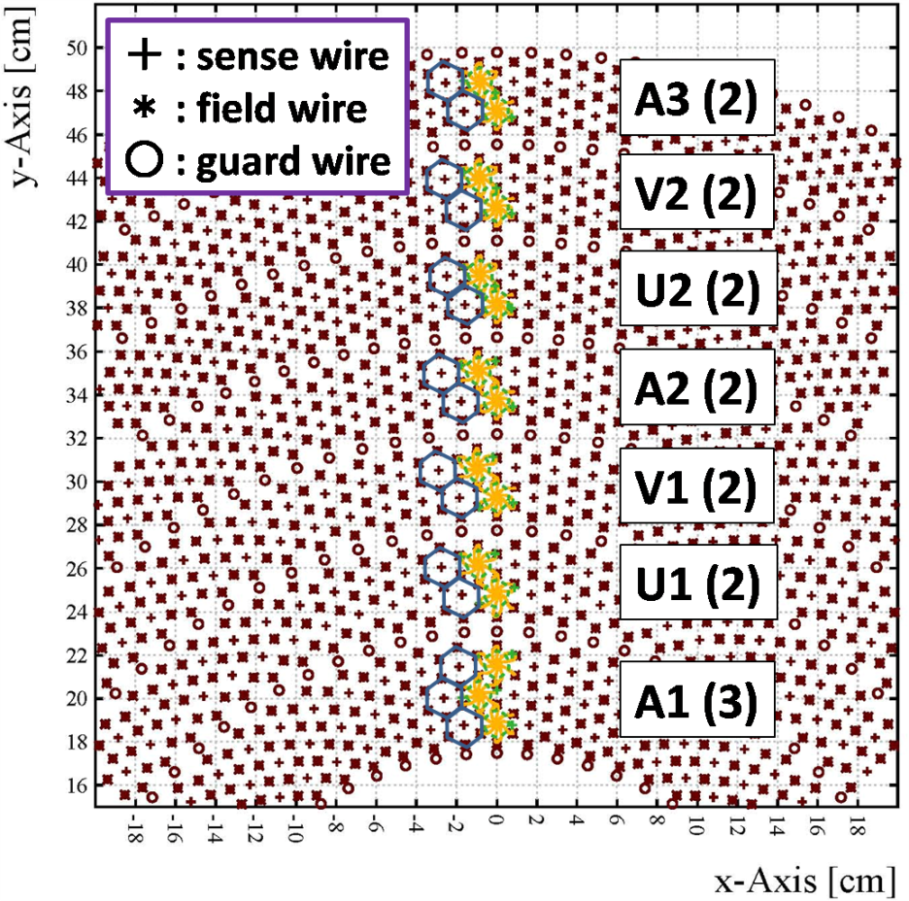
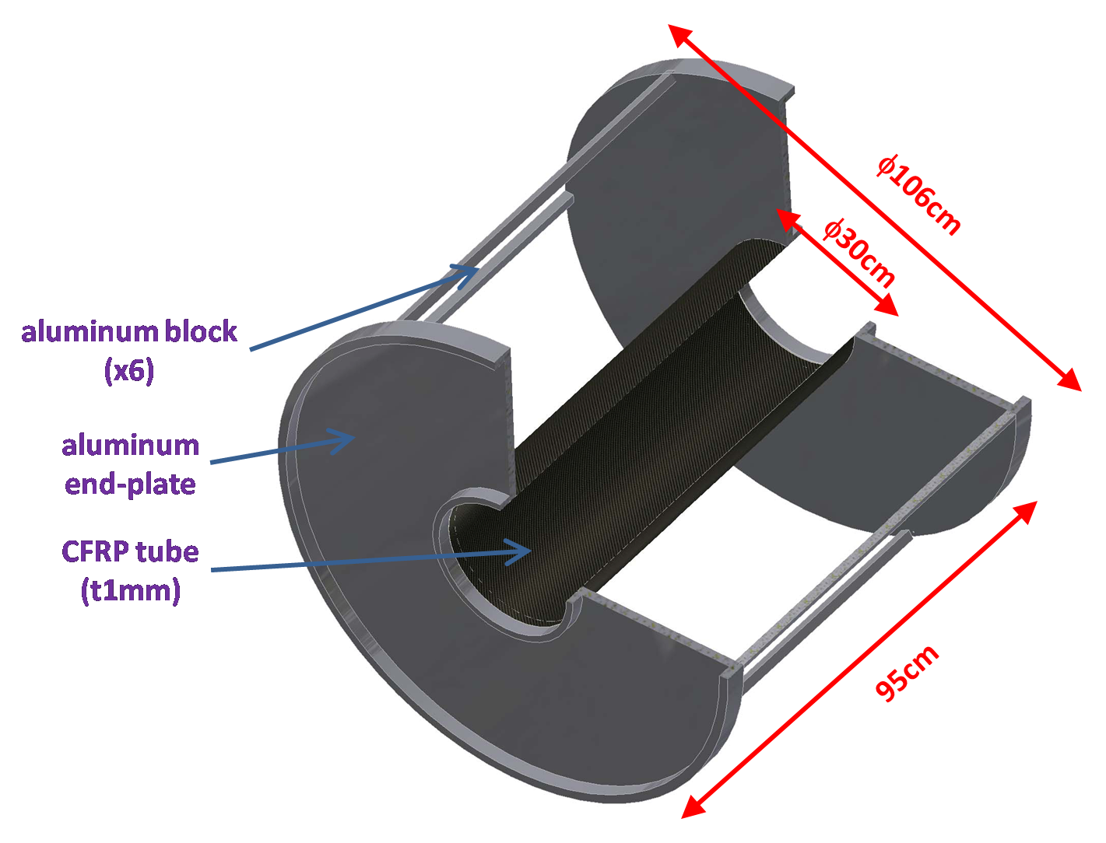
Cylindrical Drift Chamber (CDC)
made of Aluminum and CFRP
# of wires : 8136
(read-out : 1816ch)
solid angle = 2.6π
Ar:C₂H₆=50:50
hexagonal cell
(drift length ∼9mm)
15 layers
(r = 19.05∼48.45cm)
7 super layers
(AUVAUVA)

Slide 18
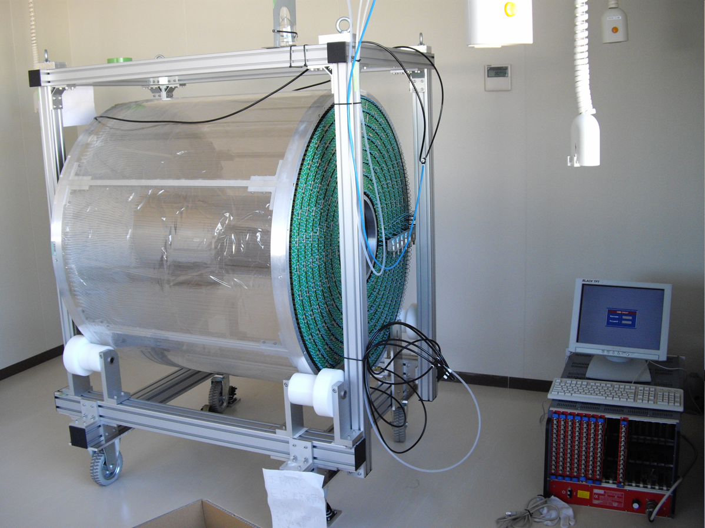
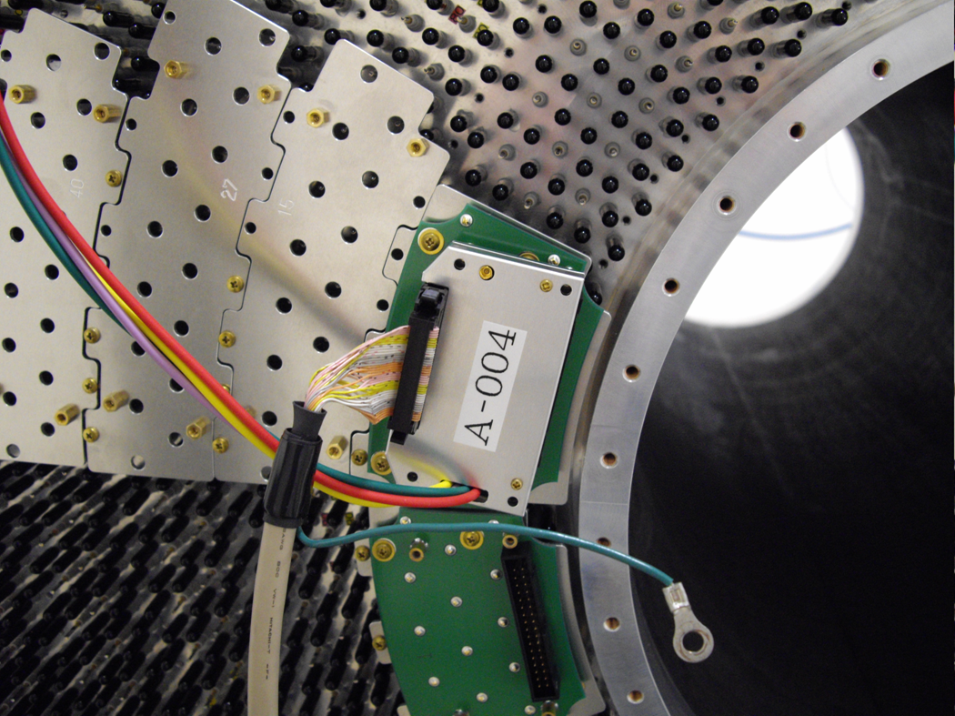
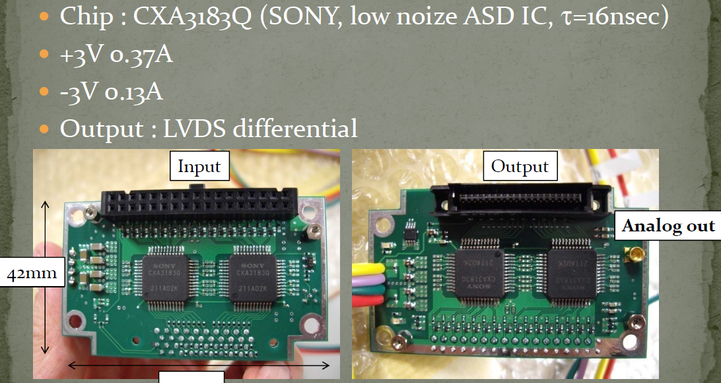
Cylindrical Drift Chamber (CDC)
Now the CDC commissioning is started at J-PARC
We brought CDC to J-PARC site
Now aging of the CDC is started
Preamp on CDC
Pre-Amp Prototype

Slide 19
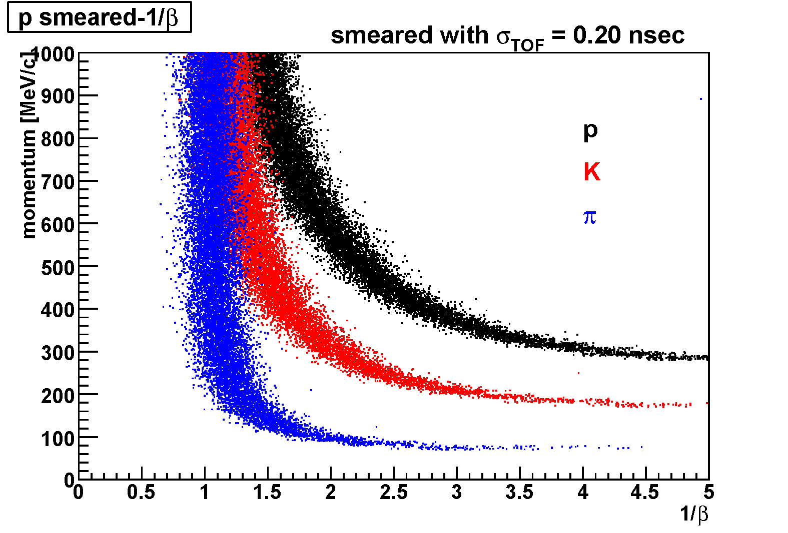
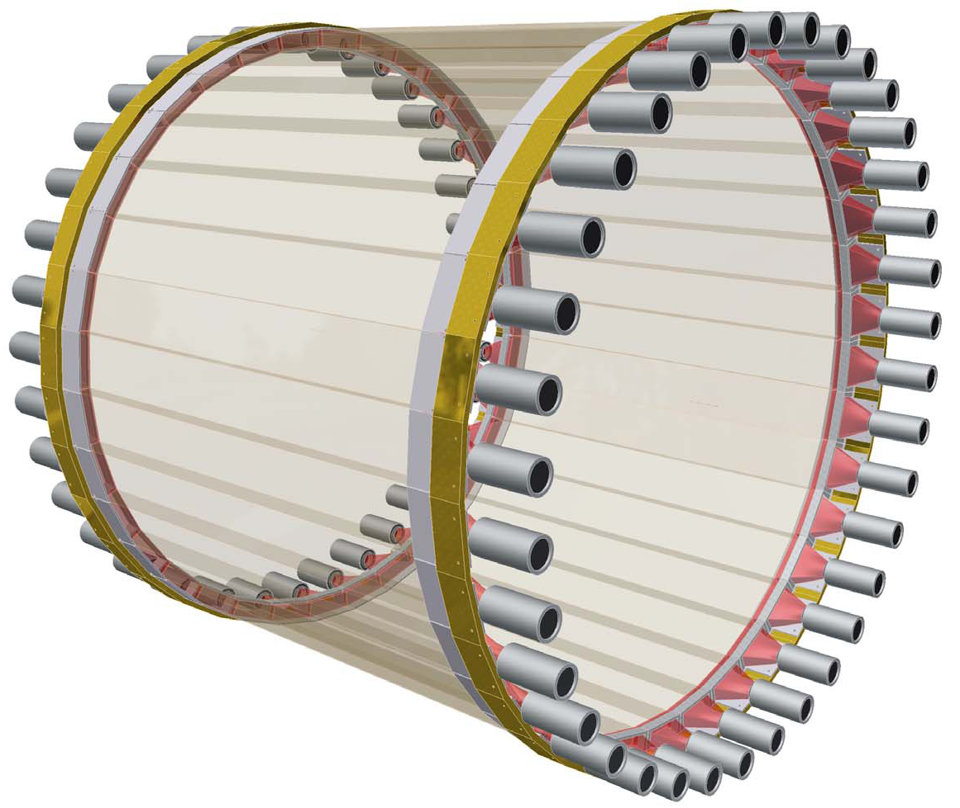
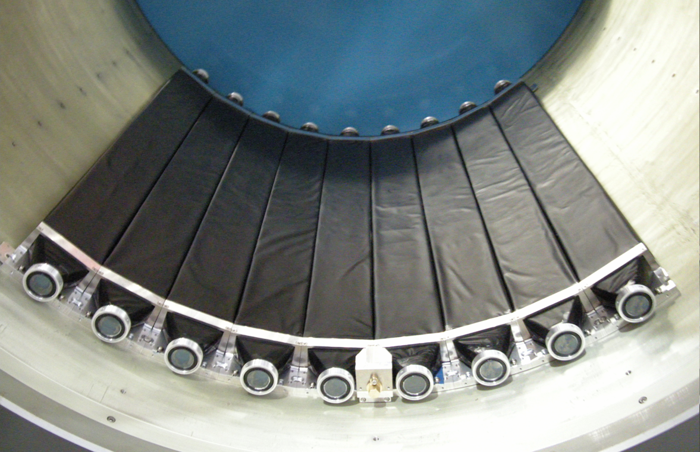
Hodoscope Counter (CDH)
CDH is used for the charged trigger and particle identification.
expected pID using ToF measurements
Sep. 11, 2008
¼ CDH system was mounted
inside the Solenoid Magnet
Plastic Scintillator :
99x30x700 mm³ （WＸTＸL）Configuration : 36 modules
PMT: Hamamatsu H8409 (fine mesh) x 72
σ_{int} = 76psec
the complete CDH system will be installed by the end of 2008

Slide 20
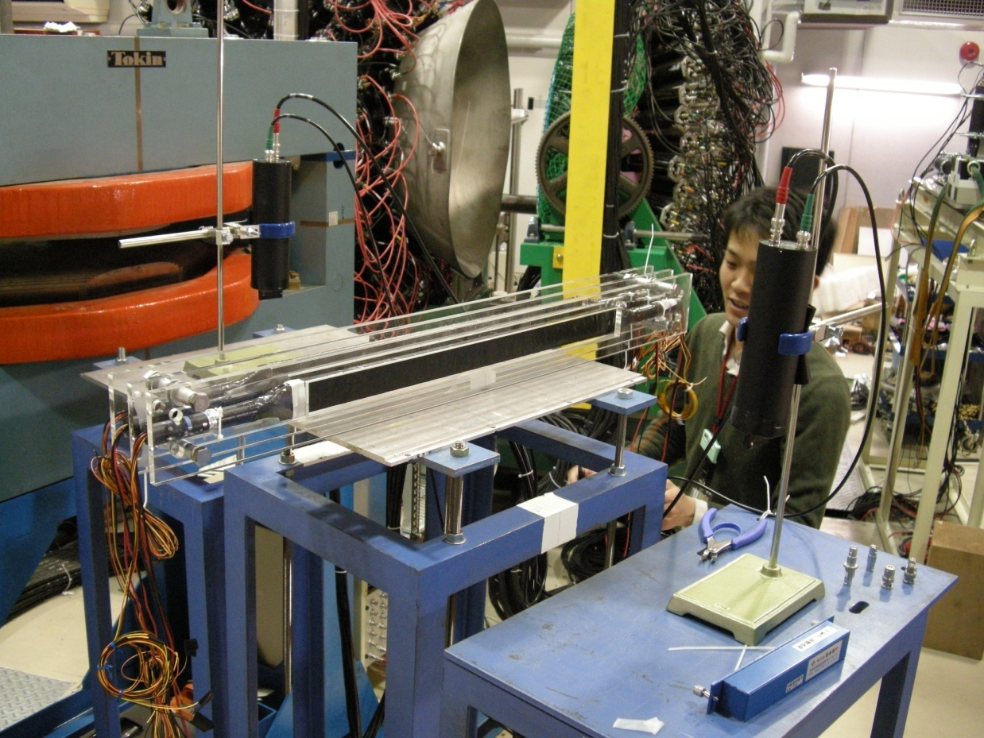
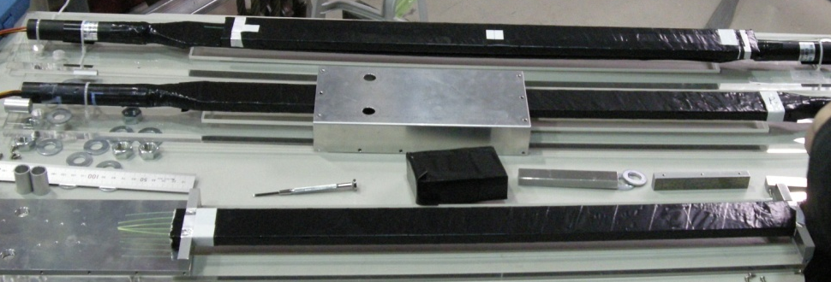
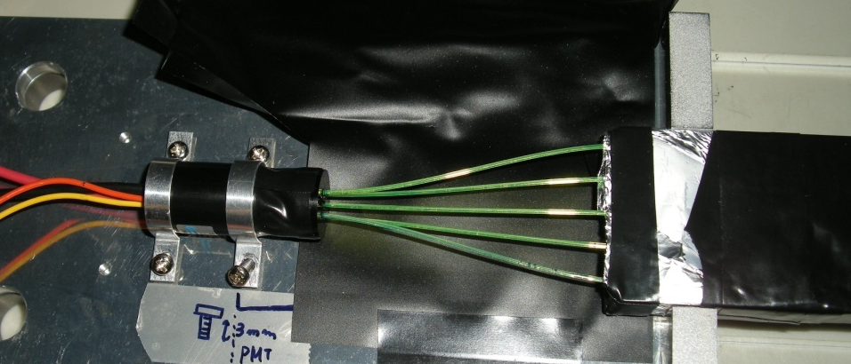
Kaon Decay Veto Counter
reduce fake triggers caused by decay of K- beam
requirements for the detector
    inside CDC & magnetic field
    small and compact
plastic scintillators embedded with wavelength shifting (WLS) fibers are in progress
Feb. 5-8, 2008
test experiment at
LNS, Tohoku Univ., Japan

Slide 21
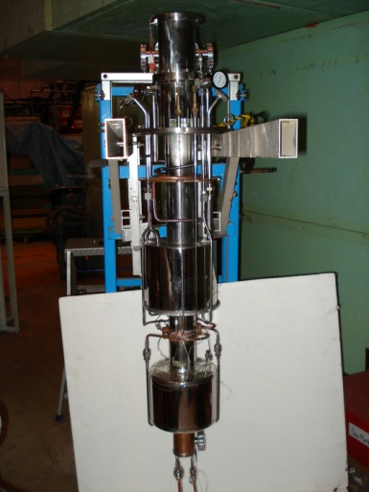
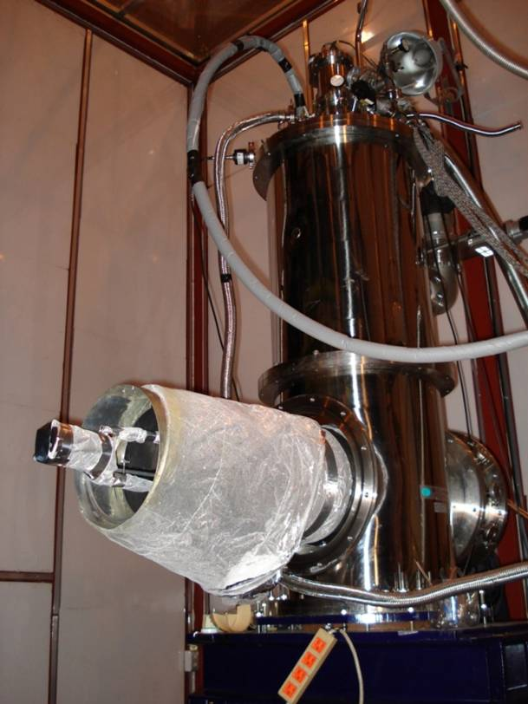
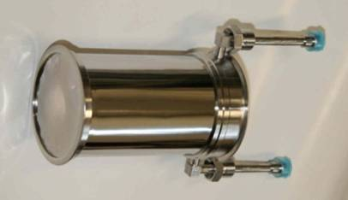
Liquid ³He Target System
Cooling test with ⁴He gas
³He liquefied system is completed by the end of this year
The x-ray detection device will be installed in the target next year
Temperature of the Target Cell | 1.25 K
Temperature of the 1K Tank | 1.24 K
Pressure in the 1K Tank | 1.2 Torr
Liq. ⁴He Consumption | 45 L/day
Heat Load of the 1K Tank | 0.18 W
E17 (kaonic ³He X-ray) will be ready in Apr. 2009
(First experiment @J-PARC Hadron-Hall)

Slide 22
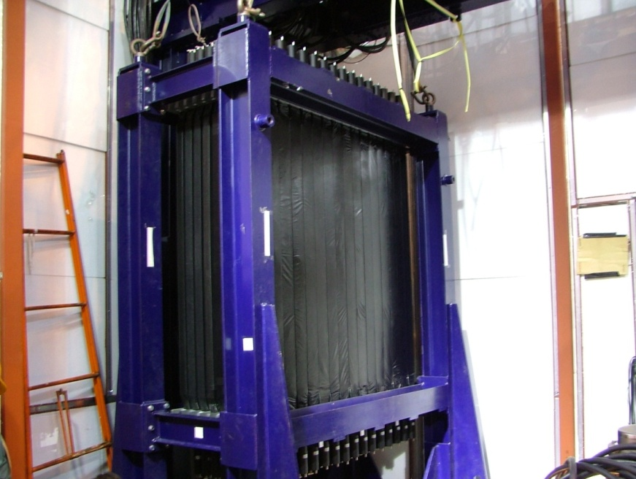
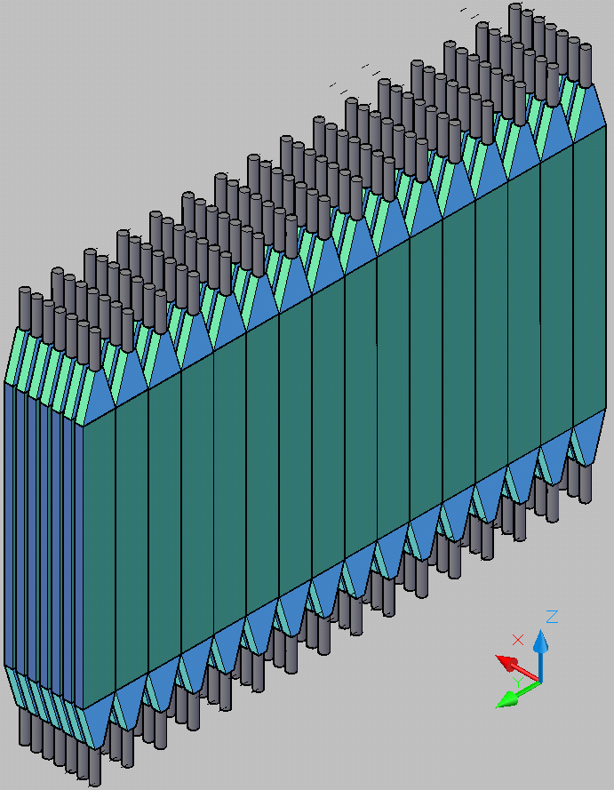
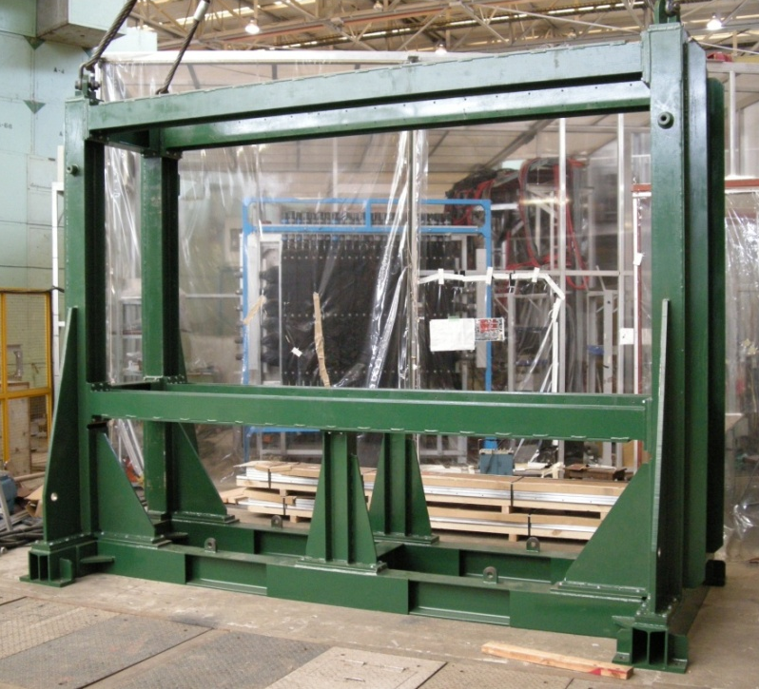
Neutron Counter
same neutron counter used for KEK-PS E549 experiment
E549 neutron counter
rearrange
3.2 m
1.5 m
20x5x150 cm³ Plastic Scintillator
Configuration : 16 (wide) x 7 (depth)
Surface area : 3.2m X 1.5m
new support frame

Slide 23
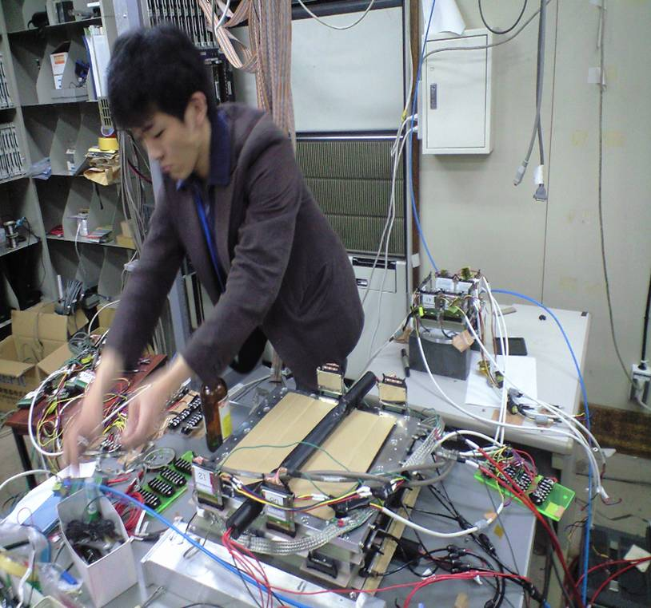
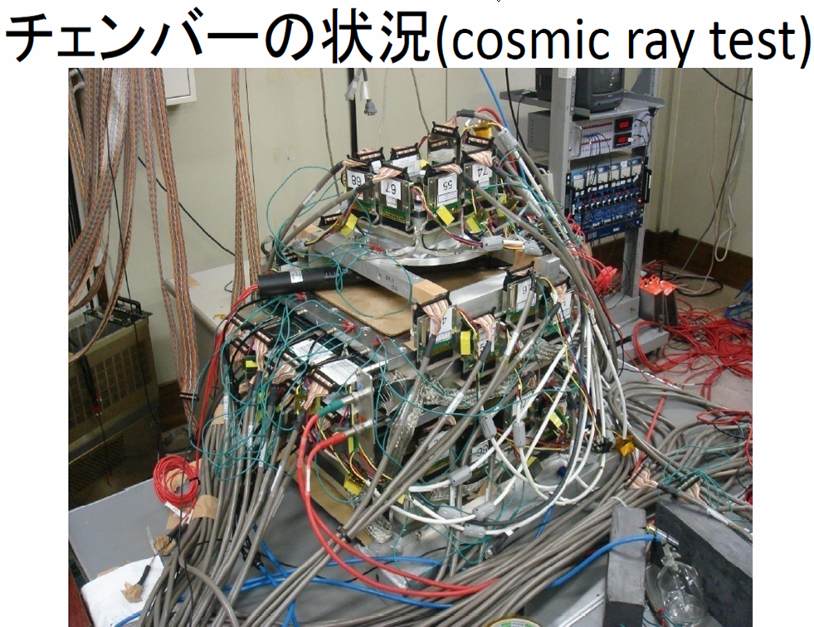
Beam Line Spectrometer
  Design of the spectrometer is almost completed
  Commissioning of the detector is under the way
  will be ready by Jan. 2009

Slide 24
Summary
J-PARC E15 experiment
  Search for the simplest deeply-bound kaonic nuclear state, K⁻pp, by in-flight ³He(K-,n) reaction
Detector construction is in progress
  Solenoid Magnet, CDC, CDH, ³He Target,
  and other detectors
Time table
Jan. 2009 | Start beam tune at K1.8BR beam line (J-PARC 50GeV PS first beam!)
Apr. 2009 | able to start E17 (Kaonic ³He X-ray spectroscopy)
Sep. 2009 | able to start E15 (Kaonic Nuclei)

Slide 25
backup

Slide 26
“K-pp” and “Two Nucleon Absorption”
³He(K-,n) K⁻pp formation
Λ
p
neutron
³He
K⁻pp
cluster
K⁻
reaction
π⁻
~ 500 MeV/c
~ 1.3 GeV/c
p
@ 1GeV/c K- and
B.E. = 100 MeV
Two nucleon absorption
p (spectator)
³He
Λ
p
K⁻
reaction
~ 1.5GeV/c
π⁻
@ 1GeV/c K-
almost stopped
p
Λ
neutron
“two nucleon absorption process” can be identified!

Slide 27
Event Rate Estimation
Parameters
  Assume production cross section as σ _{3He(K-,n)K-pp}= 10 μb/sr
  Acceptance of Neutron counter = 30 msr
  Target thickness = 20cm, density = 0.080 g/cm³
  Neutron detection efficiency = 30%
  Assume 1/3 of K-pp decay in to (Λ+p or Σ⁰+p)
  Λ+p reconstruction efficiency in CDC = 47%
Expected event rate
  1.86x10⁻⁹ per an incident K⁻
Event rate per day
  0.8x10⁶ K- per 3.53s (0.7s flat top)
  24475 spill per day = 1.96x10¹⁰ K- per day
  ~ 50 events per day
We will expect about ~1500 events in a month !!!

Slide 28
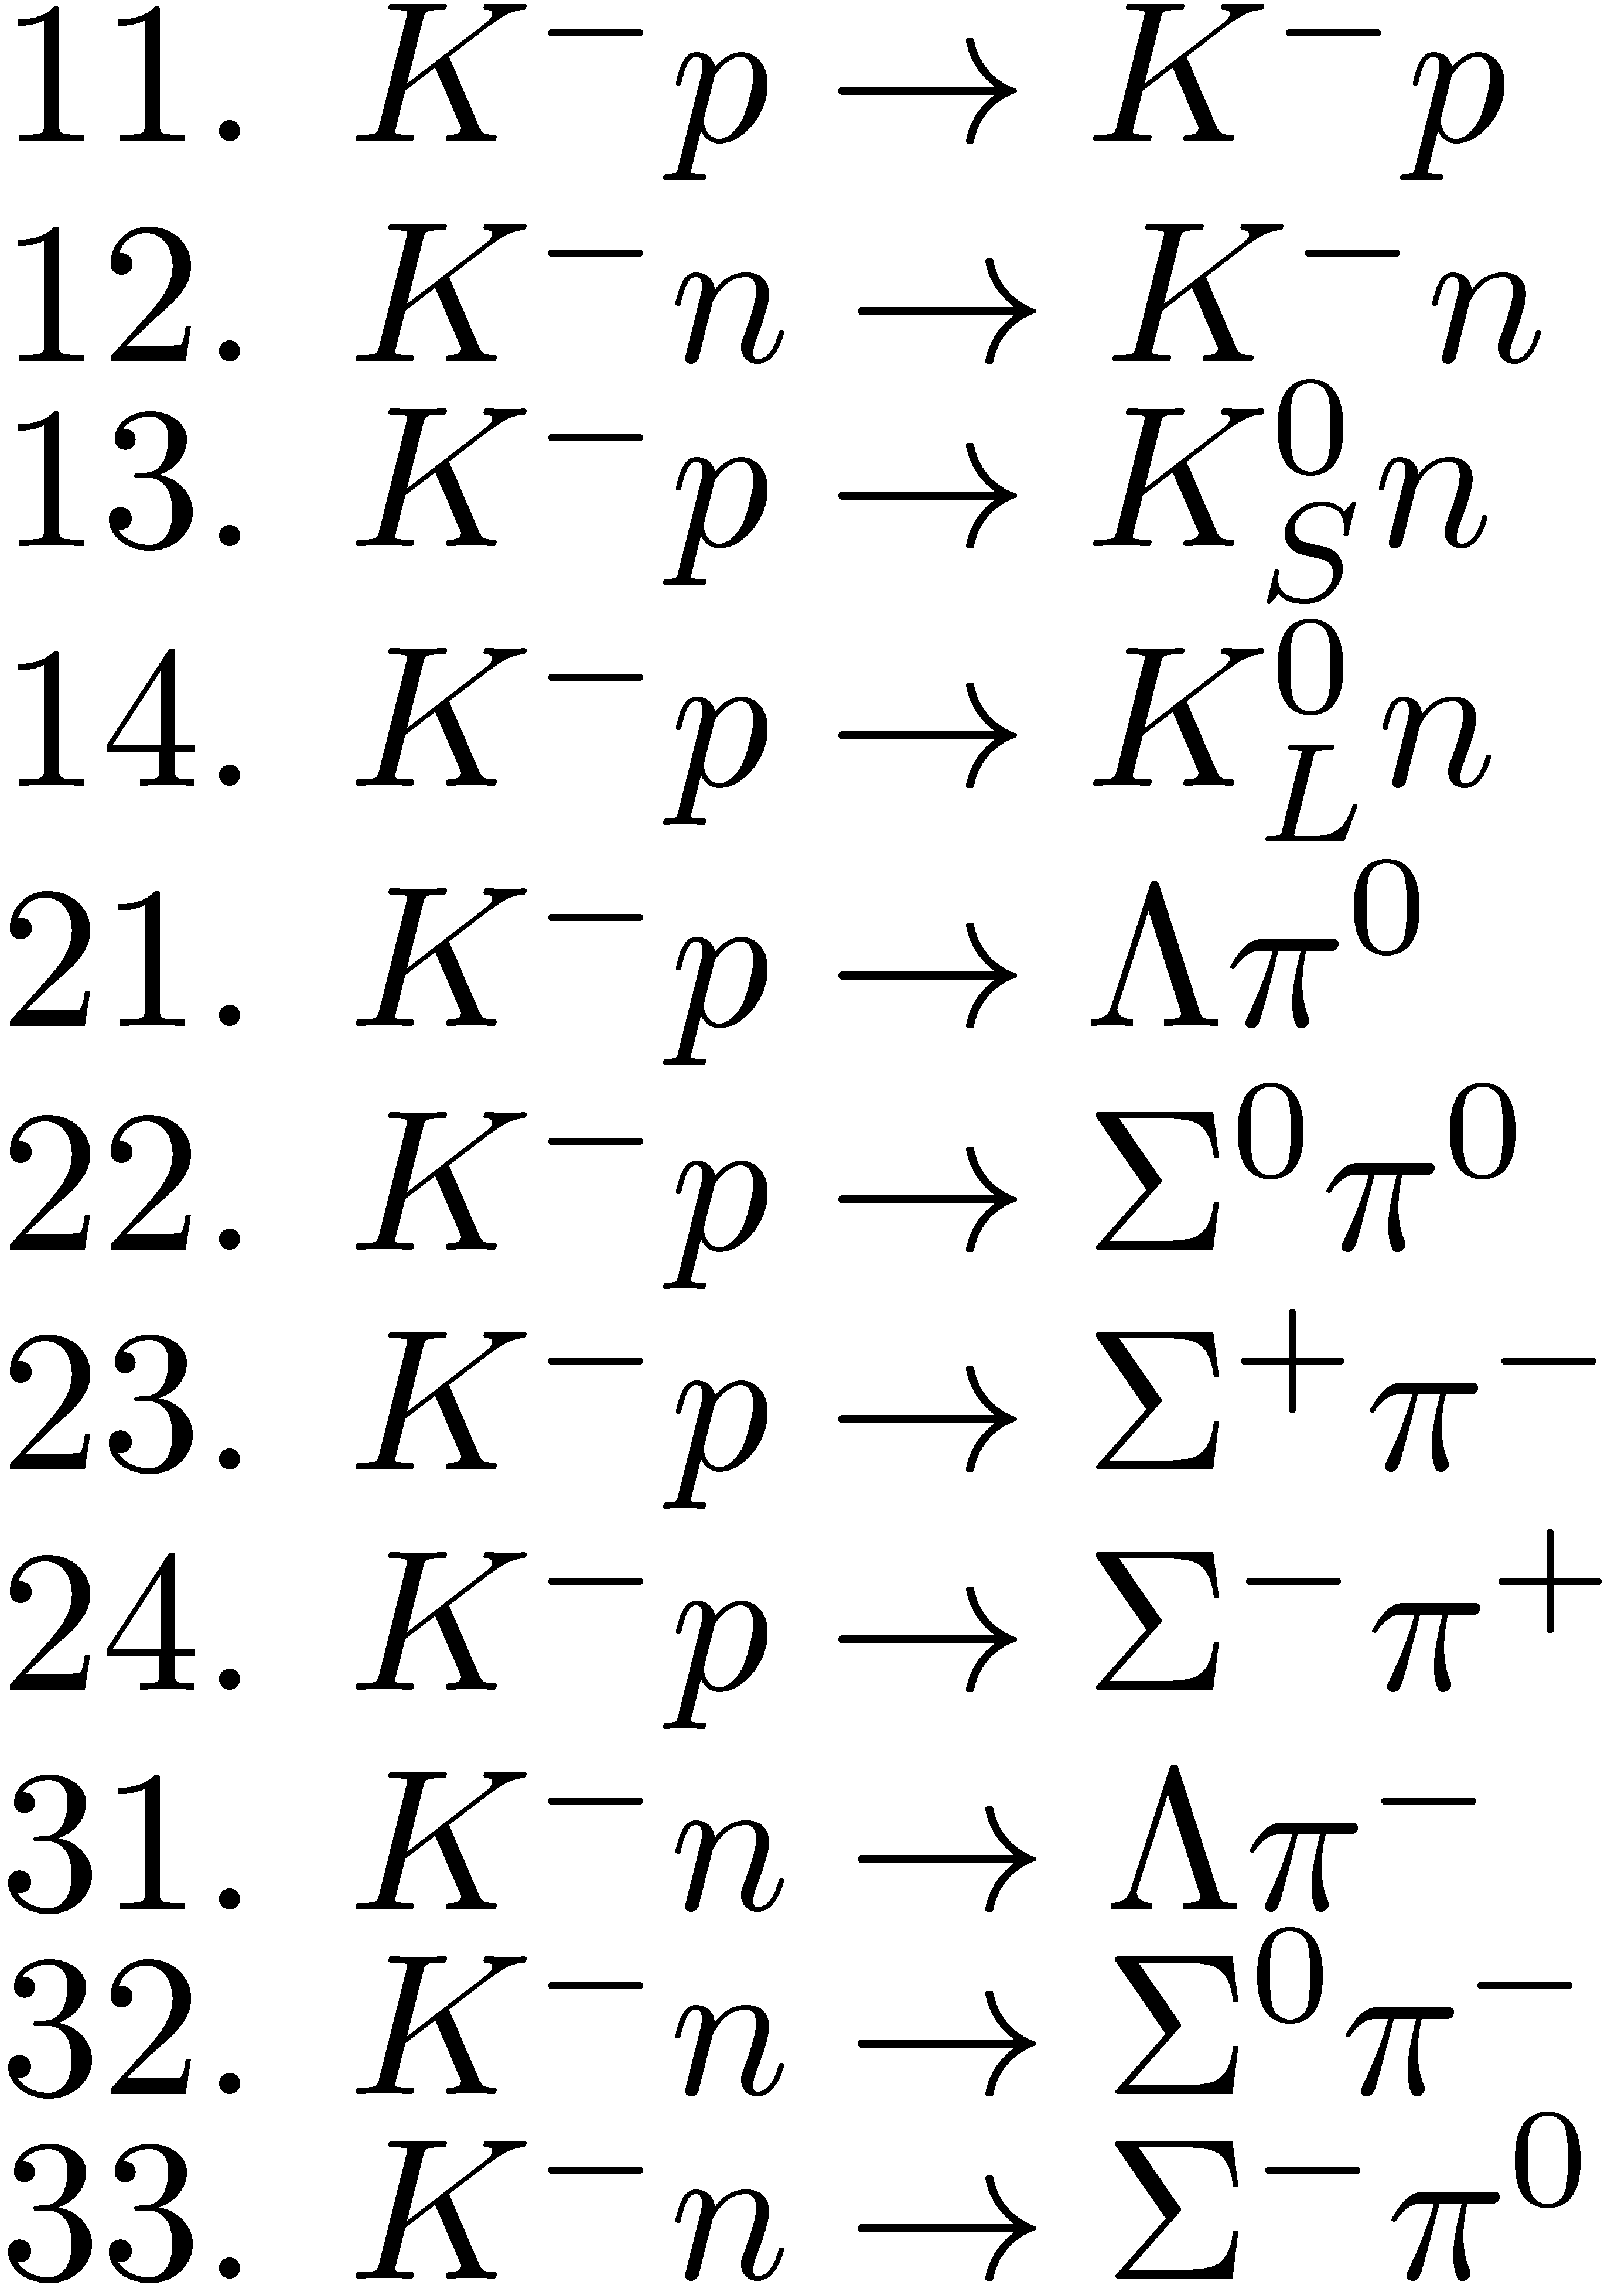
Background Estimation
Source of background
  Quasi free scattering and reaction
    Following 11 channels are considered
    Only 20-30 triggers/spill expected from these reactions
  In total, estimated trigger fired by background
  is estimated to be ~ 100 Hz

Slide 29
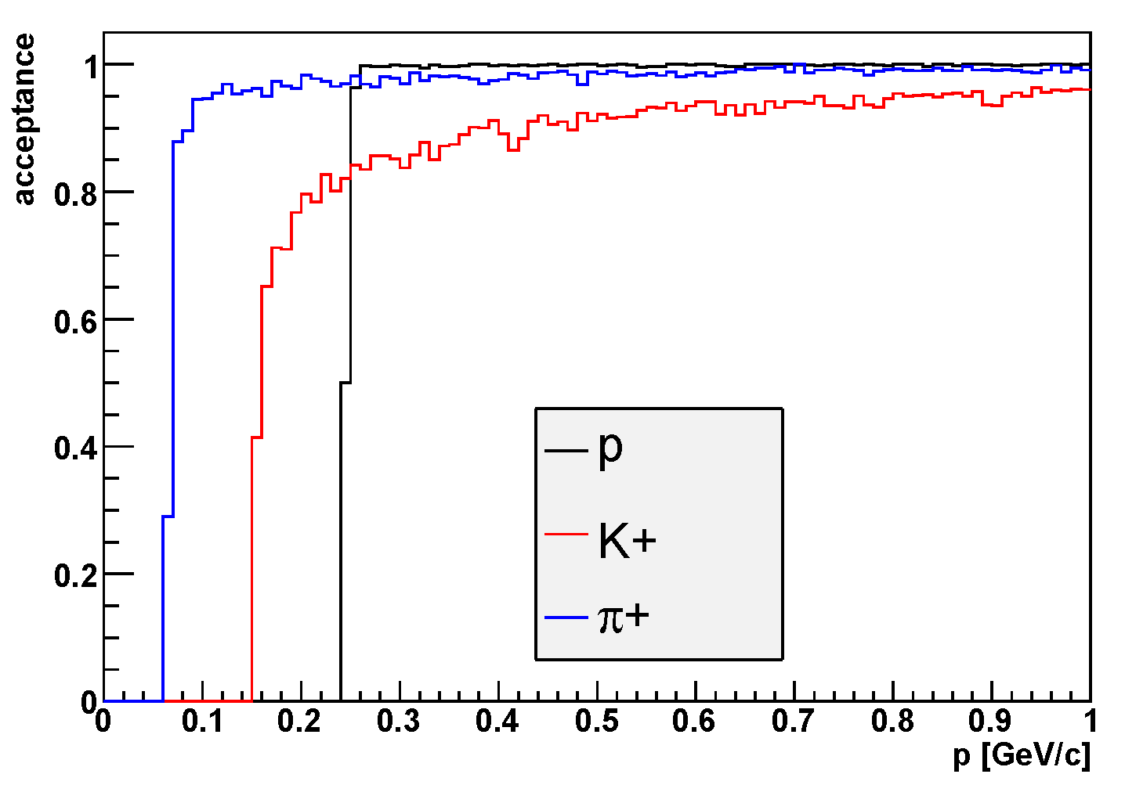
Geometrical Acceptance
generated at the center of CDS
0<p<1 GeV/c, flat distribution
60<θ<120 degree, flat distribution
accepted = track with a CDH-hit
Calculated using Geant4
decay
magnetic field = 0.5T
energy loss
proton>250MeV/c, kaon>150MeV/c, pion>50MeV/c

Slide 30
Detailed Cell Configuration of CDC

Slide 31
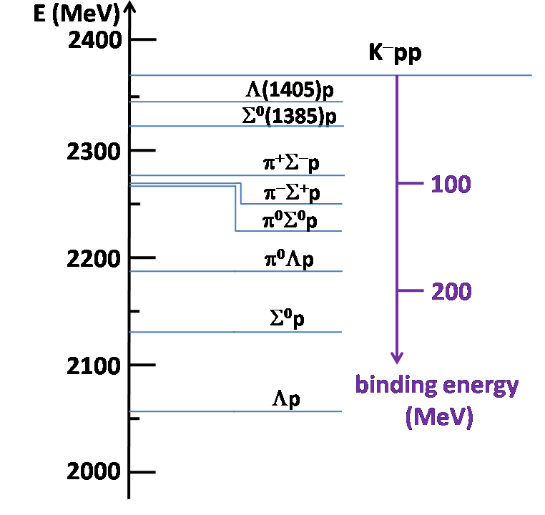


mesonic & non-mesonic decay mode
important to measure not only non-mesonic decay mode
but also mesonic decay mode
to improve z-resolution, Thick-GEM TPC
will be installed

Slide 32




Thick-GEM TPC
schematic view
field calculation with MAXWELL-2D
~500mm
φ280mm
φ170mm
~300mm
field strip
expected resolution
readout-pad
prototype
flexible print circuit board
8mm strip
10mm pitch
double sided
pad size:20x4mm
# of pad:4x4x9=144
gas:P10 (150V/cm)
designs are almost completed

Slide 33


Thick-GEM @ RIKEN
Thick-GEM
a robust, simple to manufacture, high-gain gaseous electron multiplier
cost-effectively fabricated from double-clad G10 plates, using standard printed circuit board (PCB) techniques
holes are mechanically drilled and the hole’s rim is chemically etched to prevent discharges
easy to operate and feasible to cover large areas, compared to the standard foil GEM
10cm
10cm
HV
Geometrical parameters of the test Thick-GEM
Thickness | 0.4mm
Drilled hole diameter | 0.3mm
Etched Cu diameter | 0.5mm
Pitch | 0.7mm
Size | 100mm x 100mm
Produced by REPIC Corp., Japan
[pitch:1.2mm ver.]

Slide 34



Thick-GEM @ RIKEN
test chamber
setup
⁵⁵Fe
drift mesh
readout pad
11mm
E_{drift}
TGEM #1
2mm
E_{trans}
TGEM #2
2mm
E_{trans}
R/O pad
→ ASD
effective gain of TGEM
double TGEM
ΔV_{GEM}=1225V
raw signal
effective gain ~ 1.7*10⁴
we need effective gain of ~10⁵
E_{drift}=ΔV_{GEM}*(1/2)*(1/1.1) E_{trans}=ΔV_{GEM}*(1/2)*(1/0.2)

Slide 35
(K-,p) and (K-,d) measurements
Sweeping
Magnet
Beam trajectory
K1.8BR
Beam Line
CDS &
target
neutron
Neutron
Counter
+Charged Particle
Proton TOF wall
(K-,p) and (K-,d) measurement
Forward charged particle spectrometer will provide strong new physics case in the E15 experiment
New forward charged particle spectrometer will be installed
in addition to the original E15 experimental setup

Slide 36

Performance of the 50-GeV PS
Beam Energy： 50ＧｅＶ E_{Linac} = 400MeV
  (30GeV for Slow Beam) E_{Linac} = (180MeV)
  (30GeV for Fast Beam)
Repetition: 3.4 ~ 5-6s
Flat Top Width： 0.7 ~ 2-3s
Beam Intensity: 3.3x10¹⁴ppp, 15μA
(2×10¹⁴ppp, 9μA)
Beam Power: 750kW
(270kW)

Slide 37
Beam-Line Parameters
 | K1.8 |  |  | K1.8BR |  |  | K1.1 (S-Type)
Max. Mom. | ~2 GeV/c |  |  | 1.2 GeV/c |  |  | 1.1 GeV/c
Length | 45.694 m |  |  | 26.973 m |  |  | 27.05 m
Acceptance | 2.03 msr.% & |  |  | 4.5 msr.% & |  |  | 4.1msr.% \
Intensity (ppp)# | K⁻ (×10⁶) |  |  | K⁻ (×10⁶) |  |  | K⁻ (×10⁶) |  |  | K⁺ (×10⁶)
 | 50GeV15μA | 30GeV9μA |  | 50GeV15μA | 30GeV9μA |  | 50GeV15μA | 30GeV9μA |  | 50-15 |  | 30-9
1.8 GeV/c | 9.6 | 2.0
1.1 GeV/c | 0.6 | 0.1 |  | 10.7 | 2.3 |  | 9.1 | 2.0 |  | 81 |  | 11
0.8 GeV/c |  |  |  | 2.0 | 0.4 |  | 1.7 | 0.4 |  | 18 |  | 2.5
0.6 GeV/c |  |  |  | 0.3 | 0.05 |  | 0.2 | 0.05 |  | 2.6 |  | 0.4
DC-Separator | 750kV/10cm 6m×2 |  |  | 500kV/10cm 6m |  |  | 750kV/10cm 2m×2
K⁻/π^{− $} | 2.3 (1.8GeV/c) |  | 2.6 | 10 (1.1GeV/c) |  | 12 | 4.3(1.1GeV/c) |  | 4.7
X/Ysize @ FF | 16/8 mm(FWHM) |  |  | 38/7.4 mm(FWHM) |  |  | 10/6 mm(FWHM)
& MS1 opening: ±2mm, MS2 opening: -3.25mm,+2.75mm
\ MS1 opening: ±1mm, MS2: ±2mm
# using Sanford-Wang formula, assuming 1pulse=3.53s（0.7s flat top)
$ Cloud π are not taken into account.

Slide 38
Proposals and PAC recommendation
 | (Co-)Spokespersons | Affiliation | Title | Stat
E03 | K. Tanida | Kyoto U. | Measurement of X rays from Ξ- Atom | S1
P04 | J.C. Peng/S. Sawada | U. Illinois/KEK | Measurement of High-Mass Dimuon Production at the 50-GeV Proton Synchrotron
E05 | T. Nagae | KEK | Spectroscopic Study of Ξ-Hypernucleus, 12ΞBe, via 12C(K-, K+) Reaction | S2,D1
E06 | J. Imazato | KEK | Measurement of T-Violating Transverse Muon Polarization in K+ -> pi0 mu+ nu Decays | S1
E07 | K. Imai/K. Nakazawa/H. Tamura | Kyoto U./Gifu U./Tohoku U. | Systematic Study of Double Strangeness System with an Emulsion-counter Hybrid Method | S2
E08 | A. Krutenkova | ITEP | Pion Double Charge Exchange on Oxygen at J-PARC | S1
E10 | A. Sakaguchi/T. Fukuda | Osaka U. | Production of Neutron-Rich Lambda-Hypernucleus with the Double Charge-Exchange Reaction | S1
E11 | K. Nishikawa | KEK | Tokai-to-Kamioka (T2K) Long Baseline Neutrino Oscillation Experiment Proposal | S2
E13 | T. Tamura | Tohoku U. | Gamma-ray Spectroscopy by Light Hypernuclei | S2,D1
E14 | T. Yamanaka | Osaka U. | Proposal for KL -> pi0 mu mu-bar Experiment at J-PARC | S2
E15 | M. Iwasaki/T. Nagae | RIKEN/KEK | A Search for deeply-bound kaonic nuclear states by in-flight 3HE(K-, n) Reaction | S2,D1
E16 | S. Yokkaichi | RIKEN | Electron Pair Spectrometer at the J-PARC 50-GeV PS to explore the chiral symmetry in QCD | S1
E17 | R. Hayano/H. Outa | U. Tokyo/RIKEN | Precision Spectroscopy of Kaonic 3He 3d -> 2p X-Rays | S2,D1
E18 | H. Bhang/H. Outa/H. Park | SNU/RIKEN/KRISS | Coincidence Measurement of the Weak Decay of 12ΛC and the three-body weak interaction process | S1
E19 | M. Naruki | KEK | High-Resolution Search for Θ+ Pentaquark in pi- p -> K- X Reaction | S2,D1
E22 | S. Ajimura/A. Sakaguchi | Osaka U | Exclusive Study on the Lambda-N Weak Ineteraction in A=4 Lambda-Hypernuclei | S1
S2: Stage-2 approval, S1: Stage-1 approval, D1: Assigned as Day-1

