Slide 1
J-PARC K1.8BRビームラインにおける 液体3He標的への K- ビーム照射実験(3)
京都大学/理研 佐田優太
For the E15 collaborations
2013 秋季物理学会（高知大学）

Slide 2
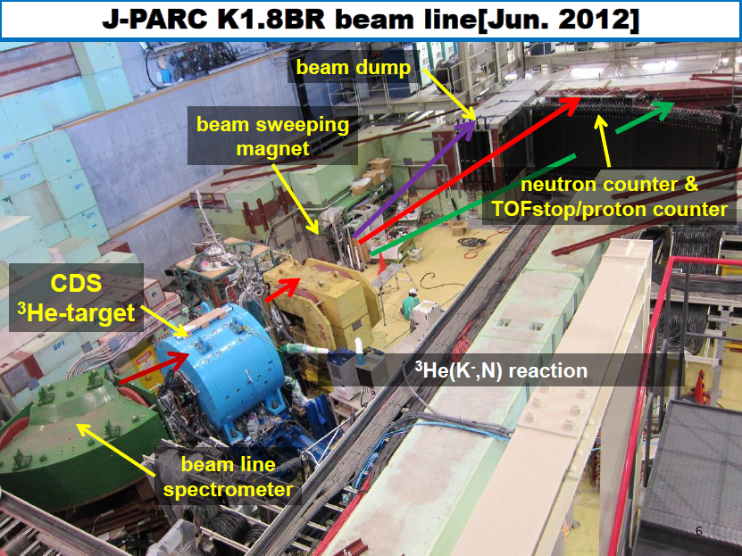
Physics @J-PARC K1.8BR
Reactions detected @K1.8BR
³He(K⁻,p) &Set up(tokuda)
³He(K⁻,n) (hashimoto)
³He(K⁻,Λpn) (this talk)
³He(K⁻,n)Λ* (enomoto)
³He(K⁻,d) (inoue)

Slide 3
Contents
Analysis for ³He(K⁻,Λpn) reaction
Tagged Λp→ppπ- events with CDS
Estimation of Λpn final state events
M.M of 3He(K-,Λp)X
Dalitz’plot of Λpn final state evets
Summary

Slide 4
³He(K-,Λpn) Reaction
4
in-flight (K⁻, n) reaction of ³He target & detection Λp @CDS
=> Search for KNN bound states both formation & Decay
K⁻
^{1.0GeV/c}
³He
Neutron
Formation
KNN
cluster
Missing mass
Spectroscopy via neutron
Decay
Mode to decay charged particles
Λ
p
π⁻
Detection of ³He(K-,Λpn) Reaction
is goal of E15 proposal
Invariant mass reconstruction
p

Slide 5
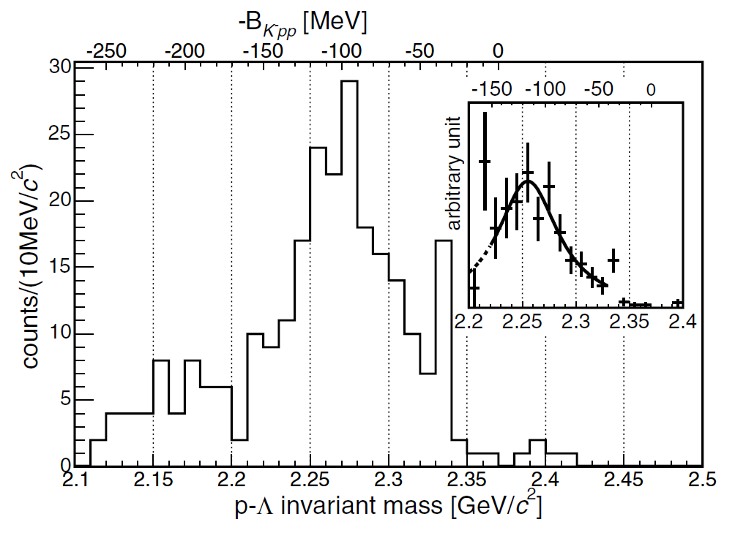
What can we see from Λp invariant mass
5
If Kpp decay Kpp=> Λp, we can detect Kpp bound state from Λp invariant mass (FINUDA exp)
FINUDA exp. is stopped K-
=>tagged back-to-back Λp
But E15 exp in-flight K- on 3He target
Λpn 3-body reaction?
Λpnπ muilt-body??
”Λp from Kpp decay in E15“ are not back-to-back.
=>to define all particles in final state is important!
FINUDA
B = 115±6±4 MeV
Γ = 67±14±3 MeV
FINUDA Exp. @ DAΦNE
⁶Li, ⁷Li, ¹²C target stop K−
Λp invariant mass

Slide 6
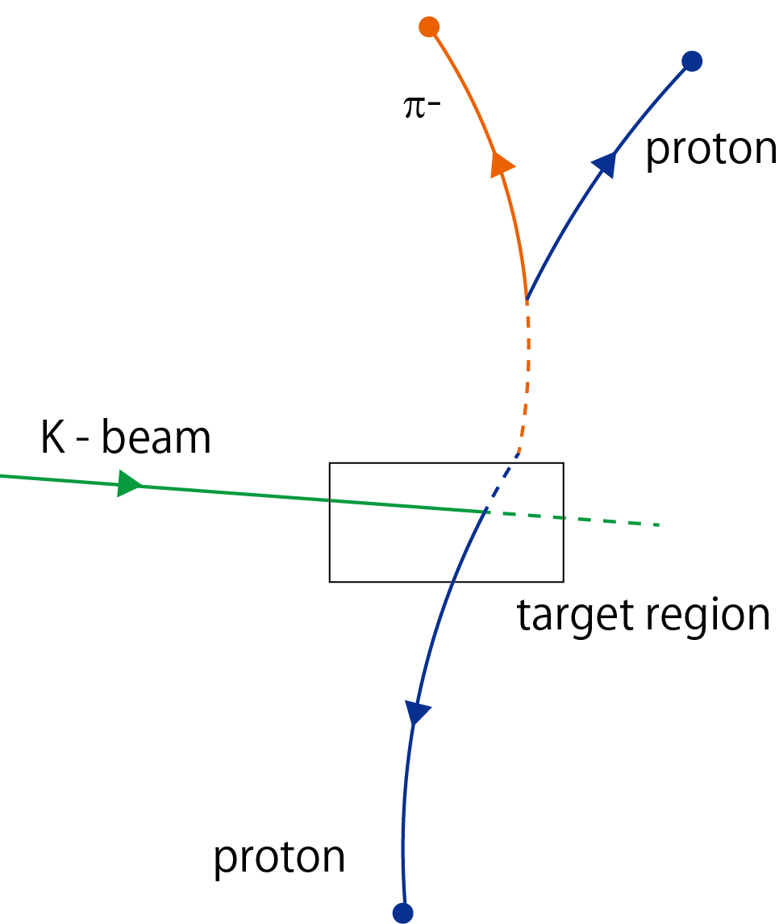
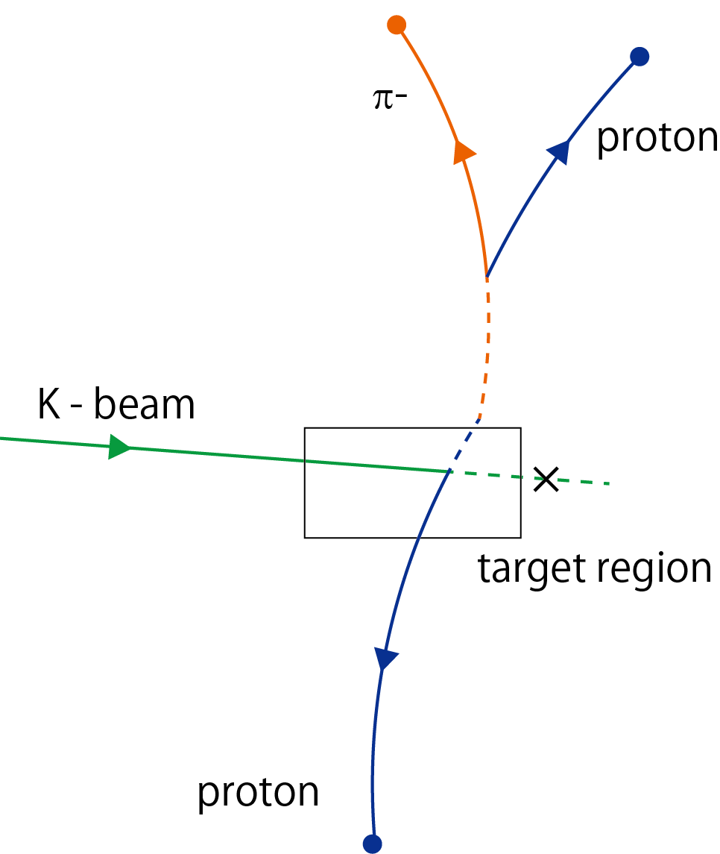
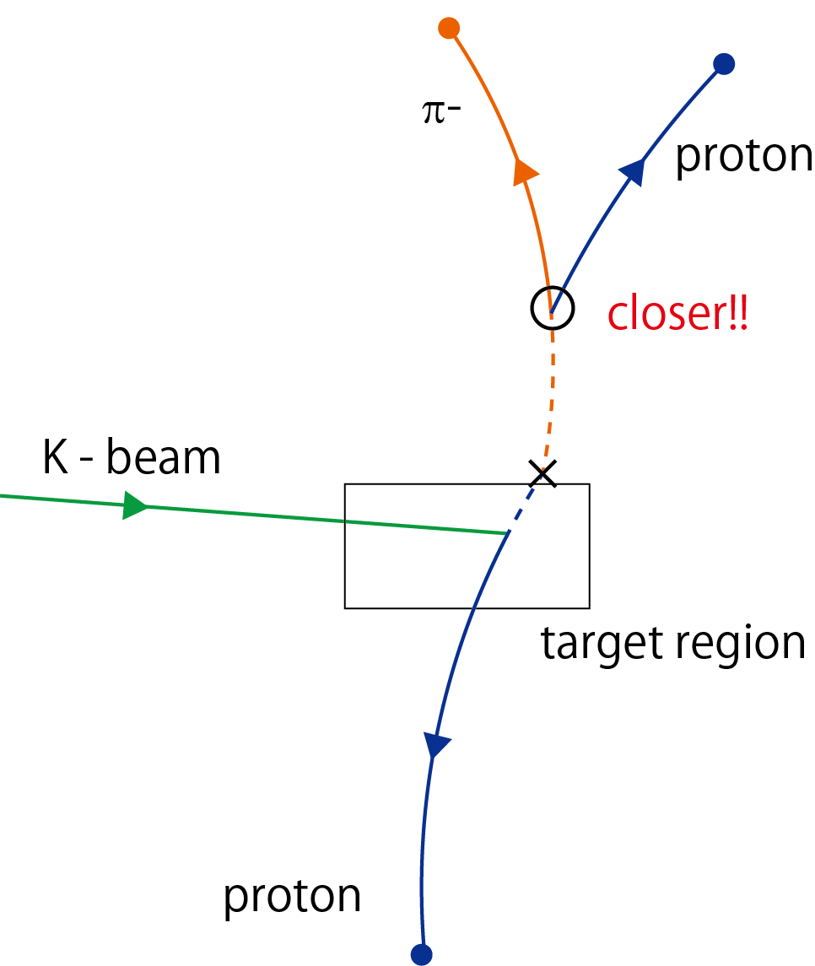
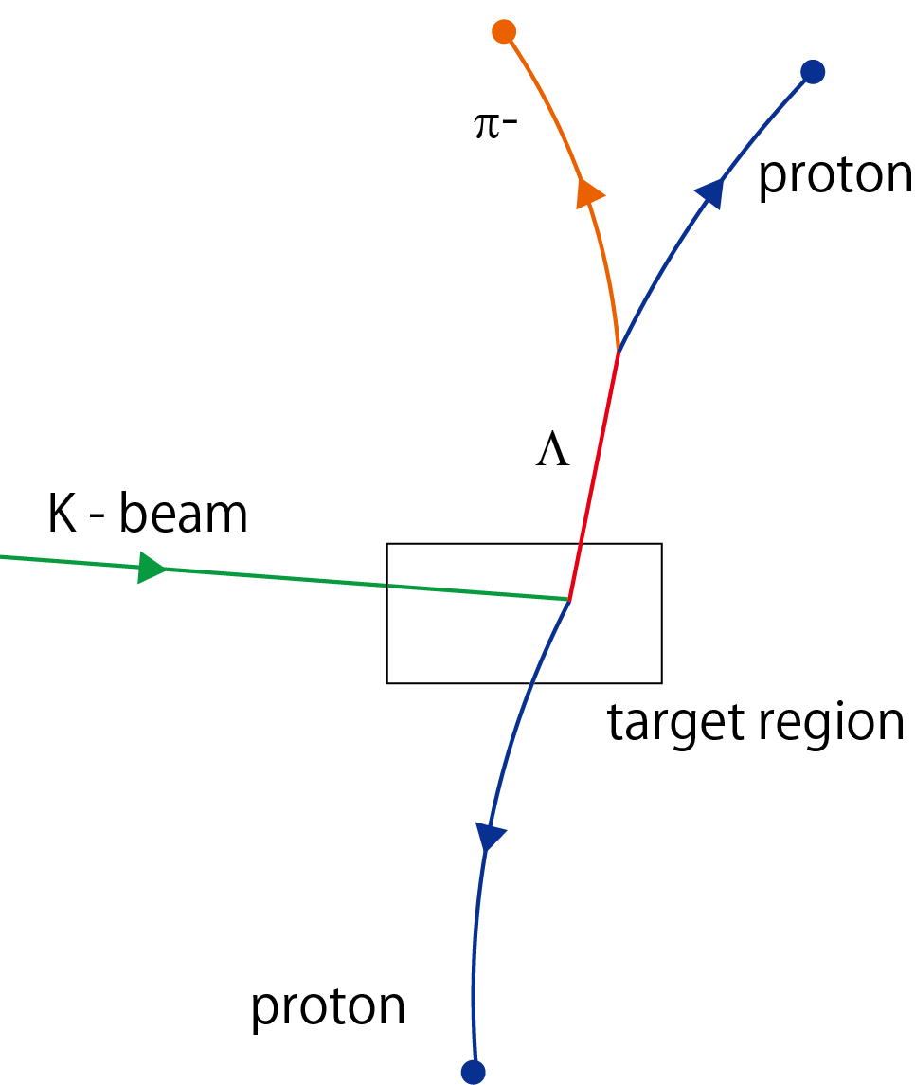
Λp event selection
Tagged ppπ- @CDS
There is no forward charged particle
If pπ’s distance of closest approach (DCA) is closer than another one,we selected the pπ- pair as Λ
Each vertex is decided clearly
=>All DCA<1cm (DCA(Λp)<2cm)

Slide 7
Energy loss correction
material | material | g/cm³ | mm |  | g/cm²
Target | 3He | 0.080 | 34 |  | 0.272
Target cell | Be | 1.848 | 0.3 |  | 0.05544
Heat Shield | Al | 2.7 | 0.3 |  | 0.081
Target CFRP | CFRP | 1.7 | 1 |  | 0.17
Air | air | 0.001205 | 70 |  | 0.008435
IH | Plastic scinti | 1.03 | 3 |  | 0.309
CDC CFRP | CFRP | 1.7 | 1 |  | 0.17
CDC gas | Ar-CH2 (50-50%) | 0.0015 | 190 |  | 0.0285
(CDC wire) | W/Al | Not considered |  |  | (0.0076)
sum |  |  |  |  | 1.1019
Energy correction in CDS
Materials in CDS sum~1.1g/cm2
Calc Bethe-Bloch formula(0.3mm step)

Slide 8
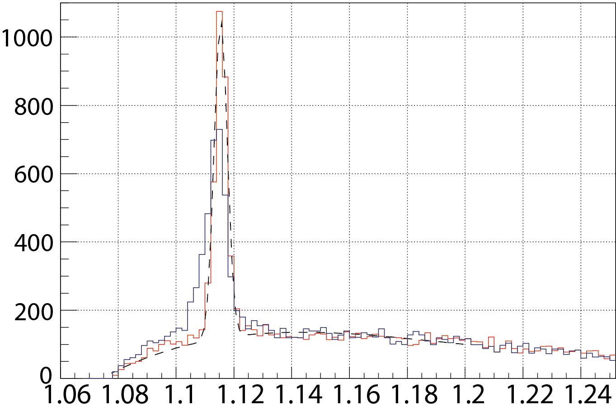
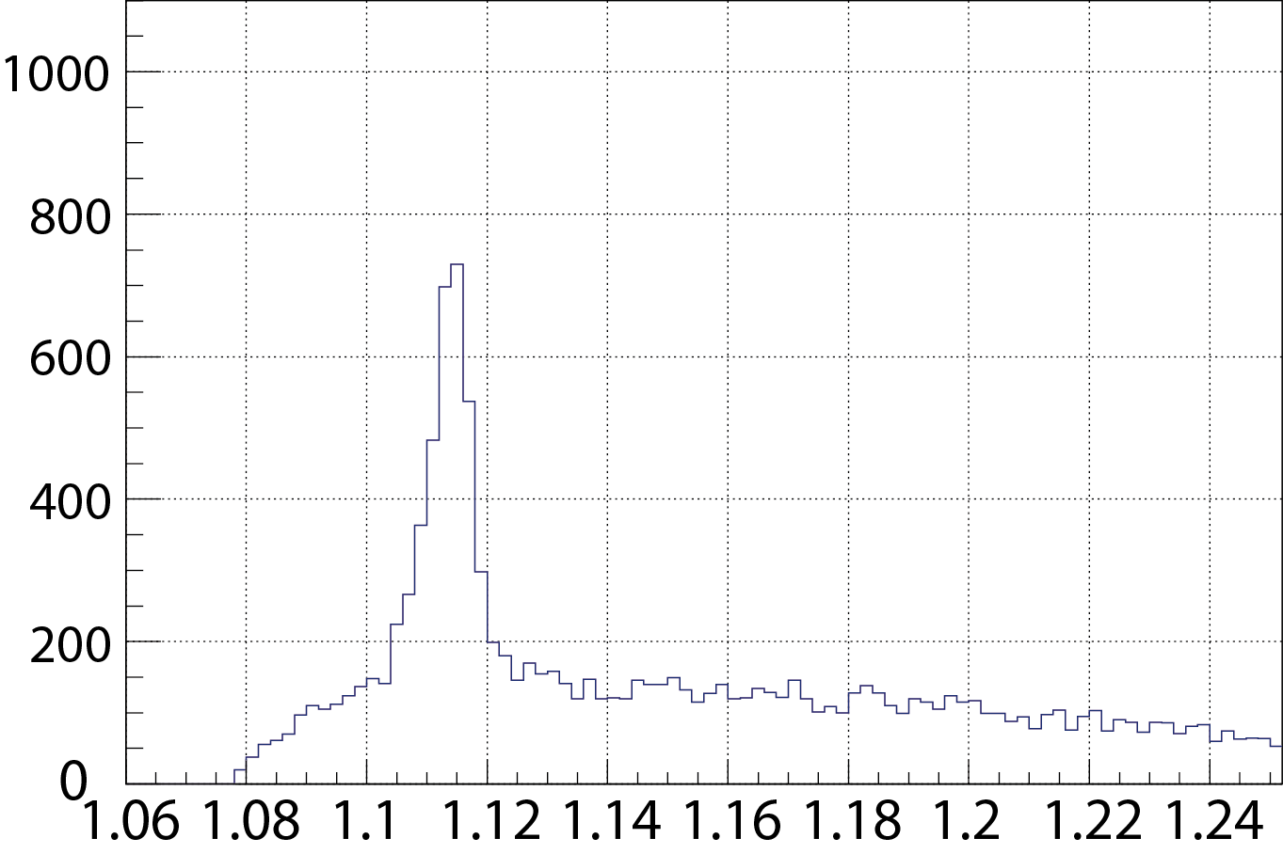
Invariant Mass pπ- @ppπ- events
Corrected Λ peak center =1115.0(±0.1)MeV/c²
=>(pdg value 1115.7MeV/c²)
S/N ratio ~65%
I.M of pπ− [GeV/c2]

Slide 9
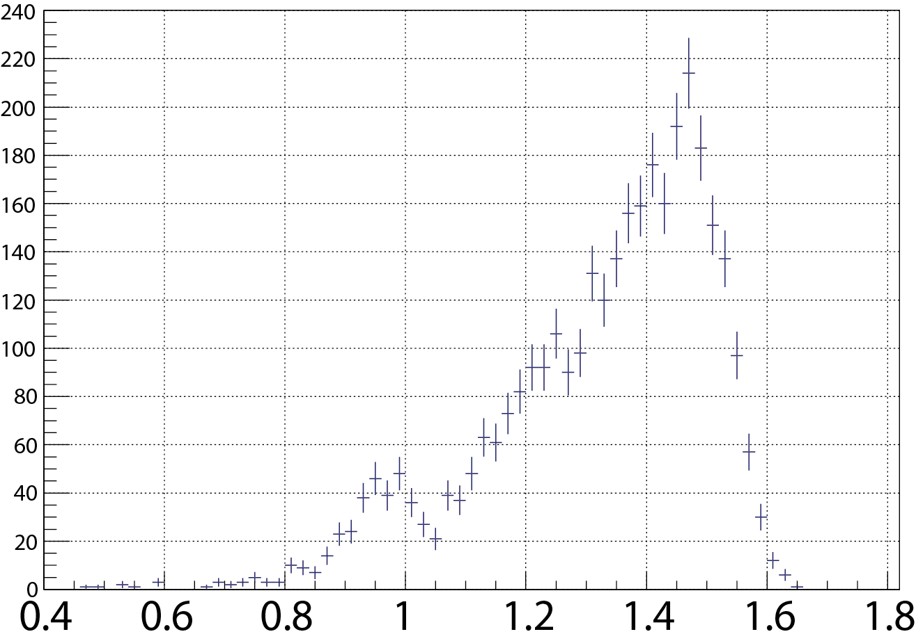
Missing mass of ³He(K⁻,Λp)X
missing n+(2)π?
Δ Ν∗?
Missing neutron events!
~400 events in 3300 events
(including γ from Σ decay Σ-> γΛ )
Preliminary
M.M of 3He(K-,Λp)X [GeV/c2]

Slide 10
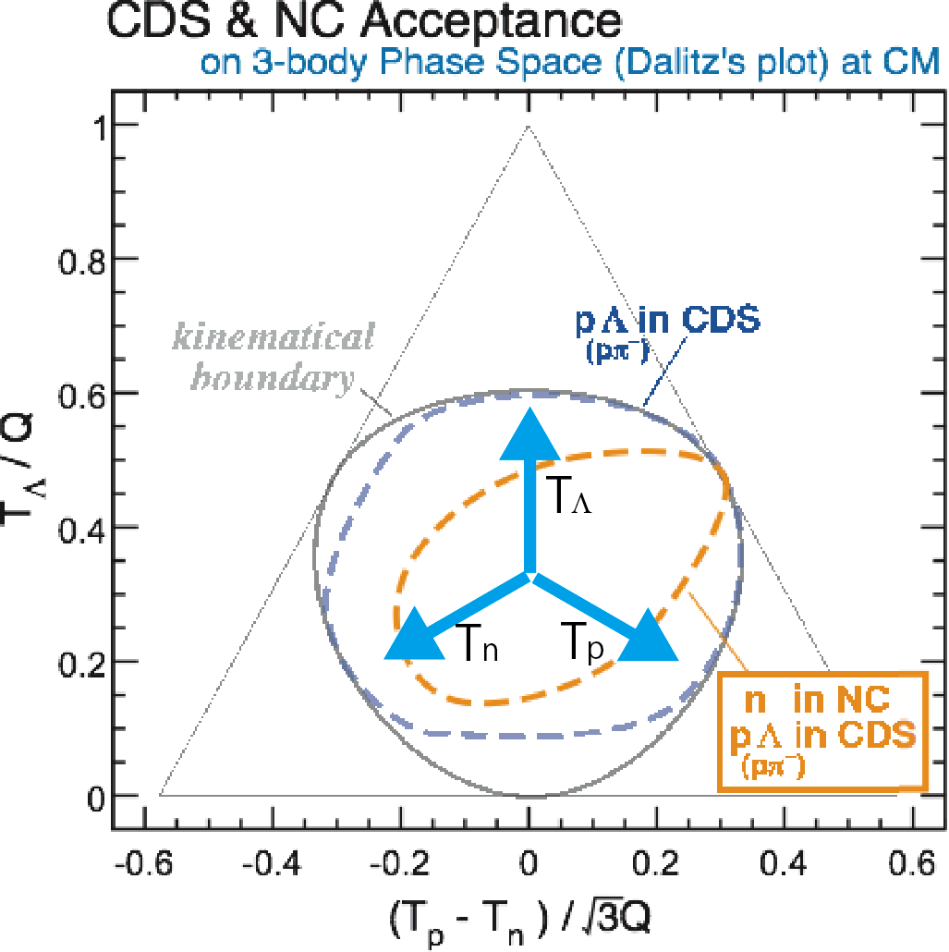
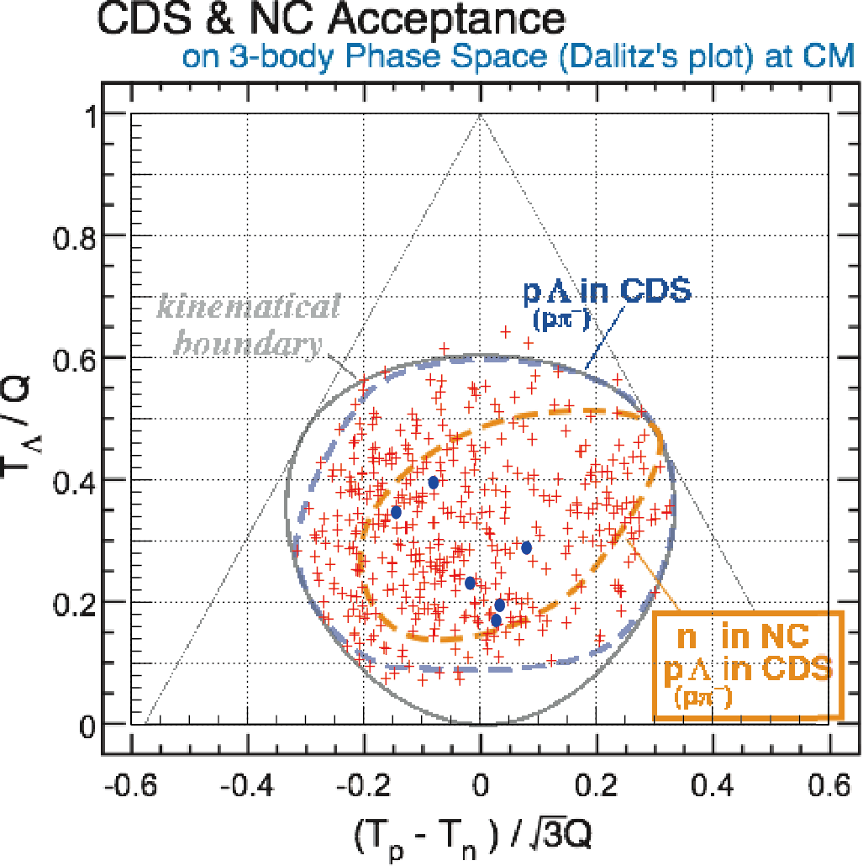
Dalitz’s plot of Λp (missing)n events
n tagged with NC
+ all
Kinetic energies of Λpn 3-bodys are plotted in phase space @CM
CDS/NC Acceptance region is calculated by MC Simulation
Plot of Λp(missing )n events are in acceptance.
=>can we use 2N/3N absorption study etc?
Λp n(tagged NC) events are very few.
=>Need more (~10 times) statistics?
Very Preliminary!!

Slide 11
Summary
Analysis for ³He(K⁻,Λpn) reaction
We have successfully accumulated Λp events in CDS
Missing neutron peak is clearly seen!
missing neutron events are ~400 events in 3300 events of Λp events
Λp n(NC detected) events are very few
3N/ 2N absorption reaction can be studied?
from these events
=>future analysis is under way

Slide 13
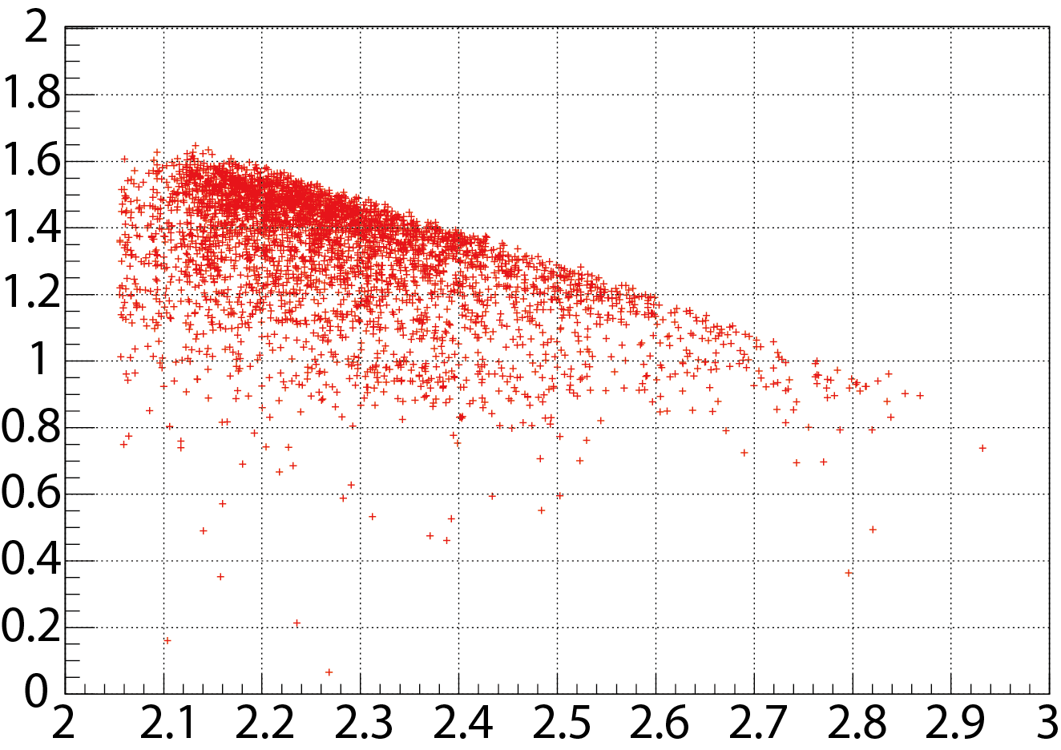
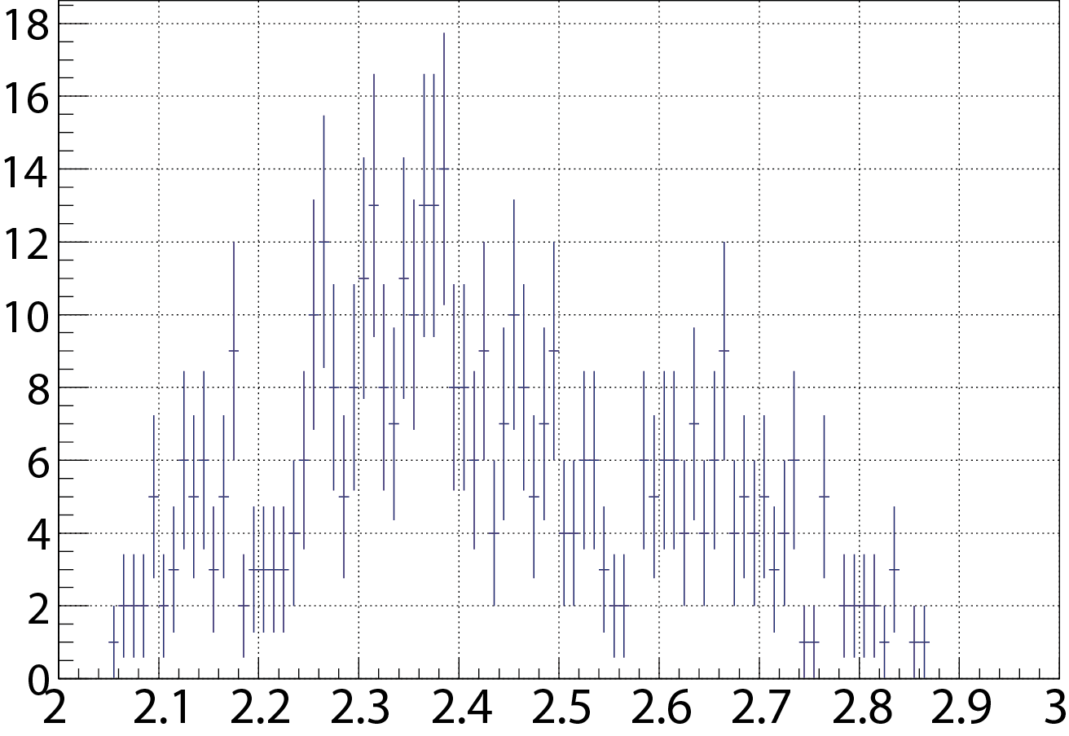
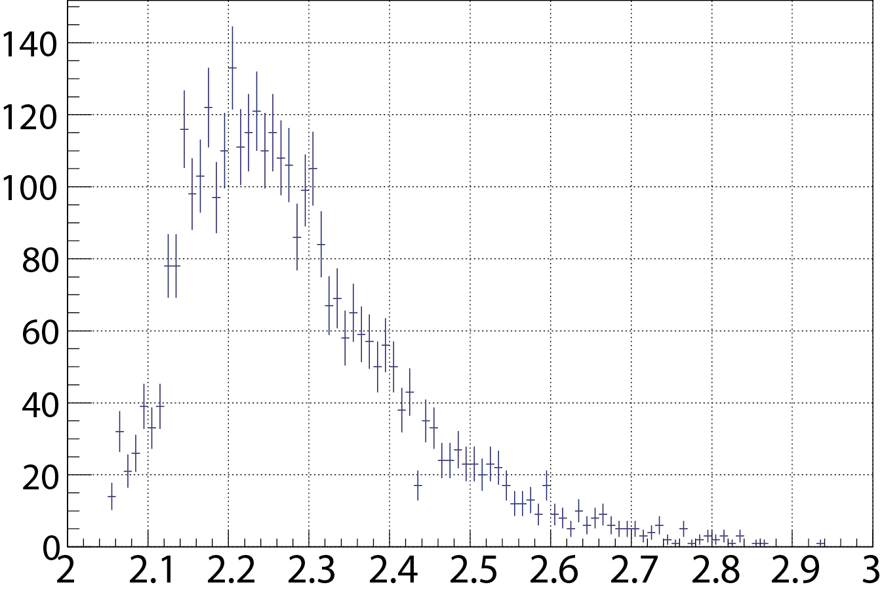
Λp invariant mass (selected missing neutrons)
Preliminary
3N absorption?
2N absorption?(n is spectator)
We can Not say these events are Kpp!!
M.M of 3He(K-,Λp)X[GeV/c2]
Projection X
I.M of Λp[GeV/c2]
Very Preliminary
Selected missing n events in Λp tagged
I.M of Λp[GeV/c2]

Slide 14
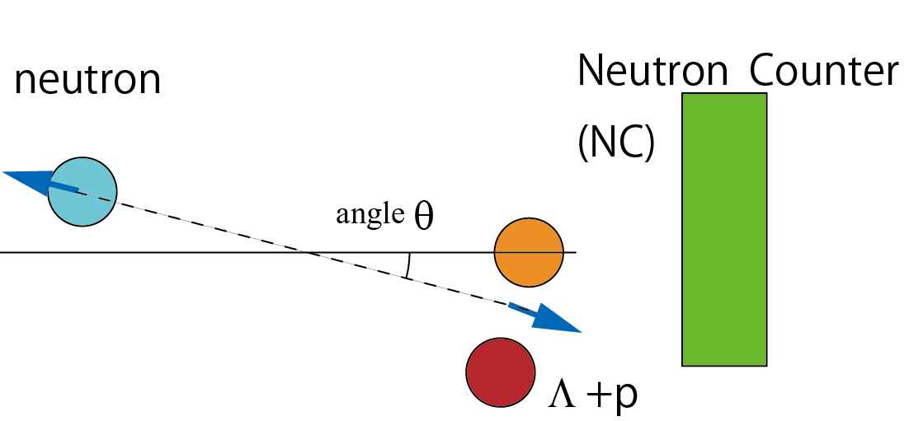
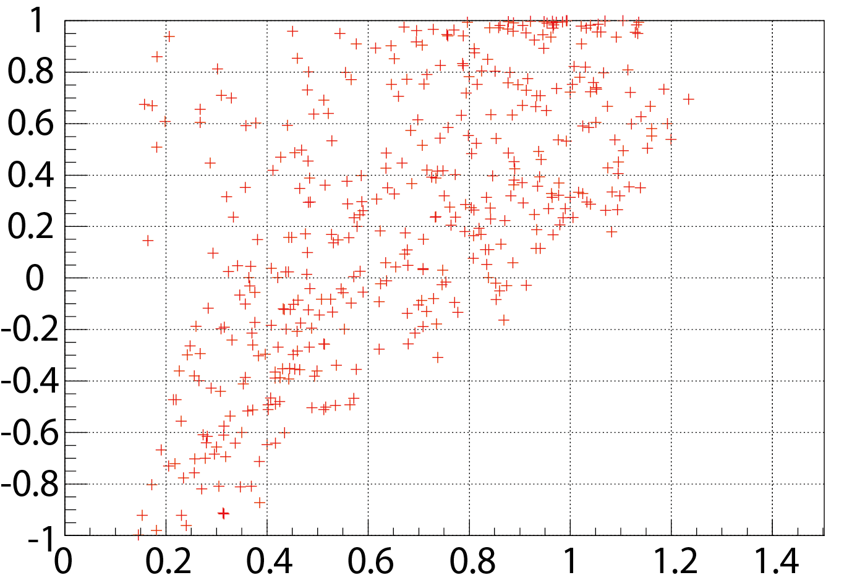
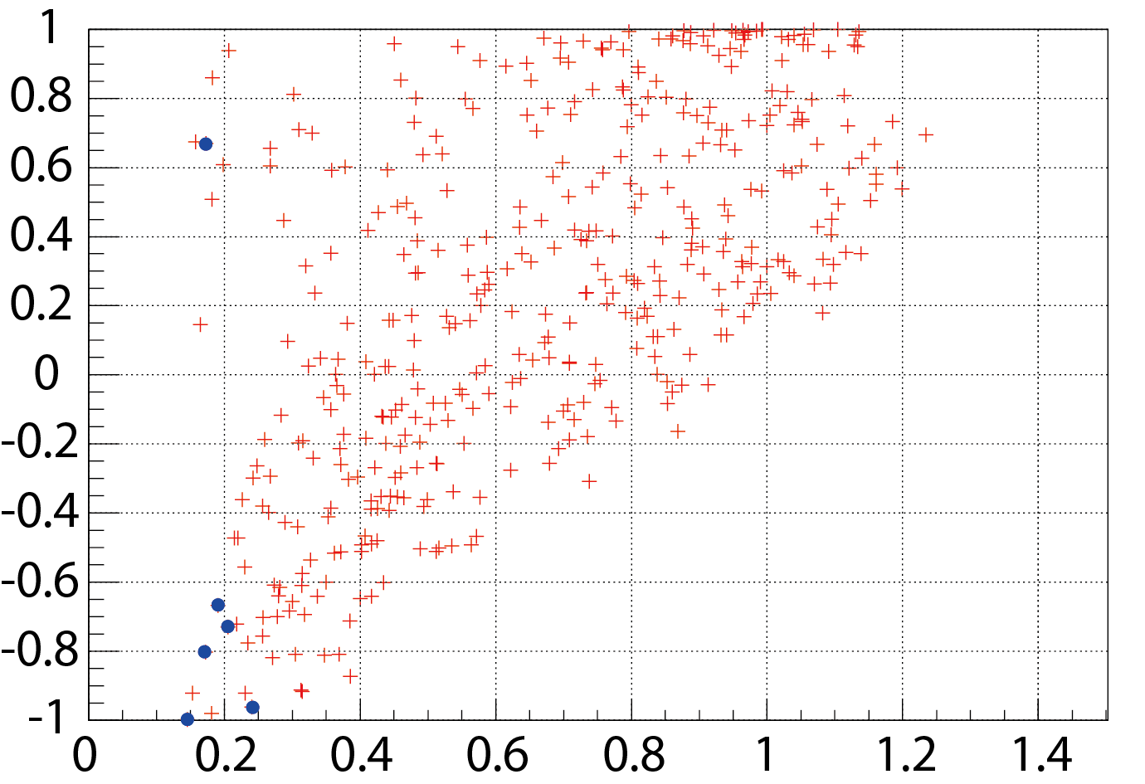
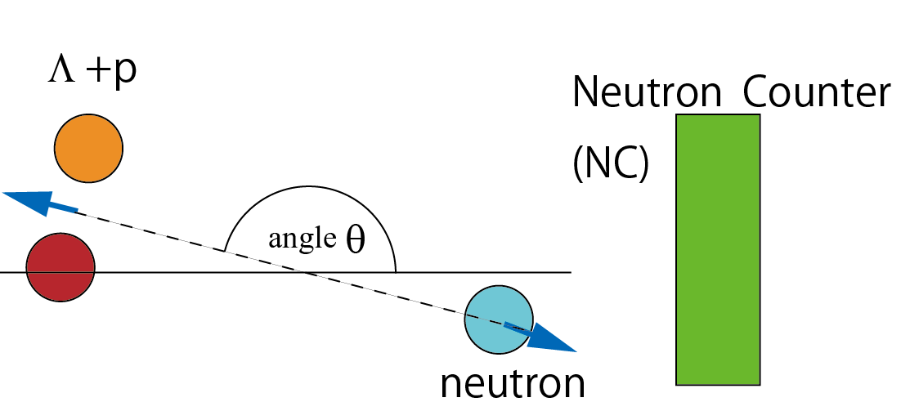
Momentum(Λ+p) vs cosθlab(beam dir.) @Λp n missing events
Neutron tagged with NC
+ all
Cos θ Lab(beam dir )
backward
Neutron in NC is very few events
NC acceptance X±6.2°Y±2.9°
Missing
neutron
Forward
Momentum of Λ+p [GeV/c]

Slide 15
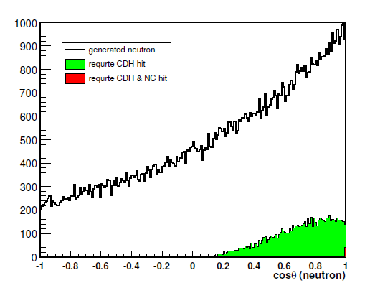

Slide 16
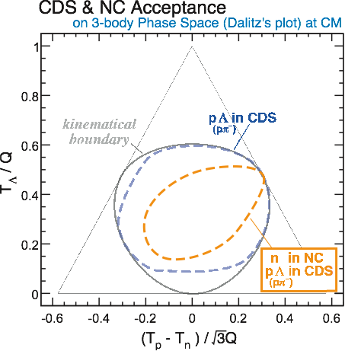
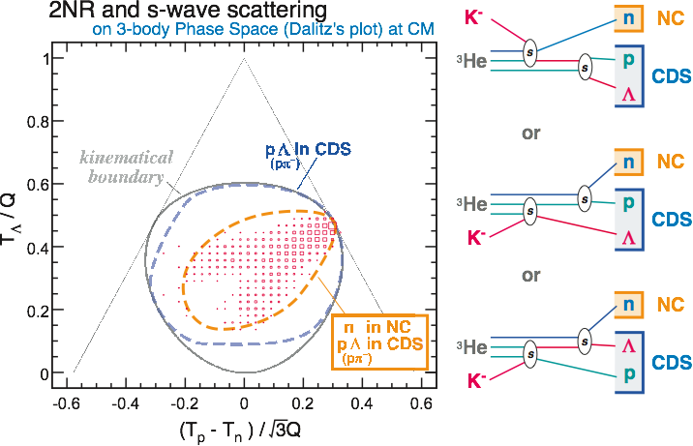
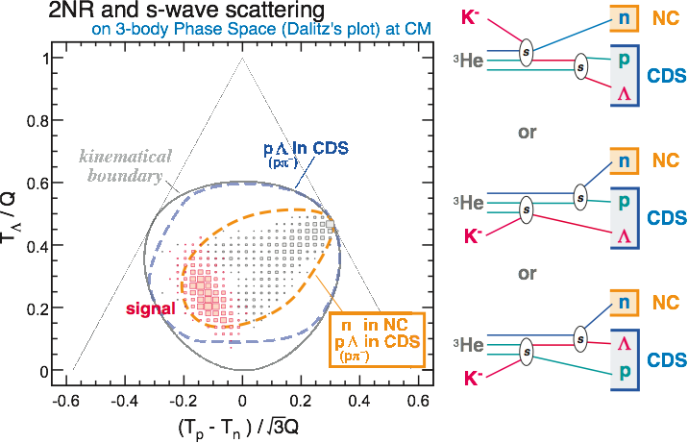
Dalitz plot (Final state Λpn)
2NA and s-wave scattering
2NA and s-wave scattering
We can separate Kpp signal to 2NA
@ E15 exp.
We will be able to observe interesting data of Λpn state!? (2NA or Kpp etc.)
TΛ
Tp
Tn
T.Hiraiwa 2010/12/2-4 Strangeness workshop 2010

Slide 17
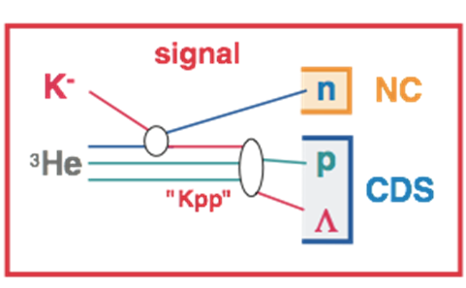
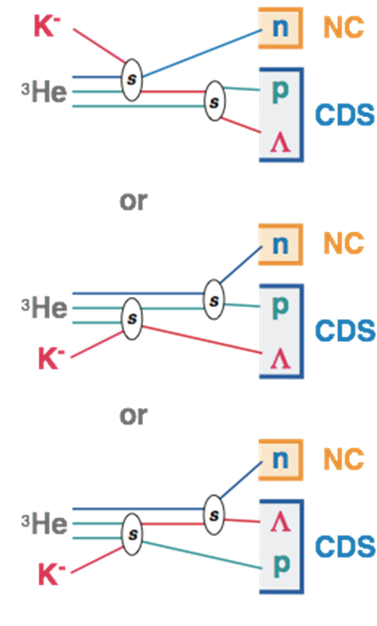
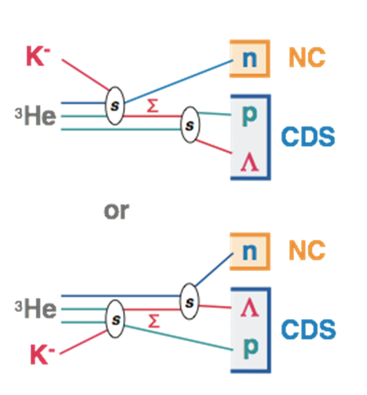
Background study (two nuclear absorption)
2NA + ΛN rescattering / ΣΛ conversion looks like a “signal” ??
(2NA itself is not a problem.)
2NA+ΛN rescattering
2NA+ΣΛ conversion

Slide 18
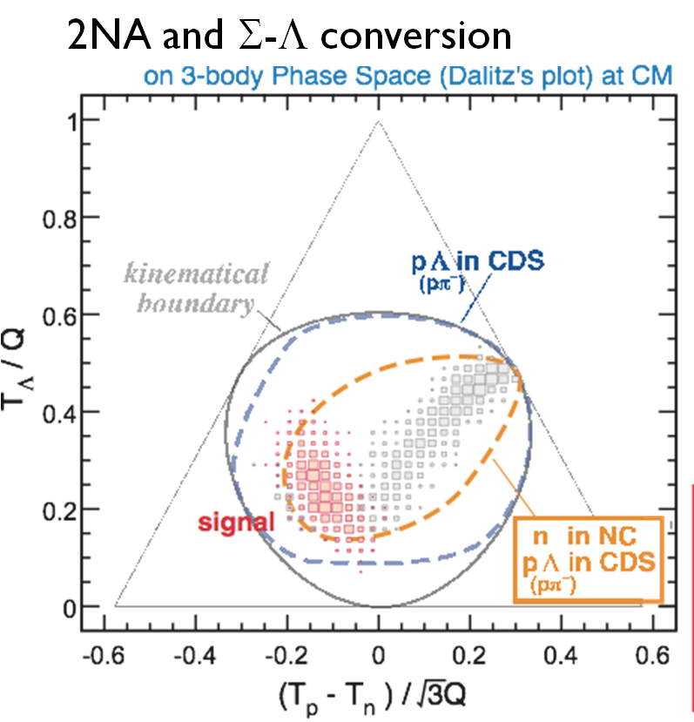
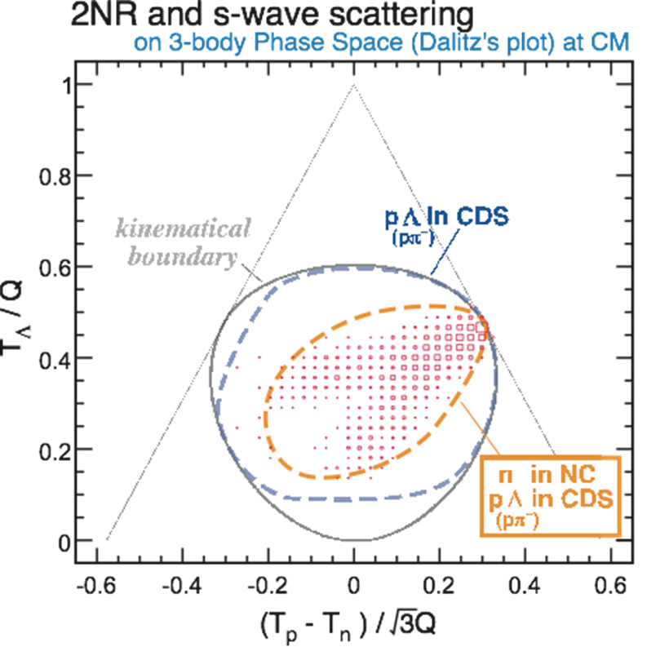
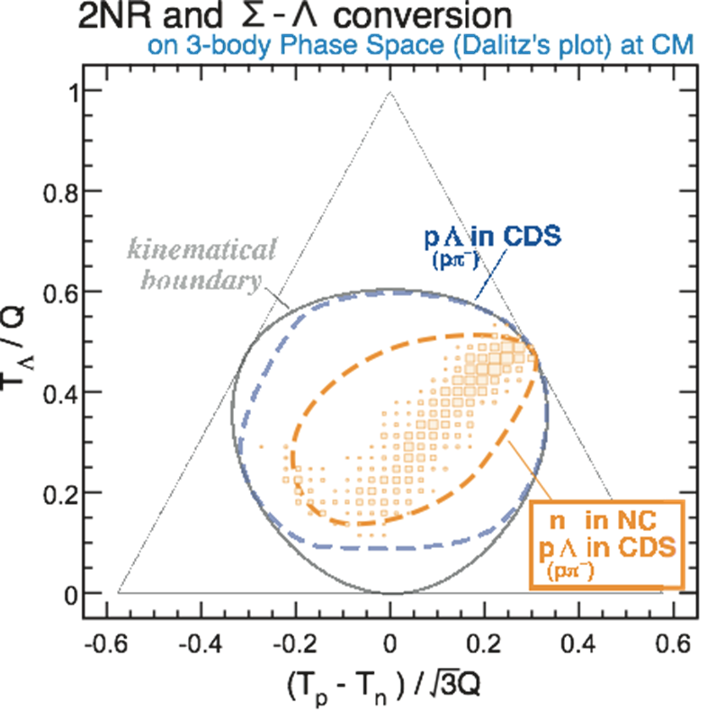
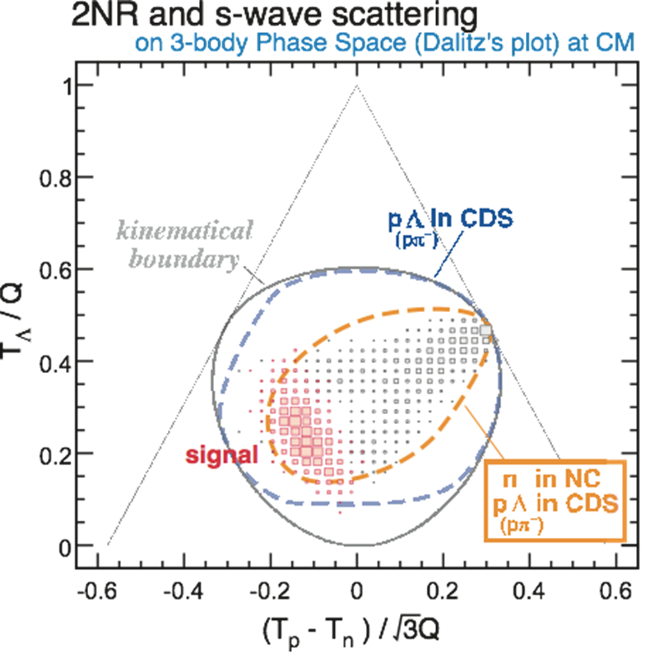
Background study 2(Dalitz’s plot)
Signal can be distinguished between background !!

Slide 19
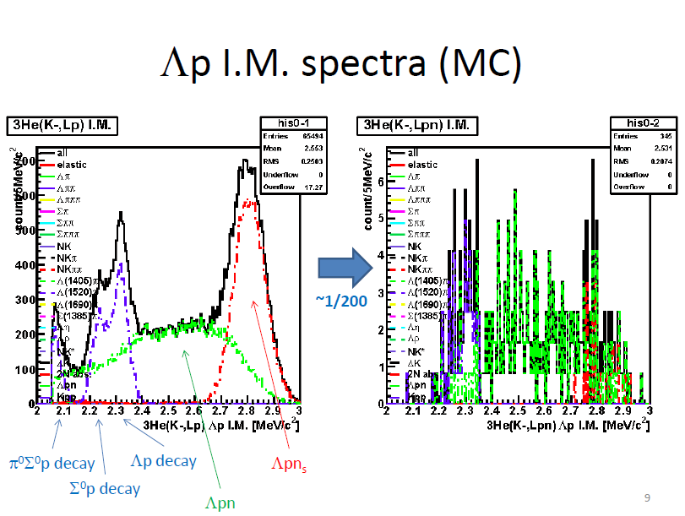

Slide 20
