Slide 1
J-PARC E15 実験における K中間子原子核探索の 最近の進展
F. Sakuma, RIKEN
for the J-PARC E15 collaboration
Results of the E15 1st physics run
Future prospects of E15
Summary
「ストレンジネスを含む原子核の最近の展開」研究会 熱川ハイツ 2014 9/25-27

Slide 2
Experimental Principle of E15
A search for the simplest kaonic nucleus, K⁻pp, using ³He(in-flight K⁻,n) reaction
two-nucleon absorption
hyperon decays
CAN be discriminated kinematically

Slide 3
E15 1st Stage Physics Run
Production run of half the request (~15/30kW*week) was successfully accomplished.
~1% of the approved proposal (270kW*4weeks)
All detector systems worked well as designed.
 | Primary-beam intensity | Secondary-kaon intensity | Duration | Kaons on target (w/ tgt selection)
March, 2013 (Run#47) | 14.5 kW (18 Tppp, 6s) | 80 k/spill | 30 h | 1.1 x 10⁹
May, 2013 (Run#49c) | 24 kW (30 Tppp, 6s) | 140 k/spill | 88 h | 5.3 x 10⁹
* production target: Au 50% loss, spill length: 2s, spill duty factor: ~45%, K/pi ratio: ~1/2
* ~70% of beam kaons hit the fiducial volume of ³He target

Slide 4
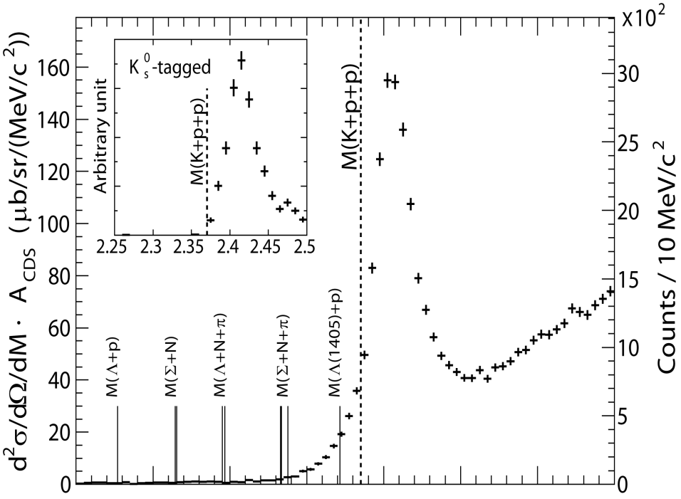
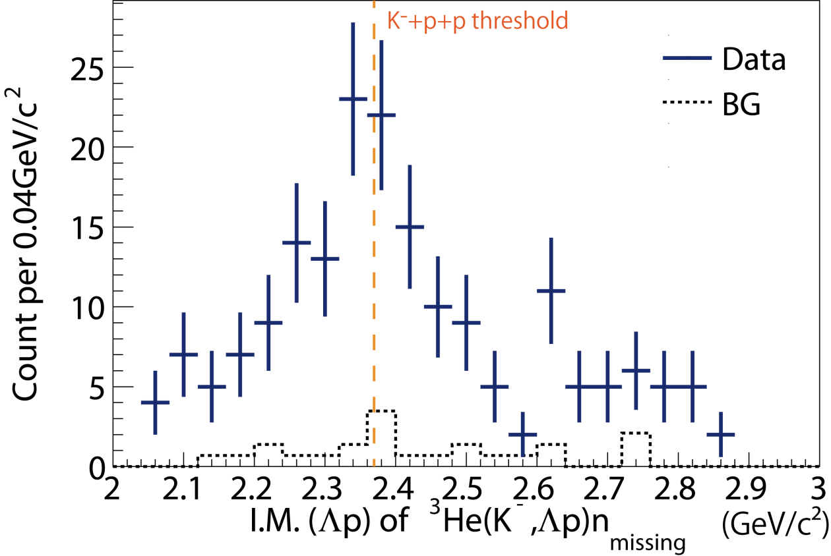
Summary of E15 1st
FINUDA/DISTO
³He(K⁻,n)X M.M.
Formation Channel
Semi-Inclusive ³He(K⁻,n)X
No significant bump structure in the deeply bound region
Excess below the threshold attributed to 2NA of Λ*n?
BG included
Λp I.M.
of ³He(K⁻,Λp)n
Decay Channel
Exclusive ³He(K⁻,Λp)n
Excess around the threshold
Cannot be from 2NA of Λ*n (final state = Λpn)
preliminary

Slide 5
Formation Channel, Semi-Inclusive ³He(K⁻,n)X
T.Hashimoto et al., arXiv:1408.5637, submitted to PLB

Slide 6
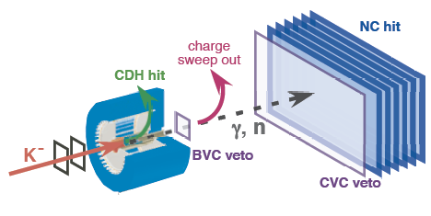
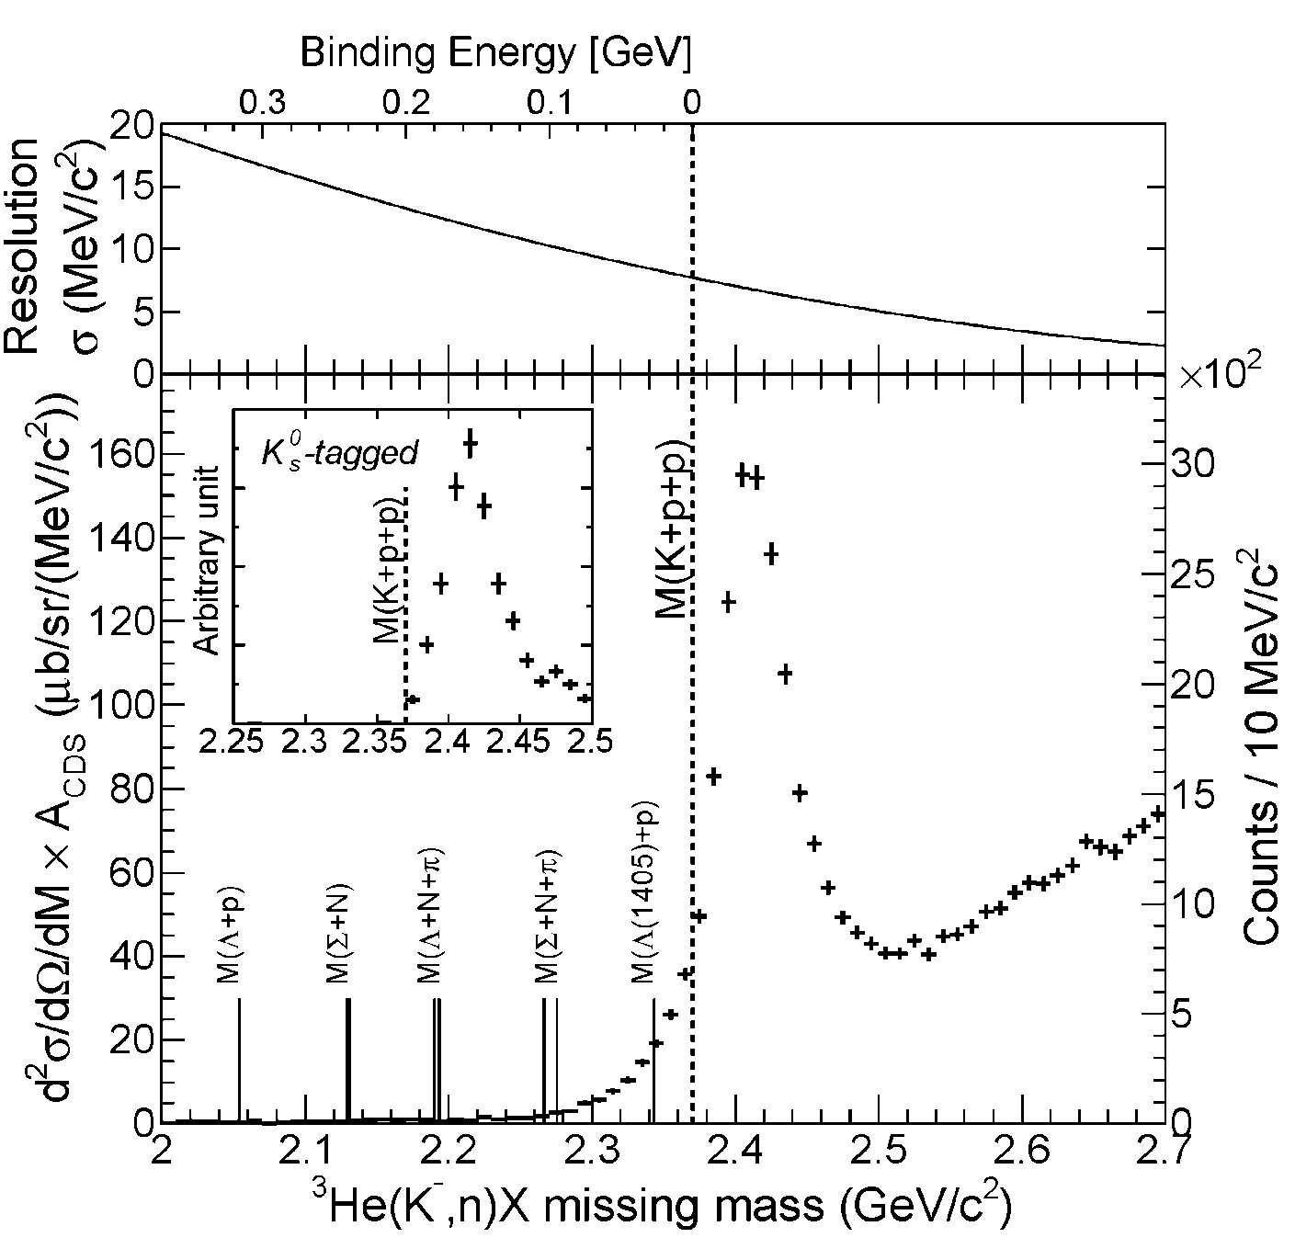
Semi-Inclusive Spectrum
Quasi Elastic
K⁻ + ³He → K⁻ + n + p_{s} + p_{s}
dσ/dΩ_{θ=0deg} ~ 6mb/sr
and
Charge-Exchange
K⁻ + ³He → K⁰ + n + d_{s}
K⁰ → π⁺ + π⁻
dσ/dΩ_{θ=0deg} ~ 11mb/sr
The tail structure is not due to “the detector resolution”

Slide 7
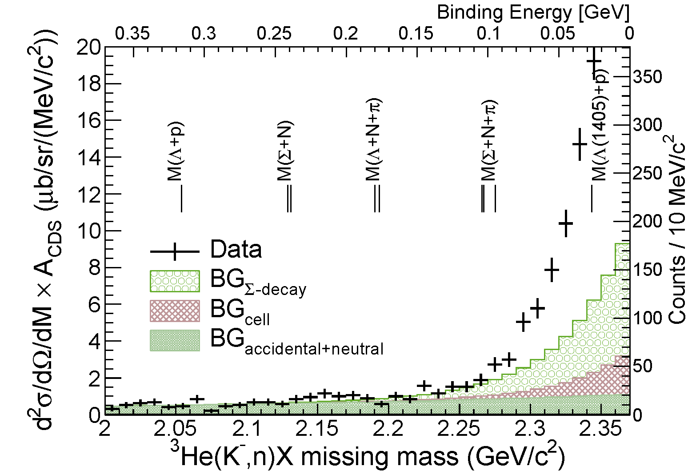
Spectrum below the Threshold
FINUDA/
DISTO
No significant bump-structure in the deep-binding region
Statistically significant excess just below the threshold

Slide 8
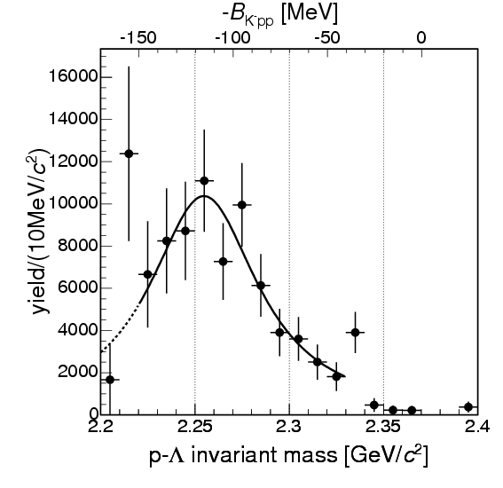
Comparison between E15 and Other Results
M(K+p+p)
FINUDA@DAΦNE
PRL94(2005)212303
A(stopped K⁻, Λp)
DISTO@SATURNE
PRL104(2010)132502
p + p → (Λ + p) + K⁺ @ 2.85GeV

Slide 9
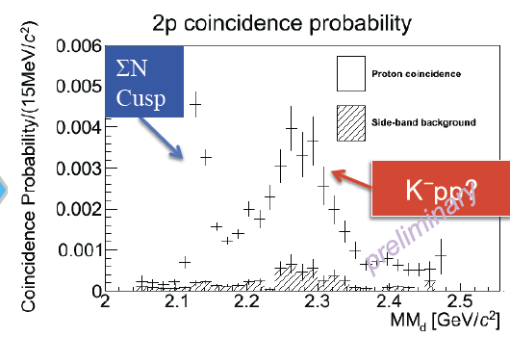
Comparison between E15 and Other Results
M(K+p+p)
E27@J-PARC
EXA2014 conference
d(π⁺, K⁺) @ 1.7GeV/c
Bump structure reported from other experiments was NOT seen in E15
Excess near the threshold can be seen only in E15

Slide 10
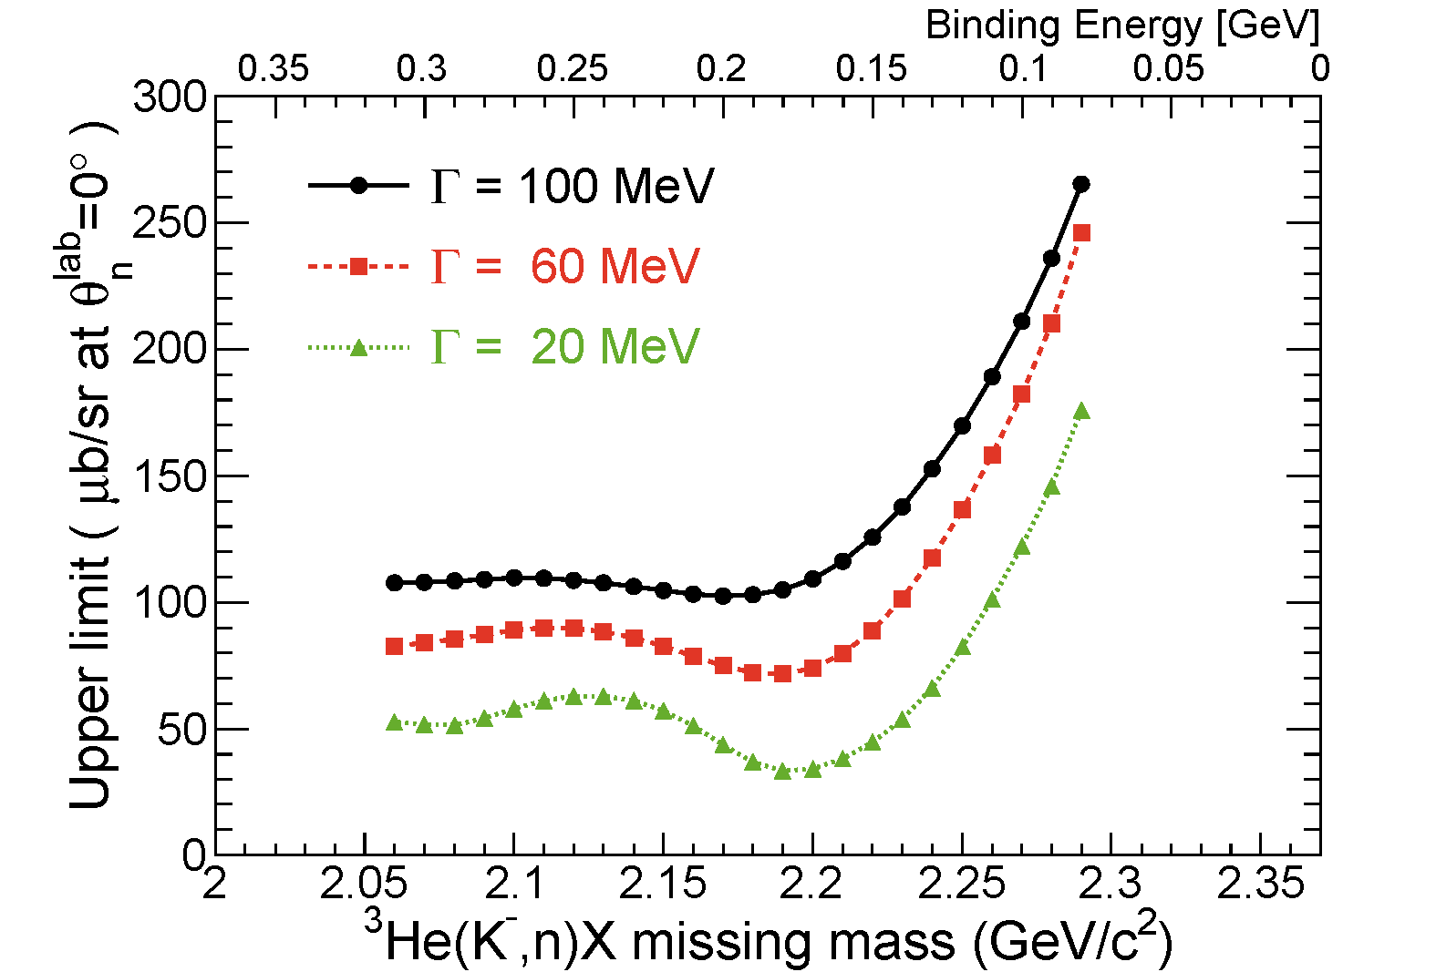
U.L. of the deeply-Bound K⁻pp
95% C.L.
Assumptions
K⁻pp → Λp decay mode (isotropic decay)
K⁻pp shape
= Breit-Wigner
0.5 - 5% cross section of quasi-free K scattering

Slide 11
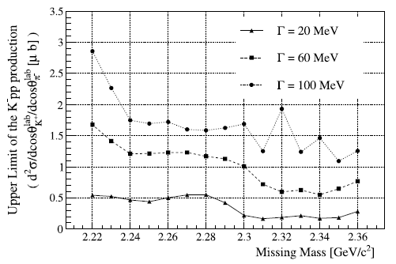
U.L. of the deeply-Bound K⁻pp
E15(K⁻+³He):
(UL) 0.5-5% of QF
FINUDA(stopped K⁻):
~0.1% of stopped K⁻
DISTO(p+p):
larger than Λ* @ 2.85GeV
LEPS(γ+d)
(UL) 1.5-26% of γN→K⁺π⁻Y
LEPS@SPring-8
Need further more statistics to compare the stopped K⁻ experiment
PLB728(2014)616
γ + d → K⁺ + π⁻ + X
@ 1.5-2.4GeV

Slide 12
Spectrum below the Threshold
?
No significant bump-structure in the deep-binding region
Statistically significant excess just below the threshold

Slide 13
Excess = Elementary Processes?
DATA
(including BG)
The tail structure is NOT reproduced by well known processes
would be attributed to the imaginary part of the attractive K^{bar}N
→ Multi-NA? K⁻pp?
BG included
SIM
Detector acceptance and all known K⁻N interactions are considered:
Cross-section [CERN-HERA-83-02]
Fermi-motion
Angular distribution
Simple assumptions:
σ_{tot} = 2*σ_{K-p} + σ_{K-n} (~150mb)

Slide 14
Excess = πΣN, πΣNN, etc?
BG from Σ-decay is subtracted in the spectra
Each process is simulated with unreasonably large CS of 100mb
➔ contributions in the binding region are negligible

Slide 15
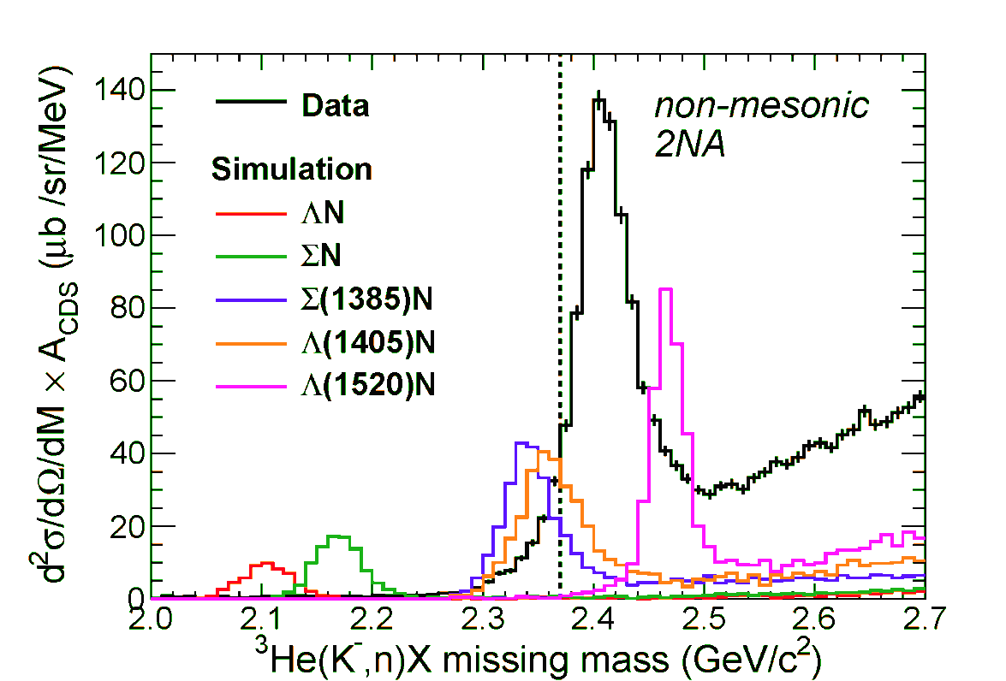
Excess = Λ*N, etc?
BW shape with
PDG values
ΛN/ΣN branches are negligibly small
Λ(1405)n branches seems to reproduce the excess
Λ(1405) shape is “simple BW with PDG values”
need rather large CS of ~5mb/sr
Exclusive measurement of πΣN is needed for further study

Slide 16
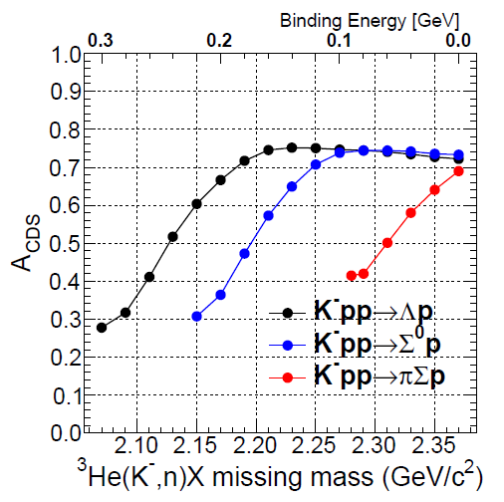
Excess = Loosely-Bound K⁻pp?
K-pp?
CDS tagging eff.
The excess is assumed to be fully attributed to the bound K⁻pp state
dσ/dΩ(θ_{lab}=0º) of the excess is ~ 1 mb/sr

Slide 17
Excess = Loosely-Bound K⁻pp?
DATA
(including BG)
Detector acceptance and all known K⁻N interactions are considered:
Cross-section [CERN-HERA-83-02]
Fermi-motion
Angular distribution
Simple assumptions:
σ_{tot} = 2*σ_{K-p} + σ_{K-n} (~150mb)
bound
SIM
Simple assumptions:
2N abs.: K⁻ ³He → Λ n p_{s}
σ/dΩ=1mb/sr, isotropic
K⁻pp prod.: K⁻ ³He → (K⁻pp)n
dσ/dΩ=1mb/sr, isotropic
K⁻pp →Λp(25%), Σ⁰p(25%), πΣp(50%)
K-pp
B.E = 50MeV
Γ = 50MeV
2N abs

Slide 18
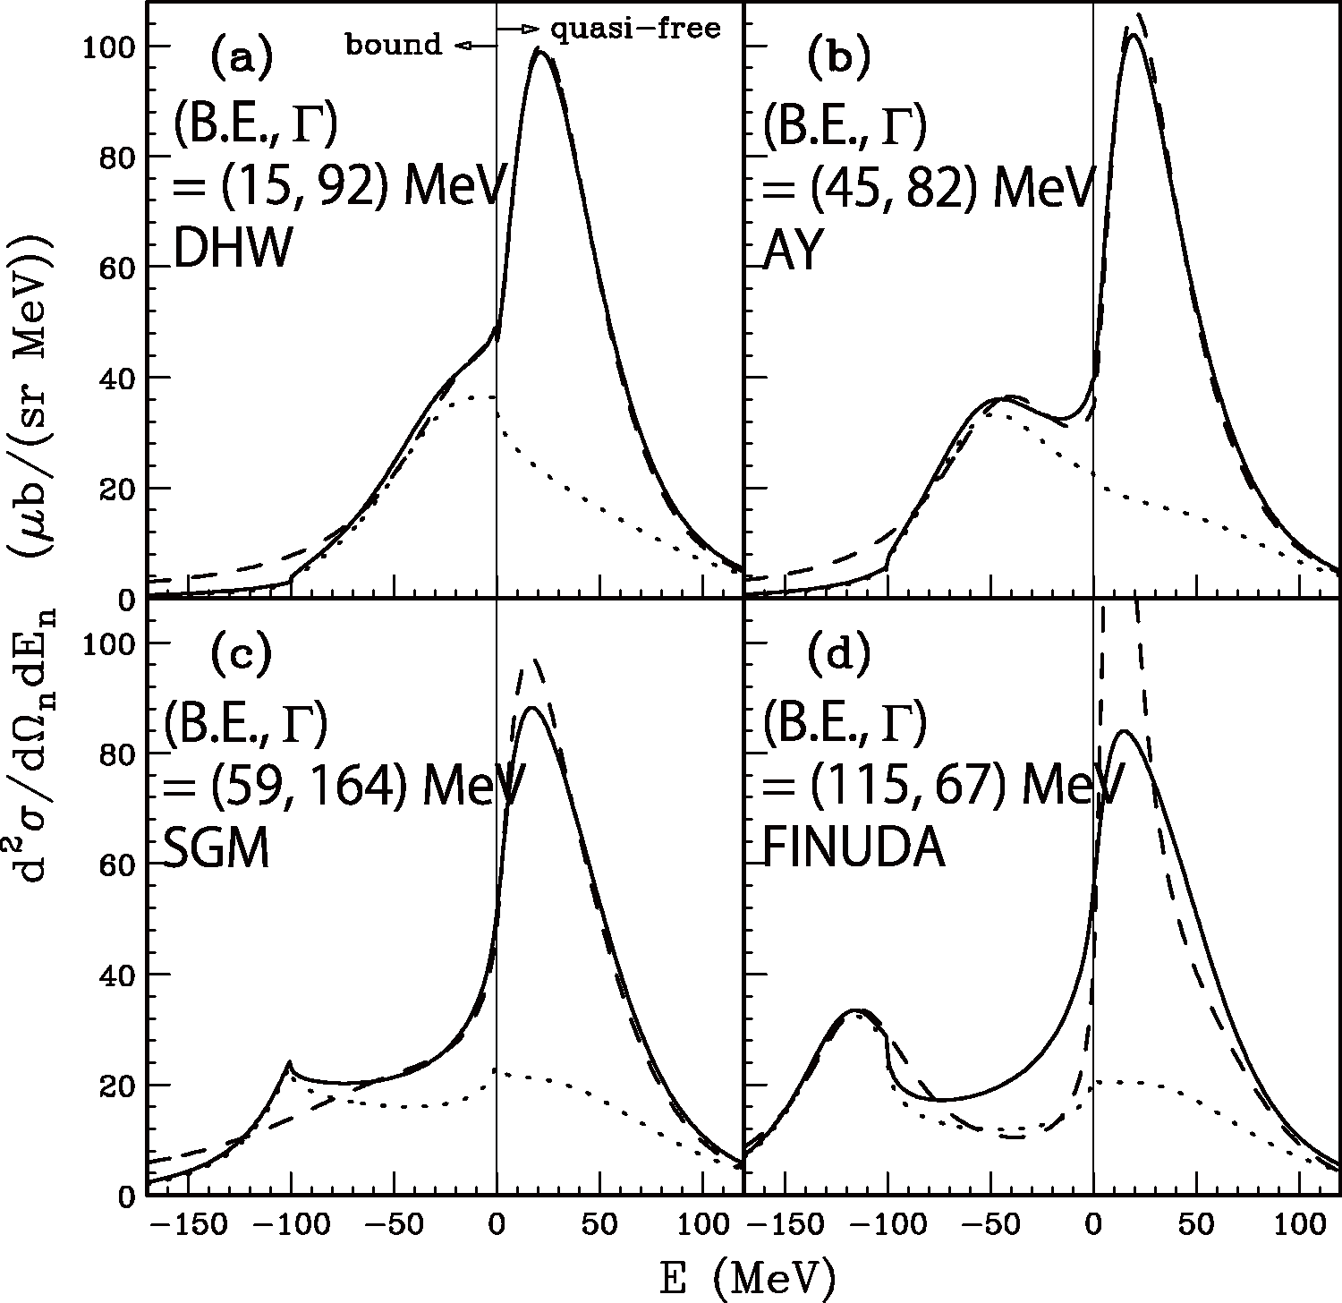
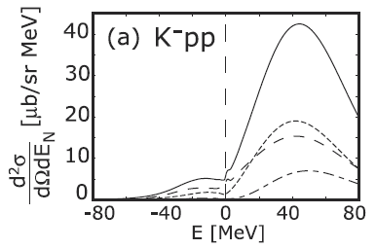
Comparison between E15 and Calc.
~ 1 mb/sr,
if excess is assumed to be K⁻pp
Koite, Harada,
PRC80(2009)055208
integrated CS:
0.1 mb/sr order
integrated CS:
mb/sr order
Yamagata-Sekihara, et al.,
PRC80(2009)045204
CS is almost consistent with KH
Loosely-bound K-pp state ???
πΣN measurement
is an important key

Slide 19
Decay Channel, Exclusive ³He(K⁻,Λp)n

Slide 20
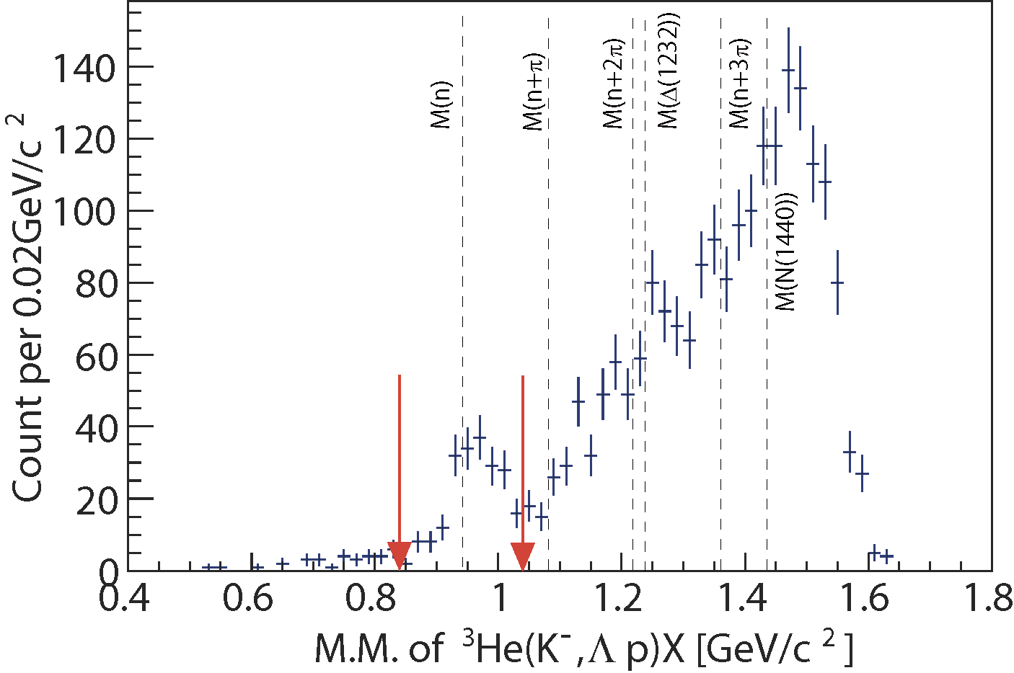
Exclusive ³He(K⁻,Λp)n events
preliminary
CDS
p
missing n
n
Λ
π⁻
p
1GeV/c
K⁻ beam
K⁻³He→Λ(Σ⁰)pn events can be identified exclusively
# of Λ(Σ⁰)pn events: ~190
Σ⁰pn contamination: ~20%

Slide 21
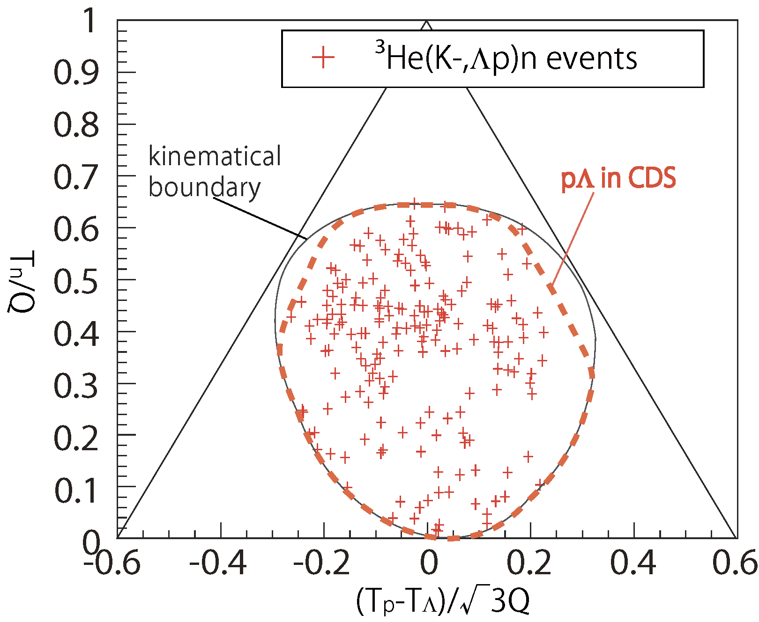
Dalitz plot
3NA:
e.g. K⁻³He→Λpn
preliminary
Events are scattered
widely in the phase-space of
K⁻+³He->Λ+p+n

Slide 22
Dalitz plot
2NA:
e.g. K⁻³He→Λpn_{s}
preliminary
2NA+2step:
e.g. K⁻³He→Σ⁰pn_{s},
Σ⁰n_{s}→Λn
2NA+2step:
e.g. K⁻³He→Λpn_{s},
pn_{s}→pn
2NA+2step:
e.g. K⁻³He→Σ⁰np_{s},
Σ⁰p_{s}→Λp
K⁻pp form.:
K⁻³He→(K⁻pp)n,
K⁻pp→Λp

Slide 23
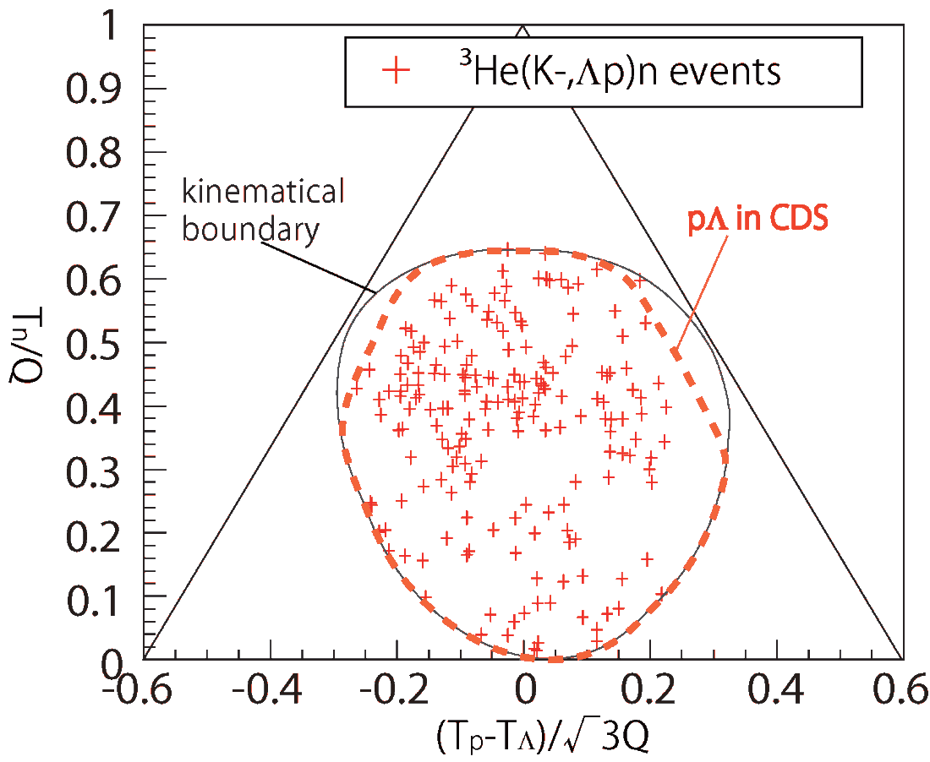
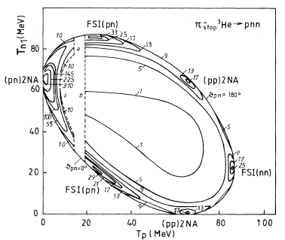
K-induced vs π-induced
[1] D. Gotta, etal., Phys. Rev. C 51. 2 (1995)
[2] P. Weber etal., Nucl. Phys A501 (1989) 765-800
[3] G. Backenstoss etal., Phys. Rev. Lett 55. 25(1985)
π⁻ stopped [1]
2nucleon absorption &FSI (50%/π _{stopped}) are clearly seen
3nucleon absorption <3% /π _{stopped}
π⁻ in-flight [2],[3]
2nucleon absorption 0.85 ± 0.17mb (266 MeV/c)
3nucleon absorption 3.7 ± 0.6 mb(220 MeV/c)
2NA/3NA ~25%
in-flight K
preliminary
stopped π
simple 2NA reactions
are negligibly small ?!

Slide 24
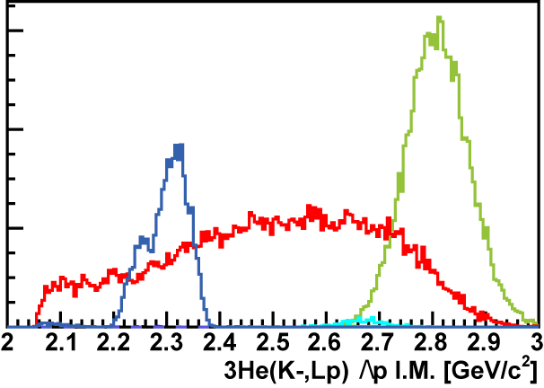
Λp Invariant Mass
preliminary
Excess around the threshold?
3NA phase-space?
2NA contribution?
FS = Λ (Σ⁰ ) pn
→ cannot be from
2NA of Λ*n
SIM
Further study is ongoing, such as contribution from 2NA+2step.
K-pp
B.E = 50MeV
Γ = 50MeV
2NA
3NA
Σ⁰p
Λp

Slide 25
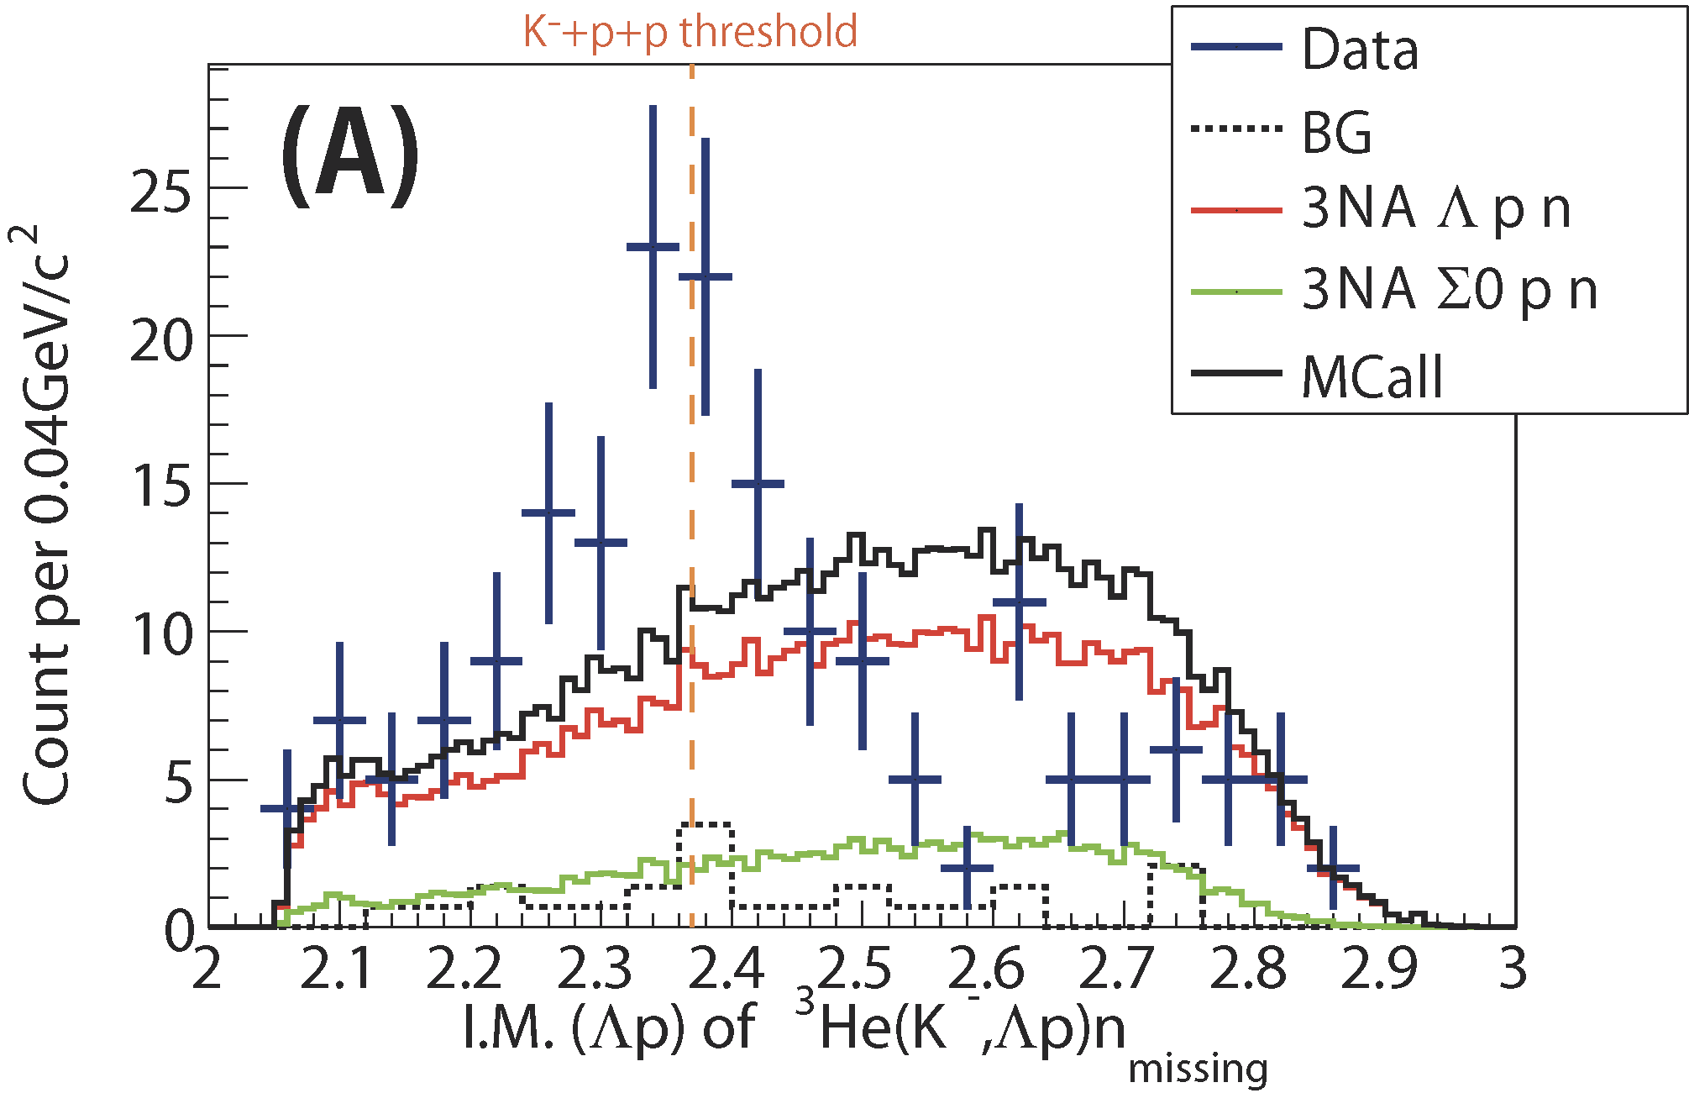
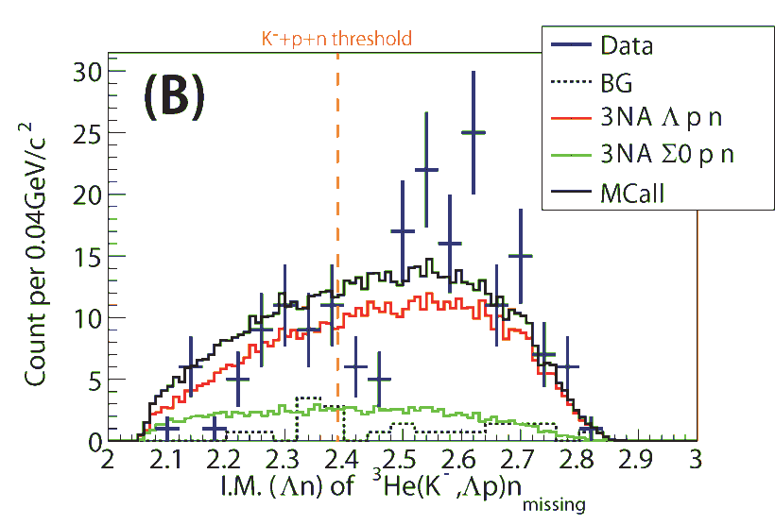
Comparison with Phase-Space
IM(Λp)
~190 events
preliminary
IM(Λn)
preliminary
total CS : ~200 μb
when phase-space distributions are assumed
Excess around the threshold?
(~ 0.1% of total cross section of K⁻³He)

Slide 26
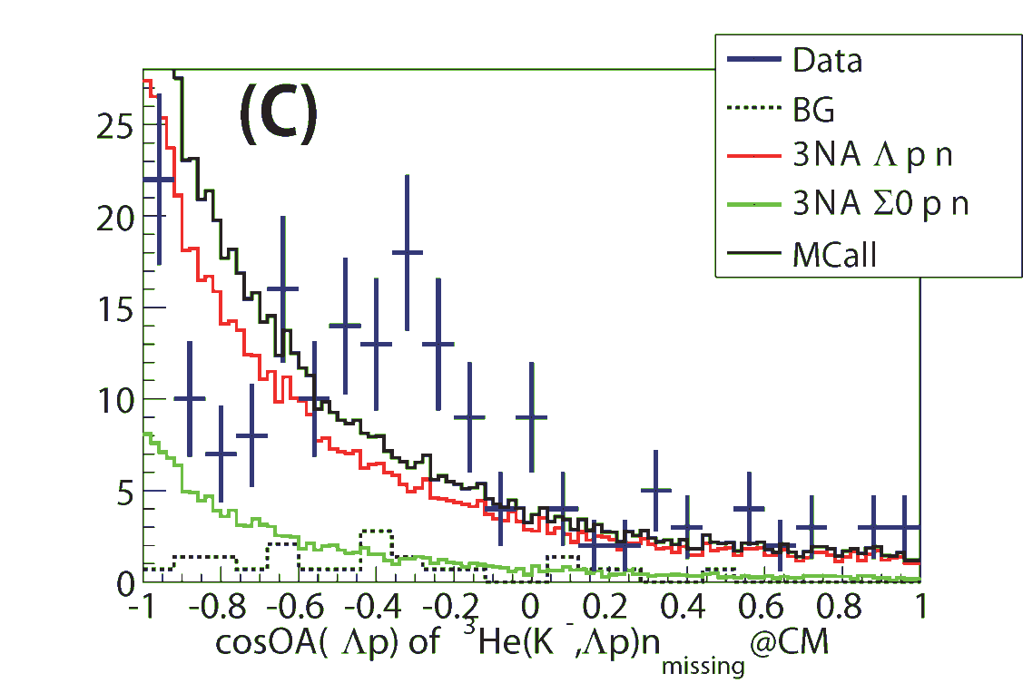
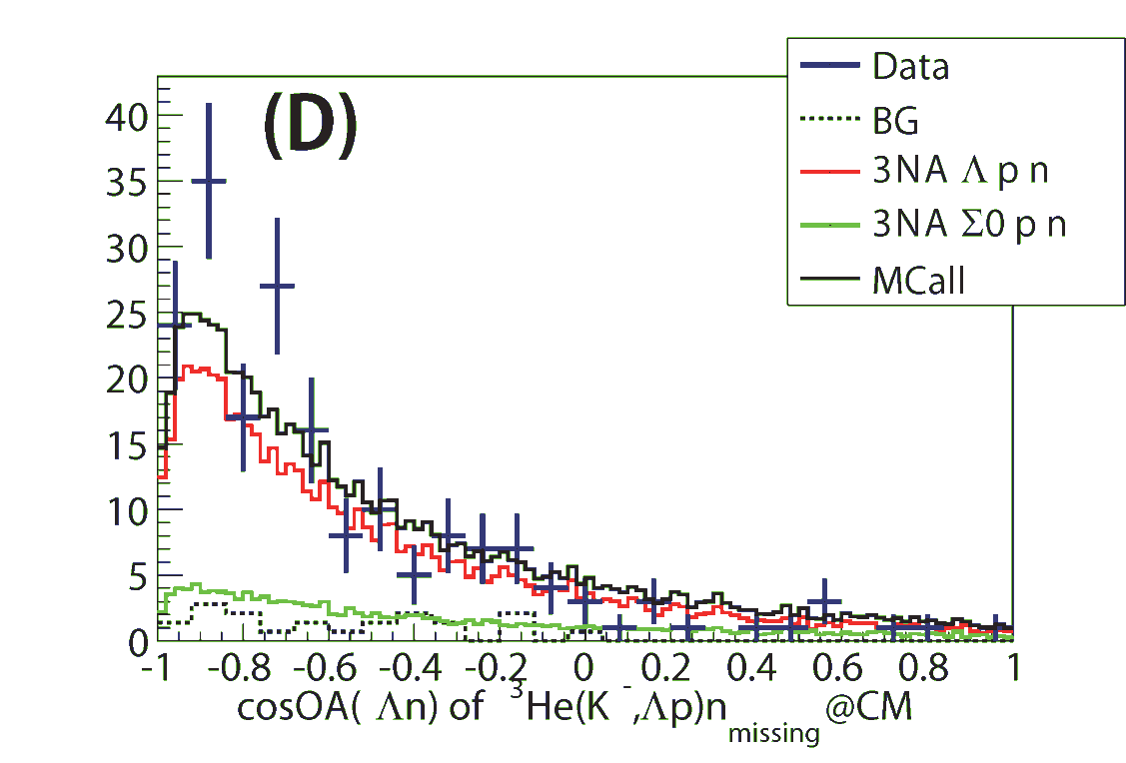
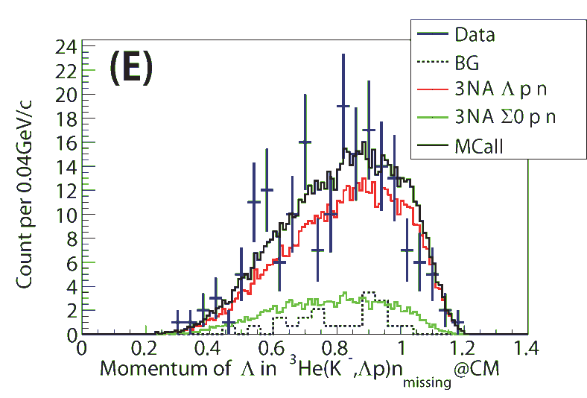
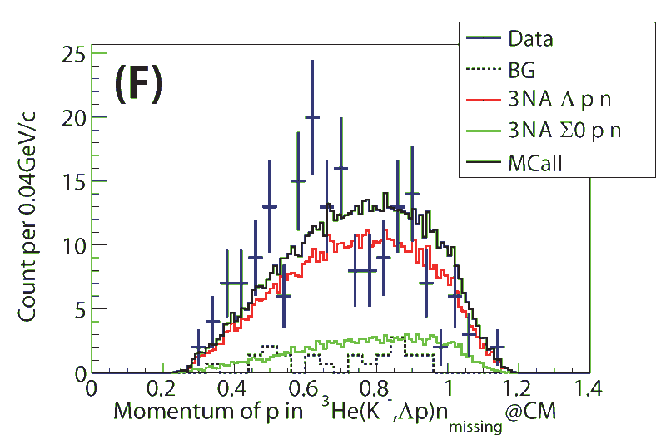
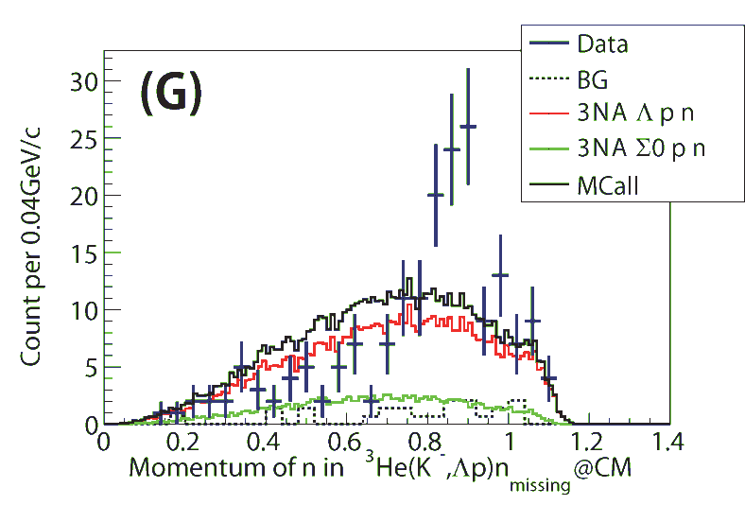
Comparison with Phase-Space
cos(Λp)
cos(Λn)
preliminary
preliminary
p_{Λ}
preliminary
p_{p}
preliminary
p_{n}
preliminary
data cannot be reproduced by the phase-space?

Slide 27
Formation + Decay Channel, Kinematically Complete ³He(K⁻,Λpn)

Slide 28
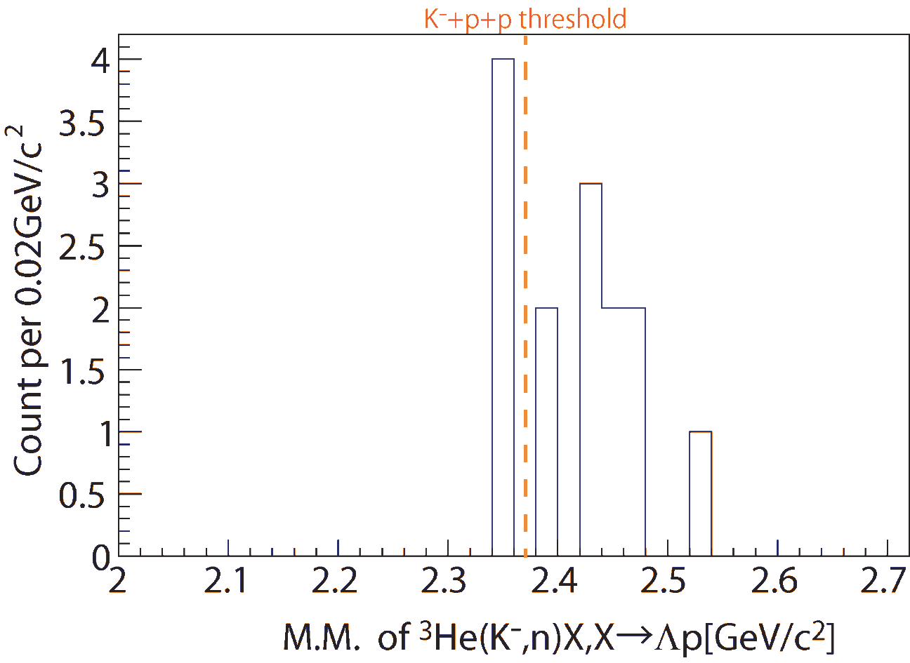
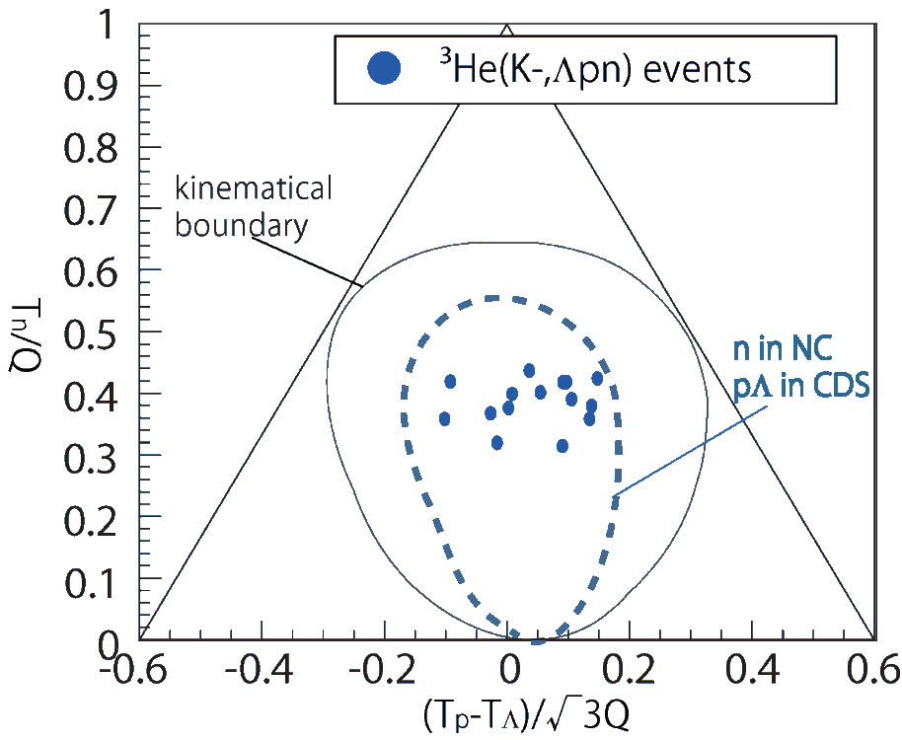
Kinematically-complete measurement of ³He(K⁻, Λpn)
preliminary
only
~15 events
preliminary
Minimum momentum transfer of the ³He(K⁻,n) reaction
→ would enhance the S=-1 di-baryon production
More than x10~100 beam time is required

Slide 29
Future Prospects of E15

Slide 30
E15 2nd stage (approved)
x10
E15^{2nd}: 50x10⁹ kaons on target
in 2015
The goal of the E15^{2nd}
confirm the spectral shape of the Λp invariant-mass by the exclusive measurement of ³He(K⁻,Λp)n
explore the neutron spectrum at θ_{lab}=0^{O} with the kinematically complete measurement of ³He(K⁻,Λpn)
to extract more information on the K^{bar}N interaction

Slide 31
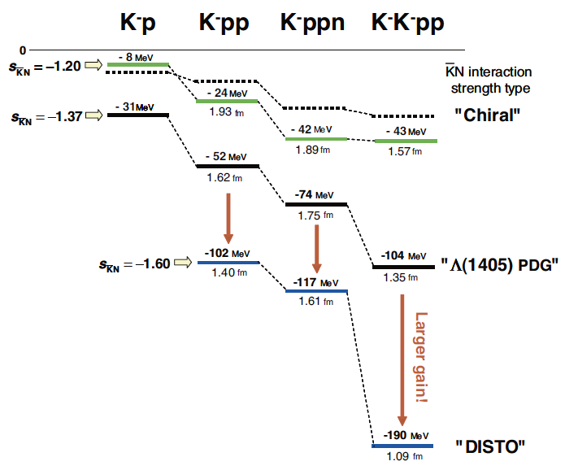
何を測ればK⁻pp解決? (個人的感想)
E15実験の統計を上げる
主目的である³He(K⁻,Λpn)完遂
energy scan (p_{K} = 0.7~1.1 GeV/c)
Production = [FINUDA] (K⁻)+(pp)?
Production = [DISTO/E27] Λ*p?
Decay Channel
これまでの実験は主にΛp-channel測定
πΣN/ΣN-channel測定が重要であろう
Molecular-state? / K-pp bound-state? / S=-1 di-baryon?
理論計算は???
もう1つK⁻: K⁻K⁻pp
Hassanvand et. al.,Phys. Rev., C84(2011)015204.
Barnea et. al., Phys. Lett., B712(2012)137.
Maeda et. al., Proc. Jpn. Acad., Β89(2013)418.
実験例: p^{bar} + ³He → (K⁻K⁻pp)+ K + K, K⁻K⁻pp→ΛΛ
… ???
スピン/パリティー
重い核

Slide 32
Summary of E15 1st
FINUDA/DISTO
³He(K⁻,n)X M.M.
Formation Channel
Semi-Inclusive ³He(K⁻,n)X
No significant bump structure in the deeply bound region
Excess below the threshold attributed to 2NA of Λ*n?
BG included
Λp I.M.
of ³He(K⁻,Λp)n
Decay Channel
Exclusive ³He(K⁻,Λp)n
Excess around the threshold
Cannot be from 2NA of Λ*n (final state = Λpn)
preliminary

Slide 33
The J-PARC E15 Collaboration

