Slide 1
Status of kaonic nucleus search experiment (E15) at J-PARC
RIKEN H. Outa
for E15 collabolation
✔ Kaonic nuclei
✔ Present status of the E15 experiment at J-PARC
Search for the K-pp bound state in the
3He(in-flight K-, n/p) reaction
－ 3He(in-flight K-, n) spectrum Hashimoto
arXiv: [nucl-ex]1408.5637 submitted to PLB
(－ 3He(in-flight K-, p) spectrum Tokuda )
－ Λp+n(missing) channel analysis Sada

Slide 2
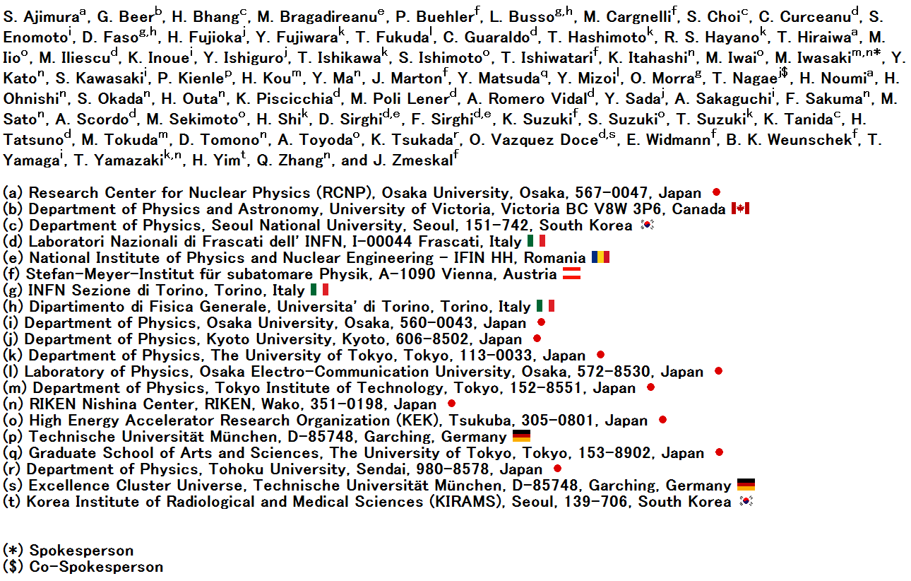
J-PARC E15 collaboration

Slide 3
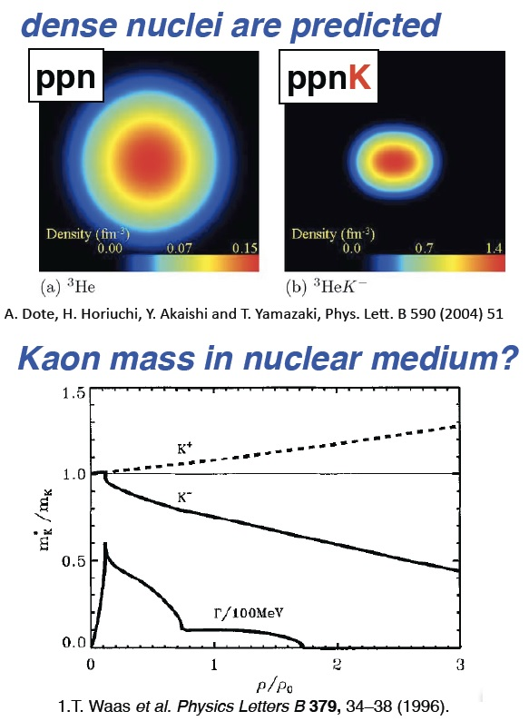
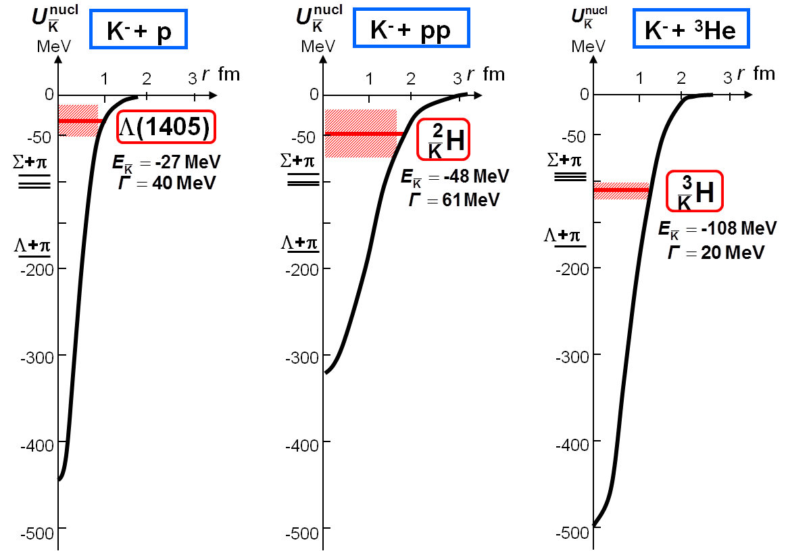
Introduction
3
Motivation :
What will happen when anti-kaon is
embedded in nucleus?
✔ Does the simplest Kaonic nucleus “K-pp” exist?
✔ How deeply bound ?
Y. Akaishi & T. Yamazaki, Phys. Rev. C65 (2002) 044005.
Y. Akaishi & T. Yamazaki, Phys. Lett. B535 (2002) 70.

Slide 6
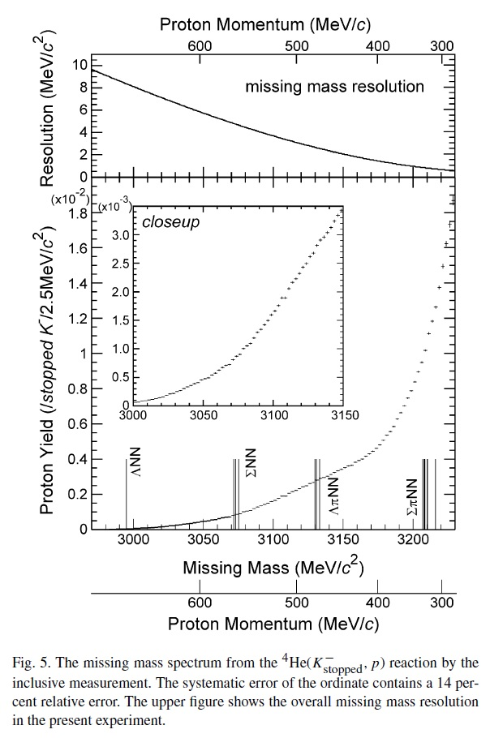
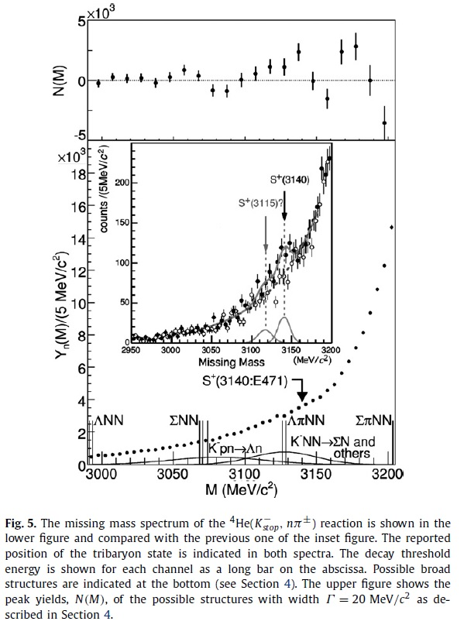
KEK-PS E549
⁴He(stopped K⁻,p)
⁴He(stopped K⁻,n)
Error bar が見えないほどの高統計
Upper limits for the narrow deeply bound status

Slide 7
E15 Experiment Setup & Performance of detectors

Slide 9
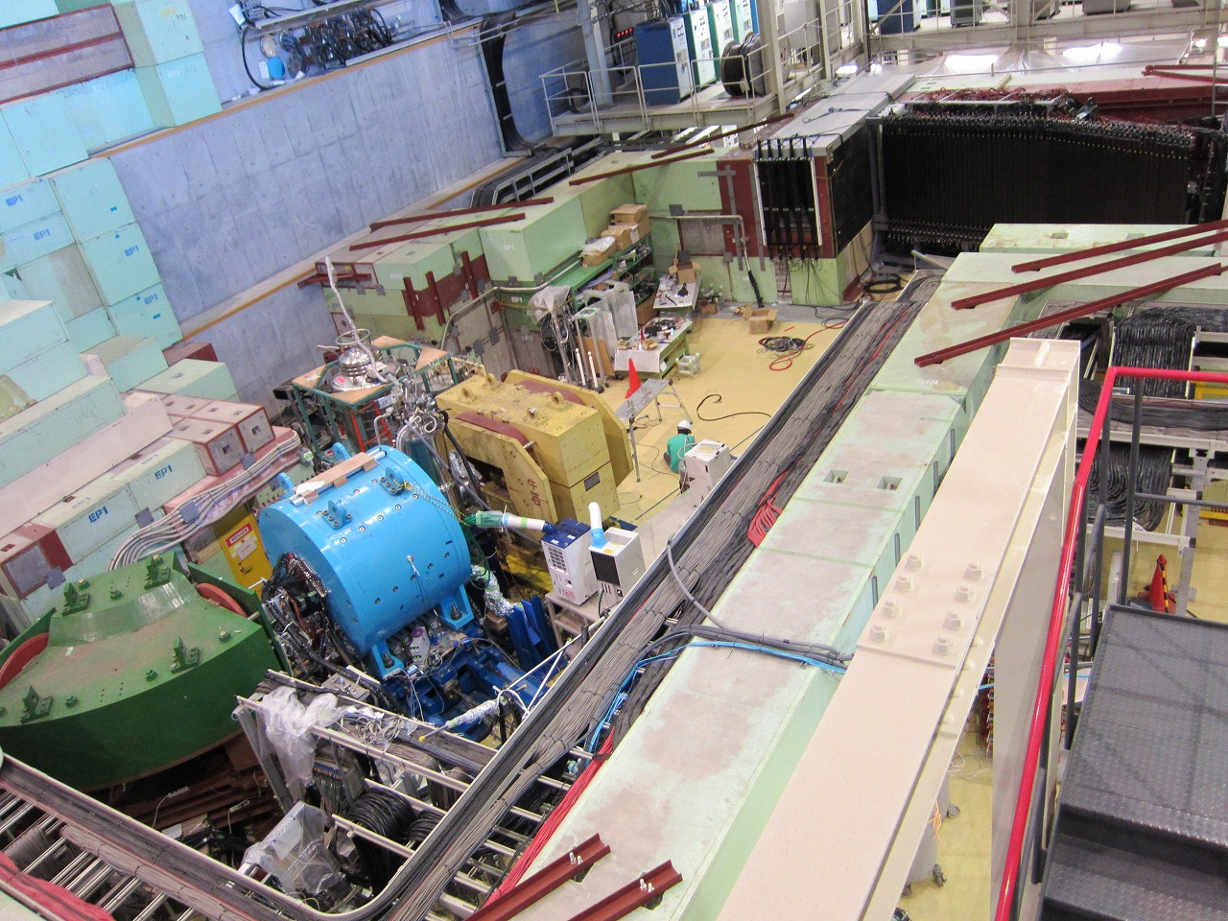
K1.8BR spectrometer [Jun. 2012]
beam dump
beam sweeping
magnet
Neutron
Charge Veto
Proton Counter
liquid ³He-target
system
CDS
CDS
(Ushiwaka)
CVC
K⁻
π
n
~15m
beam line
spectrometer
³He target
NC
p
CDC
CDH
PC

Slide 12
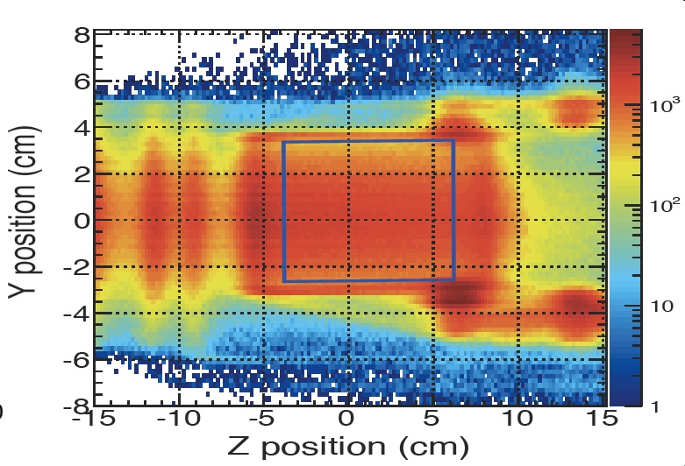

Slide 13
Efficiency = 23±4%
MM resolution ～10MeV

Slide 14
3He (K-, n) semi-inclusive spectrum ( Hashimoto )

Slide 15
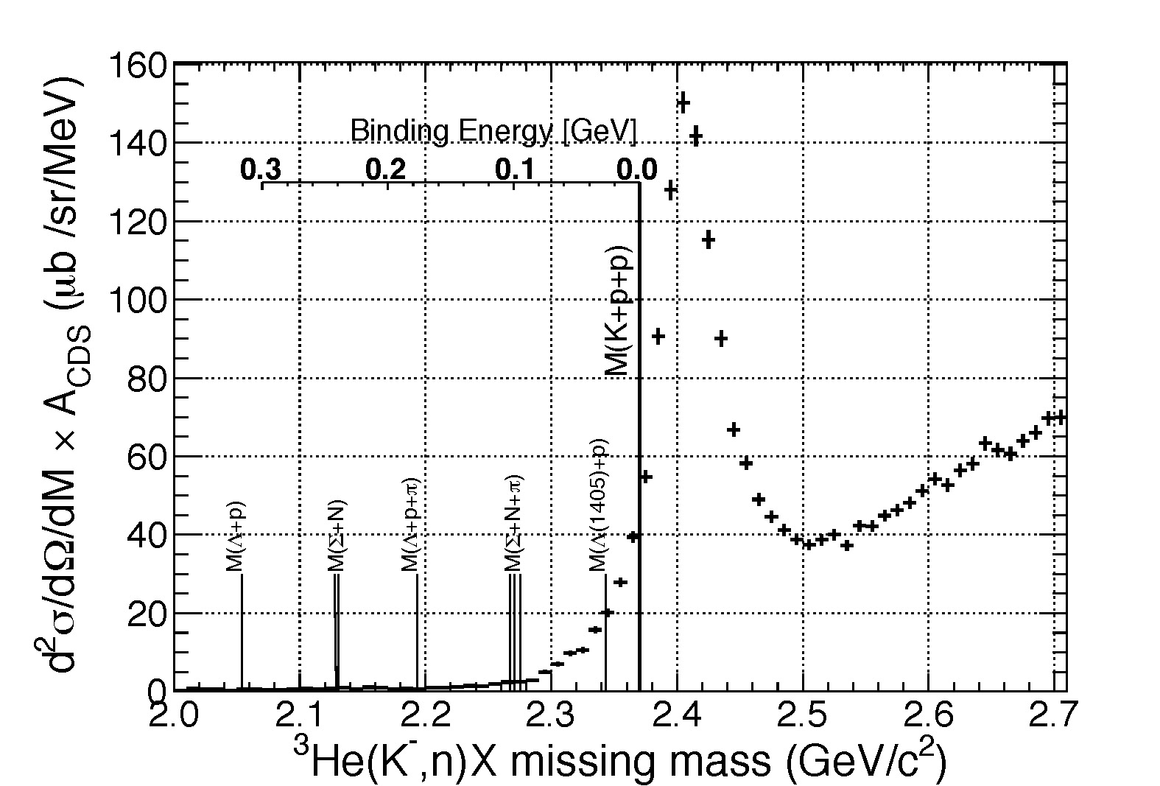
3He (K-, n) semi-inclusive spectrum

Slide 16
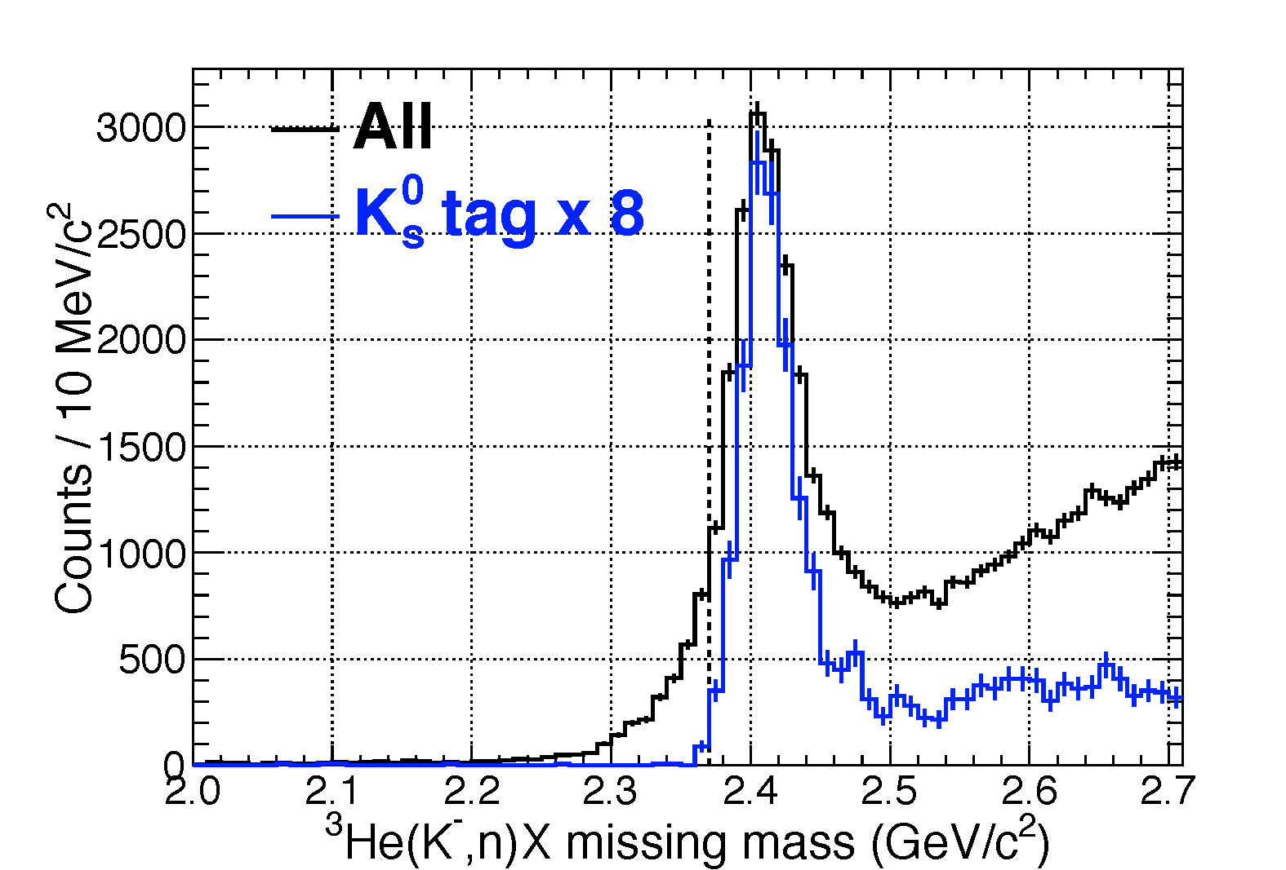
Tail component in the bound region is
NOT due to the detector resolution !!

Slide 17
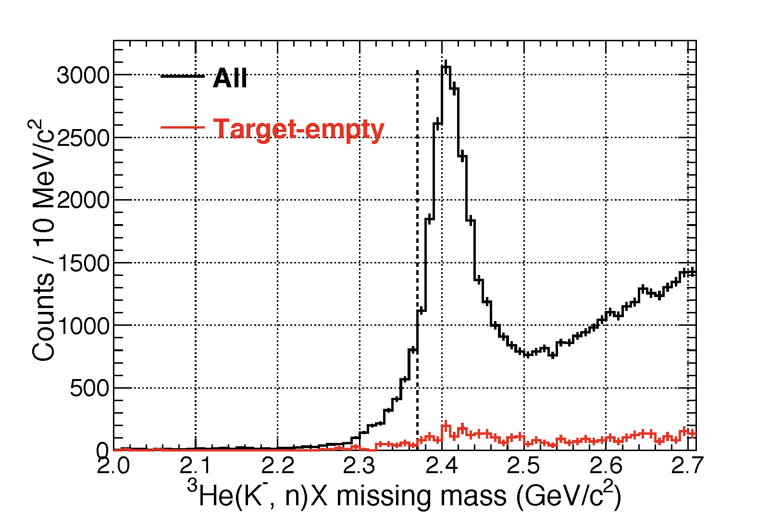

Slide 19
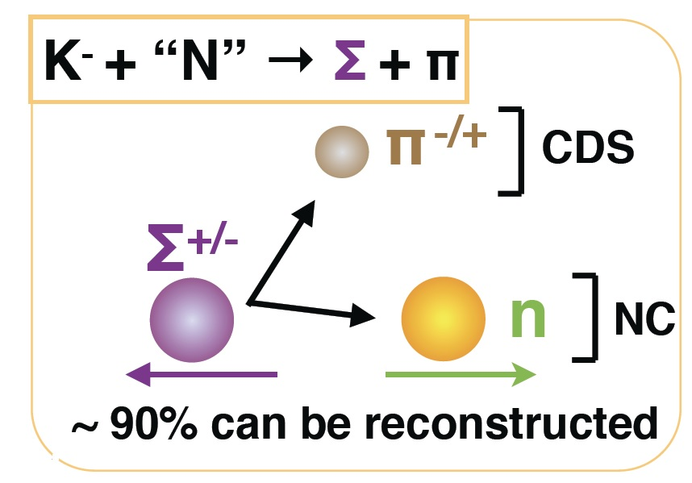
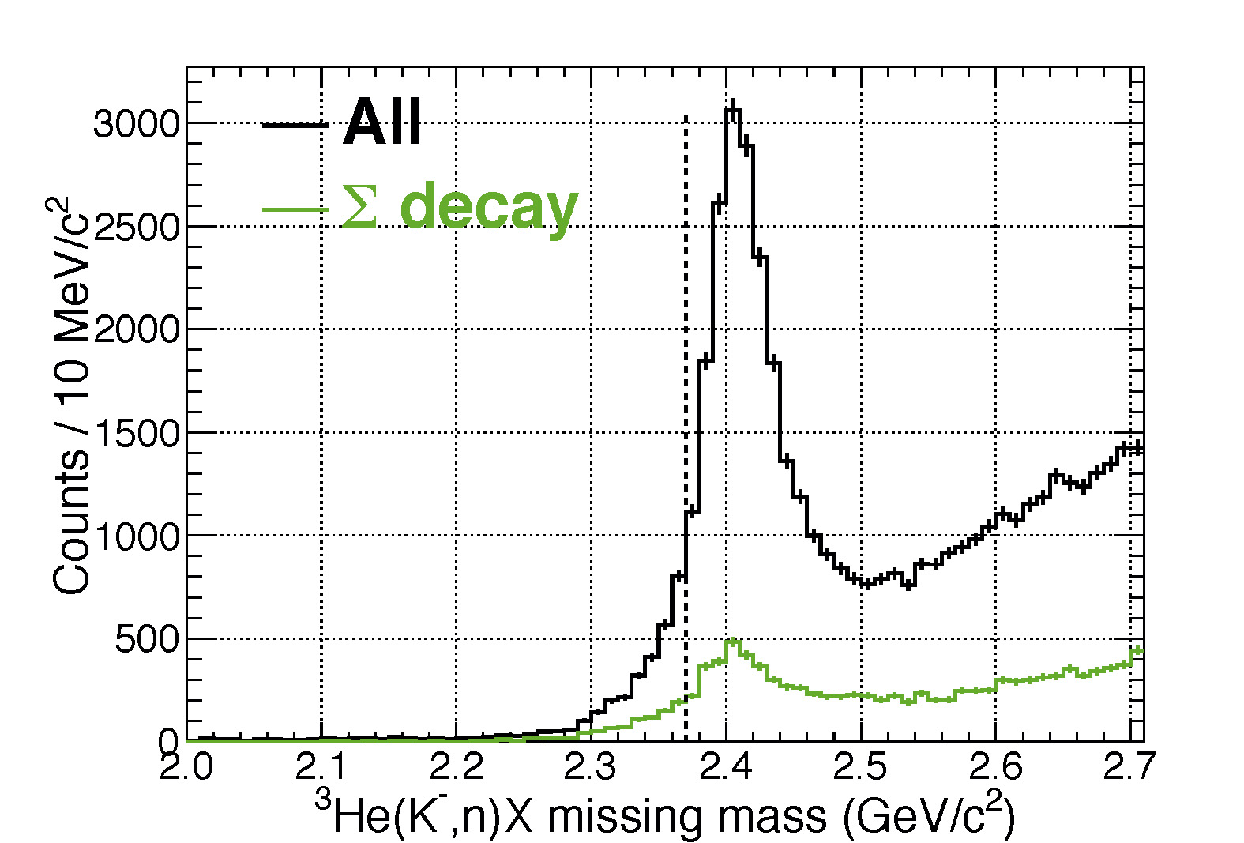

Slide 20
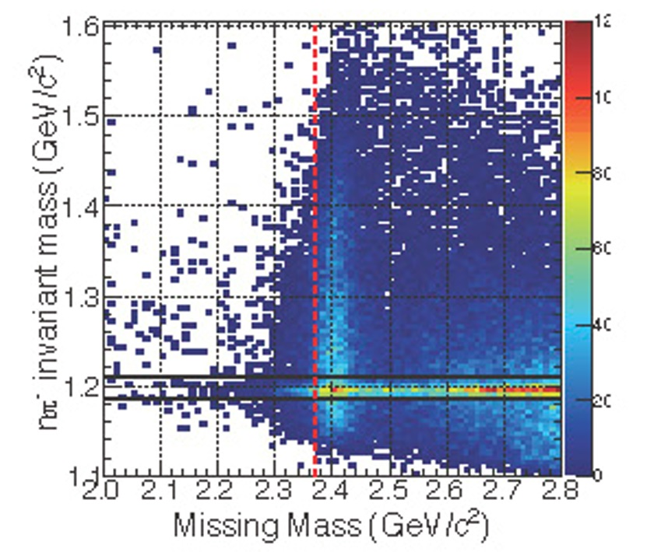

Slide 21
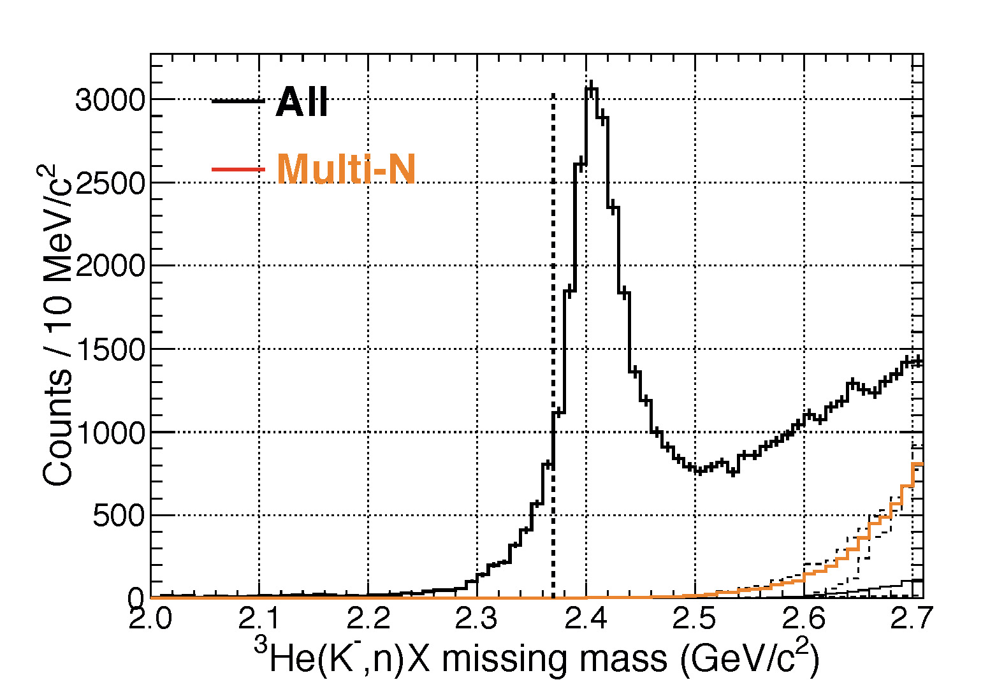

Slide 25
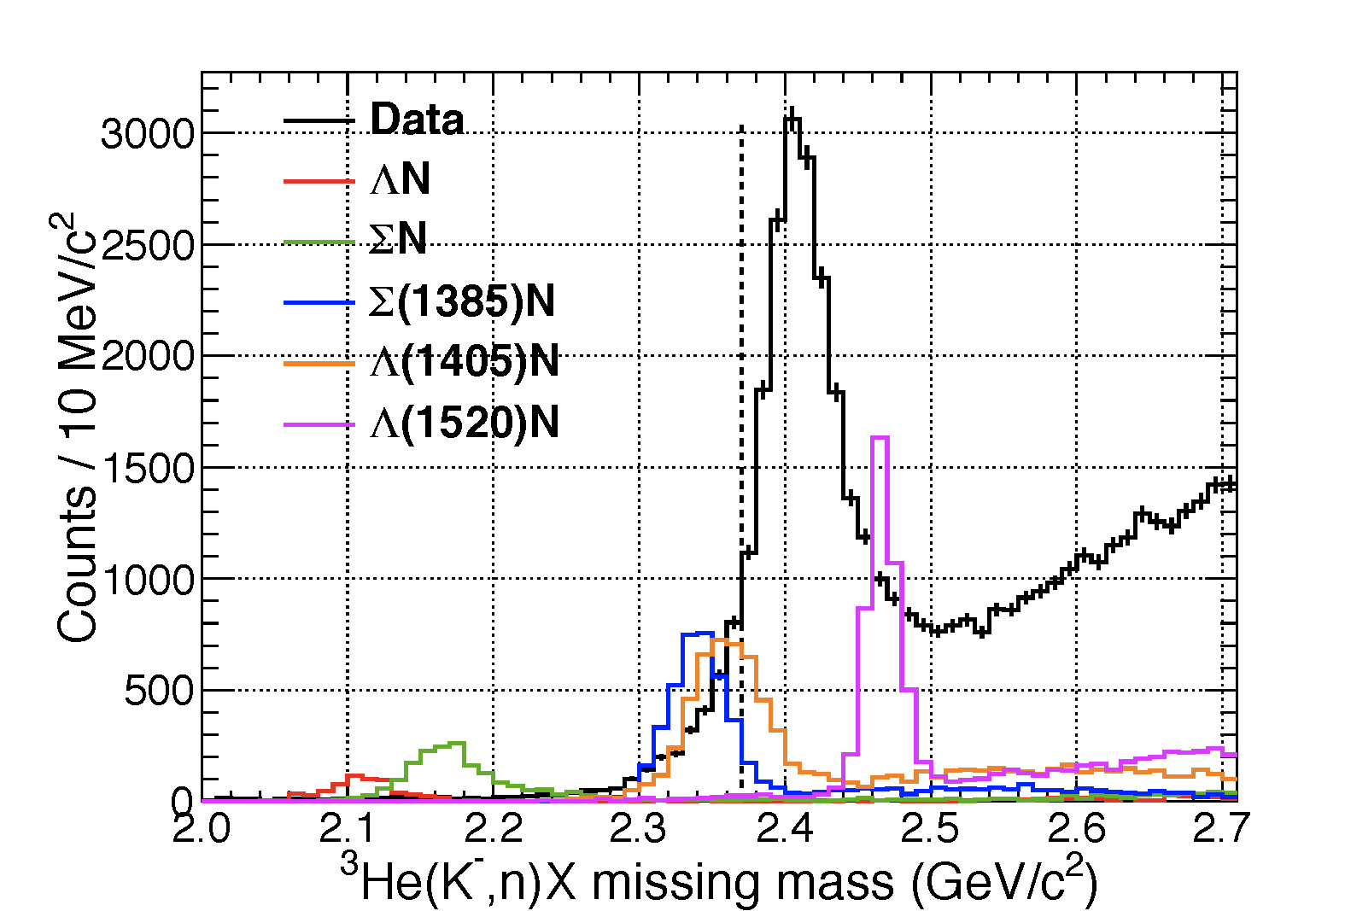

Slide 26
～1 mb/sr in bound region
if we assume the decay to
Λp/Σ0p or πΣp

Slide 27
3He (K-, p) spectrum ( Tokuda )

Slide 29
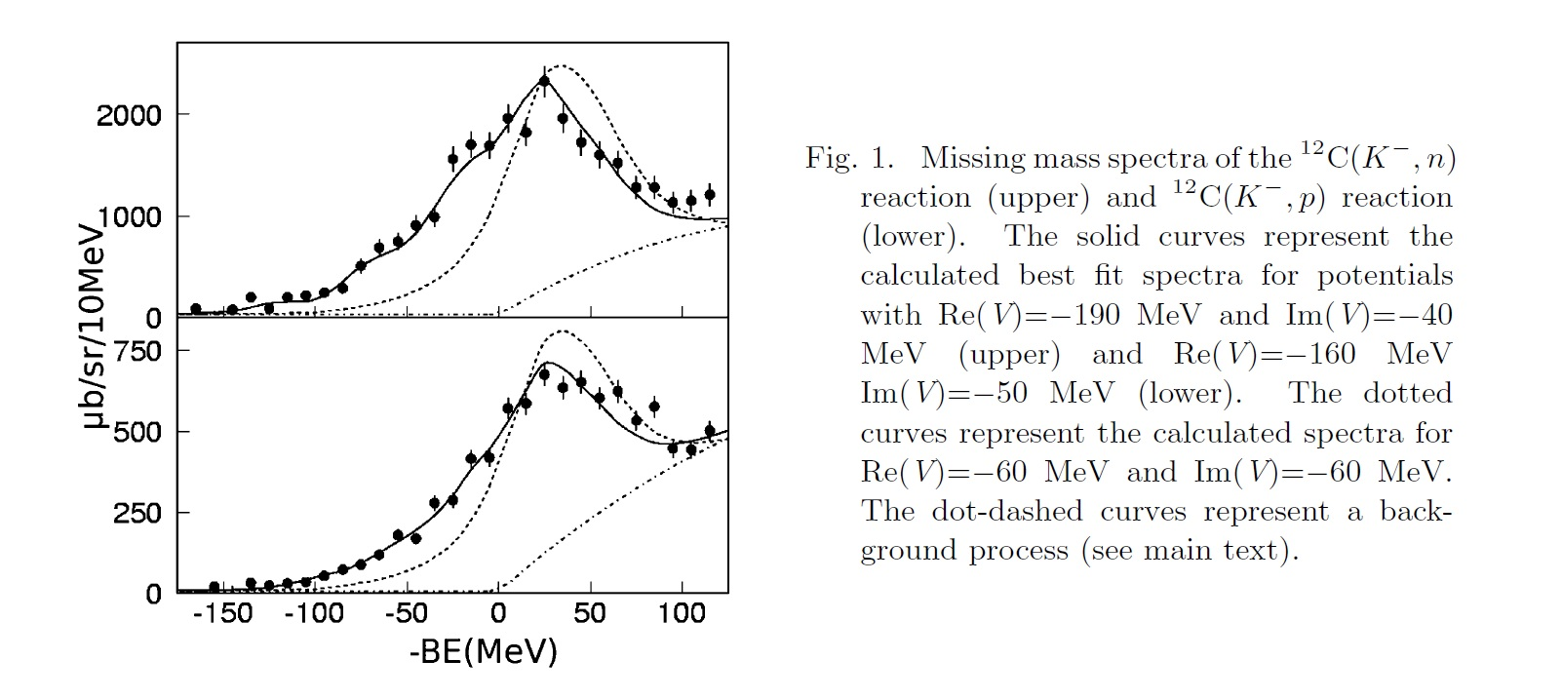
KEK-PS 548: In-flight ¹²C(K⁻,N)
(K-,n)
(K-,p)

Slide 30
3He (K-, p) spectrum (VERY preliminary!)
非公開

Slide 31
Λp n(missing) correlation ( Sada )

Slide 32
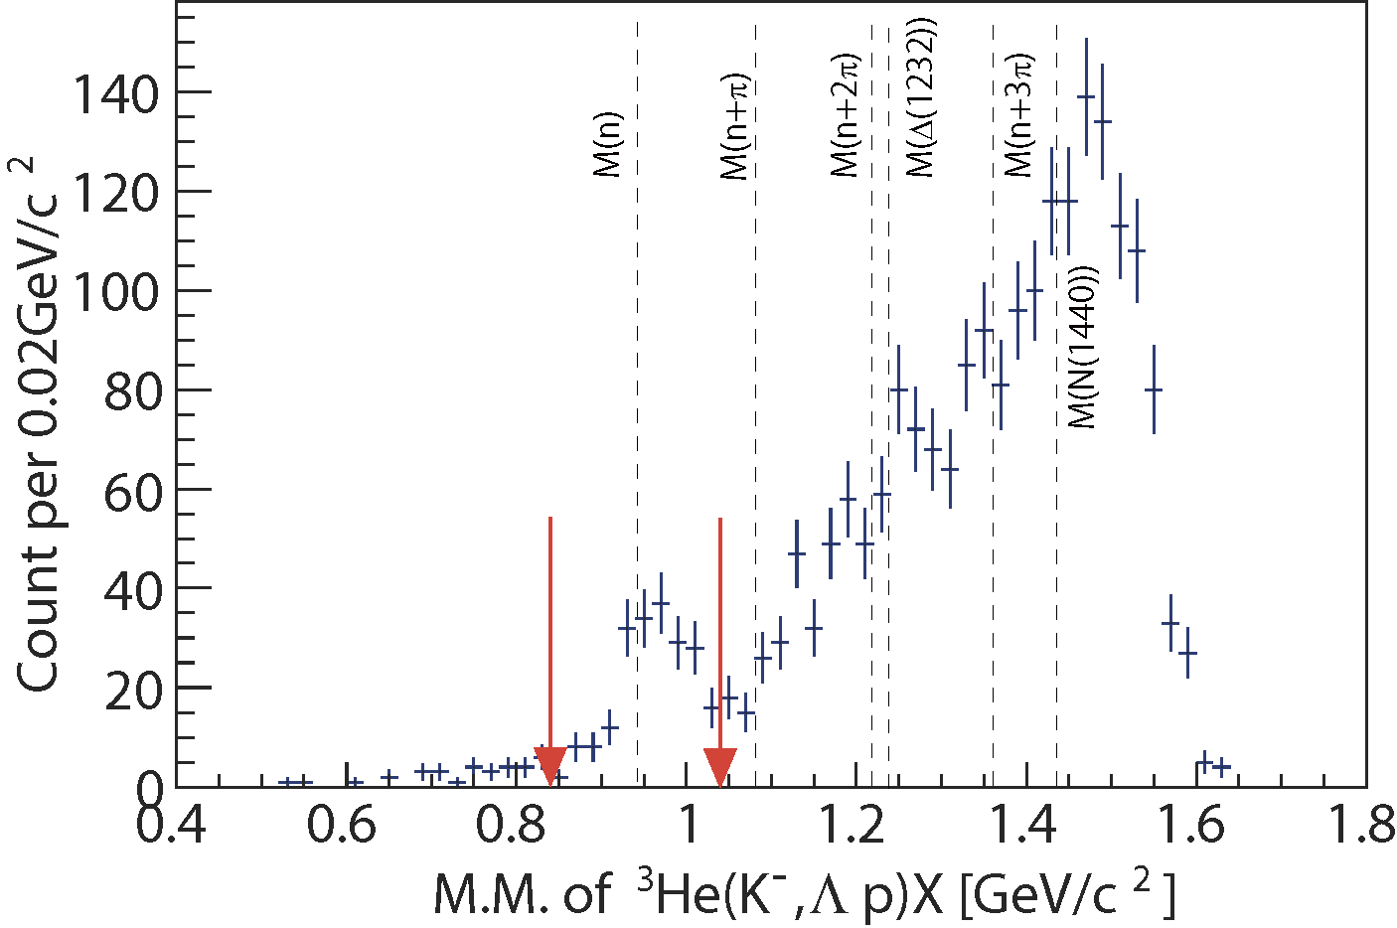
Exclusive ³He(K⁻,Λp)n events
CDS
p
missing n
Preliminary
n
Λ
π⁻
p
1GeV/c
K⁻ beam
K⁻³He→Λ(Σ⁰)pn events can be identified exclusively
# of Λ(Σ⁰)pn events: ~190
Σ⁰pn contamination: ~20%

Slide 33
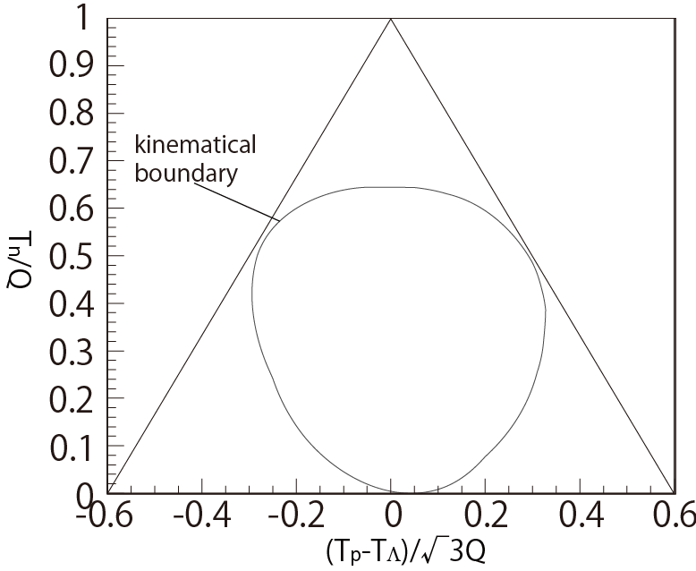
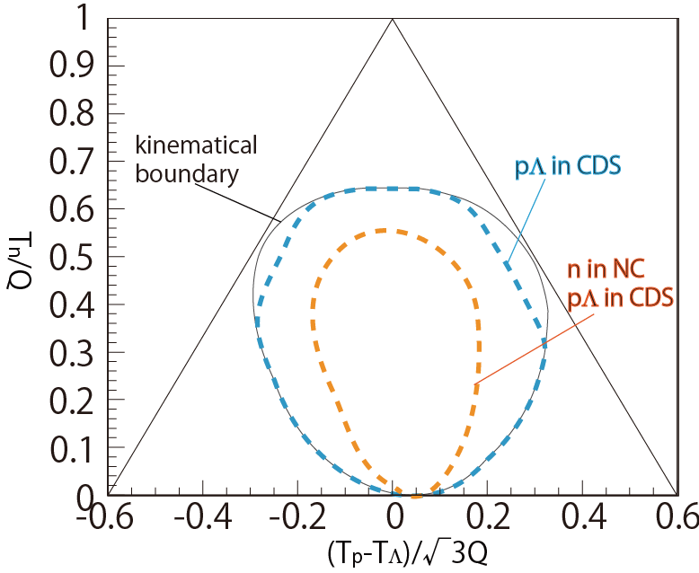
³He(K⁻,Λp)n: Dalitz plot
To check Λpn events phase space distribution
To plot in this figure, kinematics is fixed.
Checking 3 nucleon absorption or 2 nucleon absorption
If events are distributed uniformly
=> 3NA is dominant
T proton
T Λ
T neutron

Slide 34
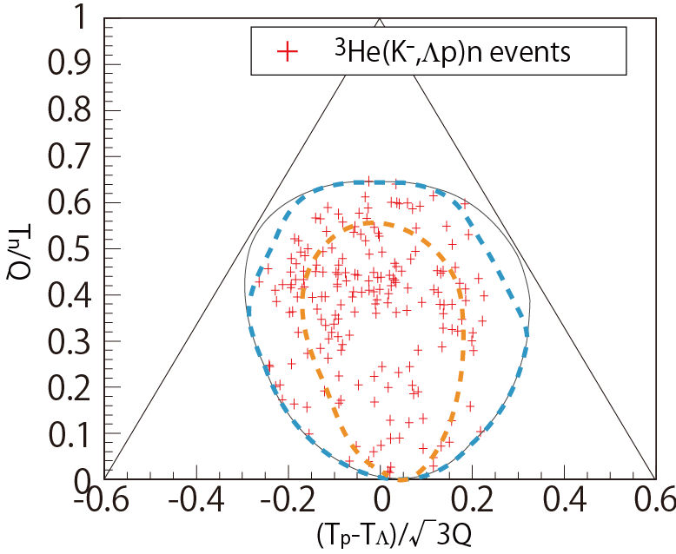
³He(K⁻,Λp)n: Dalitz plot
2NA:
e.g. K⁻³He→Λpn_{s}
Preliminary
2NA+2step:
e.g. K⁻³He→Σ⁰pn_{s},
Σ⁰n_{s}→Λn
2NA+2step:
e.g. K⁻³He→Σ⁰np_{s},
Σ⁰p_{s}→Λp
K⁻pp form.:
K⁻³He→(K⁻pp)n,
K⁻pp→Λp
Events are scattered widely in the phase-space of K⁻+³He->Λ+p+n
=>3NA is dominant!!
Notes:
Proton specも

Slide 35
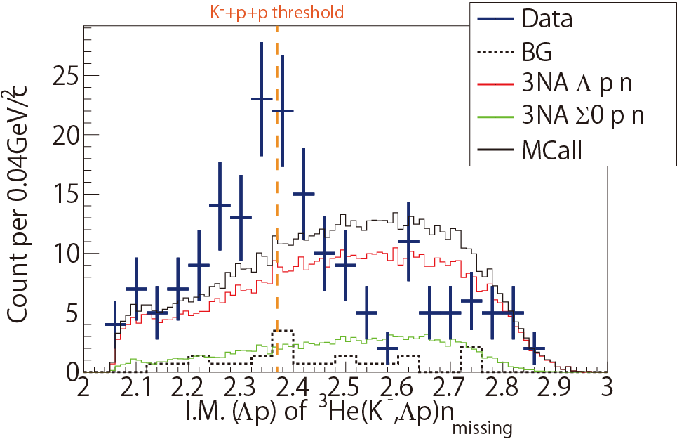
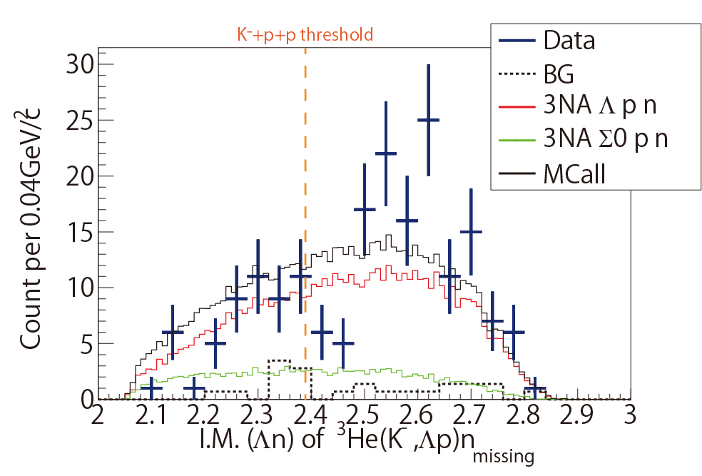
³He(K⁻,Λp)n: Invariant Mass
IM(Λp)
~190 events
Preliminary
IM(Λn)
Preliminary
total CS : ~200 μb
when phase-space distributions are assumed
Excess around the threshold?
(~ 0.1% of total cross section of K⁻³He)

Slide 37
Summary of J-PARC E15 status
✔ J-PARC E15 1st stage physics run was performed.
－ All the detector subsystems are working well
with the good performance as designed
－ Unfortunately stopped aｔ only 4 day running…
✔ Semi-inclusive 3He(K-,n) spectrum have tail component
in the K-bound region which is hard to be explained
by ordinary processes.
✔ Cross section＜ ～10⁻² of K-QE at BK～100MeV
✔ 3He (K-,p) spectrum looks very similar to (K-,n)
✔ Λ + p + n(missing) correlation analysis seems
very interesting when the statistics is much improved
in the future run.

