Slide 1
Recent results of the K^{bar}NN search via the in-flight ³He(K⁻,n) reaction at J-PARC
F. Sakuma, RIKEN
for the J-PARC E15 collaboration
HYP2015, Sendai, Sep.7-12, 2015

Slide 2
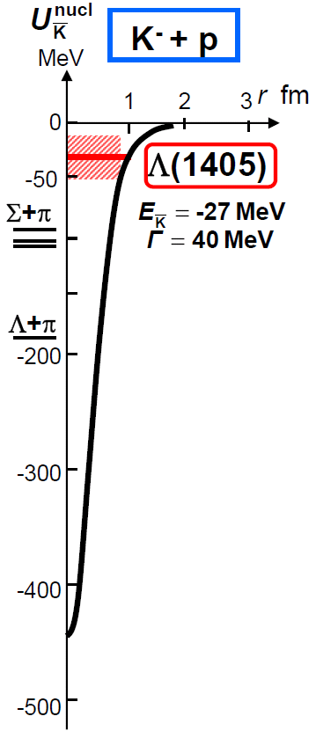
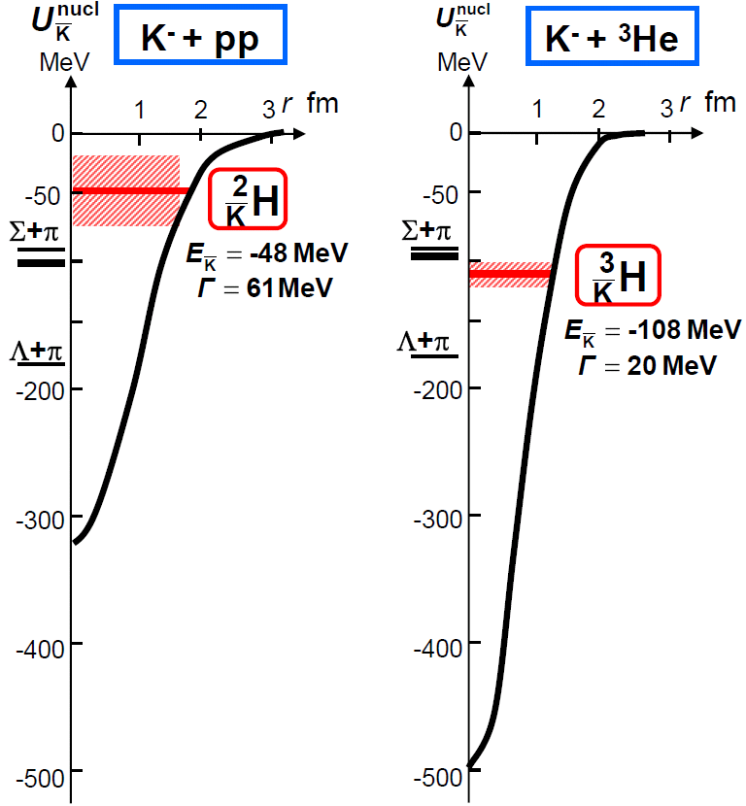
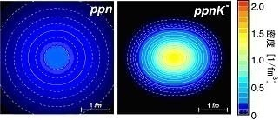
Kaonic Nuclei
Kaonic nucleus is a bound state of nucleus and anti-kaon (K^{bar}NN, K^{bar}NNN, K^{bar}K^{bar}NN, ...)
Density [1/fm³]
Y.Akaishi & T.Yamazaki, PLB535, 70(2002).
T.Yamazaki, A.Dote, Y.Akiaishi, PLB587, 167 (2004).

Slide 3
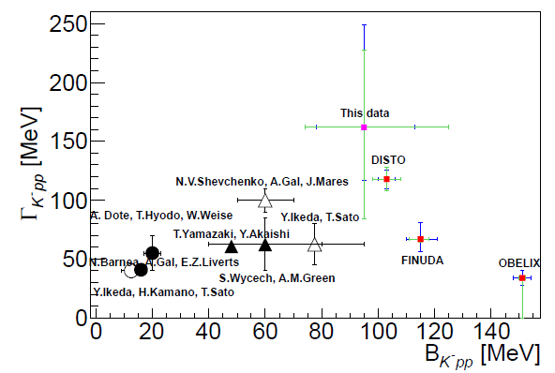
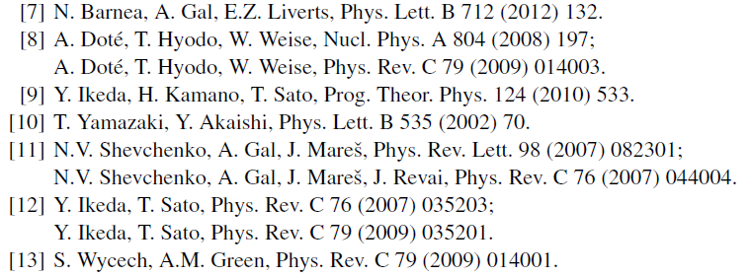
K^{bar}NN Bound State
K^{bar}NN : the simplest K^{bar}-nuclear state
A.Gal, NPA914(2013)270
Y.Ichikawa, EXA2014
E27
All theoretical studies predict existence of the K^{bar}NN
→ However, B.E. and Γ are controversial

Slide 4
J-PARC E15 Experiment
A search for the simplest kaonic nucleus, K^{bar}NN, using ³He(in-flight K⁻,n) reaction
two-nucleon absorption
hyperon decays
CAN be discriminated kinematically

Slide 5
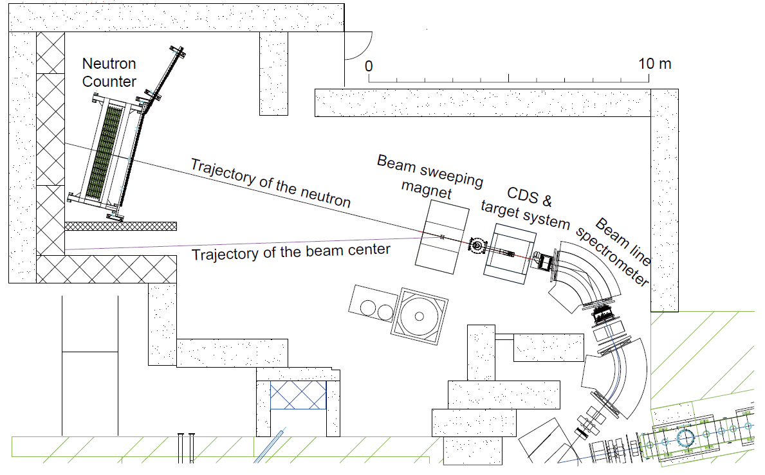
Experimental Setup
15m

Slide 6
Status of the E15 Experiment
Production run of ~1% of the approved proposal was successfully carried out in 2013.
2nd physics run will be performed in the autumn of 2015
 | Exp. Target | Primary-beam intensity | Secondary-kaon intensity | Duration | Kaons on target (w/ tgt selection)
May, 2013 (Run#49c) | ³He | 24 kW (30 Tppp, 6s) | 140 k/spill | 88 h | 5.3 x 10⁹
Apr-May, 2015 (Run#62) | H₂ | 26.5 kW (33 Tppp, 6s) | 130 k/spill | 73 h | 3.7 x 10⁹
Apr-May, 2015 (Run#62) | D₂ | 26.5 kW (33 Tppp, 6s) | 130 k/spill | 53 h | 2.8 x 10⁹
Autumn, 2015 | ³He | 40 kW (50 Tppp, 6s) | 200k/spill | 26d | 50x10⁹
E15^{1st}
calibration
calibration
E15^{2nd}
* production target: Au 50% loss, spill length: 2s, spill duty factor: 35~45%, K/pi ratio: ~1/2
* ~70% of beam kaons hit the fiducial volume of ³He target

Slide 7
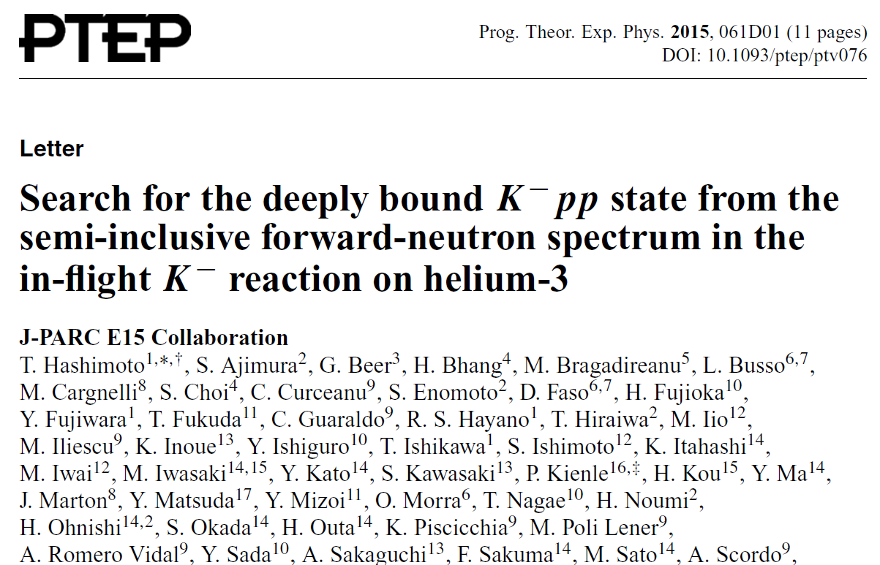
Formation Channel, Semi-Inclusive ³He(K⁻,n)X

Slide 8
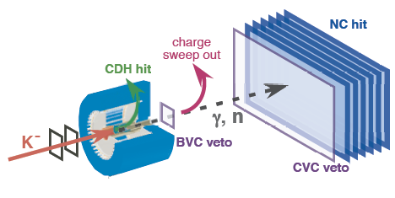
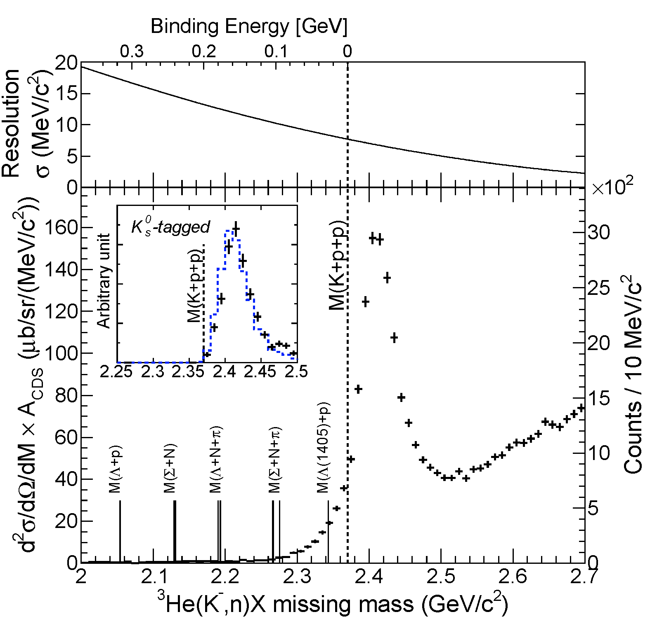
Semi-Inclusive Spectrum of ³He(K⁻,n)X
Quasi Elastic
K⁻ + ³He → K⁻ + n + p_{s} + p_{s}
dσ/dΩ_{θ=0deg} ~ 6mb/sr
and
Charge-Exchange
K⁻ + ³He → K⁰ + n + d_{s}
K⁰ → π⁺ + π⁻
dσ/dΩ_{θ=0deg} ~ 11mb/sr
tail structure
Hyperon decay

Slide 9
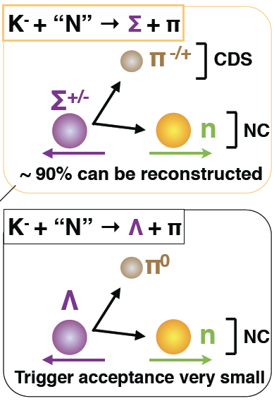
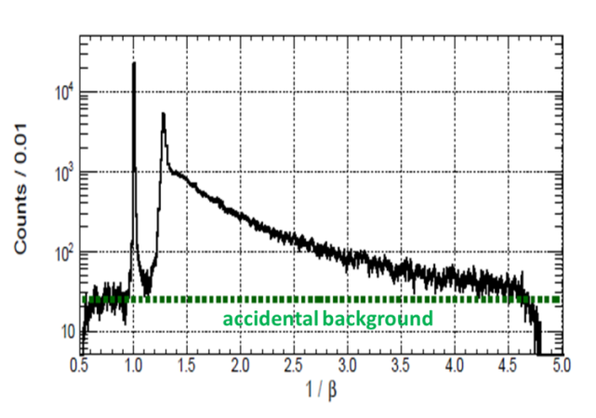
Comparison of ³He(K⁻,n)X
The tail structure cannot be explained by any elementary processes!
DATA
MC
1/β distribution for γ/n

Slide 10
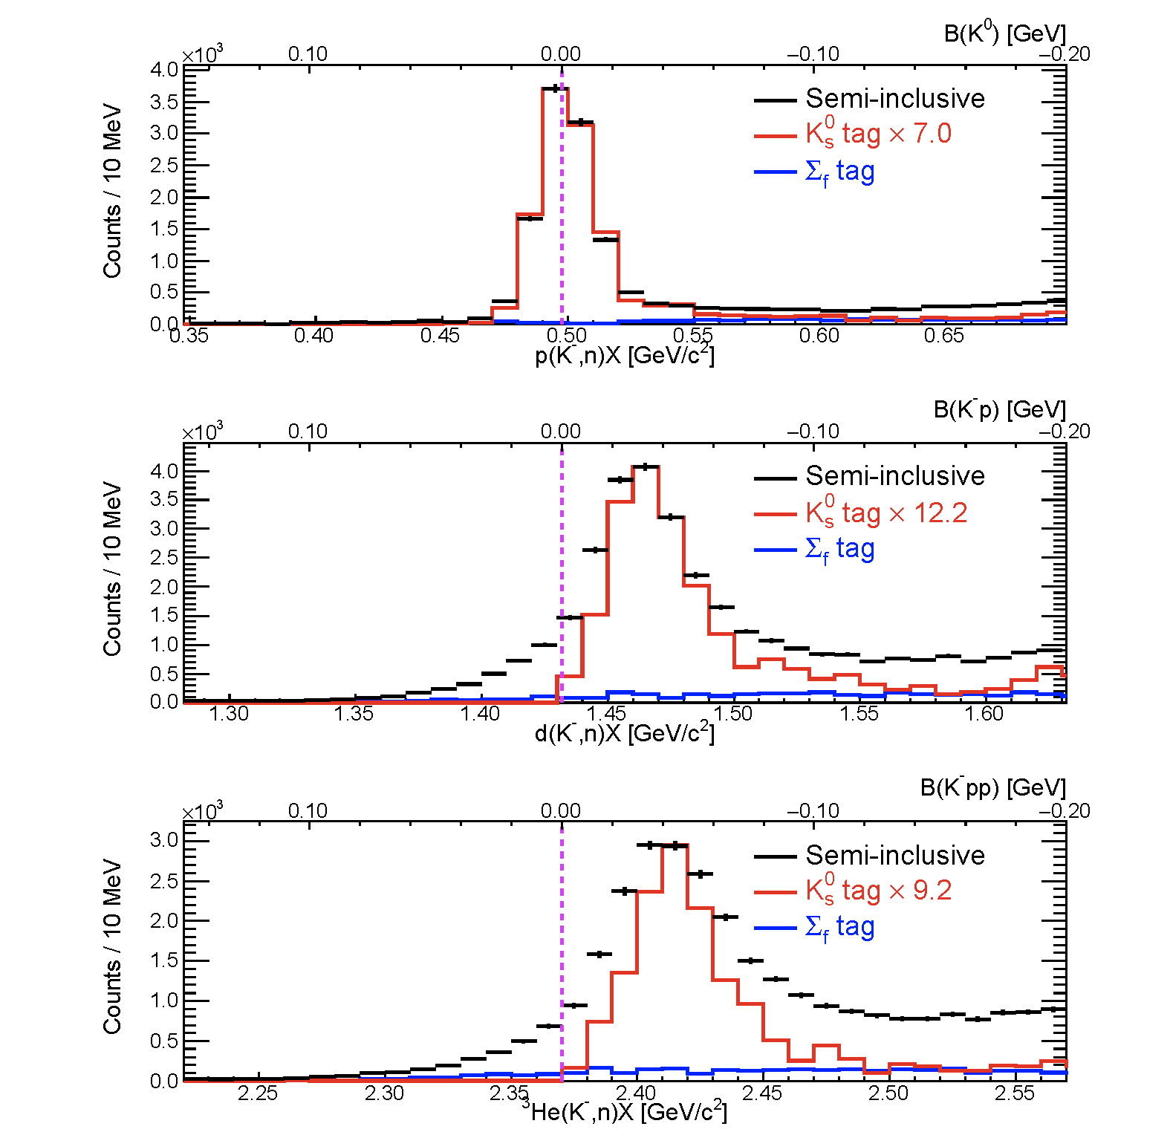
Subthreshold Excess?
preliminary
M(K⁻)
K⁻p→K⁰+n_{fw}
K⁻d→[K⁻p]+n_{fw}
K⁻³He→[K⁻pp]+n_{fw}
p(K⁻,n)X
well describes the spectrum
preliminary
M(K⁻+p)
Y*
d(K⁻,n)X
sub-threshold excess is seen
The main goal of E31
→ Inoue’s Talk (5a-2, 9/8)
Fermi motion
M(K⁻+p+p)
Y*N
³He(K⁻,n)X
sub-threshold excess is seen
Exclusive analysis is crucial!

Slide 11
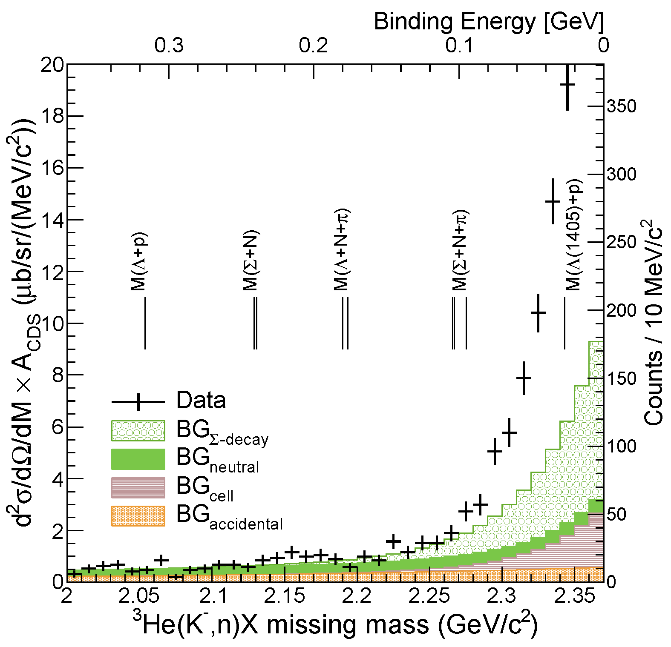
Close-Up of the Deeply-Bound Region
FINUDA/DISTO/
E27

Slide 12
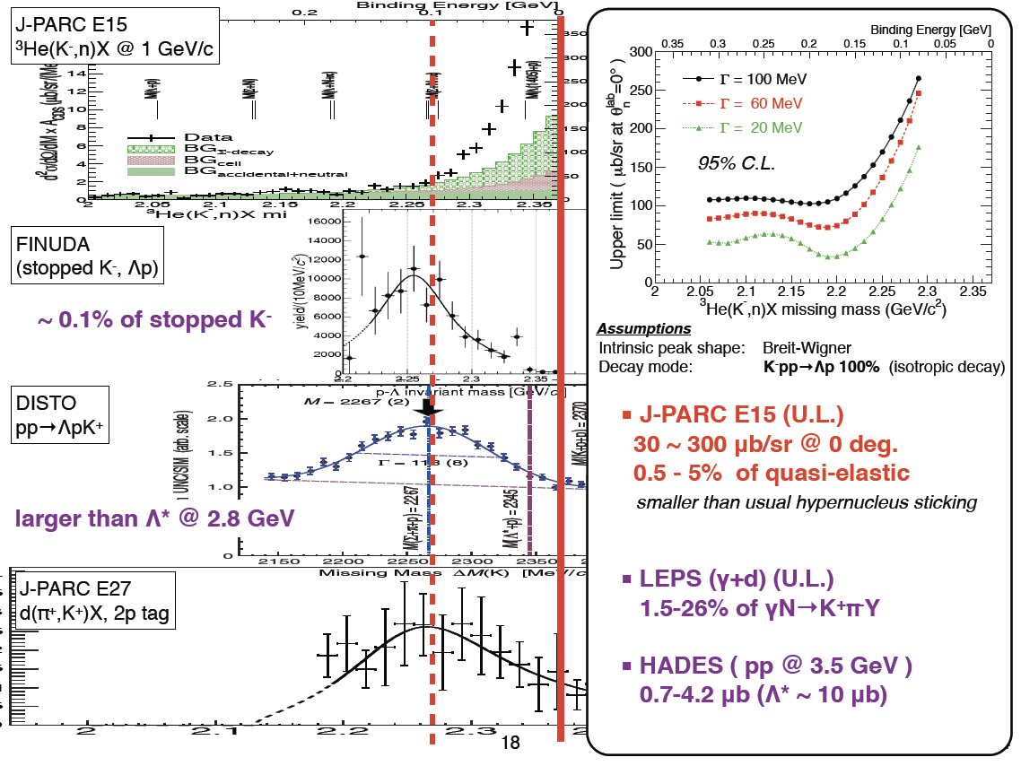

Slide 13
Decay Channel, Exclusive ³He(K⁻,Λp)n
Y.Sada et al., paper in preparation

Slide 14
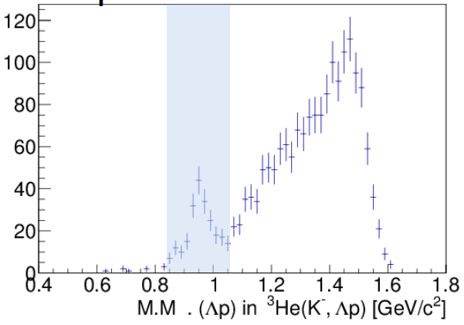
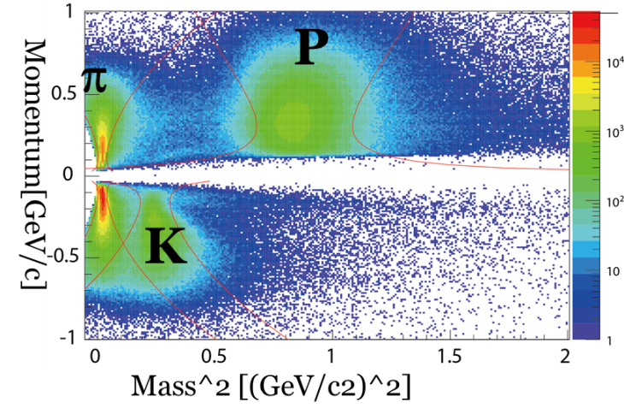
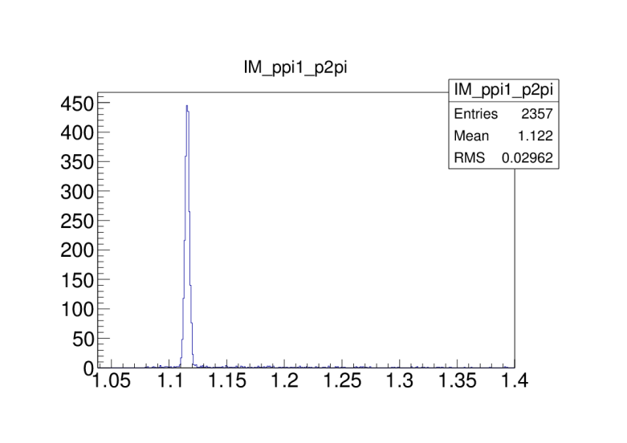
Exclusive ³He(K⁻,Λp)n events
CDS
p
missing n
preliminary
n
Counts per 20MeV/c²
Λ
π⁻
p
1GeV/c
K⁻ beam
K⁻³He→Λ(Σ⁰)pn events can be identified exclusively
# of Λ(Σ⁰)pn events: ~200
Σ⁰pn contamination: ~20%
Λ→pπ⁻

Slide 15
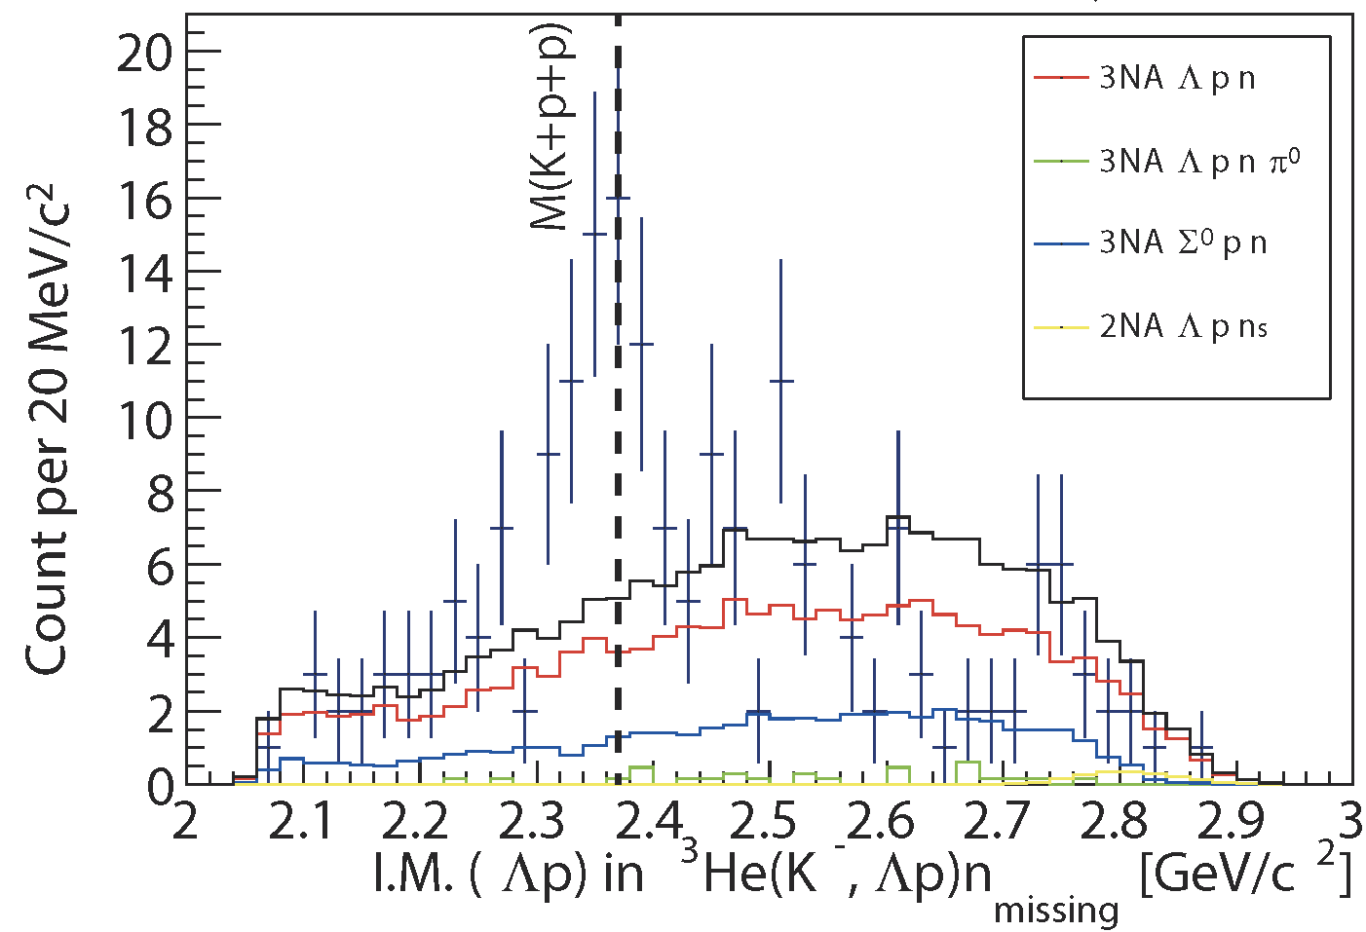
Exclusive ³He(K⁻,Λp)n by 3NA
preliminary
The spectrum CANNOT be reproduced by only 3NA
Clear structure is seen around the threshold

Slide 16
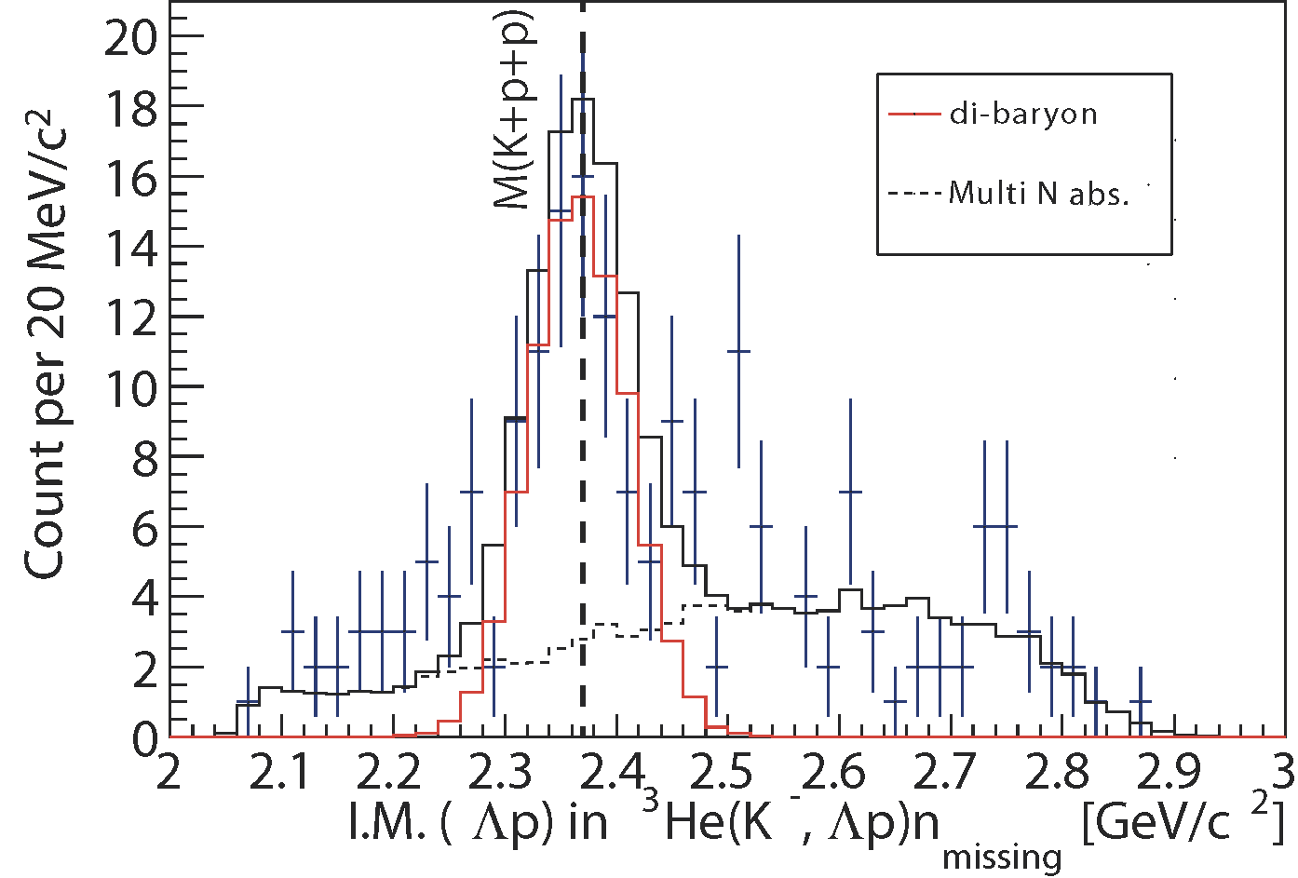
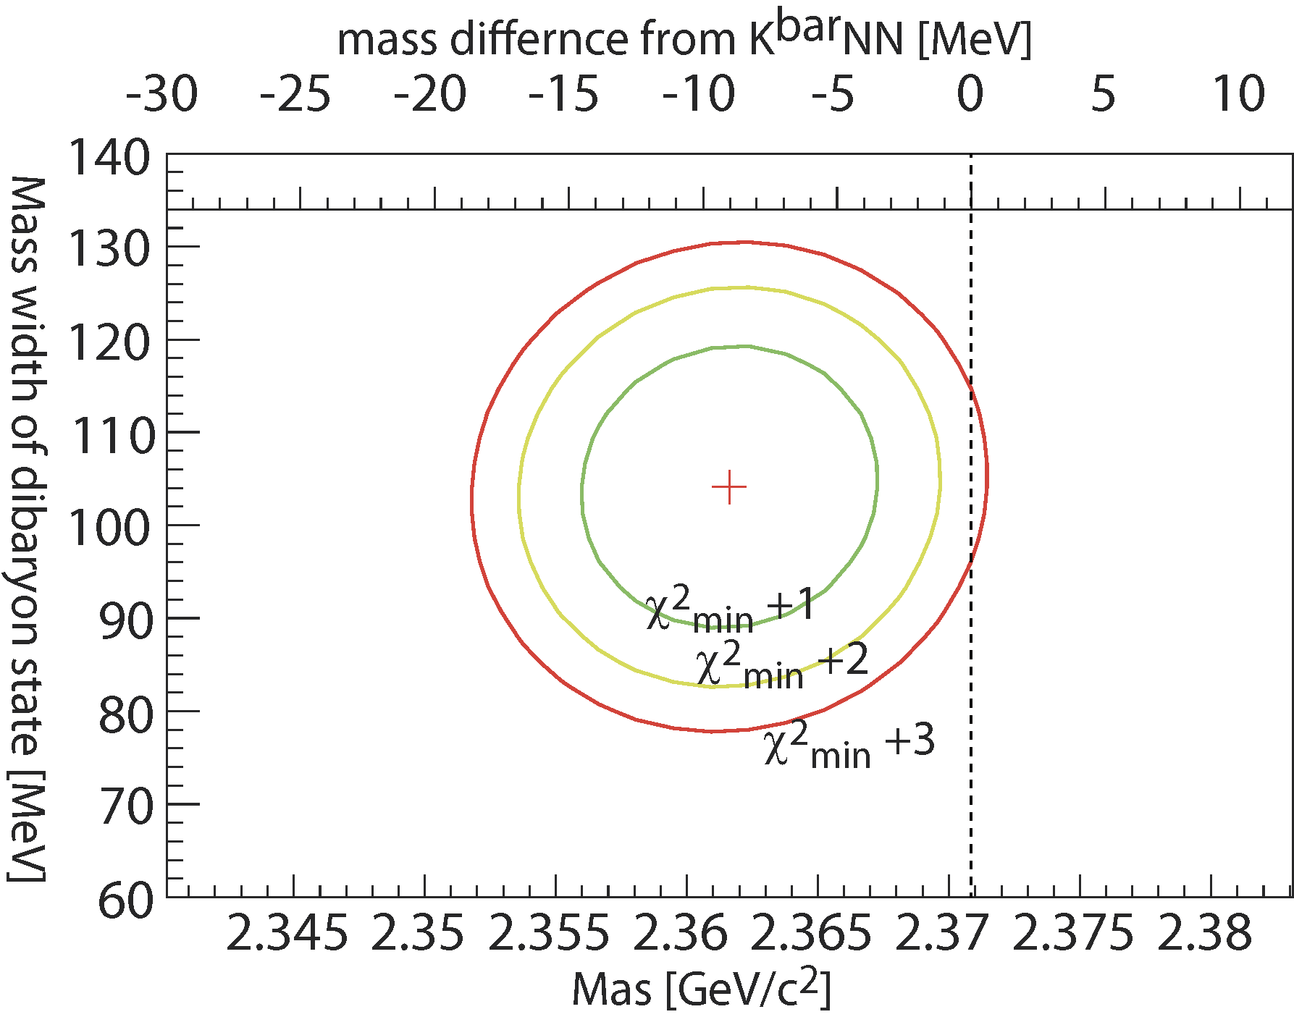
Assuming a Breit-Wigner
χ2/NDF=62.3 /49
preliminary
preliminary
χ²-test with a Breit-Wigenr and 3NAs
assumption: isotropic Λp decay
parameters: Mass, Width, and Yield

Slide 17
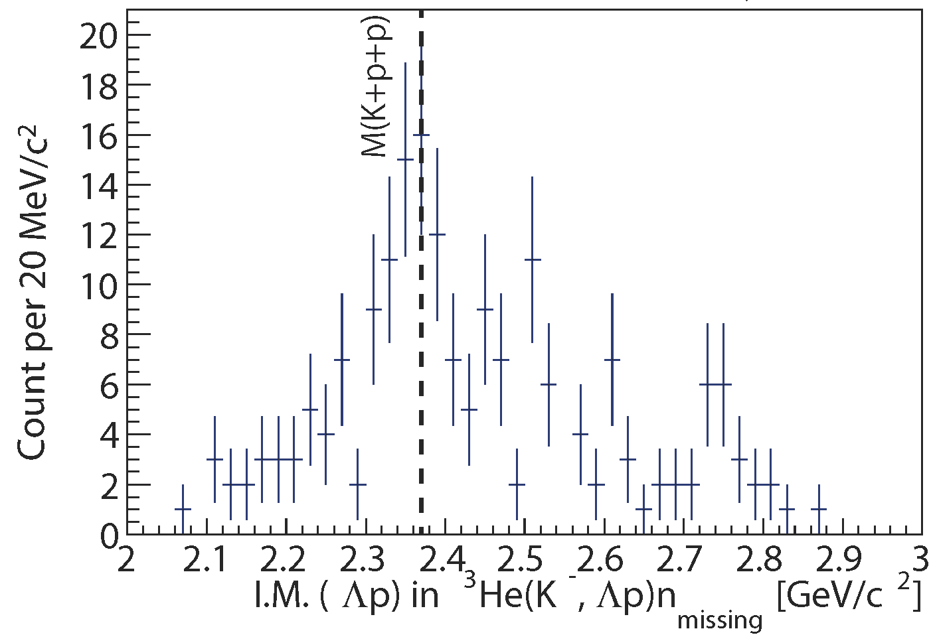
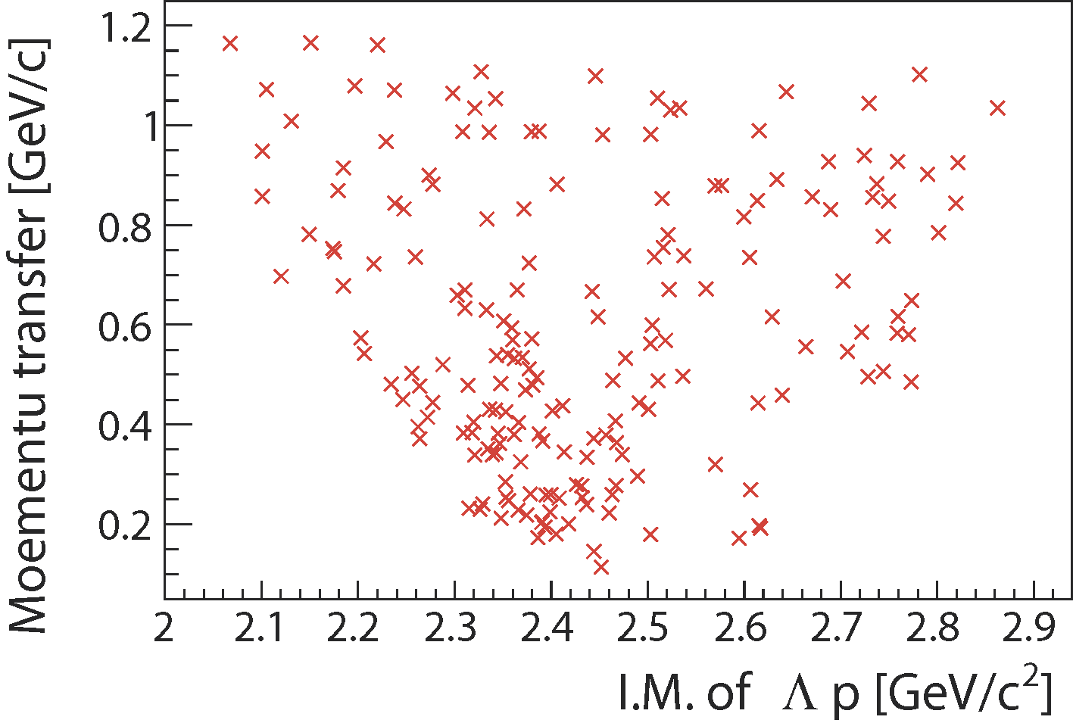
Momentum Transfer of (K⁻,n)
Mom. Trans. of (K⁻,n) vs. IM(Λp)
low-momentum transfer seems to be enhanced around the threshold
Λ(1405) production in 2NA followed by Λ*p_{s}→Λp ?
S=-1 di-baryon state of X→Λp ?
preliminary
possible candidates
(further study is in progress…)

Slide 18
Summary
FINUDA/DISTO/E27
³He(K⁻,n)X M.M.
Deeply-bound region
The bump-structure, which was reported by FINUDA/DISTO/E27, has NOT been observed
Around the threshold
Structure has been seen both in formation- and decay-channel
Contribution of Y*?
Hint of S=-1 di-baryon state?
Reaction dependence?
K^{bar}NN formation strongly depends on reaction channel?
γ/π/K/p induced reaction?
momentum transfer?
Λp I.M.
of ³He(K⁻,Λp)n
preliminary

Slide 19
The J-PARC E15 Collaboration

Slide 21
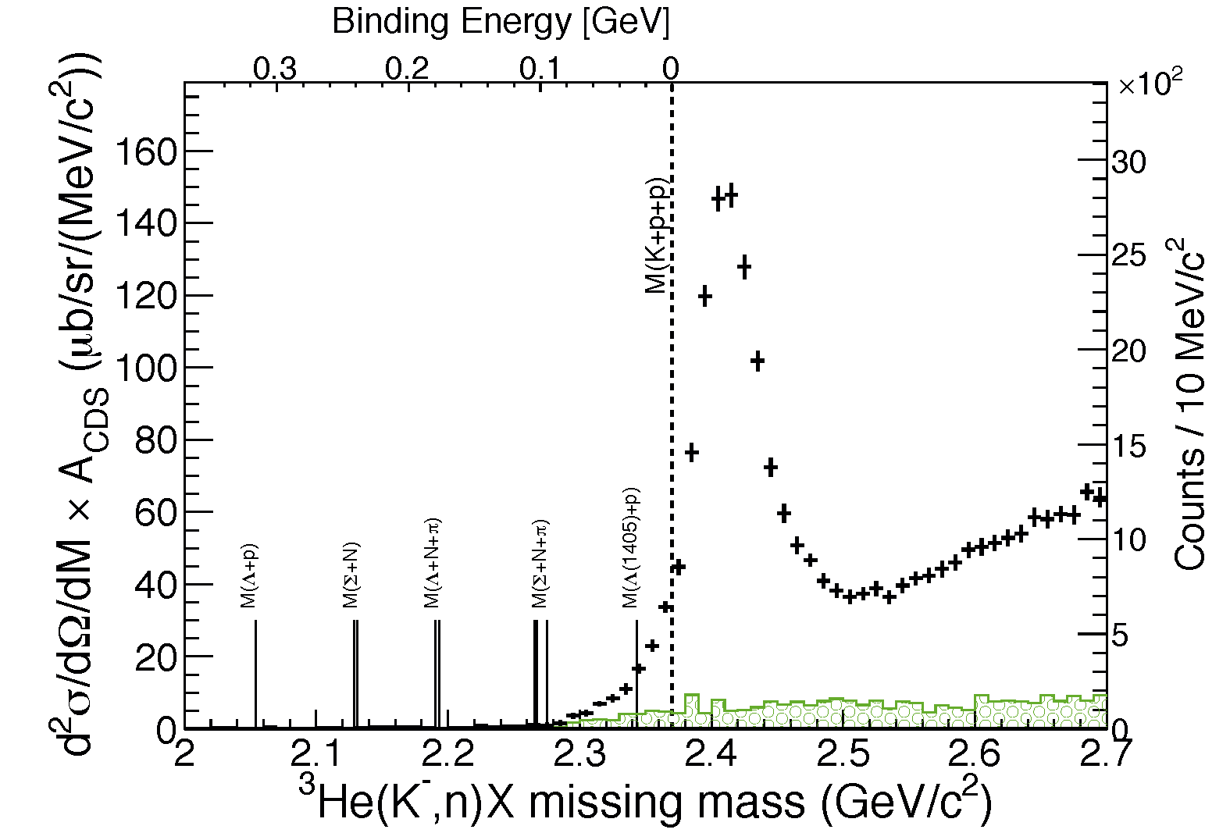
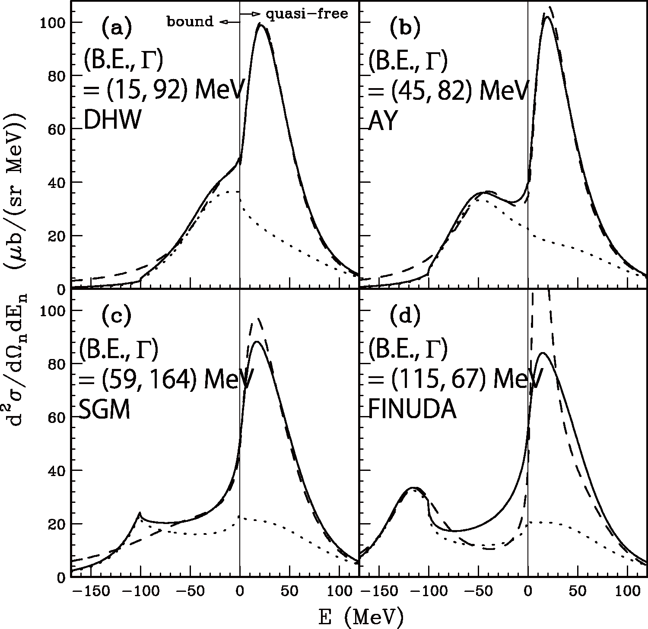
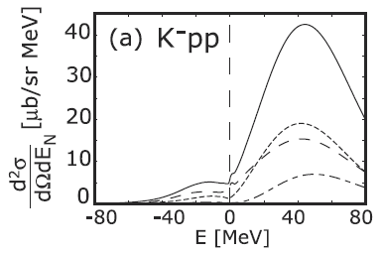
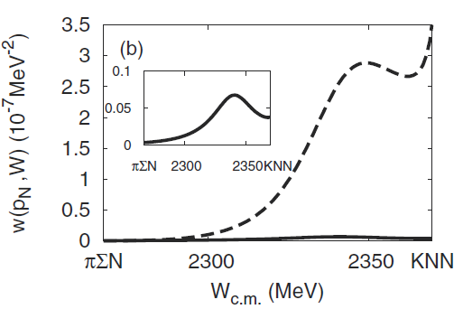
Theoretical Calculations
E15
(BG subtracted)
semi-inclusive
semi-inclusive
E15
(BG subtracted)
inclusive
inclusive
integrated CS:
~0.1 mb/sr
Yamagata-Sekihara, et al.,
PRC80(2009)045204
Koite, Harada,
PRC80(2009)055208
integrated CS:
~mb/sr
S.Ohnishi, et al.,
PRC88(2013)025204
CS is roughly consistent with KH
Exclusive πΣN measurement is an important key for further study

Slide 22
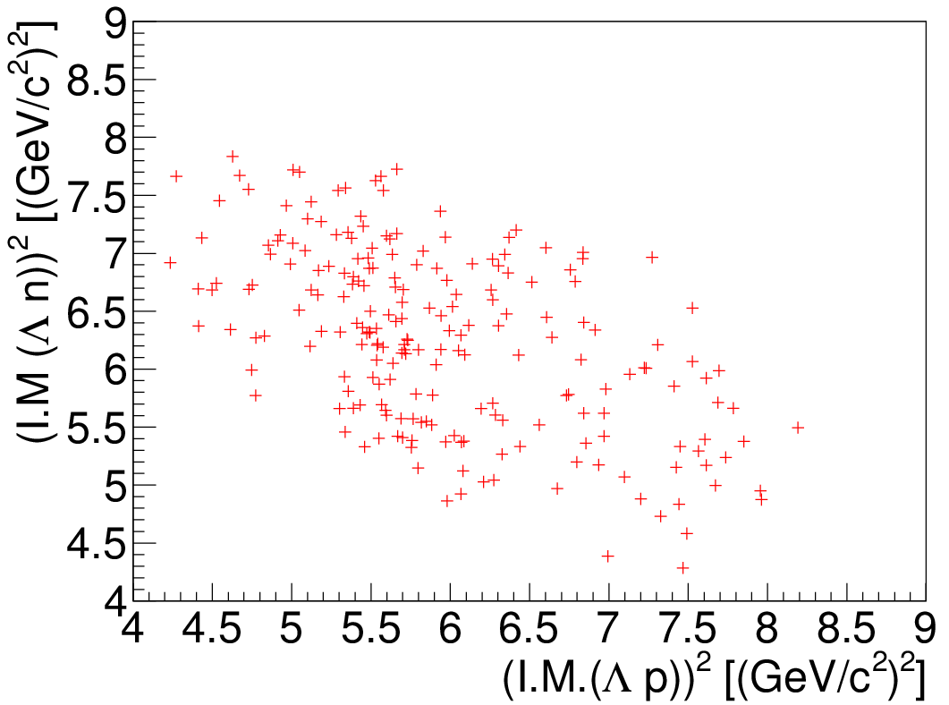
Dalitz plot of ³He(K⁻,Λp)n
M(K+p+p)²
preliminary

Slide 23
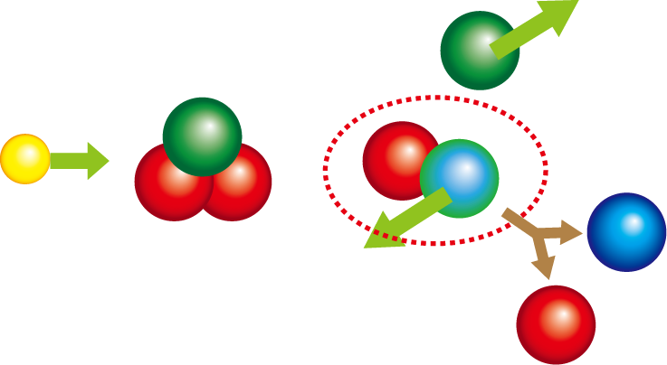
2-step Reactions?
The spectrum CANNOT be reproduced by only 3NA
Attempt to reproduce the spectrum with 2-step reactions
2NA followed by Σ”Ν”→ΛΝ conversion
KN→KN followed by K”NN”→ ΛN
2NA followed by Λ(1405)”N”→ΛN conversion
n
K⁻
³He
Λ
p

Slide 24
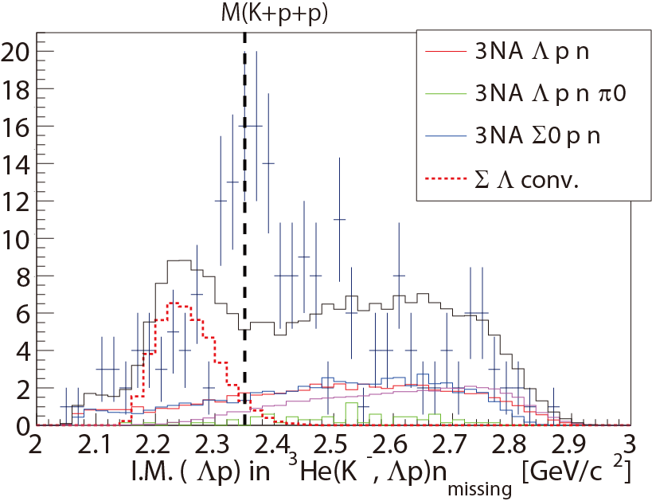
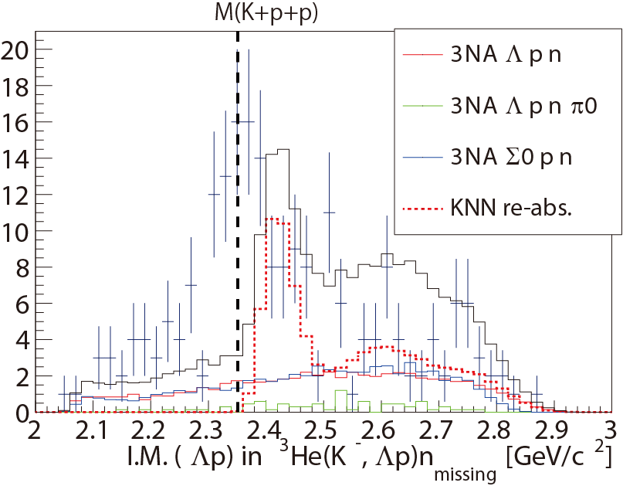
2-step Reactions? (Contn’d)
2NA followed by Σ”Ν”→ΛΝ
KN→KN followed by K”NN”→ ΛN
preliminary
preliminary

Slide 25
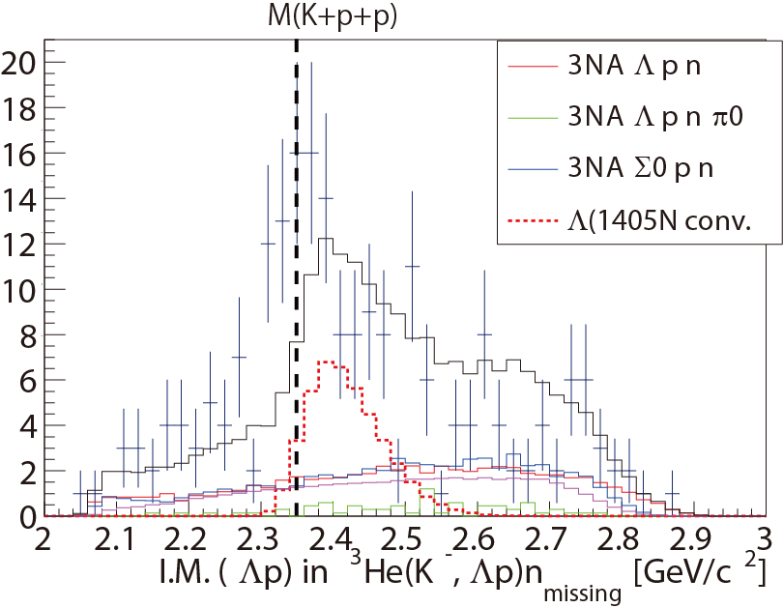
2-step Reactions? (Contn’d)
2NA followed by Λ(1405)”N”→ΛN
The structure is NOT explained by any 2-step reactions
Other possibilities
K⁻”pp” → Λp cusp?
too broad (~100MeV/c²) if the structure is attributed to the cusp
Shift of Λ(1405)?
S=-1 di-baryon??
preliminary
~40MeV/c²

Slide 26
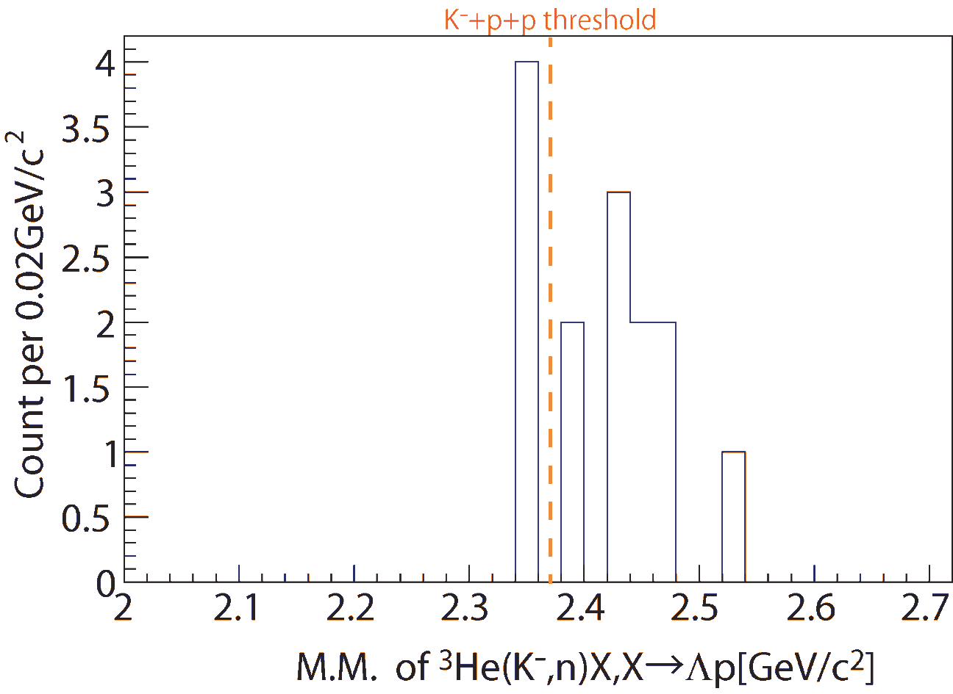
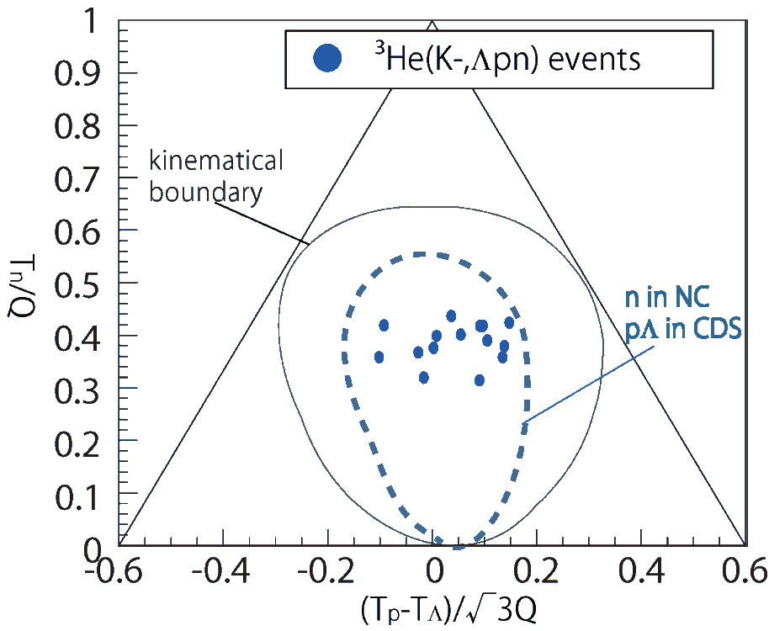
Kinematically-complete measurement of ³He(K⁻, Λpn)
preliminary
only
~15 events
preliminary
Minimum momentum transfer of the ³He(K⁻,n) reaction
→ would enhance the S=-1 di-baryon production
x100 beam time is required

Slide 27
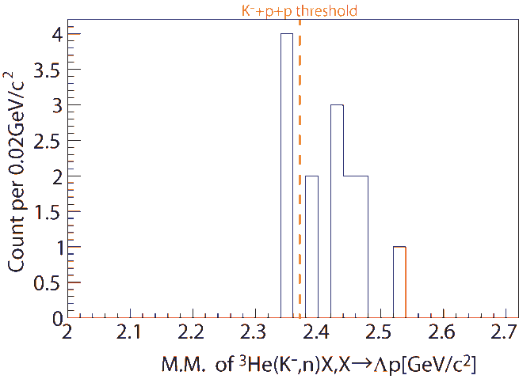
Summary
FINUDA/DISTO/E27
³He(K⁻,n)X M.M.
Formation Channel
Semi-Inclusive ³He(K⁻,n)X
No significant bump structure in the deeply bound region
Excess below the threshold
Λp I.M.
of ³He(K⁻,Λp)n
Decay Channel
Exclusive ³He(K⁻,Λp)n
Clear structure around the threshold
CANNOT be reproduced by any 2-step processes
preliminary
³He(K⁻,n)X M.M.
w/ ³He(K⁻,Λpn)
Formation+Decay
Exclusive ³He(K⁻,Λpn)
need more data
preliminary

Slide 29
preliminary
preliminary

Slide 30
preliminary

Slide 32
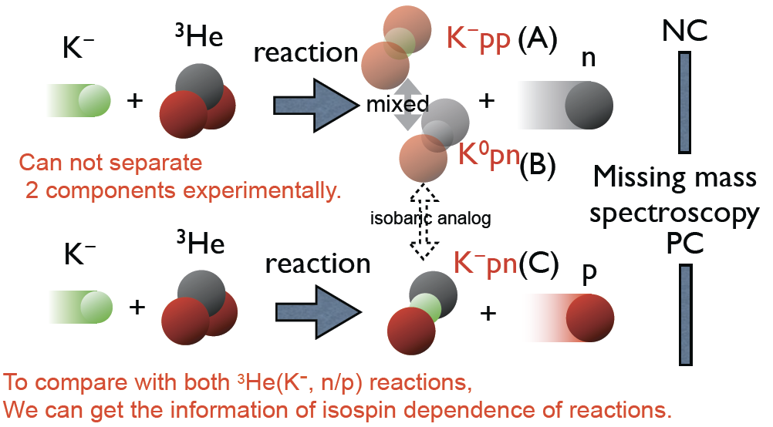
Inclusive ³He(K⁻,p)
investigate isospin dependence of ³He(K⁻,n/p)

Slide 33
Inclusive ³He(K⁻,p)

Slide 34
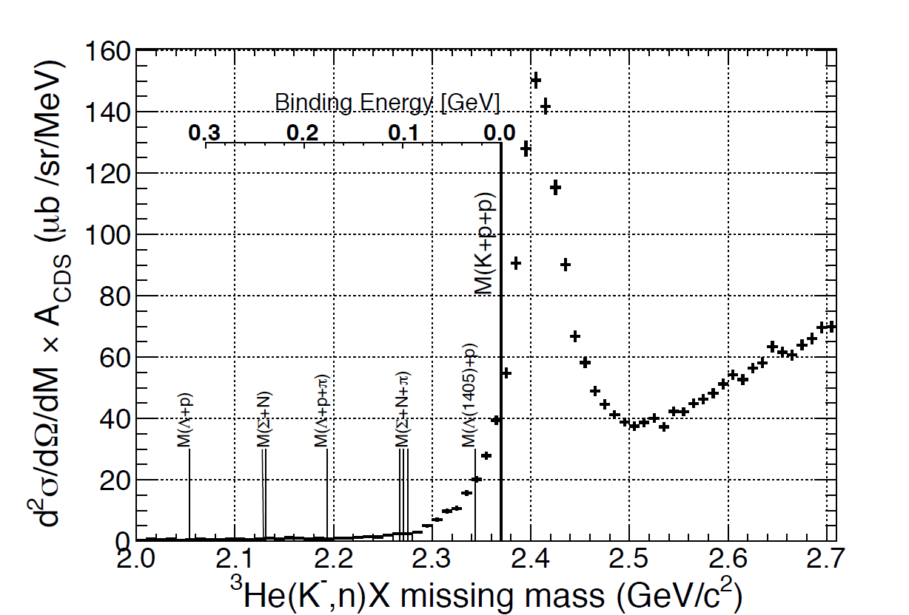
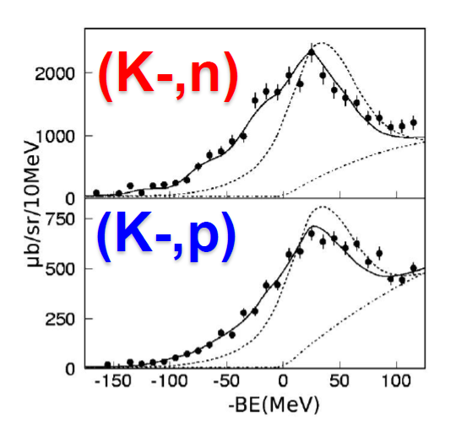
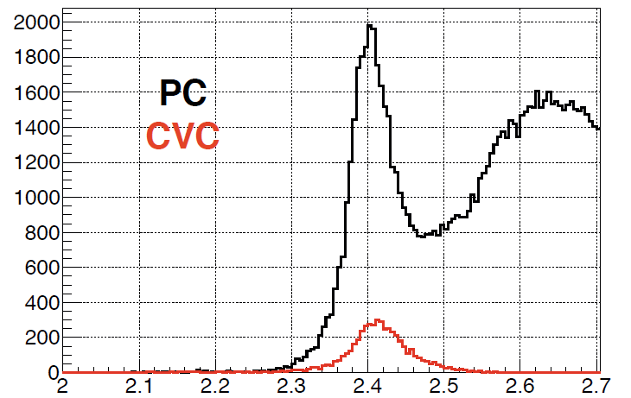
Semi-Inclusive ³He(K⁻,n/p)X M.M. spectrum
E548@KEK
(K⁻,n)
PTP118(2007)181
Re(V) = ~190MeV
very
preliminary
(K⁻,p)
Re(V) = ~160MeV
³He(K⁻,p) spectrum looks similar to (K⁻,n)

Slide 35
A.Dote
E15? if K^{bar}NN bound state

