Slide 1
MULTI-QUARK HADRON PHYICS at J-PARC
Takashi Nakano(RCNP, Osaka Univ)
September 1st, 2008@RIKEN

Slide 2
Motivation
What is a constituent quark?
Where does it work, where does not, and why?
Breakthrough: New forms of hadrons which cannot be explained by a quark model (easily).
tetraquark, pentaquark, meson-baryon & meson-meson resonances, etc.

Slide 3
Quantum Chromo Dynamics
Perturbative region
Non-Perturbative region
Current quark
Color confinement
Consitituent quark
Chiral symetry is a good symmetry
Spontaneous breakdown of chiral symmetry
Flavor SU(3) symmetry is a good symmetry
Parton model
Generation of Hadron mass
Quark model
Creation of NG bosons: π, K, η
Precise determination of spin structure functions: GPD
Multi quark hadron physics: pentaquark, tetraquark, meson-baryon resonances

Slide 4
What are effective degrees of freedom ?
‾S
d
S
u
+
u
u
or
‾S
S
u
u
d
u
d
Meson cloud picture: Thomas, Speth, Weise, Oset, Jido,Brodsky, Ma, …
| p > ~ | uud > + ε₁ | n ( udd ) π⁺ (‾du ) >
+ ε₂ | Δ⁺⁺ ( uuu ) π⁻ (‾ud ) > + ε’ | Λ (uds) K⁺ (‾su ) > …
Di-quark cluster (5-quark) picture: Zou, Riska,Jaffe,Wilczek
| p > ~ | uud > + ε₁ | [ud][ud]‾d > + ε₂ | [ud][us]‾s > + …

Slide 5
Problem
Very often, we do not know what and where to look at, a priori.

Slide 6
Best places for the study
Near the decay threshold
Multi particle production
Charge exchange and/or flavor/isospin transfer

Slide 7
Method
A quark cannot be extracted from a hadron freely.
Study the structure of the hadrons through production and decay.
Once an exotic hadron is established, its absence in some production and/or decay processes give important information on its structure.
Once an exotic hadron is established, other members of its family must exist.
Other members of a spin-flavor multiplet
Excited states
Meson-baryon duality (q*~qq)

Slide 8
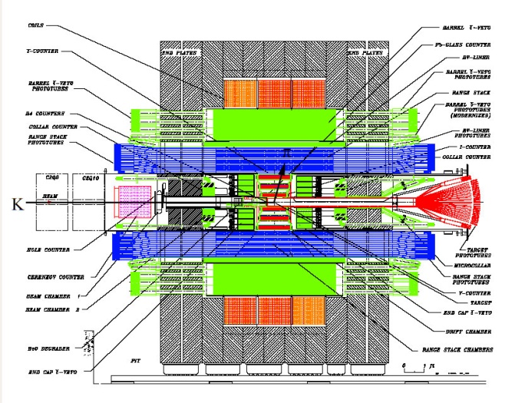
THE DETECTOR
4π coverage for both charged and neutral particles
Vertex reconstruction for short lived particles
Good K/π separation
High momentum resolution in the forward angles
E949, CLEO, BaBar, Belle,,,
+ forward spectrometer

Slide 9
THE BEAM LINE
Variety of beam particles in wide energy range.
K, K, π, p, p, etc.

Slide 10
Requirement
Collaboration: ~100 peaople
Budget: ~100 oku yen
Need flagship or booster experiment
“By the way, I believe in the existence of the Θ⁺ strongly.”
Let’s hope LEPS/Naruki Exp will provide a strong evidences.

Slide 11
Θ⁺ production
experiment at J-PARCReverse reaction of the Θ⁺ decay using a low energy K⁺ beam gives an unambiguous answer.
K＋n → Θ⁺ → K_{S}⁰p
Cross-section depends on only the spin and the decay width.
for J = ½
26.4 Γ mb/MeV
CEX (K＋n→K_{S}⁰p) ~7 mb
Inside 1 Tesla solenoid
π⁺
TPC
Forward DCs
LD₂ target
K⁺
~800 MeV/c
~420 MeV/c
proton
BeO degrader ~40 cm
π⁻

Slide 12
Synergy
Strong synergy among J-PARC, KEKB and LEPS/SPring-8 can be expected in both Physics and Detector R&D.
Interplay of experiment, phenomenology, and lattice (and even string theory).
Interplay between Nuclear and High energy physics.
THE DETECTOR and THE BEAMLINE can be used for other physics.

Slide 13
Summary
Let’s build THE DETECTOR and THE BEAMLINE for Next-Leading-Order Hadron Physics

